Slide 1
Finnish inventions to replace plastic
Spinnova, woodly and paptic

Slide 2
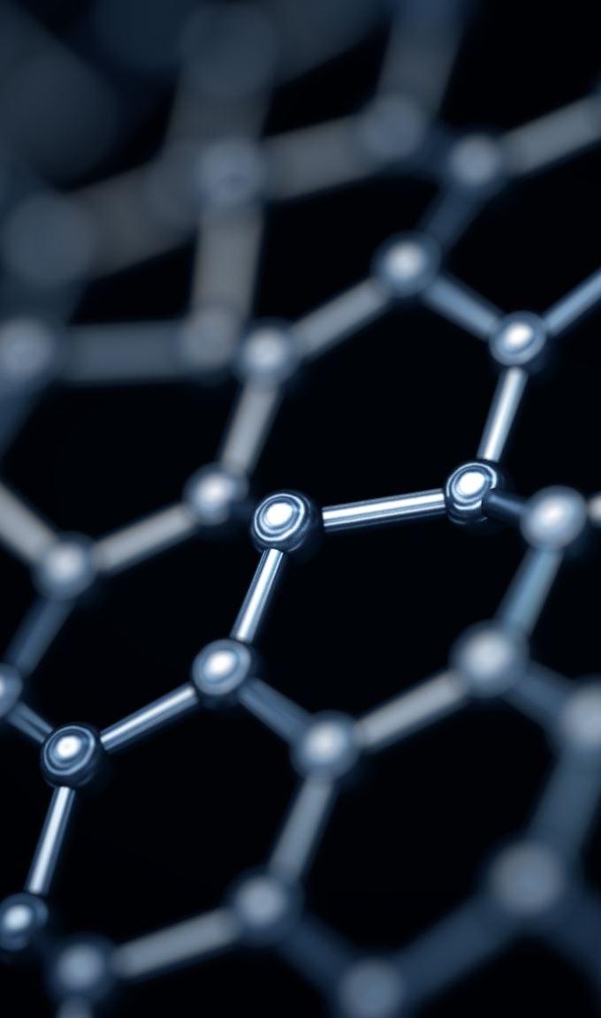
Spinnova (fiber)
Spinnova is a Finnish ecological fiber that is produced from wood or waste streams without harmful chemicals.
In the process, the pulp fiber is mechanically shredded into a very fine paste, which is forced through a nozzle into a thin fiber.
The only byproduct of the fiber is water, which evaporates into the air during the drying process.
Fiber production also consumes significantly less water and energy than cotton production.
Spinnova is produced in Central Finland, Jyväskylä

Slide 3

Spinnova (products)
Spinnova fiber can be made into fabric, which is well suited for use in the clothing and textile industry.
Spinnova fiber can be recycled many times.
https://www.youtube.com/watch?v=oapK8edFWgY

Slide 4
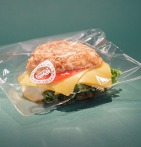
Woodly
Woodly is a completely new kind of carbon-neutral, wood-based and recyclable bio-based plastic that can be used to make various products and packaging.
Woodly comes from renewable natural resources such as sugar, wood cellulose or corn.
Woodly is not a biodegradable plastic, like biodegradable plastics can only be used once. Instead, woodly can be kept in circulation for a long time.
https://www.youtube.com/watch?v=quPDIYQxQVY

Slide 5
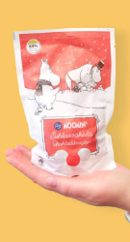

Paptic
The world's plastic waste problem and the general increase in temperature are driving companies to look for renewable packaging materials instead of fossil-based ones.
Many global brands are changing the packaging materials they use into recyclable, reusable or otherwise sustainable development.
Paptic® is a wood-based and recyclable solution to replace fossil-based plastic in packaging.​​
https://www.youtube.com/watch?v=RhsVW3zrfYA

