Slide 1
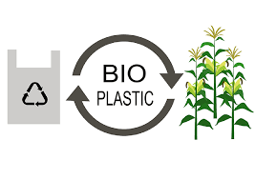
Bioplastic

Slide 2
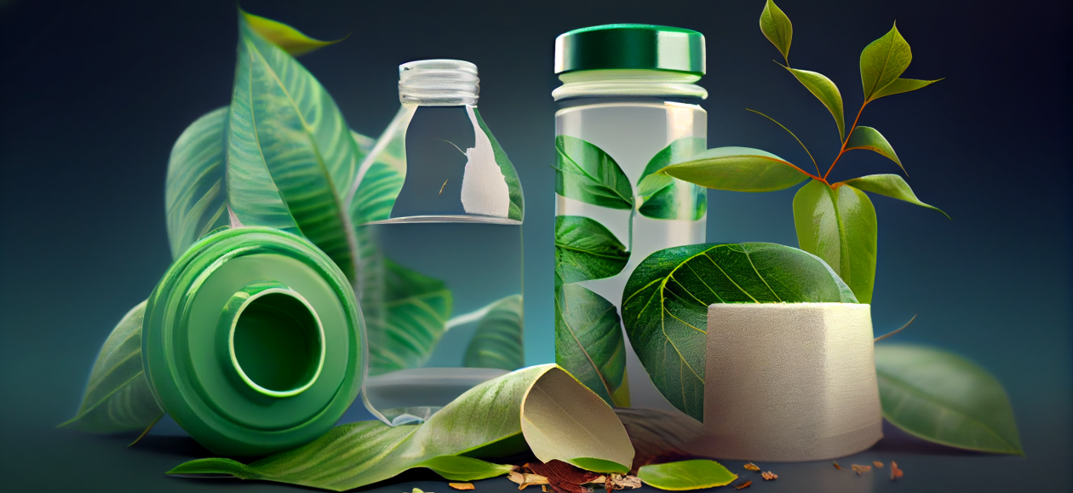
Bioplastics are biogradable or compostable plastics made from natural substances instead of oil.
Many bioplastics contain significant amounts of conventional plastics.

Slide 3

Compostable plastic
Biodegradable plastics need commercial facilities to decompose.
Some newer bioplastics will break down in a home compost.

Slide 4
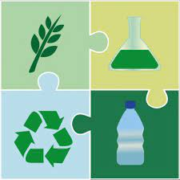
Partially bio-based, "durable" plastic
They are not compostatable.
Micro organisms can break these down, but the process generally takes longer than 3-6 months.

Slide 5
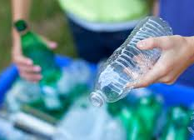
Non biodegradable plastic
These bioplastic are not easily broken down by organisms.
They will eventually degrade after many years.

