Slide 1
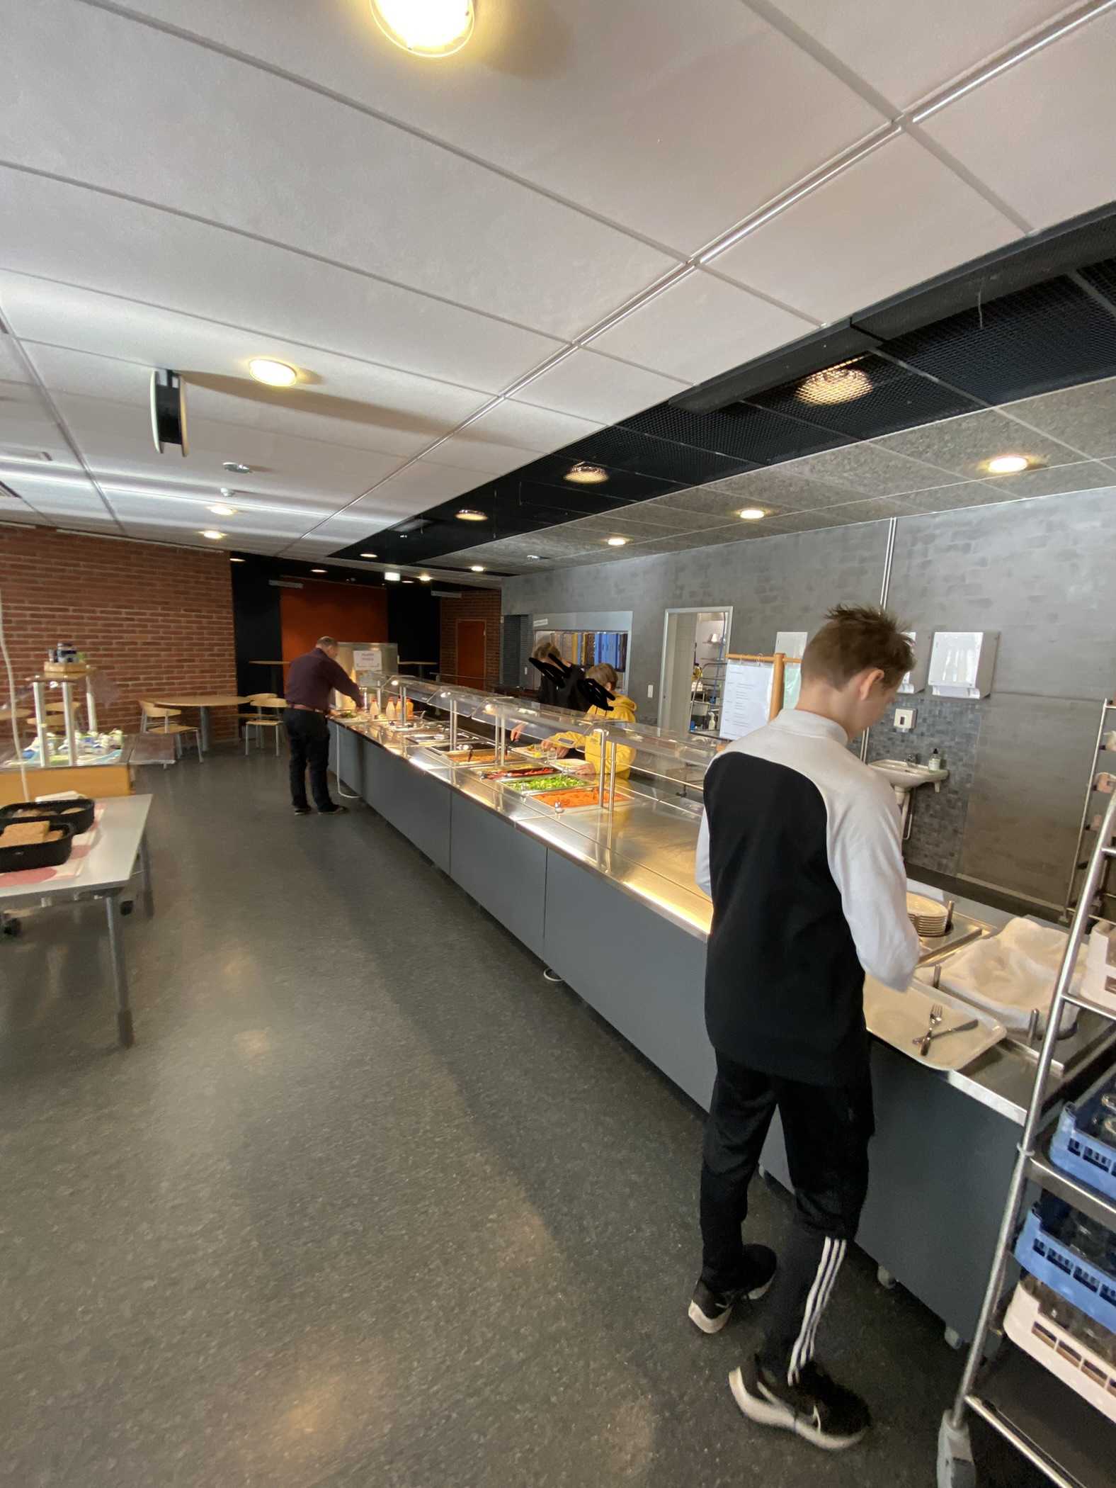
School meals in Finland

Slide 2
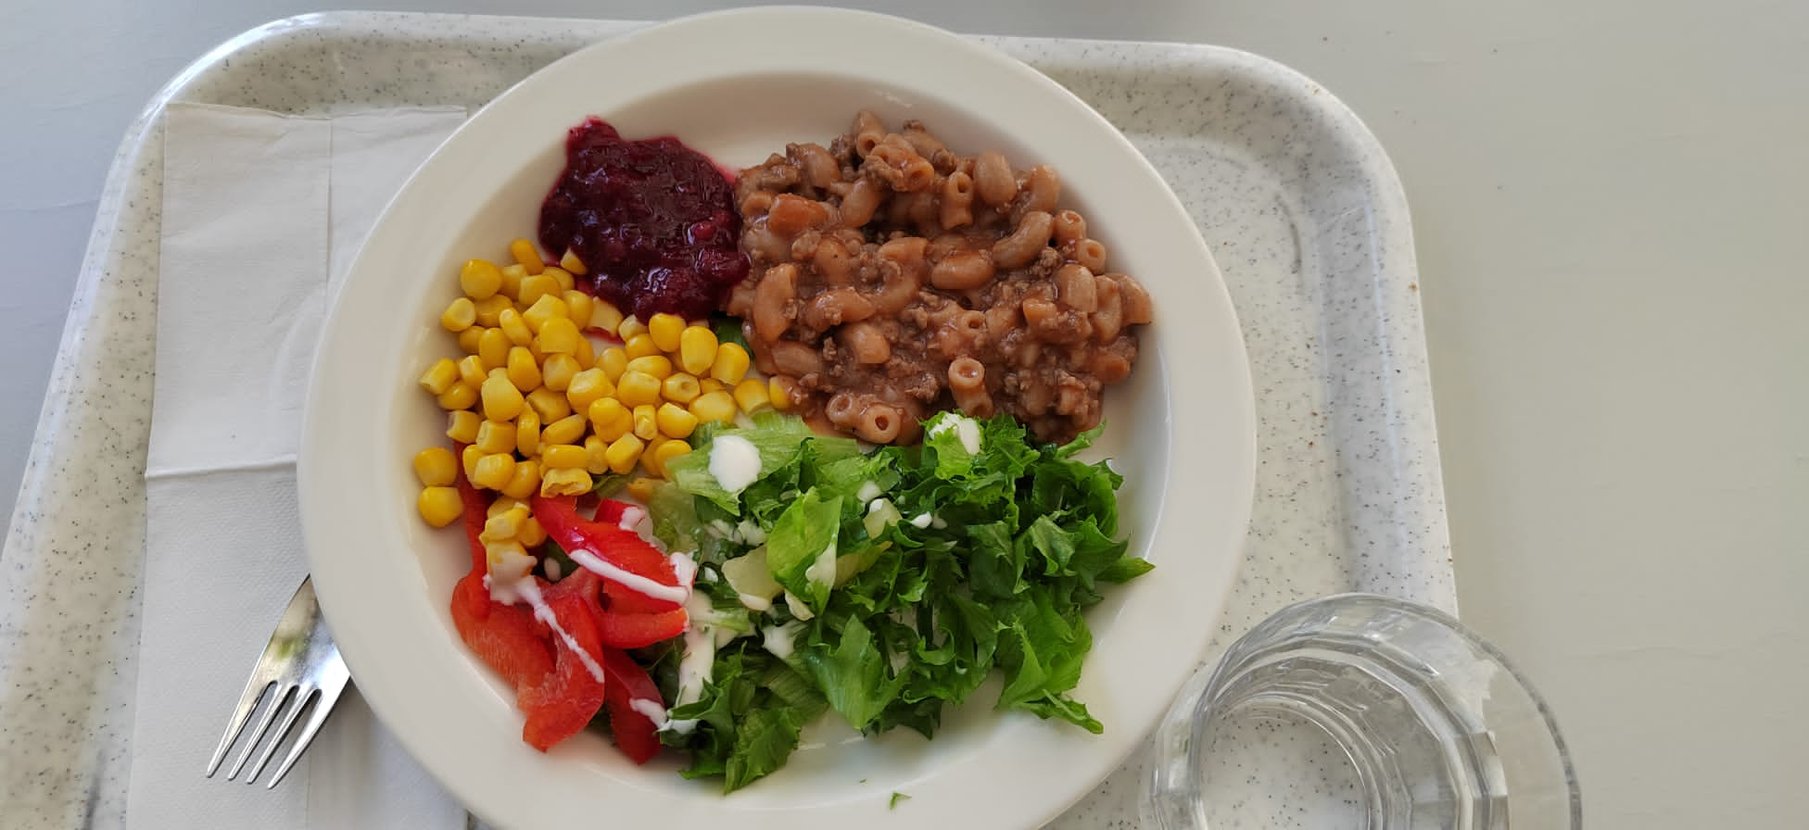
School meal meaning
School lunch helps the students physical well being and performance in school. It has instructive and also educational meaning.
Opetushallitus (2022) kouluruokailun merkityksestä
https://www.oph.fi/fi/koulutus-ja-tutkinnot/kouluruokailun-merkityksesta

Slide 3
History of free school lunch till this day
In 1943 Finland legislated a law, which makes school lunch free for everyone. But the starting year to the free lunch was 1948.
Nowdays 840000 children eats school lunch everyday in the school. The food needs to be healthy and also full of nutrients to follow the rules of curriculum.
In 1977, when all the places in Finland moved to the primary school, everyone in the school had free lunch everyday.​
Kouluruokailun historiaa (opetushallitus 2022).​
https://www.oph.fi/fi/koulutus-ja-tutkinnot/kouluruokailun-historiaa

Slide 4
Menu from 1960
Friday ​
Delicacy porridge/rye porridge​
Grahan bun 50 g​
Margarine 5 g
3 dl of milk
Liver sausage 20 g ​
Saturday
Spinach soup
Rye bread 20g​
Margarine 5 g
3 dl of milk
Cheese 20 g
​
Monday
Porridge (for water)​
Margarine 5 g
Rye bread 20 g
3 dl of milk
Cheese 20 g
Tuesday
Cabbage soup
Margarine 5 g
Rye bread 20 g
3 dl of milk
Wednesday​
Buckwheat/lingonberry porridge​​
Margarine 5 g​
Rye bread 20 g​
3 dl of milk​
Cheese 20 g​
Thursday
Tuesday soup
Margarine 5 g
Rye bread 20 g
3 dl of milk

Slide 5
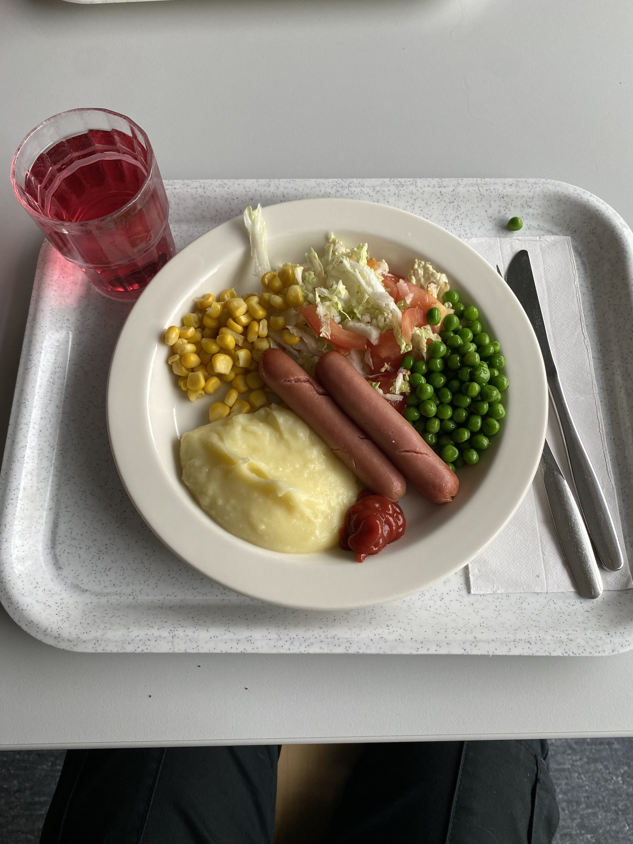
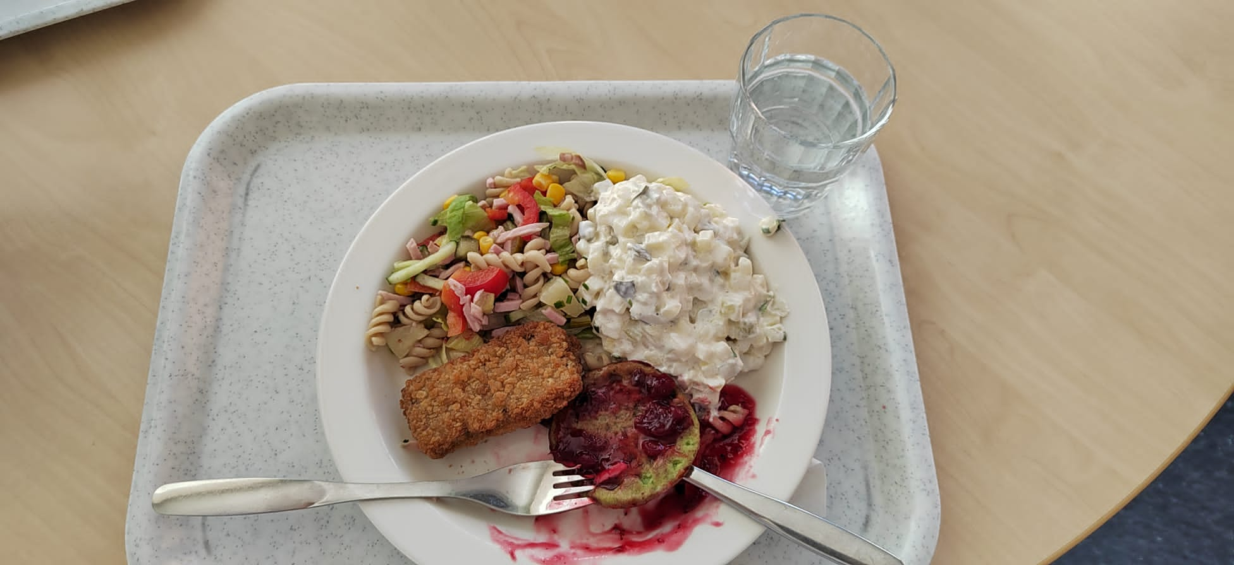
Menu from 2022
MAANANTAI
KALAKEITTOA
RUISPYÖRÖJÄ
TIISTAI
JAUHELIHAPIHVEJÄ
PUNAJUURIPIHVEJÄ
PERUNAMUUSIA
KESKIVIIKKO
BROILERIPASTAA
TORSTAI
POSSUKASTIKETTA
KASVISGRATIINIA
PERUNOITA
PERJANTAI
KINKKUKIUSAUSTA
PUNAJUURIKIUSAUSTA

Slide 6
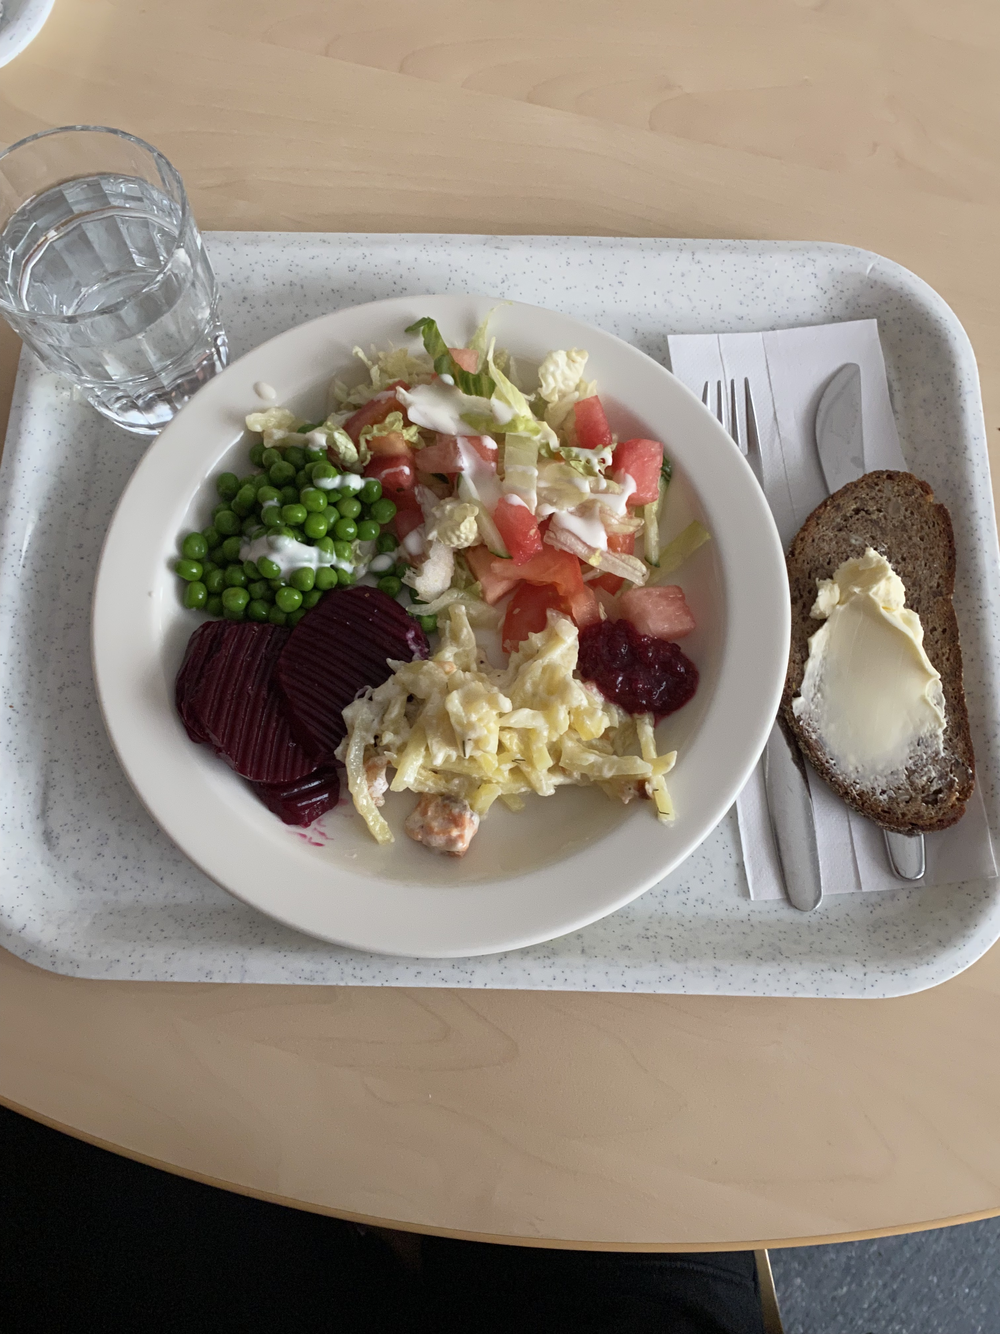
School catering in Petäjävesi
Morning porridge, lunch and special dietary requirements are served in Petäjävesi middle school.
The school meal ingredients are from wholesale for example Valio etc.

Slide 7


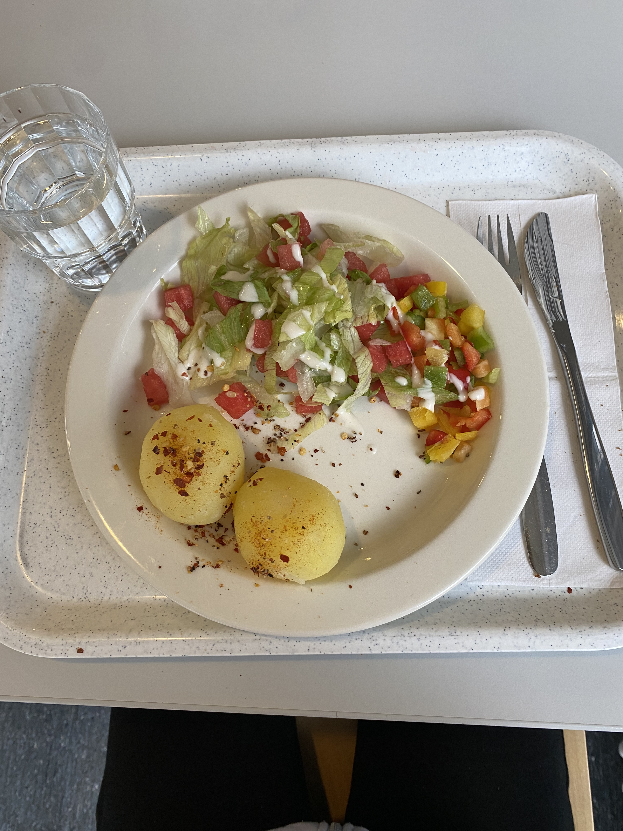
Favourite and least favourite school meals
Porridge and spinach pancakes are favorites
Seuraavassa diassa haastatteluja
​
All foods that includes fish are least favorites

Slide 8

The importance of school meals
The school lunch helps you focus on your school works. In school meals you can learn to interaction- and social skills and you take a break for your brain.
The school lunch also teach you recpect for the food. It teaches you to know food culture.
School lunch includes 1/3 of the day's nutritional needs

Slide 9
Interview

