Slide 1
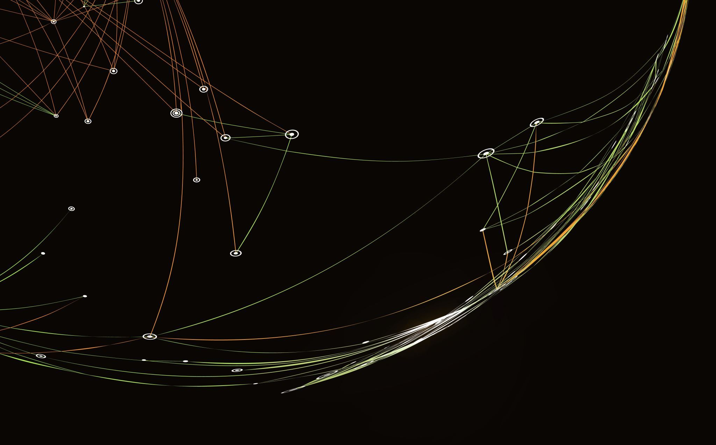
Finnish sports stars
And why they are important

Slide 2
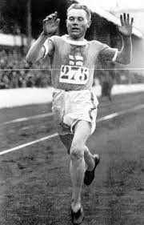
Paavo NURMI (1897-1973)
Paavo Nurmi was endurance runner.
He won 9 golden and 3 silver olympic medals.
He was the most successful olympic athlete ever
He has nicname "The flying finn"

Slide 3
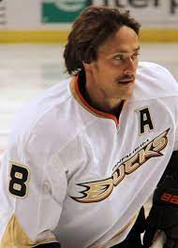
Teemu selänne 1970-
He is a hockey player.
He played in NHL.
He has made 57 400 000 euros.
He has won WC (World Champion) gold.

Slide 4
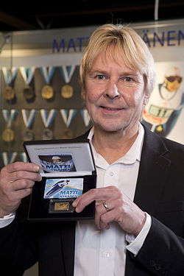
Matti nykänen 1963-2019
Matti Nykänen was a hill jumper.
He has won five olympic medals(four of them were gold)
There is a jumping hill named after him in Jyväskylä.

Slide 5
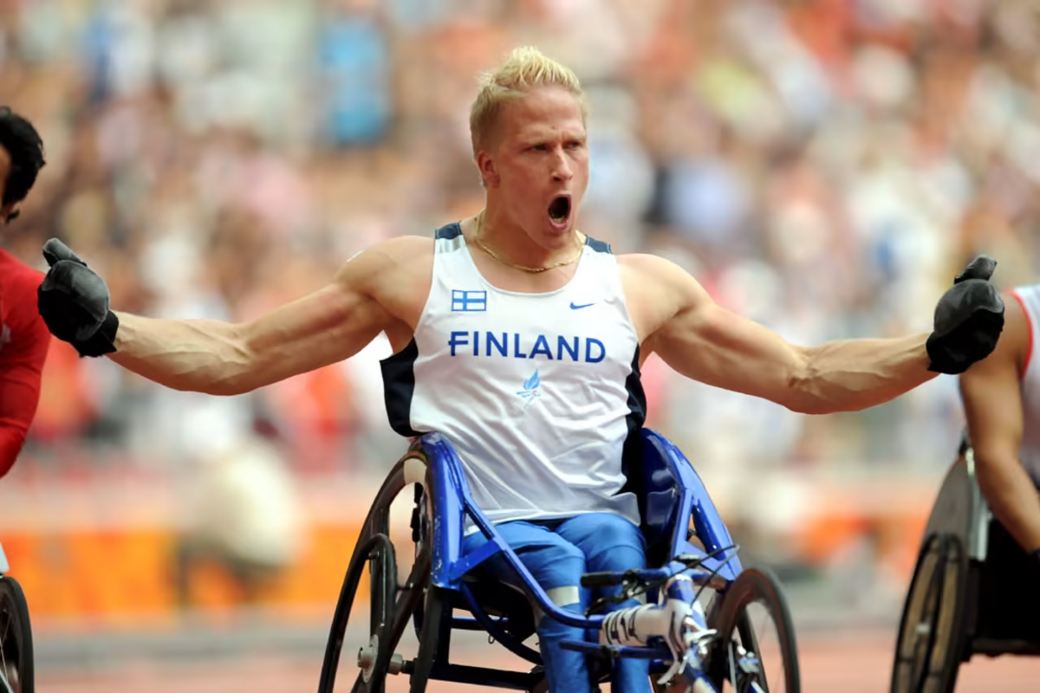
LEO-PEKKA TÄHTI 1983-
Leo-Pekka Tähti is a Finnish Paraolympic athlete. He won gold at 100 m and 200 m wheelchair race at the Athen's Paraolympics in year 2004, gold 100 m and bronze 200 m at the Paralympics in Peking in 2008, and gold 100 m in Rio de Janeiro's Paralympics in 2016.

Slide 6
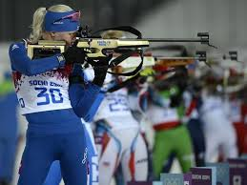
Kaisa Mäkäräinen 1983-
Kaisa Mäkäräinen is a famous biathlete.
She has won one WC gold.
She stopped her international competition career in 2020.

