Slide 1
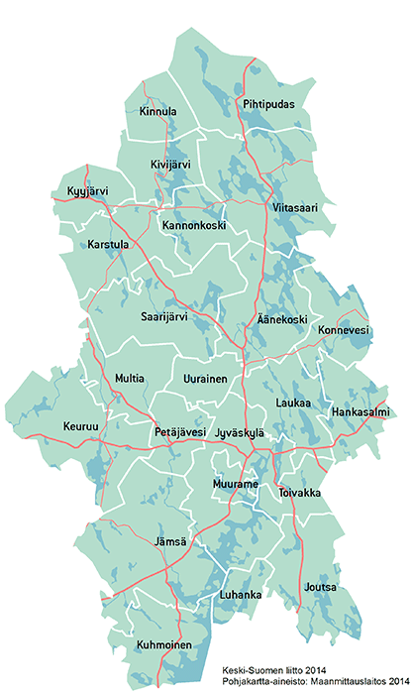
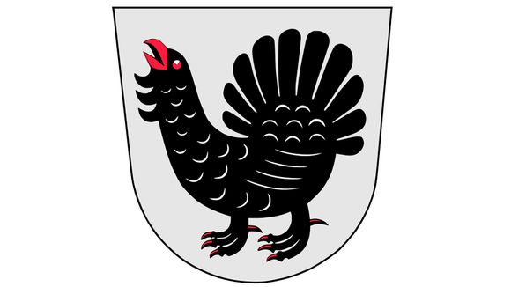
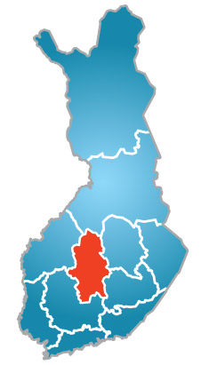
Central Finland
Central Finland has 23 localities.
Population: 276 000 (2019).
The nature here is
beautiful and there are
lots of
beautiful lakes,
swamps
and forests.

Slide 2

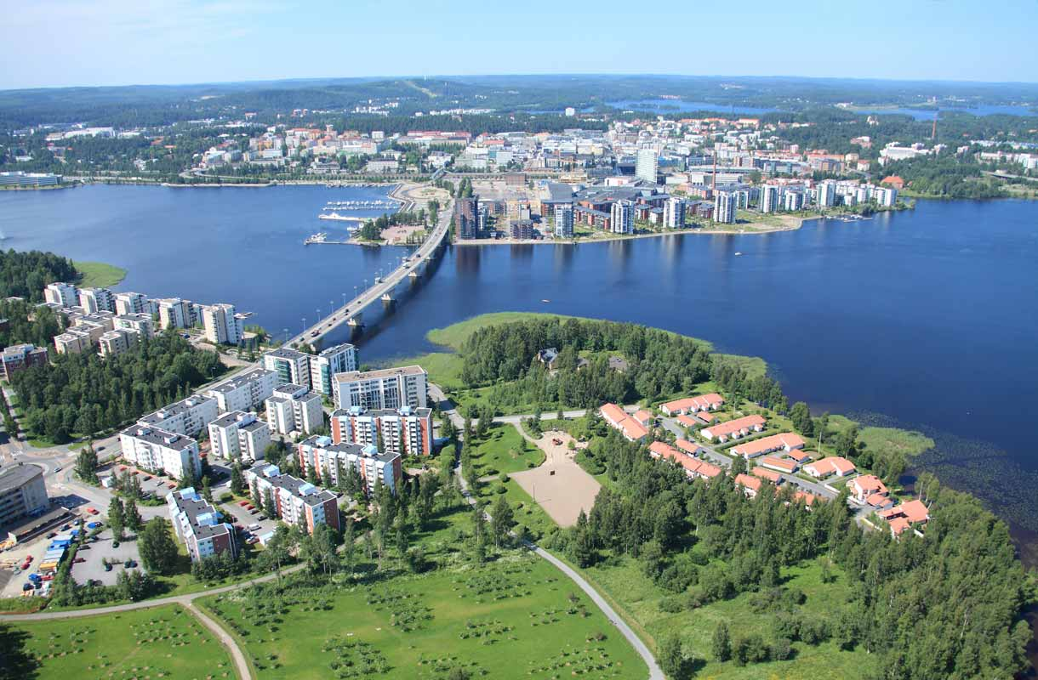
Jyväskylä - the largest
city in Central Finland
Jyväskylä is the 7th biggest city in Finland.
Population: 145 000 (2021)
Founded at 1837
Lots of people go to work in Jyväskylä from other towns around it.
Alvar Aalto has designed
lots of buildings in
Jyväskylä, for example
a university.

Slide 3
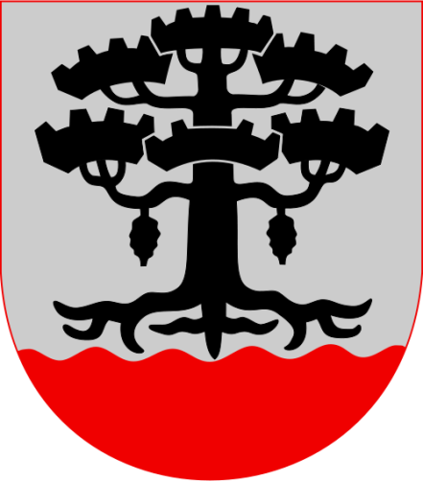
PETÄJÄVESI
- Population: 3800 inhabitants (2020).
- Surface area is 495 km²
(From which 39 km² is water)

Slide 4
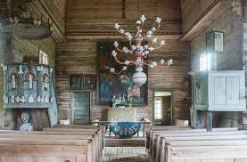
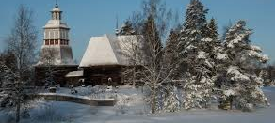
Old church
Jaakko Klementinpoika Leppänen builded Wooden church in 1763-1765.
It's been chosen to be a UNESCO'S world heritage site. It has been a UNESCO'S world heritage site since 1972
It was chosen because it is a rare wooden church and representing its own era.

Slide 5
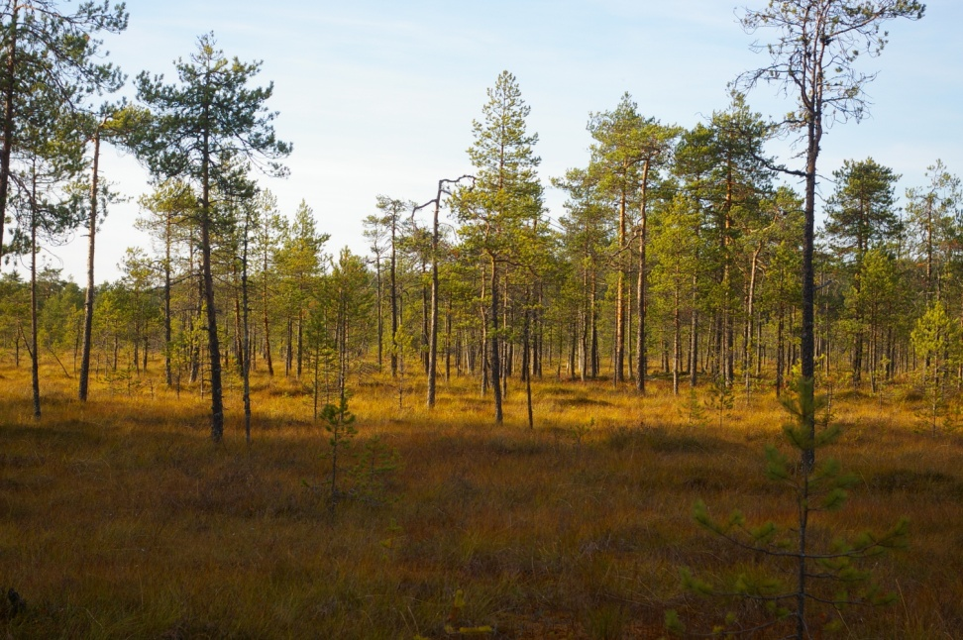
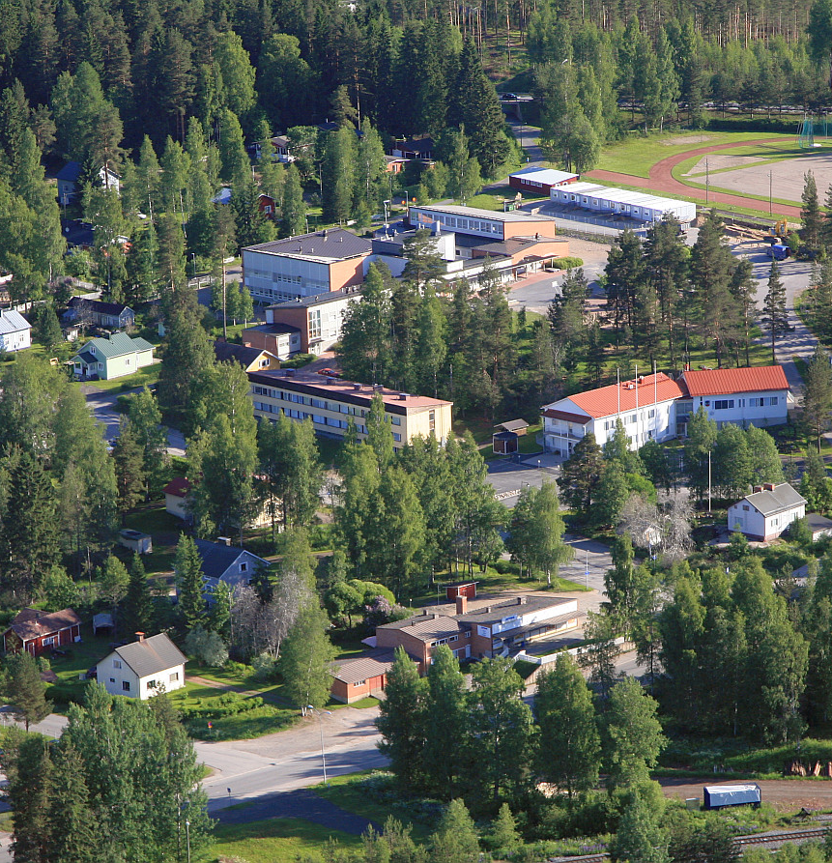
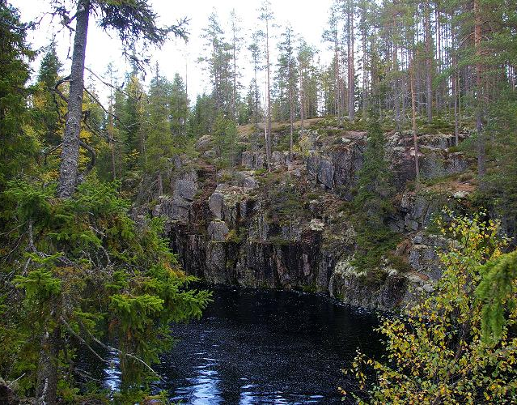
Some places in Petäjävesi
1.
1. Tampin kierros, a nature trail in a swamp
2. An Aerial picture on Petäjävesi.
3. Karhunahas, a lake in a ravine.

Slide 6

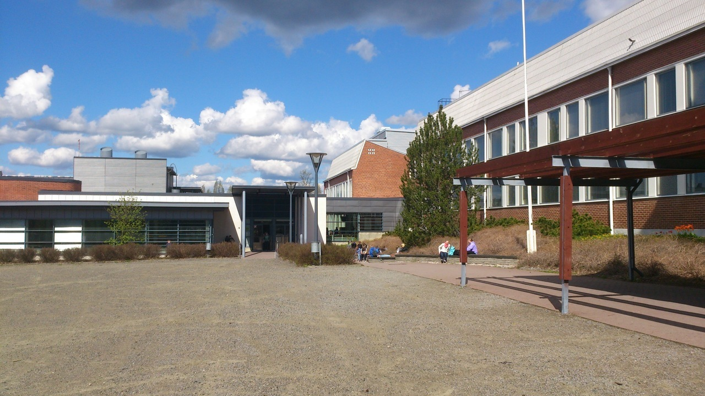
Our school, Petäjäveden yläaste
Our school has 160 students and there is a high school with 60 students in the same building.
Our school is quite small.
We have really good food here. Some of the best school foods in Finland.
There is always three classes of the same grade: a, b & c.

Slide 7
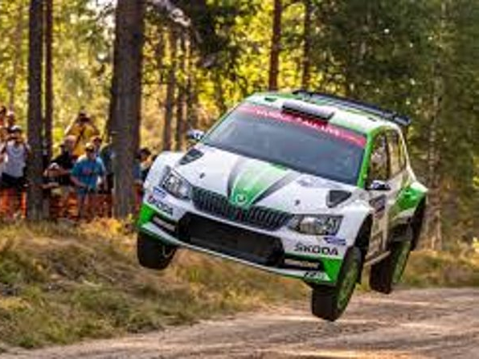
Neste rally
Neste rally is a tradition in Finland. It has been kept in Jyväskylä and also in Petäjävesi.
Neste rally's name wasn’t always neste rally, before the change it was called Thousand Lakes Rally.
It's always a very big event that has participants and spectators coming from all over the world to watch it.
Finns are rally people, most of us like to watch it.

Slide 8
The end

Slide 9
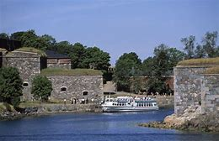
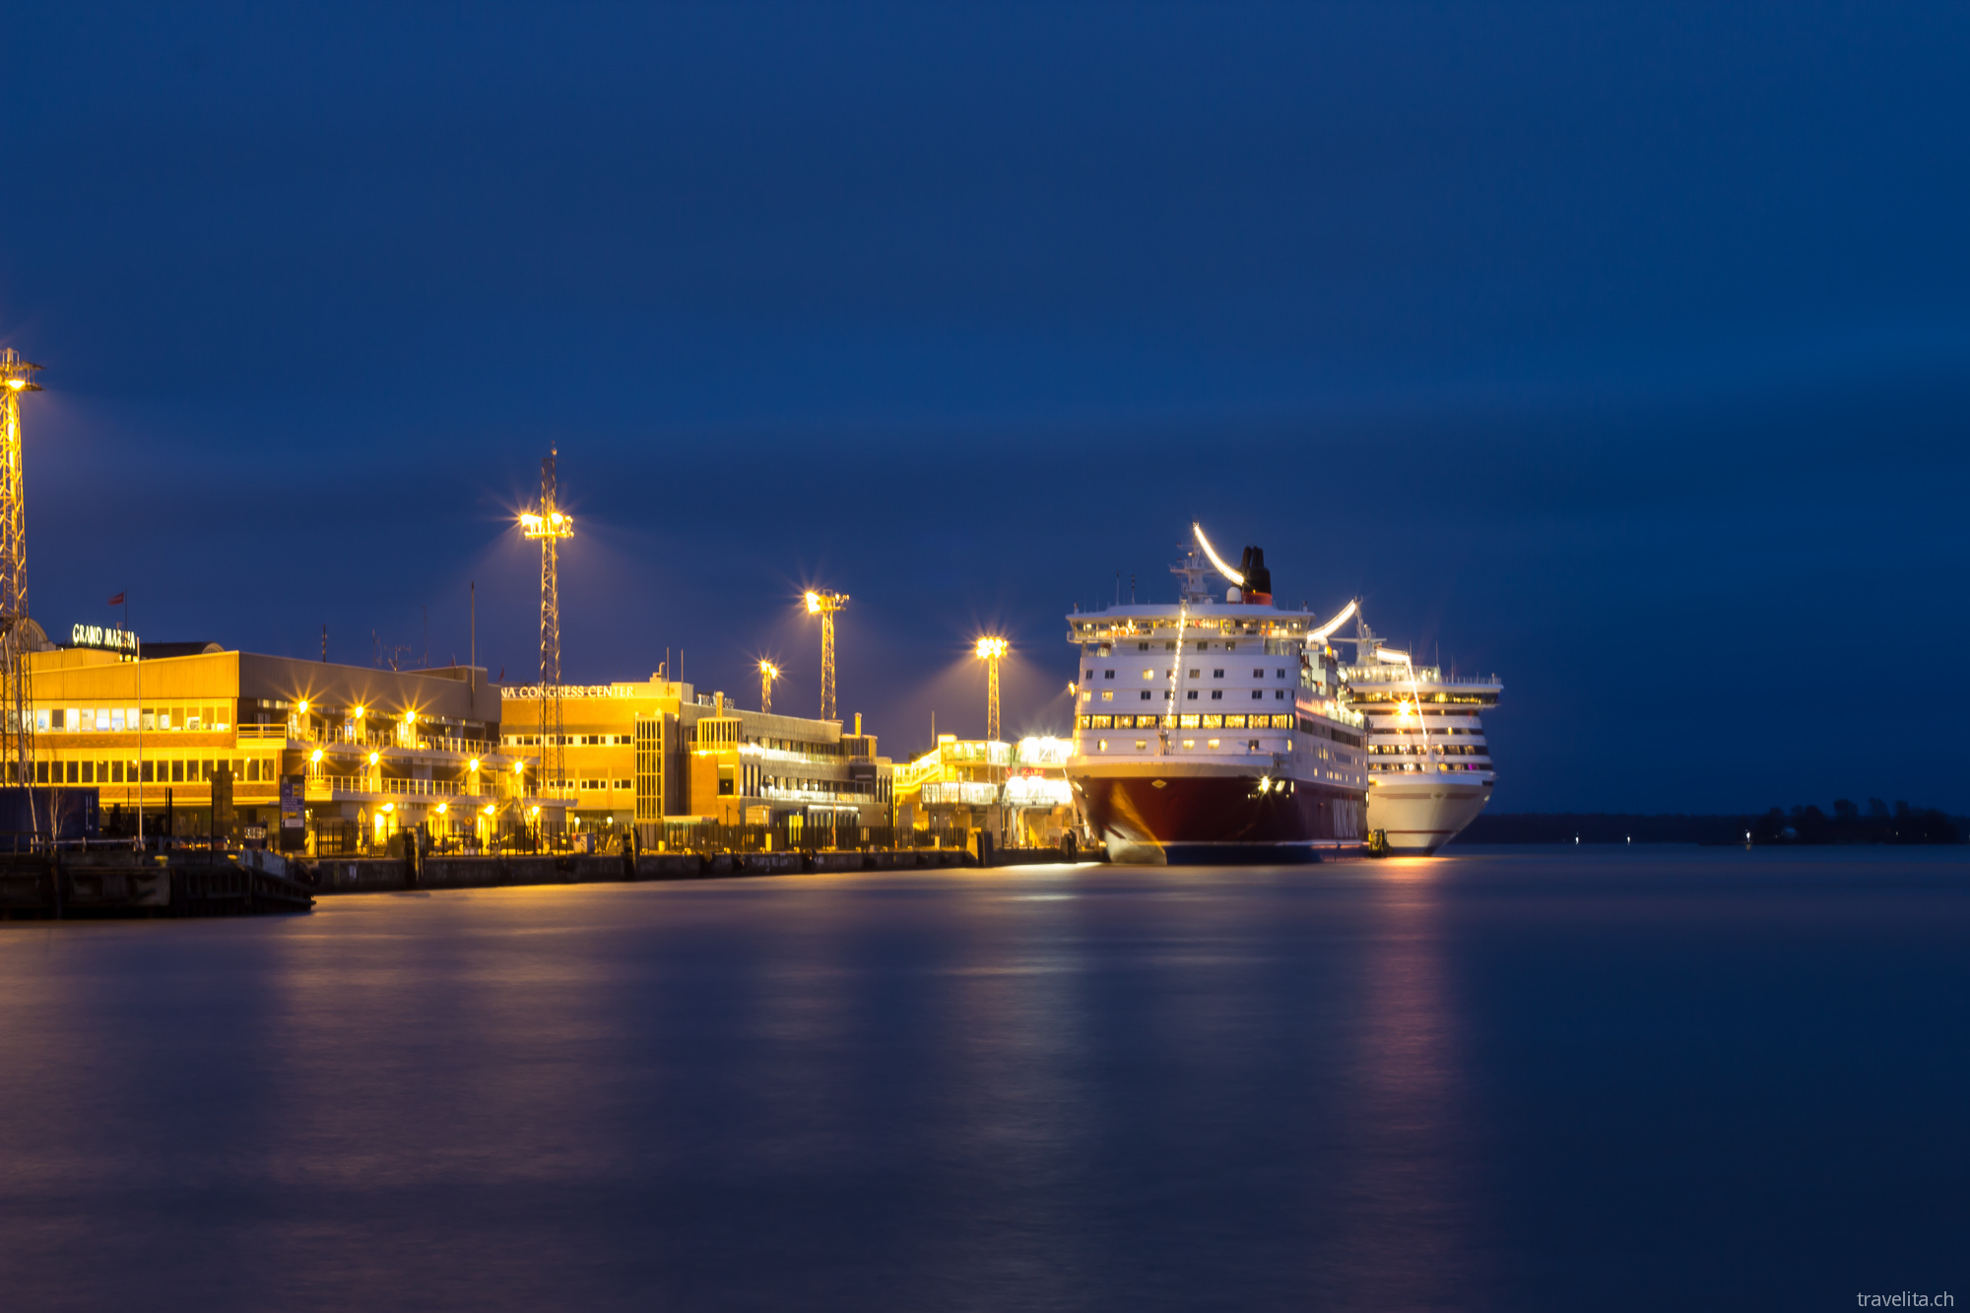
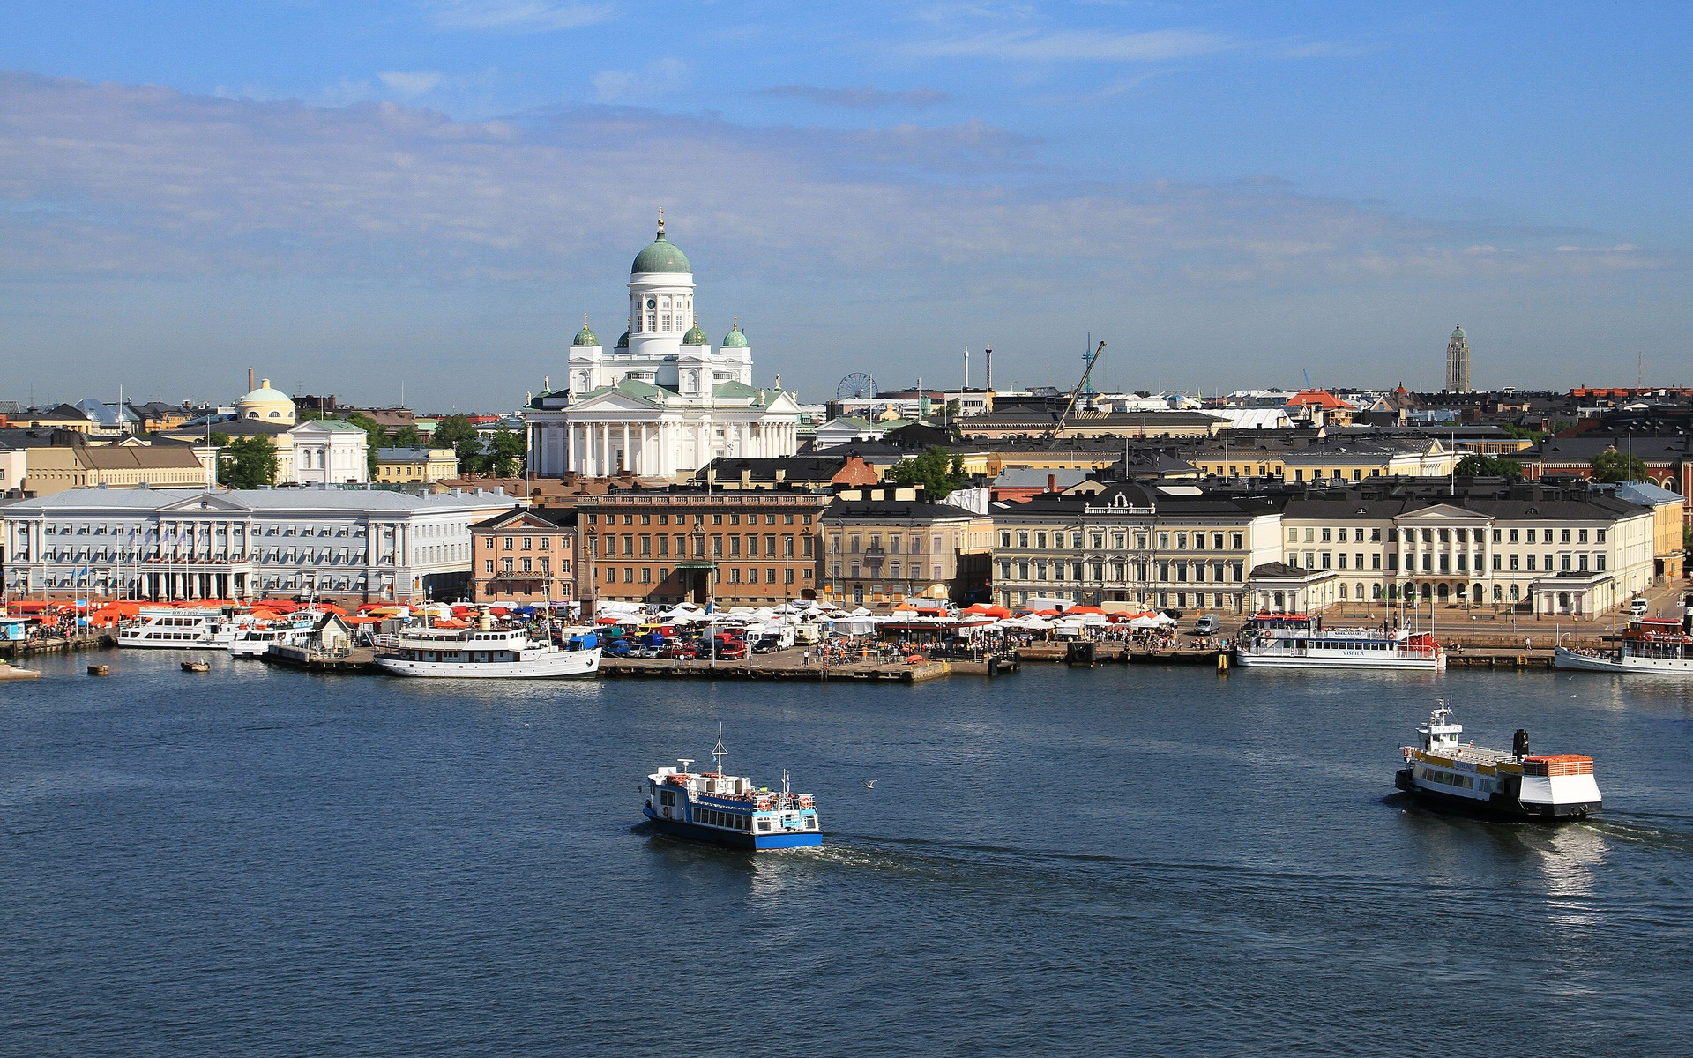
Suomenlinna world heritage site
Helsinki harbor

Slide 10
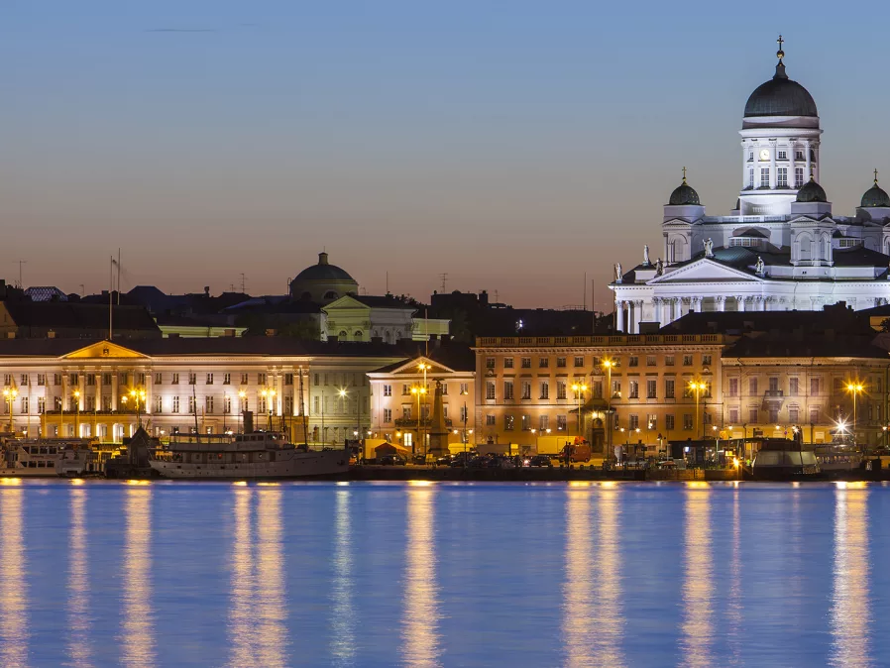
Helsinki
Helsinki is the capital city and most populous city of Finland.
Helsinki city centre's population is 645 482 but in the wider Helsinki region's population is 1 456 619.
It's the country's most important center for politics, education, finance, culture and research.
Helsinki's mayor is Jussi Pajunen

Slide 11
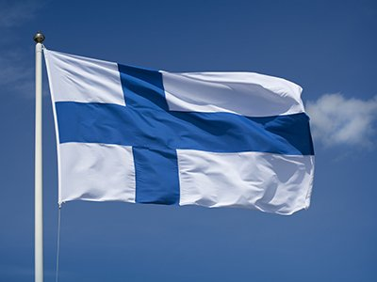
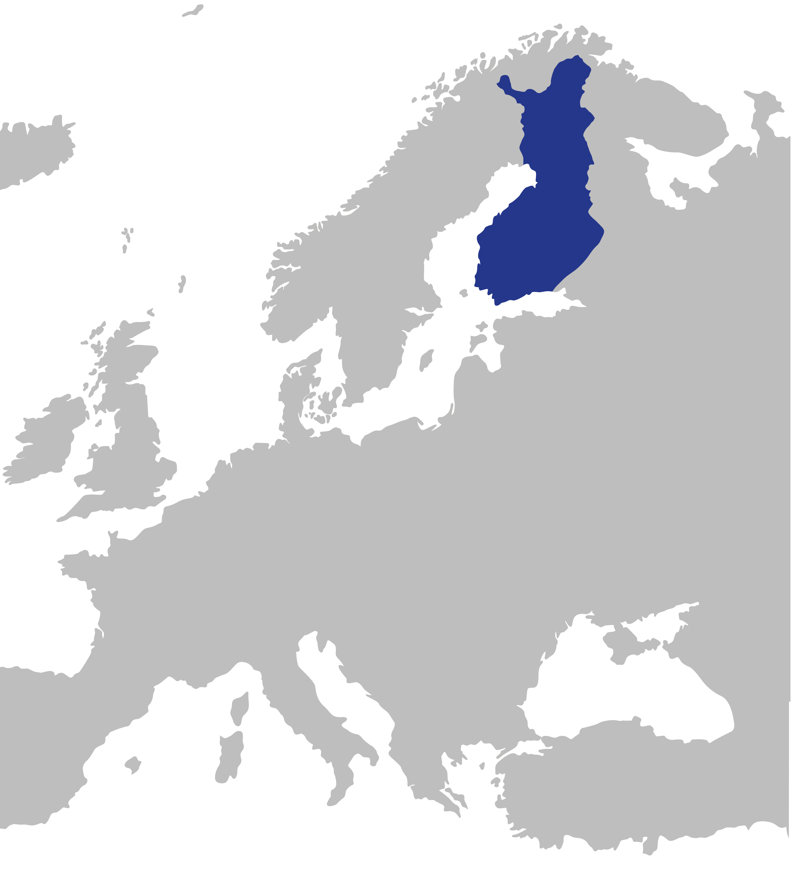
Information
Finland is located in northern Europe.
Neighbouring states: Russia, Norway and Sweden
Belongs to Nordic countries and to EU
Population: 5,5 million
Capital city: Helsinki

