Slide 1

Erasmus+ Alien species in Finnish waters

Slide 2
What does alien species mean?
Alien species are animal or plant species that humans have brought to an area either on purpose or accidentally. Some of the species are harmful; they create problems when entering new territories. The problems can be for example:
that alien species displace (invase) original species,
changes in the ecosystem
problems in waters' health.

Slide 3
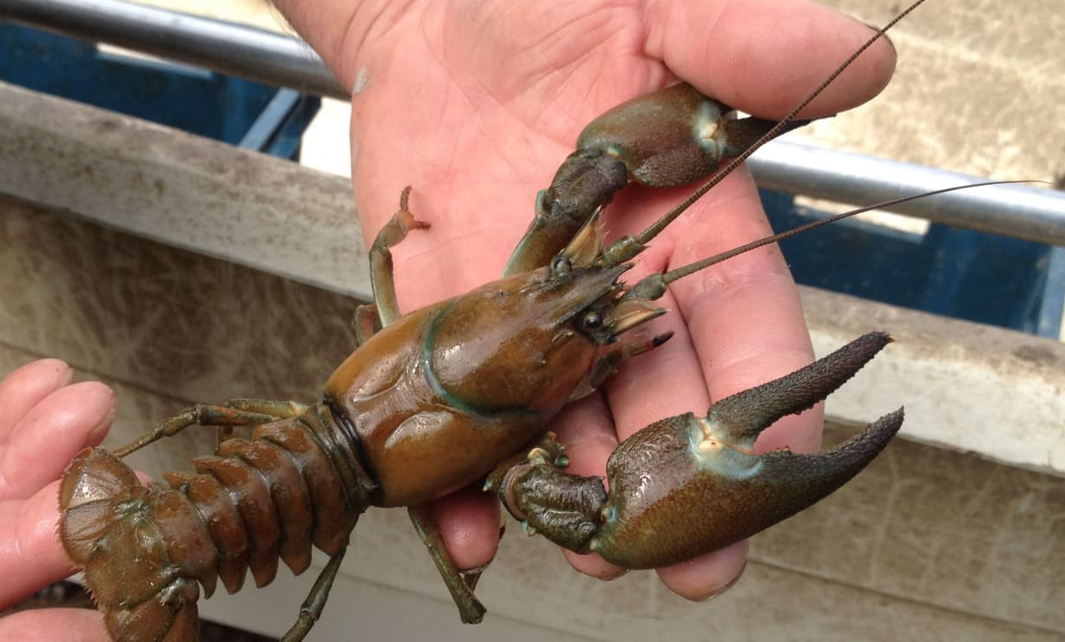
Alien species in Finland
It's estimated that there are over 300 invasive alien species in Finland.
Signal crayfish is a good example. Signal crayfish is a crab species from North America that was widely introduced to Finnish waters in the late 20th century. It spreads an infection disease (crayfish plague) and competes about living space with native Finnish crayfish, that is slightly endangered.

Slide 4
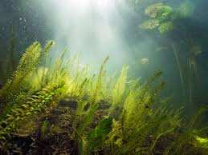
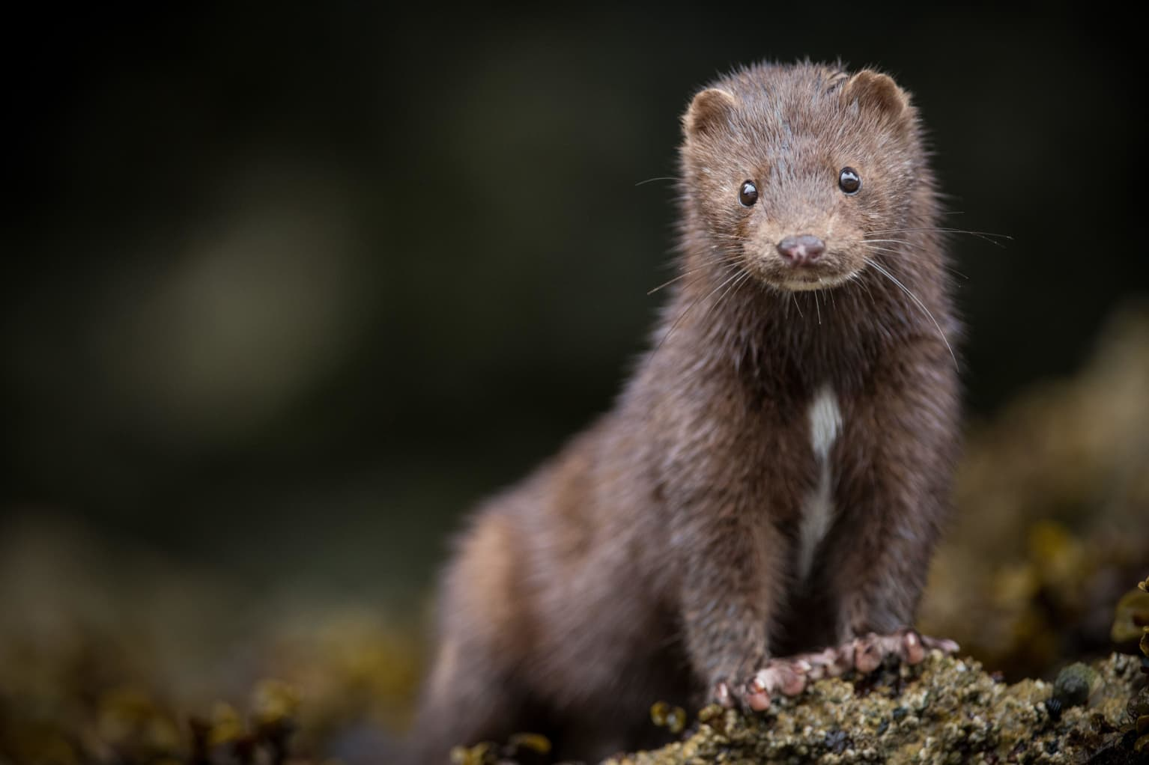
Canadian waterweed
Canadian waterweed grows underwater and spreads very easily. In lakes it can form very thick growth that can't be passed.
Mink
Mink is an invasive alien species troughout the Europan Union. Mink is originally from North America and was brought to Europe in 1920. At first place it was used in fur farming but the control was lost quite soon.
In Finland minks cause problems especially at archipelagos: they prey for birds and many other animals. Minks also carry a risk of disease.

Slide 5
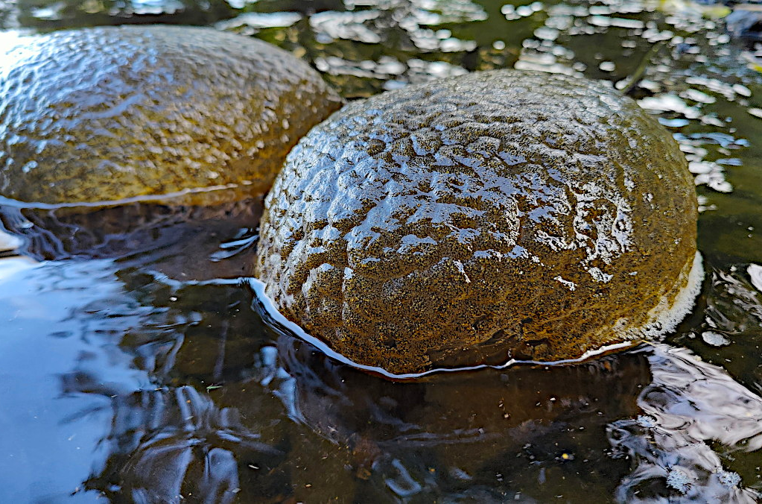
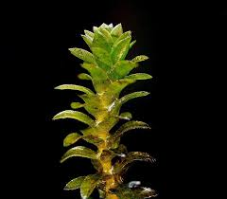
How do alien species affect Finland's natural waterways?
Invasive species affect Finnish waterways by changing the balance of the ecosystems, weakening the habitats of native species and causing harm to the biodiversity.
Invasive plants can form extensive stands that change the ecosystem of coastal areas.
Alien and invasive species can compete for food with native fish species or prey on them.
Some alien species also spread diseases that are harmful to native species in Finnish waters.
Alien species have different influence in south and central Finland compared to north Finland. In North Finland there are less people and climatic conditions prevent the species from spreading.

