Slide 1
Physics

Slide 2
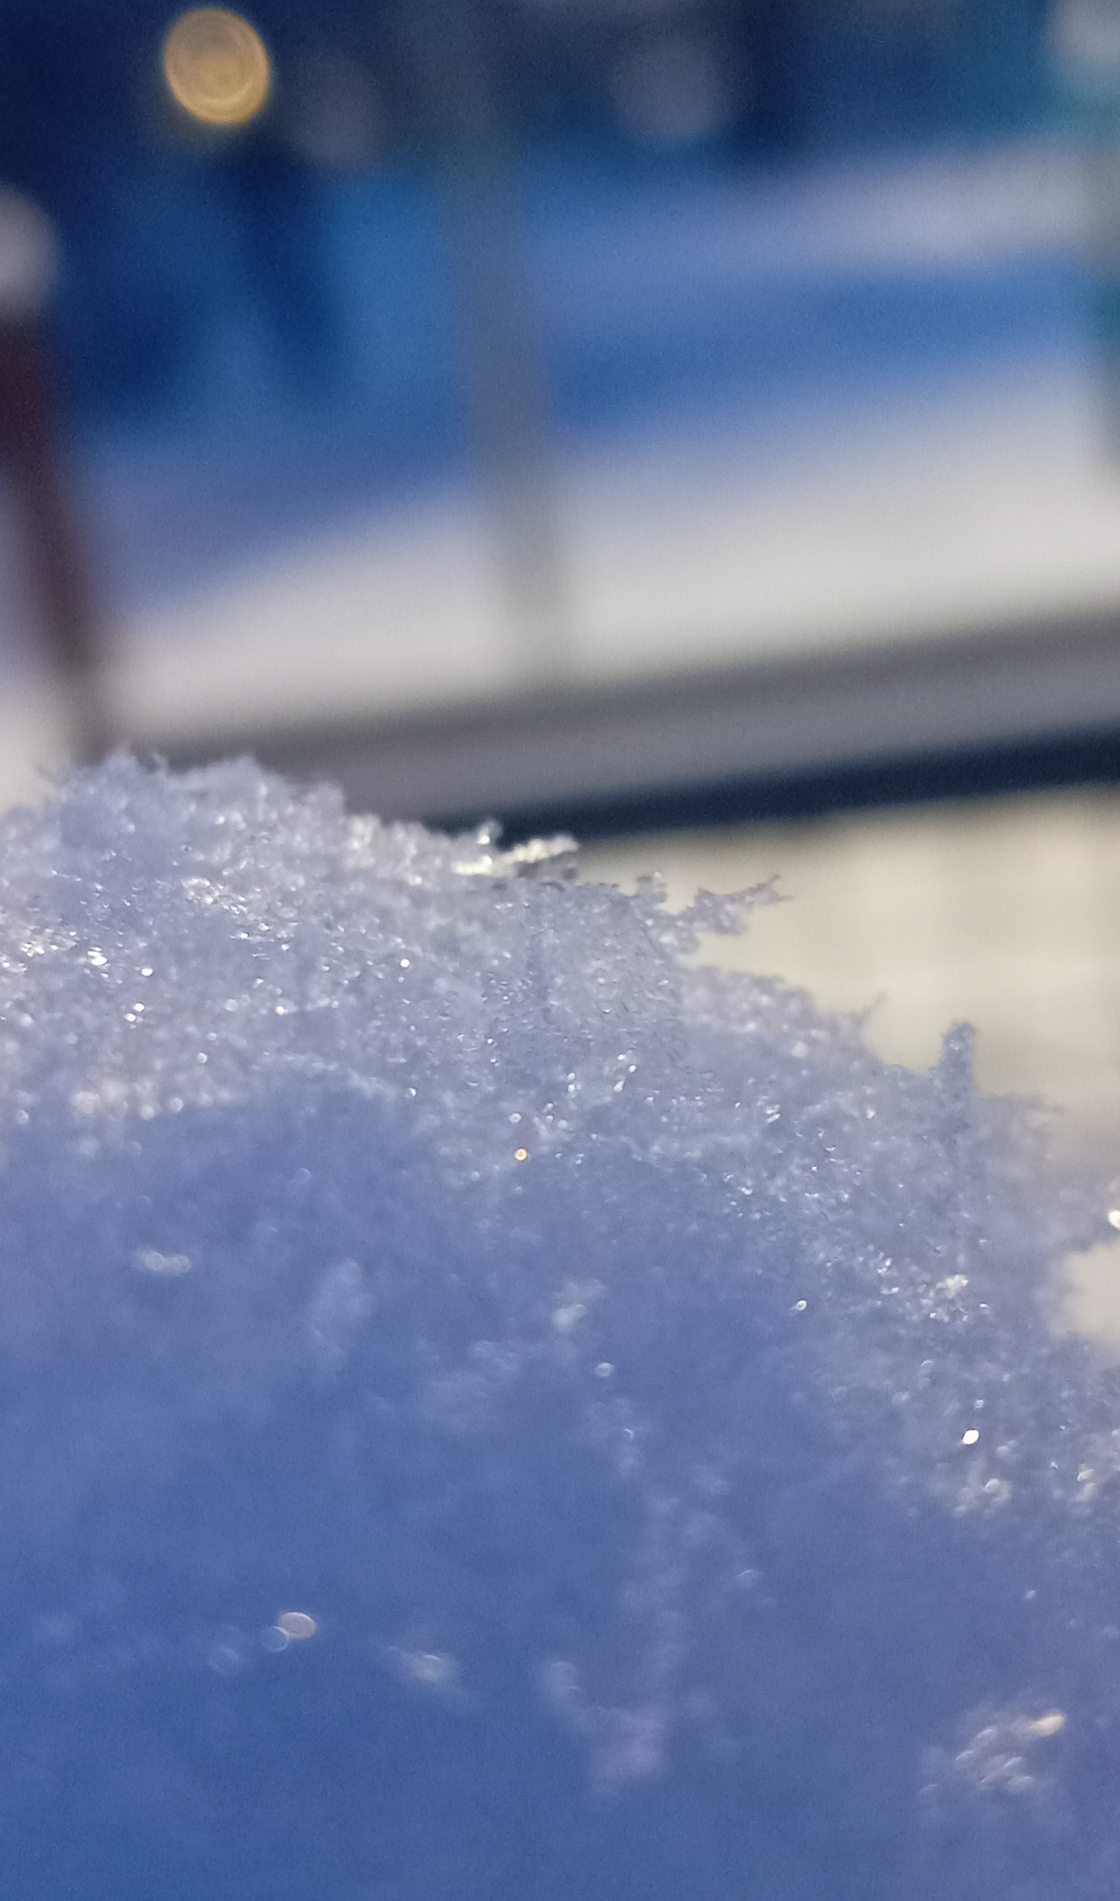
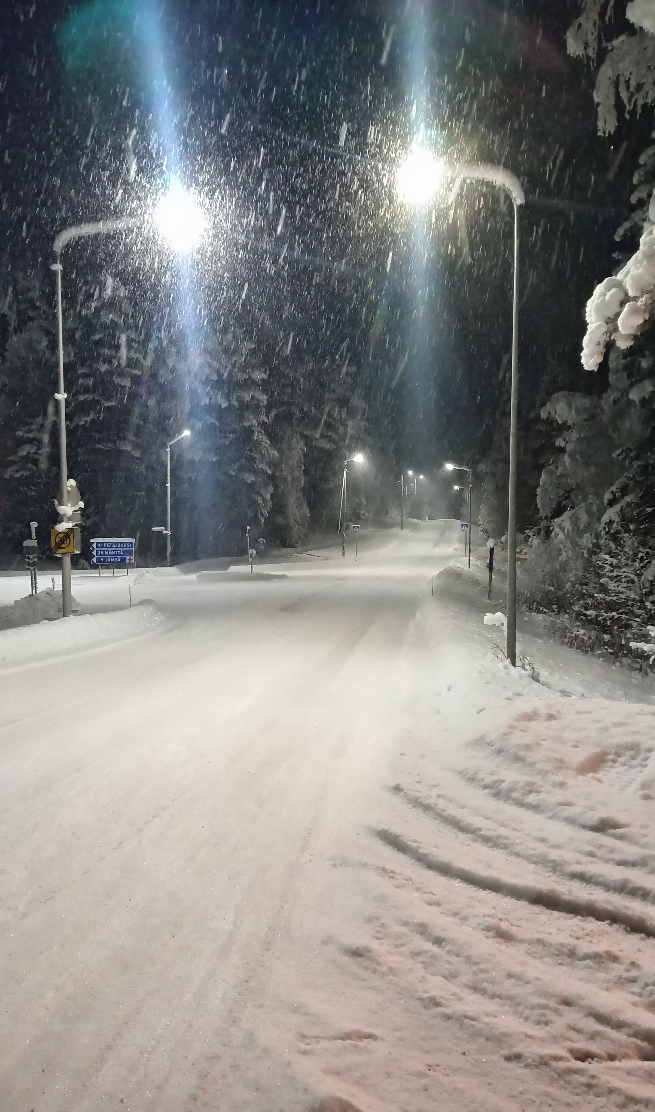
How is snow formed?
Snow is formed when water vapor in a cloud turns directly into ice crystals at low temperatures. These crystals grow, form flakes, and fall to the ground when they are too heavy for the cloud to support.

Slide 3
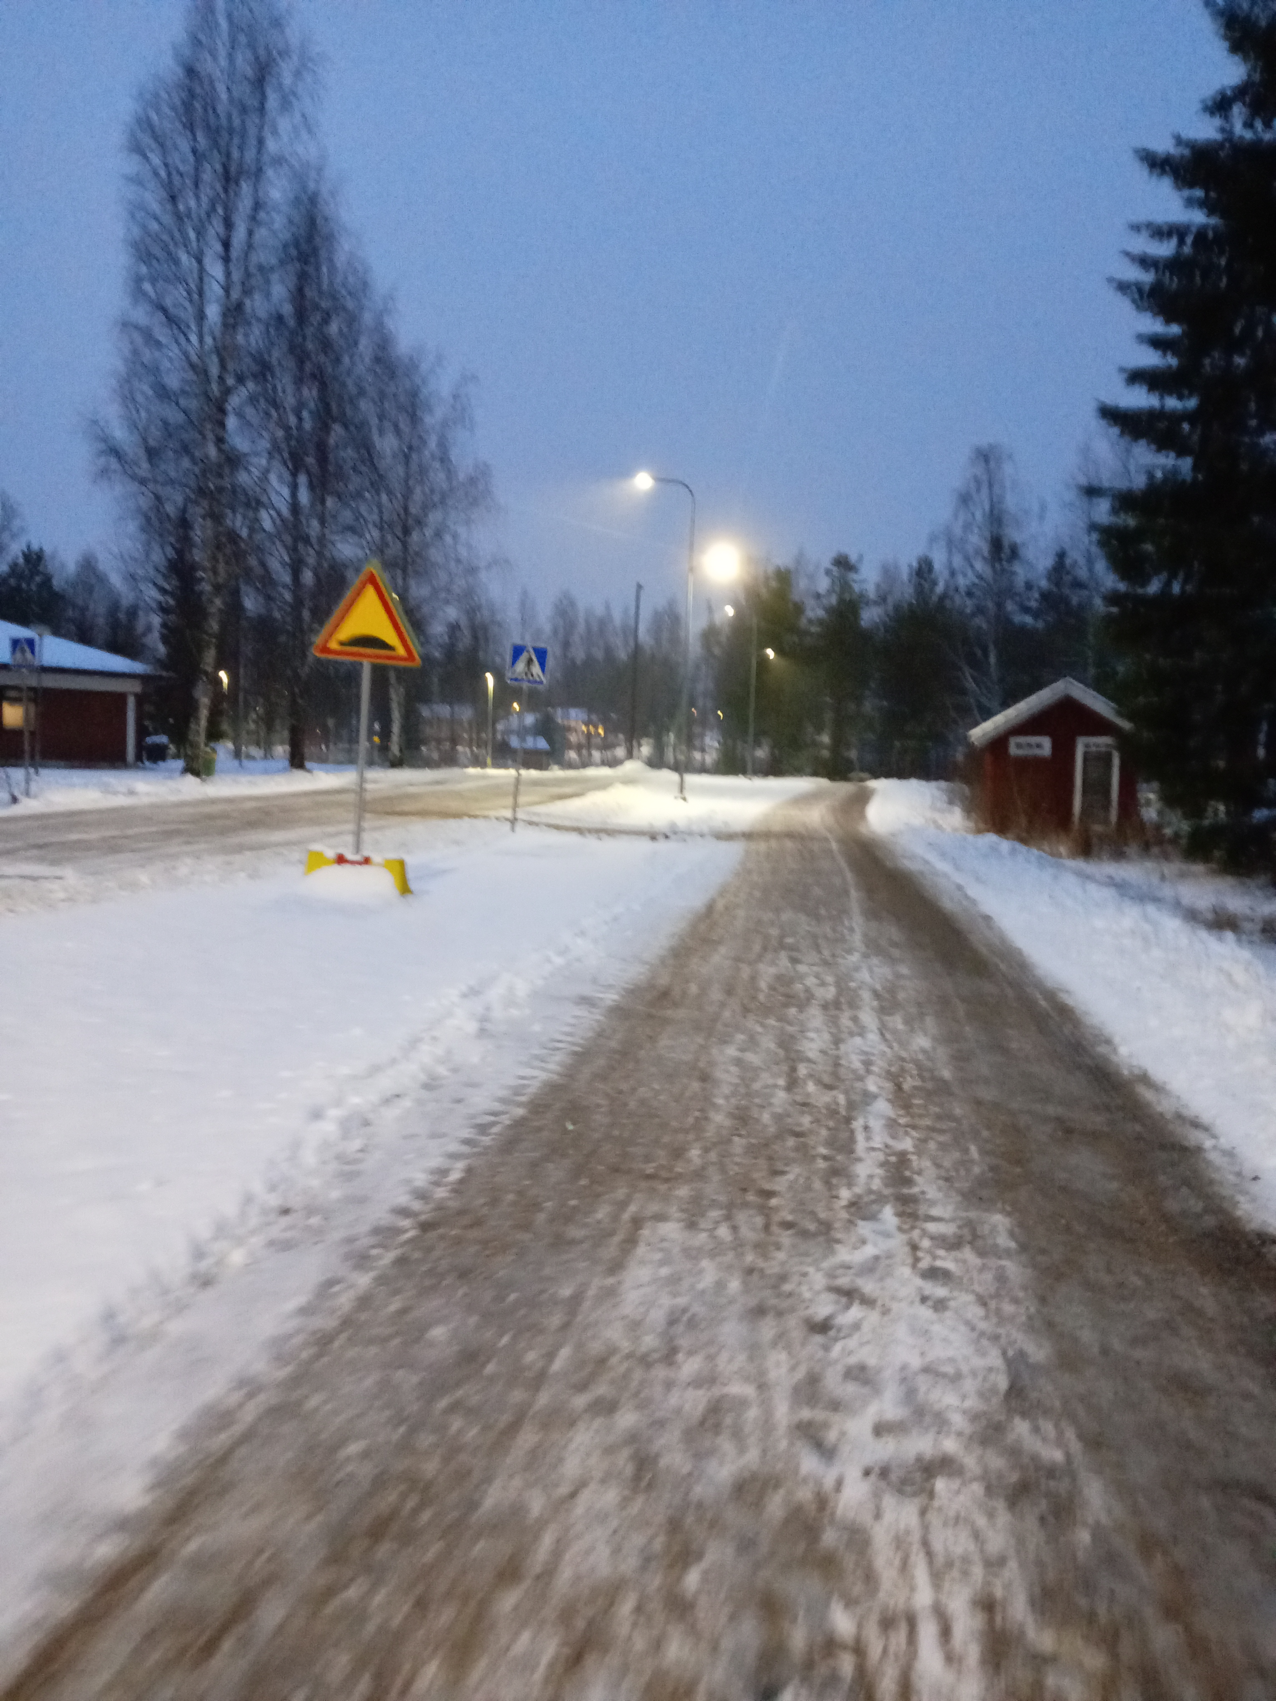
How long it takes snow to melt?
The speed of snow melting varies greatly depending on temperatures. Typically, in Finland, snow melting in the spring takes from a few weeks to over a month. The sun melts snow very efficiently.

Slide 4
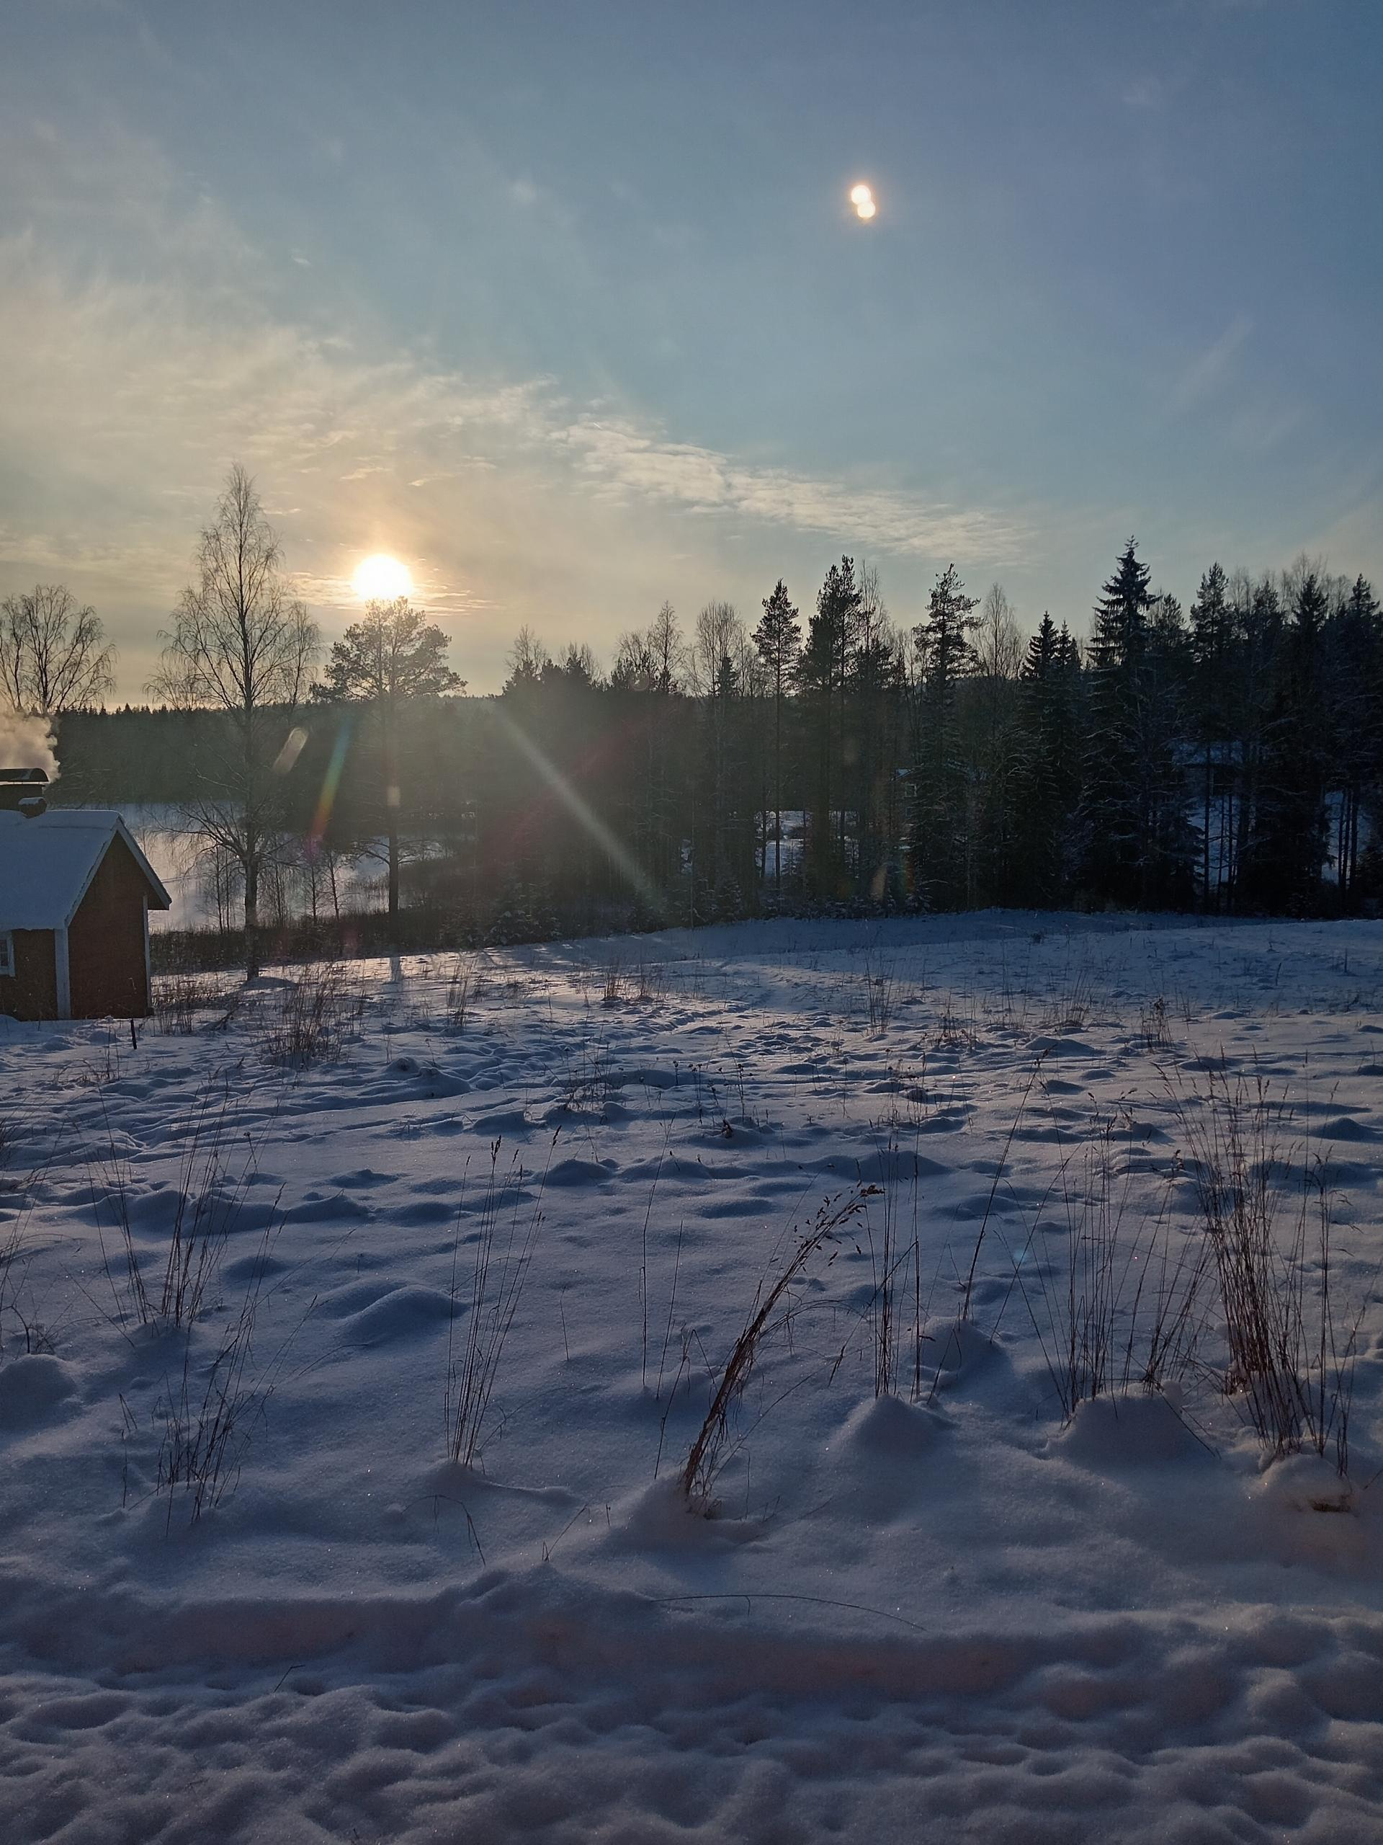
How snow reflects sunlight?
Snow reflects sunlight very effectively because its white, crystalline surface acts like a natural mirror. Fresh snow can reflect more than 80–90 percent of sunlight. Snow and ice are the most reflective natural surfaces on earth. Because of this strong reflection, it is much brighter in a snowy landscape even in cloudy weather or even at dusk.

Slide 5


Can melted snow be turned back into snow?
Melted snow can be turned into snow again as long as the temperature is below freezing. Snow is frozen water, so the process requires the water to be converted back into ice crystals. When it is very cold outside (at least -30°C), boiling water will immediately freeze and turn into a snow cloud when thrown into the air.

