Slide 1

Snow project

Slide 2
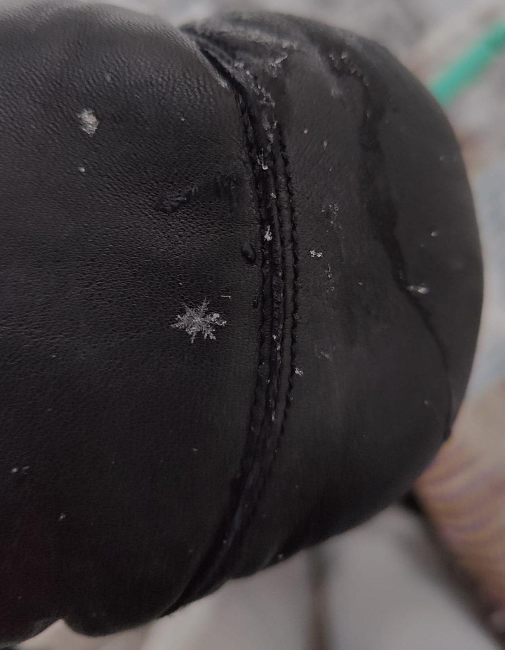
Is it possible to separate snowflakes from snow?
In cold conditions when the temperature is below 0 and especially in freshly fallen snow, the flakes keep their shape and don’t melt or stick together immediately. So it is possible to separate them from each other.

Slide 3
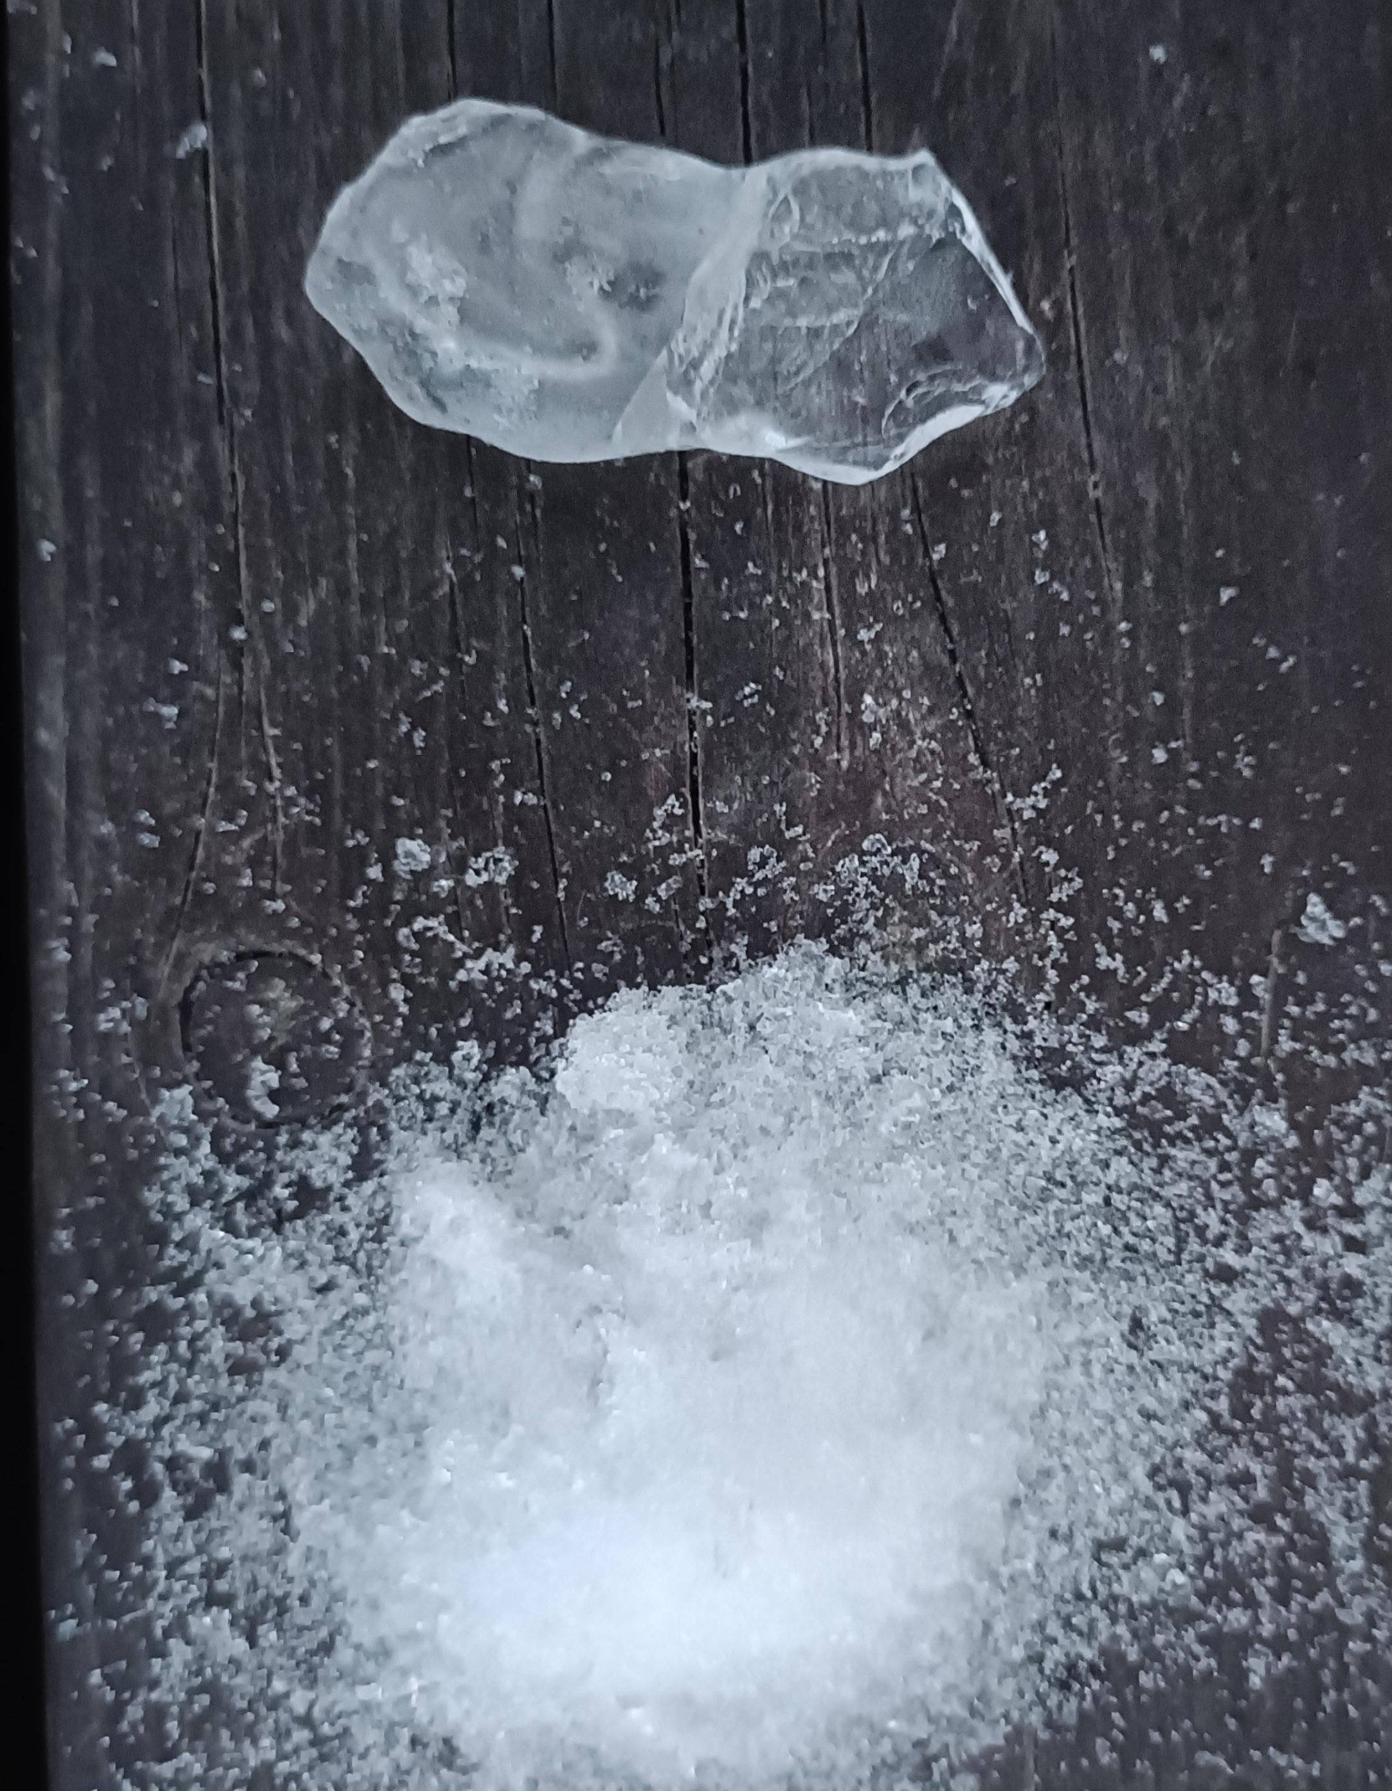
What is the difference between snow and ice?
Snow is made of tiny ice crystals that has fallen to the ground from clouds. It is usually white soft and fluffy.
Ice is liquid water that has frozen into a solid. It is clear hard and slippery.

Slide 4
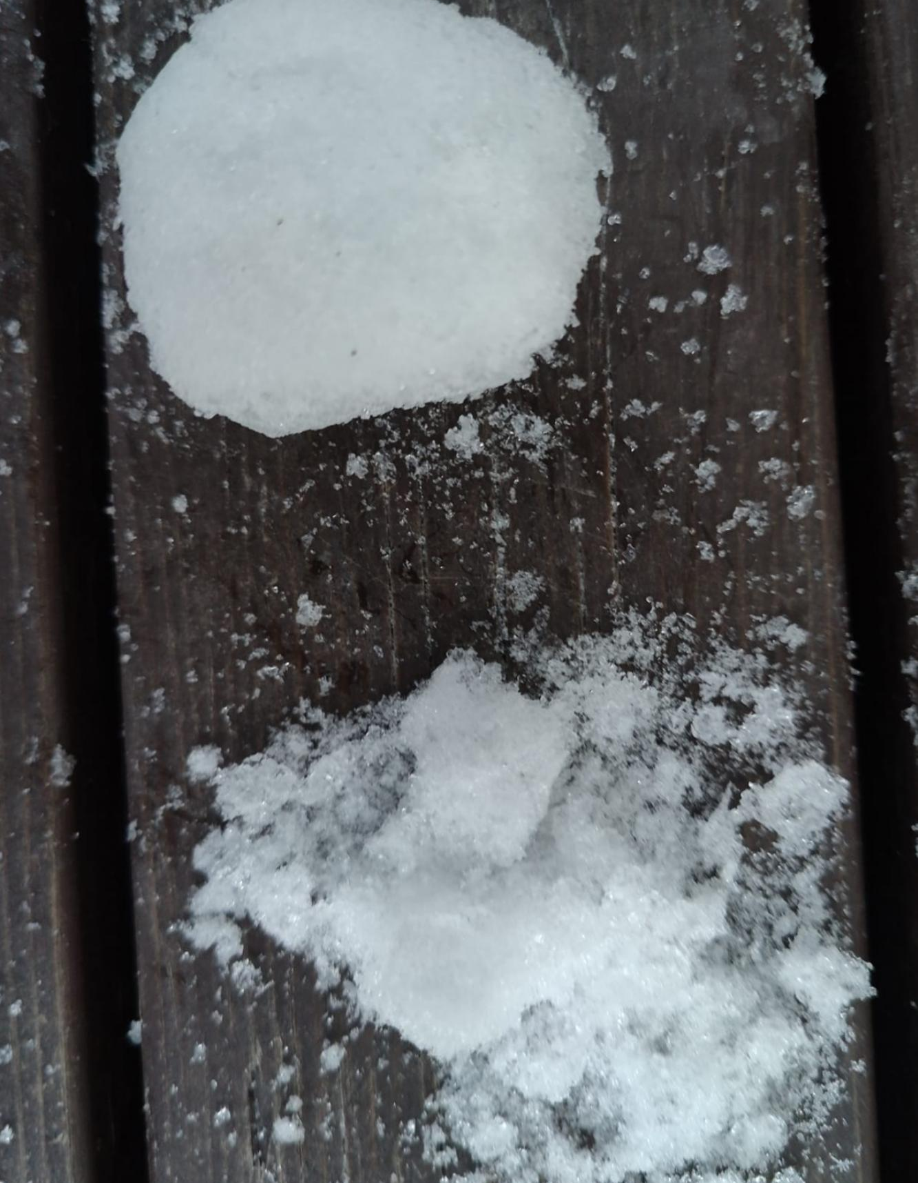
Why is it easier to do snowball from wet snow than dry snow?
It is easier to do snowball from wet snow when the temperature is under 0 because some snow has already melted into water and water makes the snow sticky.

