Slide 1
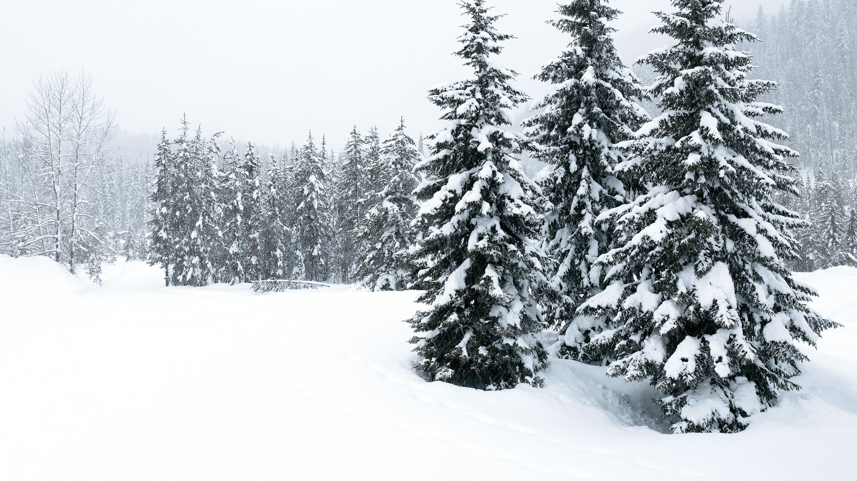
Erasmus+ Snow research

Slide 2
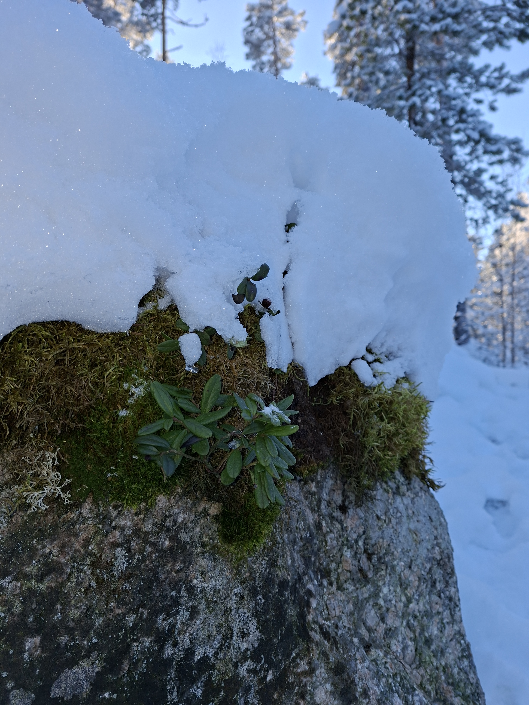
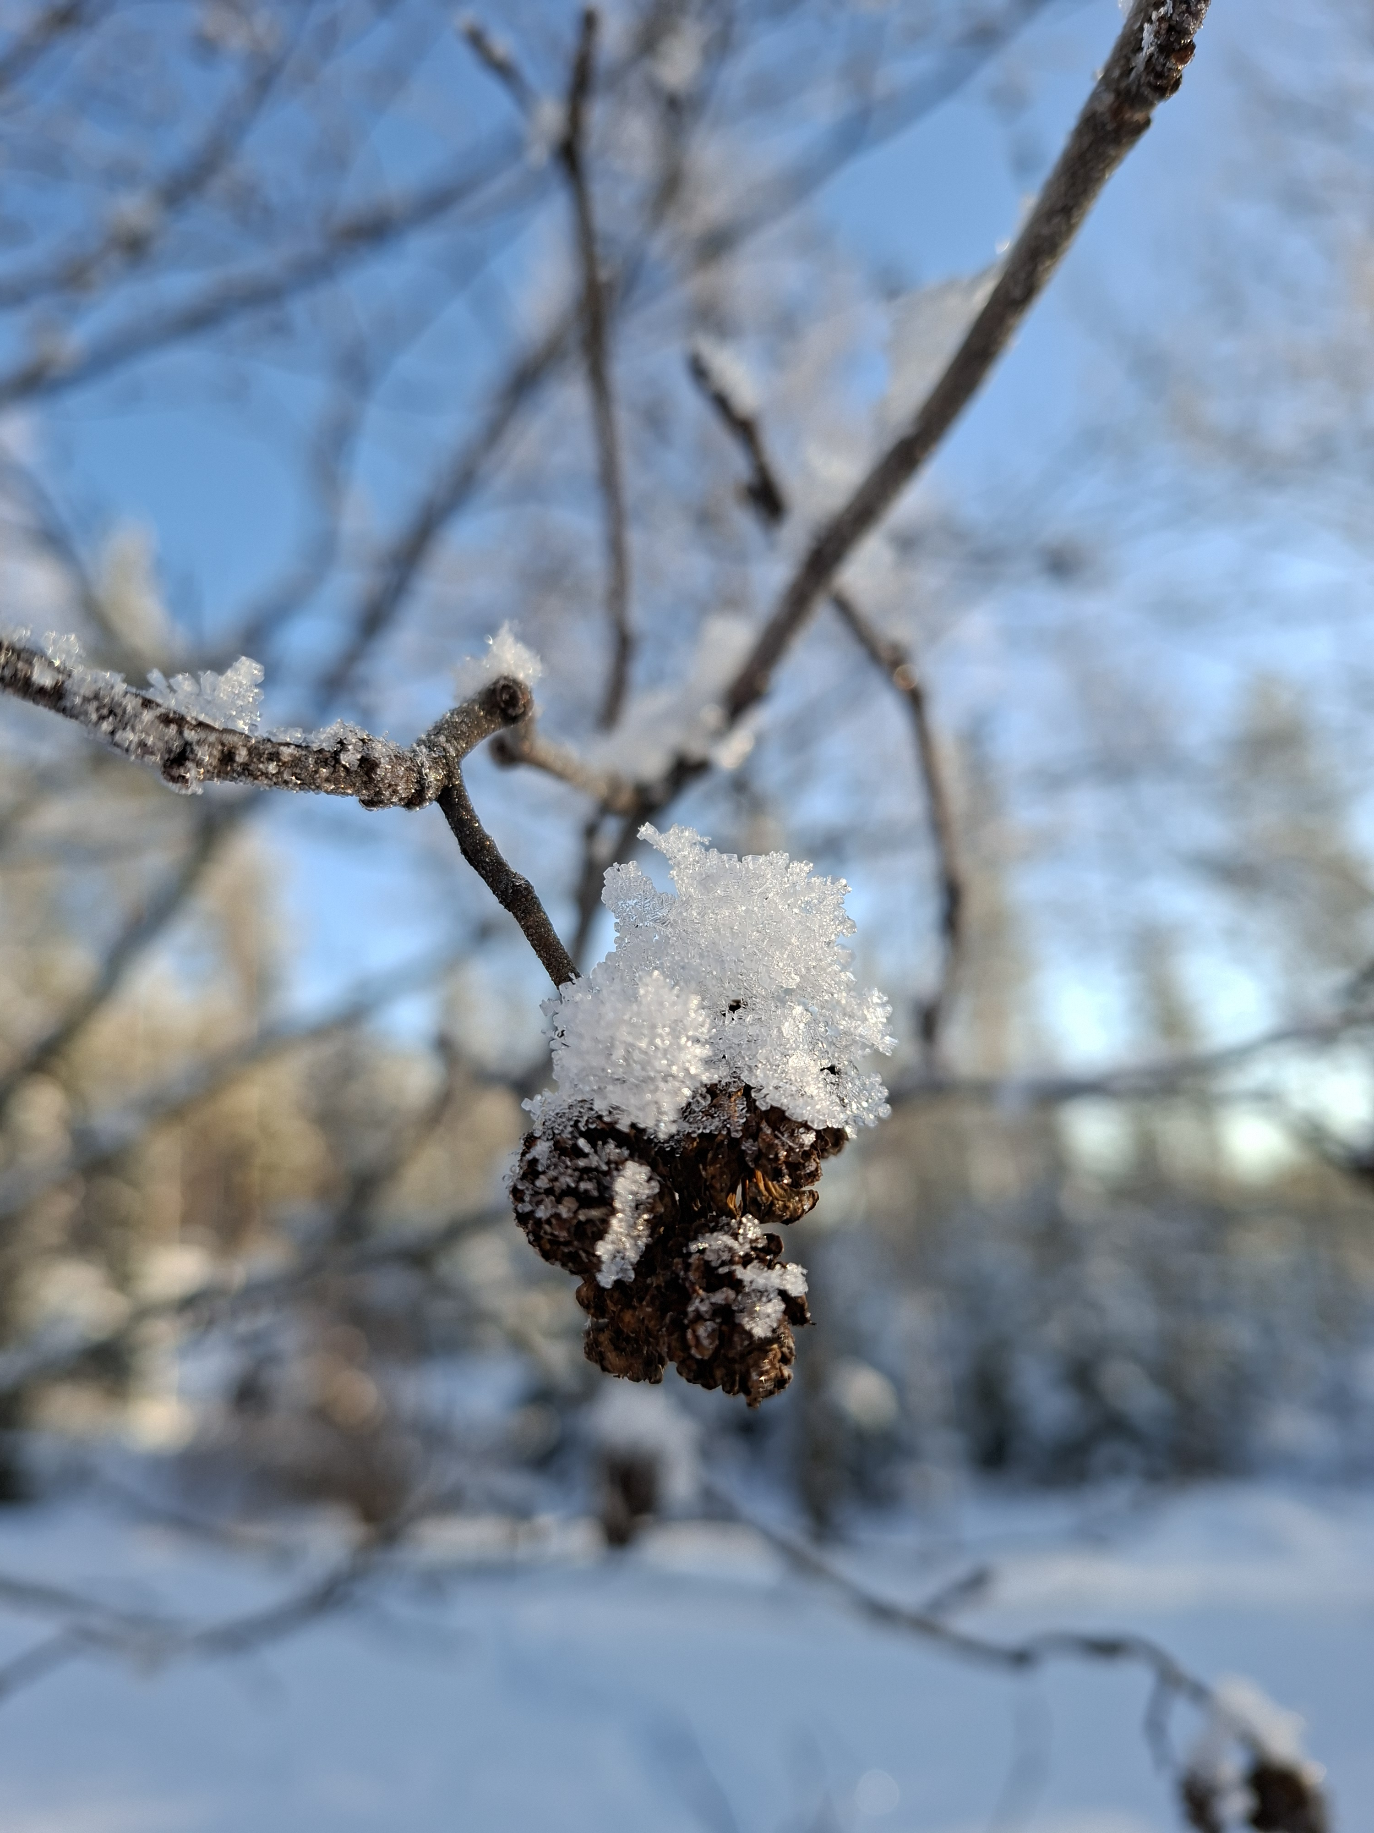
How snow affects the wintering of plants and animals?
Plants
Snow offers great cover for many plant species by protecting them from frost since the tempeture is more even under the snow layer keeping the plant buds and tissue safe from damage. A thick layer of snow prevents the ground from freezing deeply, which helps plants survive. Snow is also cabable of keeping the moisture balance of the plant even throughout the winter.
In some cases the snow can also damage the plants. When there is lot of snow for a long amount of time it can break the trunk or branches of a plant.

Slide 3
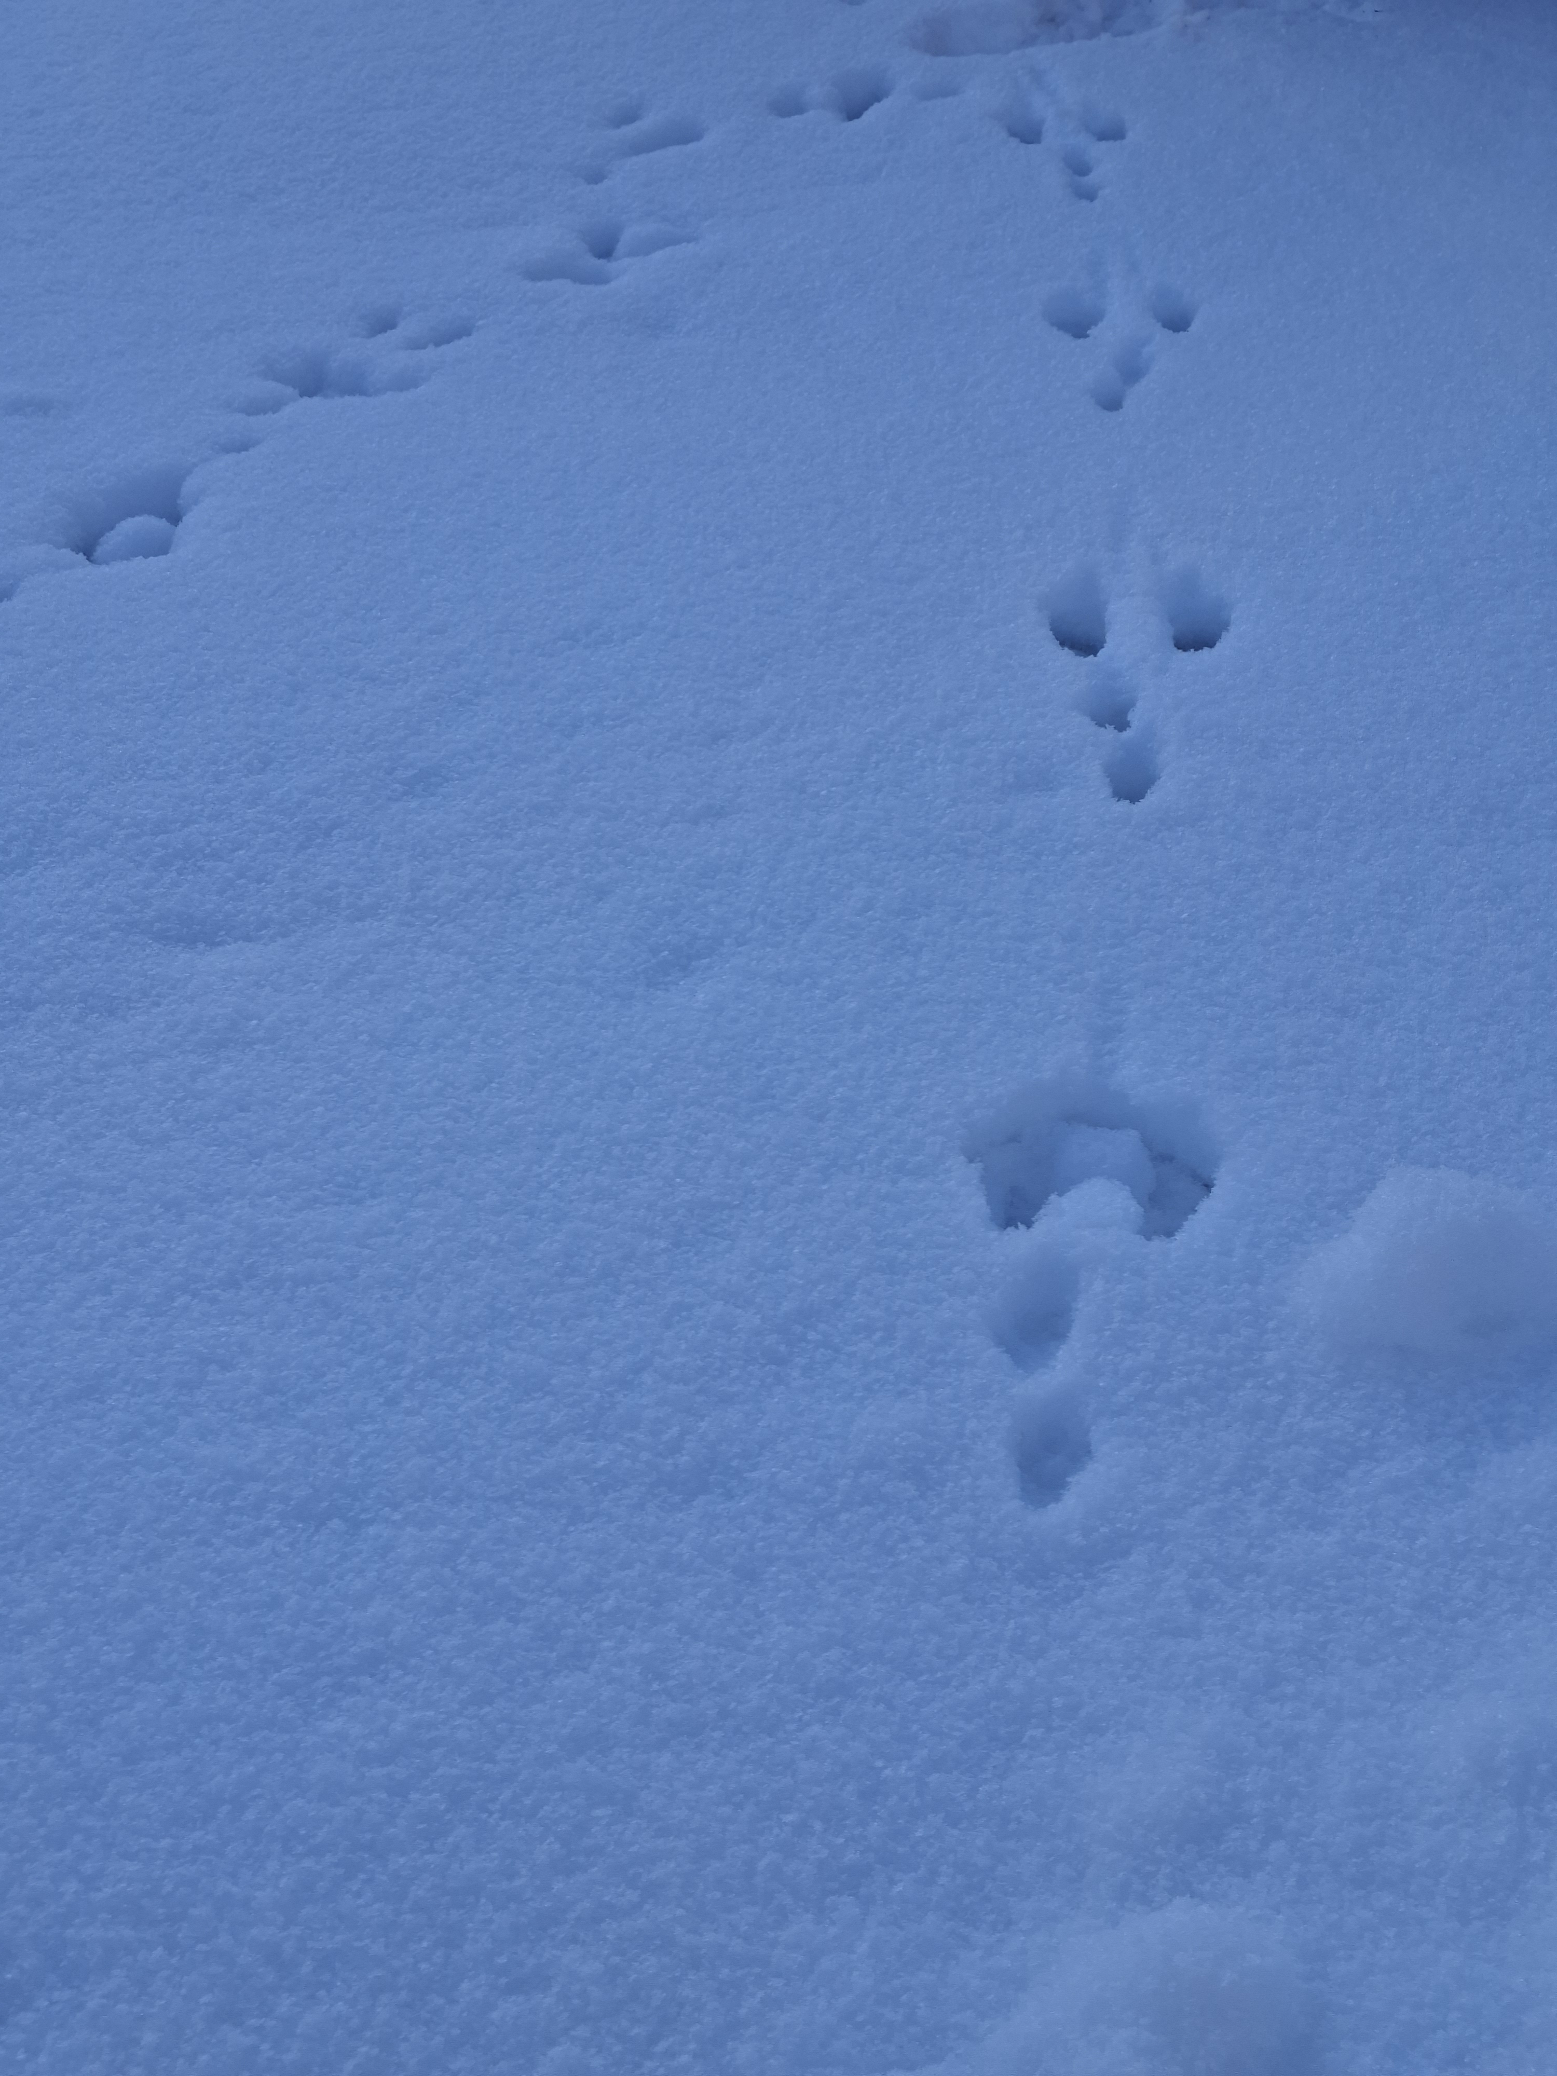
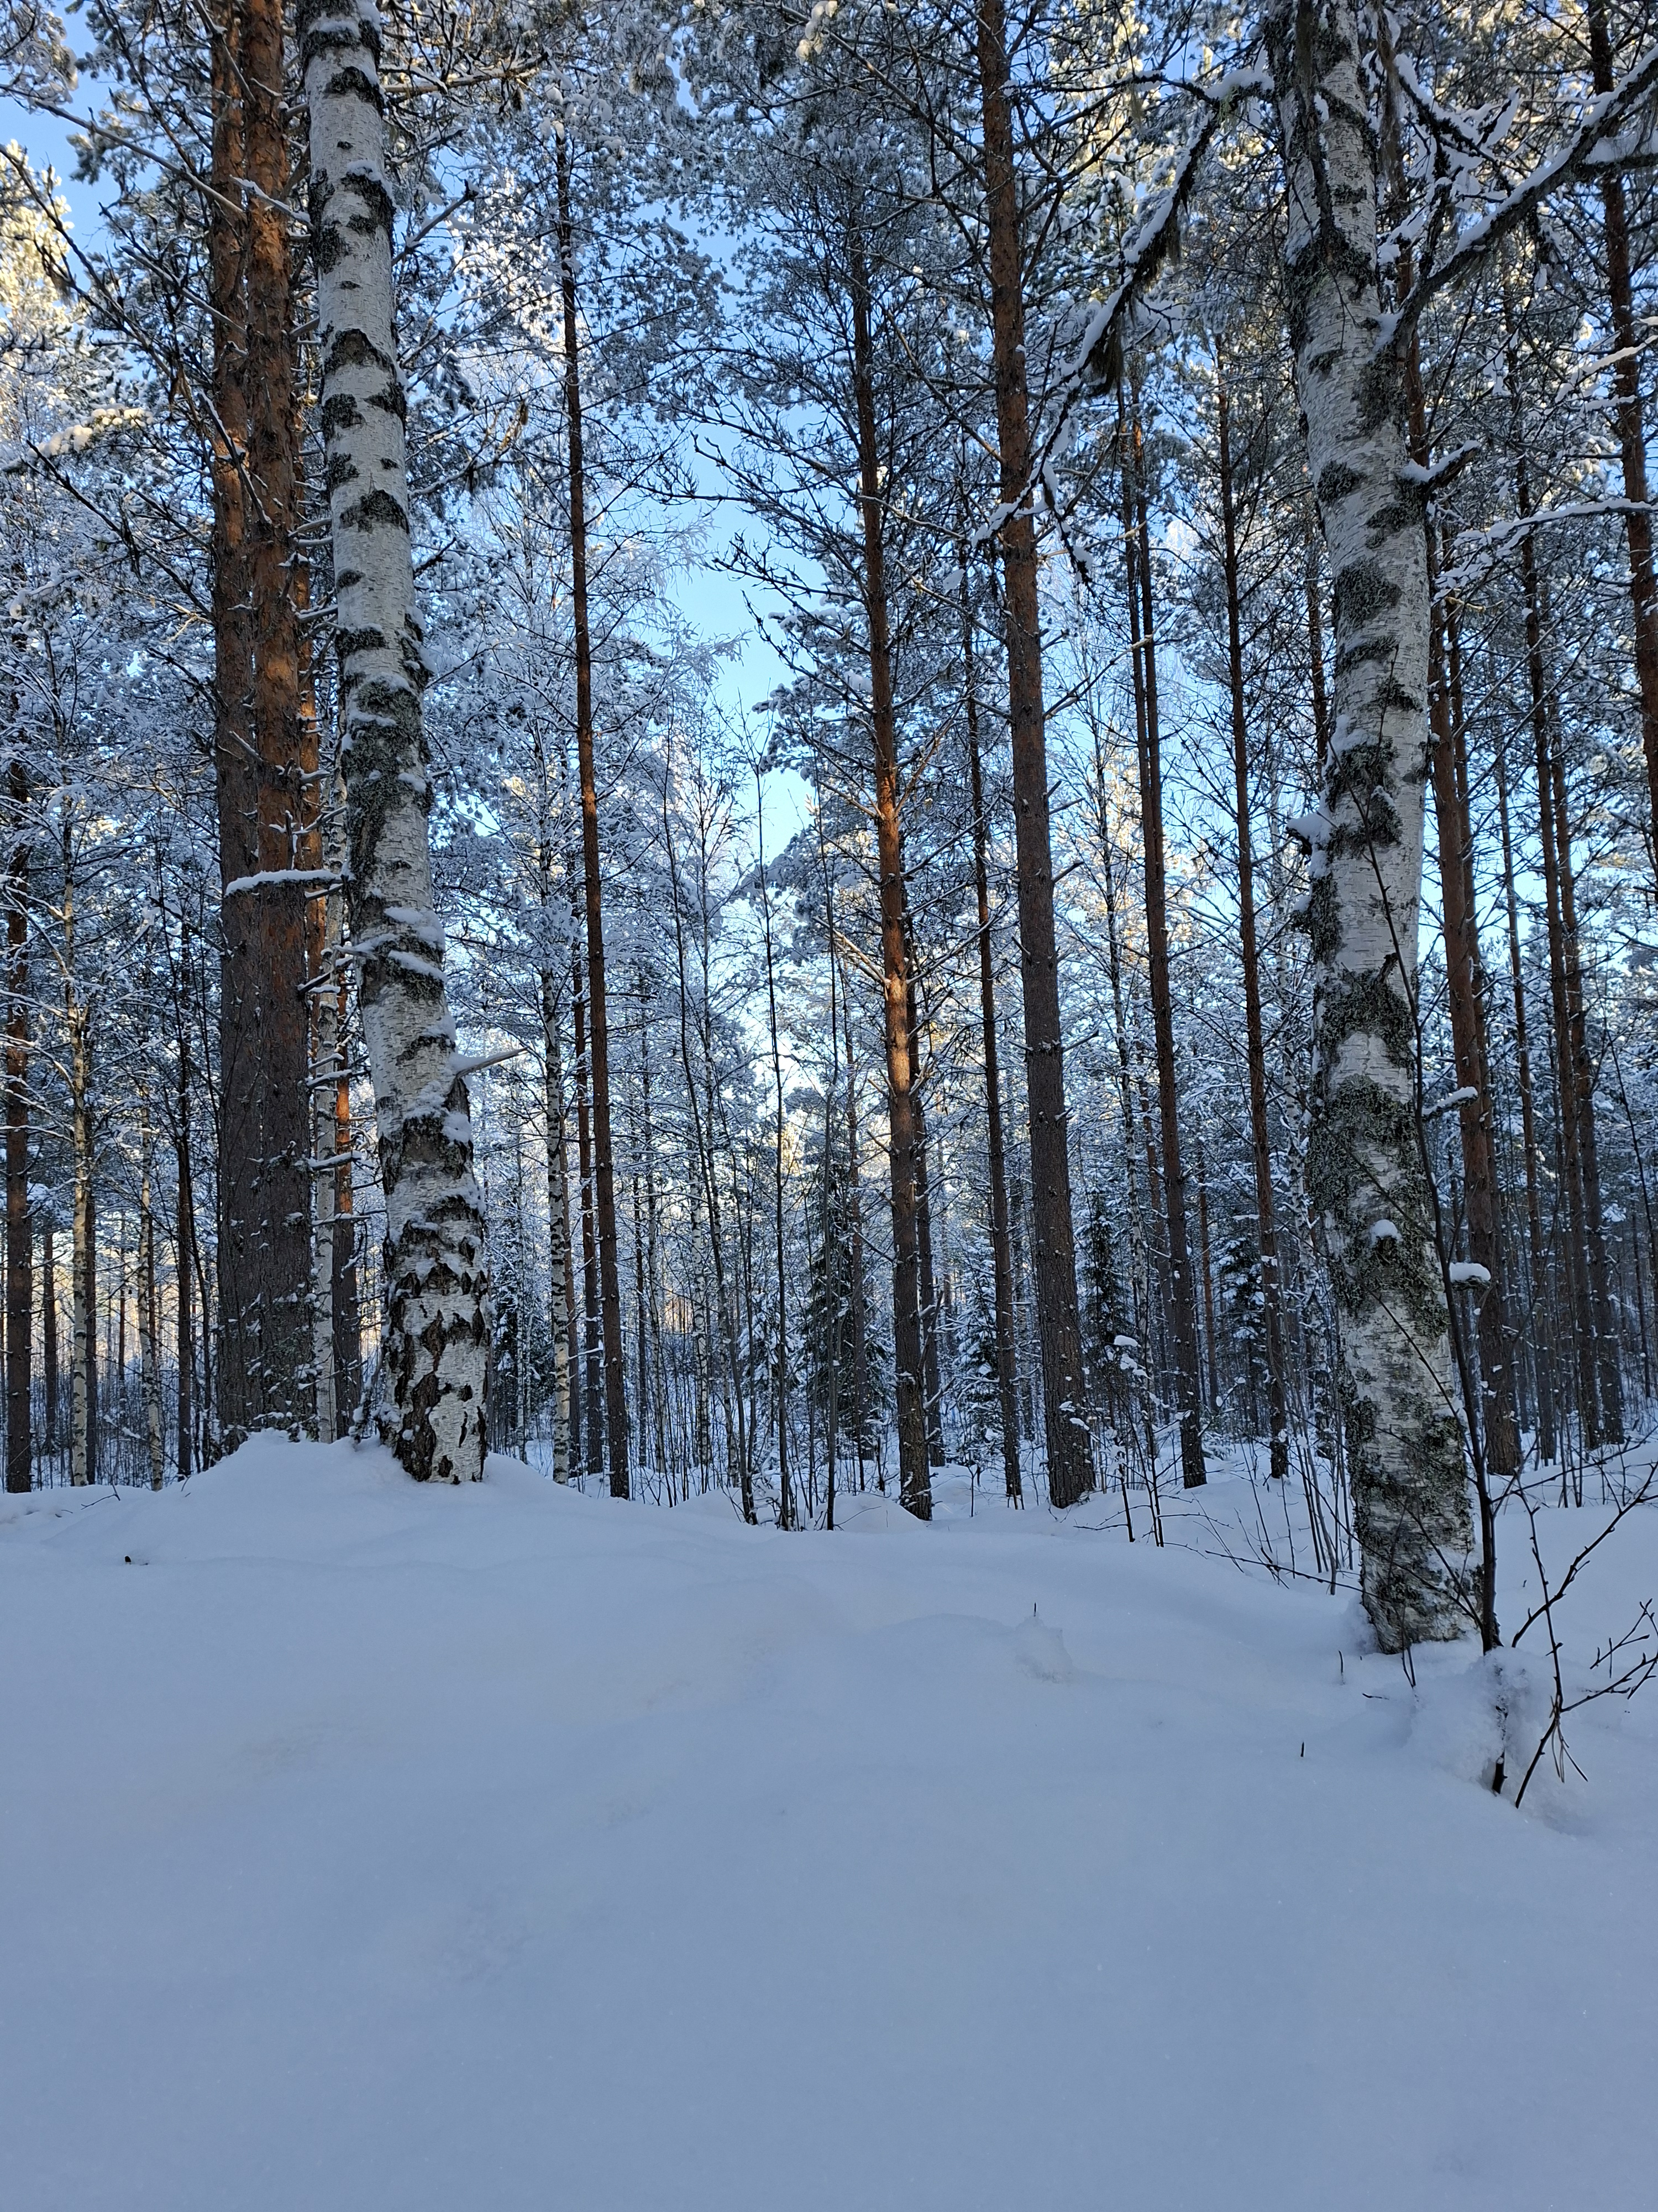
Animals
Once again, the snow acts as a good thermal insulator and the nests under the snow remain at almost zero degrees throughout the winter. Snow also gives great hideout places for small species like hares or weasels. Snow helps to protect plants, which is important for food production.
Although snow is very good for many different species it can also harm animals mainly by making it difficult to move, covering food, and increasing need of energy to stay warm. A warm winter can cause the so-called protective color to fail, as there is little or no snow, making white-furred animals such as hares easily visible to predators.

Slide 4
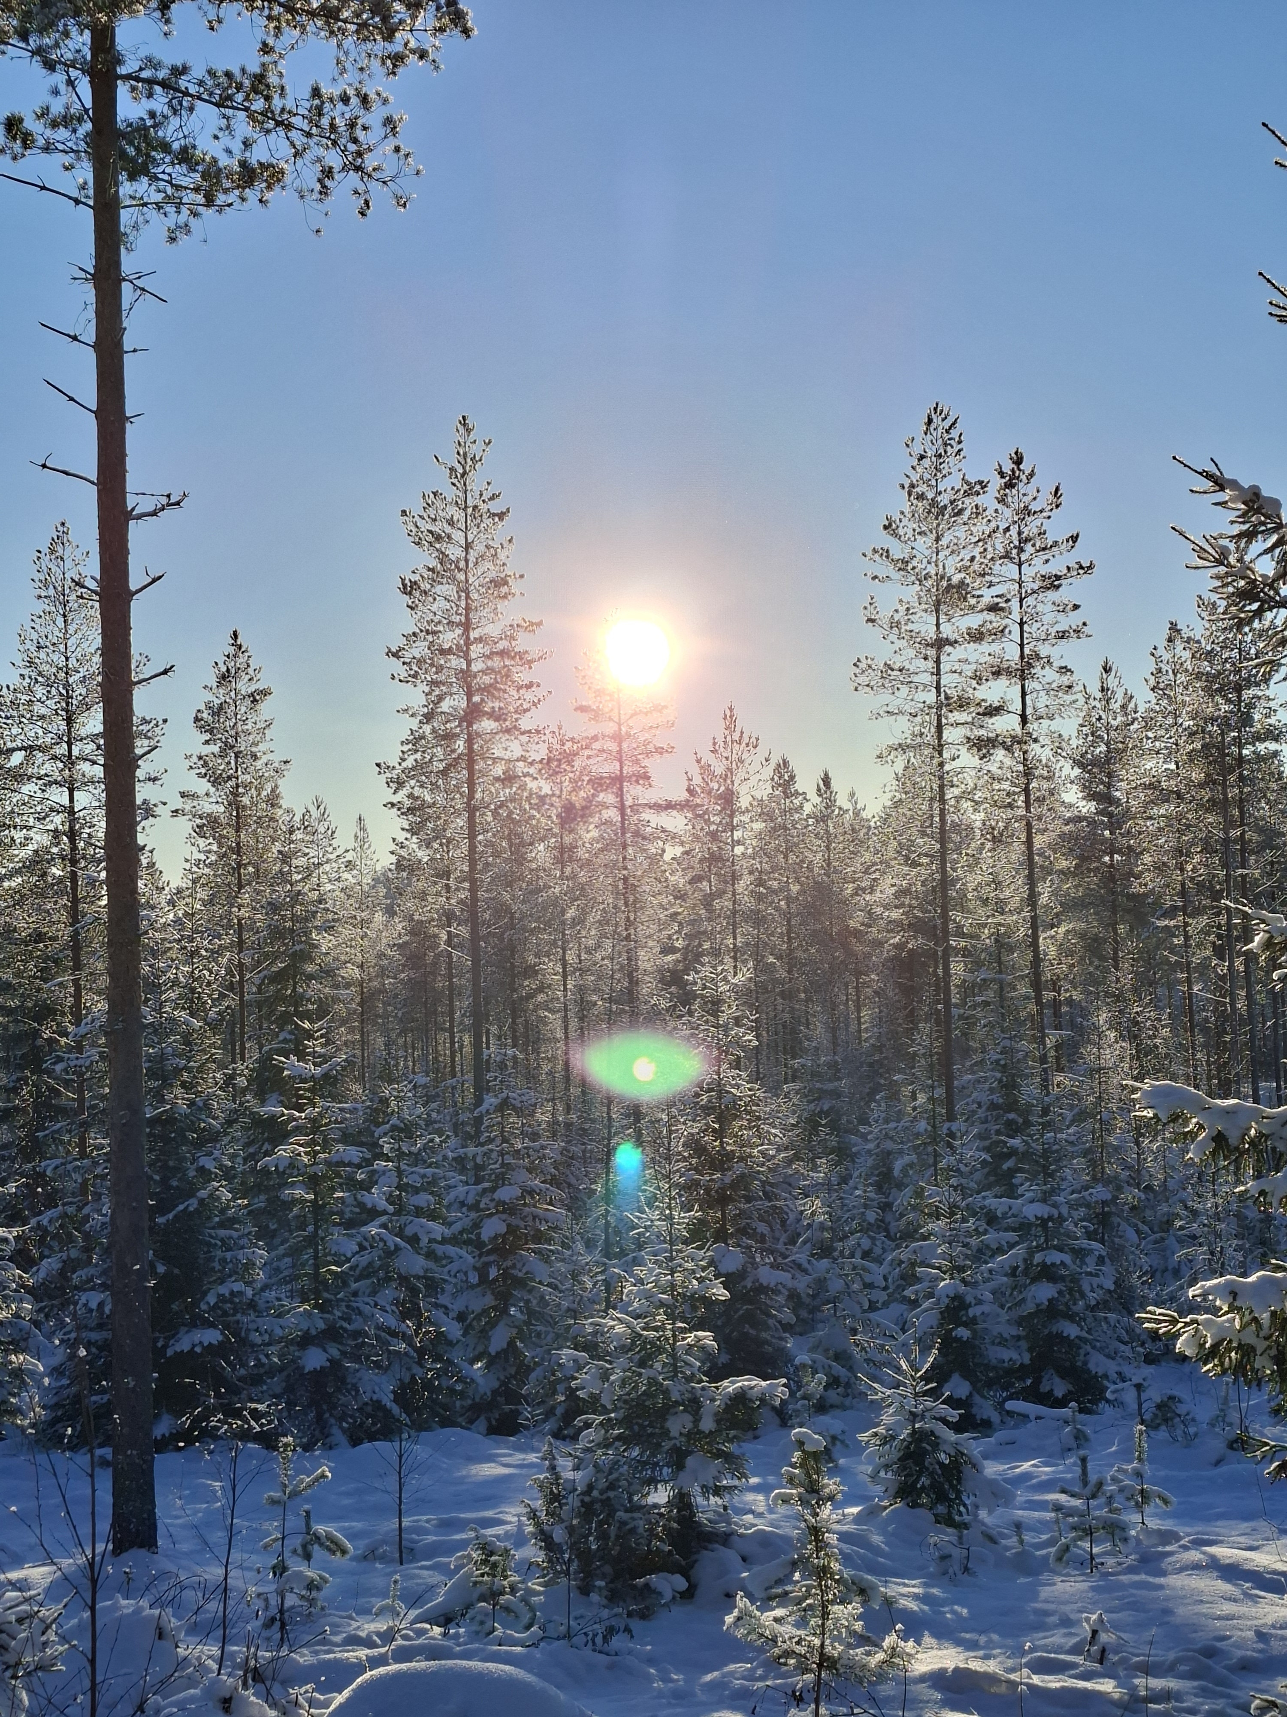
How the location of the snow affects its cleanliness?
In
In cities or places with factories and cars, snow often gets dirty. This is because smoke, dust and chemicals gets mixed into the snow. In clear nature far from people like in the forests or on mountains the snow is untouched, white and much more cleaner.
Also the altitude of places can change how clean or dirty the snow is. For example on top of fells or mountains the snow is usually much cleaner than on the ground because pollution usually stays low on the ground.

Slide 5
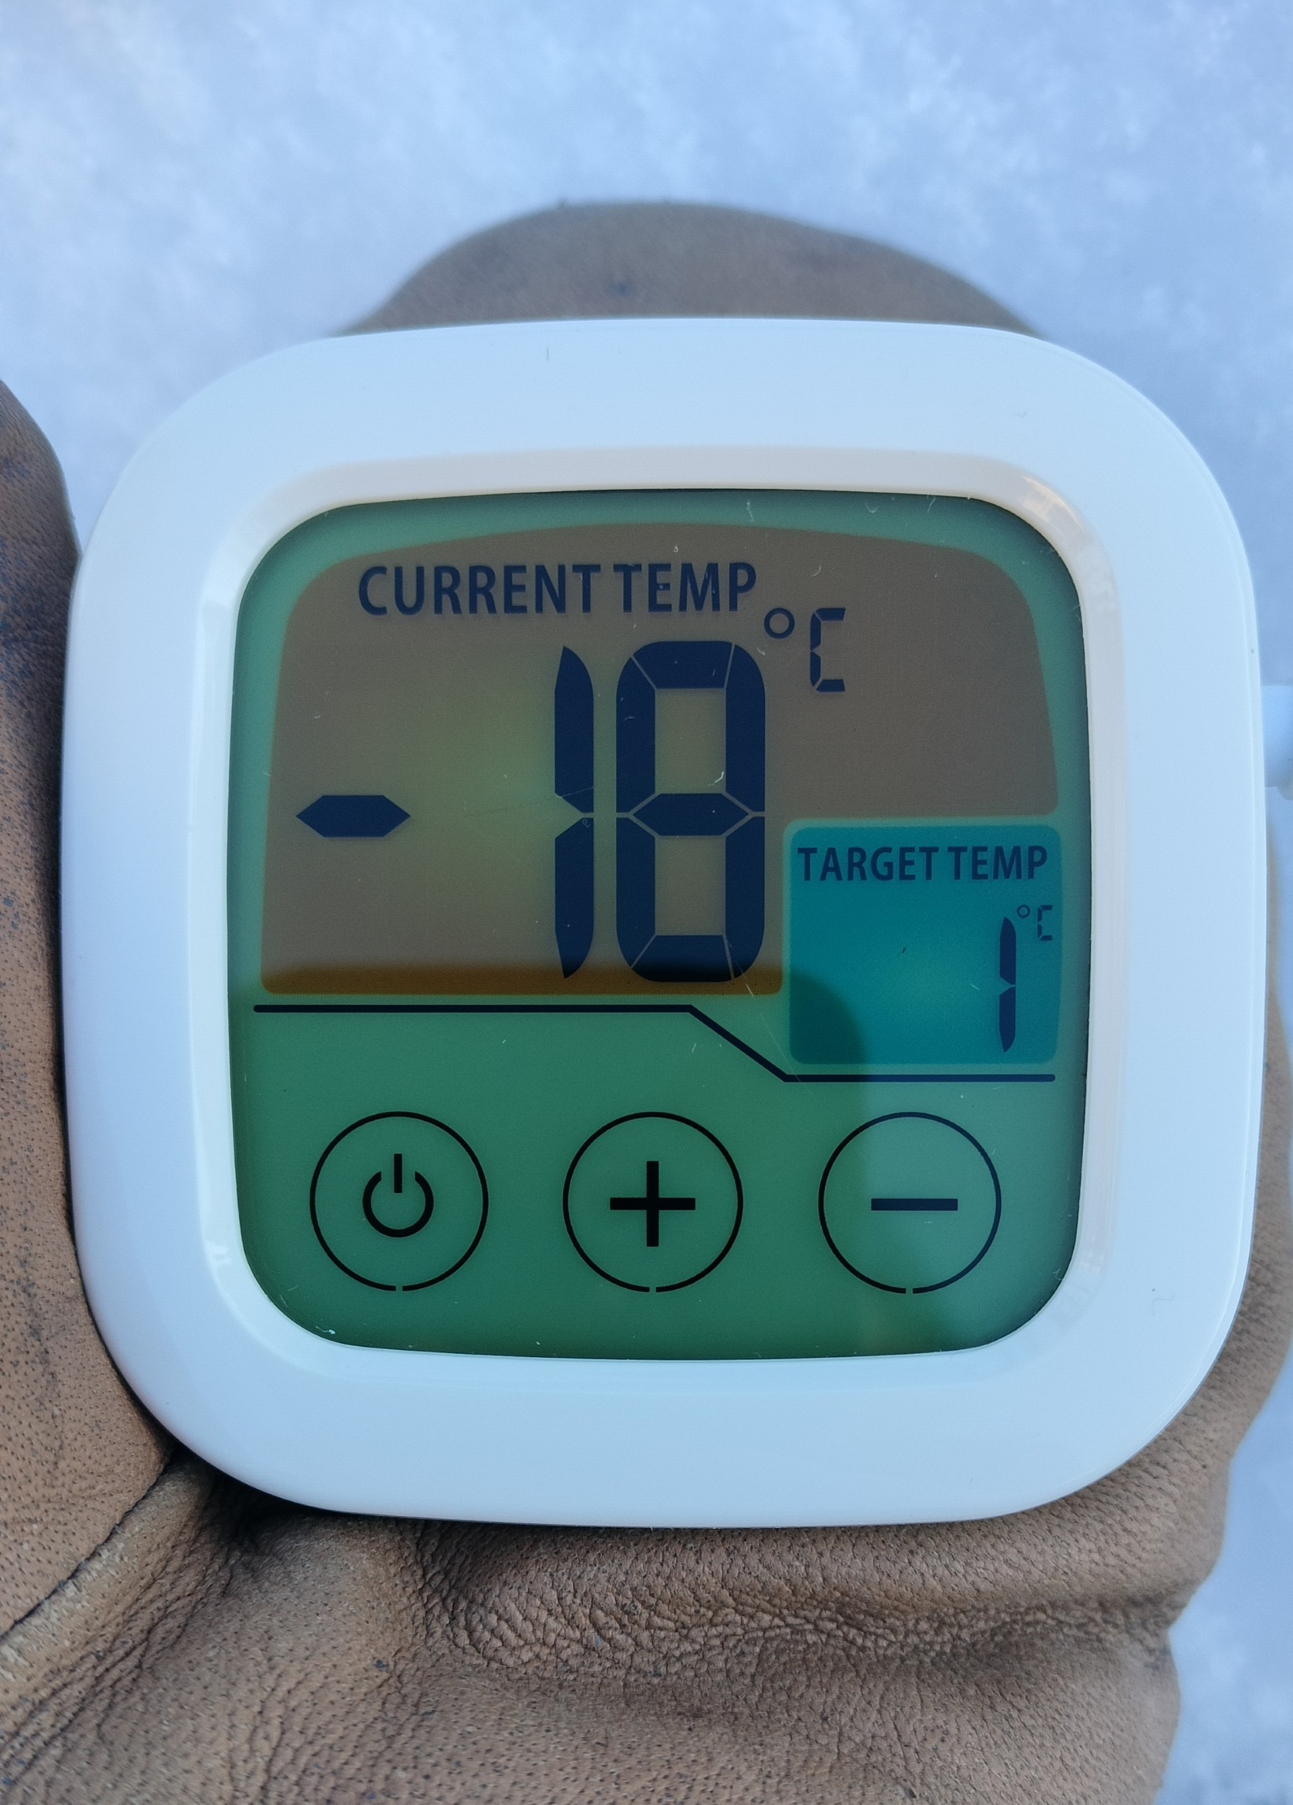
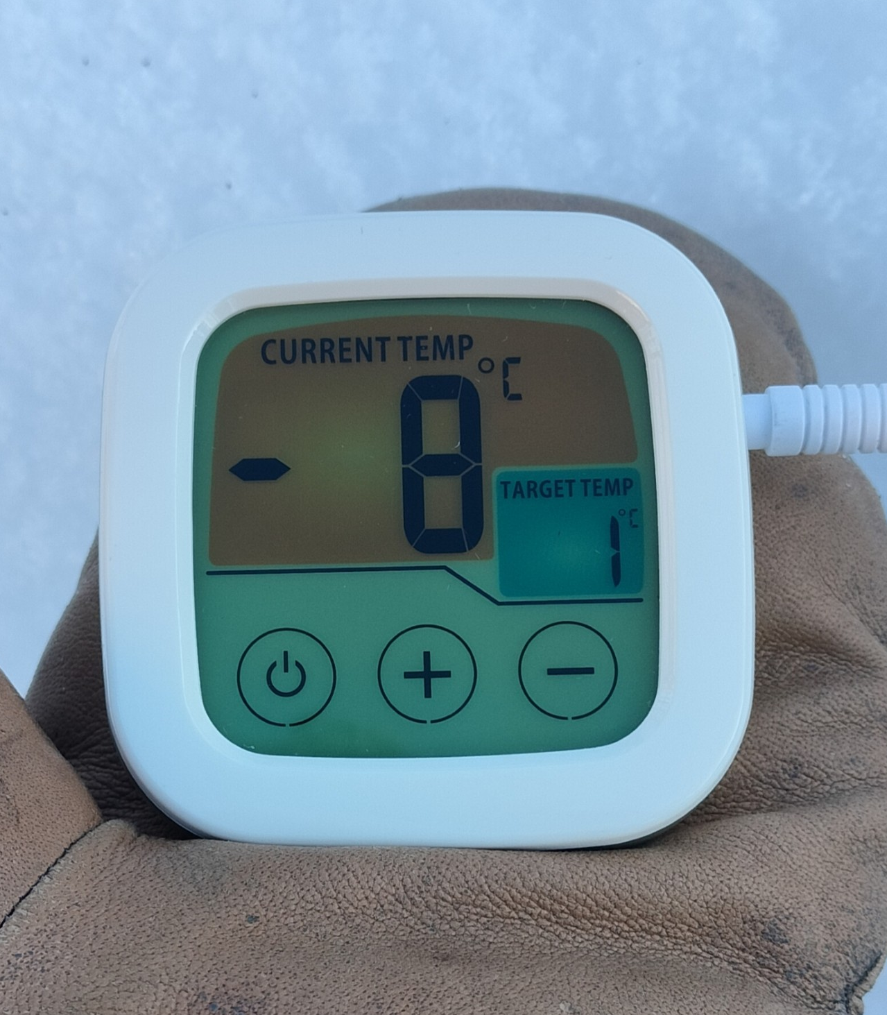
In the winter in Finland the outdoor temperature variates depending on where in Finland you are, but for example -20°C is a regular air temperature in central Finland.
What's the temperature under snow compared to the air temperature?
Snow is a good insulate. Depending on the amount and texture of the snow it prevents the ground from cooling down to the same temperature with surrounding air.
In the pictures the temperature is first measured from the air above the snow, then under about 20 centimeter layer of light snow.

Slide 6
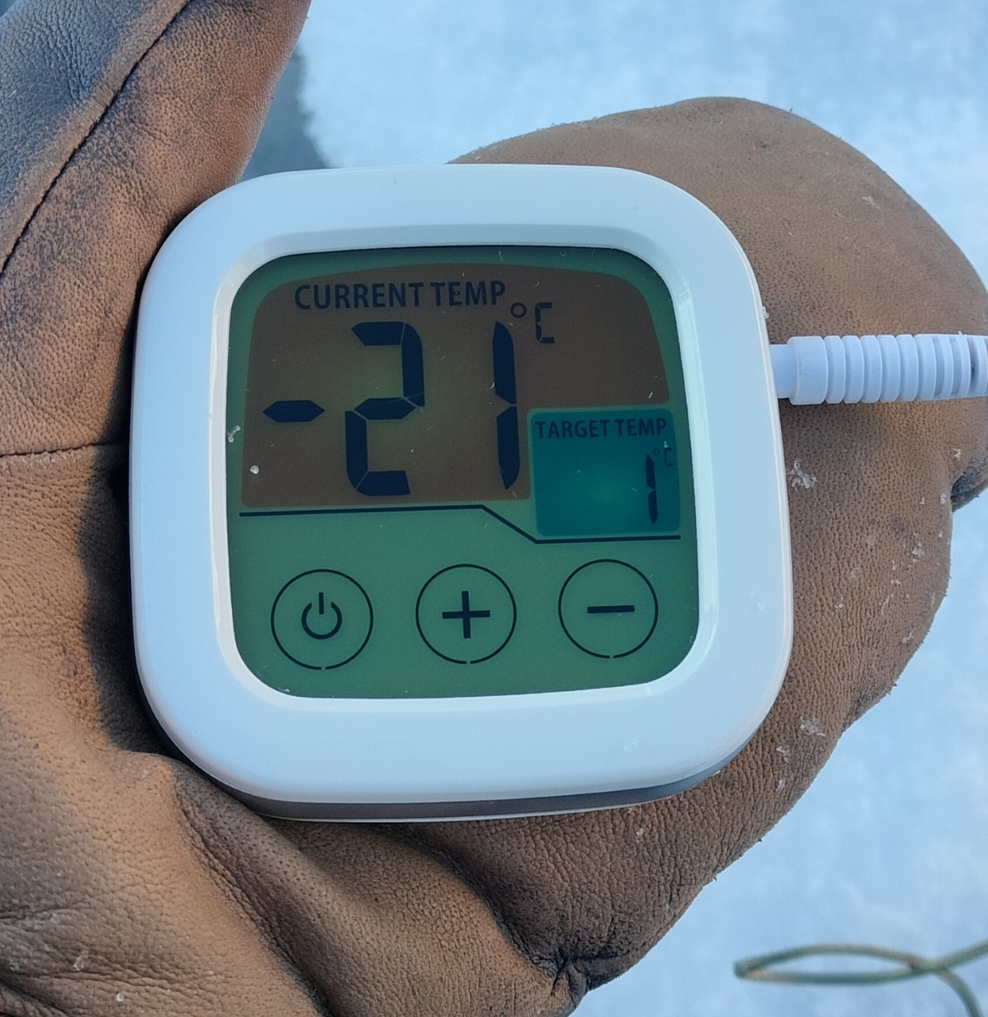
What is the temperature of snow?
The temperature of snow depends a lot on the air temperature. Anyway snow is ice so it starts melting when the outdoor temperature rises above 0°C.
This is the temperature of snow when it's -18°C outside. As you see snow can be even colder than the surrounding air.

Slide 7
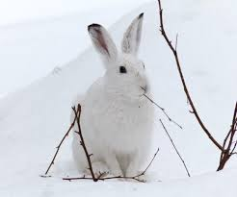
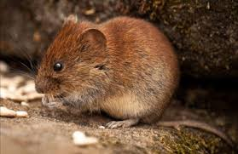
Why do some animals make nests in the snow?
Many ground-nesting birds and small mammals build nests in the snow to protect themselves from the cold and wild and to save energy. Snow also protects them from birds of prey and other predators, which can't see them through the snow layer. Voles and field voles typically nest under the snow. The hare can also burrow into the snow for protection.

Slide 8
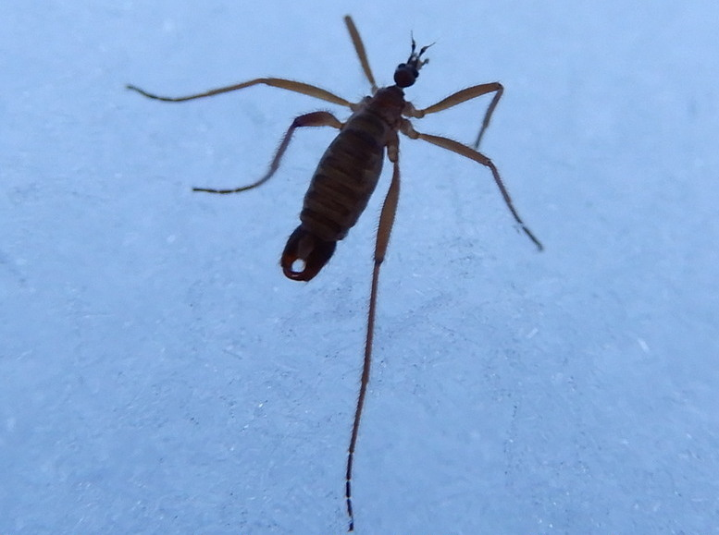
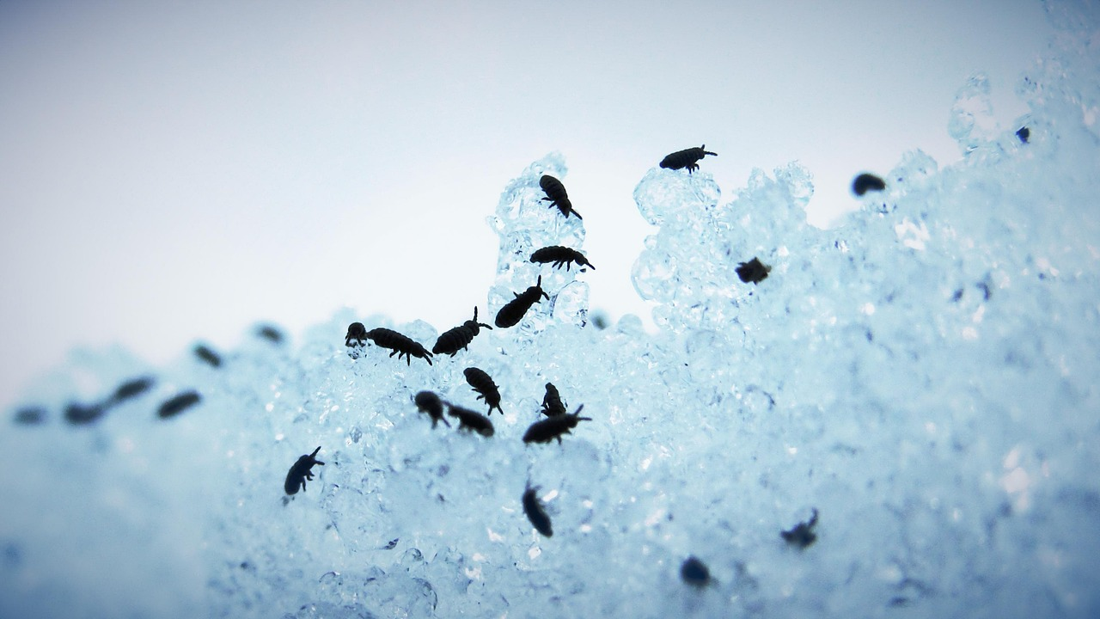
What kind of insects live in the snow?
Several cold-resistant insects live in the snow, such as springtails, winter gnats, snow beetles, and snow cherries. These species are active in temperatures from 0 degrees of Celsius up to –10 degrees of Celcius, and can be observed especially during spring frosts.

