Slide 1
Home economics

Slide 2
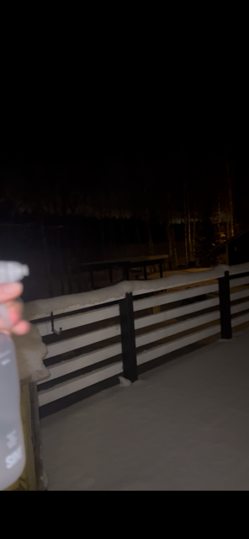
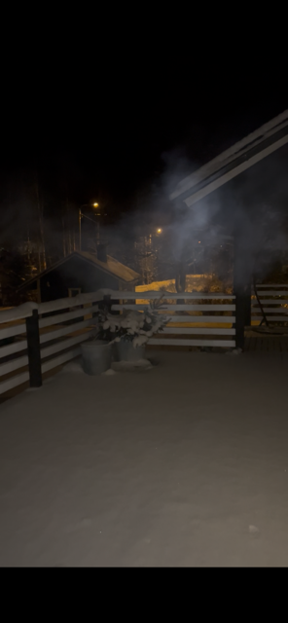

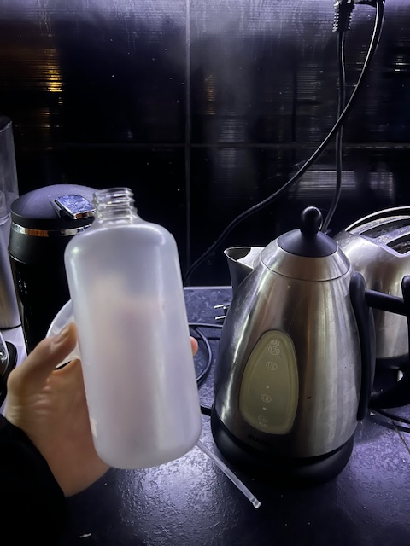
Can you make snow yourself? Yes! First you have to take hot Then you go outside and there have to be colder than –5 C. water and put it in spray bottle. You spray the hot water in the air and it turns into little snowflakes and drops to the ground.

Slide 3
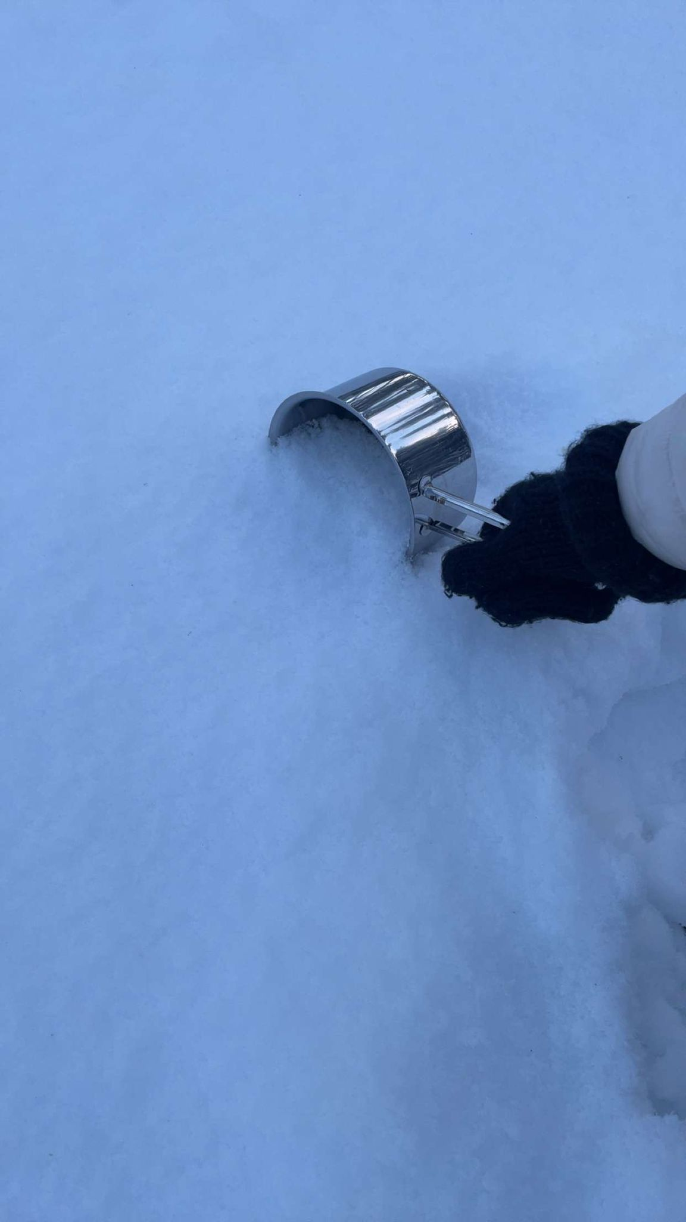
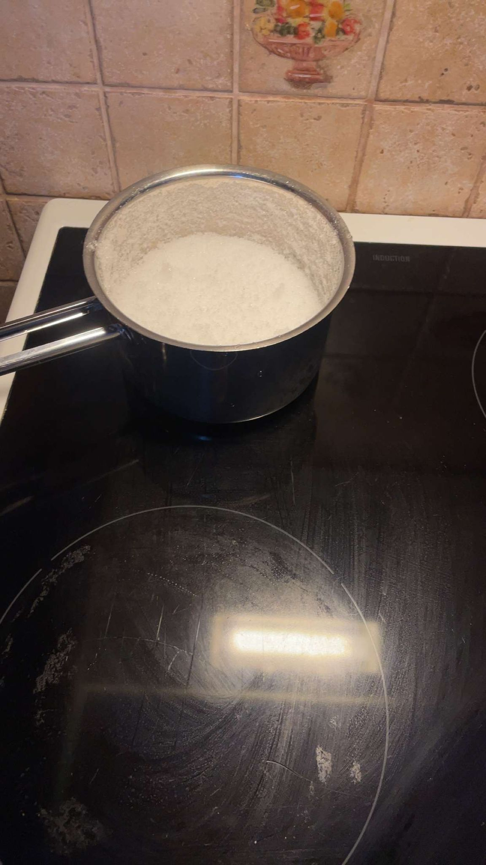
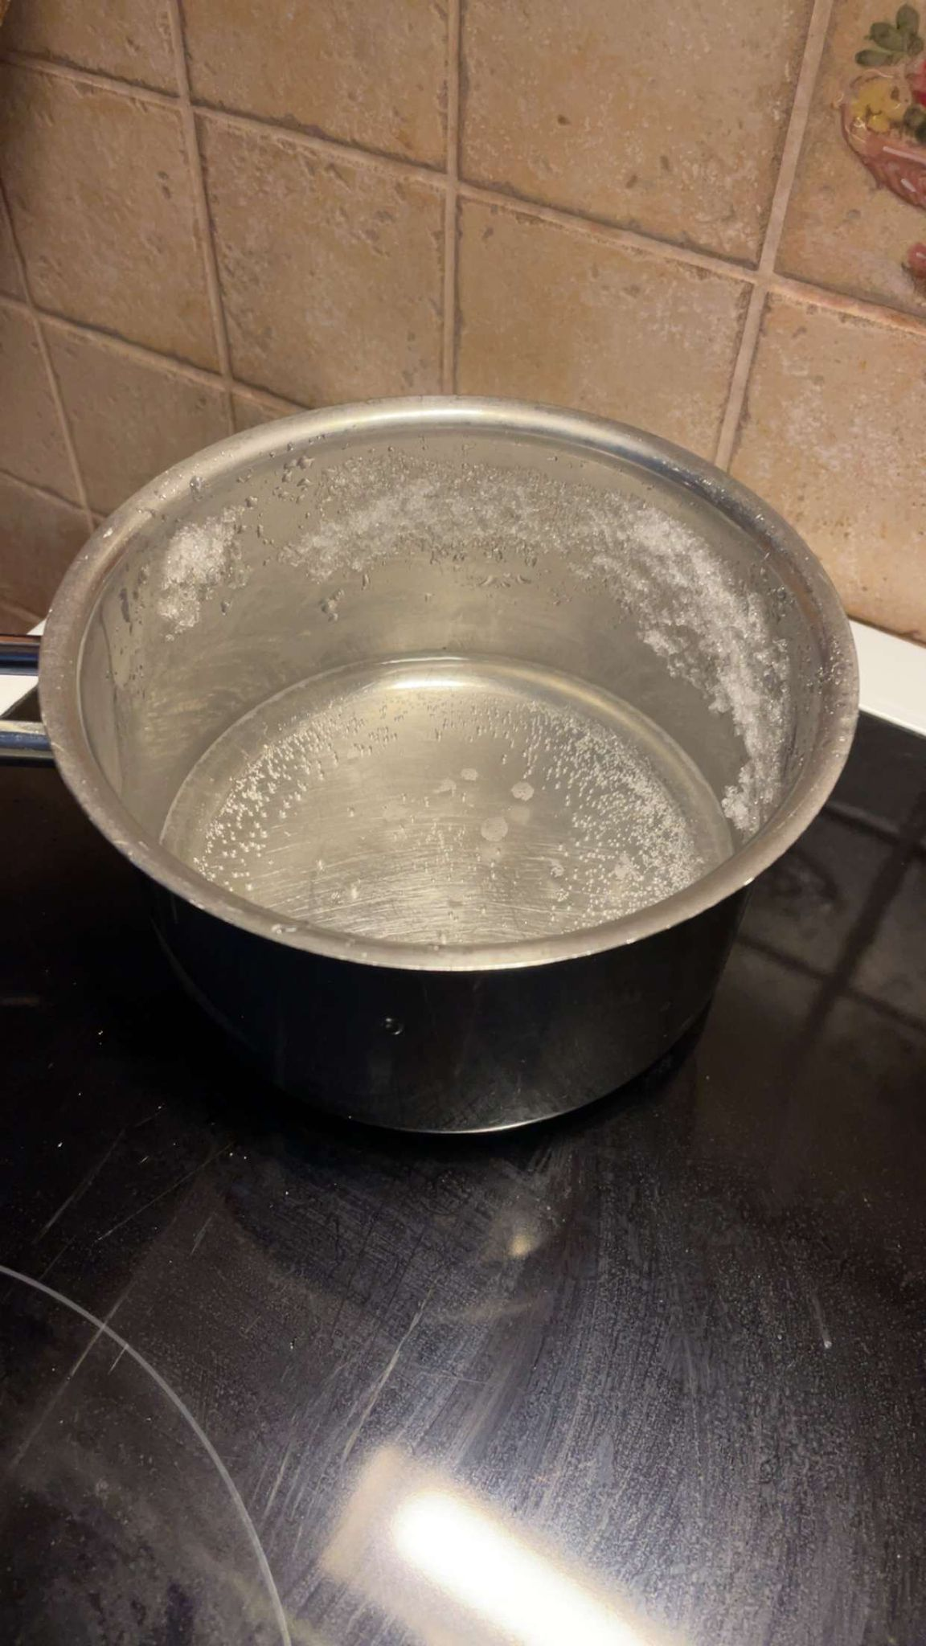
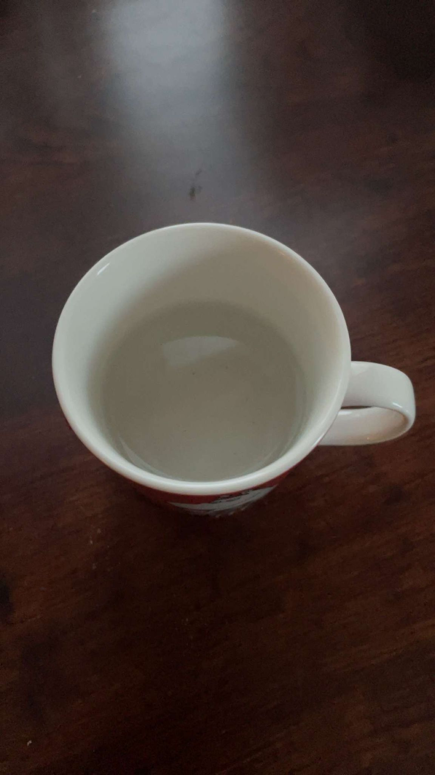
Can you get drinking water from snow?
Yes, first you take
snow outside
Then boil the snow in a pot​
After that the water
is drinkable​
Can you make food out of snow?​
Yes, boiled snow can be used for cooking.​

Slide 4
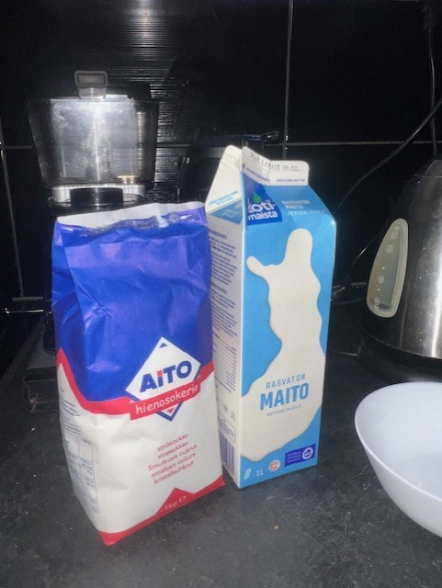
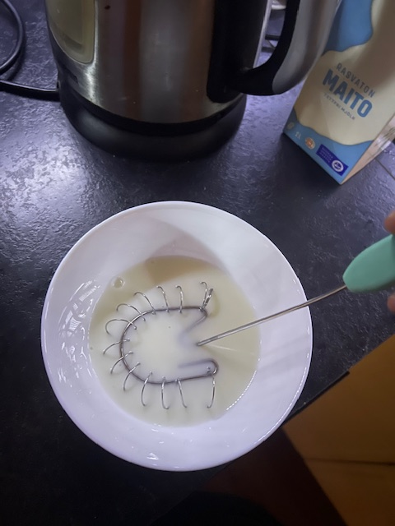
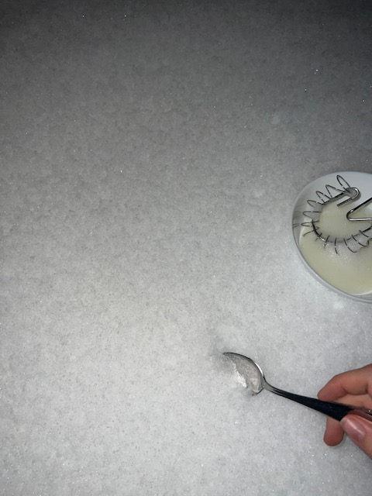
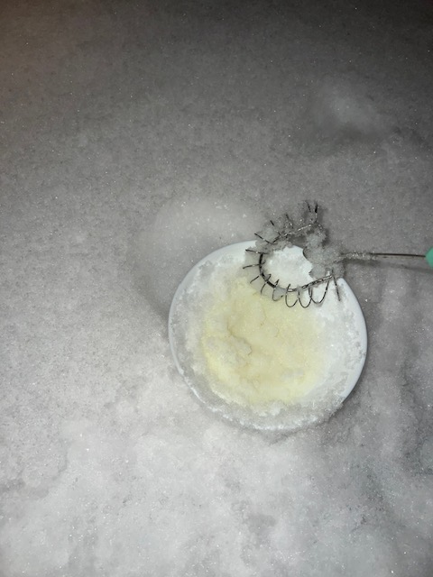
Can you make ice cream from snow? Yes, from clean freshly fallen snow. Then you go to outside and mix the fresh snow with the other substances. First mix sugar and milk or cream. (results on the next dia)

Slide 5
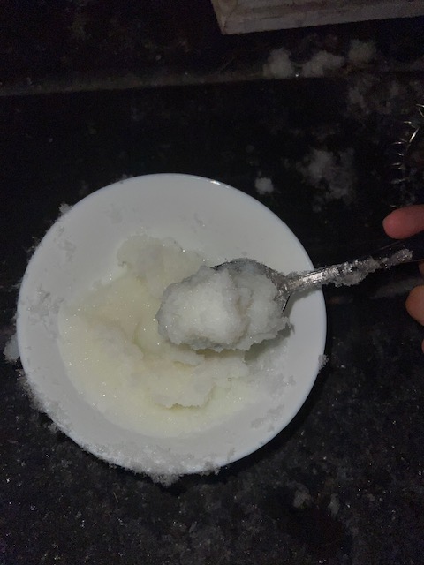
Then its ready. You have to eat it immediately so it doesn´t melt.

