Slide 1


Slide 2

Why I chose Africa?

Slide 3
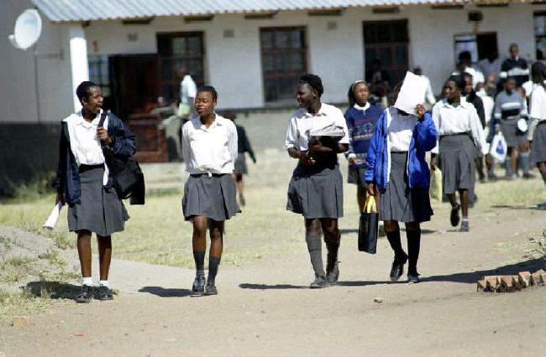
School visit!

Slide 4
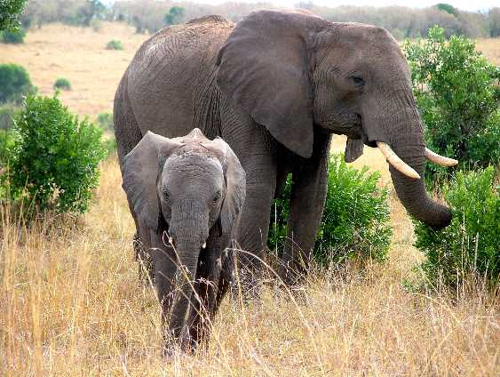
Exotic animals

Slide 5
Lovely people!

Slide 6
Bad things..

