Slide 1
How to define: peace, conflict and violence ?
Peace: negative peace, positive peace, peace as balance of power, peace in different political traditions and religions, feminist peace
Conflict: destructive conflict, constructive conflict. The difference between conflict and war?
Violence: direct violence, cultural violence, structural violence

Slide 2
What is peace?
Choose an image/picture and an experience to share what peace means to you.
Write down your definition of peace. Compare and contrast it to your peer´s definition; How do they differ? Why are they different?
Look up an NGO or IGO that claims to promote peace. How do they interpret peace? What would have influenced their definition? How different is it from your own definition?

Slide 3
To what extent is the definition of peace influenced by people´s
Position?
Interest?
Culture?
Aims?
Contextual situation?
Definition of other terms ?

Slide 4
Approaches to Peace
Pax Romana ( 27 BC-180 AD)
“ There would be peace when people would be content with their simple everyday lives, in harmony and free of desire. When there is no desire, all things are at peace” ( 600 BC Te Ching, China)
Six Stages in the evolution of peace according to Linda Groff and Paul Smoker: Interpreting peace from a very narrow to the broadest form: see p. 144 ( Course Companion)

Slide 5
Define
Negative peace
Positive peace
Balance of forces
No structural violence
Feminist peace
Environmental peace
Holistic-gaia peace
holistic inner-outer peace

Slide 6
Research: case studies
Visit the Global Peace index website: www.visionofhumanity.org
What indicators do they use to measure peace?
Do you agree with them?
Pick a country and apply narrower and broader interpretations of peace to it. Compare and contrast: would your country rank lower of higher, if a broader rather than narrower interpretation of peace was applied? Why?

Slide 7
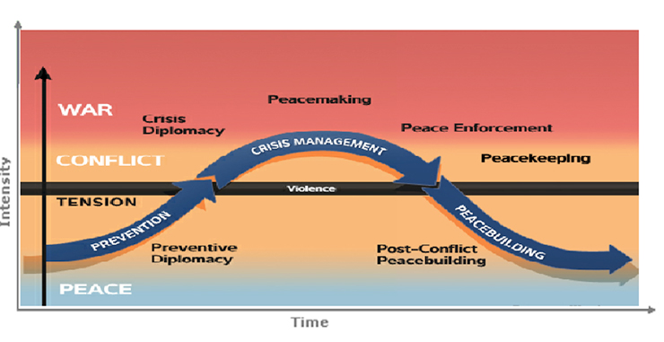
Peacekeeping, Peacemaking and Peacebuilding: all working towards “same” peace?

Slide 8
Johan Galtung: “Peace is the absence of violence”
Absence of both direct, physical violence and indirect structural violence
Positive peace is the presence of social justice; equal and egalitarian distribution of power and resources
Without development, there would be no peace

Slide 9
Choose an image/picture and an experience to share what violence means to you?
How do you think violence is different than conflict?

Slide 10
What Is Conflict?
Conflict is fundamentally about disagreement and competition over power, ideas, identity, resources or territory.
The broadest definition of conflict covers a wide spectrum, including peaceful disagreement (for example, strikes) in its mildest form, to violent conflict involving many state and non-state groups (for example, the conflict in Syria which began in 2011).

Slide 11
Causes of Conflict
Galtung (1996) suggests that attitudes, behaviours and contradictions act together to encourage violent conflict.
All three factors must be present for a full conflict to exist.
Each factor reinforces the others.
All three need to be stopped in order for conflict to end.
If only one factor exists, then conflict may be likely to develop over time.

Slide 12
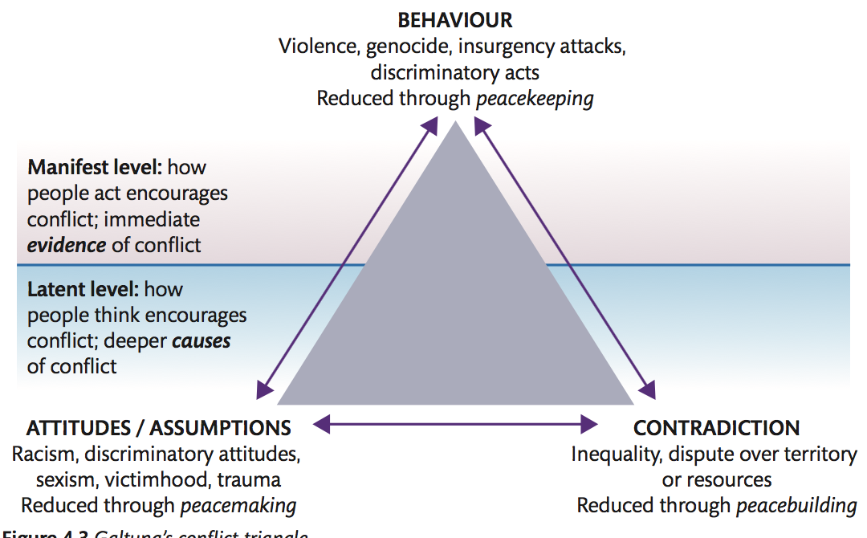

Slide 13
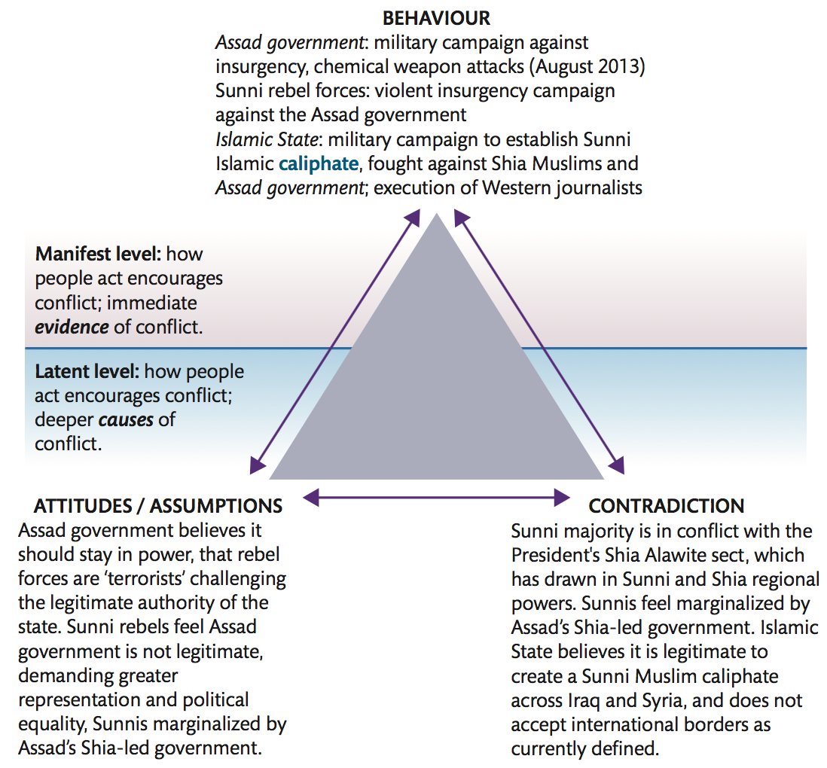

Slide 14
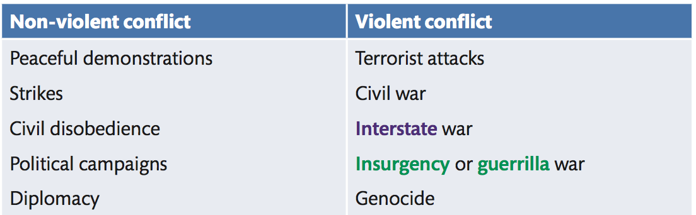

Slide 15
Types of ARMED Conflict
1) INTER-STATE conflict:
Between government parties
One of the main concerns of leaders and decision-makers
Has been very rare in the past 10 years
2) EXTRA-STATE conflict:
Between state and a non-state group outside its own territory,
Rather common in the period of decolonization

Slide 16
3) INTERNATIONALIZED & INTERNAL conflict:
Between the government of a state and internal opposition groups with intervention from other states
Has become most common since the end of the Cold war ( e.g. Ukrainian revolution)
4) INTRA -STATE-conflict
Between government troops and internal opposition without intervention from other states (since 1990´s, most conflicts in Asia and Sub-Saharan Africa)

Slide 17
5) NON-STATE CONFLICTS
Between two organized armed groups, no state involvement ( Taliban in Afganistan, Christian and Muslin groups in Philippines, various Kenyan tribes, paramilitary and revolutionary groups in Colombia

Slide 18
Moore´s five categories of conflict
Data conflicts: fake news? Inadequate , inaccurate, or untrustworthy information..
Relationship conflicts: between individuals, painful memory of the past..
Structural conflicts: structural violence inequality..
Value conflicts (Identity conflicts): Different ways of life, ideology, religion.. Political scientist S.Huntington: Clash of civilizations versus E. Said´s “The Clash of Ignorance”
Interest conflicts: Financial interests, resources, ownership of the land, environmental impacts..

Slide 19
Defining conflict and war
The United Nations defines a ‘major conflict’ as one in which at least 1000 deaths occur. As well, war usually takes place over a period of time.
Exceptions e.g. Six-day war in 1967, Falkland war in 1982 ( 10 weeks)

Slide 20
Justifying War
Multiple Perspectives:
Realpolitik – suggesting that war, as a political act, needs no moral justification.
Just war theory – suggesting that war can be justified only if it conforms to moral principles
Pacifism – suggesting the war, as an unnecessary evil, can never be justified.

Slide 21
How to justify a war?
https://www.youtube.com/watch?v=LcBovmGZSPU
What do you believe are principles of jus ad bellum (just reasons to go war) ?
Rank the jus ad bellum (arguments and be prepared to justify your rankings. Use theorists for this (Heywood p. 256-258, Course companion p.167-170)
What should be the principles of just conduct in war – jus in bello?
What do you believe are principles of jus ad bellum (just recourse to war)?
Rank the jus ad bellum arguments on page 264 and be prepared to justify your rankings as just recourse priorities are debated amongst just war theorists.
What should be the principles of just conduct in war – jus in bello?
Humanitarian intervention, self-defence, religiously or culturally condoned violence

Slide 22
Critics of Just War Theory
Is a pre-emptive attack a form of self-defense?
What makes for legitimate authority? Democratically elected leaders vs. authoritarian regimes
What is “reasonable possibility of success”? How is that determined, especially in light of “new wars”?
Look back at jus ad bellum and jus in bello: do they ever conflict with one another?
Michael Walzer (2007) talks about the problems of “dirty hands” even in just war. For example, even in WWII there was Dresden and Hiroshima and Nagasaki
Just war thinking may be applicable only in circumstances in which the parties to a dispute share the same or similar cultural and moral beliefs?

Slide 23
Can standards of justice be applied to war, and what are the implications of doing so?
Write a personal response to this question. Use your own arguments and justify those with the theories. Use key concepts and levels of analysis throughout.

Slide 24
Liberals and Social Constructivists on War
Liberals explain that authoritarian and imperialist states have designed their societies in a way that heavily relies on armed forces to maintain domestic order while the ‘democratic peace’ thesis argues that the construction of democratic societies promotes peace both internally and externally.
Social constructivists stress cultural and ideological factors that make war more likely, either by portraying the international environment as threatening and unstable, or by giving a state or political group a militaristic or expansionist self-image.

Slide 25
All Realists
All realists – classical, neoliberal/structural, offensive or defensive – agree that it is the balance of power that helps prevent war.
States will avoid war if they calculate that their chances of victory are weak
Decisions about war and peace are therefore made through a kind of cost-benefit analysis, in which rational self-interest may dictate either the use of war or its avoidance.
States that wish to preserve peace must therefore prepare for war, hoping to deter potential aggressors and to present any other state of coalition of states from achieving a position of predominance.
The Realist View of War: War as a Policy Instrument

Slide 26
Neo-realists on War
Neo-realists believe war is inevitable because of the anarchic international system that forces states to rely on self-help.
Offensive realists in particular believe that regardless of constitutional or governmental structures states seek to maximize power.
This suggests that international relations are to be characterized by a restless struggle for advantage, with military conflict being an unavoidable fact of life.
Security dilemma

Slide 27
Marxists on War
Marxists view war as a consequence of the international dynamics of the capitalist system.
They believe capitalist states will inevitably come into conflict with one another as each is forced to expand in the hope of maintain profit levels by gaining control over new markets, raw materials or supplies of cheap labour.

Slide 28
How to define war?
In Clausewitz’s view, all wars have the same ‘objective’ character’: “War is merely a continuation of politics (or policy) by other means.”
War is therefore a means to an end, a way of forcing an opponent to submit to one’s will.
Both war and peace are characterized by the rational pursuit of self-interest, and therefore by conflict; the only difference between them is the means selected to achieve one’s goals.
States thus go to war when they calculate that it is in their interest to do so.

Slide 29
Hegemonic war: war that is fought to establish dominance of the entire world order by restructuring the global balance of power.
Guerrilla war: (Spanish) Literally, ‘little war’; an insurgency or ‘people’s’ war, fought by irregular troops using tactics that are suited to the terrain and emphasize mobility and surprise rather than superior firepower.

Slide 30
From ‘old’ wars to ‘new’ wars
Features of ‘new’ wars
The tend to be civil wars rather than inter-state wars
Issues of identity are usually prominent
War are asymmetrical, often fought between unequal parties
The civilian/military distinction has broken down
They are more barbaric than ‘old’ wars

Slide 31
Civil wars rather than inter-state wars
About 95 % of armed conflicts since the mid 1980´s have been conflicts within states, not between the states
Possible causes:
Spread of democracy
Advance of globalization
Changing moral attitudes to war often linked to the role of the UN
Development of weapons technology, especially nuclear weapons

Slide 32
Civil Wars Rather than Inter-state Wars
Civil wars are more common in the post-colonial world where colonization left a heritage of ethnic or tribal rivalry, economic underdevelopment and weak state power, hence the emergence of failed states.
See: http://fundforpeace.org/fsi/comparative-analysis/

Slide 33
Asymmetrical Nature of War
Previously interstate war took place between opponents at a relatively similar level of economic development
Modern asymmetrical wars: industrially advanced and militarily sophisticated states against enemies that appear to be ‘third-rate’.
Guerrilla warfare: surprise attacks, through the use of small-scale raids, ambushes and attacks
Also the use of terror tactics from IED ( Improvised explosive device) to suicide attacks (including the use of children) are a part of asymmetrical warfare. You never know who is the enemy? It is not simply a uniformed soldier; it could be a child pushing a wheelbarrow

Slide 34
Huntington’s Clash of Civilizations
Samuel Huntington (1993) in his ”clash of civilizations” thesis argued that the 21st century would see conflict not between ideology or as a result of economics, but instead because of culture.
His thesis gained traction after 9/11 where global terrorism was seen as a symptom of an emerging “clash of civilizations”.
Was viewed as a realist because he saw traditional power driven states as the key factors on the world stage.
This conflicted with the growing neoliberal notion of interdependence and globalization.

Slide 35
The Security Dilemma
a condition in which actions taken by one actor to improve national security are interpreted as aggressive by other actors, thereby provoking military counter-moves.
1) dilemma of interpretation – what are the motives, intentions and capabilities of others in building up military power?
2) Second, there is a dilemma of response – should they react in kind in a militarily confrontational manner, or should they seek to signal reassurance and attempt to defuse tension?

Slide 36
Johan Galtung – Defining Violence
“I see violence as avoidable insults to basic human needs, and more generally to life, lowering the real level of needs satisfaction below what is potentially possible. Threats of violence are also violence”
The five classes of basic needs
survival needs
well-being needs
identity, meaning needs
freedom needs
Ecological balance
The sum of all five, for all, will define 'peace'.

Slide 37
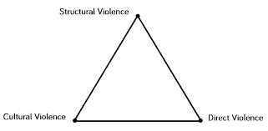

Slide 38
Structural Violence
When a government or other forms of power functions in a way that results in physical , mental or other harm to individuals or groups or the environment.
This may be through inequalities that deny people fundamental rights.
Structural violence:
is a conscious choice – the structure of government causes physical or mental harm to others;
leads to preventable suffering not being prevented;
causes people to be harmed through lack of basic necessities which may be given to others
is widespread , but often unchallenged and unacknowledged
is harder to measure than direct violence and say who is responsible for it.

Slide 39
Cultural Violence
Structural violence is very much the responsibility of governments and those in power whereas cultural violence is embedded within all levels of a society
Cultural violence can be identified in the mindset, beliefs and values of a society.
Cultural violence:
May be government-driven (culture influencing government structures) or society-driven (grassroots culture influencing society's behavior)
Is any aspect of a culture that is used to legitimize violence in its direct or structural forms
May be harder to eliminate as it is embedded in the mindset of a society and is linked to cultural or religious values that become seen as legitimate.

Slide 40
Direct Violence
Direct Violence – is when an individual or group is physically attacked or mentally harmed through direct action.
Direct violence is:
often straightforward to identify
possible to investigate and establish who was responsible
possible to measure
possible to identify in such a way that those responsible can be held to account.

Slide 41
Galtung’s Conclusion
Violence can start at any corner in the direct-structural- cultural violence triangle and is easily transmitted to the other corners.
Violent structure seems to be institutionalized and the violent culture internalized, direct violence also tends to become institutionalized, repetitive, ritualistic.
triangular syndrome of violence should then be contrasted in the mind with a triangular syndrome of peace: cultural, structural and direct peace

Slide 42
Violence Against Nature as an Example
How about violence against nature?

Slide 43
The Slave Trade – Modern Day Slavery as Examples
From history (Atlantic triangular trade ) to the current moment
Guardian article : https://www.theguardian.com/global-development/2019/jan/14/indian-village-where-child-sexual-exploitation-is-the-norm-sagar-gram-jan-sahas

Slide 44
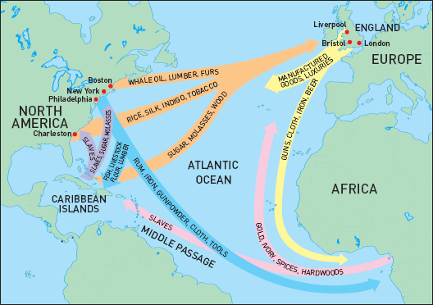
Atlantic Triangular Trade

Slide 45
Causes of internal conflict: can lead to war!
Structural Factors: weak states, intra-state security concerns, ethnic geography
Political Factors: discriminatory political institutions, exclusionary national ideologies, inter-group politics, elite politics
Economic Factors: economic problems, discriminatory economic systems, modernization
Cultural/ Perceptual Factors: patterns of cultural discrimination, problematic group histories

Slide 46
Civilian/Military Distinction has Broken Down
War now takes place in cities instead of the old notion of a battlefield. Civilians are under attack!
the use of landmines, suicide bombs, IEDs, and terrorism in general.
This often results in refugee crises with millions displaced, sometimes permanently.

Slide 47
A New Degree of Barbarism
Practices such as kidnapping, torture, systematic rape and the indiscriminate killings that result from landmines, car bombs and suicide attacks have become routine features of modern warfare.
This is sometimes explained in terms of the implications of identity politics through which the enemy is defined in terms of their membership of a particular group rather than in terms of their role or actions.

Slide 48
Postmodern Warfare
Often referred to as ‘virtual war’, ‘computer war’ or ‘cyber war’
Keep weapons development to a maximum and actual conflict between major powers to a minimum.
computing and satellite technology to facilitate ‘surgical’ strikes, stealth technology that eludes radar detection, anti-missile missiles, widespread electronic surveillance, sophisticated networked communication across all parts of the armed forces.
Postmodern warfare increases the accuracy and scale of devastation while limiting the number of causalities.

Slide 49
Postmodern Warfare
The United States high-tech weaponry has consolidated its hegemonic power where other states have jumped on the US military bandwagon and not attempted to balance the American’s power.
Still, air power rarely wins wars on its own – at least at this stage. It can force withdrawal, like in the case of Kosovo, still, that was a three days that turned into 78 days.
Similar to lessons learned from Nuclear weapons, unless you are going to indiscriminately bomb, high-tech warfare, no matter how precise, cannot target highly mobile enemies that, in cases of insurgencies, are increasingly difficult to distinguish from the civilian population.

Slide 50
Realpolitik
Is the defining feature of political realism
Matters of war and peace are beyond issues of morality
War is a universal norm of human history
Believe that conflict occurs because from innate human aggression or aggression due to unlimited human appetites and scarce resources
Believe in negative peace
Argue against just wars on the grounds that war fought for political gain tend to be limited by the fact that their protagonists operate with clear strategic objectives whereas just wars lead to war because of the expansive goals and the moral fervor behind them.
Not amoral more ethical nationalist

Slide 51
Criticisms of Realpolitik
Legitimize war and the use of force by making them appear to be a part of the ‘natural order of things’.
Feminists argue that the emphasis on national interest and military might reflect an essentially masculinist view of international politics.
The assertion that matters of war and peace are beyond morality reflect a stunting ethical sensibilities.

Slide 52
Current Conflicts
Choose an on-going conflict, research a conflict and determine which jus ad bellum was met or whether any just recourse was met at all: https://en.wikipedia.org/wiki/List_of_ongoing_armed_conflicts
Michael Walzer on The War in Iraq: https://www.youtube.com/watch?v=W_1rqRYaQnA

Slide 53
Pacifism
Pacifism is the belief that all war is morally wrong.
This is based on
War is wrong because killing is wrong. This principle is based on the sanctity or oneness of life sometimes rooted in religious convictions. For example, Quakers, the Amish, the Mennonites, Hinduism, Buddhism and Jainism.
The result has been a practice of conscientious objection in times of war
The Amish: https://www.youtube.com/watch?v=82wRG5tGF7k - 9:30-12:30 & 34:00-END
Contingent pacifism places greatest stress on the wider and often longer term benefits of non-violence for human well-being.
Violence is never a solution because it breeds more violence through developing a psychology of hatred, bitterness and revenge

Slide 54
Pacifism and Global Politics
Legal pacifism embodied in the UN who’s aim is to ensure the peaceful resolution of international disputes through upholding a system of international law.
Pacifists have looked to transcend sovereignty and embraced the notion of positive peace (not just the absence of war but also an end to the causes of war). Positive peace has been linked to political and social justice
Pacifism has helped to fuel the emergence of a growing peace movement.

Slide 55
Critics of Pacifism
Humanitarian wars and Consequentalism: “an otherwise morally objectionable action can be justified if it results in a positive outcome” . For example, either violent rebellion, or foreign nations sending in troops to end a dictator's violent oppression may save millions of lives, even if many thousands died in the war.
R2P- Responsibility to Protect-doctrine ( UN, 2005): responsibility to protect populations from genocide, war crimes, ethnic cleansing and crimes against humanity

Slide 56
Non-Violent Conflict, in what kind of societies do these exist?
A legitimate structure or process for dialogue is in place, and everyone involved is using this.
Democratic structures allow the population to be consulted. The results of these consultations are considered legitimate.
The parties involved in the dispute are dependent on each other and would be harmed if the dispute became violent.
Violent solutions are against the core interests of all parties.

Slide 57
Violent Conflict
Much conflict results in violence. The most obvious form of violence in conflict is direct violence which can be measured by the numbers of people killed or injured, and by measuring the physical damage to infrastructure. Commonly, this type of violence takes place during a war. These conflicts can be violent for several reasons.
Lack of trust between both sides of the conflict.
No structure exists for the dispute to be resolved peacefully, through dialogue or democratic means.
Grievance and trauma are sustaining, and deepening, the conflict.
Violent approaches are seen as the only way to secure core interests.

Slide 58
Causes of Conflict
For example, violent behaviour will deepen contradiction.
This may harden attitudes and deepen a sense of grievance or injustice.
Peacekeeping can help reduce behaviours that encourage conflict.
Peacebuilding can help reduce contradictions.
Peacemaking can change the attitudes that fuel conflict.

Slide 59
Causes of Conflict
In Galtung’s model, violent conflict can be analysed at the manifest and latent levels.
The manifest level is the immediately obvious evidence of violent conflict, for example the number of people killed or injured.
The latent level is where the deeper causes and conditions of conflict can be analysed.
It is important to remember that Galtung’s conflict triangle applies to both violent and non-violent conflict.

Slide 60
Conflict Dynamics
While every conflict has different dynamics, analysts have identified similarities between conflicts.
Conflicts typically escalate and de-escalate through several phases.
Ramsbotham and Woodhouse (1999) formulated a model of conflict dynamics.
This helps policymakers to identify the best responses that will help with conflict resolution at each stage of both the escalation and de-escalation of violent conflict.

Slide 61
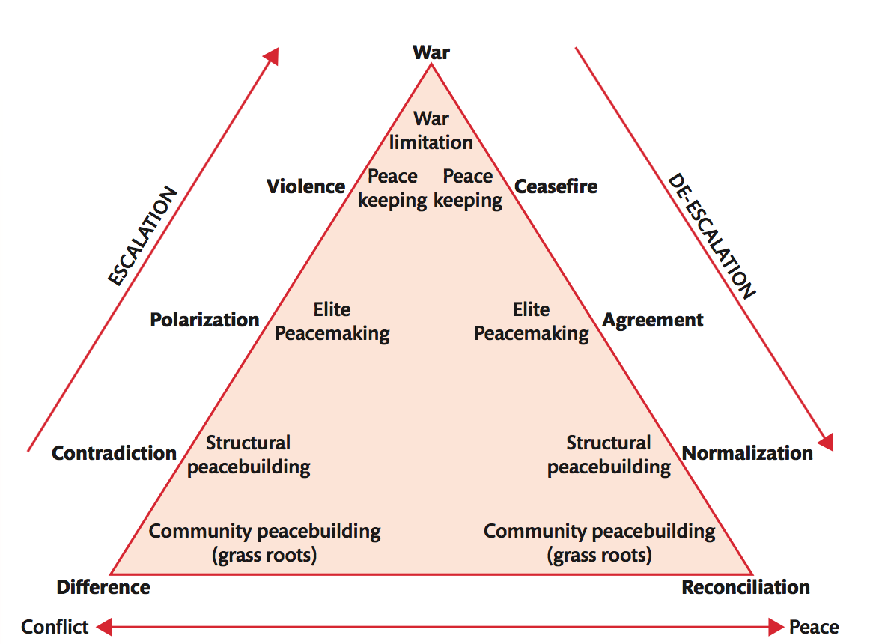

Slide 62
Promoting Peace and Security
The principal aim of the UN is ‘to maintain international peace and security’, in fact these are the conditions under which the UN can/should be judged.
There has been no WWIII, but realists would argue that is a result of the ‘balance of terror’ i.e. the stalemate that exists as a result of MAD (Mutual assured destruction) is a doctrine of military strategy and national security policy in which a full-scale use of nuclear weapons by two or more opposing sides would cause the complete annihilation of both the attacker and the defender
The capacity of the UN to enforce a system of collective security?

Slide 63
Promoting Peace and Security
The UN’s inability to address issues of peace and security is compounded by the P5’s ((China, France, UK, USA, Russia) use of the veto
Also, despite the provision in the UN Charter for the setting up of the Military Staff Committee as a subsidiary body of the Security Council, resistance amongst the P5 has prevented the UN from developing its own military capacity
This has meant that wen the UN has authorized military action, it has either been subcontracted (US-led forces in Korea and Iraq (1991) or regional bodies such as NATO (Kosovo) or the African Union (Darfur).

Slide 64
A New World Order?
In 1991, after the end of the Cold War, the UN intervened militarily in Kuwait, this being only the second time since Korea. Furthermore, the US didn’t pursue the Iraqis into Iraq for fear of operating outside of the UN mandate.
As a result, George H.W. Bush declared a New World Order.
Following this The Security Council also approved non-military enforcements in Afghanistan Angola, Ethiopia and Eritrea, Haiti, Iraq, Rwanda , Somalia and the former Yugoslavia.

Slide 65
Collapse of collective security?
The failures on UN peacekeeping missions in Rwanda and Yugoslavia and the US invasion in Iraq that was vocally opposed by leading UN Security Council members: lack of trust of the UN?
Furthermore, with the Cold War over, countries were less willing commit resources to the cause of collective security.

Slide 66
Multi-polarity as a UN Problem: Syria
The lack of effective UN intervention to end Syria’s civil war, or to reduce the scale of the bloodshed (accepting that the decommissioning of Syria’s chemical weapons would not accomplish either goal), can be explained by one key factor – the absence of consensus in the UN Security Council over Syria.
This again highlighted how the UN is a creature of the will of the Security Council.
In the case of the Cold War the UN was pushed to the side by the bipolar world of the P2 – USSR and USA.
In the case of the post-cold war world, unipolarity became and issue when the US ignored UN recommendations not to invade Iraq.
Now, in the case of Syria, we have the US UK and France siding with the Syrian rebels and China and Russia siding with the Assad government.

Slide 67
Non-Violent Conflict: Embargos by the UN
The only times that non-military enforcement measures were employed by the UN were against two international pariahs, Rhodesia (present-day Zimbabwe) and South Africa.
Economic sanctions were imposed on Rhodesia in 1966, on the grounds that the white minority regime’s unilateral declaration of independence constituted a threat to peace.
An arms embargo was imposed on the apartheid regime in South Africa in 1977 following the suppression of unrest in black townships the previous year.
Otherwise, war and conflict proceeded essentially without UN involvement.

Slide 68
Peacekeeping
Peacekeeping is sustaining negative peace to allow positive peace to be built.
When a ceasefire is agreed, independent peacekeepers may be sent to the area.
They will ensure that the peace holds, allowing positive peace to be built.
The priority is monitoring agreements made during the peacemaking process.
This may be done by armed forces from an international or regional body such as the United Nations (UN) or African Union (AU), or by unarmed monitors from an organization such as the Organization for Security and Cooperation in Europe (OSCE).

Slide 69
UN Peacekeeping
The term peacekeeping is not found in the UN charter although it has come to be the most significant way in which the UN has fulfilled it responsibility to maintain international peace and security.
Chapter 6: resolve disputes peacefully through negotiation and mediation.
Chapter 7: resolve disputes using military force.
Current UN peacekeeping missions: https://peacekeeping.un.org/en

Slide 70
Peacekeeping in Action
Classical or first generation UN peacekeeping involved the establishment of a UN force placed between the parties to a dispute once a ceasefire had been implemented.
They only remained in countries with the agreement of the host states and their propose was to provide a shield against future hostilities rather than to resolve the deeper source of the conflict or enforce a permanent settlement.
During the cold war this neutrality was key to the UNs role.

Slide 71
Peacemaking
Peacemaking is stopping violent conflict and creating negative peace. A pause or end to immediate violence is achieved, commonly through negotiation.
Pausing violence may allow for further mediation or negotiation and the building of trust between both sides in a conflict.
The original causes of conflict will not yet be resolved, but a pause in violence enables stabilization, for example through a ceasefire or truce.

Slide 72
Peacebuilding
Peacebuilding is the building of sustainable, positive peace and long-term conflict resolution.
This includes stabilization efforts to build longer-lasting peace and security, in order to achieve positive peace.
Commonly, it involves significant development assistance to improve health and education, address inequality and rebuild destroyed infrastructure.
It may also involve deeper reconciliation efforts, such as Truth and Reconciliation Commissions, amnesties or trials for war criminals.

Slide 73
Peacemaking and Peacebuilding
In the post-Cold War world had the Security Council becoming more interventionist now that the USA and USSR were no longer trapped in a zero-sum game.
Less interstate war and more intrastate war changed the UN peacekeeping role to once of peace enforcement or peace making.
No longer were peacekeeping teams going into countries to keep a peace agreement and ensure stability, instead they were there to force agreement and create stability.
This also led to multi-dimensional peacekeeping or peacebuilding which included implementing a comprehensive peace agreement, the use of force to achieve humanitarian ends, the provision of emergency relief and steps towards political reconstruction .

Slide 74
Does UN Peacekeeping Work?
In 2007 the Rand Corporation did a study of eight UN peacekeeping missions where they found that seven of them were successful in keeping the peace and six promoted democracy.
Nevertheless, there is the Bosnia, Rwanda and Somalia failures!
Although the military remain the backbone of most peacekeeping operations, the many faces of peacekeeping now include administrators and economists, police officers and legal experts, electoral and specialists in civil affairs and governance.
the introduction of the UN Peacebuilding Commission https://www.un.org/peacebuilding/ : brings together all relevant actors to develop post-conflict peacebuilding strategies

Slide 75
The Future of the UN in a Multipolar World
The impact of a now multipolar world on the UN is difficult to determine.
Claim: distribution of global power is likely to favour multilateralism and encourage states to rely more on a system of collective security, rather than on violent self-help.
Counterclaim: multi-polarity is likely to be associated with increased conflict and greater instability in which case the future history of the UN may replicate that of the League of Nations: power rivalry could make the task of international mediation and negotiation difficult and even impossible.

Slide 76
Challenges for UN Peacekeeping
Would UN need to have rapid deployment capacity, the ability to send peacekeepers to different corners of the globe at short?.
The changing nature of war and armed conflict raises particular difficulties for the UN in its peacekeeping and peacebuilding roles
the rise of identity wars and the links between civil strife, humanitarian and refugee crises and endemic crime make sustainable peace difficult to achieve, they also strain the relationship between the quest for global justice and the respect for state sovereignty ( R2P- doctrine challenges state sovereignty )
The case of Darfur https://www.nytimes.com/2008/03/24/world/africa/24darfur.html -
- UN intervention to keep the peace and provide humanitarian aid can be blocked by an unwilling host government.
- On the other hand if the UN accepts the responsibility to protect, it is difficult to see where intervention will end.

Slide 77
Is the UN Obsolete?
Page 448, develop an argument for presentation to the class. Use contemporary examples on peacekeeping and peacebuilding. Refer to contemporary conflicts.

Slide 78
Nature of International Law
Domestic law has distinguishing characteristics
Law is made by government and applies throughout society
It takes precedence over all other norms and social rules with universal jurisdiction
Laws are compulsory; citizens are not allowed to choose which laws to obey and which to ignore because law is backed up by a system of coercion and punishment
International law differs from domestic law
There is no supreme legislative authority to enact international law and no world government or international police force to compel states to uphold their legal obligations.
International law is soft law – law that is not binding and cannot be enforced

Slide 79
Sources of International Law
Legal obligations that arise from treaties are very clearly rooted in consent, in that states enter into treaties freely and voluntarily.
Once treaties are signed and ratified, the must be obeyed, as expressed in the principle of pacta sunt servanda (the treaties are binding).
This consent is conditional because states can contract out of treaties on the grounds that significant changes have occurred in the conditions existing at the time the treaties occurred – also referred to as rebus sic stantibus.

Slide 80
Why Is International Law Obeyed
Those who dismiss the idea of international law tend to view law strictly in terms of command.
This implies that enforcement is the only reliable means of bringing about compliance.
If compliance were seen as the core feature of an effective legal system, few, if any domestic legal arrangements world qualify as such.
Rape, theft and murder continue to occur in all countries of the world despite being legally prohibited.
Even Hans Morgenthau acknowledged that “during the 400 years of its existence international law las in most instances been scrupulously observed”

Slide 81
Why Is International Law Obeyed
Countries tend to obey international law out of:
Self-interest and reciprocity
Fear of disorder
Fear of isolation
Fear of punishment
Identification with international norms

Slide 82
Why Is International Law Obeyed
Self-Interest or Reciprocity:
States calculate that, in the long run, compiling will bring benefit or reduce harm.
A relationship of mutual exchange between or amongst states that ensures that favours are returned for favours or that punishment is returned for punishment.
Fear of Disorder:
States generally prefer order over disorder and with a set of “rules of the game” uncertainty ad confusion is reduced among states and each benefitting from shared expectations and enhanced predictability.
Even defensive realists, who’s primary motivation is to maintain security rather than maximize power, see value in obeying international law.

Slide 83
Why Is International Law Obeyed
Fear of Isolation
A state’s level of conformity to international law is a key determinant of its membership of international society.
A record of compliance with international law can therefore enhance the standing and reputation of a states, giving it greater soft power and encouraging other members of the international community to work with it rather than against it.
See the 2003 invasion of Iraq at the bottom of page 344.
States that routinely defy international law run the risk of isolations and may even be treated as international pariahs, sometimes paying a high price for this in diplomatic and economic terms.

Slide 84
Why Is International Law Obeyed
Fear of punishment
Although international law is not routinely enforceable, there are circumstances in which obedience to international law is brought about through the fear of punishment.
Punishment in these cases is not dispensed by a world police force but by states themselves, actin individually or collectively.
Identification with international norms
International law is considered to be rightful and morally binding
Domestically many follow laws not because there are consequences to their infringement but simply because theft, murder, etc. are seen as morally reprehensible.
Outline perspectives on international law on page 346.

Slide 85
The International Court of Justice
The Court has had many success in laying down principles by which disputes may be judged including territorial water decisions.
The Court has also handed down an number of ‘advisory opinions’ which have helped set the tone for post-conflict international affairs.
The ICJ also has significant weaknesses, particularly as it relates to jurisdiction; the Court is strictly limited to states.
Individuals, corporations, NGOs and other non-state bodies are excluded from direct participation in cases.
This prevents the Court from taking action over a wide range of human rights and humanitarian issues, meaning that other tribunals and courts (such as the international criminal tribunal for Rwanda and the ICC) have had to be established

Slide 86
The International Court of Justice
The greatest weakness is that it lacks compulsory jurisdiction and has no mechanism for enforcing its judgements.
States that have signed the treaty creating the ICJ are allowed to chose whether they want to be subject to the compulsory jurisdiction of the Court by signing the optional clause (the clause that gives countries the option of agreeing or not agreeing in advncae to be bound by the decision of the Court), and only about one-third of states have agreed to do so.
States are able to revoke their commitments under the optional clause.
https://www.theguardian.com/world/2017/feb/18/bosnia-to-appeal-2007-un-court-ruling-clearing-serbia-of-genocide?CMP=Share_iOSApp_Other

Slide 87
Developments in the Laws of War
The 1945 UN Charter significantly narrowed the scope of legally justified warfare.
It laid down only two circumstances in which force could be legitimately used:
self-defence, in which states have an unqualified sovereign right to use force if subjected to a physical attack by another state (Article 51)
when the use of force has been sanctioned by the Security Council as part of a peace enforcement action (Article 42).
The Nuremberg Principles extended such thinking into international criminal law by establishing the idea of ‘crimes against peace’, allowing individuals to be prosecuted for ‘planning, preparing, initiating or waging a war of aggression, or conspiring to do so’.

Slide 88
Developments in the Laws of War
In the case of just war thinking related to the conduct of war, rather than the justifications for war, the principal development has been the idea of war crimes.
The war crimes that were recognized by the Nuremberg Principles included the murder or ill-treatment of civilian populations, hostages and prisoners of war.
The four Geneva Conventions, adopted in 1949, with two additional protocols in 1977 and a third one in 2005, marked the widest and most detailed attempt to codify war crimes, providing one of the foundations for international humanitarian law.
Amongst the war crimes they identified are the following:
Willful killing
Torture or inhuman treatment, including biological experiments
Willfully causing great suffering or serious injury to body or health
Compelling civilians or prisoners of war to serve a hostile power
Willfully depriving civilians or prisoners of war of a fair trial
The taking of hostages
Unlawful deportation, transfer of confinement
Wanton destruction and appropriation of property not justified by military necessity.

Slide 89
Developments in the Laws of War
One of the most significant, if controversial, developments in the laws of war is the development of the idea of ‘crimes against humanity’.
The earliest notion of a crime against humanity (even though the terminology was not used) surfaced during the campaign to abolish the slave trade.
The 1815 Declaration on the Abolition of the Slave Trade, for instance, condemned the slave trade for offending against the ‘principles of humanity and universal morality’.

Slide 90
Developments in the Laws of War
The most detailed and ambitious attempt to codify the crimes that can be categorized as crimes against humanity is found in the 1998 Rome Statute, which established the International Criminal Court.
This highlights crimes including murder, extermination, enslavement, deportation, torture, rape or sexual slavery, racial and other forms of persecution, and the crime of apartheid.
Although genocide is clearly a crime against humanity in a general sense, it is treated as a separate category of crime, indeed as the ‘crime of crimes’, by the Genocide Convention and in the Rome Statute

Slide 91
Developments in the Laws of War
War crimes are ‘violations of the laws and customs of war’, crimes against humanity have the following three characteristics:
The crimes must target civilians.
They must be widespread or systematic, and repeated.
They must be intentionally committed.

Slide 92
Developments in the Laws of War
The concept of crimes against humanity in particular is underpinned by a form of moral cosmopolitanism that holds that the proper stance towards humanity is one of respect, protection and support
Critics of the concept have nevertheless questioned whether such a broad category of crime can ever be meaningful, and have also raised doubts about the supposedly universal moral principles on which it is based.

Slide 93
International Tribunals and the International Criminal Court
Reports of massacres and ethnic cleansing in the former Yugoslavia led in 1993 to the creation of the International Criminal Tribunal for the former Yugoslavia (ICTY), located in The Hague, the Netherlands, the first genuinely international tribunal convened since Nuremberg and Tokyo.
The ICTY was also the first tribunal to invoke the Genocide Convention.
The Tribunal was mandated to prosecute crimes against humanity, violations of the laws of war, and genocide committed in the various Yugoslav wars.
The most prominent figure indicted by the ICTY was Slobodan Milosevic´, the former head of state of the Federal Republic of Yugoslavia.
Milosevic´ was the first head of state to be prosecuted under international humanitarian law.

Slide 94
International Tribunals and the International Criminal Court
In 2002, the Special Court for Sierra Leone was set up jointly by the UN and the government of Sierra Leone, to consider serious violations of international humanitarian law that had occurred during Sierra Leone’s ten-year civil war.
This involved the indictment in 2003 of the former president of Liberia, Charles Taylor, for his alleged role in supporting rebel forces that used amputations and rape to gain control of Sierra Leone’s diamond mines.

Slide 95
International Tribunals and the International Criminal Court
These various tribunals and courts, and especially those set up to examine atrocities committed in former Yugoslavia and Rwanda, influenced the development of international criminal law in a number of important ways.
In the first place, they re-focused attention on large-scale human rights violations, particularly through high-profile trials of senior political figures.
Apart from anything else, this strengthened the idea that establishing personal culpability for war crimes, crimes against humanity or genocide may reduce the incidence of mass atrocities, as leaders recognize they are no longer able to act as if they are above international law.

Slide 96
International Tribunals and the International Criminal Court
Second, whereas previous war crimes trials had been concerned with acts that took place in the context of inter-state war, the ICTY and the ICTR recognized that crimes against humanity may take place during an internal armed conflict or even during periods of peace, thereby expanding the remit of international humanitarian law.
Third, the tribunals nevertheless highlighted the enormous cost and often inefficiency of dealing with crimes against international humanitarian law through the mechanism of ad hoc UN-backed tribunals.
For instance, it took over two years to begin trying cases in the ICTY and the ICTR, and many trials lasted for months and, in some cases, years.
During 2000, these tribunals accounted for over 10 per cent of the UN’s regular budget, with their total cost by 2009 being estimated at $1.6 billion.
Such concerns led to pressure for the replacement of ad hoc tribunals by a permanent institution with global jurisdiction, in the form of the International Criminal Court (ICC).

Slide 97
International Tribunals and the International Criminal Court
The controversial nature of the ICC was apparent from the outset. Although 120 states voted in favour of the Rome Statute, 21 abstained, including India and a range of Arab and Caribbean states, and 7 voted against.
It is widely believed that the states which voted against the Statute were the USA, China (see p. 251), Israel, Libya, Iraq, Qatar and Yemen (although the states were not formally identified).
As of today, 124 countries were members of the Court and a further 31 countries have signed but not ratified the Rome Statute.
Non-member states include China, India, Russia and the USA, which significantly reduces the scope of the ICC’s jurisdiction and threatens its international credibility, perhaps in a way that is reminiscent of the League of Nations
Only two permanent members of the P-5 – the UK and France, its least powerful members – have ratified the Rome Statute.
Not one of the nuclear powers outside Europe has ratified the treaty, meaning that the ICC is dominated by European, Latin-American and African states

Slide 98
Is the International Criminal Court an effective means of upholding order and justice?
Read page 356, take the position assigned to you and be prepared to defend it.

Slide 99
Conflict Resolution and Post-Conflict Transformation
Peacekeeping- separating the confict parties
Peacemaking- consultation, arbitration, the role of the peacemaker: ”the ideal mediator”
Impartial on the issues related to the conflict
Influential and powerful
Should have devoted time and attention to the dispute ( also after the peacemaking)
Should have a strong incentive to reach a durable agreement

Slide 100
Ukraine in 2015, pp. 189-191 and in 2023
To what extent was Chancellor Merkel an ideal mediator in 2015?
How could the current Russo-Ukrainian war be ended?
* Try to apply Positions , Interests and Needs –tool to the current Ukrainian conflict

Slide 101
Positions, Interests, Needs Conflict Resolution Tool
The distinction between Positions, Interests and Needs (PIN) of parties in conflict is a classic tool used in conflict analysis and resolution.
This tool helps us to understand the difference between the statements of each party and the emotions that are behind them, thus a tool for opening communication channels.
The theory of Positions, Interests and Needs is based on the idea that there are a few basic universal needs.
On the basis of these needs people pursue certain interests and create positions that they believe will satisfy their interests and needs

Slide 102
Positions
A position is the stance taken on an issue by a conflict party, based on underlying interests rooted in core issues defined as needs.
Positions are located in the realm of communication and interaction as they are the articulation by the conflict parties of the often complex factors that make up a conflict.
Positions are usually informed by an actor’s perceived needs, but also by the actors’ location in a particular conflict or negotiation setting.

Slide 103
Needs
Needs are not necessarily only linked to basic needs for survival such as the need for safety and security, but can be related to assertion of identity.
It can become difficult in a situation of conflict transformation if the needs of the conflicting parties are on different levels, as this can affect the power relations within a conflict.
For example if one party has needs directly related to survival they will often have less power and lower economic means, making their position a weak one within an asymmetric conflict.
Needs are the goals pursued by an individual or a group in order to survive.
They can have an objective nature if the lack of provision of these needs results in a physical threat to survival (basic needs).

Slide 104
Needs
They can also be subjective (perceived needs) when they are not a direct factor in survival. Positions on the other hand are the expression of the aim or goal of a conflict party.
Positions are always subjective. Needs and positions can be the same thing in two situations:
With perceived needs – where the conflict party cannot separate their personal perception of a need from the reality of the situation
When the conflict party expresses their need clearly within their position.

Slide 105
Interests
The interests of a conflict party are what they need to achieve in order to meet their needs.
It can be difficult to distinguish between needs and interests, and this is where the subjective view of the conflict parties and conflict analyst can result in different views of the conflict and its possible resolution.
Examples of the PIN conflict resolution tool in action is located here:
https://www.irenees.net/bdf_fiche-experience-770_en.html

