Slide 1
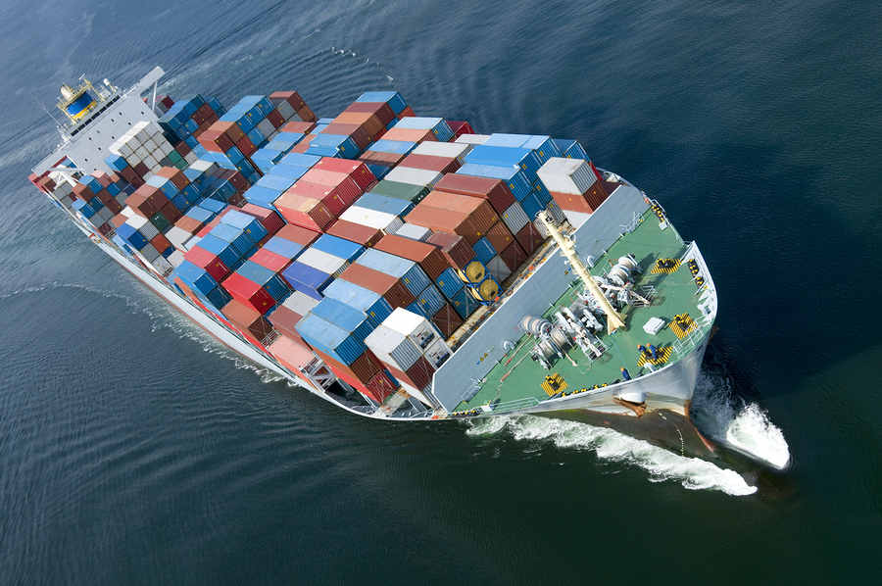
Theoretical Perspectives: Liberalism
IB Global Politics

Slide 2
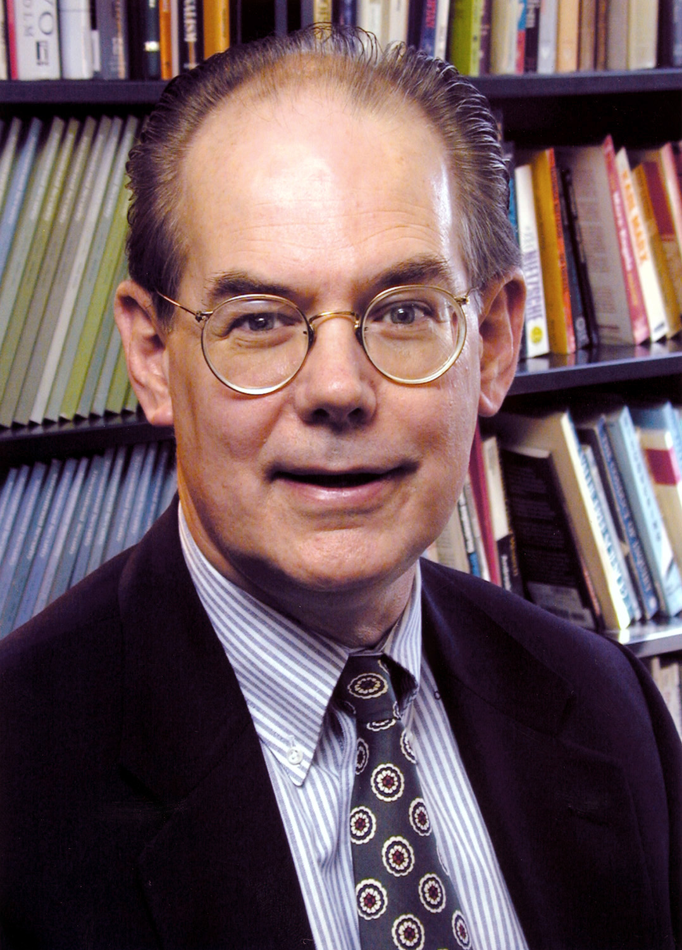
Remember Realism?
It makes sense for states to pursue power
Offensive and defensive realists disagree on how much power is enough
Global political system is characterized by power
Dominated 20th century thinking about global politics – most other theoretical perspectives can be considered reactions to and criticisms of realism

Slide 3
Liberalism in Global Politics
Next to realism, liberalism is most accepted alternative theoretical perspective for understanding global politics
Other theoretical perspectives include idealism, neo-Marxism, constructivism and feminism

Slide 4
A note of caution…
Liberalism / liberal should not be confused with the way in which they are used in domestic politics – meaning left of centre
In international relations, liberalism refers to an emphasis on interdependence between states
Realism stresses great continuity in international relations across centuries, contemporary liberalism sees great changes

Slide 5
Key principles
Societies and states have become so interdependent by second of 20th century that, according to liberalism, the way they relate to each other changed in fundamental ways
Identify the biggest changes taking place in societies from the late 19th century to the present day ( three main revolutions)
Interdependence: The idea that states and their fortunes are connected to each other
What happens in one state can have affects on another state
Relations between two states can greatly affect the relations between other states

Slide 6
Examples of interdependence between states?

Slide 7
Liberalism suggests a particular kind of interdependence characterized the international system
Started after WWII and was in place by 1970s
This kind of interdependence is known as Complex Interdependence

Slide 8
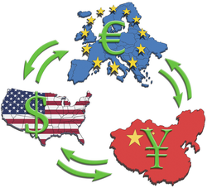
3 Components of Complex Interdependence
Multiple channels
Multiple issues
Decline in use and effectiveness of military force

Slide 9
Multiple channels between a variety of actors in global politics
Realism sees states as only significant actors – so global politics is confined to state-to-state relations
Liberalism does not deny importance of state-to-state relations – but it proposes that states are not the only important actors in global politics

Slide 10
Non-state actors in global politics
Transnational corporations e.g McDonalds, Apple, Nestle..
Nongovernmental organisations e.g. Catholic church, Red Cross, Amnesty International, Human Rights Watch, Doctors without frontiers..
Intergovernmental organisations e.g. United Nations (UN), European Union (EU), World Trade Organization (WTO), International Monetary Fund (IMF), European Union (EU), African Union, Arab League, Association of Southeast Asian Nations (ASEAN)
➞ International Organisations as a whole
According to Liberalism, these are all important international connections across state boundaries

Slide 11
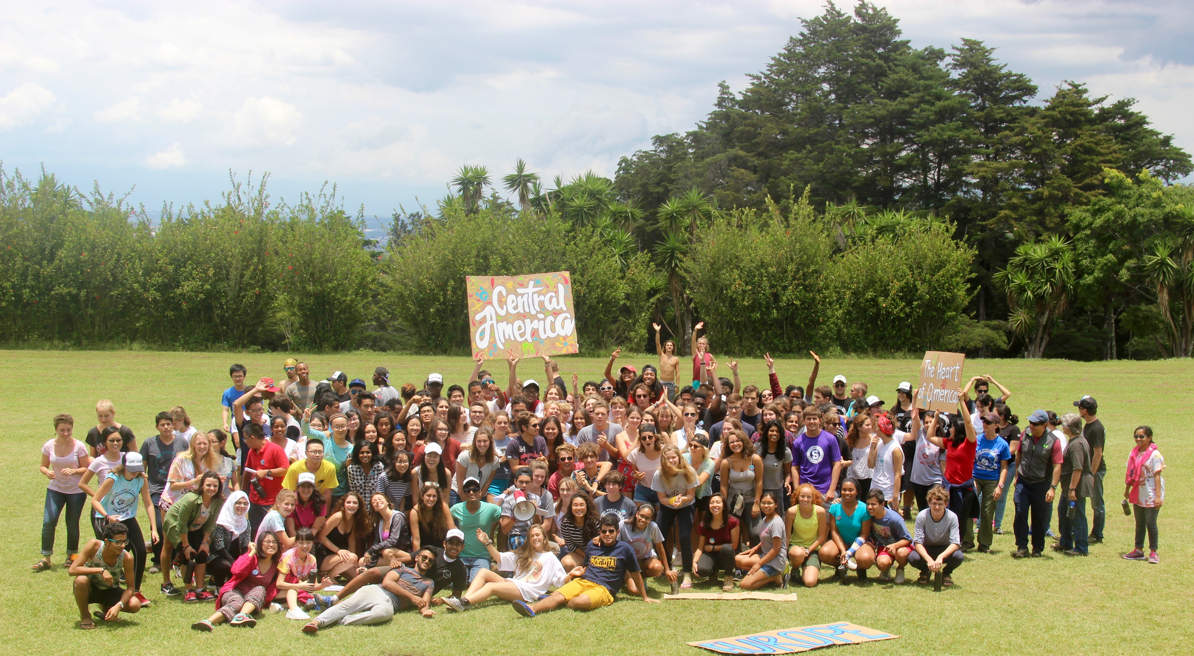
Substate actors also make up multiple channels in a complex, interdependent world
Non-multinational business that buy imported goods from abroad
Provincial government trade missions
Individuals – who travel abroad or may have friendships with individuals in other countries

Slide 12
Liberalism sees a complex web of connections across the globe
Focusing on only state-to-state relations misses an important part of global politics
  States are not the only actors to have interests that drive their actions
  Non-state actors have own goals and interests that may different to those of the state

Slide 13
Multiple issues of interest to variety of global actors
States are not only interested in military security
Economic, ideological, religious and cultural issues are part of the global agenda
Examples?
Even issues that realists would see as purely domestic can have an effect on the global system
  E.g. Environmental regulations may be adopted by a state to protect its own citizens but may affect trading partners if imports must meet new regulations
So domestic policy can become foreign policy as a result of connections between issues, channels and interdependence between actors

Slide 14
Complex interdependence means military force is not as effective or frequently used as in the past
Many issues of concern to states and non-state actors do not lend themselves to military action – climate change?
It makes no sense to conquer a trading partner through military force– would destroy economic export market
Complete interdependence means states are constrained in use of military power because this power only harms multiple interests of states and other actors

Slide 15
The three components of complex interdependence lead liberalism to expect much more cooperation in global politics than realism does

Slide 16
Comparing Liberalism and Realism
Liberals do not deny the existence of conflict but argue cooperation is the norm.
States trade peacefully; sign nonaggression pacts; share military responsibilities
Some states have small/no militaries
Some centuries old military rivalries have been transformed into military/economic partnerships

Slide 17
If the world is so anarchic and dangerous, then why do states cooperate?

Slide 18
States cooperate because it is in their interests to do so…

Slide 19
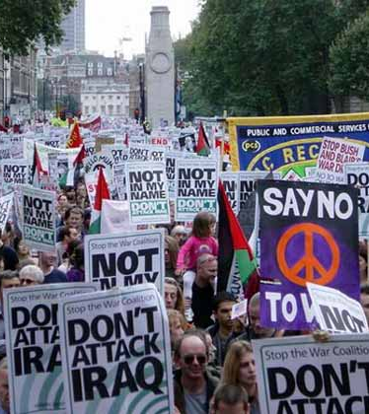
Justifying the liberal perspective…
States realize that hostile actions are likely to harm their interests as much as those of any potential rival
The multiple channels that connect non-state actors constrain states
Even if leaders recognize security threats and want to employ conflictual means, they often face resistance from public or powerful interest groups

Slide 20
The relationship between liberalism and democracy
In democracies, where opposition is legal and citizens can hold their leaders to account, multiple channels are more likely to constrain leaders from conflict
Key point: According to liberal theory, the effects of complex interdependence will be more significant in a more democratic world

Slide 21
Other factors responsible for increased complex interdependence
Spread of democracy
  Decolonization
Nuclear weapons
Wealth redistribution
Technological developments associated with globalization

Slide 22
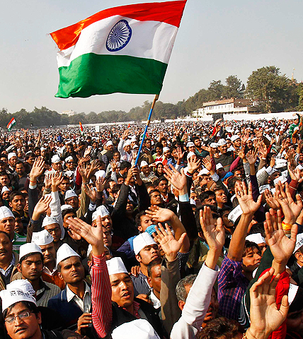
Spread of democracy
End of WWII – shift from fascism to democracy in Italy, Japan and Germany
European powers began to give up colonial possessions – many of which became democracies

Slide 23
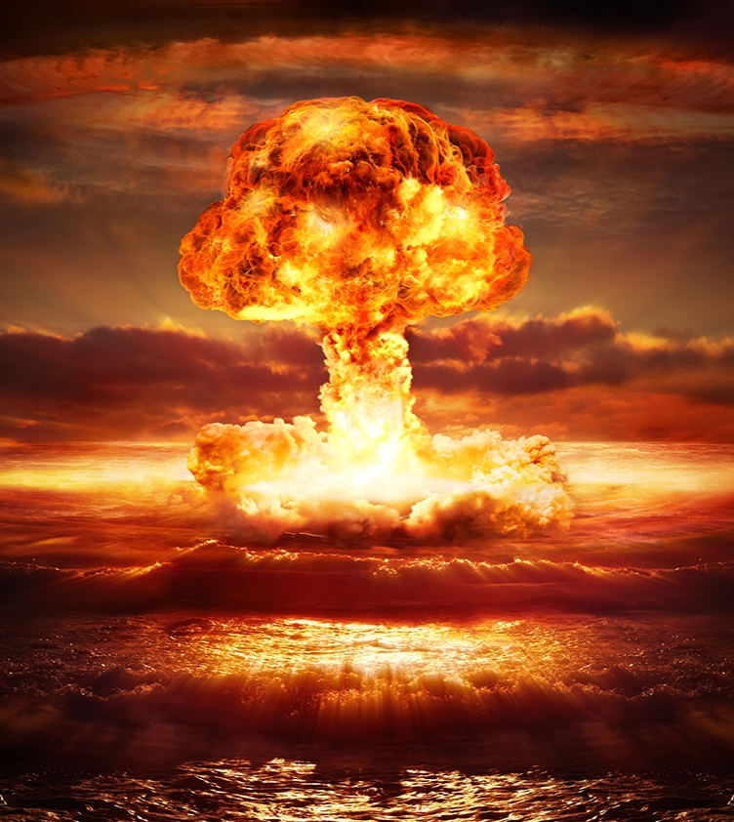
Nuclear weapons
Force – at least all out war – is less of an option for major powers
Using major weapon in the arsenal risks significant damage to all humanity

Slide 24
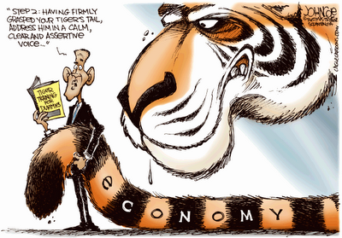
Wealth Redistribution
Post-WWII, wealth began to be distributed around world rather than concentrated in Europe
Rise in MNCs
Oil producing states begin to cooperate – OPEC
Asian ‘Tiger Economies’

Slide 25
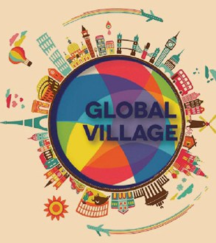
Technological Developments
Phones, TV, jet aircraft, internet, satellites – increased communication
‘Shrinking’ of the world – global village
Part of process of globalization

Slide 26
Complex Interdependence is critical for understanding current and future world politics

