Slide 1
Non-Governmental Politics of Human Rights
IB Global Politics
Human Rights Unit

Slide 2
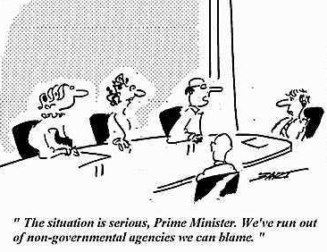
States are not the only actors in the HR sphere
Non-State Actors also have an effect on global human rights policy and diplomacy
In particular, NGOs (Non-governmental organisations)

Slide 3
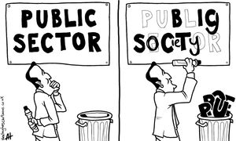
NGOs are part of civil society
Civil society – public political space that is neither the market nor the state
Civil society actors can operate nationally or transnationally
Today, NGOs are central feature of global human rights regime

Slide 4
Amnesty International
One of best know examples of transnational human rights NGO
Based in London, founded 1961
Over 2,000,000 members and subscribers in over 150 countries
https://www.amnesty.org/en/ - check out the link and find out more

Slide 5
Human Rights Watch – NY based research and advocacy organisation
Fédération international de droits de l’homme – umbrella organisation for 155 human rights NGOs globally
Minority Rights Group – London based global advocate for disadvantaged ethnic, national, linguistic, cultural, religious minorities globally
International Lesbian, Gay, Bisexual, Trans and Intersex Association

Slide 6
Amnesty International
One of best know examples of transnational human rights NGO
Based in London, founded 1961
Over 2,000,000 members and subscribers in over 150 countries
https://www.amnesty.org/en/ - check out the link and find out more

Slide 7
Some other things…
Many TNGOs in other areas also include human rights centrally in their mission (despite not being HRNGOs)
OXFAM International
Médecins Sans Frontières
Catholic Relief Services
Transnational NGOs are vastly outnumbered by tens of thousands of national groups

Slide 8
Resources and Strategies
Principal resources are information and energy of ordinary people
Strategies include ‘name + shame’ – e.g. Amnesty’s letter writing campaign
Aim to embarrass offending governments and mobilize foreign citizens to pressure own governments to act on behalf of victims

Slide 9
An example of lobbying…
Amnesty International Nederland has membership of 300,000 (out of population of 16.5 million) – approx 1.8% of population
Roughly same membership as second largest trades union (CNV)
Results in powerful voice for human rights in Dutch foreign policy
COMPARISON: NRA in USA has membership of 4.3 million – approx. 1.4% of population and is one of most power lobbying groups in the US.

Slide 10
Does non-governmental mean exactly that?
Civil society advocacy is deeply embedded in system of sovereign states. Why?
Implementing and enforcing human rights is a state responsibility – thus, NGOs have to act on or through states
TNGOs increasingly attempt to coordinate with local counterparts – mobilize supporting pressure from states and multilateral actors

Slide 11
Assessing NGO Advocacy
Important not to idealize human rights NGOs
Some are essentially largely ineffective expressions of good intentions
Issues of political and financial accountability
Lack power of states and diplomatic stature of international organisations
Power of public opinion is limited and hard to pin down

Slide 12
On the other hand…
No other interests to distract them from advocacy ( like economic interests, political interests..)
Many develop reputations for accuracy and impartiality – use as a resource
Important check on ‘tendency of states to allow competing national interests and considerations of diplomatic discretion to mute human rights criticism’ (Donnelly)
Key mechanism for spreading awareness of international human rights norms and mobilizing opinion

