Slide 1
“Kiihdytin hiukkasen” –competition results
Alpha –team, Jyväskylä
H. Tann, JYU
P. Ruotsalainen, JYU

Slide 2
²⁴¹Am, 60 keV
gamma-ray transitions following beta-decay of ¹³³Ba and ¹⁵²Eu.
- Figure shows gamma rays detected in JUROGAM 3 germanium array during the first calibration/test run. Different radioactive sources were used during this test run:
- ²⁴¹Am alpha source inside JYtube and JUROGAM 3 (see next slide). This nuclide emits 5.5 MeV alpha particles, which are followed by an immediate emission of 59.5 keV gamma-ray (see slide 6.).
- ¹⁵²Eu and ¹³³Ba sources inside JUROGAM 3. These nuclides emit various different gamma rays in energy range between 80 keV – 1500 keV. These gamma rays were used to calibrate JUROGAM 3 Ge detectors.

Slide 3
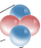
Schematic of the experimental setup in the calibration/test run to verify and test alpha-gamma coincidences.
In the calibration/test run also ¹³³Ba and ¹⁵²Eu sources were used to calibrate JUROGAM 3.
JYtube detector for alpha particles
𝛼 particle
²⁴¹Am source
𝛾 ray
JUROGAM 3
Ge detector

Slide 4
Coincidence time ”peak”
Flat time difference background -> not correlated radiation events
- Figure shows time difference between radiation events detected in JUROGAM 3 detectors and JYtube detector obtained from the calibration/test run.
- If the time difference between the two radiation events is close to 0, it means that these radiation events are detected almost simultaneously, i.e., they are coincident and originate from the same decay process.
- This figure shows that there are coincident events in the data as there is a visible “peak” near time difference 0.
- It must correspond to the events where the alpha particle from ²⁴¹Am decay is detected in JYtube and the subsequent 59.5 keV gamma-ray transition in JUROGAM 3.
- One can use the time difference information to select coincident radiation events in a computer code used to analyse the data.

Slide 5
²⁴¹Am, 60 keV
- Figure shows gamma-ray transitions detected in JUROGAM 3 when a prompt coincidence between JUROGAM 3 and JYtube has been required (= time difference of the radiation events is within 0 and 500 ns).
- It means that the gamma rays observed in JUROGAM 3 have been detected almost at the same time as the alpha particles in JYtube.
- Only ²⁴¹Am source emits coincident alpha and gamma radiation and consequently gamma rays emitted from ¹³³Ba and ¹⁵²Eu sources are removed due to the required coincidence condition (compare this to spectrum in slide 2).
- As a result we can confirm that our experimental detector setup and data acquisition system was working somewhat normal manner.

Slide 6
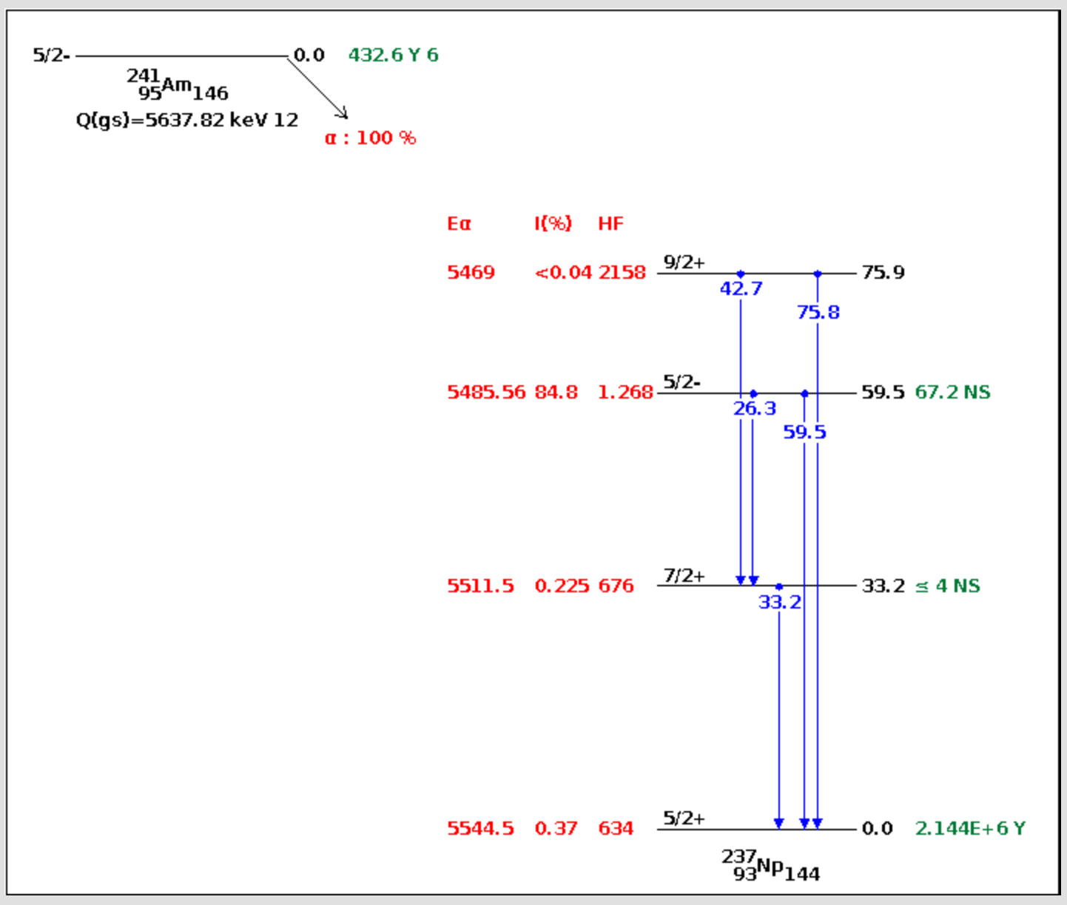
²⁴¹Am, 60 keV
All gamma rays detected in JUROGAM 3
²⁴¹Am decay scheme
²⁴¹Am, 60 keV
Gamma rays in coincidence with alpha particles in JYtube
Alpha decay of ²⁴¹Am with E_{𝛼}=5485.56 keV feeds an excited nuclear state in ²³⁷Np, which decays to the ground state of ²³⁷Np by emission of 59.5 keV gamma-ray transition.

Slide 7
- Ultimate aim in this study was to do the Rutherford scattering experiment utilising JUROGAM 3 and JYtube detectors.
- Alpha particles emitted from ²⁴¹Am were impinged on a thin gold foil. If (and when) atomic nucleus is very small and dense, then every now and then the alpha particles should scatter backwards from the gold foil. These alpha particles are detected in the JYtube detector. The resulting 59.5 keV gamma ray should be detectable in coincidence in JUROGAM 3. Note, that no alphas can reach the JYtube detector directly from the source.
- The principle of the experiment is illustrated in the schematic figure below:
JYtube detector for alpha particles
𝛼 particle
¹⁹⁷Au foil
𝛾 ray
²⁴¹Am source
JUROGAM 3
Ge detector

Slide 8
- If successful, expect to see the 60 keV gamma-ray peak in JUROGAM 3 spectrum in coincidence with JYtube.
- The probability for the event that alpha particle scatters exactly to the backward direction is very small (expect only 1 alpha/minute or so) and not all these can be detected as no radiation detector is 100% efficient.
- Data was collected for about 16 hours.
JUROGAM 3 only
When JYtube is not required, the 59.5 keV gamma ray is visible together with the other contaminating background gamma rays. This is as expected.
²⁴¹Am, 60 keV
JUROGAM 3 + JYtube coincidence
Here JUROGAM 3 + JYtube coicidence is required and we expect to get rid of most of the background visible in the top panel and to have a clean coincidence with the 60 keV gamma ray. As one can see, the background is clearly reduced (by 4 orders of magnitude!), but we don’t have clear evidence for the 60 keV gamma ray peak.
The other peak to the right from the expected 60 keV peak originate from some very long lived radioactive nuclide present in the target chamber, which has been created probably in a some experiment performed in 2019. This nucleus either beta- or alpha decays (detection in JYtube) and then emits the gamma-ray (detection in JUROGAM 3). In a way, this was an interesting finding, which could be only resolved in a long measurement like this.

