Slide 1
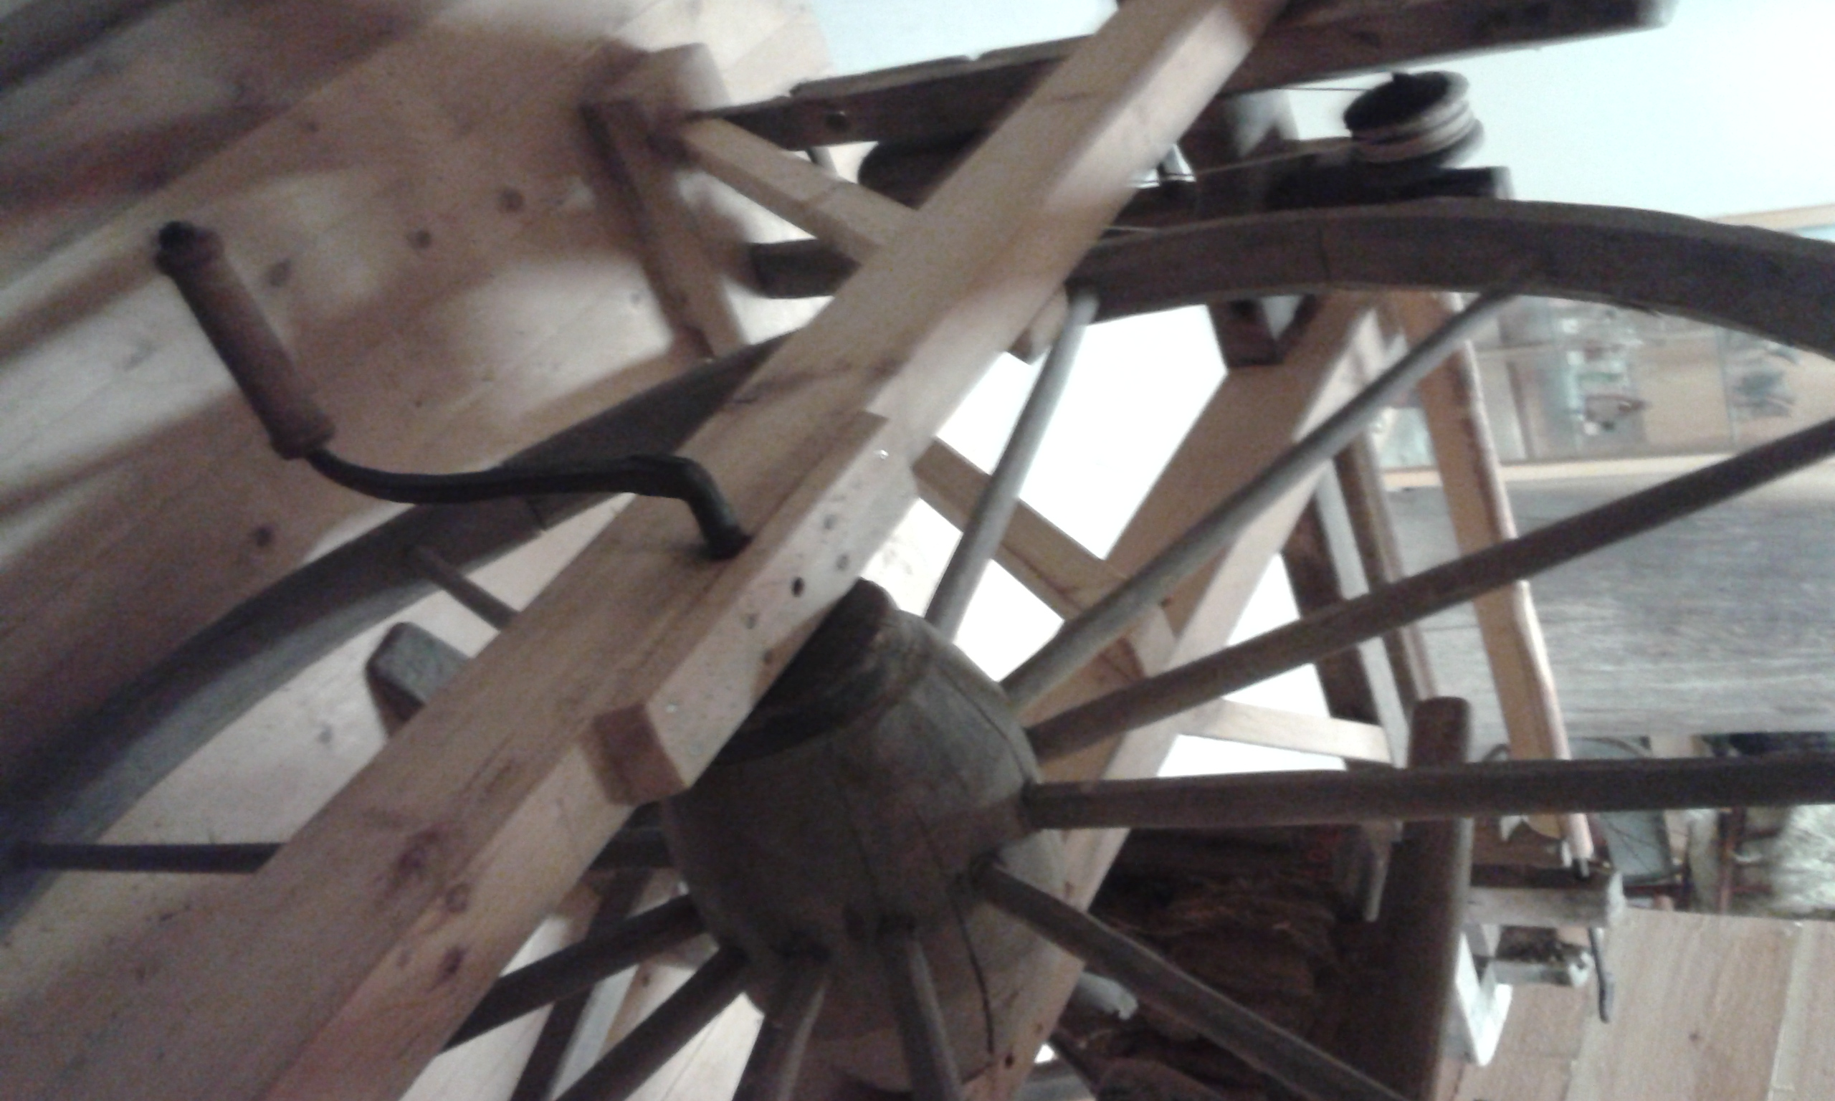
Old Manual wood LATHES
Tekijät: Hytölän koulun 5.-6.lk. Siiri Keurulainen, Juho Jääskä, Ida Laulainen

Slide 2
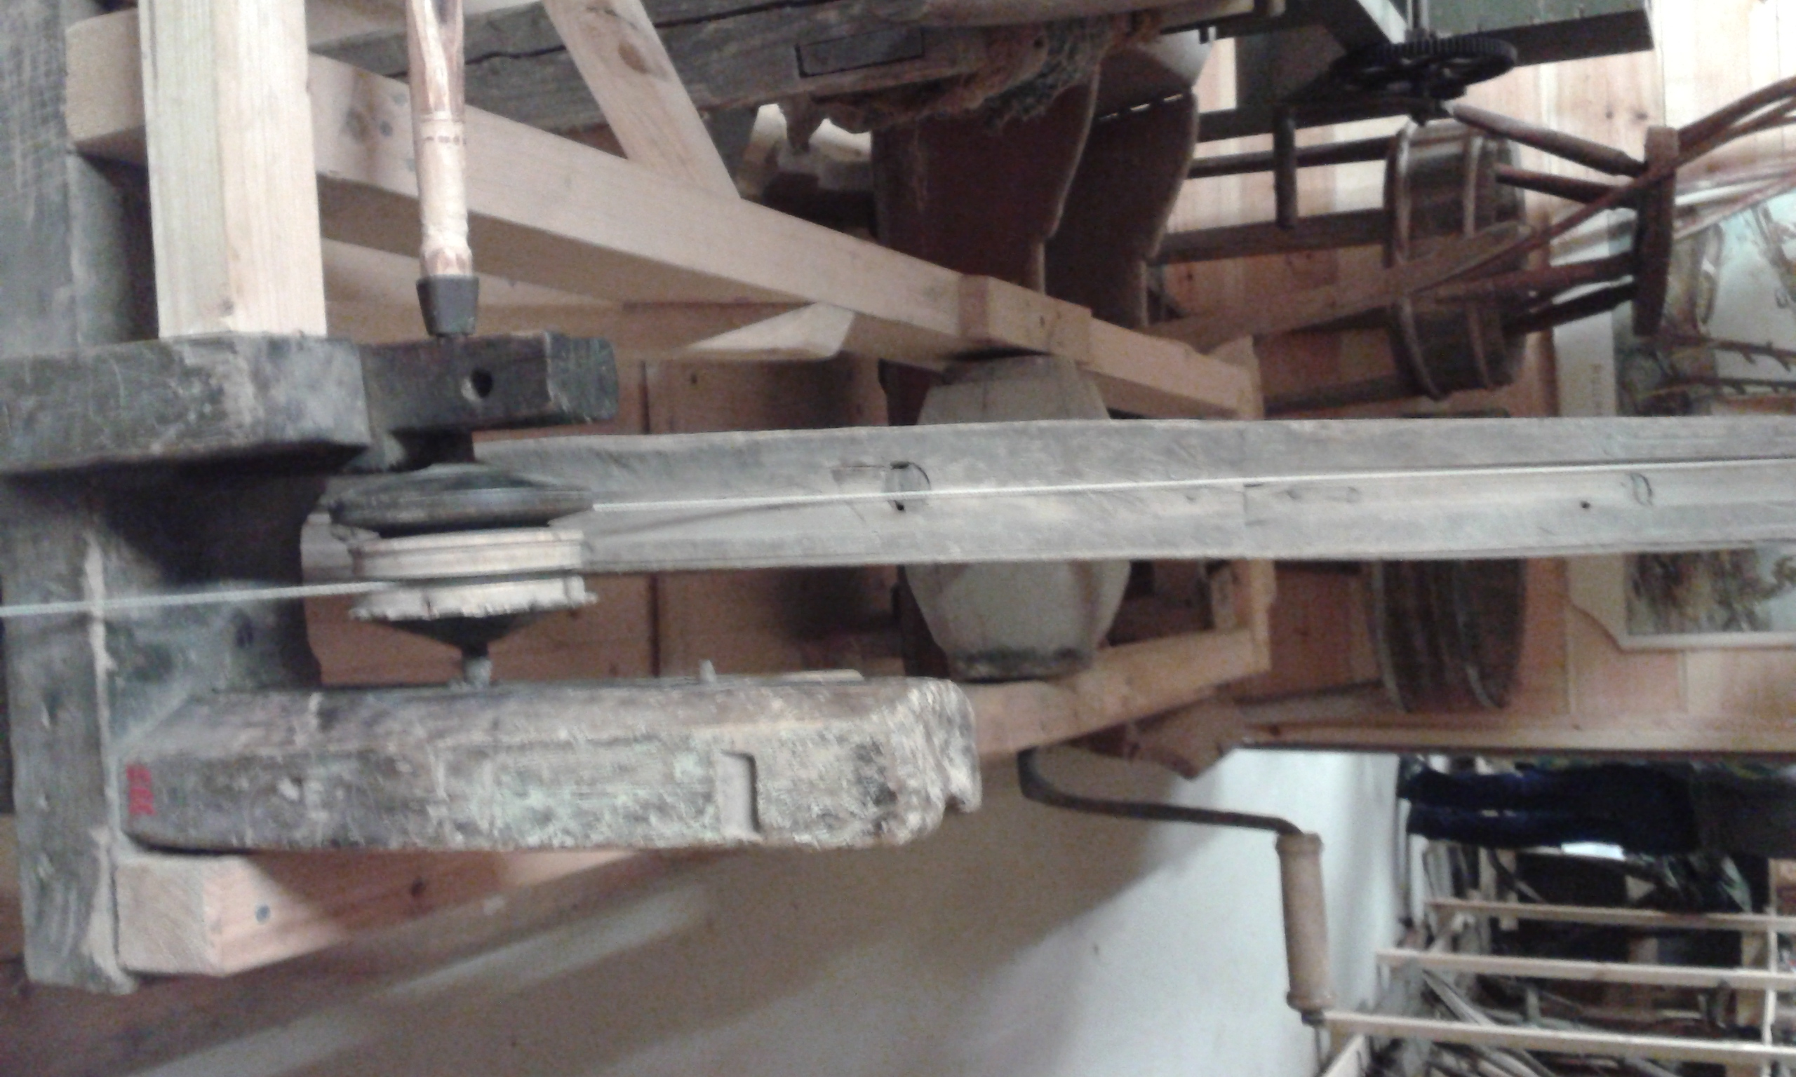
History
Manual wood lathes was an important tool for carpenters.

Slide 3
Purpose
A manual lathes used for making different kinds of artefacts, as well as making arrowheads for hunting.

Slide 4
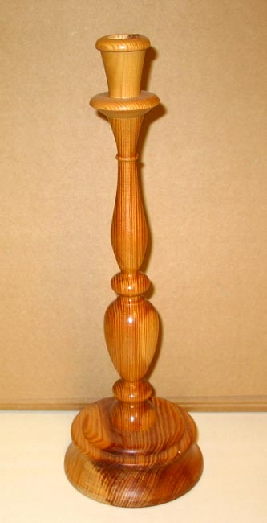
Objects made of wood lathe
For everyday life was prepared candle holders, fur hunting arrowheads called VASAMA and a variety of utensils. Also, the arms of the arrow could be lathed wood turning.

