Slide 1
Geeni Manipulointi
Onko se eettistä?

Slide 2
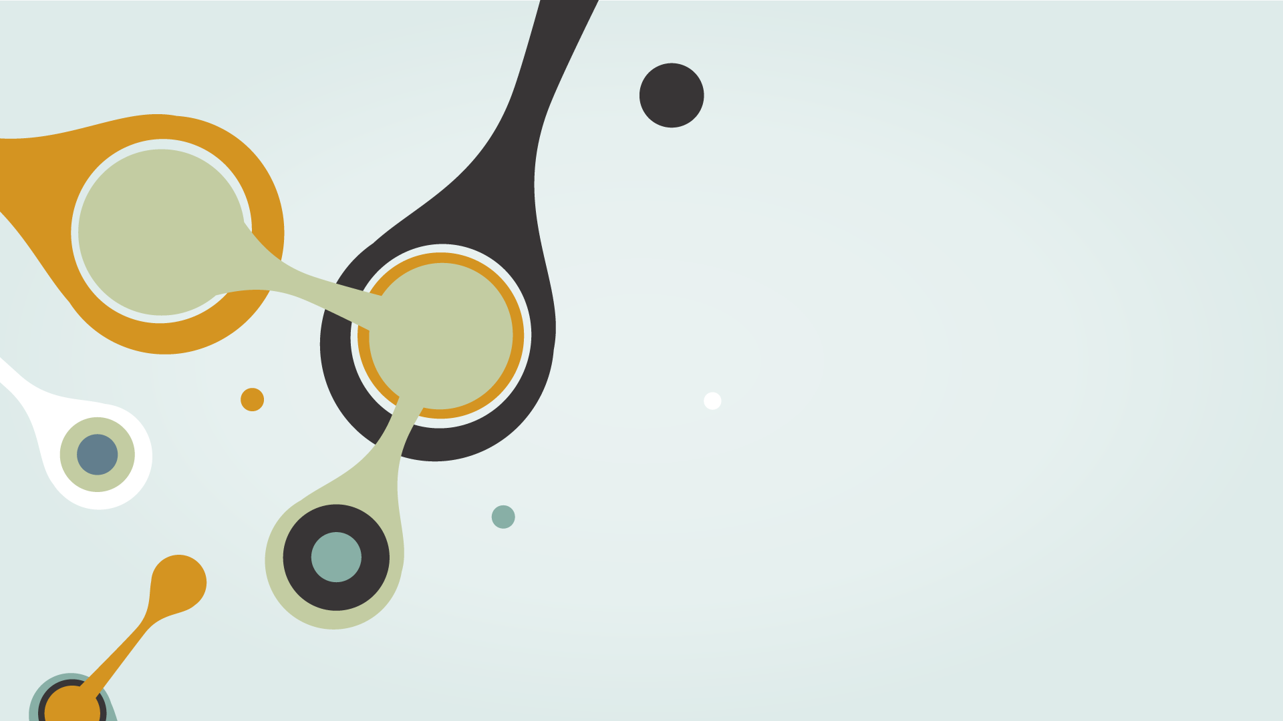
Mitä se tarkoittaa?
Geenimanipulaatiolla tarkoitetaan perimän muuntelua ja haluttujen ominaisuuksien aikaansaamista uusissa yksilöissä.

Slide 3
Onko Geenimanipulaatio tunnettua/yleistä?
Geenimanipulointi ei ole asia, mistä puhutaan usein tai edes mainitaan, sillä sitä pidetään epäeettisenä ja humanitäärisiä oikeuksia rikkovana. Yleisin geenimanipulaation muoto on GMO, eli geenimanipuloitu organismi esimerkiksi jokin kasvis jonka geeniperimää ja ominaisuuksia on räätälöity
Moni ihminen ei suostu menemään lähellekkään geenimutatoituja organismeja, koska niitä pidetään terveyttä vaarantavana ja ympäristön vihollisina

Slide 4
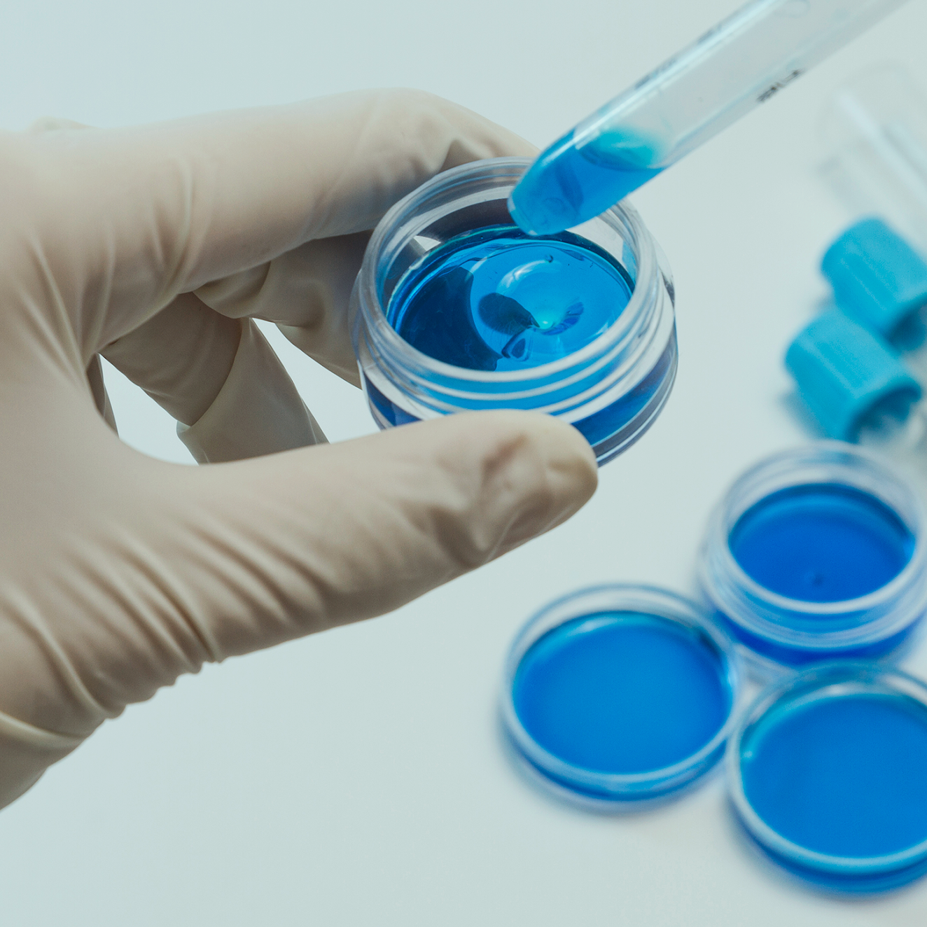
Hieman historiaa aiheesta
Geenitekniikan sanotaan alkaneen vuonna 1973, kun yhdysvaltalainen Paul Berg onnistui siirtämään erään viruksen DNA:ta erään bakteerin kromosomin osaksi. Berg palkittiin tästä hyvästä kemian Nobelin palkinnolla vuonna 1980.

Slide 5

Kristinuskon ja maiden mielipide geenimanipulaatioon
01
02
03
Kirkko
Jumala
Lait
Kirkon mukaan Jumalan kuvaa ja teosta ei saa muuttaa
Jumala kieltää elävien asioiden yhdistelyn
Pitää varmistaa, ettei geenitekniikan käyttö aiheuta haittaa ihmisen terveydelle tai ympäristölle.

Slide 6
01
ANNOUNCEMENTS
You could enter a subtitle here if you need it

Slide 7
1st ANNOUNCEMENT
Mercury is the closest planet to the Sun and the smallest one in our Solar System—it’s only a bit larger than our Moon

Slide 8
HIGHLIGHTS OF THE MONTH
MARS
02
SATURN
01
VENUS
03
Despite being red, Mars is actually a cold place. It’s full of iron oxide dust
Saturn is the ringed planet. It’s composed mostly of hydrogen and helium
Venus has a beautiful name and is the second planet from the Sun

Slide 9
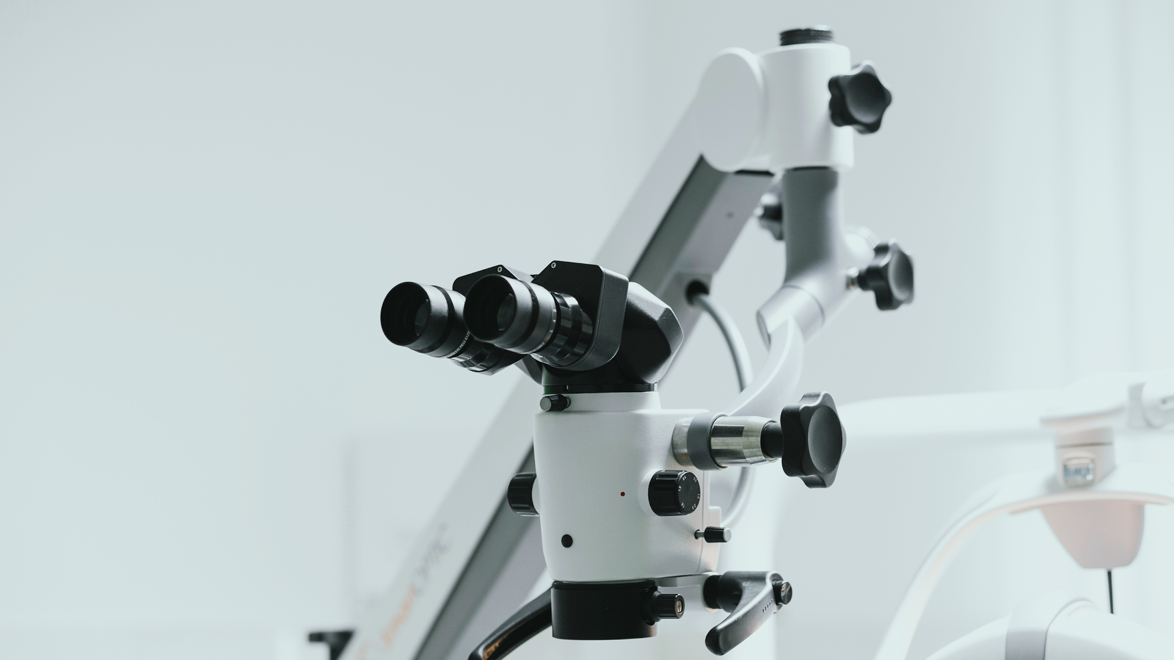
A PICTURE IS WORTH A THOUSAND WORDS

Slide 10

IN DEPTH
02
You could enter a subtitle here if you need it

Slide 11
IN DEPTH
01
03
02
JUPITER
SATURN
MARS
It’s the biggest planet in our Solar System and the fourth-brightest object in the sky
Yes, this is the ringed one. It’s a gas giant, composed mostly of hydrogen and helium
Mars is actually a cold place. It’s full of iron oxide dust, giving the planet its reddish cast

Slide 12

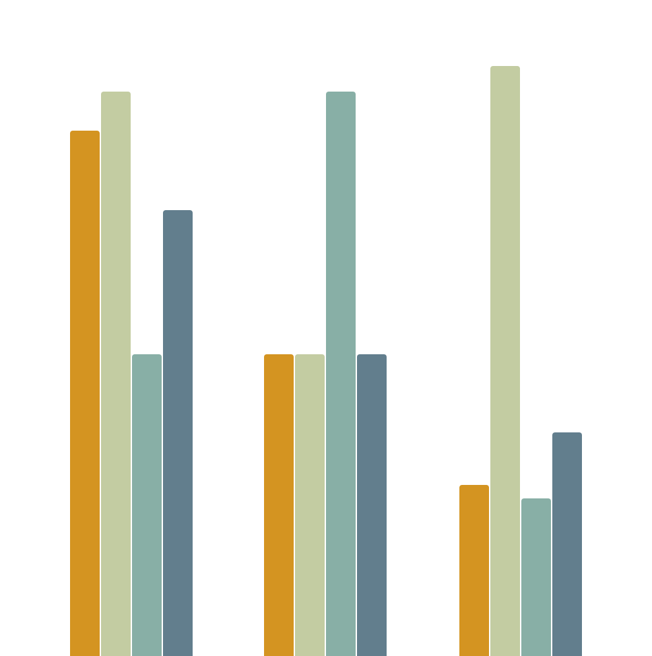
IN DEPTH
MERCURY
MARS
VENUS
NEPTUNE
Mercury is the closest planet to the Sun
Despite being red, Mars is actually a cold place
Venus has a beautiful name, but it’s terribly hot
Neptune is the farthest planet from the Sun
2013
2015
2018

Slide 13

SECTOR NEWS
VENUS
MERCURY
MARS
NEPTUNE
SATURN
JUPITER
Venus has a beautiful name, but it’s terribly hot
Mercury is the closest planet to the Sun
Despite being red, Mars is actually a cold place
Neptune is the farthest planet from the Sun
Saturn is the ringed one and a gas giant
It’s the biggest planet in our Solar System

Slide 14
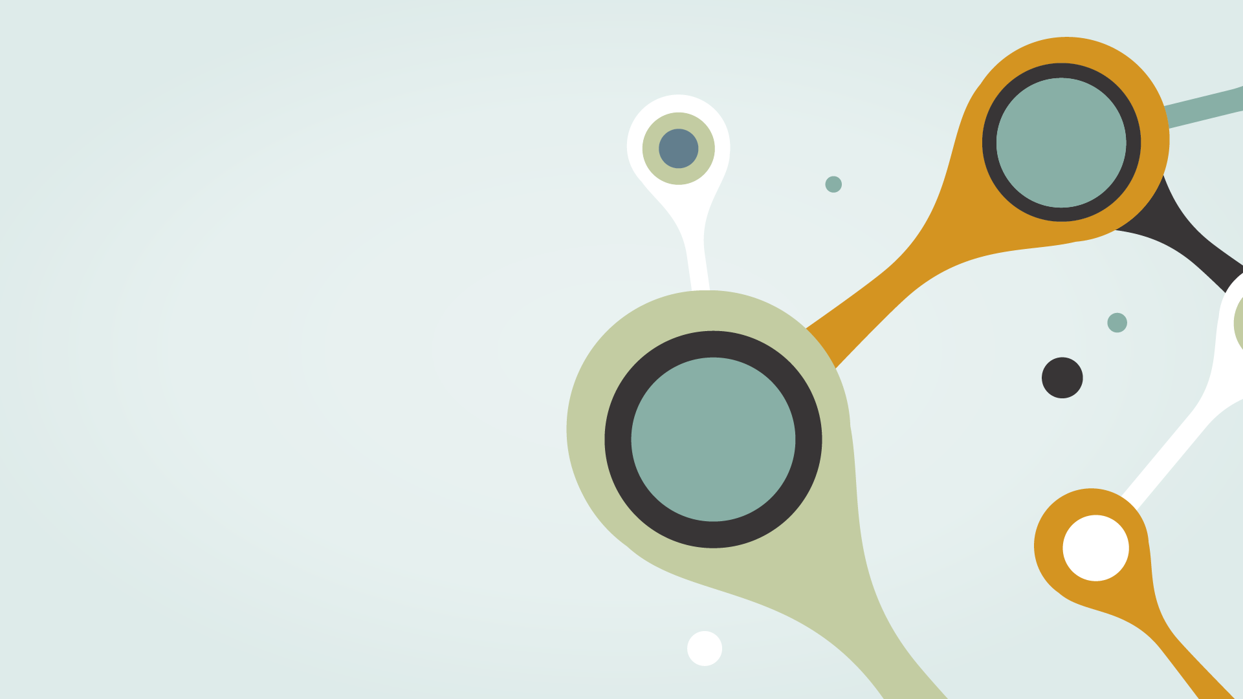
IN BRIEF
03
You could enter a subtitle here if you need it

Slide 15
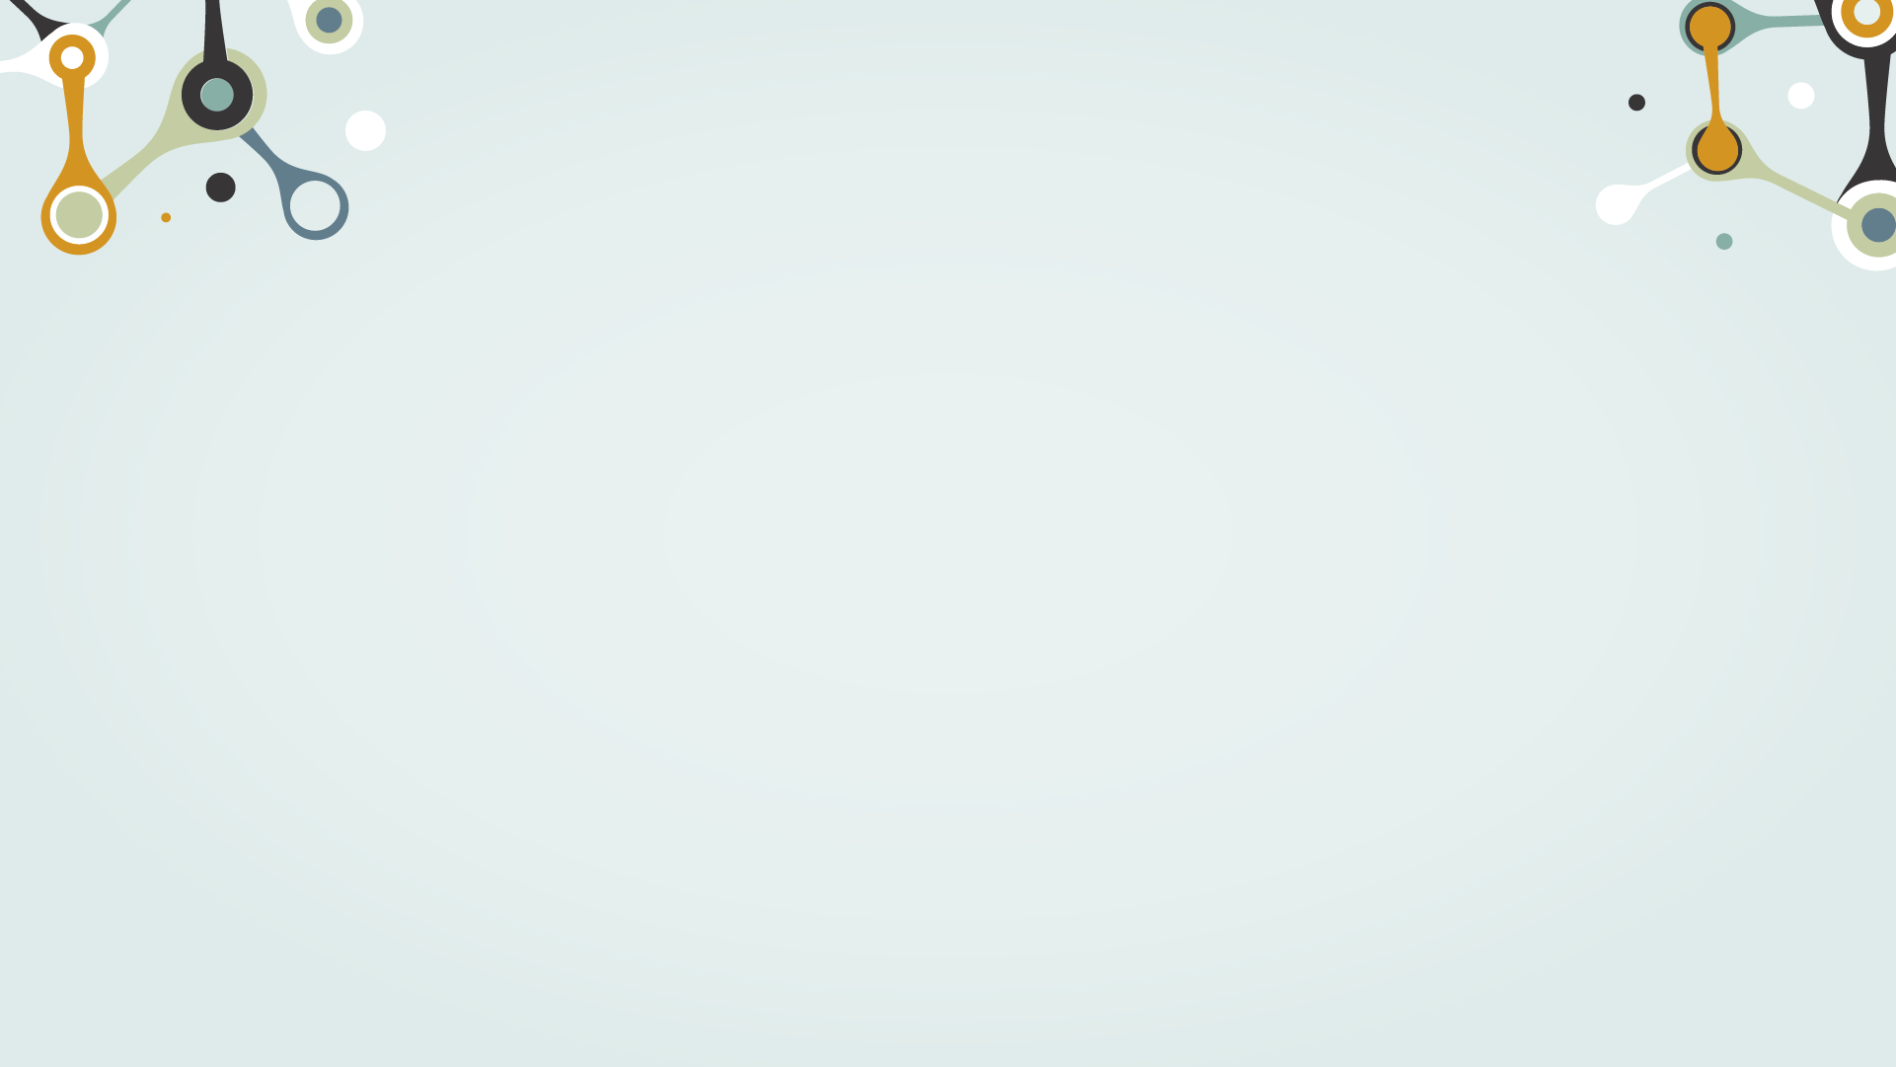
IN BRIEF
This is an item on your list
This is an item on your list
This is an item on your list
This is an item on your list
This is an item on your list
This is an item on your list
This is an item on your list
This is an item on your list

Slide 16
PARTICIPANT REVIEWS
—LANE SHARPE
—EMILIO BAIRD
—WOODROW FOX
—ANIYAH DOTSON
“Despite being red, Mars is a cold place”
“Mercury is the closest planet to the Sun”
“Saturn is the ringed one and a gas giant”
“Venus is the second planet from the Sun”

Slide 17
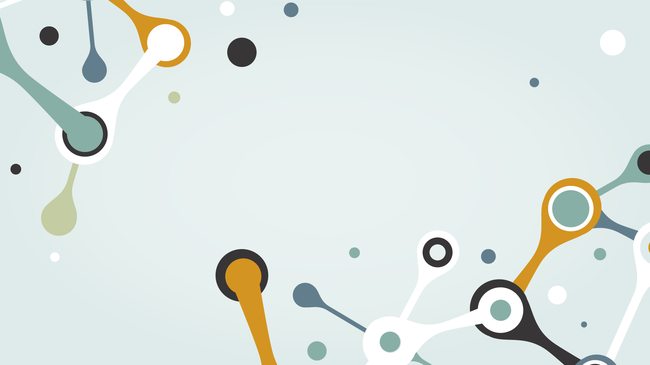
AWESOME WORDS

Slide 18
NEWS
VENUS
MARS
SATURN
Venus has a beautiful name and is the second planet from the Sun. It’s hot, even hotter than Mercury
Despite being red, Mars is a cold place. It’s full of iron oxide dust, which gives the planet its reddish cast
Yes, Saturn is the ringed planet. It’s a gas giant, composed mostly of hydrogen and helium

Slide 19
OUR NUMBERS
 | MASS (EARTHS) | GRAVITY (EARTHS) | DIAMETER (EARTHS)
MARS | 100 | 355 | 370
MERCURY | 490 | 150 | 890
VENUS | 1,000 | 260 | 245

Slide 20
OUR LOCATIONS
MARS
MERCURY
SATURN
Despite being red, Mars is a cold place
Mercury is the closest planet to the Sun
Saturn is the ringed planet and a gas giant

Slide 21
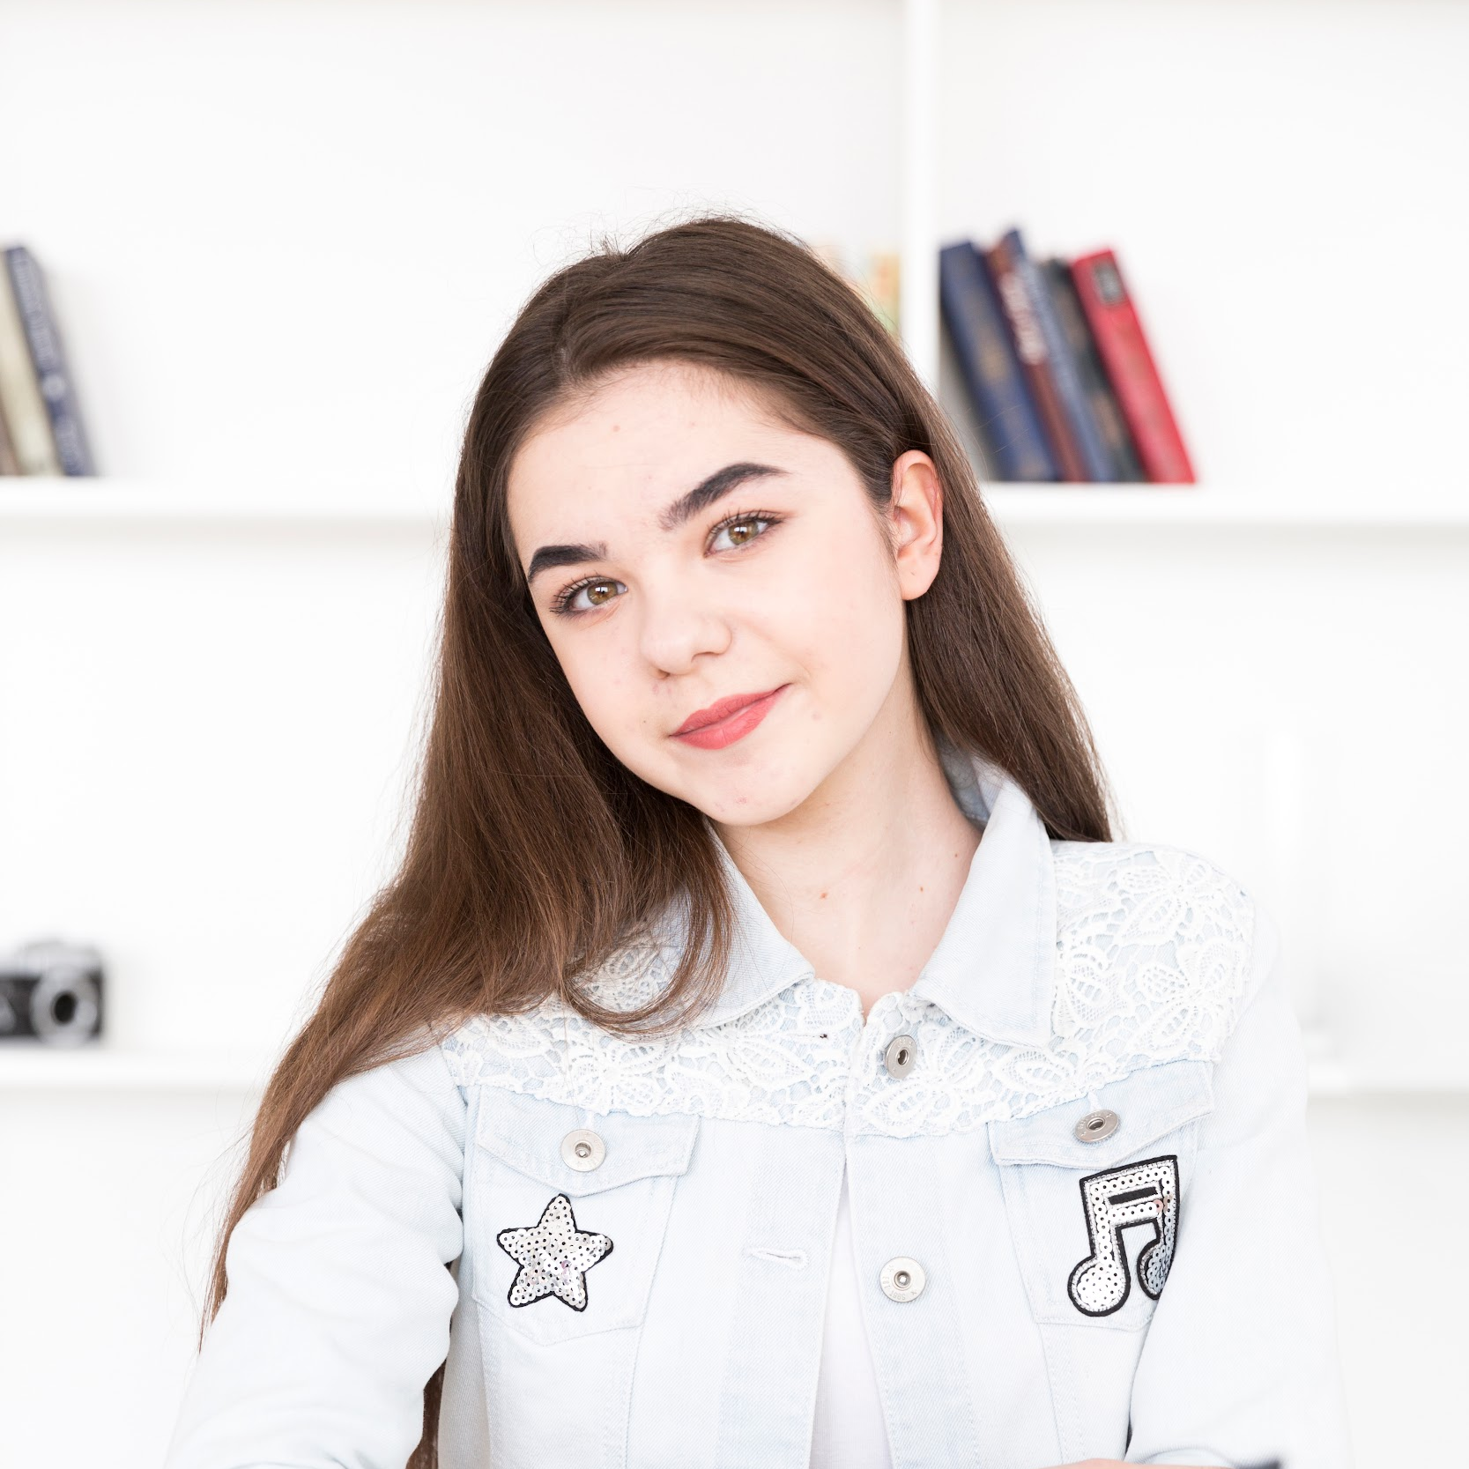

WELCOME
JULIA LARA
HELENA PATTERSON
You can replace the image on the screen with your own
You can replace the image on the screen with your own

Slide 22

05
EVENTS
You could enter a subtitle here if you need it

Slide 23
REVIEW OF PAST EVENTS
SATURN
NEPTUNE
01
02
03
04
05
JUPITER
MERCURY
VENUS
Saturn is the ringed one and a gas giant
It’s the farthest planet from the Sun
It’s the biggest planet of them all
Mercury is the closest planet to the Sun
It’s the second planet from the Sun

Slide 24
UPCOMING EVENTS
MERCURY
VENUS
MARS
APRIL 12
MAY 04
JUNE 23
Mercury is the closest planet to the Sun
Venus is the second planet from the Sun
Despite being red, Mars is actually a cold place

Slide 25
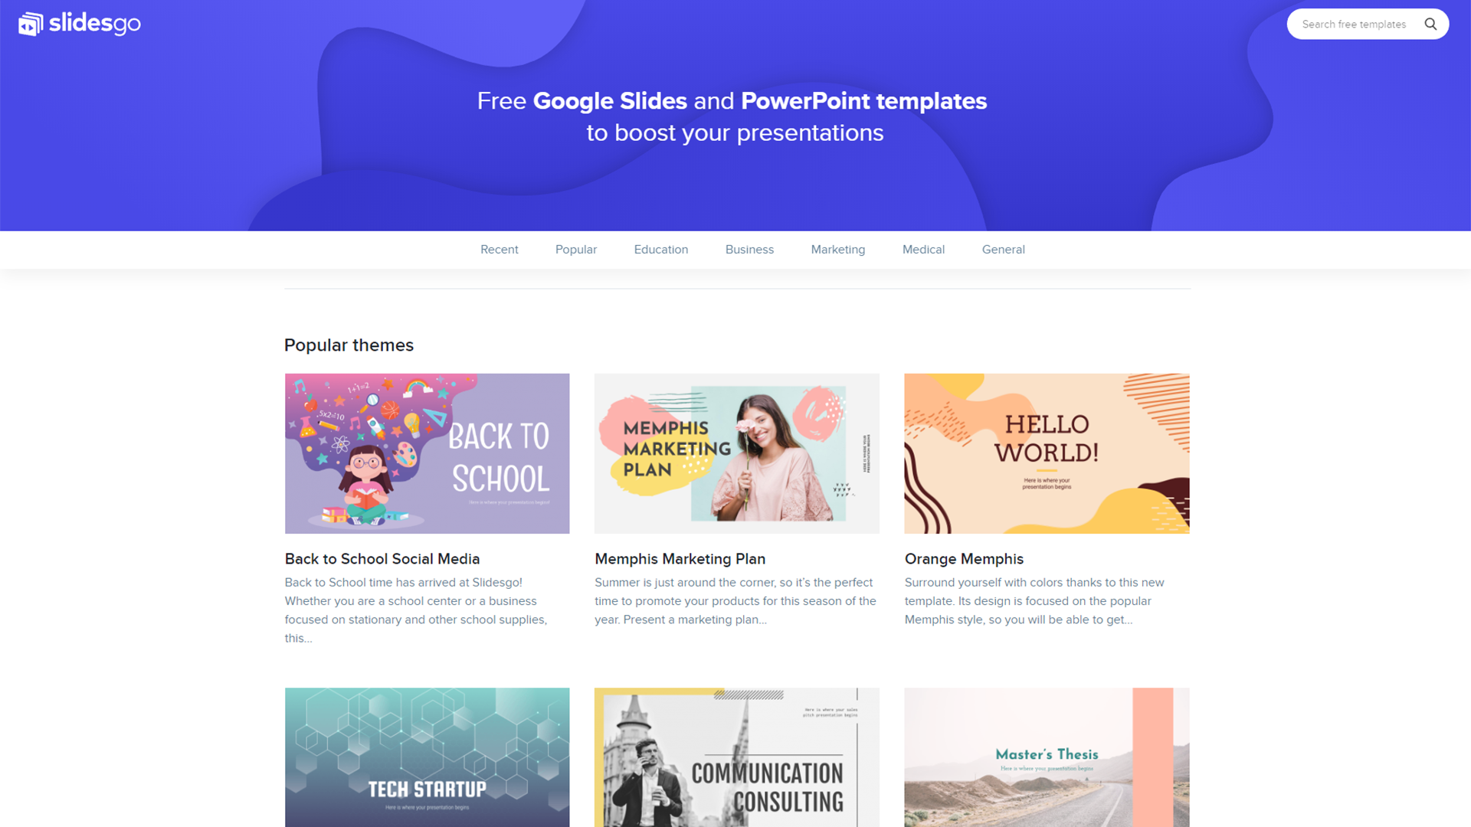


SNEAK PEEK
You can replace the images on the screen with your own work. Just delete these ones and add yours

Slide 26
THANKS
Do you have any questions?
youremail@freepik.com
+91 620 421 838
yourcompany.com
Please keep this slide for attribution

Slide 27
CHEMISTRY ICONS

Slide 28
ALTERNATIVE RESOURCES

Slide 29
RESOURCES
Did you like the resources on this template? Get them for free at our other websites.
PHOTOS
Female student sitting with book and smiling
Teenage student sitting at table in classroom
Modern microscope in laboratory
Scientist making test in laboratory
VECTORS
Abstract science background
Chemistry test tubes
Flat chemistry background
Flat chemistry laboratory with flasks
Flat chemistry background
Flat chemistry background II

