Slide 1
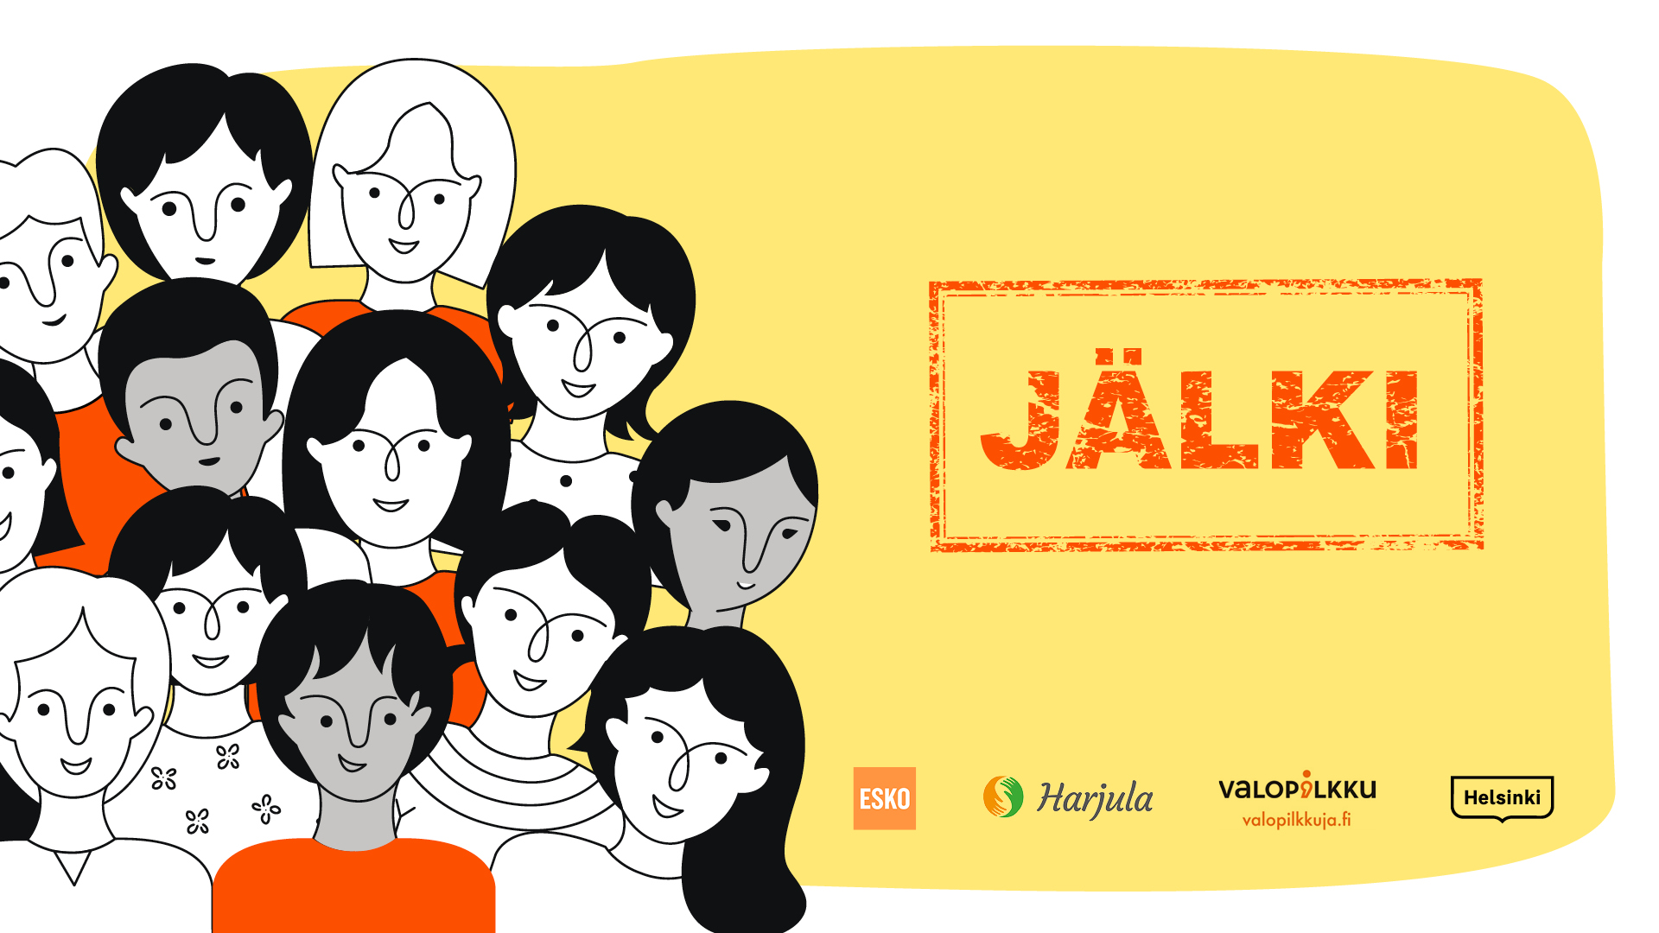
Notes:
The MARK -class is about bullying among youth and prevention of bullying. As we put things into words, intervene and talk about the subject together with the youth, we build mutual trust.
This guideline will provide extra tools to support a conversation with the youth in the MARK -prevention of bullying class. In addition to the guideline, a video https://youtu.be/DHaSsR2j4L0 and a PowerPoint -presentation will be shown to the youth. The class can be used both in schools and in leisure time activities. Fifth- through ninth-graders are the target group.
The class material has been produced in cooperation by youth preventive social work with substance abusers Klaari Helsinki, Valopilkku support and counceling center on bullying, managed by Harjula Setlementti registered association, and Esko school of performing arts in Espoo. Filming and editing was done by Luuppi Media of Helsinki city youth services.
The objective
The objective is to encourage the youth to talk and reflect on what they could do, so there would either be no bullying, or that it would stop: how to discontinue the silence and bravely intervene in bullying?
Schedule
Watch the MARK -video together with the youth: approx. 15 minutes
Dealing with the themes on the video and discussion: at least 45 minutes, when using activating exercises at least 90 minutes
Activating exercises
Activating exercises can be employed to support the discussion and for deeper reflection. All activating exercises are simple and easy to carry out. The exercises might make the youth nervous, if they have no prior of experience in something similar. For this reason it is important for the youth to feel safe as they state their opinions, or do improv and use their body language.The main thing is that no one in the group ridicules anyone's performance. Doing the exercises should be encouraged, but no one must be forced to do them. Trying out the improv pays off – many youngsters may get excited and get more involved.
If the youth, however, are not excited about the exercises, you can go back to having just a discussion. If there is bullying in the group, or the youth are on bad terms with each other, it is recommended you stick with the discussions. Since the time is limited, the teacher can carry out only some exercises based on the video themes.
You should use
No/Yes -claims can be used in the discussion with all groups. ”Yes” is a thumbs up and a ”no” is a thumbs down. ”I don't know what to say” is a horizontal thumb.
Couples- and group discussions should be used to reflect on things.
The structure of the class: video and pp -show with exercises
1. Video (15min) to be watched together.
2. a) Short group chat (5–7 min), during which the youth may share their thoughts on what they have seen on the video. Ask each group to tell what is on their mind and was their something familiar and recognizable in the video situations.
Alternatively
2. b) How many stars would you give to the video? (5–7 min) After the video, ask how many stars they would give it. The number of stars can be shown with fingers. Five is the maximum. After the stars have been counted, you can ask the youth what their reasons for the ratings were. Finally you can tell what the average rating was.

Slide 2
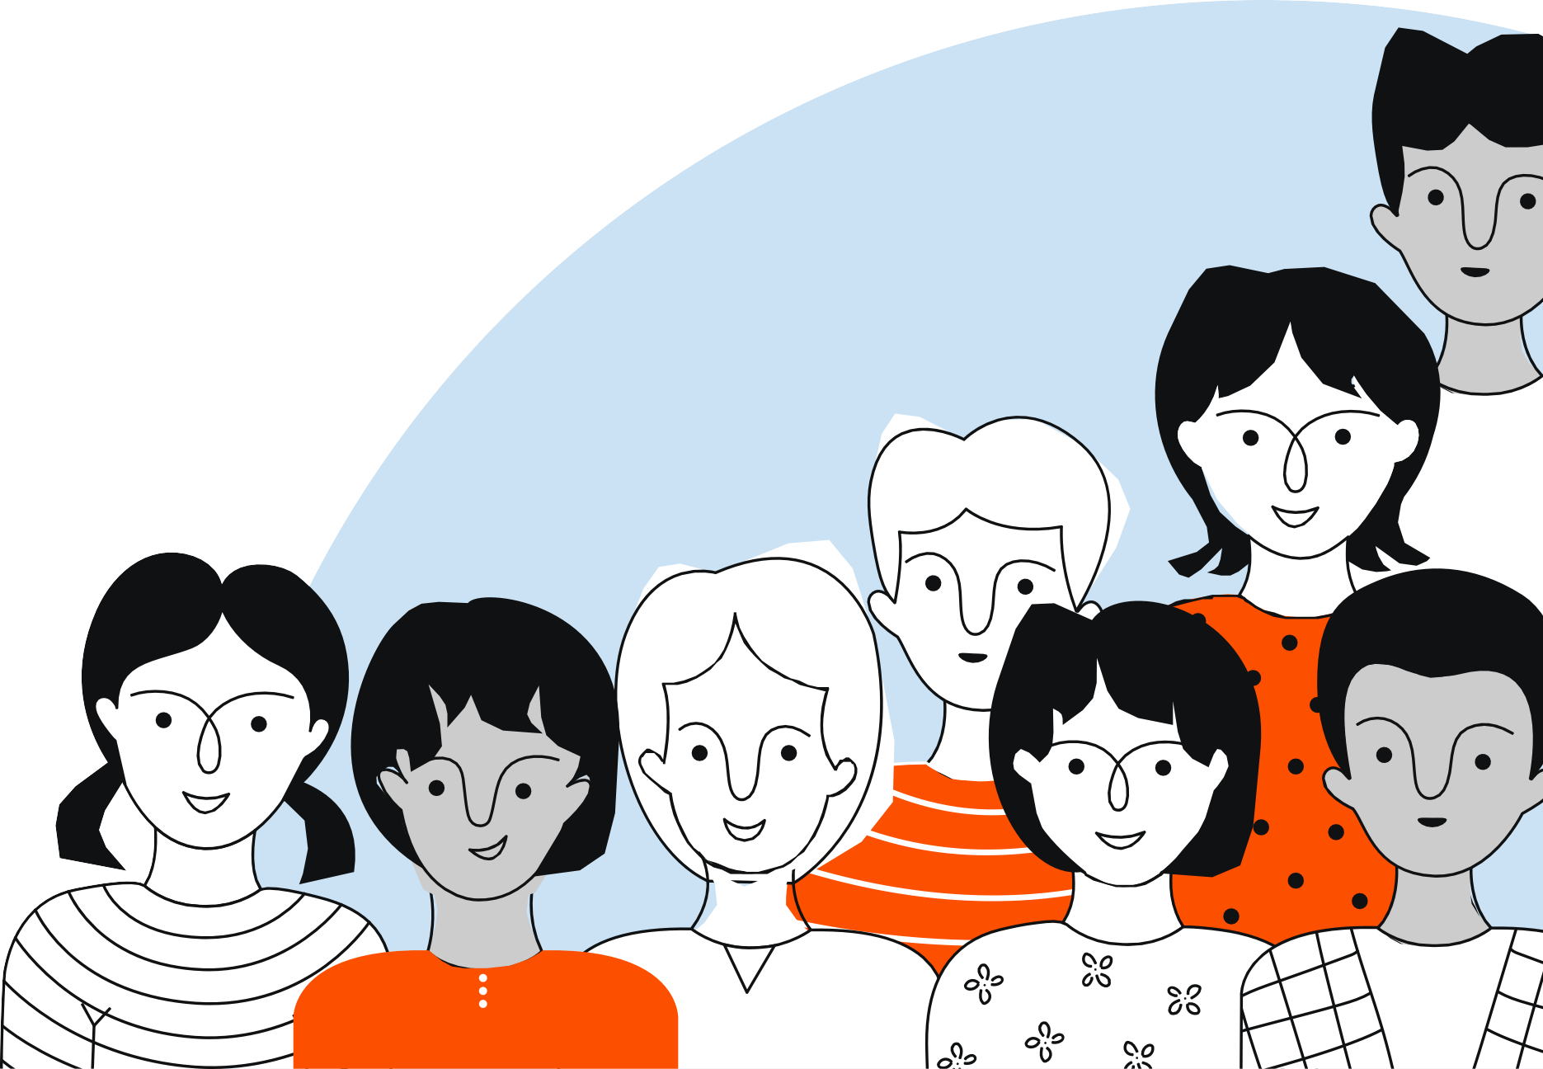
Bullying leaves a mark
A school class, hobby group or other community where bullying occurs is an environment that arouses insecurity and fear in all its members.
Bullying would end if the majority visibly and loudly stood up against it and if bullying was openly discussed.
Silence contributes to the continuation of bullying.
Don’t be quiet.

Slide 3

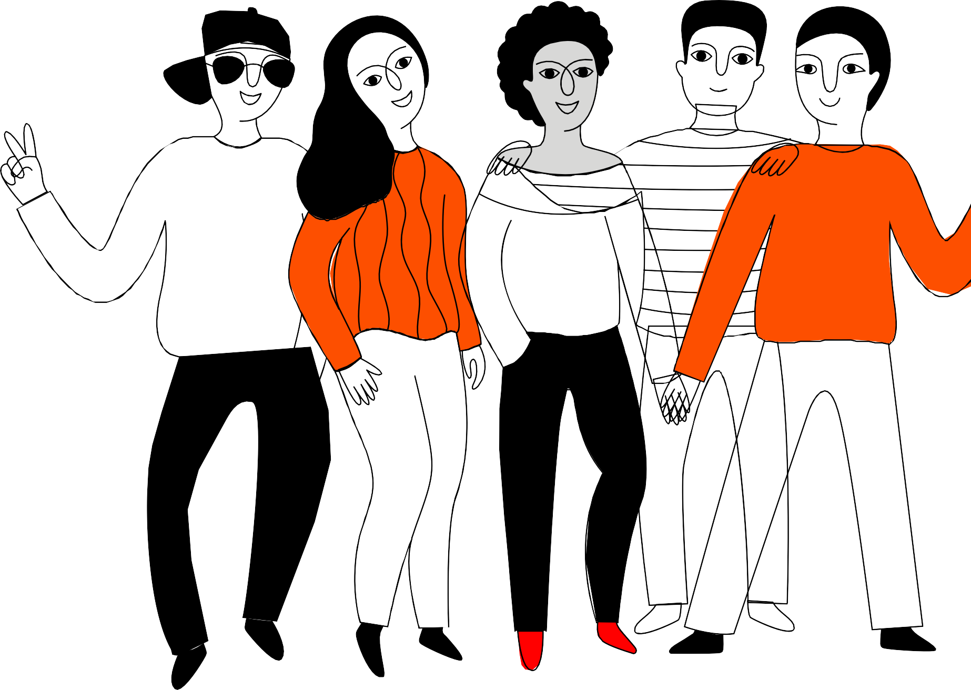
Peer pressure and formation of cliques
Everyone has the need to belong to a group and feel important.
Everyone feels peer pressure sometimes. Peer pressure controls us even if we are not always aware of it.
Click formation gives group members a sense of security. Strong clique formation and the need to be accepted increase the likelihood of perceiving people outside the group as threats or opponents.
Notes:
roup pressure and formation of cliques.
Explain what a clique means (a group of similar-minded people, which doesn't easily allow people in).
- Talk together about what kinds of different cliques may exist and how you usually spot one.
Explain what group pressure means ( a person's need to act like how people usually act in the group, or what is expected from a group member)
- In what types of situations can you face group pressure?
- Have the youth experienced group pressure in some situations?

Slide 4
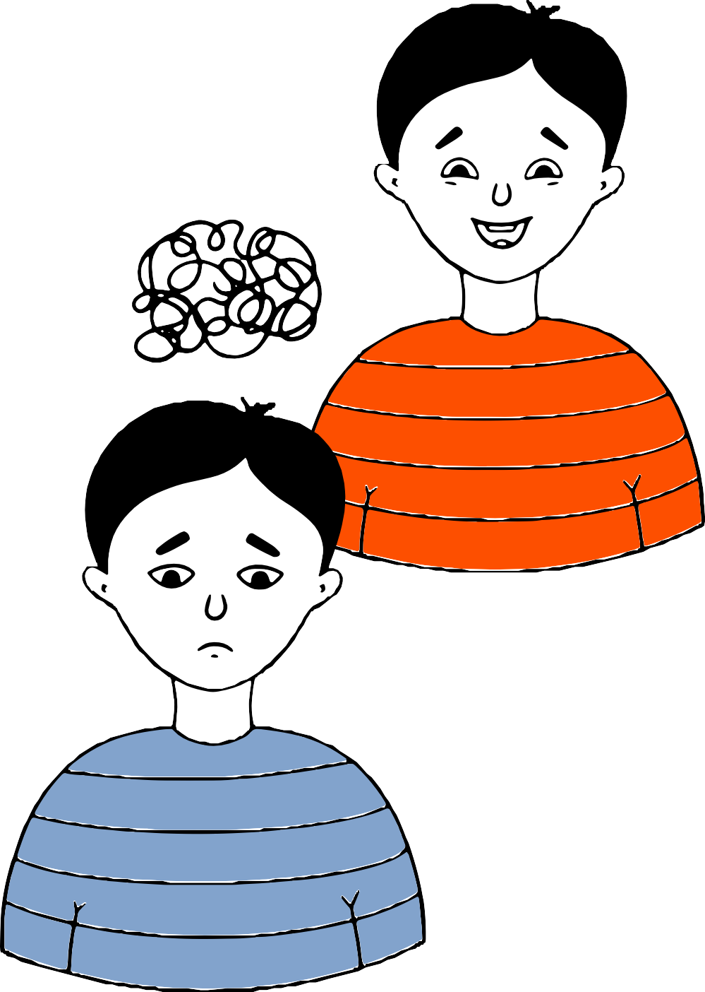
Positive or negative peer pressure?
Positive peer pressure: The group motivates and encourages its members to perform well. Peer pressure prevents bullying when the group members do not accept abusive behaviour towards other group members or that someone is excluded.
Negative peer pressure: The group members do things they might not otherwise do. It can be difficult to resist peer pressure if you are afraid of being left out of the group or being bullied. Group members can change their behavior, make mistakes or go against their principles.

Slide 5
Different roles within a group
In a group, a role means a group member's behavior or way of participating that others expect of him.
Which role do you have at school and in your free time? Do you have many different roles?
The roles are created based on the group's internal interaction: a role or several roles are developed for each group member.
What kind of role would you like to have?
The roles can be permanent or vary in different situations. They can be hard to get rid of, even if you want to.
Do you do what is expected of you or do you do what you want?
Notes:
Different roles within a group
Explain what GOOD interaction means.
- How does good interaction work and how can you spot it?
You can ask the youth to reflect on the questions on the slide.
A tip!
You can come back to the questions later. You can also ask the students to reflect on things at home.
Activating exercise (optional)
Being left outside a group (5-10min)
Form a big circle, in the middle of which a volunteer can go to on his/her turn. Everyone turns their back on that person in the middle and stops answering the person's hellos or questions.
A question: How did you feel being left outside? What are your wishes?

Slide 6
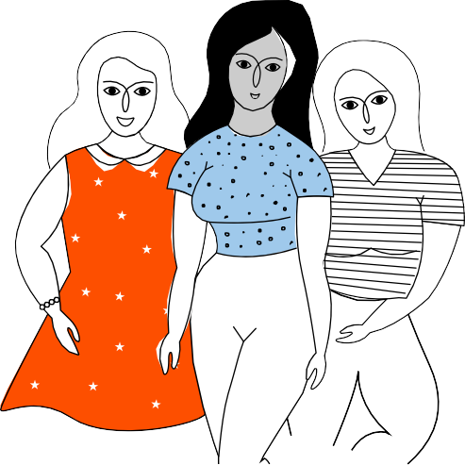
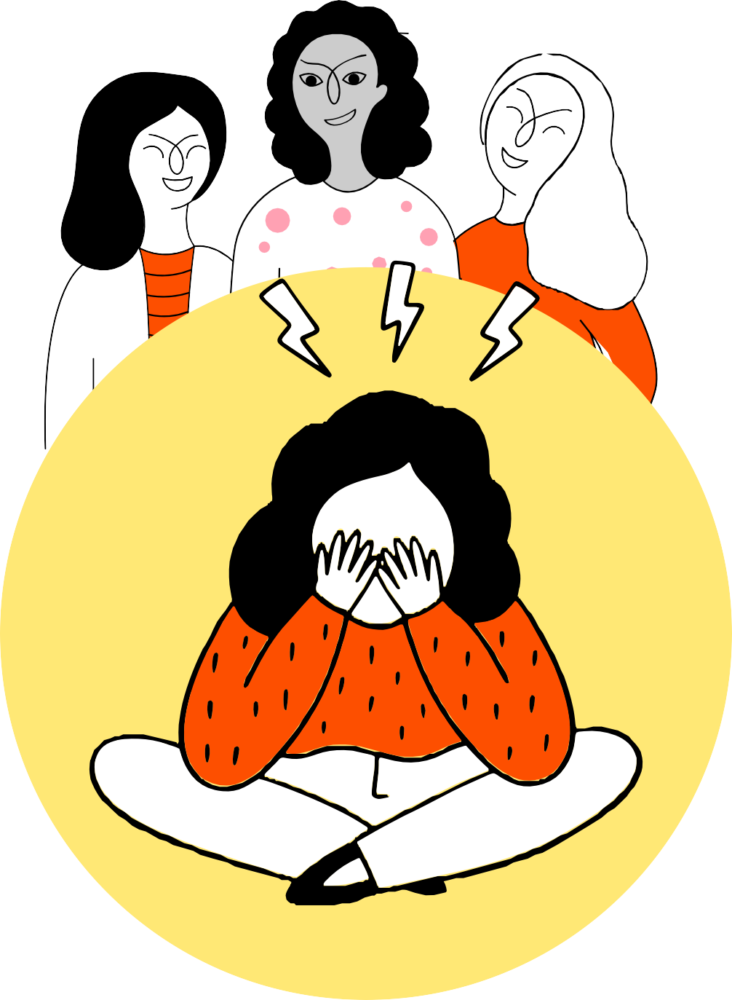
Roles in a bullying situation
The target of bullying can be anyone.
The bully starts the bullying and may incite or pressure others to bully.
The bully’s assistant is involved as a helper in the situation. In some cases, the assistant does the “dirty work” while the bully themselves stays in the background in a bullying situation.
The defender of the target of bullying takes their side or supports them and tries to get the others to stop bullying.
The defender has an important role that calls for courage.
Notes:
Roles in a bullying situation
- What could be the reason, if someone is bullying you?
- What can the bully's helper do? ( Helper can lie on behalf of the bully, for example at a hearing.)

Slide 7
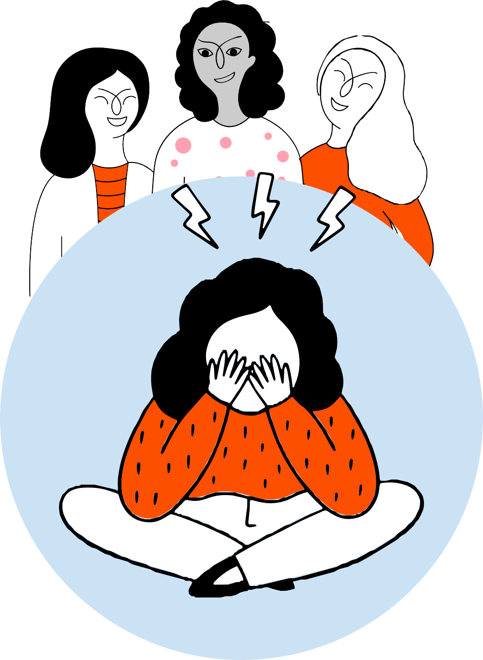
Roles in a bullying situation
The reinforcer gives the bully positive feedback, for example by laughing, encouraging, commenting or coming to look at the situation.
The bystander i.e. the silent witness sees the bullying situation but doesn’t dare or want to intervene in it, and in that way accepts the bullying. They might be afraid of being bullied themselves. Silent witnesses are of great importance in terms of whether the bullying continues.
The outsider stays aside and does not notice the bullying situation – they might not even see it.
The behaviour of the reinforcers and spectators enables the bullying and maintains it.
Notes:
Roles in a bullying situation
A person can be both bullied and a bully.
- What tips could you give to a bystander to encourage him/her to intervene?
Activating exercise (optional)
Negative and positive statue (10 min)
First you create a negative statue, ”an image” of students at a video scene, where bullying takes place. After this, you edit ”the image” by changing the expressions and poses of the statue, so that no bullying would take place.
The main question is what should change in the image, to have no bullying in the situation. (The pose, the place, expression or a gesture.)

Slide 8
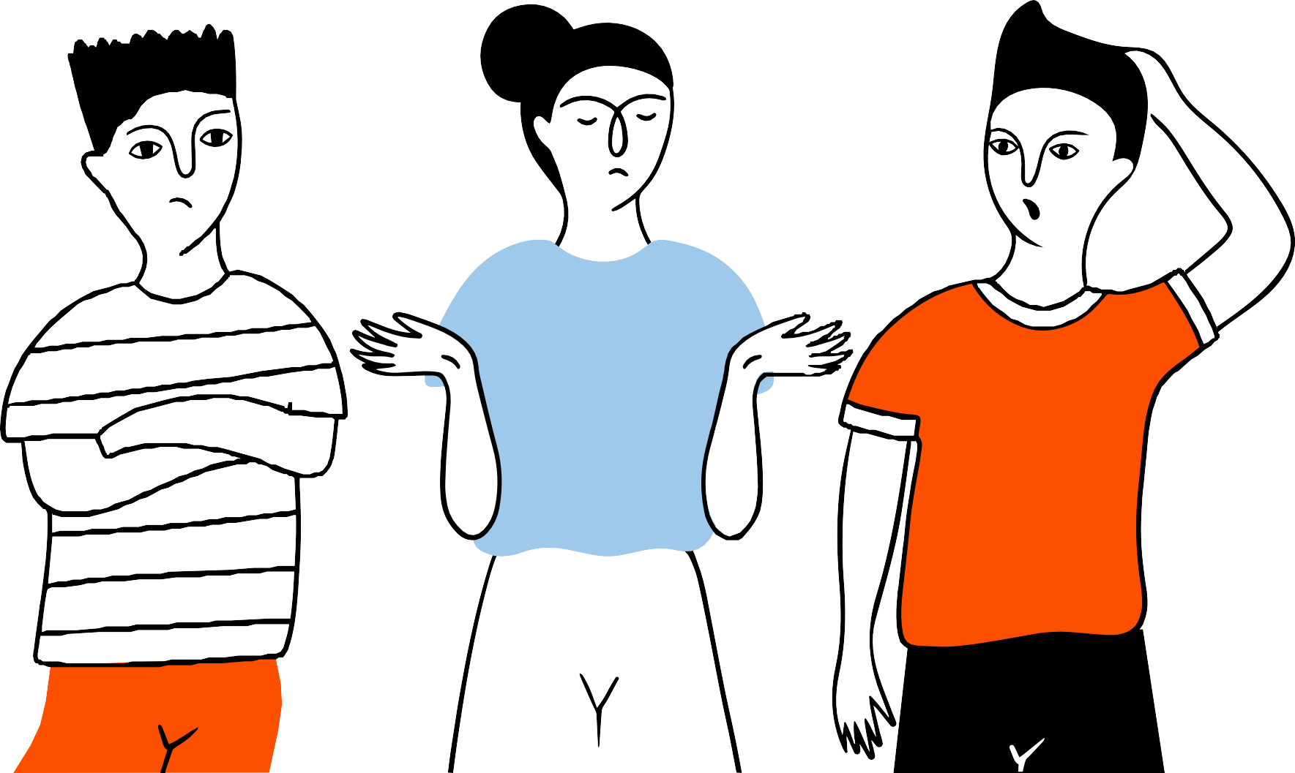
Silent bullying
No words are needed for bullying.
Bullying is not always visible or easy to detect.
Gestures, facial expressions and body language tell about the relationships between group members and their attitudes towards other people.
Silent bullying usually takes place invisible to adults, using various gestures and facial expressions.
Silent bullying means, for example, laughing or grinning at the wrong things behind or in front of the victim, using different tones or emphases, imitation, rolling the eyes, sighing, turning your back or ignoring.

Slide 9

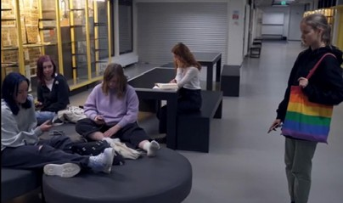
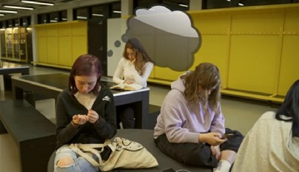
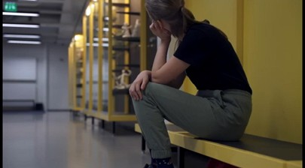
Exclusion from a group
How did peer pressure emerge in the situation? What kind of power relationships did the group have?
In what ways did the group in the video signal that one of the youngsters was not welcome?
Could anyone have done anything differently in the situation? How? Would the situation have been different then?
Who or what could have helped the one left out?
How did it feel for the person who was left out? How did it feel for the youngsters who shut her out?
Notes:
Exclusion from a group
Explain the term power relationship (someone has power over somebody and causes this person to do things on his/her own behalf.)
- Was this the first time, that the youth was excluded? What was the reason? What can happen to a young person, if they are continuously excluded? (Loss of self-esteem, feeling of worthlessness, isolation.)
- What kinds of roles did you recognize in the group?
- In the movie and pictures a young person is sitting by him/herself. Is that person a part of the group? What is this person's role?

Slide 10


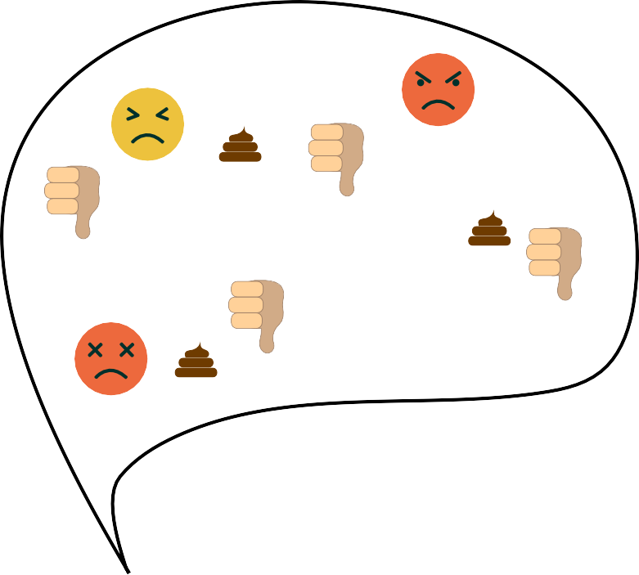
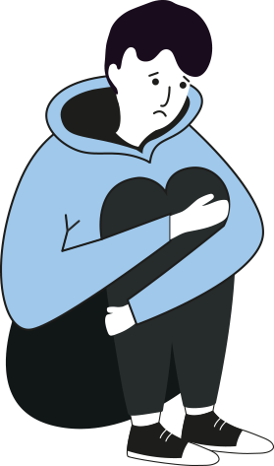
Words, emojis and likes can hurt
Bullying can start online and then move to the real world, or vice versa.
UGLY
LOL
There is a low threshold for participating in online bullying: it is easy to get involved, for example, through likes and emojis.
FOOL
IDIOT
It's easy to hurt with words when you don't see how bad the other person is feeling. Compassion does not arise for the victim in the same way as face to face.
Bullying online is at least as harmful and serious for the victim as any other form of bullying. It can be deeply traumatizing.
Notes:
Words, emojis and likes can hurt
Activating exercise (optional)
What was the situation supposed to be like? (10 min)
Choose a bullying situation from the three examples on the video.
Create a small scene (or a statue/”image”): how should the situation proceed to have no bullying?

Slide 11
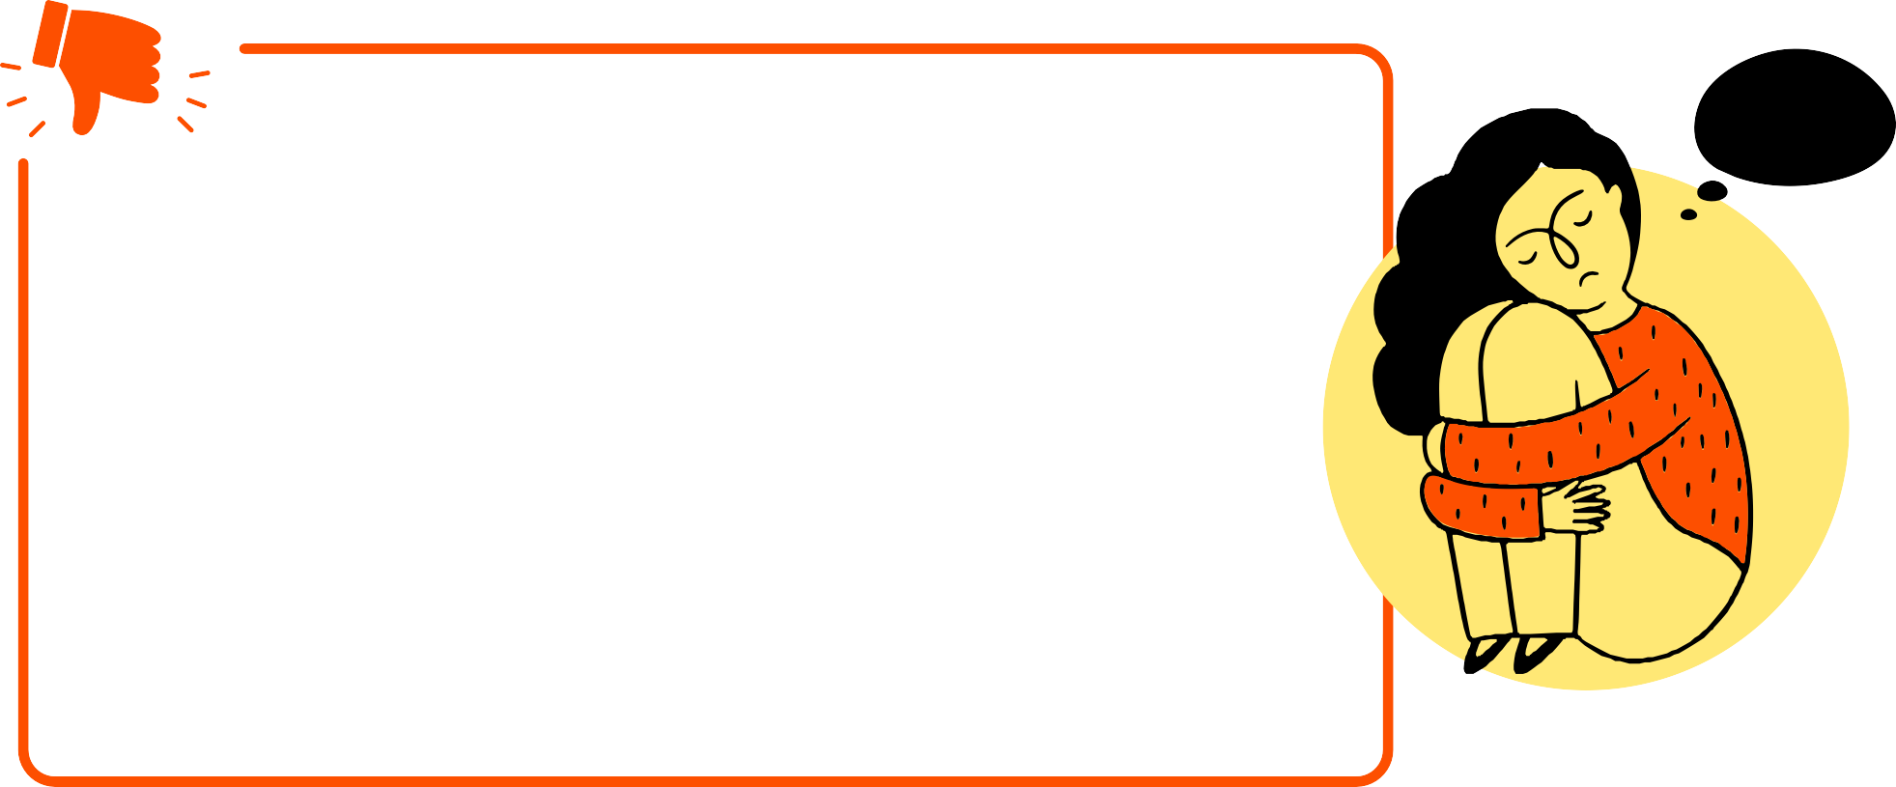



Defining and labelling others
Slandering and labelling the victim are methods of bullying that make the target stand out in a negative way.
Labelling another person can, for example, mean mocking the other or calling them names because of their appearance, way of speaking, sexual orientation or their perceived difference.
As the bullying continues, the stigma begins to have a negative effect on the victim's identity, self-image and self-esteem. Eventually, the victim begins to believe that what is said about them is true.

Slide 12

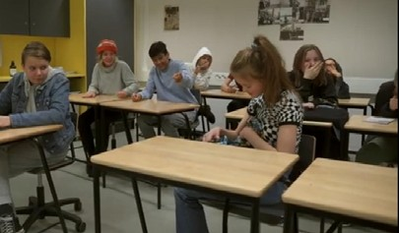
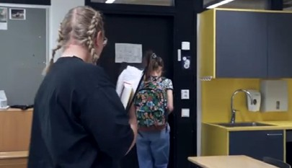
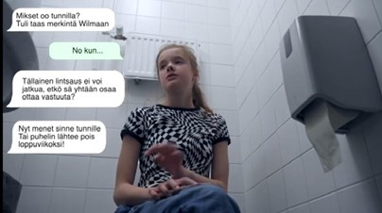
Who would intervene in bullying?
What happened in the situation in the video? Which different roles did you identify?
Could anyone have done anything differently in this situation? How could it have made the situation different?
What or who could have helped the person in the video?
Who could you tell about bullying? How do you get the courage to tell?
Notes:
Who would intervene in bullying?
- What happened on the video? What kinds of roles did you recognize? (Mother's role, teacher's role, classmates' roles.)
- What was the mood in the class like? Why?
- Could somebody have intervened? Who?
- What could have happened, had somebody changed their behavior or acted differently? What would have been the end result then?
- How can you show support to the bullied person? How can you help that person?
- How can you change from a bystander or a silent condoner into a bullied person's supporter?
- Is it hard to defend someone? Why can it feel hard to defend a bullied person?
- What could help for someone to have the courage to defend a bullied person?
Activating exercise (optional)
What would I think, if I was in the role of laughing students, a teacher's or a mother's role? (10 min)
The class instructor asks, for example, what a mother would think in the situation. (The instructor places his/her hand on a student's shoulder and the student can speak aloud what the role character in question would say.)
Switch roles and the instructor will ask again, what the role character in question would think in that situation.
Was the perspective changed? Did you you get clarity as to why some people behaved in a certain way?

Slide 13


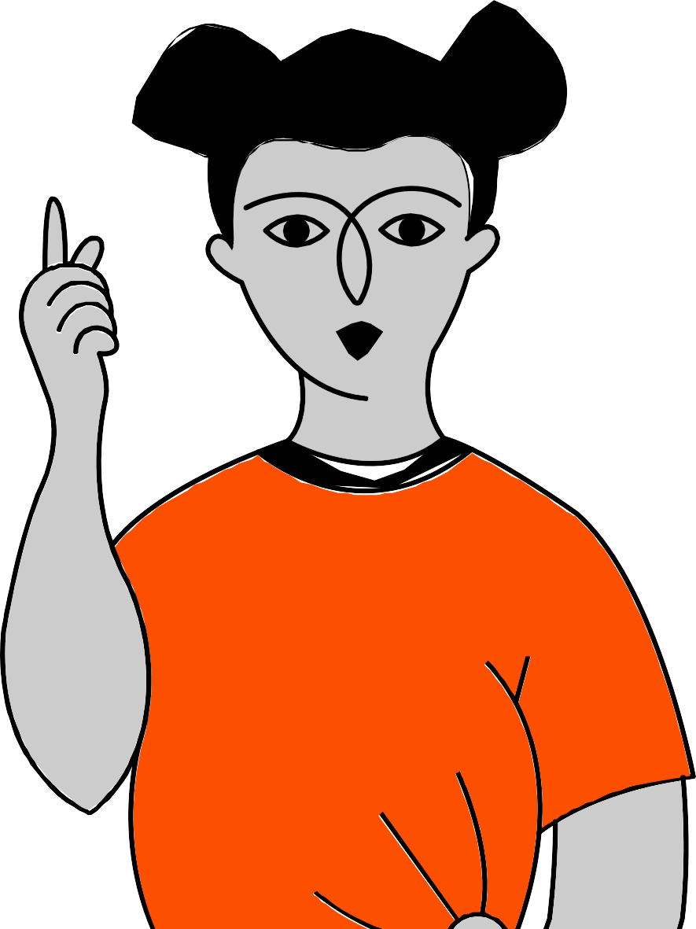
How to help a bullied person?
What is your way of helping someone who has been bullied?
Talk to them, sit next to them and spend time with them.
Send them encouraging messages.
Help them get out of the bullying situation.
Ask the person or persons to stop bullying.
Notice them, for example by greeting or asking them to come along.
Speak in a positive and pleasant tone about them to others.
Notes:
How to help a bullied person?
A tip!
You can give title question to the group to write about or to reflect on independently.

Slide 14


How to act with a bully, if you want to make a positive impact?
Consider whether it would be best to talk to the bully privately or so that others can hear.
Tell the bully that you do not accept what he is doing but do not judge them as a person.
Highlight the bully's good qualities and appeal to them.
Talk to the bully about the consequences their behavior may have for themselves and for the victim.
What kind of consequences can the victim or the bully get?
Notes:
Activating exercise (optional)
Separate instructions for bullies and the bullied persons (10 min)
Suppliest: pieces of paper and pencils
The students will write instructions anonymously on different colored pieces of paper, for example, red pieces of paper for bullies and blue ones to the bullied persons.
- What advice would you give, if someone was bullied, or somebody's friend was bullied?
- What would you say to the bully?
What is the most natural way for you to act or intervene in injustices?
The class instructor will read some of the pieces of paper aloud. Discussion.

Slide 15
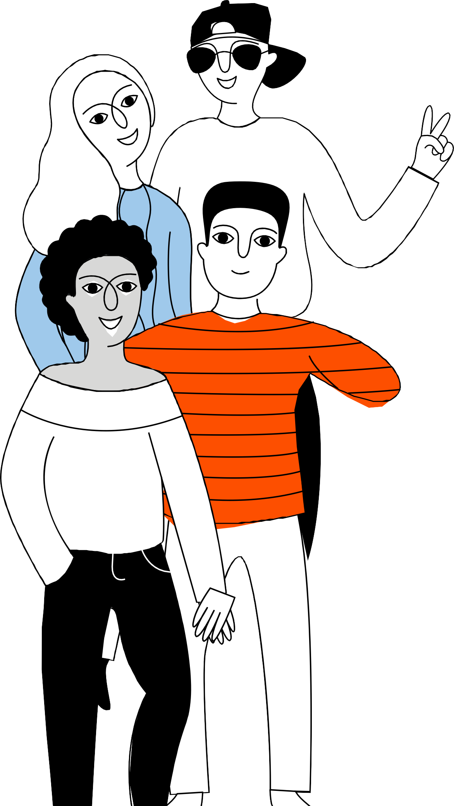
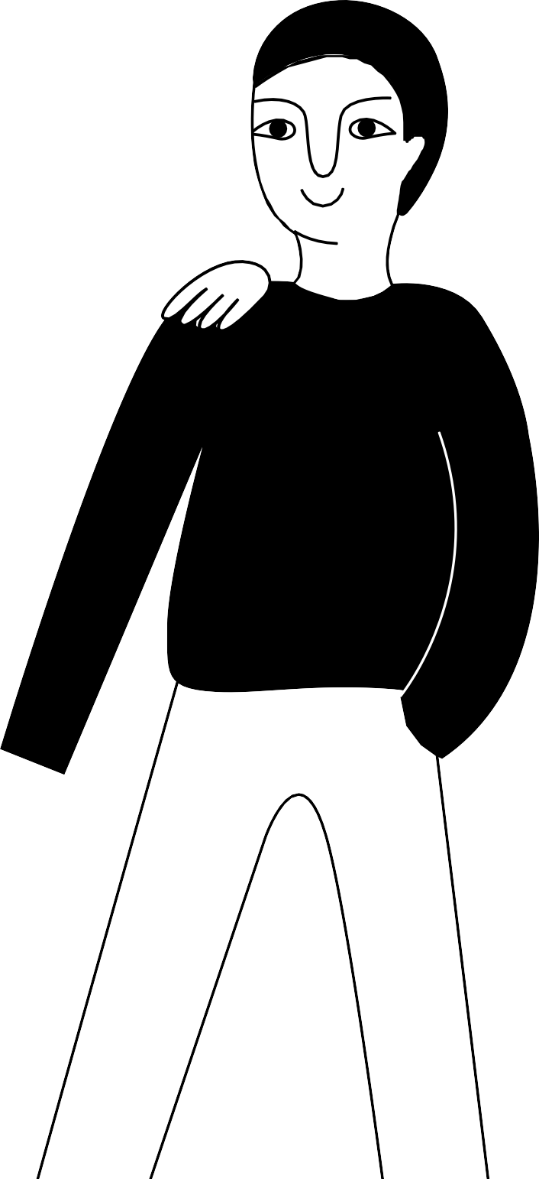



What kind of a mark will you leave behind?
Notes:
What kind of mark will you leave behind?
Finally: What do we learn from this?
Alternatively
Everyone will tell what the shared theme class taught them.
Everyone will express with a single word what the class was like.
By the distance between their hands, everyone will show how interesting or necessary the class was, or with their thumb: was the topic important.
Did you get new ideas? You can ask the students to share them.
A tip!
You can give a home assignment by telling the students to write under the title: ”What kind of a mark will I leave behind?”
The themes under discussion may stir up all kinds of emotions and thoughts in the students. Tell the students how adults will intervene in bullying and what kinds of things are being dealt with in your community. Tell them also who to turn to, if the student sees bullying, is concerned about a friend, or is being bullied him/herself. After the discussion on the theme, it is good to monitor what kinds of impacts the Mark -class had on the group and the dynamics between the group members.
The source for slide 13: points 1–4 adapted according to Tukioppilaan opas, The Mannerheim League for Child Welfare

