Slide 1
Reactivity 3.4: Electron-Pair Sharing Reactions
Define the following terms:
-Nucleophile
-Electrophile
-Substitution
-Electrophilic addition

Slide 2
Substitution Reactions
Halogenoalkanes include a polar halogen-carbon bond
Reagents with a non-bonding pair of electrons will be attracted to a carbon atom and substitution occurs
Curved arrows will show the movement of electron pairs
C
Nu⁻:
Br⁻

Slide 3
Nucleophilic substitution
For primary halogenoalkanes, the proposed mechanism is bimolecular nucleophilic substitution (S_{N}2 mechanism)
C₂H₅Br + OH⁻ → C₂H₅OH + Br⁻
A transition state with OH⁻ and Br⁻ present is suggested

Slide 4
Nucleophilic substitution
For tertiary halagenoalkanes, the mechanism is unimolecular nucleophilic substitution (S_{N}1 mechanism)
C(CH₃)₃Br + OH⁻ → C(CH₃)₃OH + Br⁻
Step 1:
C(CH₃)₃Br → C(CH₃) ₃ + Br⁻ (slow!)
C(CH₃)+₃ + OH⁻ → C(CH₃)₃OH (fast!)
Slow step determines the rate!
Secondary halogenoalkanes can proceed through S_{N}1, S_{N}2, or both

Slide 5
Factors Affecting the Rate of Nucleophilic Substitution
Electron density is determinate in nucleophile effectiveness:
--Anions more reactive than corresponding neutral species.
--Less electronegative elements with non- bonding e⁻ pair are better nucleophiles
CN⁻ > OH⁻ > NH₃ > H₂O

Slide 6
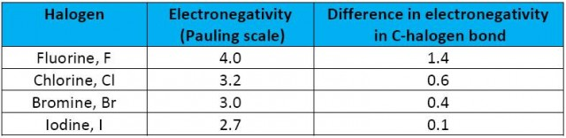
Factors Affecting the Rate of Nucleophilic Substitution
Iodoalkanes react the fastest, Chloroalkanes slowest (bond enthalpies 238(I), 276(Br), 338(Cl) kJ mol ⁻¹)
Tertiary halogenoalkanes react the fastest.
-Activation energy of the transition state
is relatively high, therefore S_{N}2 is slower

Slide 7
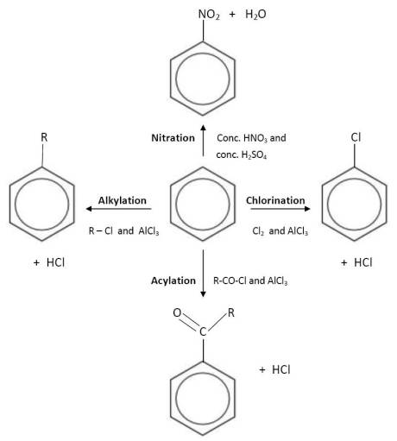
Substitution Reactions of Benzene

Slide 8
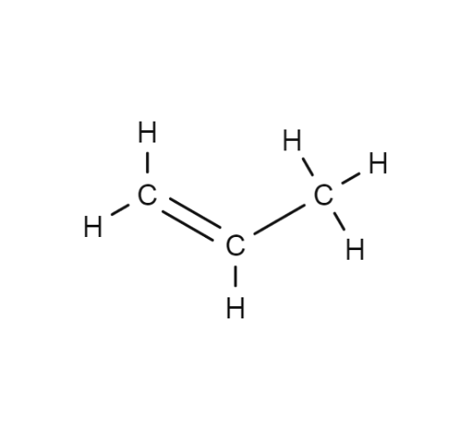
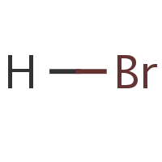
Electrophilic Addition Reactions
Consider symmetric and asymmetric alkenes
Markonikov’s rule states:
When hydrogen halides add to asymmetric alkenes, two products are possible
The halide will add to the carbon with the most alkyl substituents
What are the possible products and which will be the major product?

Slide 9
Explaining Markonikov’s Rule
Still considering propene:
There are two carbocation intermediates possible, one primary and one secondary (draw these)
Alkyl groups tend to push electrons towards the carbon atom they are attached to, stabilizing the positive charge on the carbon (positive inductive effect) 1⁰ < 2 ⁰<3 ⁰ (most stable)
The more stable carbocation is preffered
Also can be used with interhalogens

