Slide 1
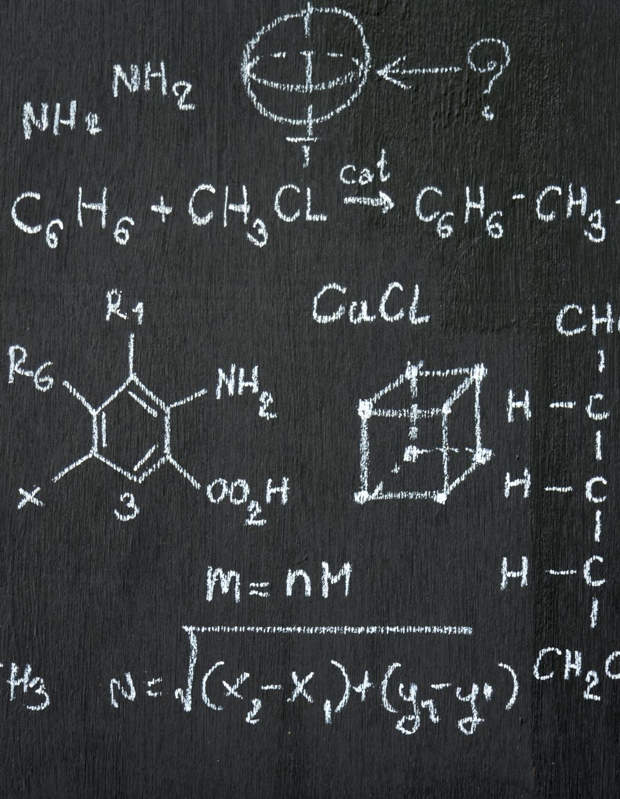
ENTROPY AND FREE ENERGY
The general tendency in nature is towards disorder
The probability of a state existing is its entropy (S)
Can be measured, unlike enthalpy
The less order, the greater probability of that state and the greater its entropy, making entropy a measure of the degree of order in a system
examples are:
Mixing of different types of particles
Change in state where distance between particles increases
Increased movement of particles (Heating)
Increasing the number of particles(hydrogen peroxide to water and oxygen)
The greatest increase in disorder is usually found where the number of gaseous particles increases
The change in the disorder of a system is called an entropy change (ΔS)
The more disorder, the greater the value
Systems that are become more ordered have negative entropy values

Slide 2
Spontaneity
Spontaneous reactions occur if chemical reactions result in an overall increase of entropy in the universe.
Spontaneity depends upon both enthalpy and entropy changes
The combination of these two factors can be expressed as Gibbs energy change (ΔG)…a.k.a. the free energy change
The standard fee energy change (ΔG°) = ΔH° - TΔS°
Spontaneous reactions must be able to do work (from a less stable to more stable state); therefore, ΔG must be negative

