Slide 1
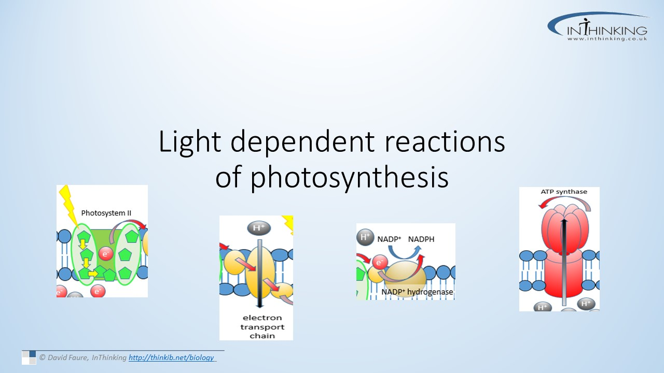

Slide 2
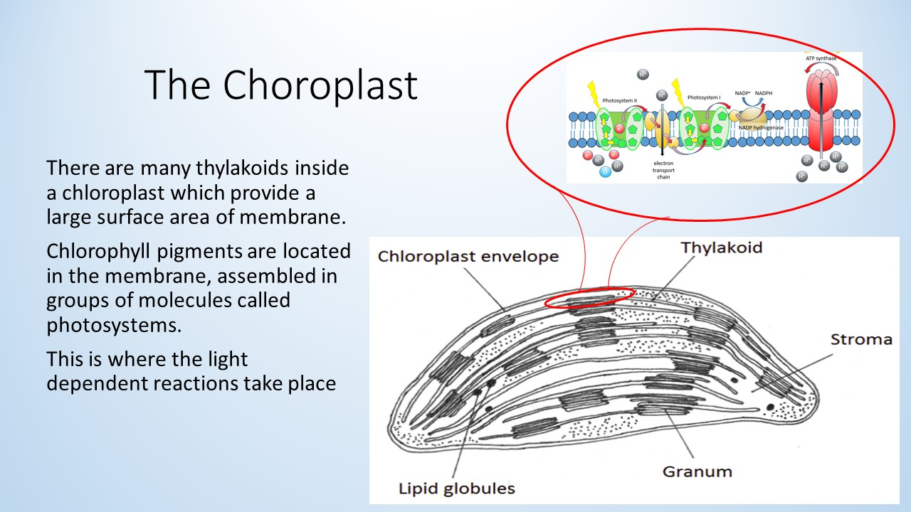

Slide 3
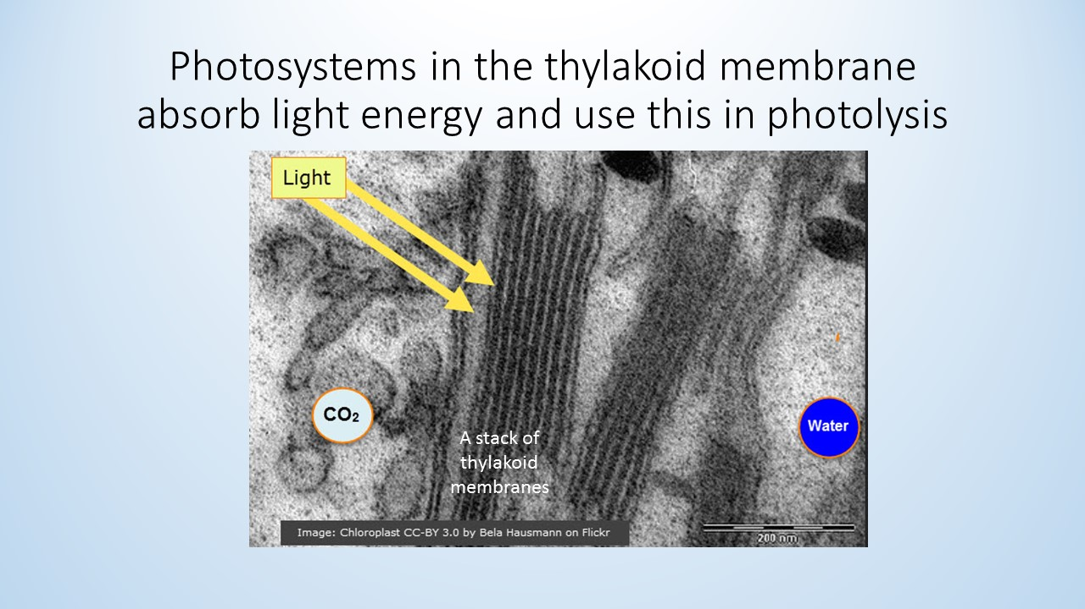

Slide 4
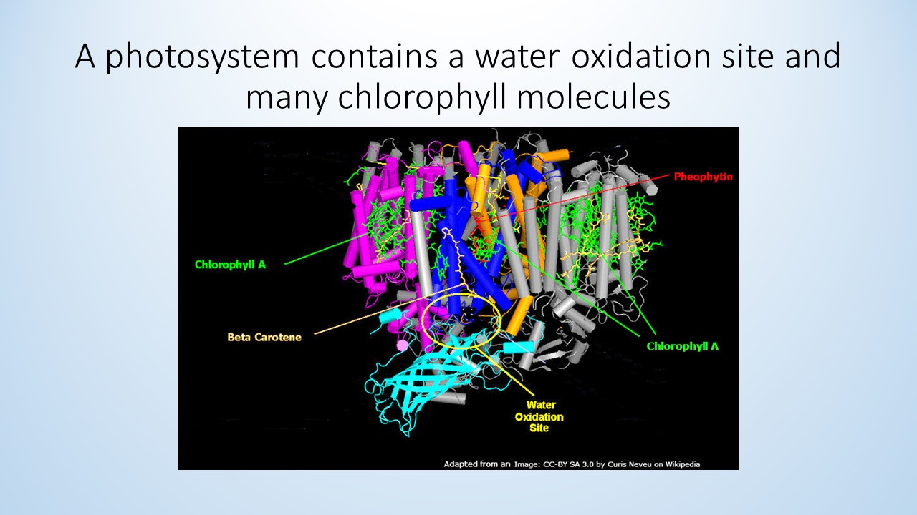

Slide 5
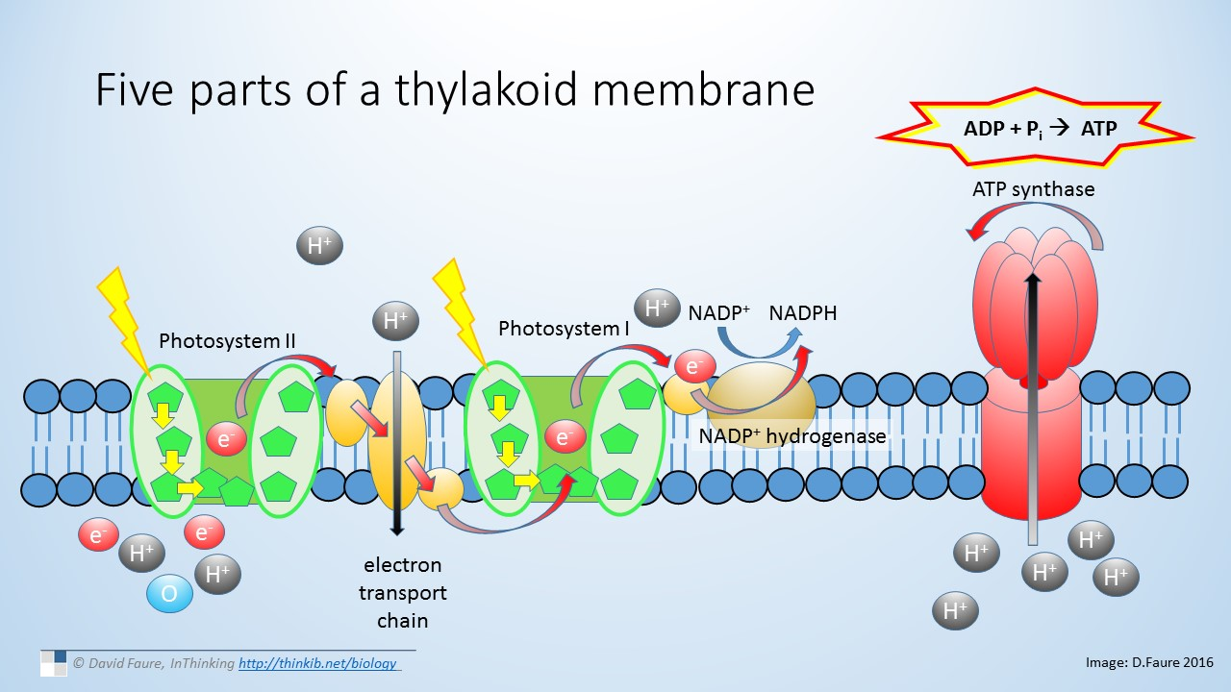

Slide 6
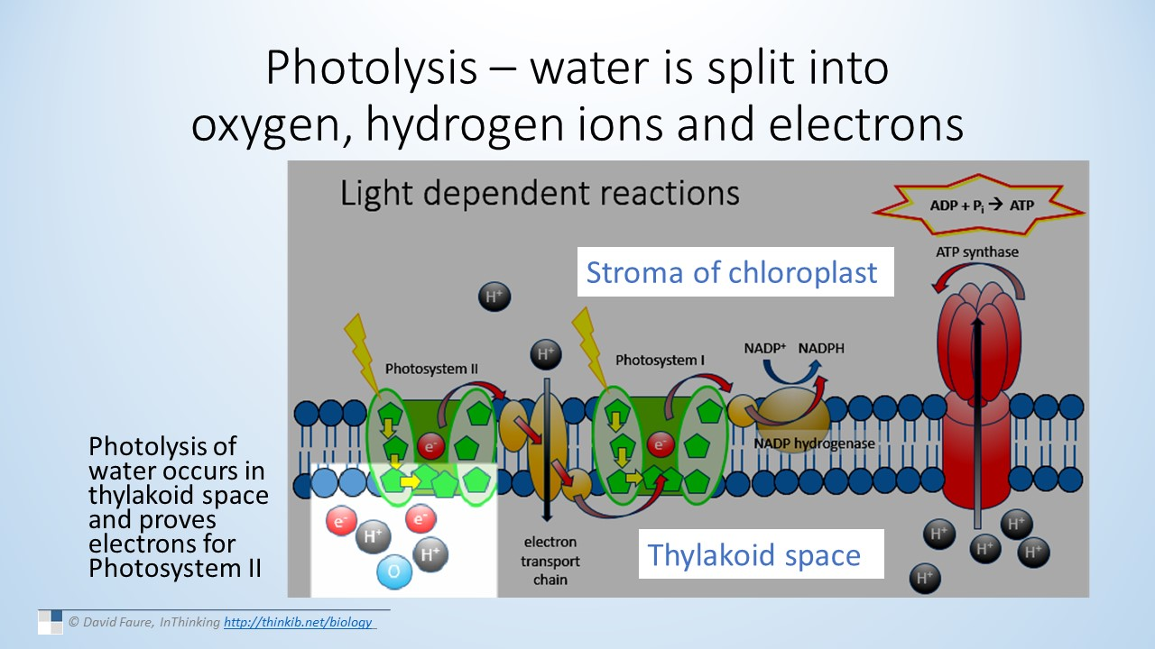

Slide 7
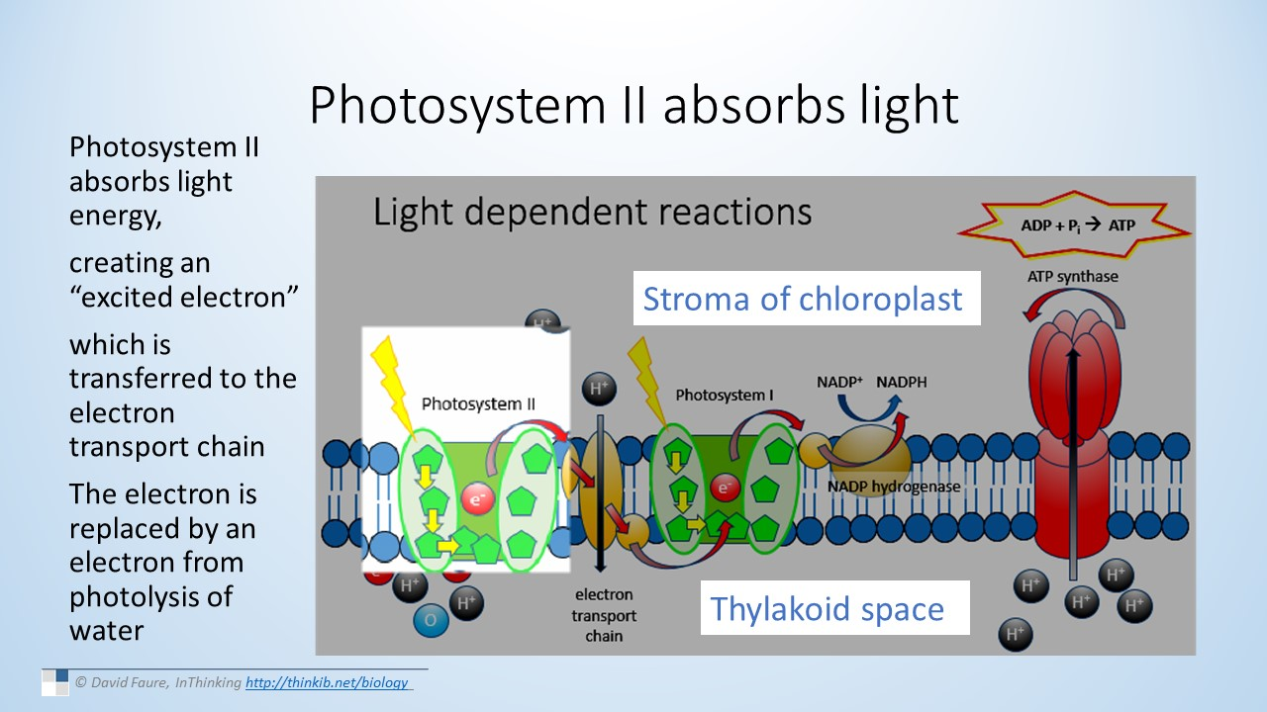

Slide 8
PRODUCTION OF OXYGEN
When photosystem II gives away electrons, it becomes positively charged, and very attractive to electrons
Oxygen is produced by the photolysis of H₂O
H⁺ ions are another by product
Oxygen is excreted as a waste product
Photosystem II is soooo
attractive! Especially
after light split us from
H⁺and O
Photosystem II
++
e⁻
Tell me about it. Especially
it lost those other two electrons
e⁻

Slide 9
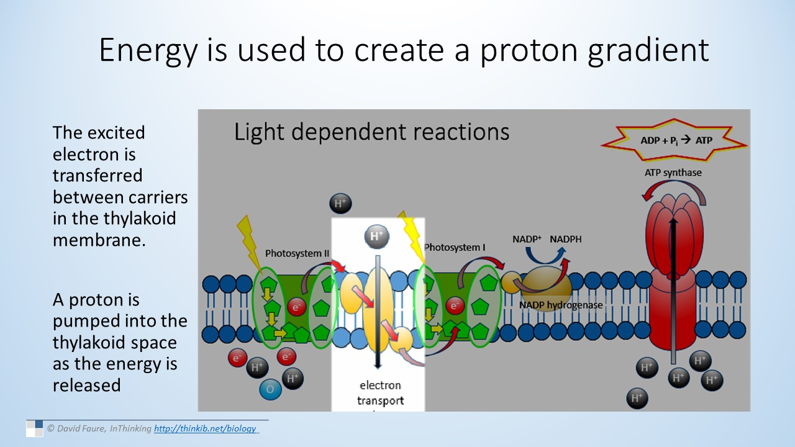
(you have seen something similar before!)

Slide 10
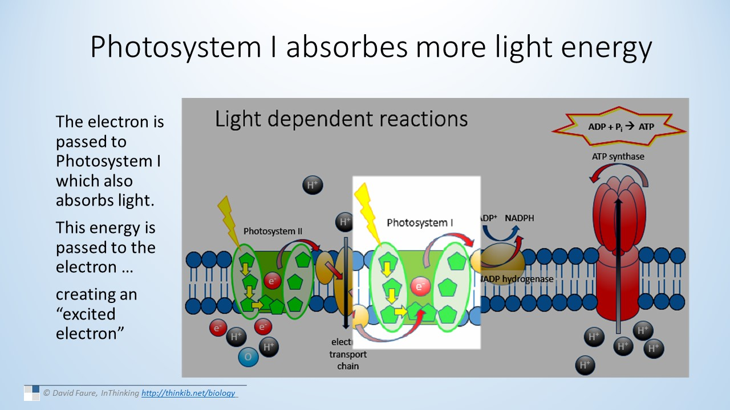

Slide 11
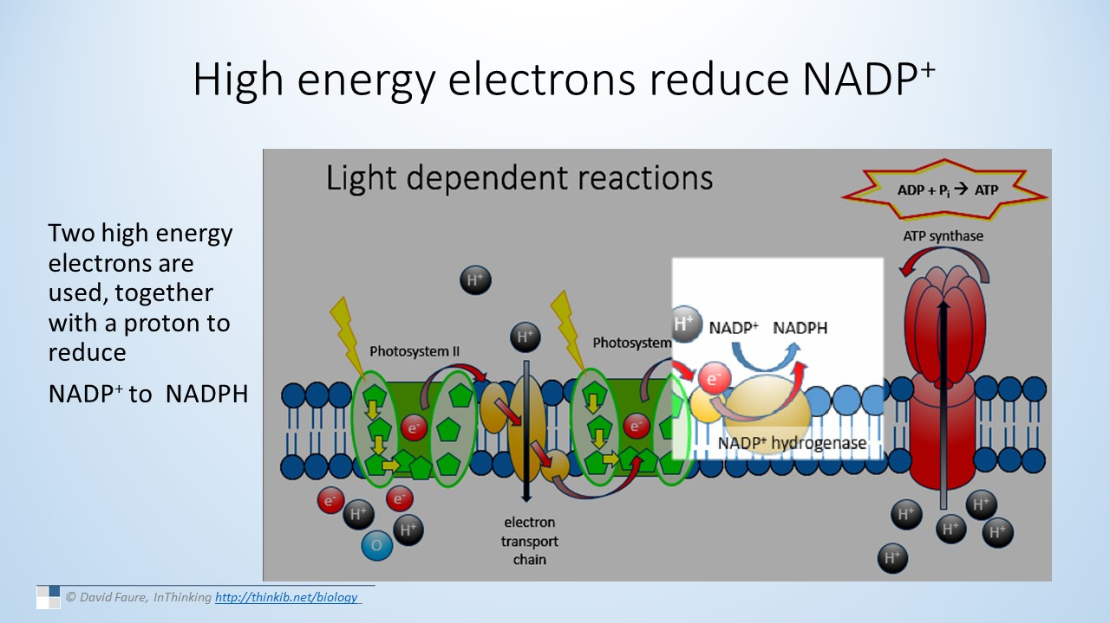

Slide 12
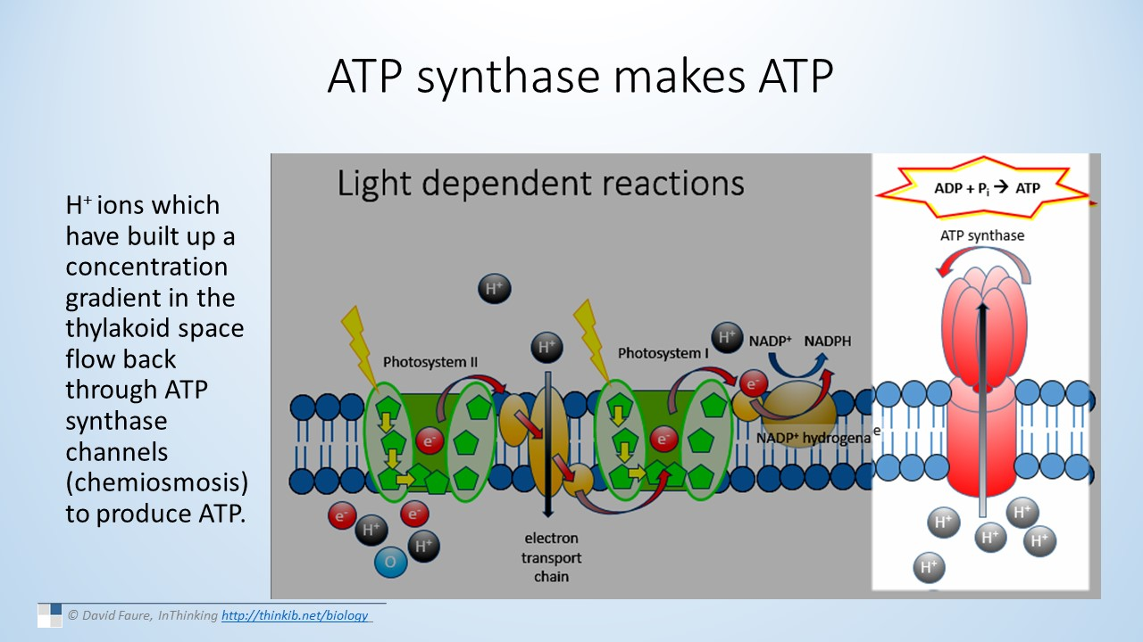

Slide 13
LIGHT-DEPENDENT REACTIONS: A SUMMARY
When light strikes a chlorophyll molecule, electrons are excited and move to a higher energy level.
In the thylakoid membranes (surface area)
Photosystems contain great amounts of chlorophyll
Electron flow is coupled with H⁺ ions pumped across thylakoid membrane, forming gradient
ATP formed (ATP synthase)
Two of these will reduce NADP+ to NADPH
e⁻
chlorophyll
Light excites electrons in chlorophyll

Slide 14
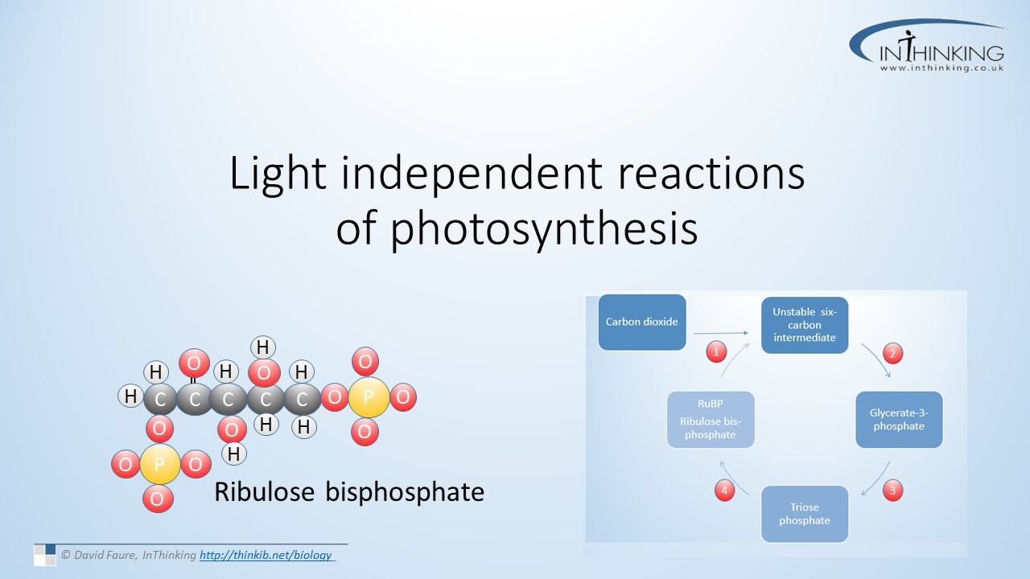

Slide 15
CALVIN CYCLE
Light-independent reactions taking place in the stroma
RuBP = Ribulose biphosphate, a 5-carbon sugar is both the starting compound and product of the cycle
Addition of CO₂ leads to a 6-carbon compound, or two 3-carbon compounds
6-carbon compound may eventually form glucose phosphate
When CO₂ enters chloroplasts by diffusion, it combines with RuBP= carbon fixation
Catalyzed by the enzyme rubisco
  Large amounts of this available in stroma

Slide 16
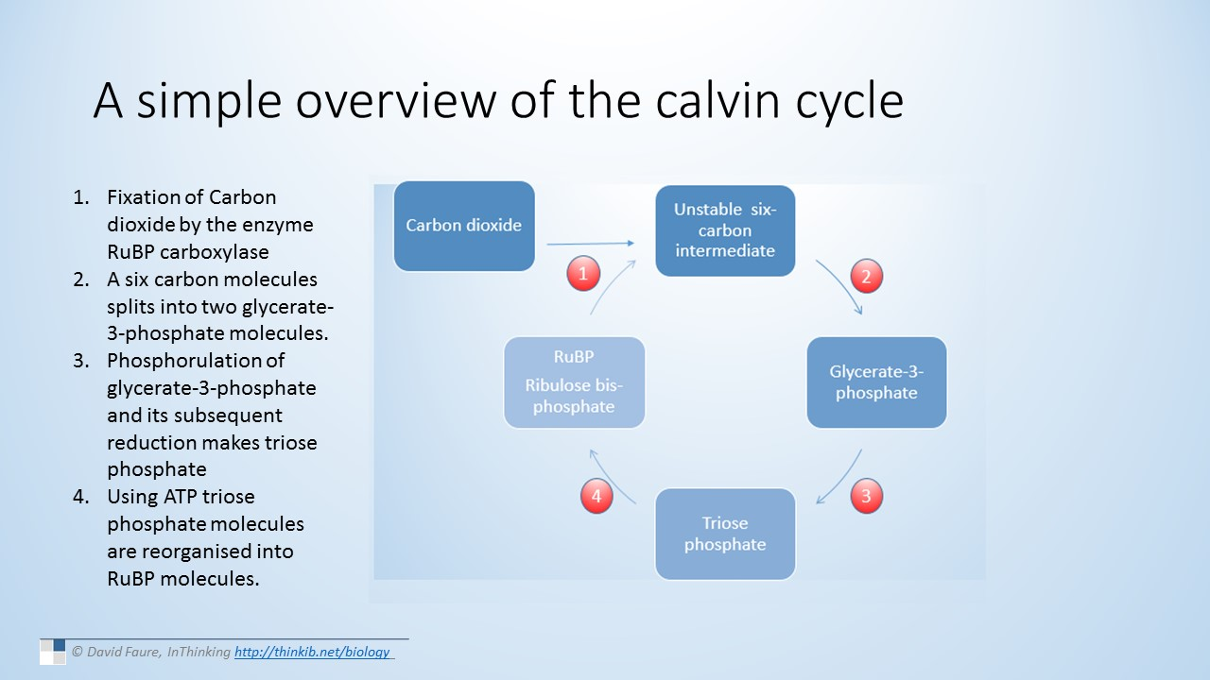

Slide 17
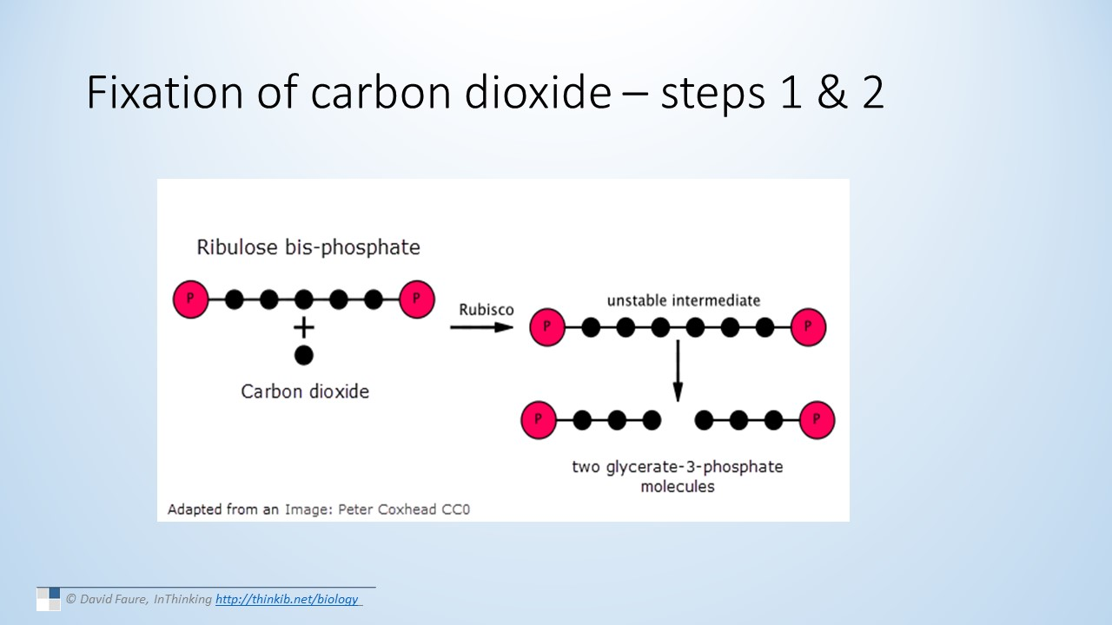

Slide 18
