Slide 1
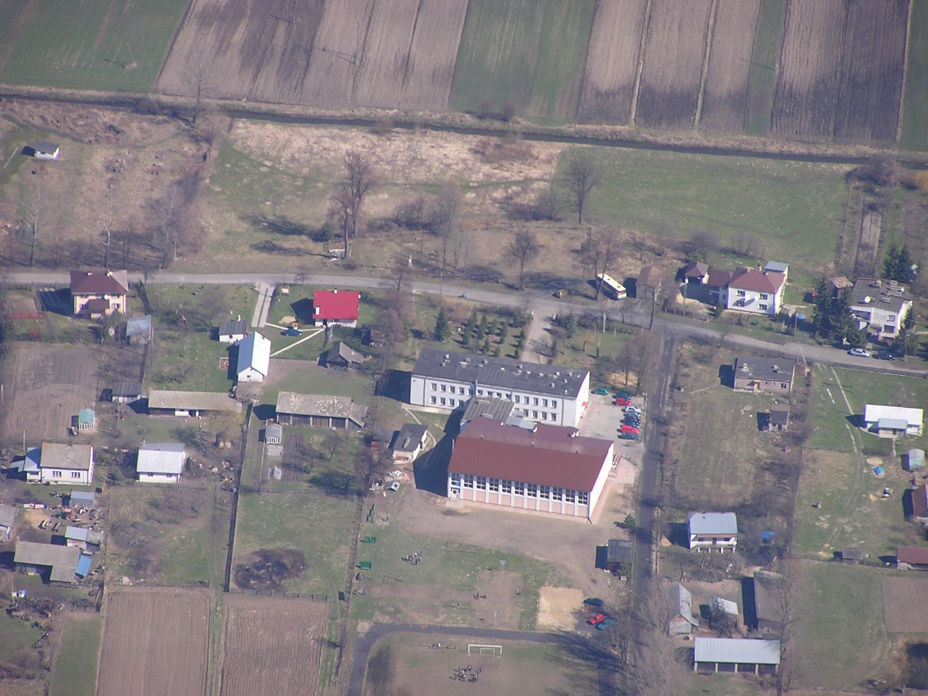
Zespół Szkół Publicznych w Baszni Dolnej

Slide 2
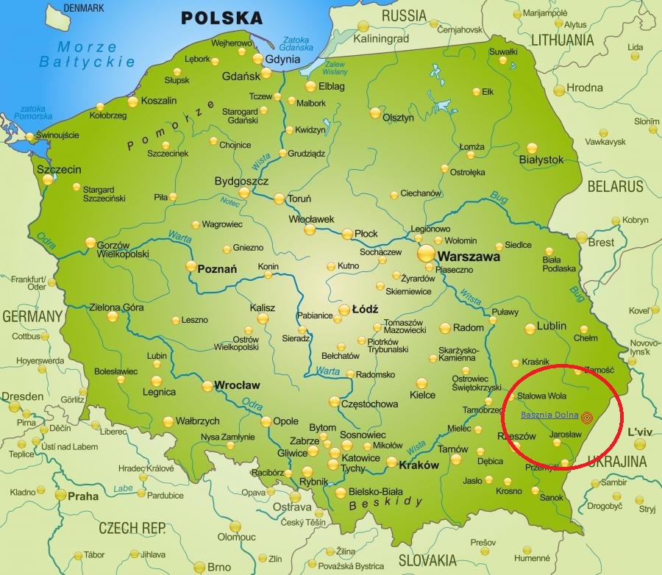

Slide 3
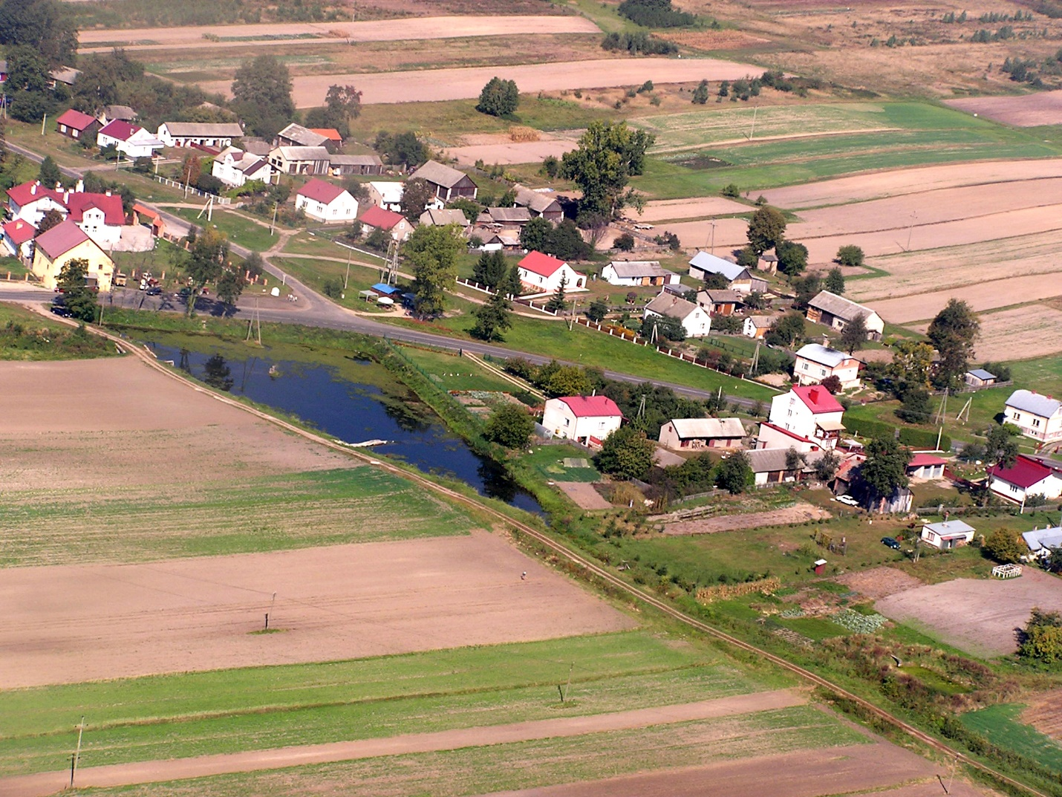
Our school in Basznia Dolna is located in the picturesque village:
in the south-eastern part of Poland,
Subcarpathian Voivodeship
Lubaczów County,
in the Lubaczów municipality situated
on the banks of Sołotwy.

Slide 4
Hi! Here we are - students and our teachers.

Slide 5
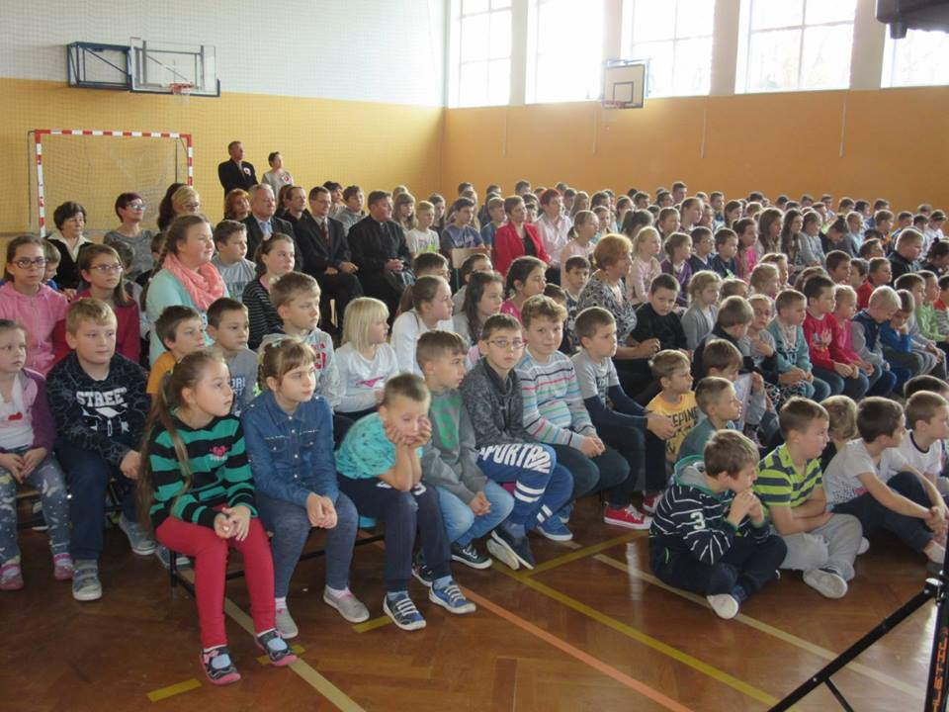
In the Zespół Szkół Publicznych in Basznia Dolna there are:
• Kindergarten,
• Wincenty Witos Primary school
• Henryk Sienkiewicz Junior High School
A place to grow, develop and learn ...

Slide 6
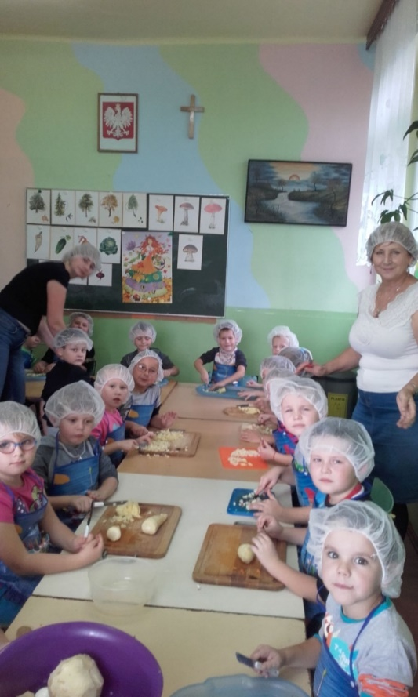
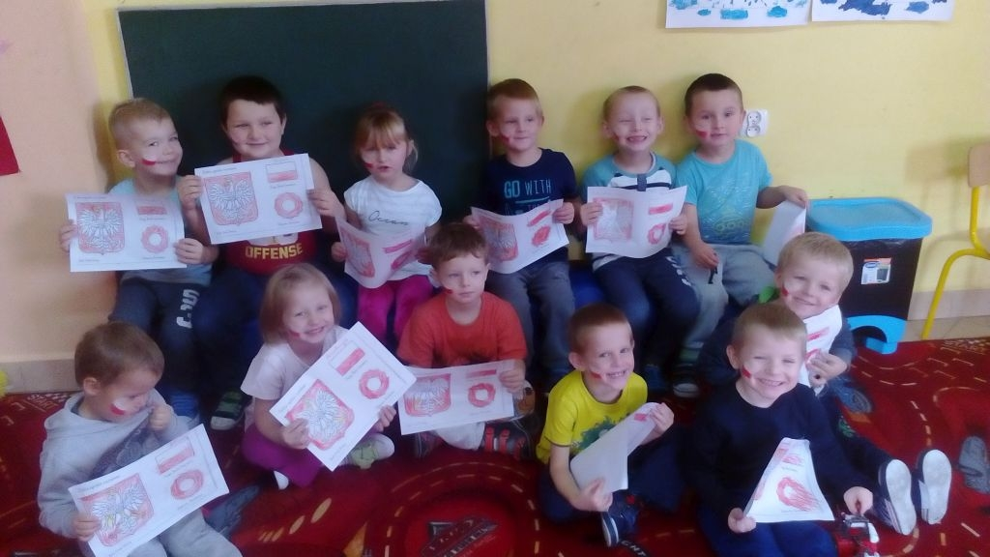
Kindergarten provides our youngest pupils with extensive educational and socializing classes for kindergarten playgroups of:
3-4 years old
5 years old
Class ,, 0 "- preparing a
6-year-old children for compulsory
education
Through fun to knowledge - we like it! ☺

Slide 7
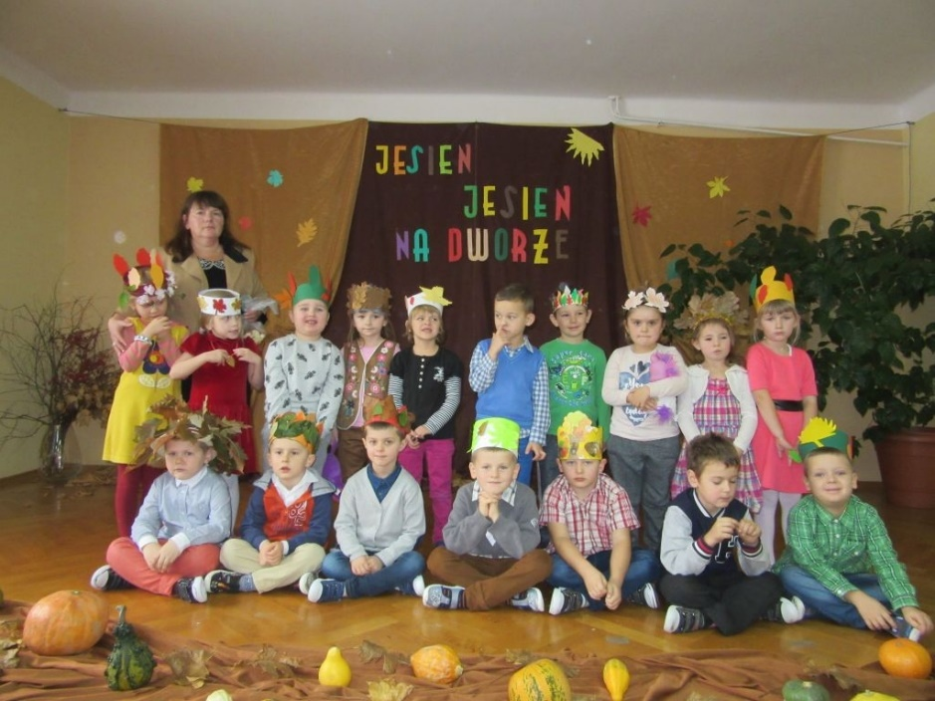
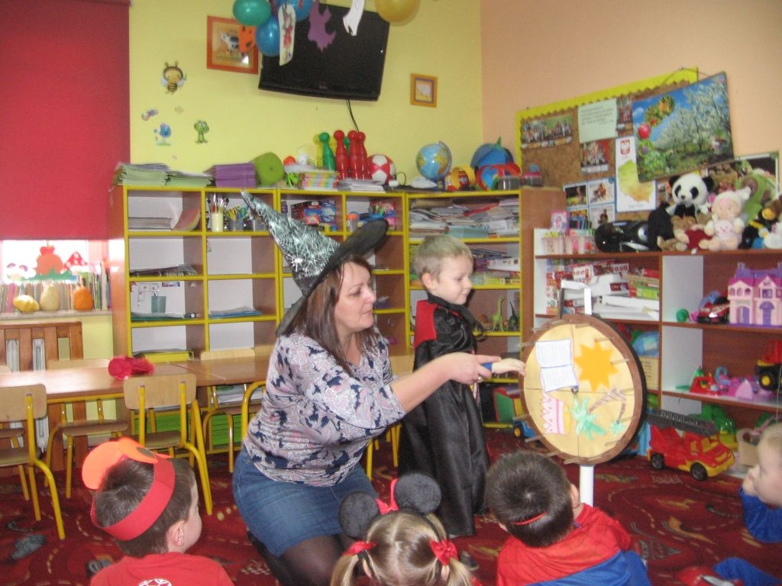
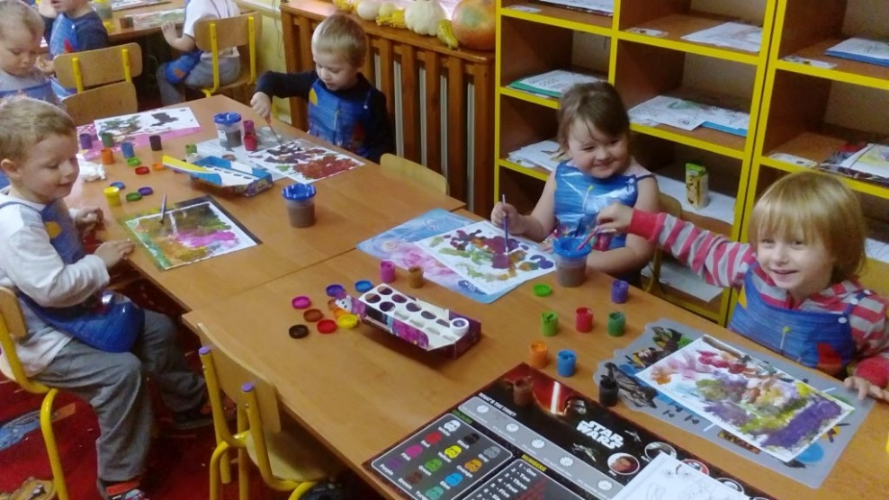

Slide 8
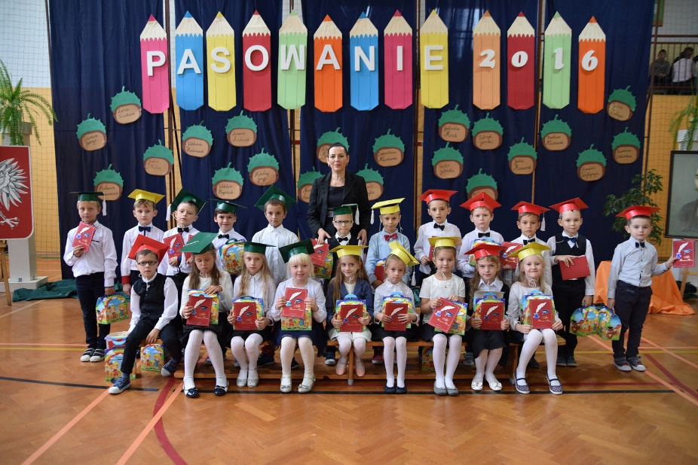
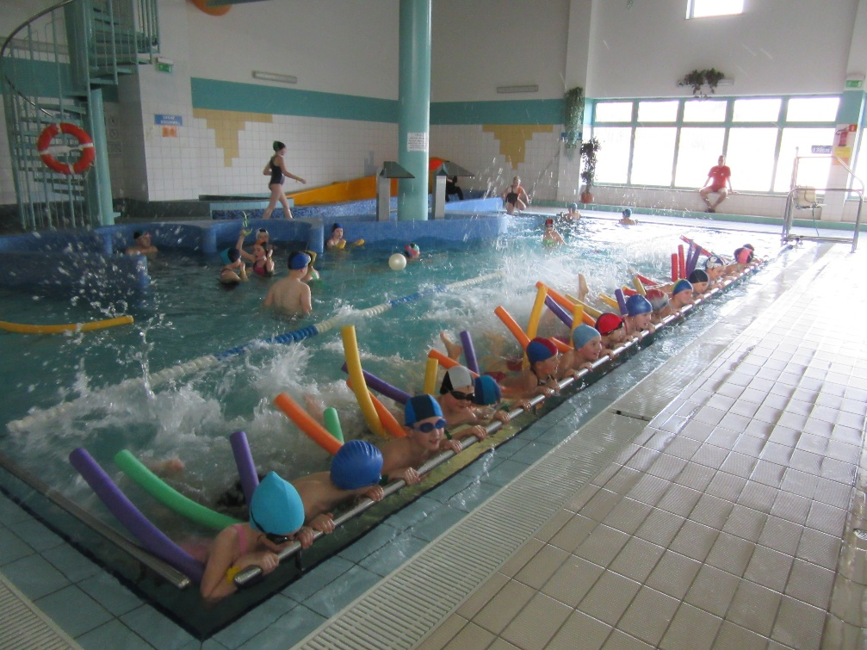
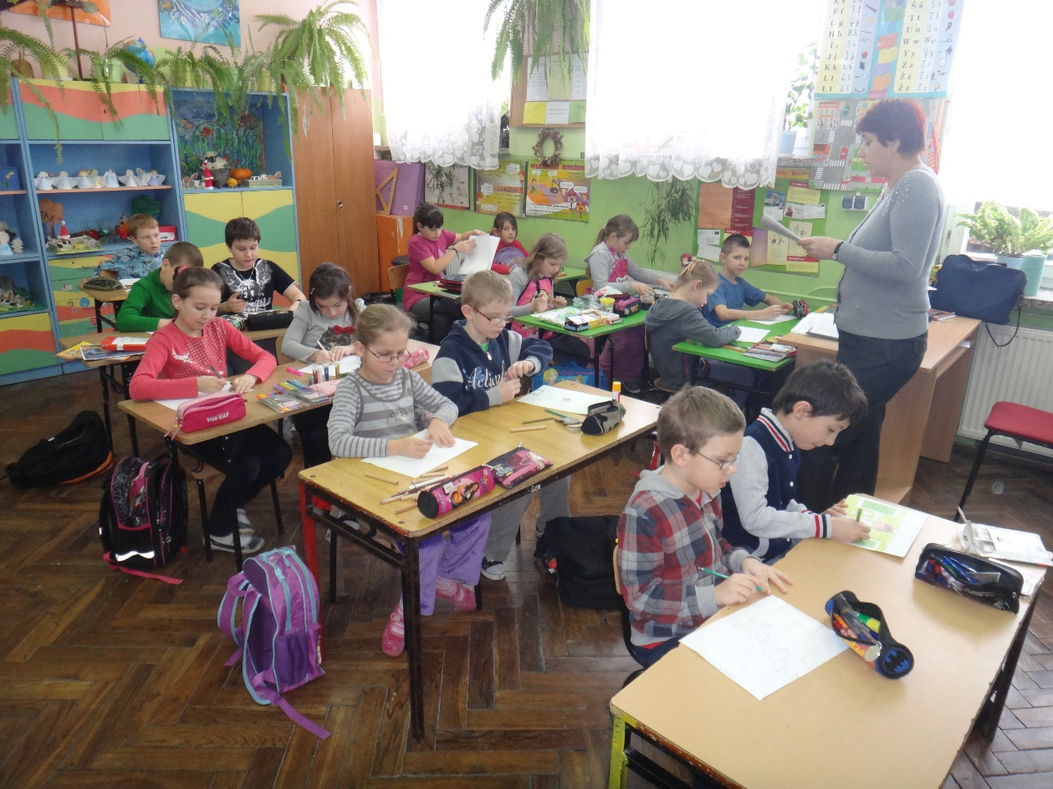
Levels of education in Primary school include:
Class I-III - primary education

Slide 9
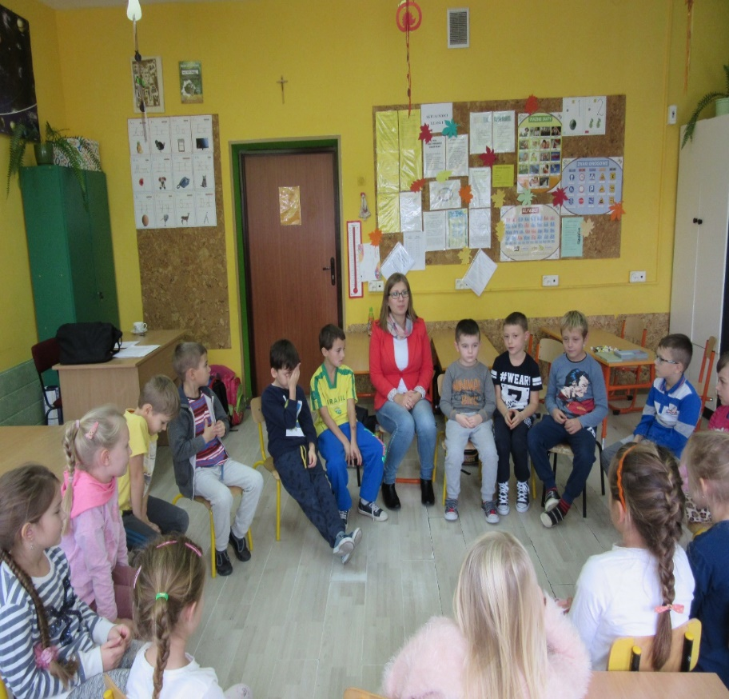
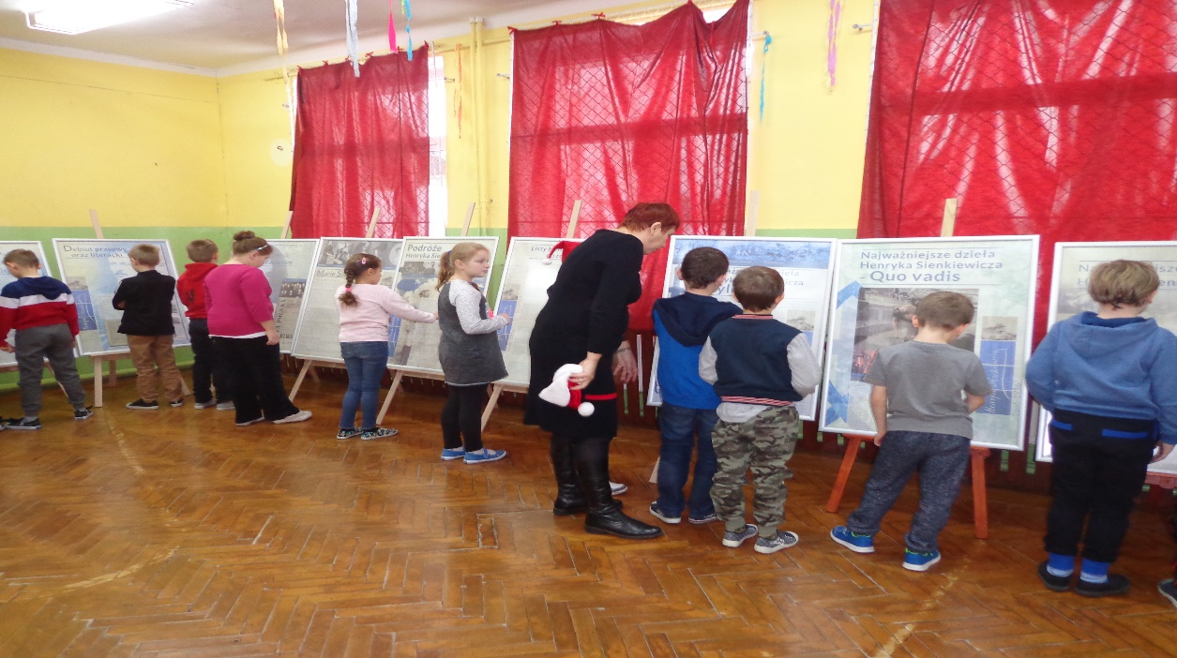
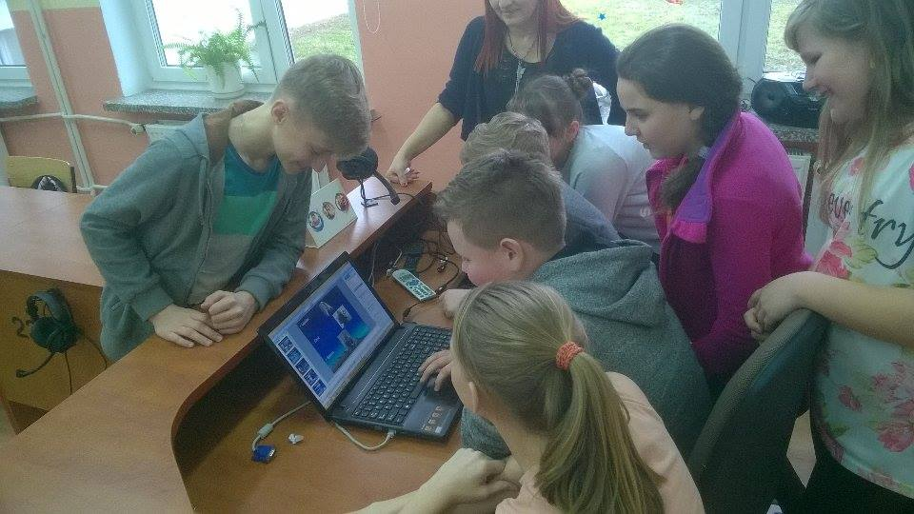
Class IV-VI - system of education, with lessons and classes
being its core elements.

Slide 10
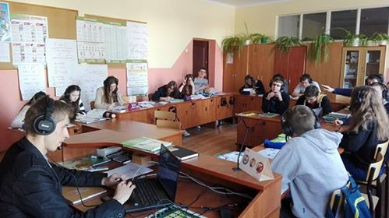
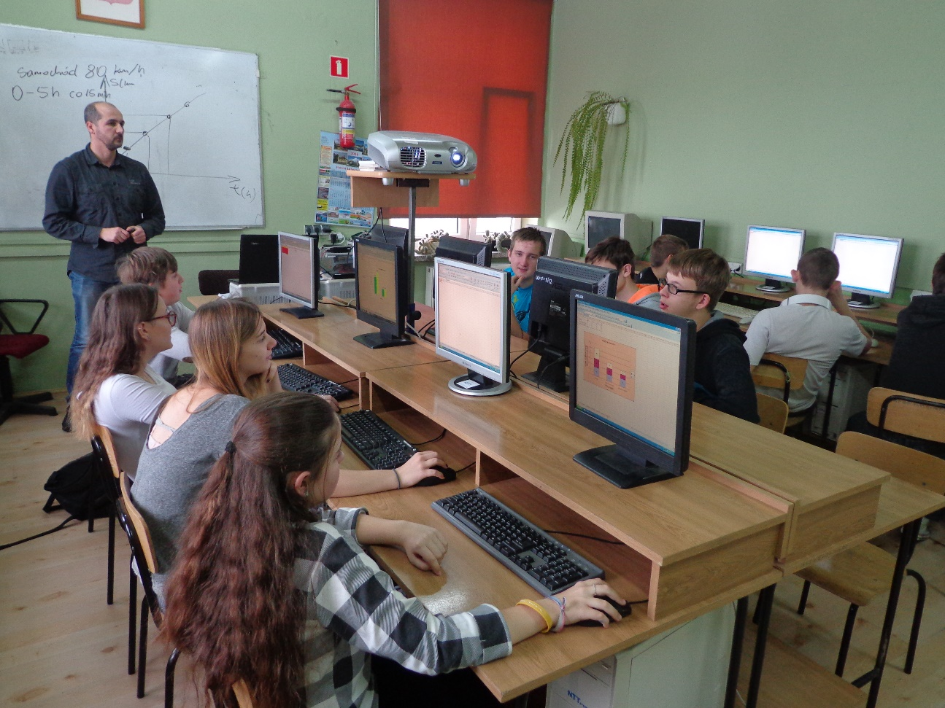
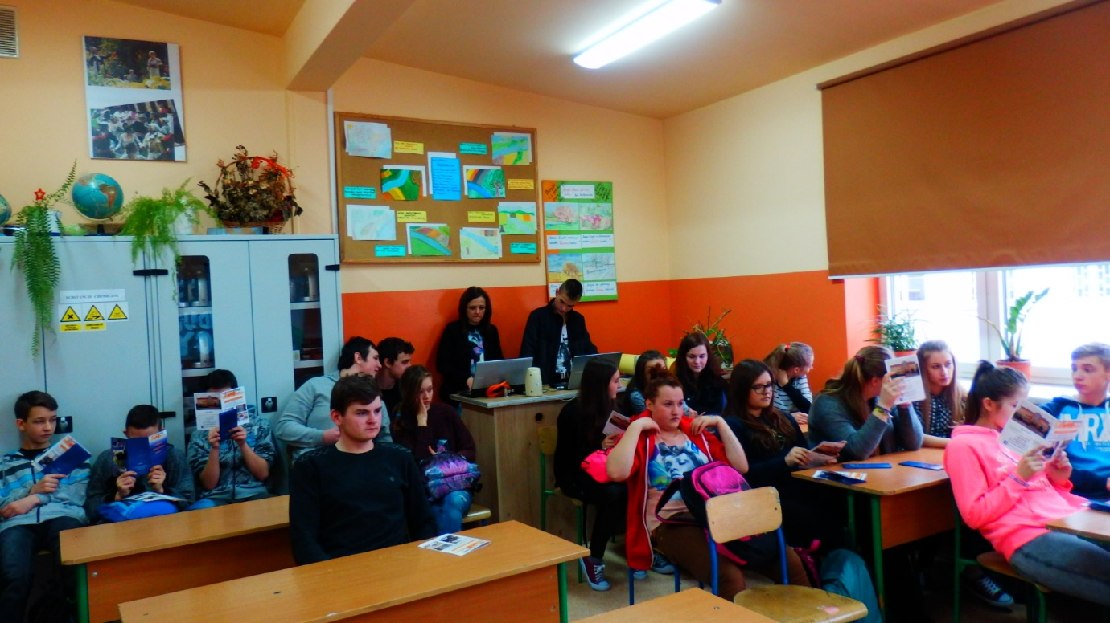
Another compulsory level of education is Junior High School. The core elements of its system are lessons and classes.

Slide 11
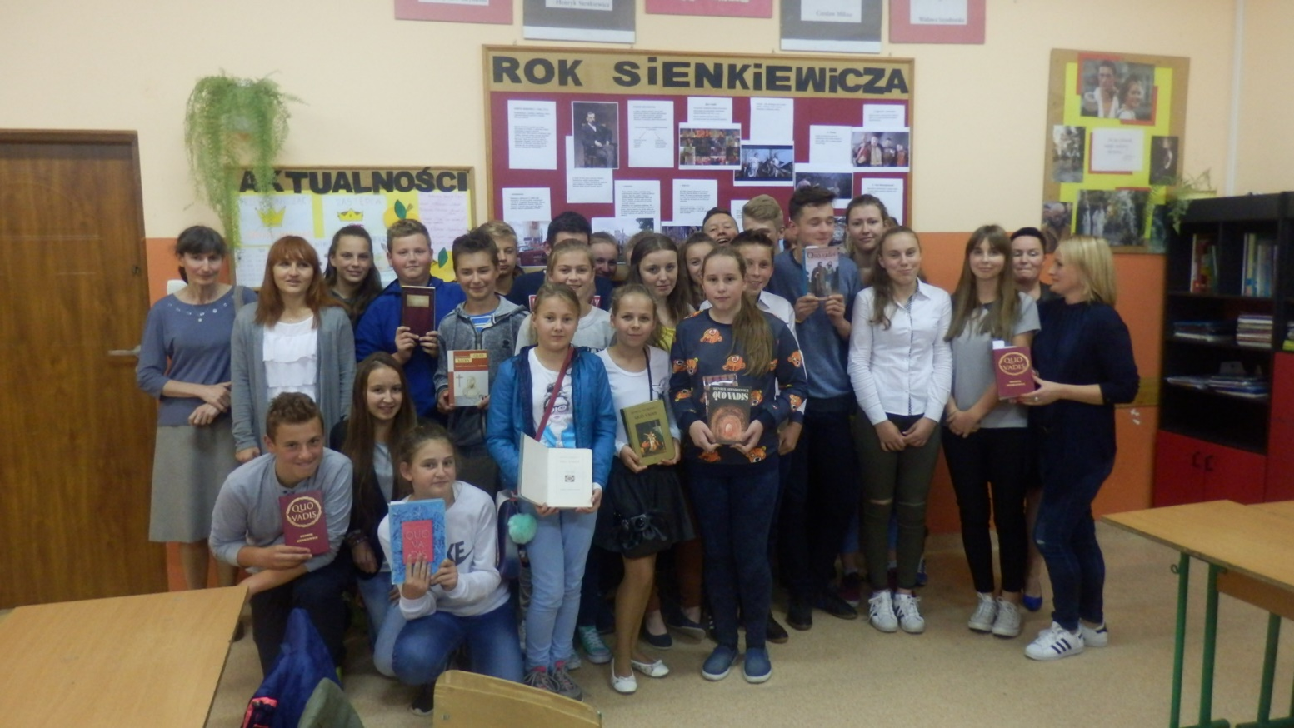
An important part of education is to implement educational projects that develop our interests.

Slide 12
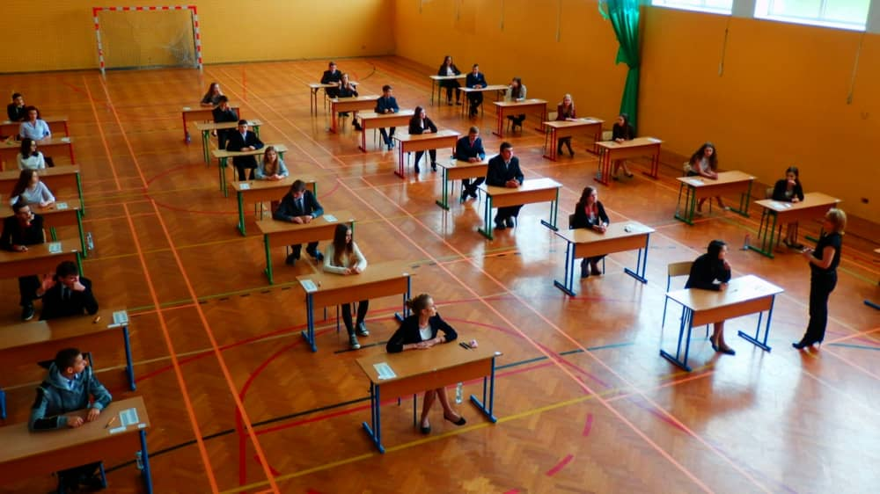
Education in Junior High School ends with external examinations, the results of which determine the subsequent election of schools!

Slide 13
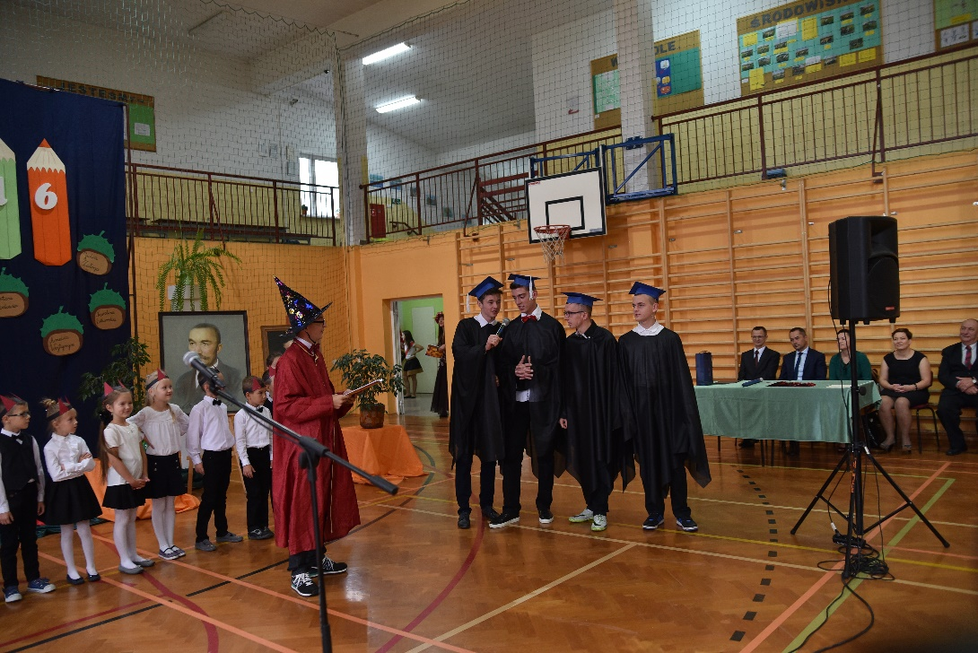
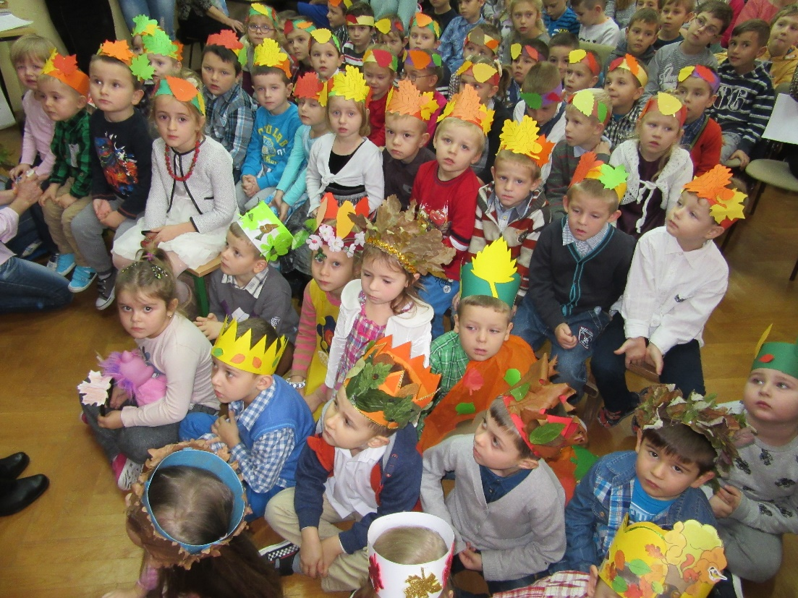
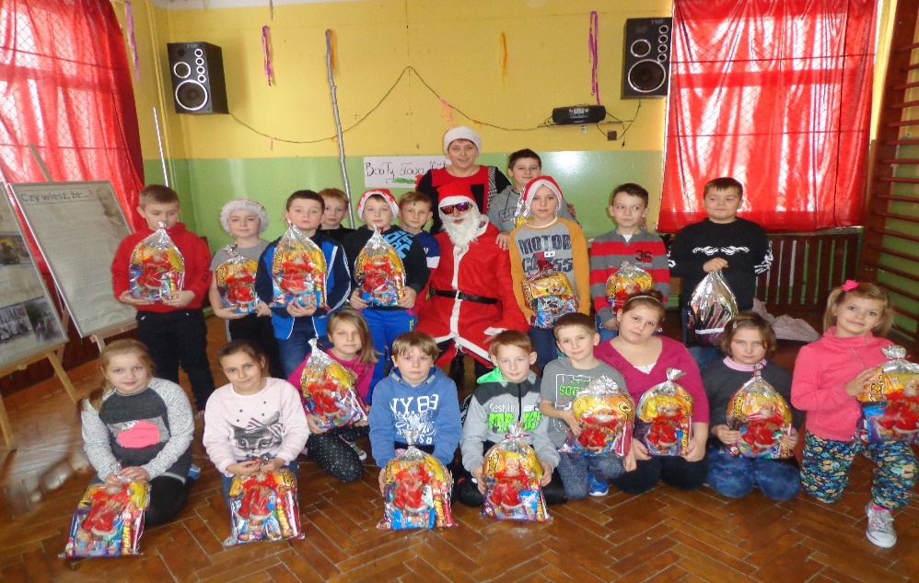
develop our scientific and artistic interests,

Slide 14
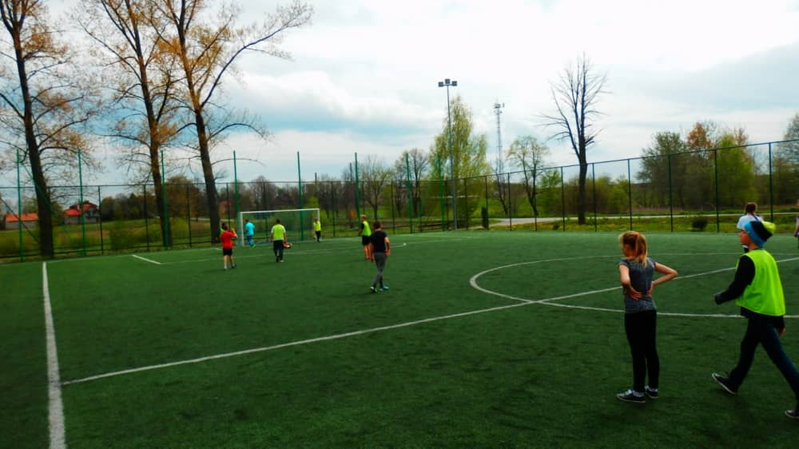
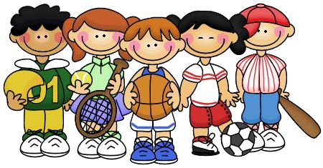
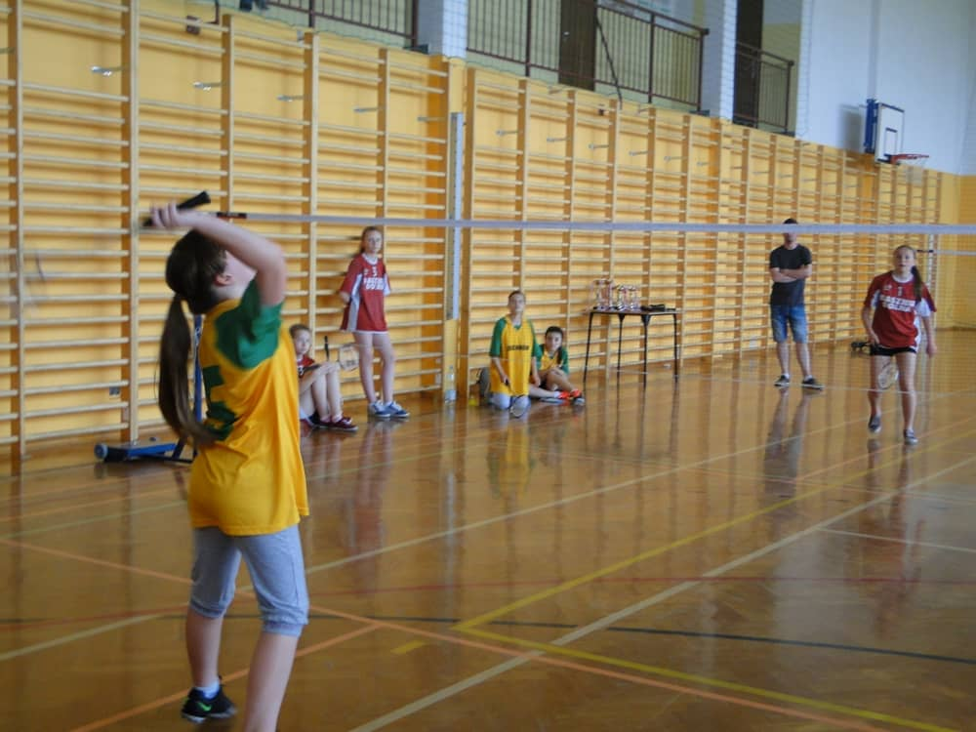
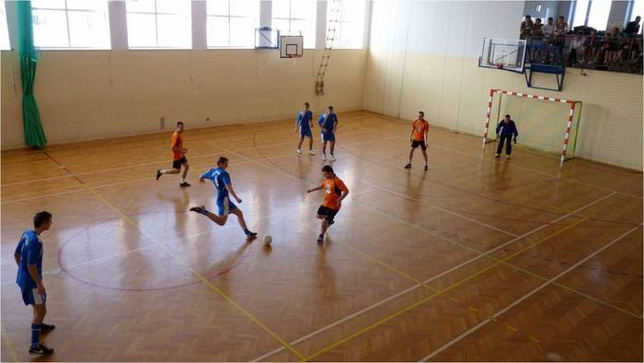
enhance our physical development,

Slide 15
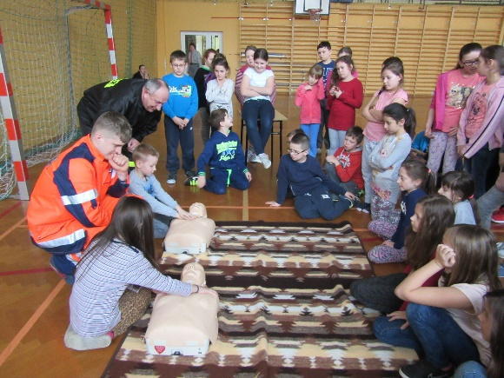
shape our personality and sensitivity,

Slide 16
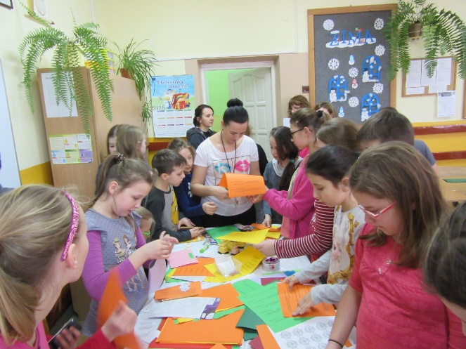
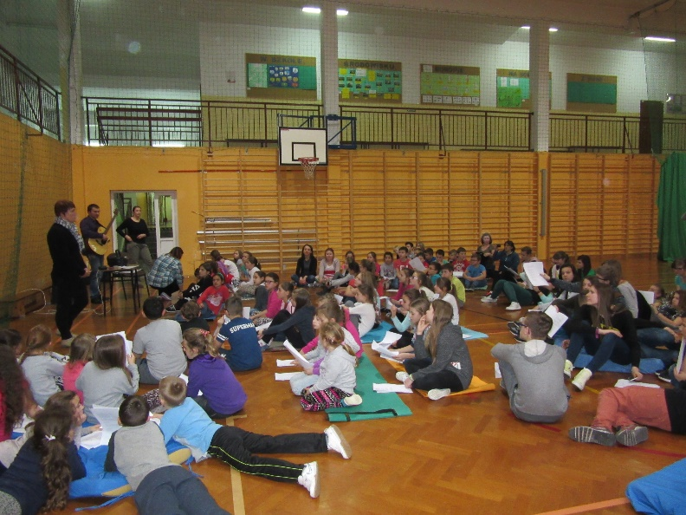
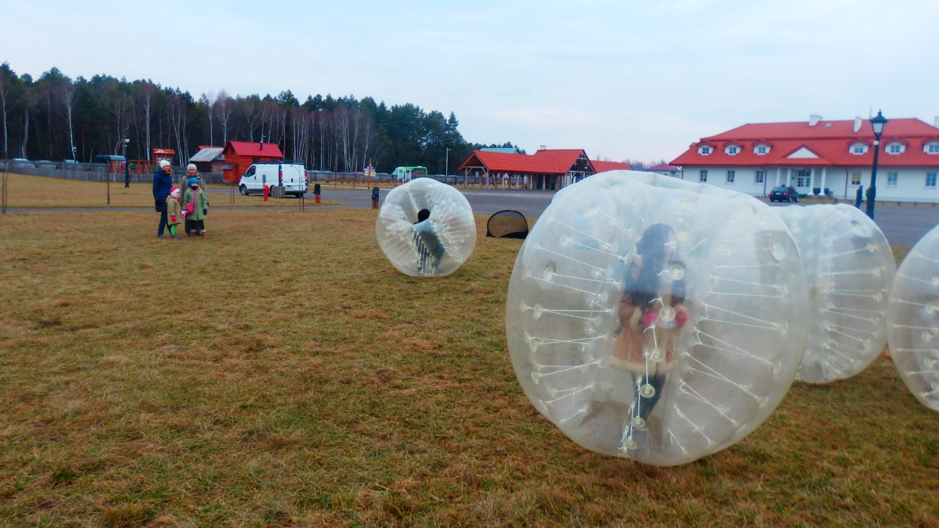

Slide 17
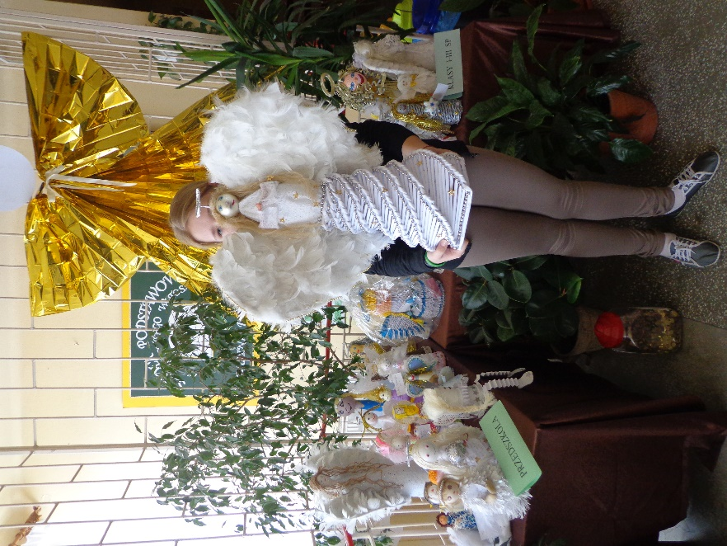
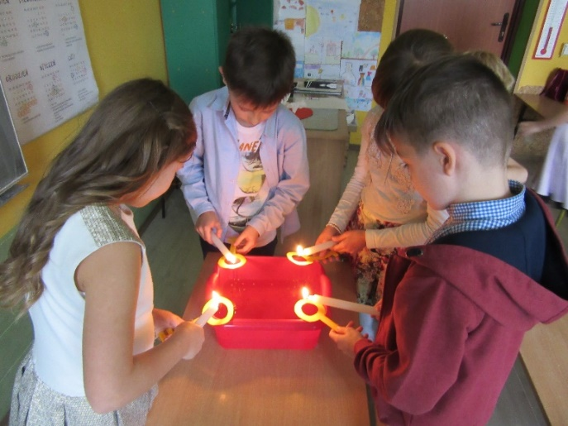
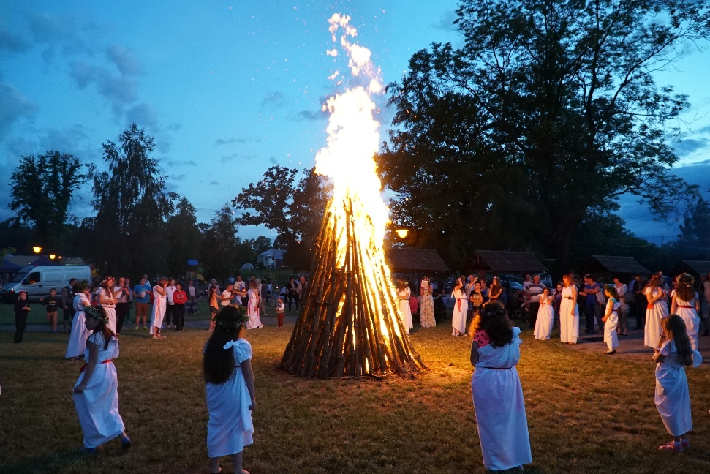
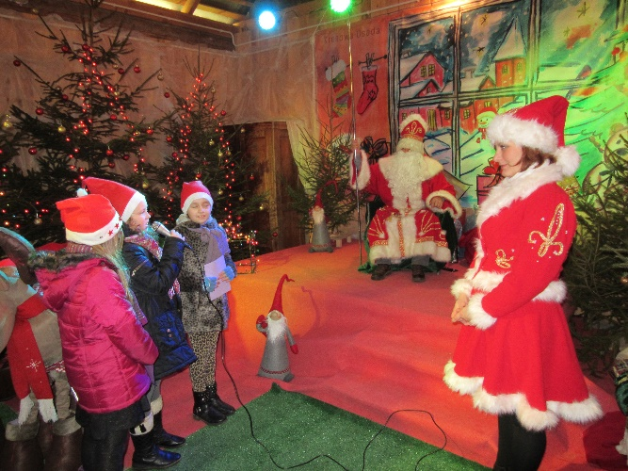
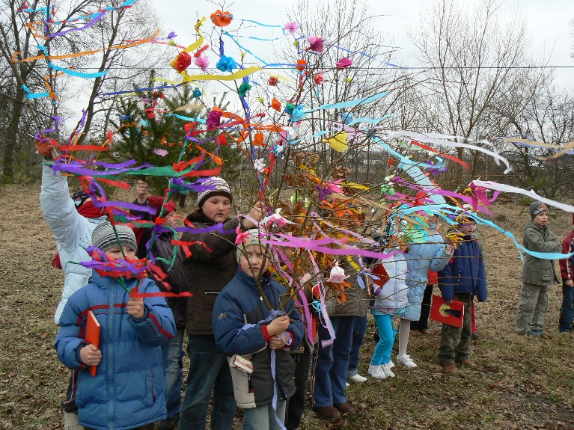
create cultural and social life of the school and surrounding environment.

Slide 18
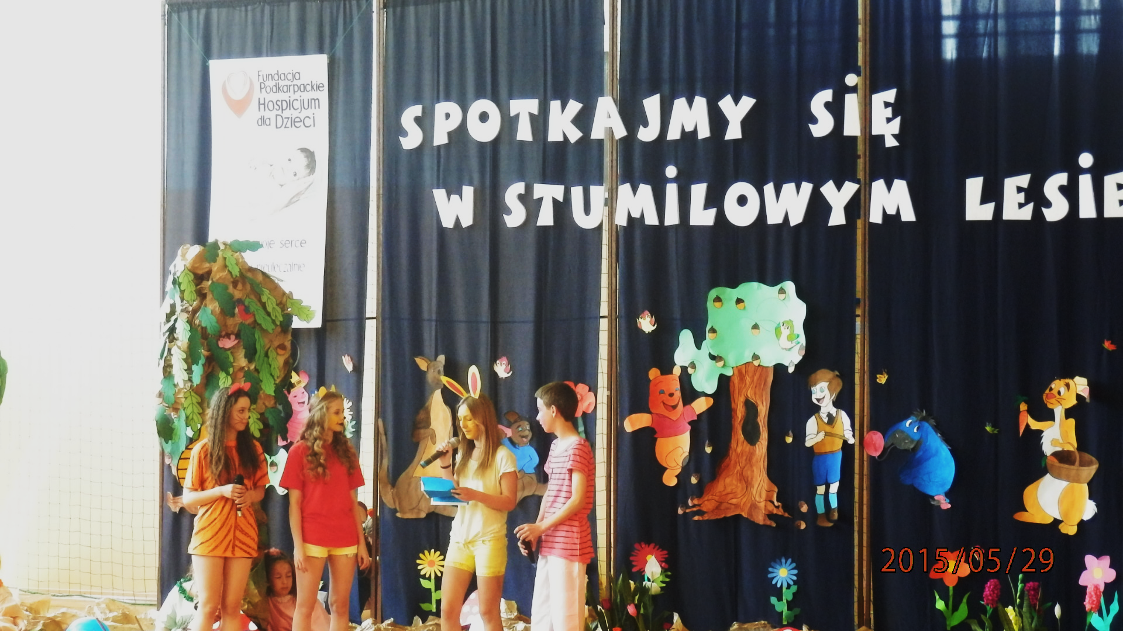
Voluntary
For several years we have been active
in School Club Volunteer ,, Amici "
helping the ones in need,
both children and adults.
During the charity for dependents of
Subcarpathian Hospice for Children in Rzeszow.

Slide 19
We like education outside of the school, like:

Slide 20
Trips to the Wanda Siemaszkowa Theatre and Mask Theatre in Rzeszow for performances and workshops.

Slide 21
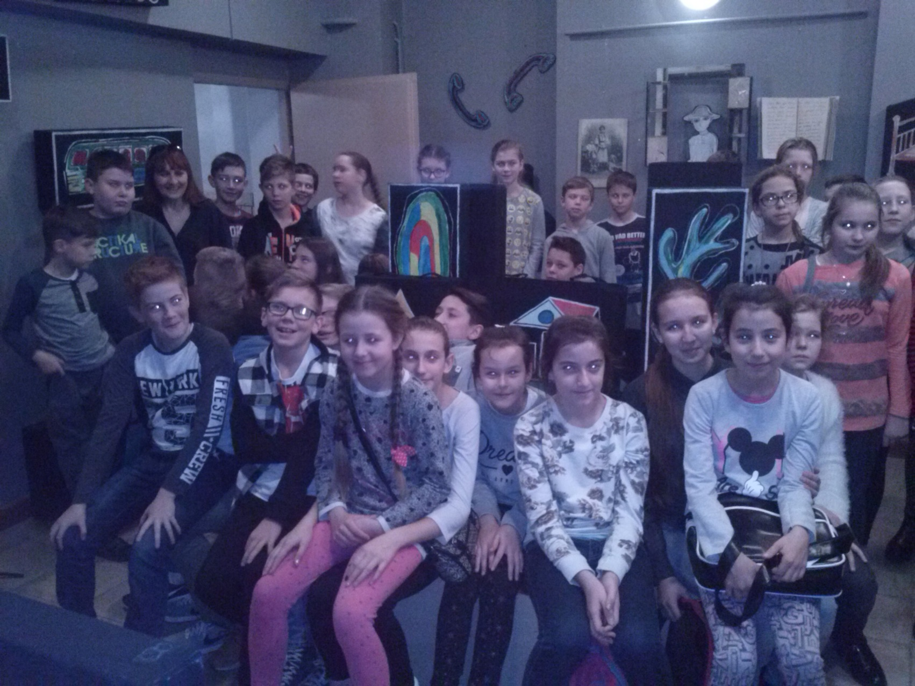
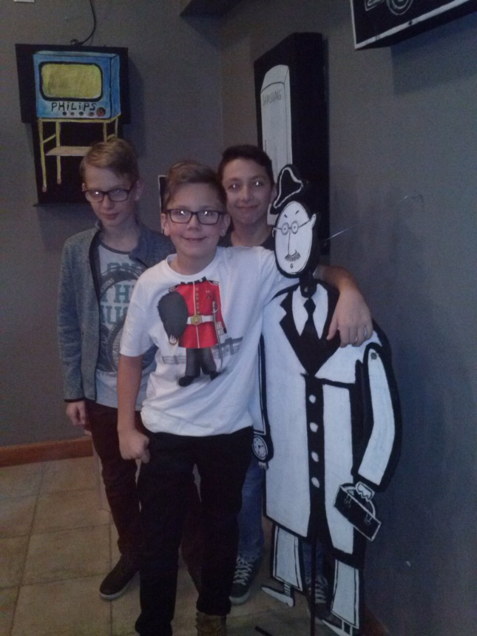
Trips to the cinema to see films, after which we meet for discussions in our Film Club,

Slide 22
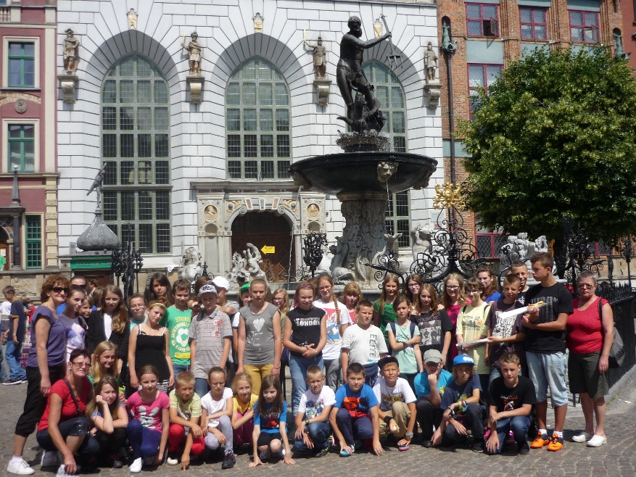
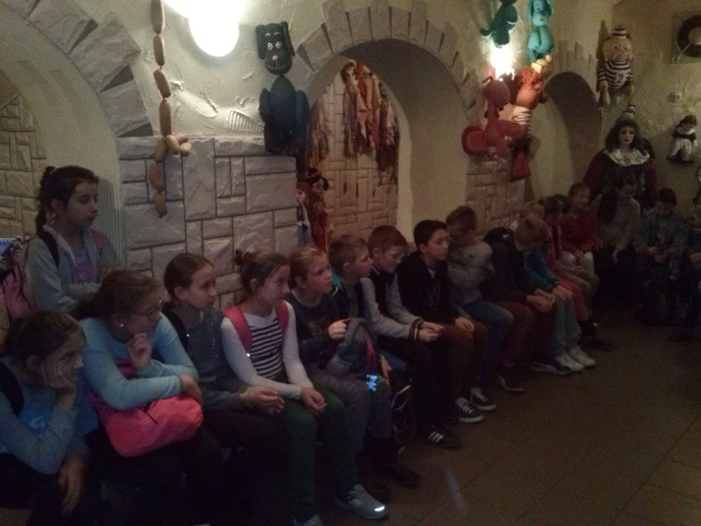
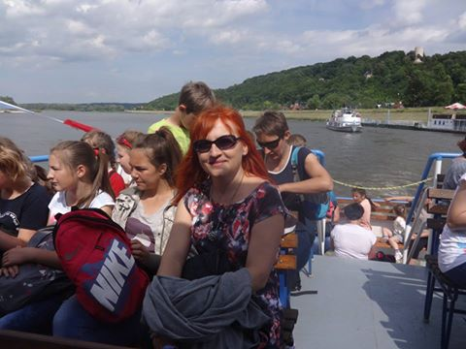
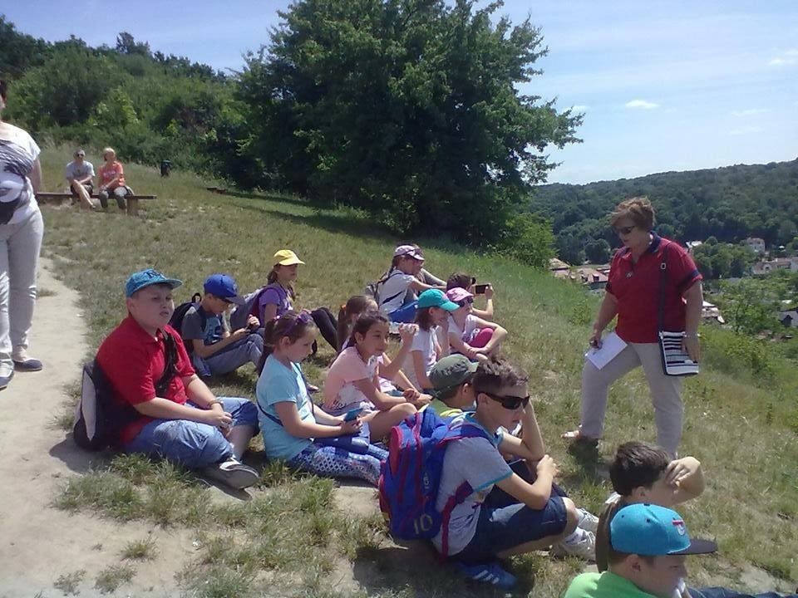
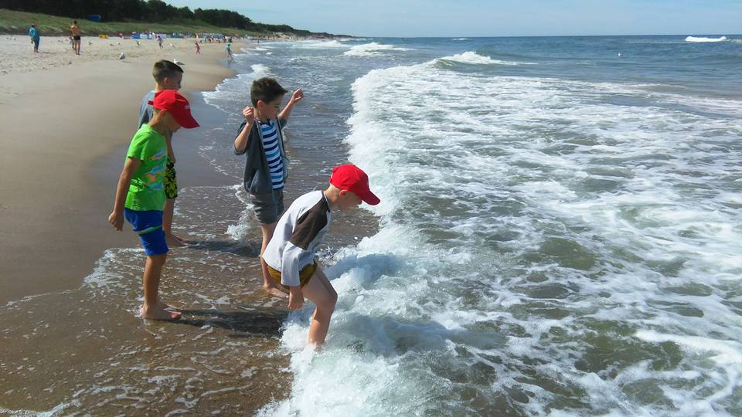
integration trips,

Slide 23
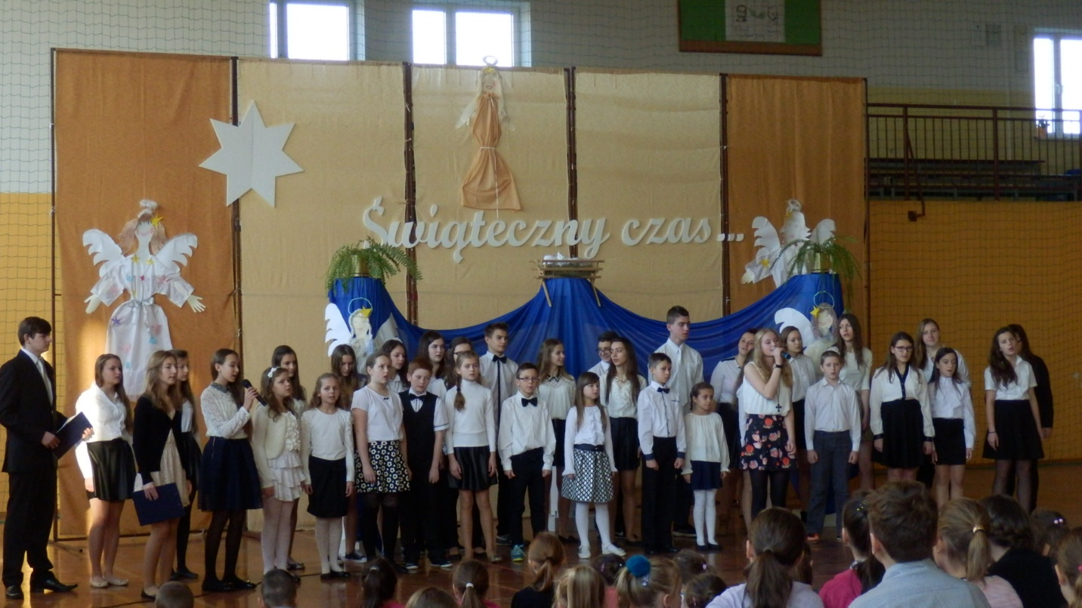
We fulfil ourselves on small and big stages, providing emotions to the recipients and a lot of satisfaction for ourselves. We take part in:
• meetings with interesting people and creators,
• school and national ceremonies,
• charity campaigns and contests,
• undertakings which cultivate culture and tradition.

Slide 24
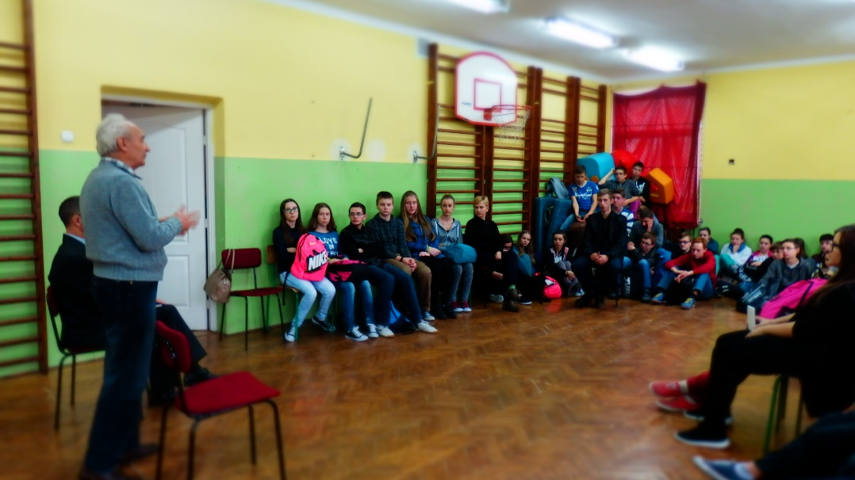
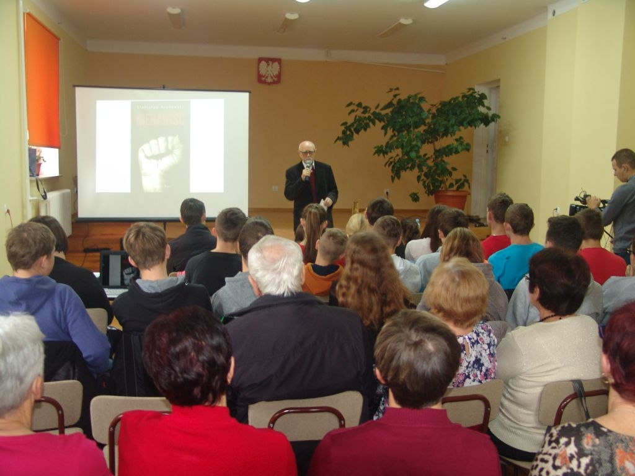
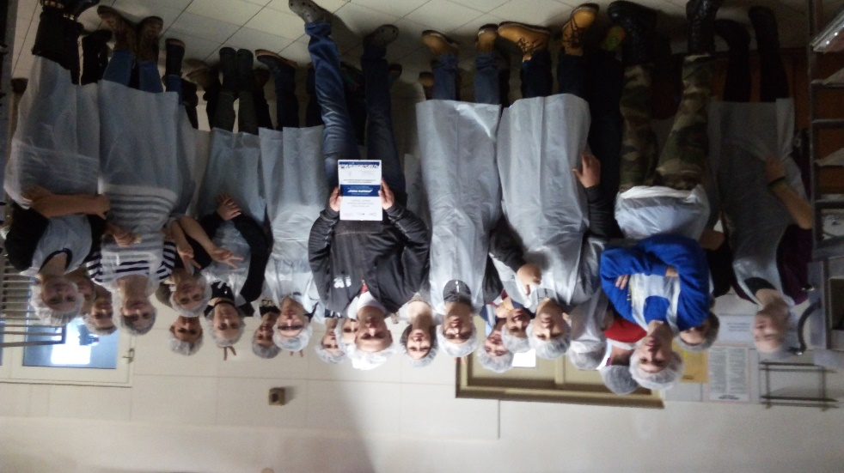
• meetings with interesting people and creators,

Slide 25
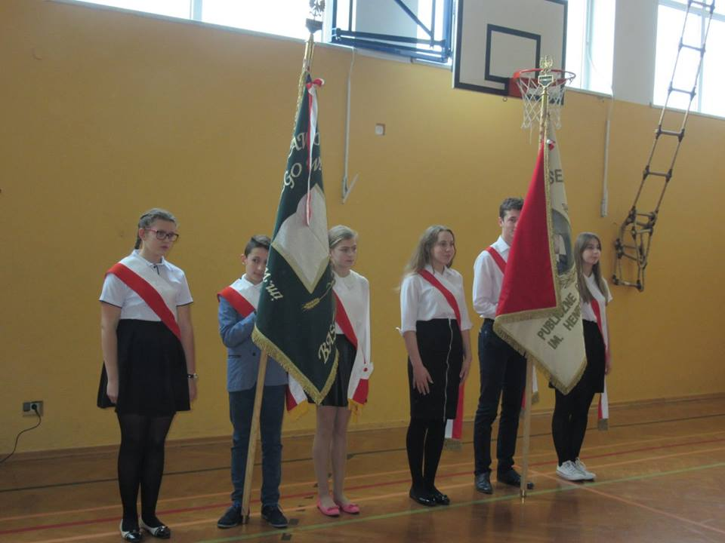
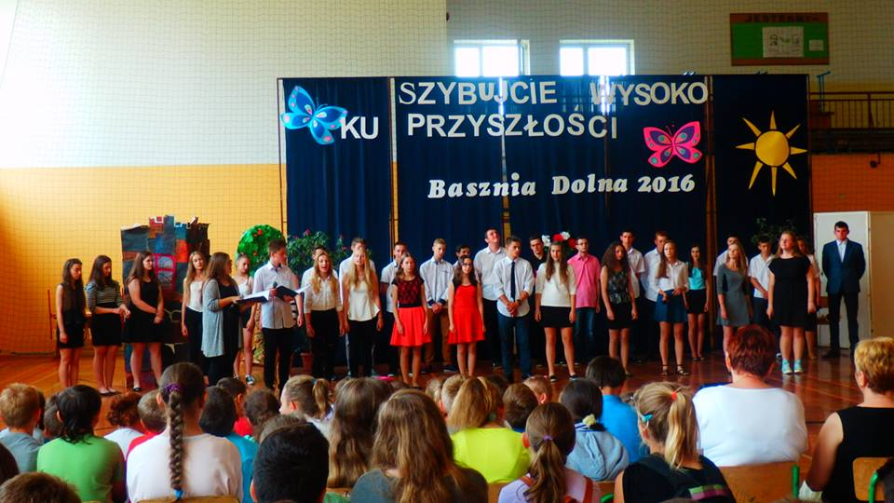
• school and national ceremonies,

Slide 26
• charity campaigns and contests,

Slide 27
• undertakings which cultivate culture and tradition.

Slide 28
Scout-hearted fellows
IX Stout-hearted fellows ,,Green Forest Friends" focuses younger students, who play, work and spend their time together. They participate in various cultural and social events.

Slide 29
Scouting is our strong point. We operate in the 21st Senior-Scouting Division named after Aleksander Kamiński. We care for what’s the best in scouting: Virtue – Honour - Motherland

Slide 30
We protect the environment on daily basics. We participate in ecological events in our school and neighbourhood, for example:

Slide 31
Planting trees,

Slide 32
Clean Up the World,

Slide 33
Waste segregation,

Slide 34
International Mother Earth Day

Slide 35
We have a national certificate: “Health Promoting School”. We proceed according to the slogan: ,, Let's be healthy! - We know, so we operate", so we pay attention to what we eat and how we spend our free time. Our recipe is physical activity from an early age.

Slide 36
We are “Talent Explorer School”. We can pursue their own passions and interests in many areas and forms:

Slide 37
• subject-area competitions and Olympiads,

Slide 38
• sports competitions and tournaments,

Slide 39
• art and music competitions,

Slide 40
• literary competitions, theatre previews.

Slide 41
A ,, Witoski " dance team is operating in our school, which brings together those who like to dance. Here we are acquiring skills to perform basic steps and figures in the social, contemporary and folk dances.
Everyone can try their hand.

Slide 42
Thanks to the programs “Money Saving School” and “Banking Education” we teach our pupils how to manage their finances from an early age. We are doing pretty good. Every year we are in the forefront.
grain by grain and the hen fills her belly

Slide 43
Our sports club “Libero” is very popular. These are our subdivisions:
• Football – boys and girls,
• Volleyball – boys and girls,
• Handball - boys and girls,
• Checkers,
• Athletics.

Slide 44
In conclusion, we would like to invite you all to the unique places in our area, which are worth seeing.

Slide 45
Borderland settlement in Basznia Dolna is a magical thematic village, with Polish, Ukrainian, German and Jewish traditions.

Slide 46
Parrish house in Podlesie is a educational-conferencing center and it was founded on the basis of the former German settlement. Here the past mixes with the present, to plan for the future.

Slide 47
In Radruż there is a Greek Catholic church dedicated to St. Paraskeva from the sixteenth century. At the first contact with the structure we may be surprised by the amount of wood used for its hill. It can be described as ,, wooden council. "

Slide 48
The Borderland Museum in Lubaczow offers constant exhibitions associated with the history of the town and the surrounding area. You can submerge yourself in the past in this place.

Slide 49
See you in Basznia Dolna! Nähdään Basznia Dolna! Uvidime se v Basznia Dolna! Pasimatysime Basznia Dolna! Hasta luego en Basznia Dolna!

