Slide 1
THE ARTS: MUSIC
IB TOK LAJM

Slide 2
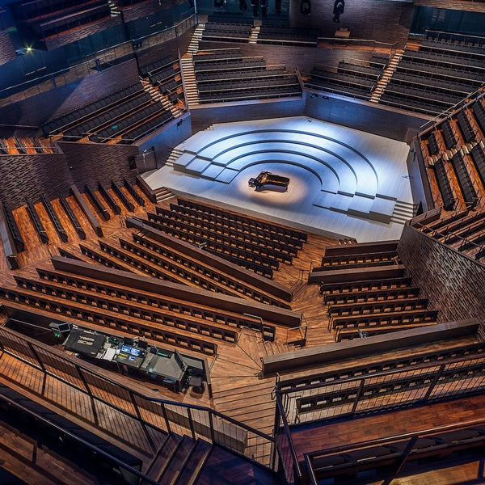
Welcome to the concert hall!
Switch off your cell phone or put it in flight mode
Do not use any other electronic devices either

Slide 3
Piece no. 1

Slide 4
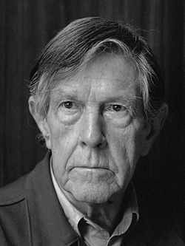
TASK
You just heard a piece called 4’33’’ composed by experimental composer John Cage (1912–1992) in 1952
  Was this piece art?
  If so, on what basis?

Slide 5
4’33’’
A piece consisting of four minutes and thirty three seconds of silence in three parts
The idea behind the piece is that any auditory experience may constitute music
In a concert hall setting you pay attention to all ambient sounds during the ”silence”
Duration is the only shared element with sound and silence

Slide 6
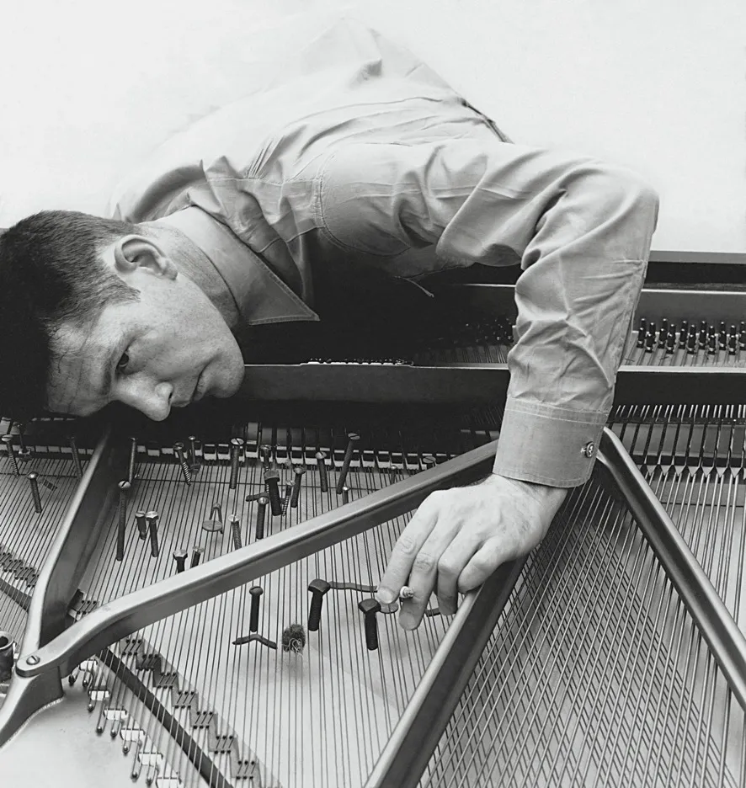
EXTRA TASK
Watch this version of John Cage’s 4’33’’ performed by symphony orchestra
  Did it give you a new insights into the piece?

Slide 7
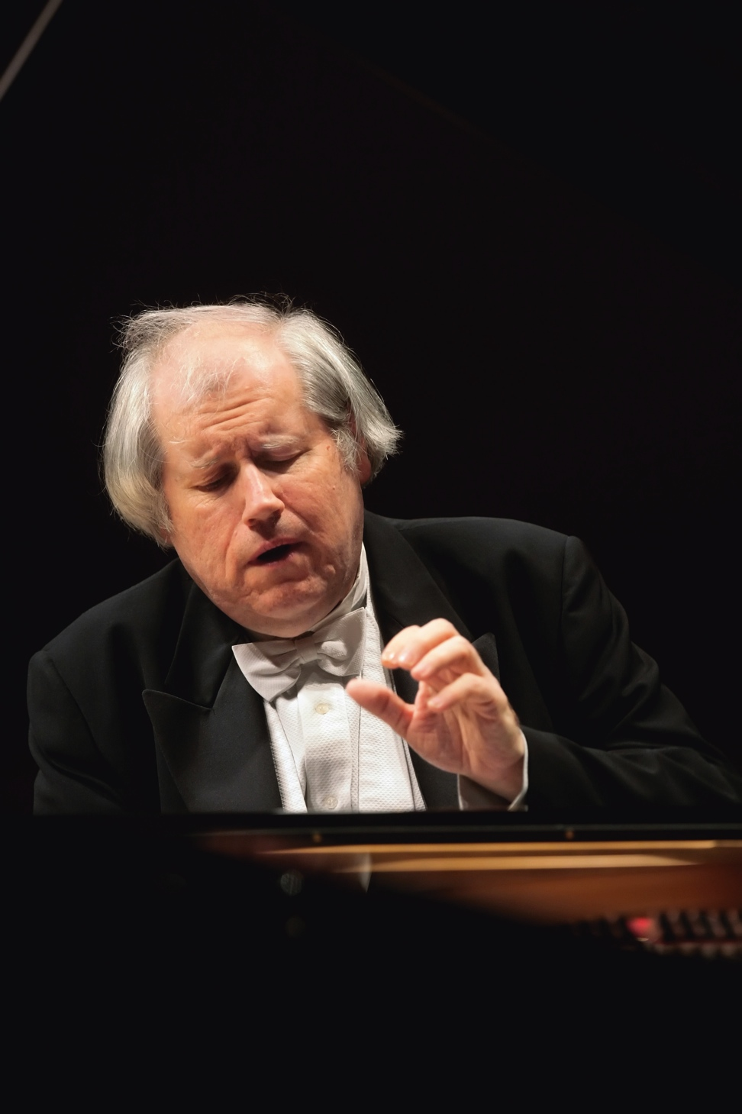
Piece no. 2
Grigory Sokolov plays Siloti’s arrangement of Prelude in B Minor by Bach

Slide 8
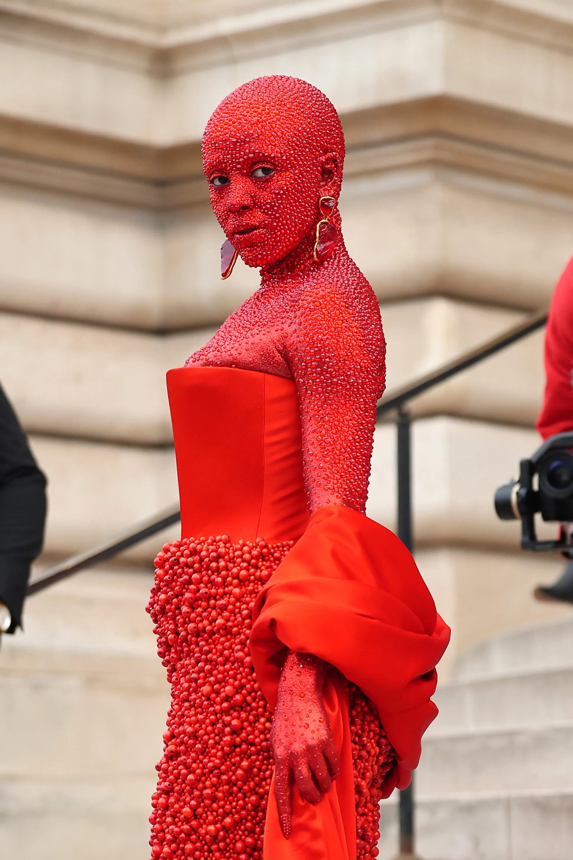
Piece no. 3
Paint The Town Red by Doja Cat

Slide 9
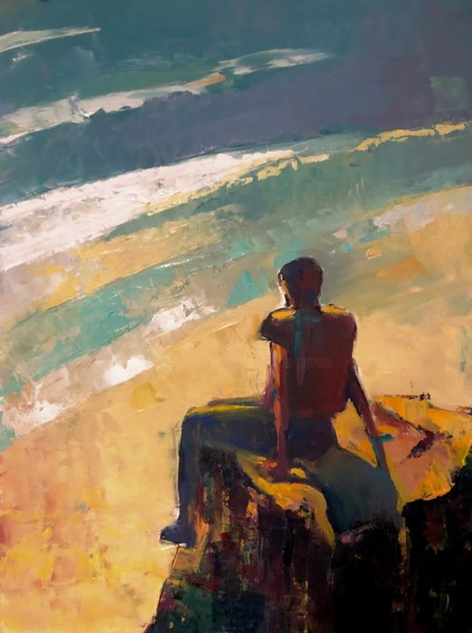
TASK
You have heard a well established classical piece and a pop song
  Is there any way to justify that the piece no. 2 is more valuable and/or meaningful than the piece no. 3 or vice versa?

Slide 10
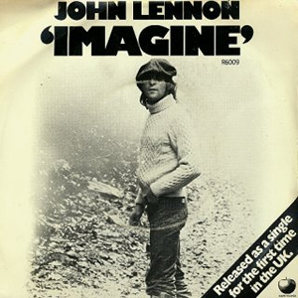
Piece no. 4
Imagine by John Lennon

Slide 11
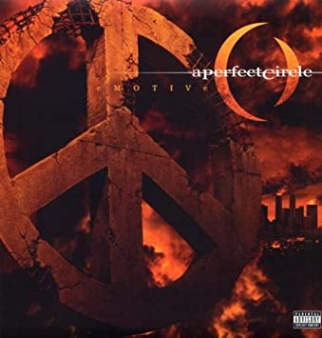
Piece no. 5
John Lennon’s Imagine rearranged by A Perfect Circle

Slide 12

TASK
Did the meaning / intention change in the rearrangement?
Did the rearrangement make you feel in a different way?
Were you able to get different kind of knowledge?

Slide 13
TASK
To what what extend do different interpretations in the arts influence our knowledge?
Can art change the way we interpret the world?

Slide 14

Piece no. 6
Leonard Cohen’s Halleluja by Espen Lynd, Kurt Nilsen, Alejandro Fuentes and Askil Holm

Slide 15

Piece no. 7
Leonard Cohen’s Halleluja by J Star

Slide 16
TASK
Are there any objective standards for good art?
What are justifications for claiming that there are objective standards for good art?

Slide 17
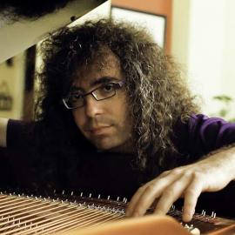
TASK
Watch the Mark Applebaum’s TEDx-Talk on the meaning of music
  Can this talk change the way you think about music and creativity?

Slide 18
Picture sources
Concert hall, Helsinki Music House <https://foursquare.com/musiikkitalo> Accessed 21st of September 2021.
John Cage 1 <https://fi.wikipedia.org/wiki/John_Cage> Accessed 25th of August 2022.
John Cage 2 <https://www.newyorker.com/magazine/2010/10/04/searching-for-silence> Accessed 25th of August 2022
Grigory Sokolov <http://jaanilansio.fi/tag/grigori-sokolov/> Accessed 21st of September 2021.
Doja Cat <https://www.vogue.co.uk/beauty/article/doja-cat-schiaparelli-couture-2023> Accessed 29th of September 2023.
Contemplation <https://www.artmajeur.com/en/charles-tapiero/artworks/13037216/contemplation> Accessed 23rd of September 2021.
Imagine by John Lennon <https://fi.wikipedia.org/wiki/Imagine_(John_Lennonin_kappale)> Accessed 23rd of September 2021.
A Perfect Circle <https://www.amazon.com/Emotive-Perfect-Circle/dp/B0006SSQFM> Accessed 23rd of September 2021.
Reflection <https://greatresultsteambuilding.net/5-questions-reflect-end-year-season-project/> Accessed 23rd of September 2021.
Lynd, Nilsen, Fuentes, Holm <https://twitter.com/vsn1hd/status/1231173984265392128> Accessed 23rd of September 2021.
J Star <https://twitter.com/thexfactor/status/373886146717044736> Accessed 23rd of September 2021.
Mark Applebaum <https://music.stanford.edu/people/mark-applebaum> Accessed 23rd of September 2021.

