Slide 1
MATHEMATICS
TOK Jyväskylän Lyseon lukio

Slide 2
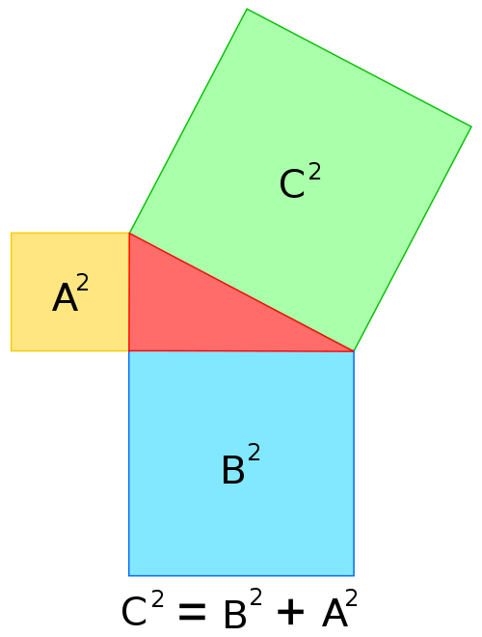
TASK
What is mathematics?
  Write a brief definition or do a mind-map
Don’t use any assistive devices!

Slide 3
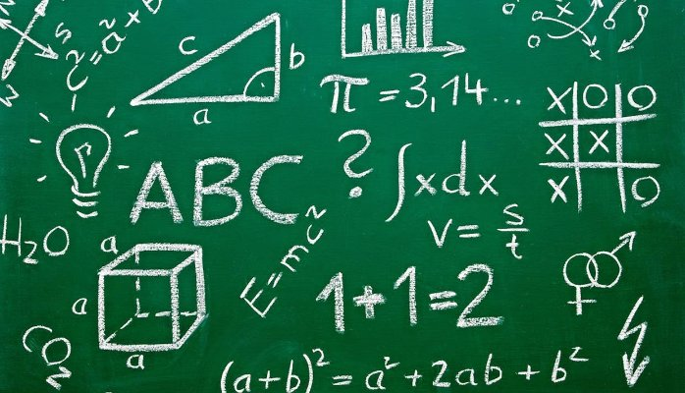
What is mathematics?
Mathematics is the research of axiomatic abstractions based on deductive reasoning
  Mathematics does NOT research the observable reality, but ideas
  Mathematical knowledge is NOT based on observations, but can be inspired by reality

Slide 4
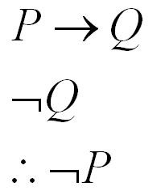
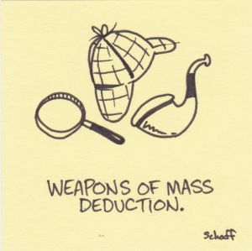
What is mathematics?
Deductive reasoning
  The truth of the premises guarantees the truth of the conclusion
  The conclusion must necessarily follow from the premises
Logically valid

Slide 5
What is mathematics?
Axioms or basic assumptions form the basis of mathematics (cannot be proven)
Definitions create mathematical objects
Theorems are proven right with the help of axioms and definitions using deductive reasoning
Proven theorems can be used as a base for new theorems

Slide 6
What is mathematics?
Prove that
(b+c)*a = b*a + c*a
Deduction
(b+c)*a = a*(b+c) I (2)
= a*b + a*c I (1)
= b*a + c*a I (2)
Two algebraic axioms
  (1) a*(b+c) = a*b + a*c
  (distributive law)
  (2) a*b = b*a
  (commutative law)

Slide 7
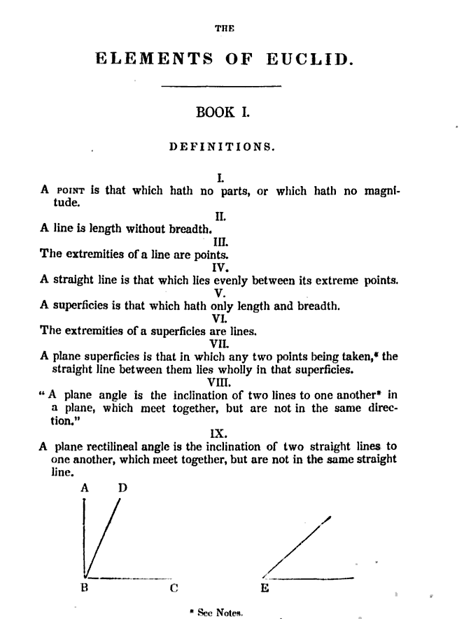
What is mathematics?
See the Wikipedia article about Hilbert’s axioms related to geometry

Slide 8
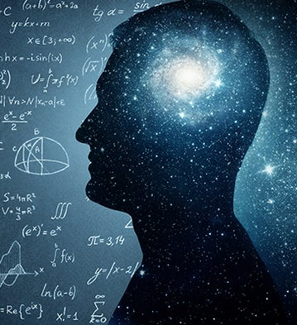
TASK
How is the construction of knowledge in mathematics different from other sciences?
  Compare mathematics with other AOKs

Slide 9
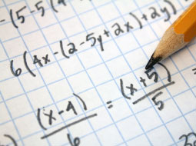
TASK
How do we know
about mathematics in the first place?
  How have we come up with all the knowledge about mathematics?

Slide 10
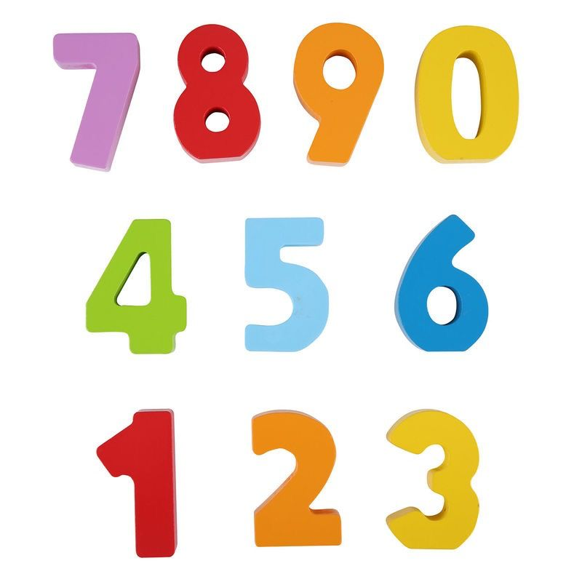
TASK
Watch this educational video about the acquisition of knowledge in mathematics
  How do we know about numbers?
  What kind of perspectives can be taken on the topic?

Slide 11
TASK
What is the relationship between mathematics and reality?
Is mathematics found or invented?
  If mathematics is found, where have we found it exactly? And what have we found exactly?
  If mathematics is invented, how can we describe the reality so efficiently with it?
FIND ARGUMENTS FOR BOTH PERSPECTIVES!

Slide 12
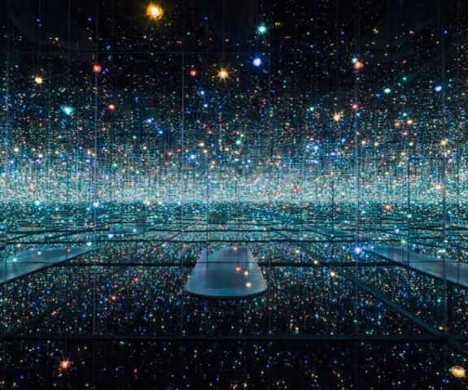
TASK
Watch this educational video about the relationship between mathematics and reality
  Write down the arguments that are new to you

Slide 13

TASK
Watch this Vsauce video about the Banach-Tarski paradox
  What does this video tell you about the nature of mathematics and the relationship between mathematics and the reality?

Slide 14
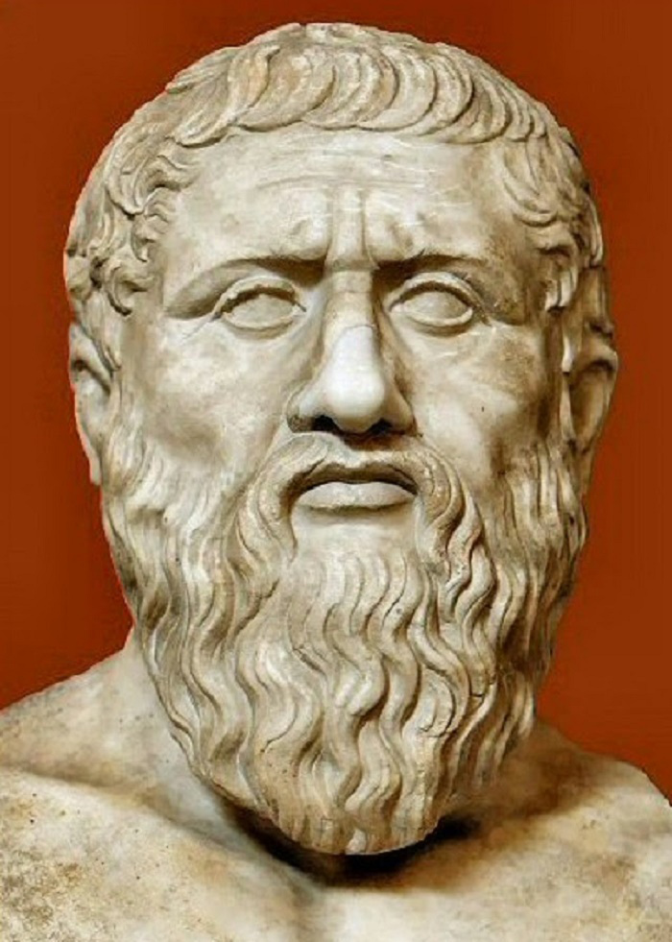
Truth in mathematics
According to the classical definition of knowledge, truth is the correspondence between a belief and the reality
  How does this work in mathematics?

Slide 15
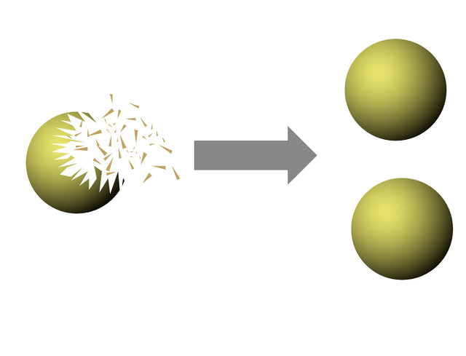
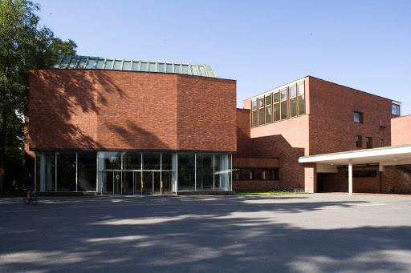

Truth in mathematics
” ”

Slide 16
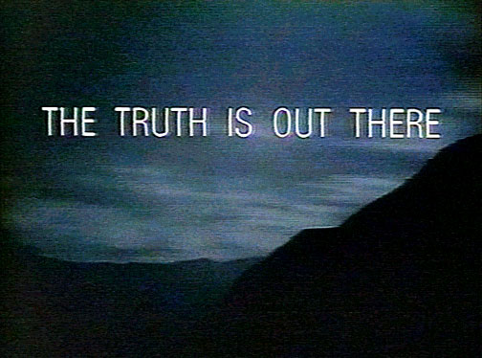
TASK
If the correspondence between mathematical ideas and reality is not always clear, is mathematics true at all?
What does the truth mean in mathematics?

Slide 17
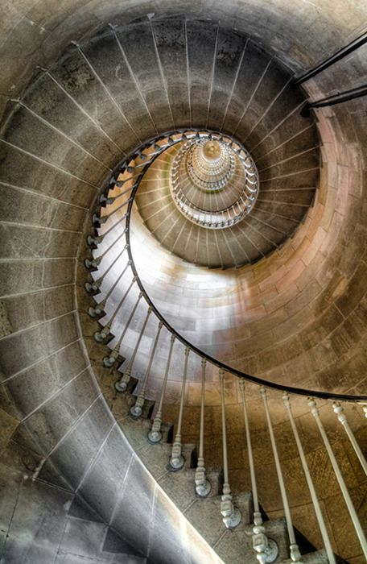
TASK
Find out real-life examples to the questions below
  Where can mathematics be applied?
  Where mathematics cannot be applied?

Slide 18
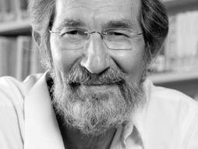
TASK
Watch the Geoffrey West TED-Talk ”The surprising math of cities and corporation”
  How can math be applied to understand the nature of urbanization?

Slide 19
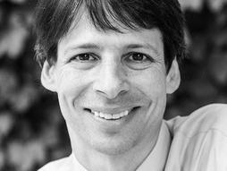
TASK
Watch the Arthur Benjamin TED-Talk ”The magic of Fibonacci numbers”
  How can mathematics be inspiring and beautiful?

Slide 20
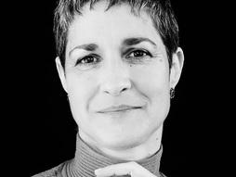
TASK
Watch the Margaret Wertheim TED-Talk ”The beautiful math of coral”
  How can the mathematical knowledge drawn from the natural world inspire us to create fantastic art?

Slide 21

TASK
How can you implement the things you have learned from this AOK in your TOK essays?
  Form pairs/groups and engage in conversation

Slide 22
Picture sources
Pythagorean theorem <https://fi.wikipedia.org/wiki/Pythagoraan_lause> Accessed 30th of October 2017.
Math board <http://www.basicknowledge101.com/subjects/math.html> Accessed 10th of October 2017.
Modus Tollens <https://thelycaeum.wordpress.com/2014/05/17/modus-ponens-and-modus-tollens/> Accessed 30th of October 2017.
Elements of Euclid <https://sites.pitt.edu/~jdnorton/teaching/HPS_0410/chapters/non_Euclid_Euclid/index.html> Accessed 13th of October 2021.
Mathematics and universe inside a head <https://blogs.scientificamerican.com/cross-check/is-mathematics-like-science-pluralistic/> Accessed 28th of October 2019.
Calculations <https://alison.com/course/advanced-algebraic-concepts-and-applications-in-mathematics> Accessed 28th of October 2019.
Numbers <https://www.hellobaby.ca/hape-lacing-numbers-and-colors-pack.html> Accessed 28th of October 2019.
Mathematical reality <https://pintofscience.co.uk/event/infinity-reality-and-other-mathematical-problems> Accessed 30th of October 2017.
Plato <https://antiikinhistoriajakulttuuri.com/2015/08/20/platonin-ja-aristoteleen-erilaiset-naiskuvat/> Accessed 27th March 2017.
Banach-Tarski paradox <https://www.thisisdavidjones.com/blog/2018/03/banachtarski/> Accessed 13th of October 2021.
The truth is out there <http://quotesgram.com/the-truth-will-come-out-quotes/> Accessed 15th of August 2015.
Stairs <https://fi.pinterest.com/kendadavis11/grey-brown-bound/> Accessed 28th of October 2019.
Geoffrey West <https://www.ted.com/speakers/geoffrey_west> Accessed 13th of October 2021.
Arthur Benjamin <https://www.ted.com/speakers/arthur_benjamin> Accessed 13th of October 2021.
Margaret Wertheim <https://www.ted.com/speakers/margaret_wertheim> Accessed 13th of October 2021.
The TOK essay 1 <http://ibmeme10.blogspot.fi/2014/09/how-to-write-tok-essay.html> Accessed 7th of September 2015.

