Slide 1
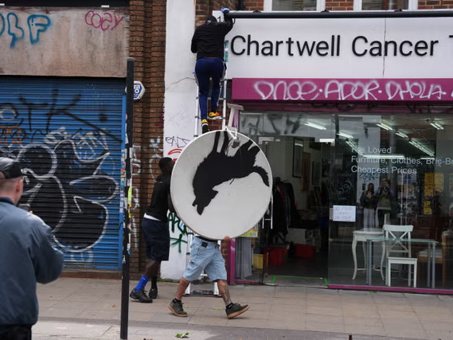

Slide 2
THE ARTS
TOK LAJM / VALM

Slide 3
TASK
Teachers divide you into groups
You must produce a work of art
In addition, you need to justify why your work is art => what is the meaning of your artwork?
Moreover, you need to justify what kind of knowledge one can gain from your artwork
You need to present your artwork to the class towards the end of the lesson
The role of the audience is to function as an art critic and interpret the artwork

Slide 4
TASK
The teacher divides you into four groups
(1) Each group familiarises themselves with a topic related to the arts and, creates a product and prepares to present the key results at the end of the lesson
Use teacher’s handout
Upload the product to ManageBac
(2) Each also must familiarise another group’s topic and function as an opponent
Ask questions, contradict statements and give feedback

Slide 5
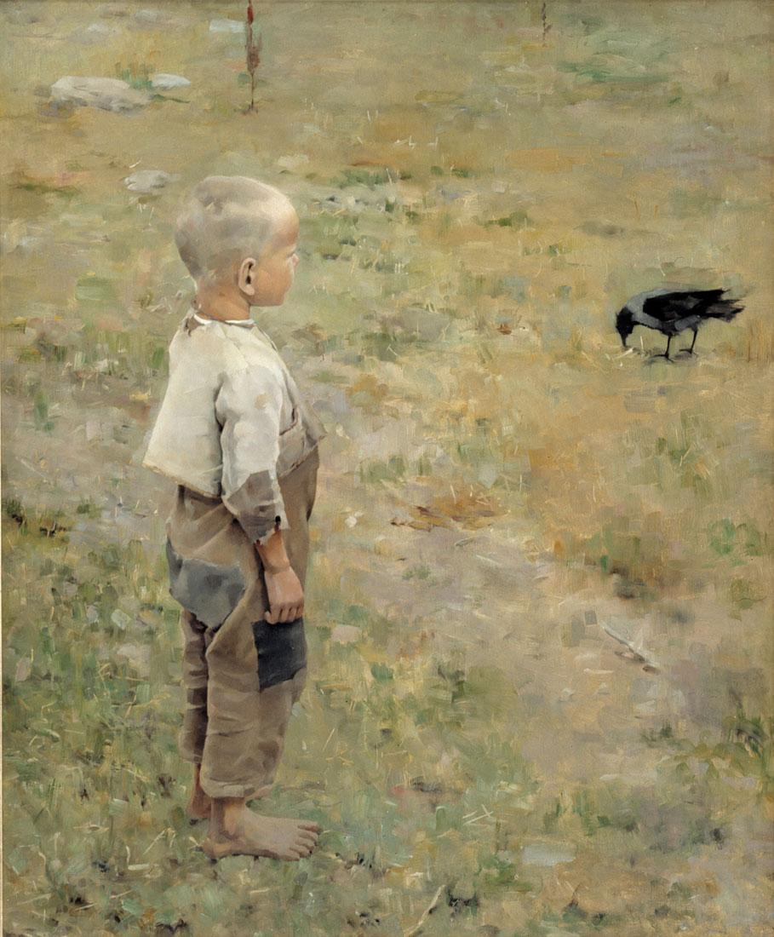
TASK
Groups and their themes
Interpretation in arts
Social character of arts
Ethics of arts
Culture and arts

Slide 6
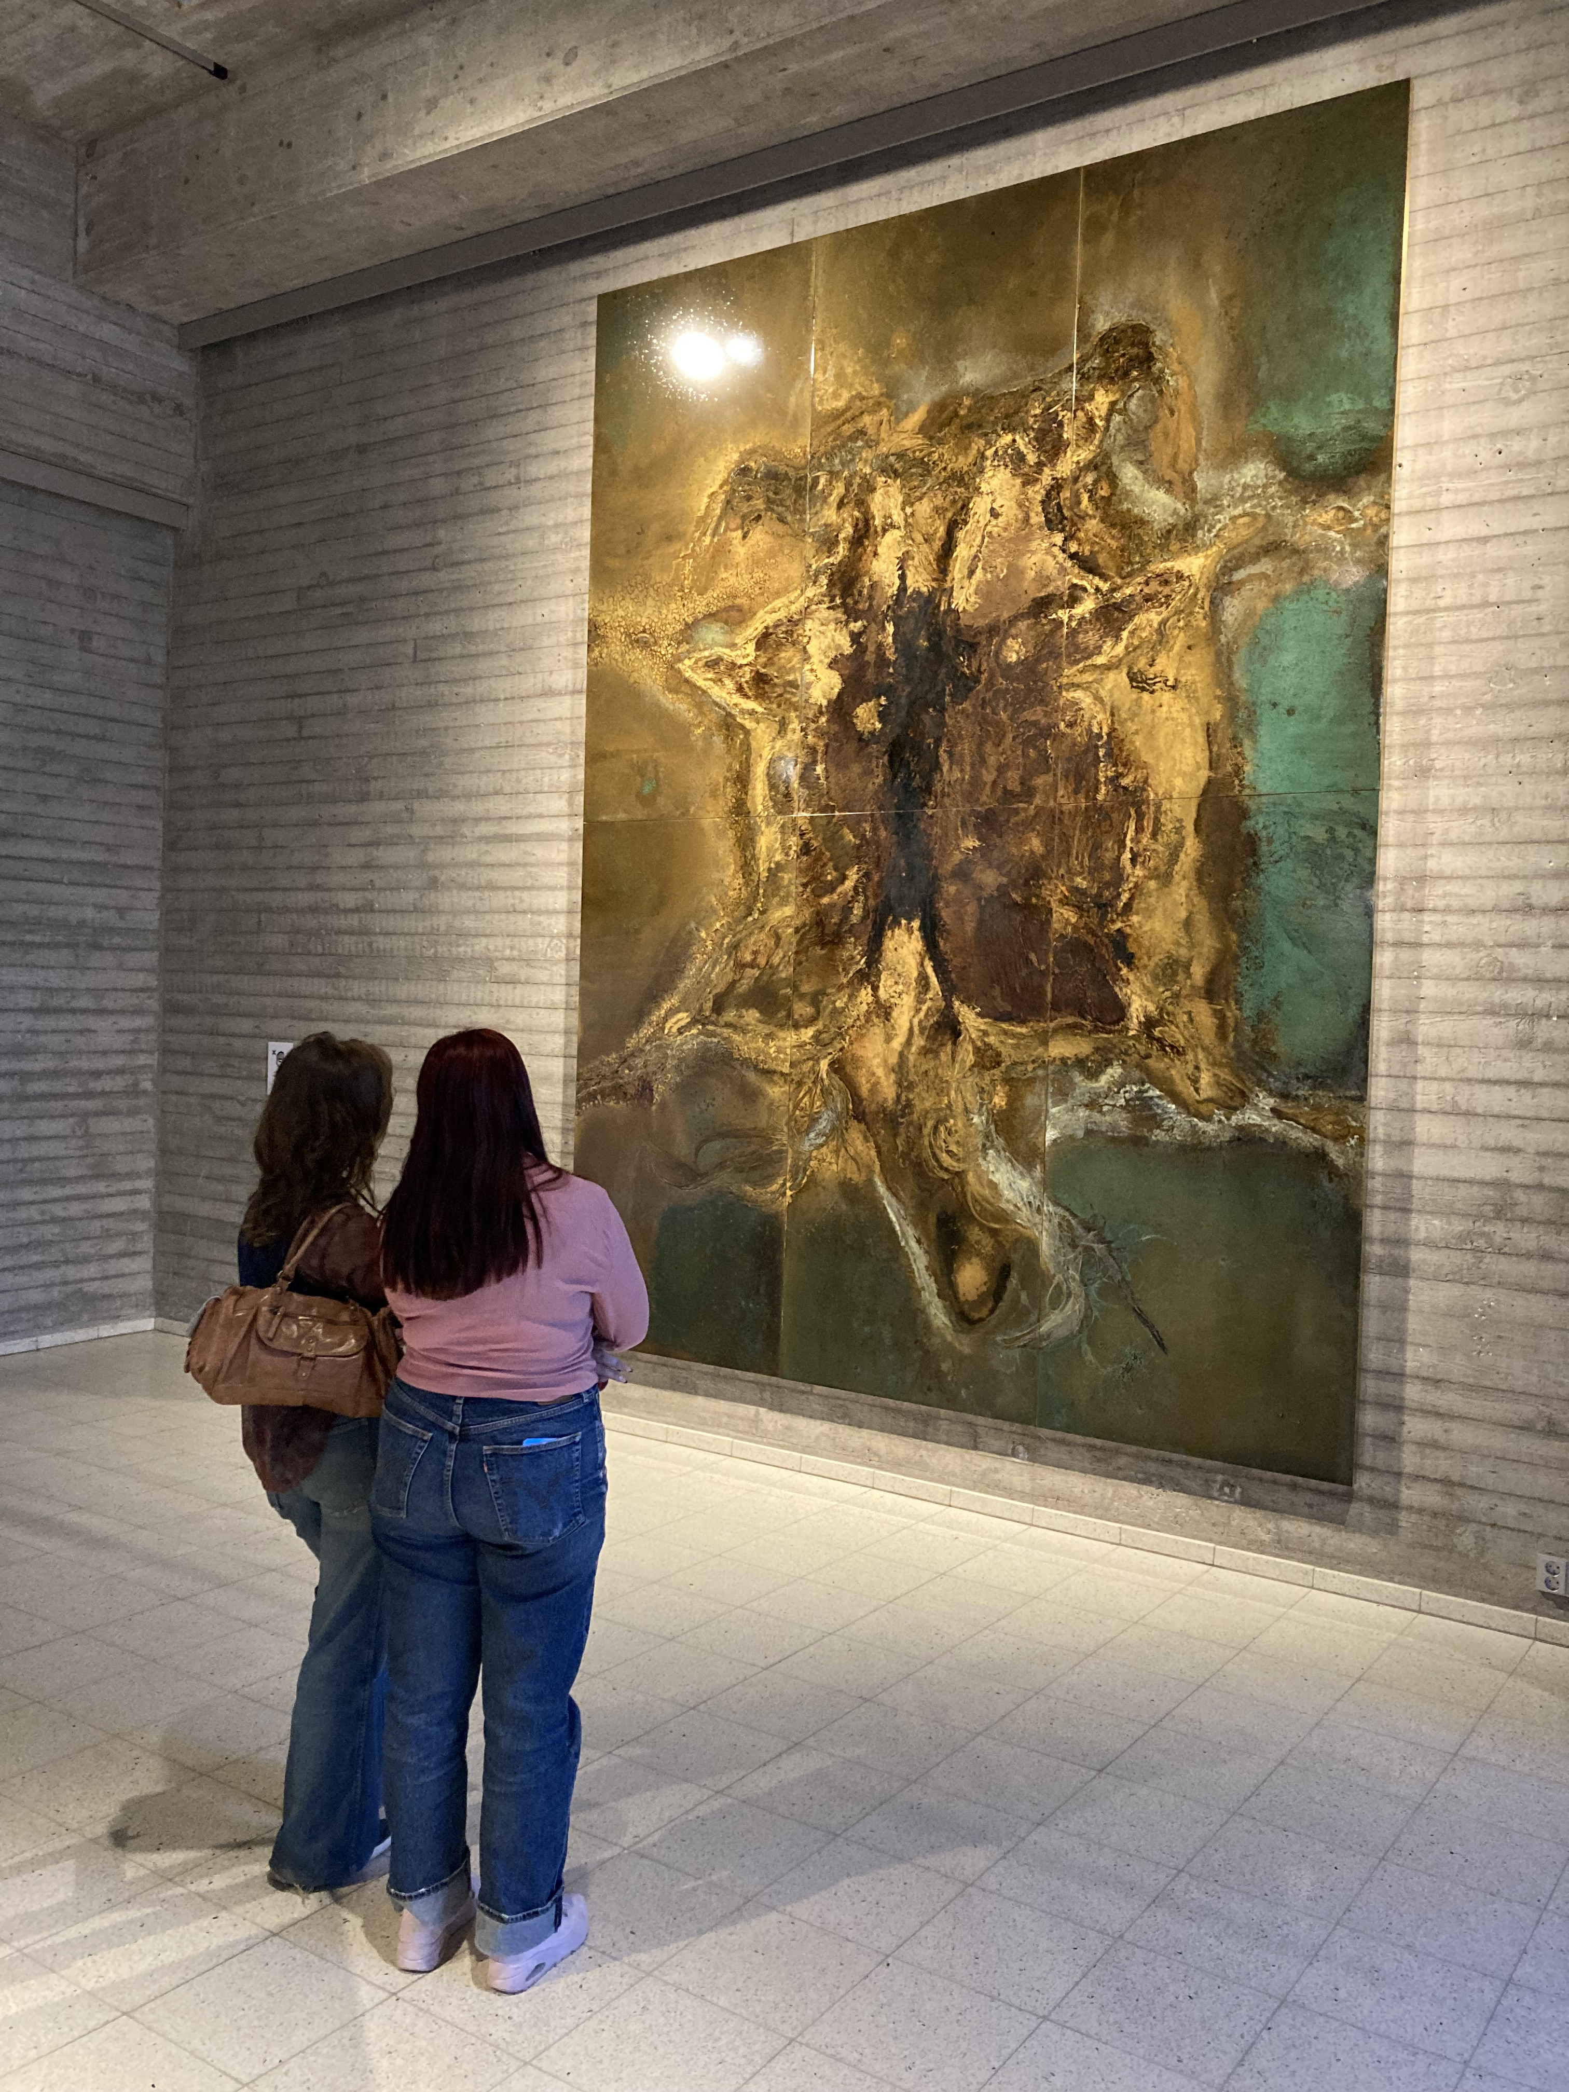
TASK
Reflect your experiences in Tampere from TOK perspective
Use the teachers’ handout
Upload your document with pictures to ManageBac by the end of the lesson

