Slide 1
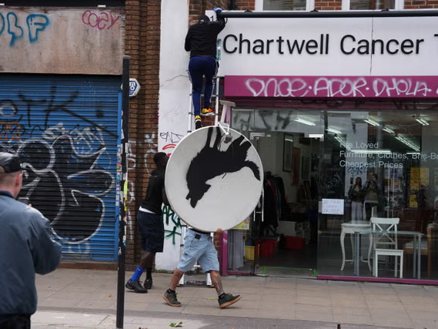

Slide 2
THE ARTS
TOK Jyväskylän Lyseon lukio

Slide 3
TASK
Teachers divide you into groups
You must produce a work of art
  In addition, you need to justify why your work is art => what is the meaning of your artwork?
  Moreover, you need to justify what kind of knowledge one can gain from your artwork
You need to present your artwork to the class towards the end of the lesson
  The role of the audience is to function as an art critic and interpret the artwork

Slide 4
TASK
The teacher divides you into four groups
  (1) Each group familiarises themselves with a topic related to the arts and, creates a product and prepares to present the key results at the end of the lesson
    Use teacher’s handout
    Upload the product to ManageBac
  (2) Each group must also familiarise another group’s topic and function as an opponent
    Ask questions, contradict statements and give feedback

Slide 5
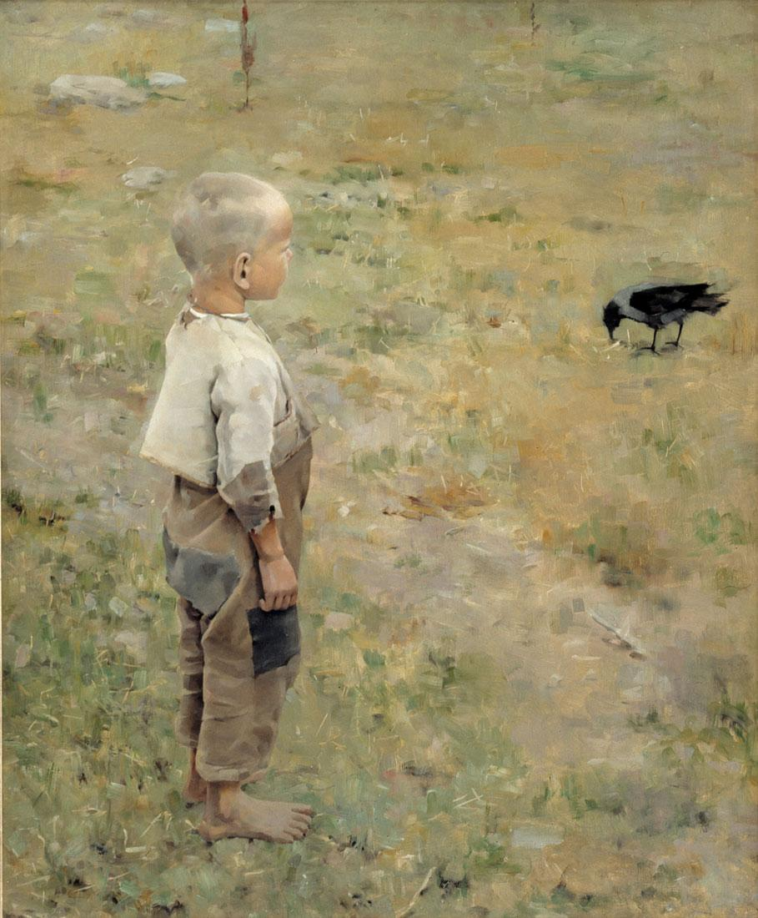
TASK
Groups and their themes
  Interpretation in arts
  Social character of arts
  Ethics of arts
  Culture and arts

Slide 6
TASK
Compere the arts to the AOKs you have covered
  What are the differences, similarities and overlaps with natural sciences, human sciences and history?
Utilise the knowledge framework
  Scope
  Perspectives
  Methods and tools
  Ethics

