Slide 1
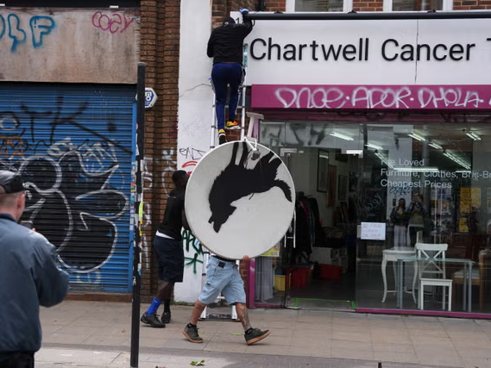

Slide 2
THE ARTS
TOK LAJM / SALS

Slide 3
TASK
Teachers divide you into groups
You must produce a work of art
In addition, you need to justify why your work is art => what is the meaning of your artwork?
You need to be able to present your work in the classroom by the deadline
  The role of the audience is to function as an art critic and interpret the artwork

Slide 4
TASK
The teacher divides you into four groups
  (1) Each group familiarises themselves with a topic related to the arts and prepares to present the results at the end of the lesson
    Use teacher’s handout
  (2) Each also must familiarise another group’s topic and function as an opponent
    Ask questions, contradict statements and give feedback

Slide 5
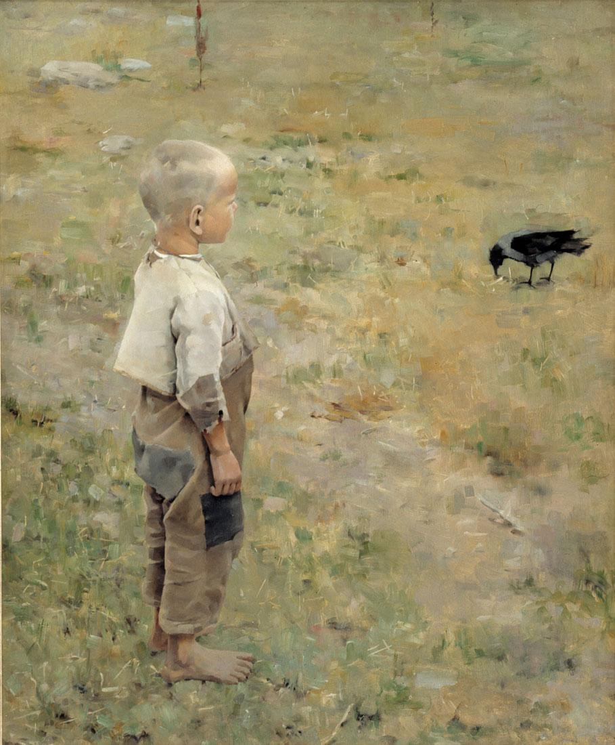
TASK
Groups and their themes
  Interpretation in arts
  Social character of arts
  Ethics of arts
  Culture and arts

Slide 6
TASK
Compere the arts to the AOKs you have covered
  What are the differences, similarities and overlaps with natural sciences and human sciences?
Utilise the knowledge framework
  Scope
  Perspectives
  Methods and tools
  Ethics

