Slide 1
Mathematical models
IB 2 TOK
SALS

Slide 2
Mathematical models
What is a mathematical model?
Where are mathematical models applied?

Slide 3
Case study: the double slit experiment
https://www.youtube.com/watch?v=NvzSLByrw4Q
To explain electrons behaviour, two models are needed…
Electrons are like particles
Mathematical models: exact positions, trajectories…
Electrons are like waves
Mathematical models: trigonometric functions for interference patterns…
…but neither can describe the reality.

Slide 4
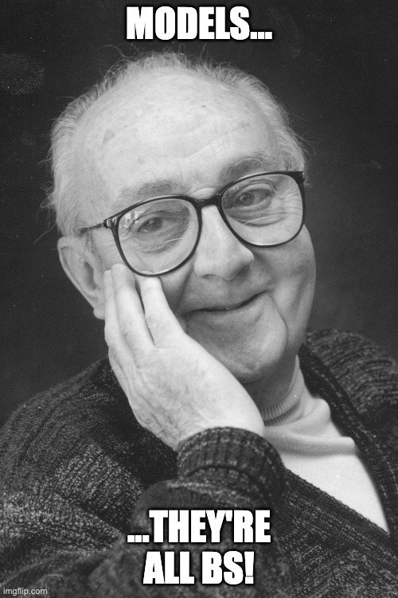
Prescibed title:
5. To what extent do you agree with the claim “all models are wrong, but some are useful” (attributed to George Box)? Discuss with reference to mathematics and one other area of knowledge.
Engage in conversation over the title
Produce a claim (’I agree’ or ’I disagree’) and justify it

