Slide 1
THE NATURAL SCIENCES
TOK LAJM

Slide 2
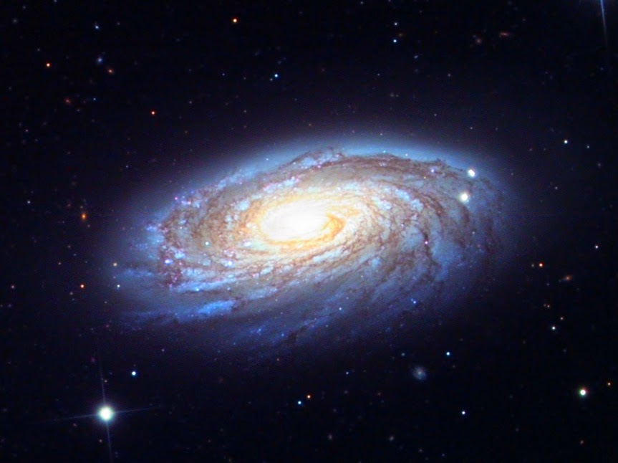
Character of natural sciences
The natural sciences seek to discover laws of nature – regularities in the natural world
”If A, then B”
Mathematical precision
Attempt to produce knowledge that is independent of human agency

Slide 3
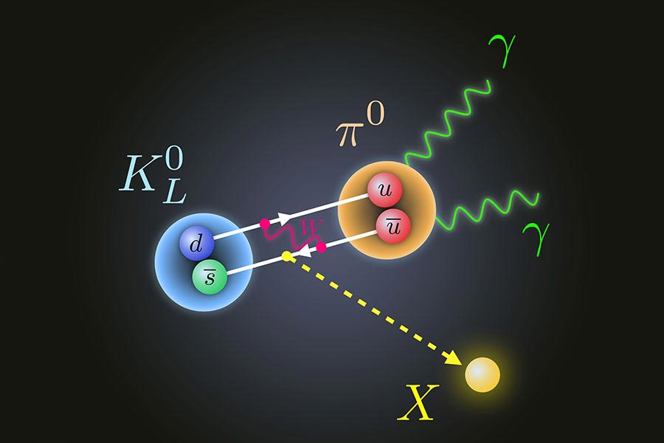
Character of natural sciences
Rely on evidence, rationality and the quest for deeper understanding
Observation and empirical experimentation play a crucial role
Testing hypotheses
Importance of theories

Slide 4

TASK
What is science?
Try to give a general definition of science
Don’t use any assistive devices or materials!

Slide 5

TASK
Do the The Internet Infidels Test of Scientific Literacy by Richard Carrier
DON’T use any assistive devices or materials!
Check your answers with the help of Mr. Carrier’s webpage

Slide 6
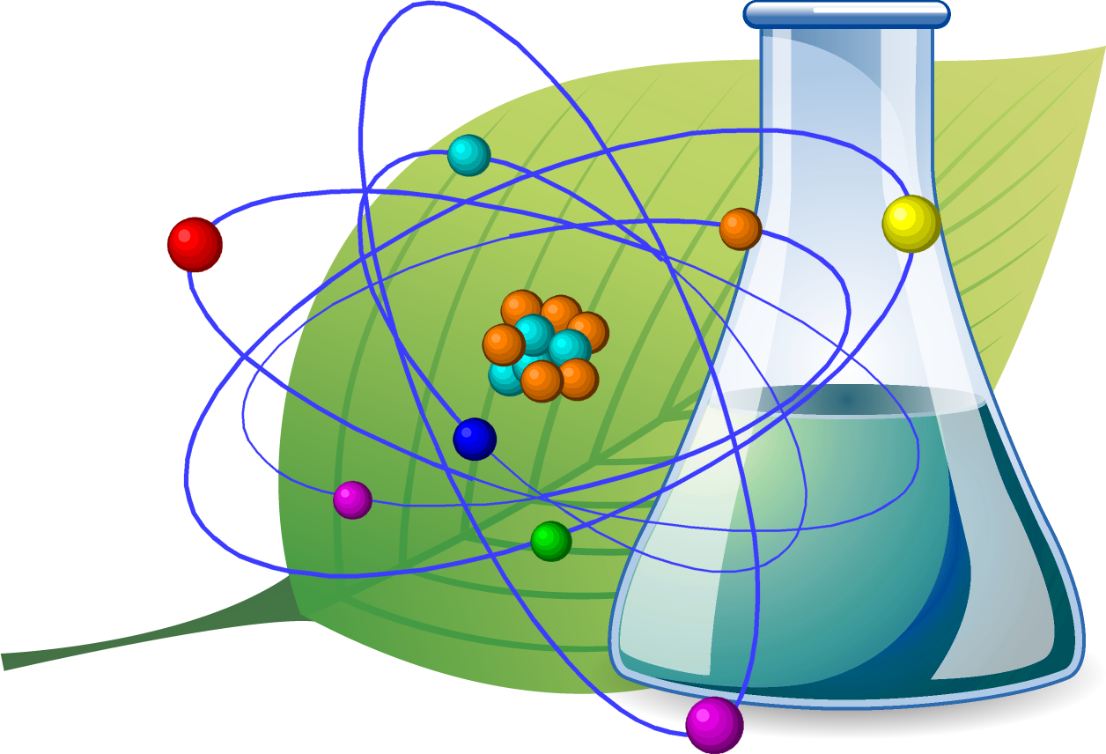
TASK
Should the natural sciences be regarded as a body of knowledge, a system of knowledge or a method?

Slide 7
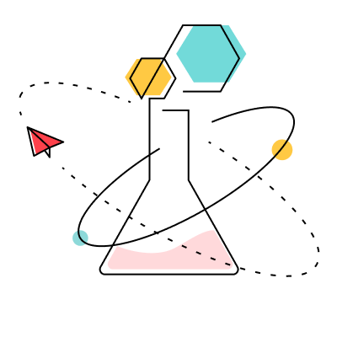
What is science?
(1) Research process
(2) Body of knowledge that is acquired through the use of scientific research process

Slide 8
What is science?
Common criteria for scientific knowledge
(1) Objectivity
(2) Criticality
Any claim or method can be questioned
(3) Openness
All research has to be published for peer-review
(4) Progressivity
Erroneous beliefs are corrected and methods are being constantly developed
(1)–(4) → Science is self-correcting

Slide 9

What is science?
Pseudoscience looks like a real science, but does NOT meet the criteria for scientific knowledge
How to differentiate between real science and pseudoscience?

Slide 10
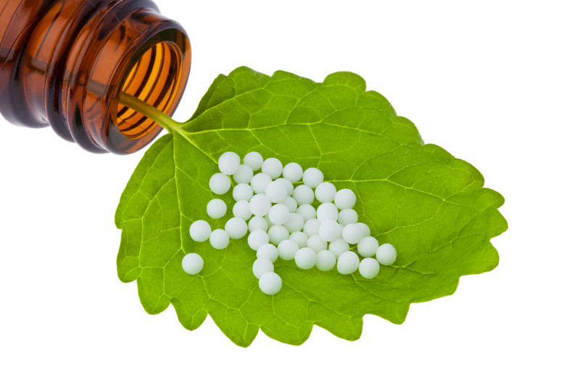
TASK
Go online and search examples of pseudoscience
How pseudoscience does NOT meet the criteria for scientific knowledge?

Slide 11
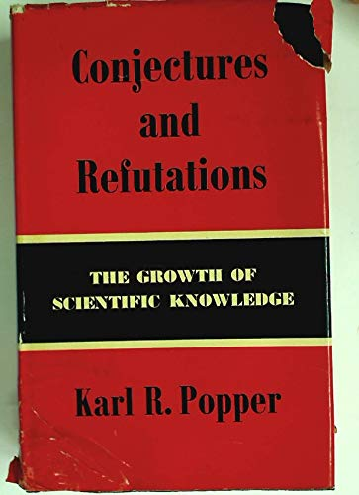
Karl Popper (1902–1994)
Conjectures and Refutations: The Growth of Scientific Knowledge (1963)

Slide 12
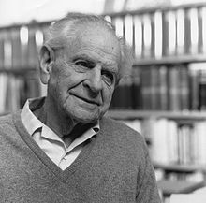
Karl Popper (1902–1994)
Science cannot be right all the time
Only claims that can be proven wrong can be scientific
”If science is true, it ceases to be science”

Slide 13
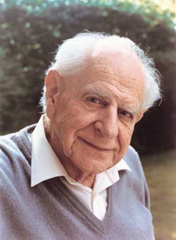
Karl Popper (1902–1994)
Brave and imaginative conjectures and refuted hypothesis are particularly important for science
With the help of refuted hypothesis we know at least what is NOT true
FALSIFICATIONISM

Slide 14
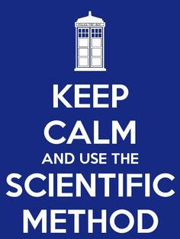
TASK
What kind of things should be included in a good scientific research?
Engage in conversation with your pair/group
Write down your ideas

Slide 15
TASK
Create a hypothesis and design a research plan to empirically test your hypothesis with scientific method
Describe the stages of your research
Mere research plan is enough!
Example hypotheses:
(1) Sunbathing causes skin cancer
(2) The amount of carbon dioxide in the atmosphere influences global warming
(3) If you increase temperature, then solubility of salt will increase

Slide 16

Scientific method
We CANNOT prove the hypothesis right based on the test results
We can only prove the hypothesis wrong
FALSIFICATIONISM

Slide 17
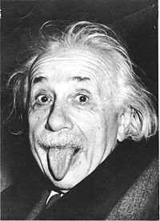
Albert Einstein (1879–1955)
”No amount of experimentation can ever prove me right; a single experiment can prove me wrong”

Slide 18
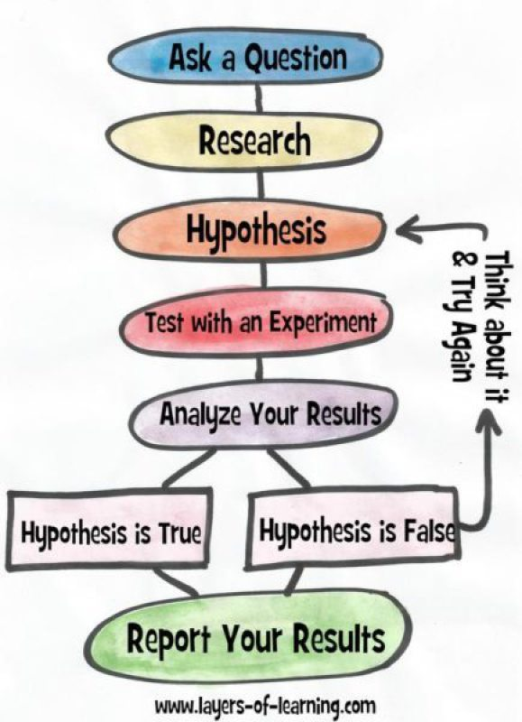
TASK
Is there a single scientific method?

Slide 19

TASK
How can it be that scientific knowledge changes over time?

Slide 20
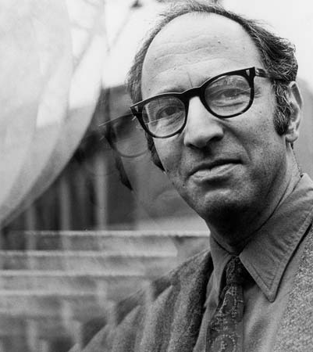
Thomas Kuhn (1922–1996)
The Structure of Scientific Revolutions (1962)
Pointed out the importance of history in scientific progress

Slide 21
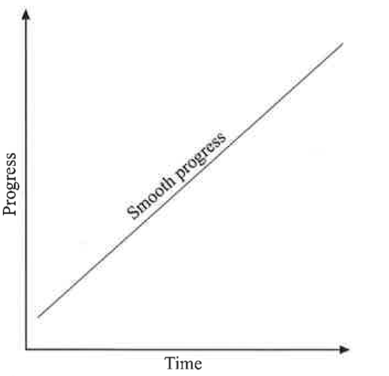
Thomas Kuhn (1922–1996)
Karl Popper assumes that through falsificationism scientific knowledge accumulates linearly
Popper’s approach is more transverse, whereas Kuhn’s is more longitudinal

Slide 22
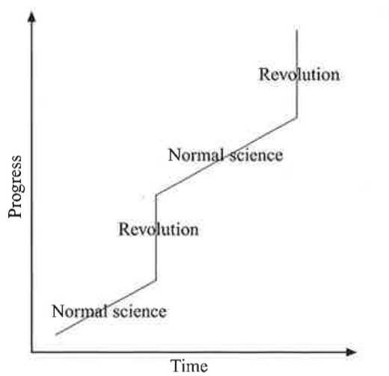
Thomas Kuhn (1922–1996)
(1) Normal science
(2) Crisis of science
Anomalies, unsolved problems for the normal science starts to emerge
(3) Scientific revolution

Slide 23
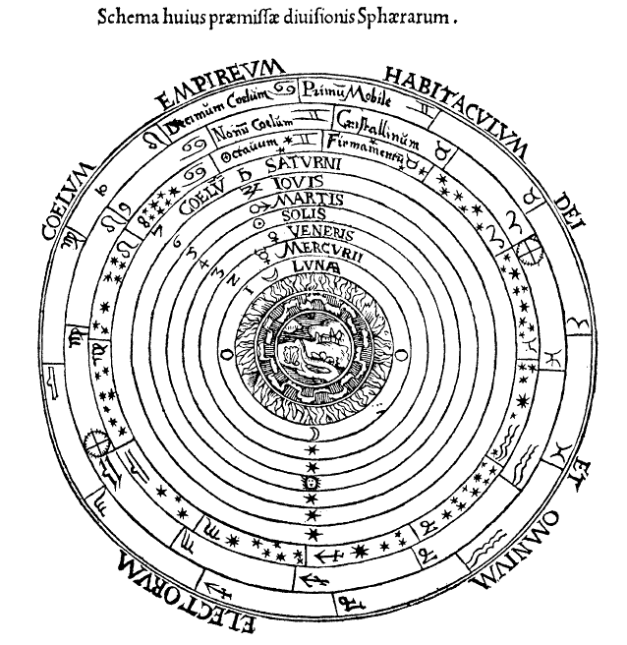
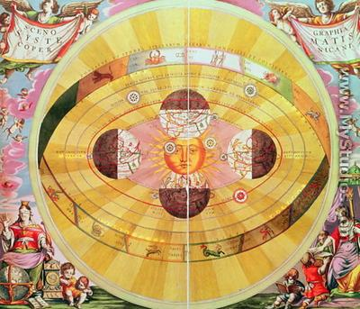
Thomas Kuhn (1922–1996)
Geocentric universe
Heliocentric universe

Slide 24
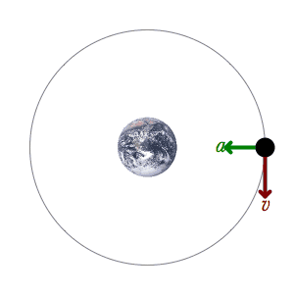
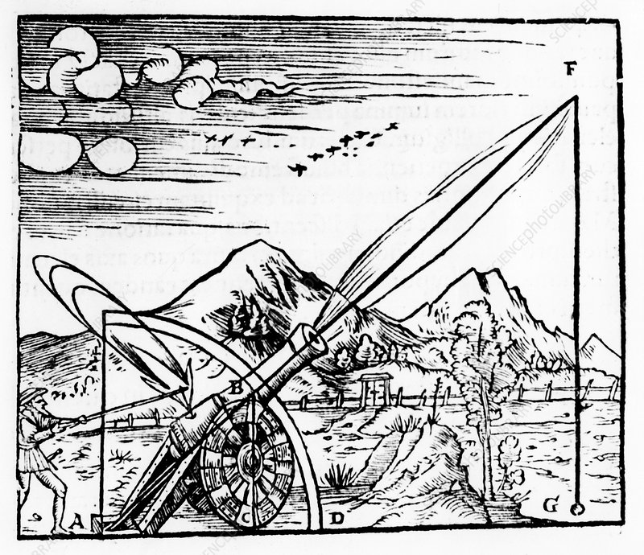
Thomas Kuhn (1922–1996)
Aristotelian physics:
Teleological explanations
Newtonian mechanics:
Causal explanations

Slide 25
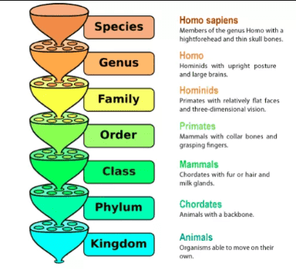
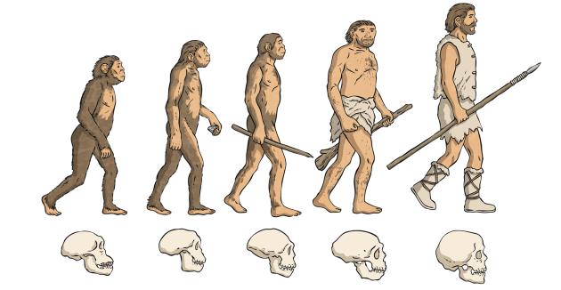
Thomas Kuhn (1922–1996)
Linnean taxonomy
Theory of evolution

Slide 26
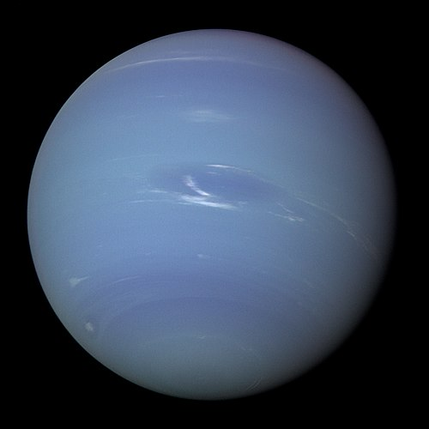
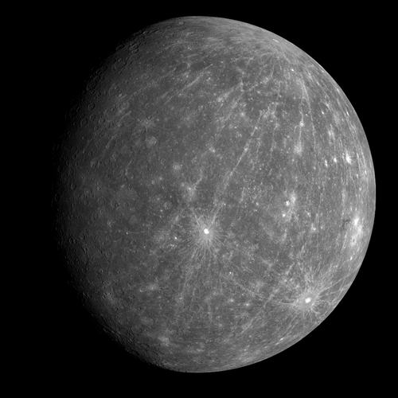
Thomas Kuhn (1922–1996)
Einstein’s theory
of relativity
Newtonian mechanics

Slide 27
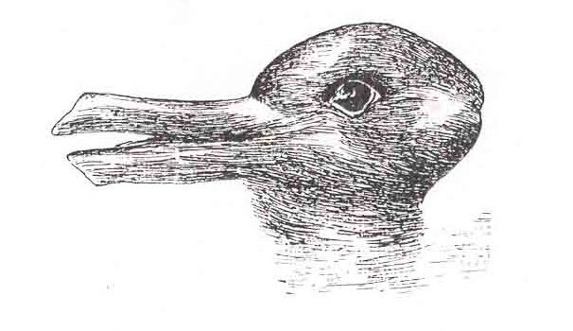
Thomas Kuhn (1922–1996)
Paradigm
A fundamental framework for scientific research during the stage of normal science
Different paradigms can be incommensurable

Slide 28

TASK
What role do paradigm shifts play in the progression of scientific knowledge?

Slide 29
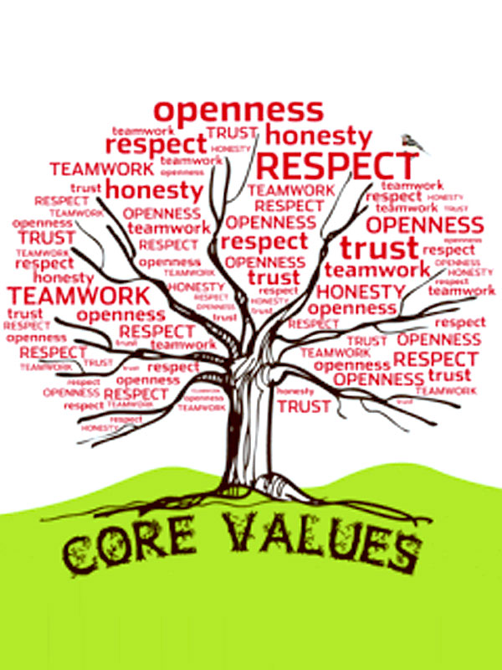
TASK
Is science, or should it be, value free?
In what ways have developments in science challenged long-held ethical values?

Slide 30
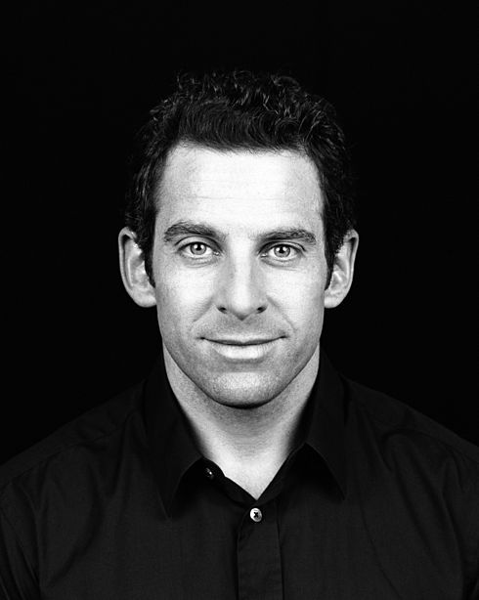
TASK
Watch Sam Harris’ TED-talk Science can answer moral questions
Can we derive objective moral facts or principles by using the methods implemented by the natural sciences?

Slide 31
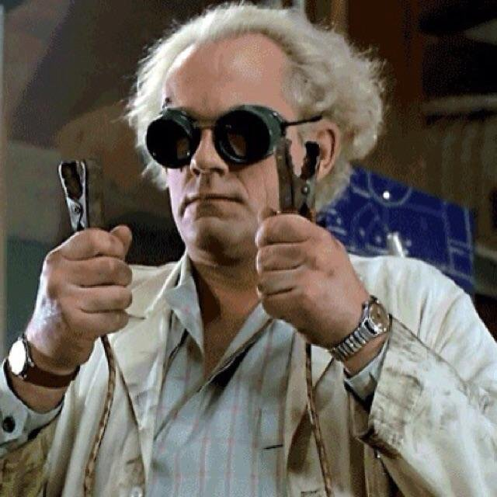
TASK
Do scientists exert a greater influence on society what is ethically acceptable?
What are the responsibilities of scientists?

Slide 32

TASK
What kind of a meaning can natural sciences have for an individual?
Why are some people suspicious of scientific findings, and to what extend is it justifiable?

Slide 33
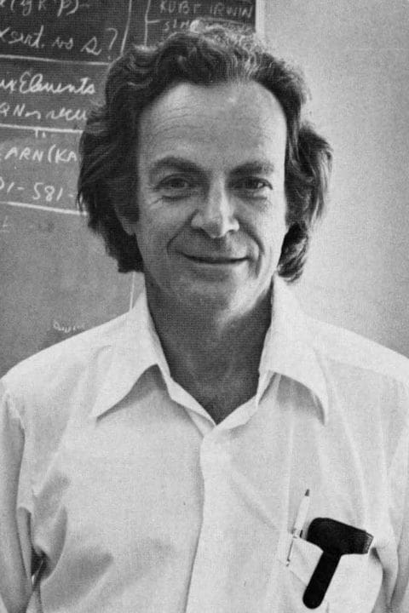
Richard Feynman (1918–1988)
”It doesn’t make any difference how beautiful your guess is, it doesn’t matter how smart you are who made the guess, or what his name is ... If it disagrees with experiment, it is wrong. That’s all there is to it.”

Slide 34
Picture sources
Science <http://www.brstf.org> Accessed 24th of October 2015.
Science symbols <https://www.freepik.com/free-photos-vectors/science> Accessed 11th of February 2019.
Science’n a leaf <https://scitourn.com/inst/> Accessed 7th of October 2021.
Science bottle <https://chanzuckerberg.com/science/> Accessed 7th of October 2021.
Science and pseudoscience <http://undsci.berkeley.edu/article/philosophy> Accessed 24th of October 2015.
Homeopathy <http://www.rosemareehomeopath.co.nz> Accessed 24th of October 2015.
Conjectures and refuations <https://www.abebooks.com/9780710065070/Conjectures-refutations-growth-scientific-knowledge-0710065078/plp> Accessed 8th of October 2021.
Karl Popper 1 and 2 <https://en.wikipedia.org/wiki/Karl_Popper> Accessed 24th of October 2015.
Galaxy <https://en.wikipedia.org/wiki/Galaxy> Accessed 24th of October 2015.
Tardis and scientific methods <http://www.nndb.com/people/164/000087900/> Accessed 24th of October 2015.
Affirming the consequent <http://evolutiondismantled.com/affirming-antecedent-consequent> Accessed 15th of October 2015.
Albert Einstein <https://fi.wikipedia.org/wiki/Albert_Einstein> Accessed 15th of October 2015.
Scientific method formula <https://layers-of-learning.com/a-simple-introduction-to-the-scientific-method/> Accessed 26th of October 2018.
Change <https://www.chieflearningofficer.com/2021/03/24/6-steps-to-lead-a-successful-change-management-initiative/> Accessed 8th of October 2021.
Thomas Kuhn <http://global.britannica.com/biography/Thomas-S-Kuhn> Accessed 15th of October 2015.
Graphs depicting scientific progress. van de Lagemaat, Richard: Theory of Knowledge for the IB Diploma, Second edition, Cambridge University Press 2015, page 364.

Slide 35
Picture sources
Geoncetric universe <https://en.wikipedia.org/wiki/Aristotelian_physics> Accessed 8th of October 2021.
Heliocentric universe <https://discover.hubpages.com/education/Scientifis-Revolutions-Nicolaus-Copernicus> Accessed 8th of October 2021.
Aristotelian physics <https://www.sciencephoto.com/media/1002359/view/gunner-firing-a-cannon-1561> Accessed 8th of October 2021.
Newtonian mechanics <https://en.wikipedia.org/wiki/Classical_mechanics> Accessed 8th of October 2021.
Lennaean taxonomy <https://bio.libretexts.org/Bookshelves/Introductory_and_General_Biology/Book%3A_Introductory_Biology_(CK-12)/05%3A_Evolution/5.01%3A_Linnaean_Classification> Accessed 8th of October 2021.
Evolution <https://www.twinkl.ro/parenting-wiki/evolution> Accessed 8th of October 2021.
Neptune <https://fi.wikipedia.org/wiki/Neptunus> Accessed 8th of October 2021.
Mercury <https://fi.wikipedia.org/wiki/Merkurius> Accessed 8th of October 2021.
Duck-rabbit <http://piilari.info/optiset-harhat/> Accessed 15th of October 2015.
Paradigm shift <https://www.macmillandictionaryblog.com/paradigm> Accessed 8th of October 2021.
Value tree <https://www.peakmarinetech.com/core-values.html> Accessed 7th of October 2021.
Sam Harris <https://fi.wikipedia.org/wiki/Sam_Harris> Accessed 7th of October 2021.
Mad professor from the movie Back to the future <https://peakd.com/@holovision/a-hivemind-community-for-mad-scientists> Accessed 7th of October 2021.
Suspicios meme <https://www.thelostogle.com/2014/01/22/all-these-suspicious-reports-about-suspicious-items-sure-are-suspicious/> Accessed 26th of October 2018.
Richard Feynman <https://moviefit.me/persons/76204-richard-feynman> Accessed 7th of October 2021.

