Slide 1
HISTORY
TOK LAJM / SALS

Slide 2
ORIENTATION
What is history?
Why is history an AOK of its own in the TOK curriculum?
AOKs in the TOK curriculum are:
  History
  The human sciences
  The natural sciences
  The arts
  Mathematics

Slide 3
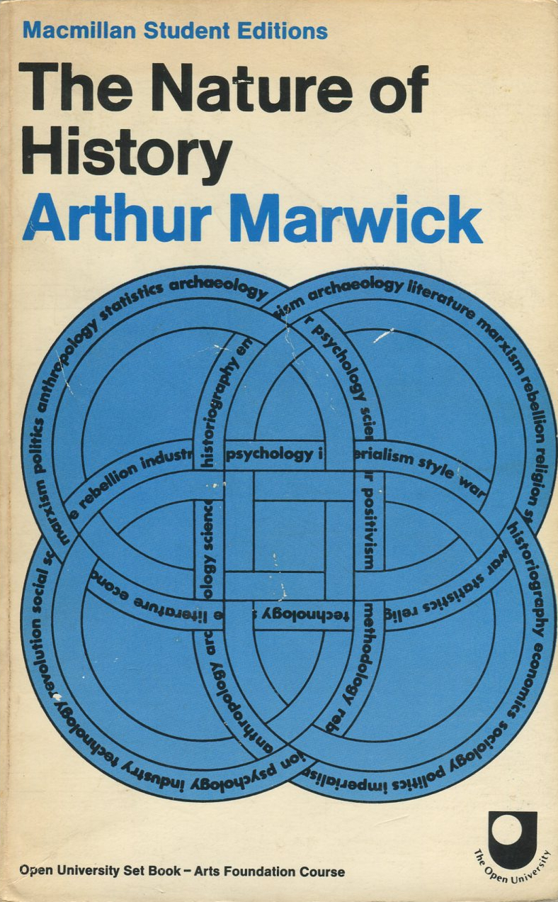
TASK
”Try to imagine what it would be like to live in a society where there was absolutely no knowledge of the past”
What thoughts arise?

Slide 4

TASK
Watch Timothy Snyder’s video Why History Matters
  Try pick the key points from Snyder’s video

Slide 5
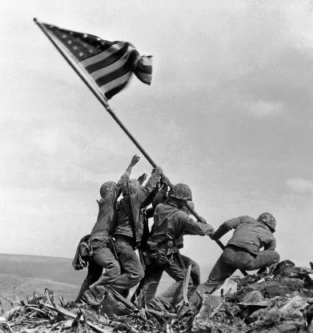
Character of history
We cannot directly observe to the past, historical events, but we can try to find out what happened from the echoes that remain
History utilises evidence from the past, historical sources

Slide 6
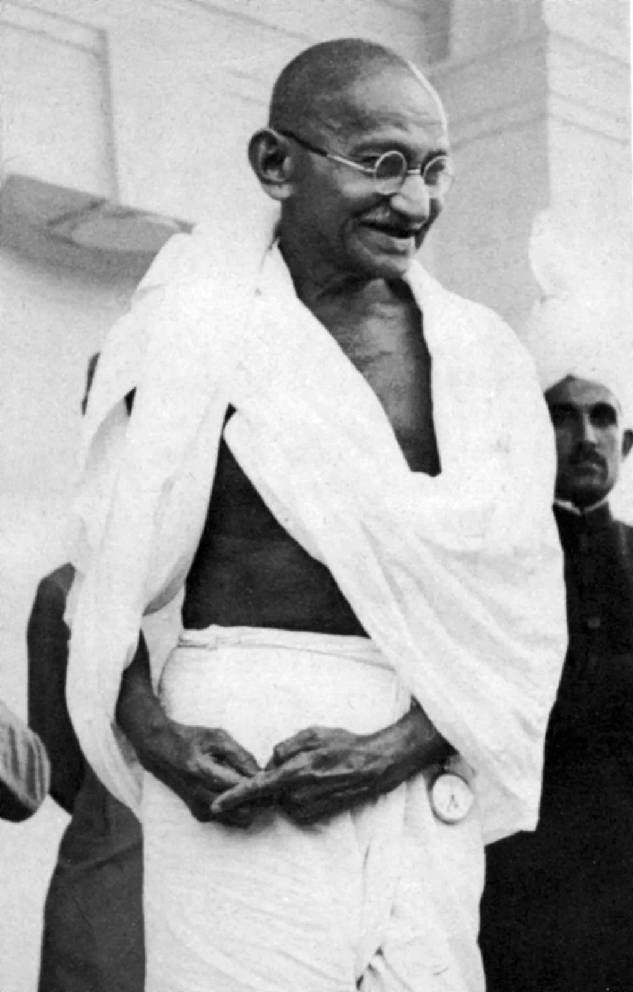
Character of history
Historians evaluate historical sources
  Sources need to be interpreted; importance of discipline literacy and use of language
  Interpretations allow multiple perspectives

Slide 7
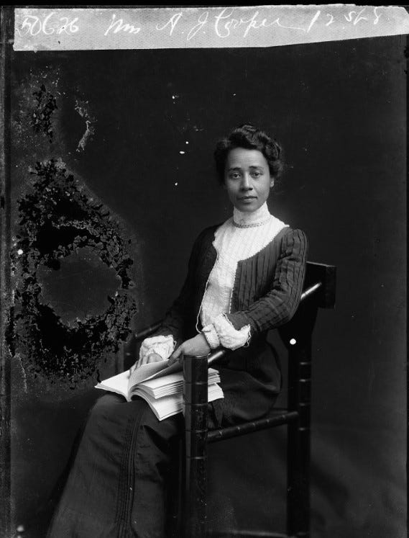
Character of history
Historians evaluate the sources from the perspective of their research
  The context of historians influences what evidence they choose and how and why they write about them

Slide 8
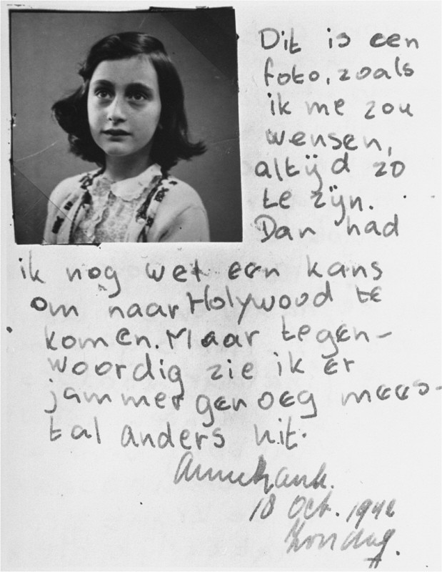
Character of history
History can promote empathy
  Understanding of human lives in diverse places and at different times

Slide 9
TASK
Discuss the questions below concerning historical significance:
  Why have certain historical aspects been recorded and preserved and others have been lost?
  Why is history used to promote a particular topic?
  Why can different textbooks of history tell different versions of the same event?
How is history entwined with power?

Slide 10
Character of history
Historical sources are divided into primary and secondary sources
Primary source is an original source that hasn’t been modified in any way
  E.g. statistics, diary, letter, official document, speech or poster
Secondary source is e.g. a published research on primary sources
Both primary and secondary sources are used in historical research
Evaluation of sources requires a historical research question

Slide 11
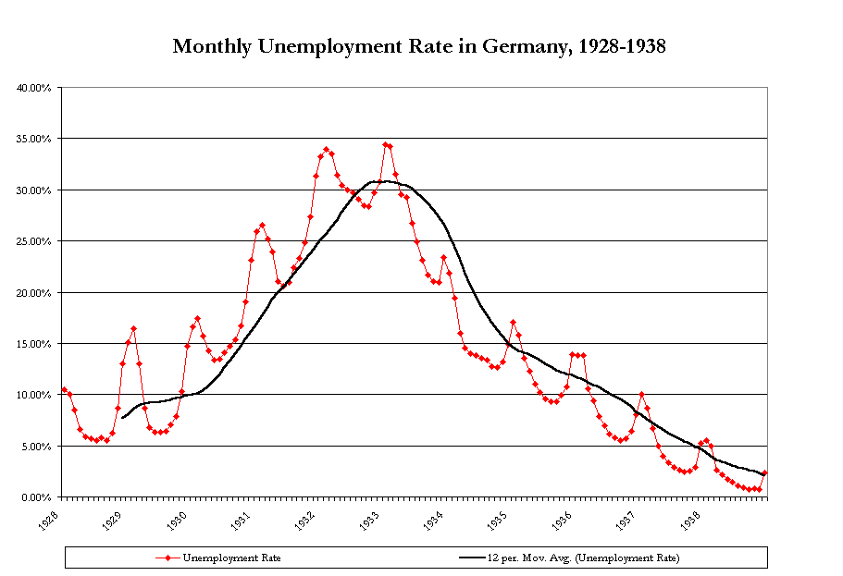
TASK
Your research question is: Why did Hitler rise to power?
Find a primary source related to this historical research question

Slide 12
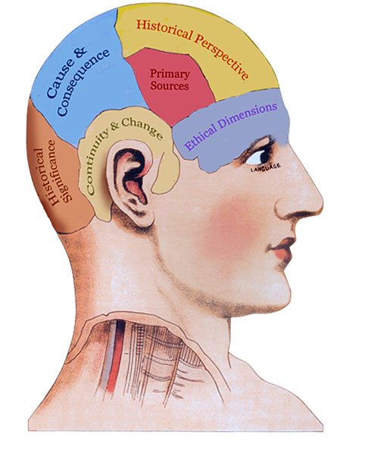
TASK
Teacher divides you into five groups
  Each group must contain at least one IB History student
Practice historical thinking with IB History students throughout five different checkpoints

Slide 13
Character of history
History is NOT
  Memorizing facts
  Presentism: evaluating the past from present situation and present-day values
  Ifs: e.g. what IF Hitler did not rise to power?
History is historical thinking through key concepts:
  Significance
  Primary sources
  Continuity and change
  Cause and consequences
  Historical perspectives
  Ethical dimensions of interpretations

Slide 14

Character of history
History is like a foreign country
  What do you need to do to understand a foreign country?

Slide 15
Historical skills
Evaluation of primary sources regarding a particular research question
Contextualisation: knowing how to connect the research question with each historical situation
Corroboration: skills to compare and contrast the sources regarding a particular research question; similarities and differences between sources
Historical thinking requires historical skills

Slide 16
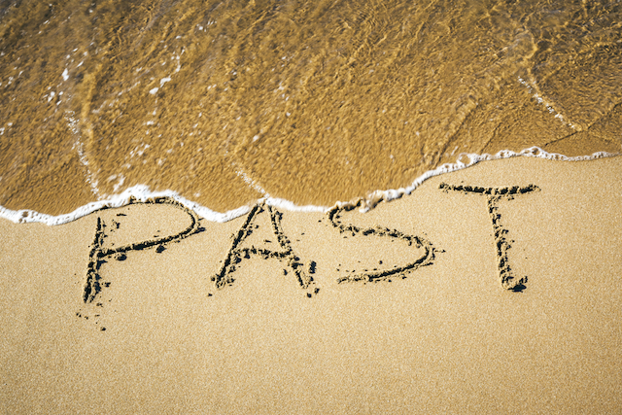
TASK
Is knowledge about the past different from other kinds of knowledge?
Are all AOKs concerned with knowledge of the past to some extent?

Slide 17

TASK
On what criteria can a historian evaluate the reliability of their sources?

Slide 18
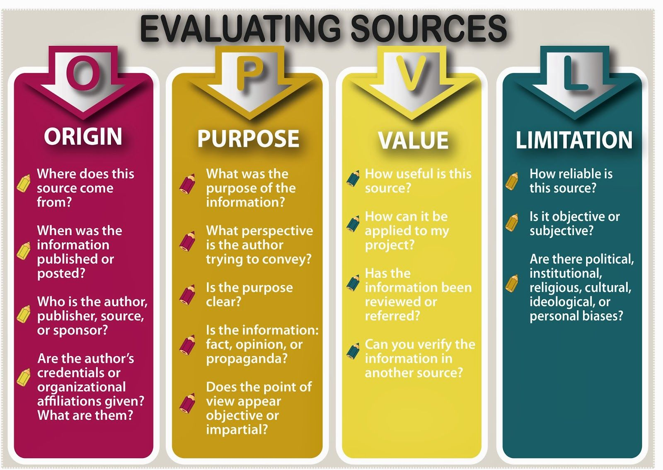

Slide 19
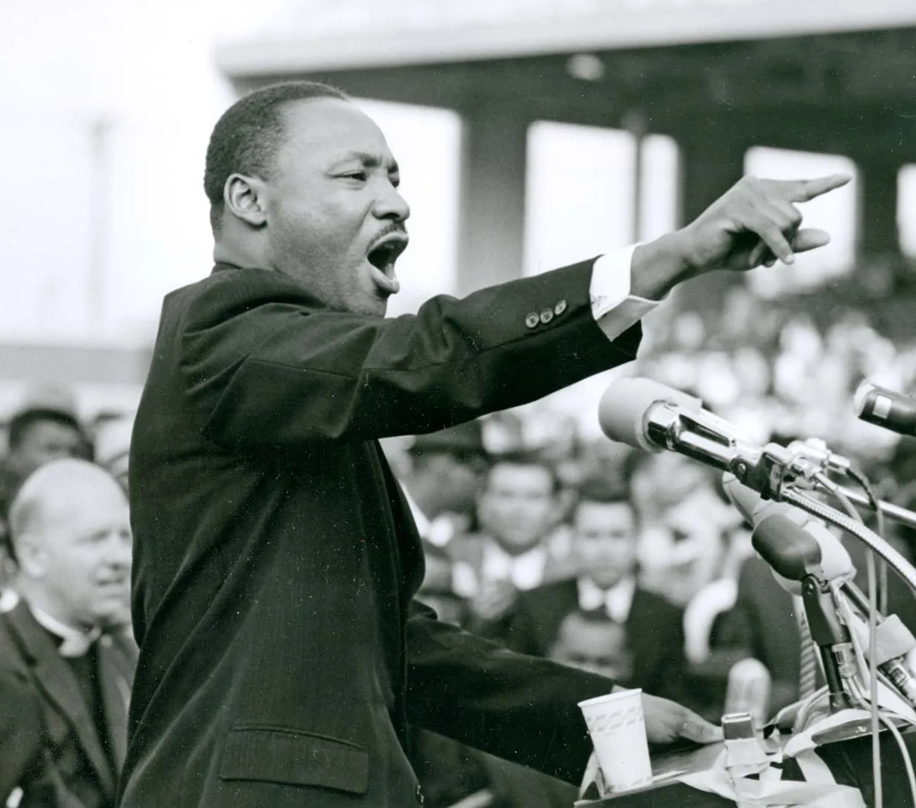
TASK
Teacher divides you into seven groups
Each group must evaluate ONE historical speech as a historical source through a RQ and the OPVL source evaluation model
  Use the teacher’s handout

Slide 20
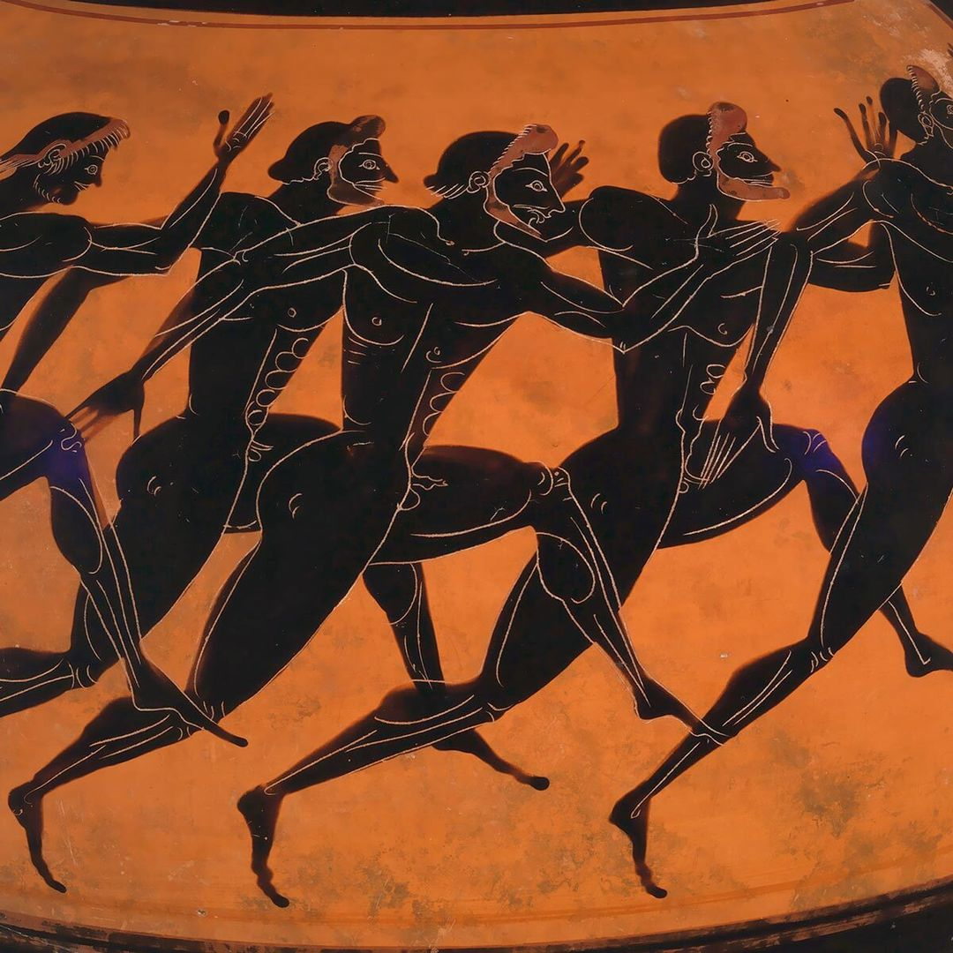
TASK
Is historical knowledge ’scientific’?
  Can (and should) history be approached in a ’scientific’ way?
  What makes history ’scientific’ and what doesn’t?

Slide 21
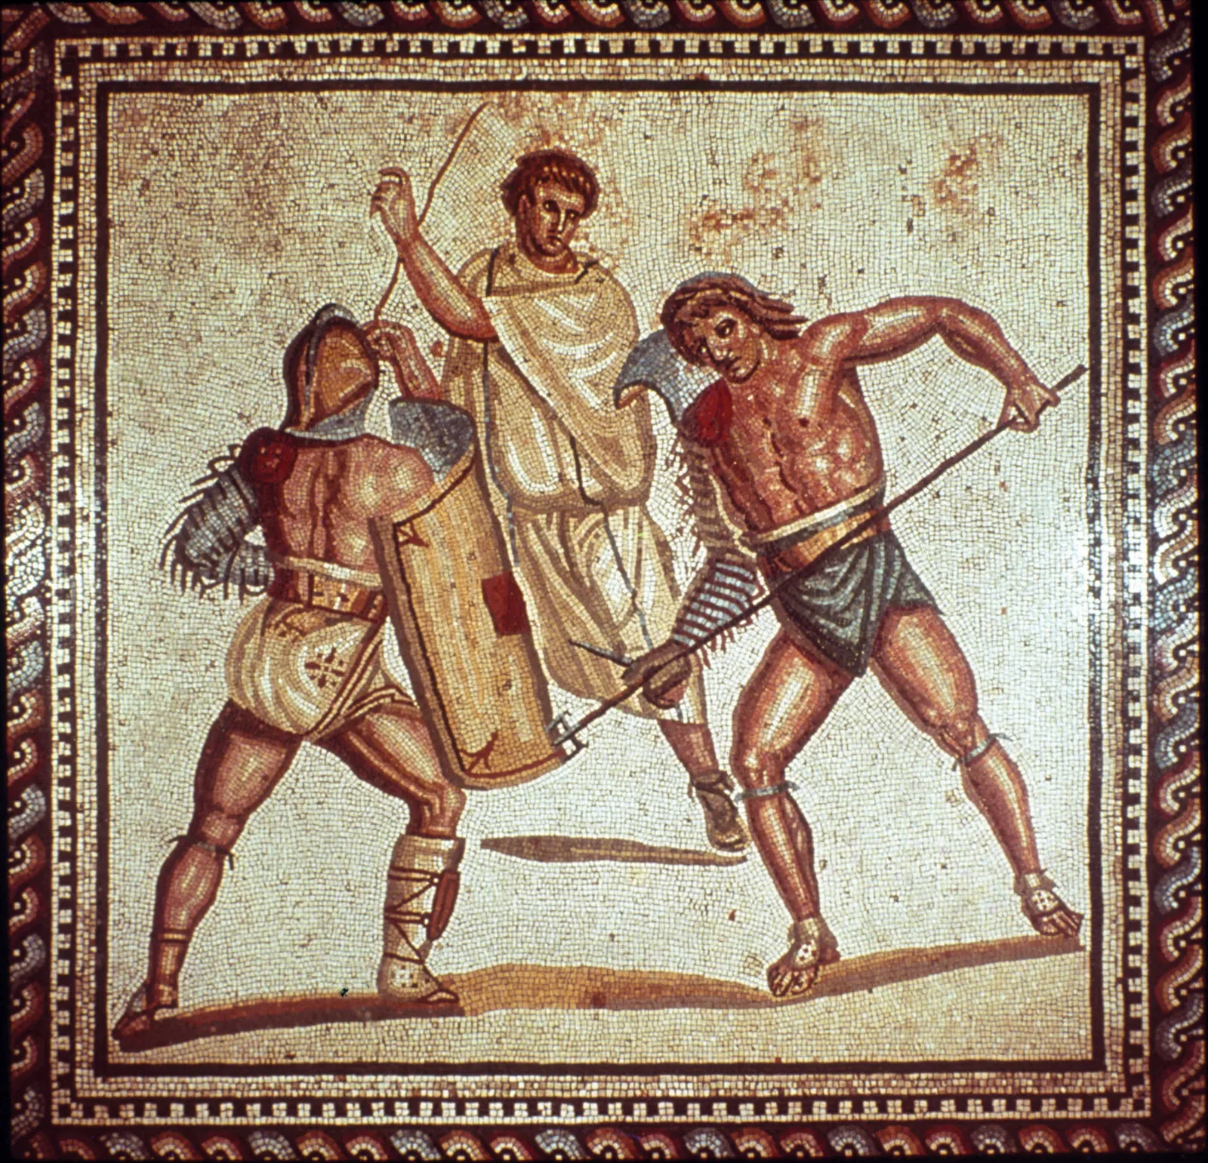
TASK
What counts as a fact in history?
Is truth the goal of all historical inquiry?

Slide 22
Picture sources
The Nature of History <https://www.goodreads.com/book/show/2497282.The_Nature_of_History> Accessed 20th of August 2024.
Timothy Snyder <https://history.yale.edu/people/timothy-snyder> Accessed 16th of August 2024.
Raising the USA flag in Japan 1945 <https://www.dailynews.com/2015/11/10/special-historical-significance-of-this-veterans-day-guest-commentary/> Accessed 21st of August 2024.
Mohandas Gandhi <https://www.britannica.com/biography/Mahatma-Gandhi> Accessed 21st of August 2024.
Black female historian <https://aninjusticemag.com/black-women-historians-in-america-the-pioneers-3311aa191bad> Accessed 21st of August 2024.
Anne Frank <https://encyclopedia.ushmm.org/content/en/article/anne-frank-biography> Accessed 21st of August 2024.
Weimar republic unemployment statistic: <https://pages.uoregon.edu/dluebke/NaziGermany443/410Unemployment1928-1938.html> Accessed 28th of August 2024.
Historical thinking head <https://historicalthinking.ca/historical-thinking-concepts> Accessed 21st of August 2024.
Foreign country <https://uk.style.yahoo.com/12-foreign-countries-where-youre-050000868.html?guccounter=1&guce_referrer=aHR0cHM6Ly93d3cuZ29vZ2xlLmNvbS8&guce_referrer_sig=AQAAAA5_9WBPcUSGlMTcb_JVx3udGAQUGYdBZmbVnyMigzOFaB5r2mwCQHcRu9Cy3vdsr4pvcvtXSsCVFXoVxK0UY9C93S4Eb8nbdSj5432zMbWyyqzi5GTpTfsT4Lp0z9eEdt-WIvLmBPWf9_mNxTO36wC5fts0FjHqNDfCJKAsJuLe> Accessed 30th of August 2024.
Past and wave <https://tinybuddha.com/blog/you-dont-need-to-fix-the-past-in-order-to-have-a-new-future/> Accessed 22nd of August 2024.
Book with magnifying glass <https://www.tes.com/teaching-resource/source-skills-audit-for-history-students-11395672> Accessed 22nd of August 2024.
Evaluating sources – OPVL <https://branksome-asia.libguides.com/c.php?g=938848&p=7027932> Accessed 21st of August 2024.
Martin Luther King, Jr. <https://www.britannica.com/biography/Martin-Luther-King-Jr> Accessed 21st of August 2024.
Ancient Greek athletes <https://www.metmuseum.org/perspectives/articles/2021/7/ancient-greek-olympic-games> Accessed 22nd of August 2024.
Gladiators <https://www.britannica.com/sports/gladiator> Accessed 22nd of August 2024.

