Slide 1
Knowledge and Technology
Scope
Perspectives
Pre-TOK
Sakari Salo

Slide 2
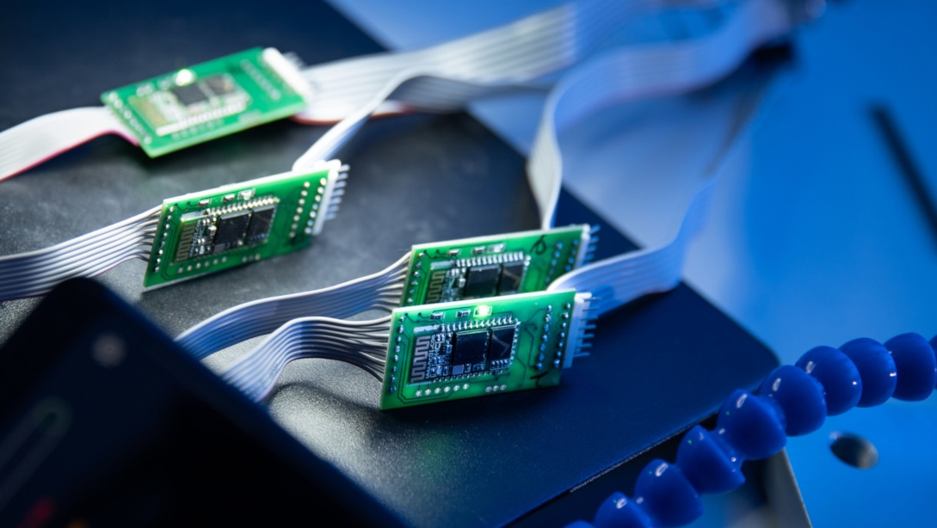
Activity:
What is technology?

Slide 3
Activity: What would world look like without technology?
Have a conversation in small groups
What would be missing?
What would have to be added to the world to take the place of technology?
How are people living?
How are they communicating?

Slide 4
Activity: What would world look like without technology?
Narrow your imagining to the question of technology in the context of construction knowledge
What would it be like for scientists if there was no technology available?
Could an artist construct knowledge?
Would an expert historian be able to develop the types of historical claims that you’re used to?
How much mathematical knowledge would be available if there was no technology?

Slide 5
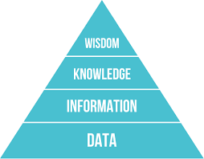
Scope
What is the relation between Data, information and knowledge?

Slide 6
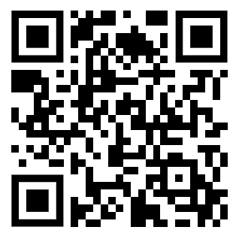
Activity
Use the QR code to visit the website at NASA. Review the following sub-pages:
Evidence
Causes
Effects
Scinetific Concensus
Vital Signs
See if you can apply the concepts of data, information and knowledge by indentifying discrete elements where each is being presented.

Slide 7
Activity: Access to the Internet
How do you access internet?
Make a list of all the ‘access points’ that you can take advantage of to access the internet. Fill the table.
Review your list and consider all the ways in which the availability of the internet might be limited by people, institutions or circumstances beyond your control.
What effect would this have on your status as a ‘knower’? What communities of knowledge would still be available to you? What communities of knowers would you lose access to? How would this affect your ability to construct knowledge?
Ways in which you access the internet | Why are you able to take advantage of that access point? | What might limit your access to that access point?

Slide 8
Activity: is knowledge on the internet reliable?
Engage in conversation in small groups
Does social networks reinforce our existing perspective rather than boost our engagement with diverse perspectives?

Slide 9
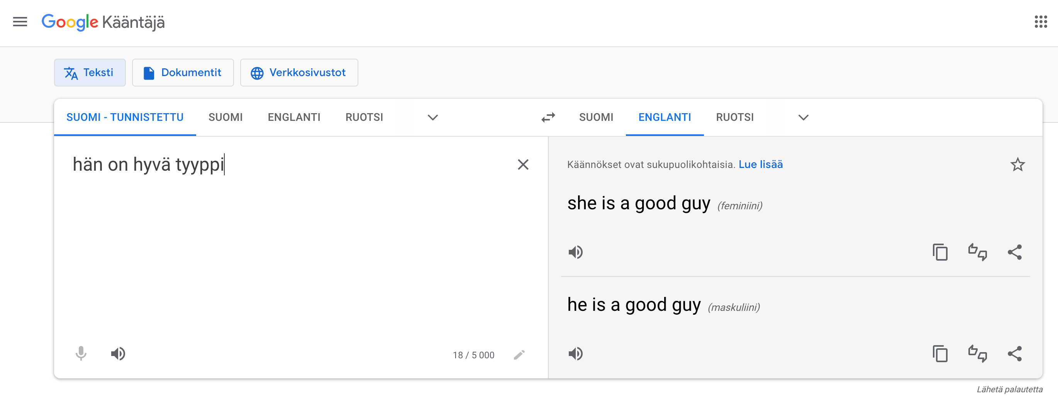
Activity: Bias and technology
Can algorithms be biased?
Engage in conversation In small groups

Slide 10
Artificial intelligence
Debate!
Knowledge question: In what sense, if any, can a machine be said to know something?
Two sides:
Pro: A machine can know something!
Against: A machine knows nothing!

