Slide 1
Knowledge and Technology
Methods and Tools
Ethics
PRE-TOK
Sakari Salo

Slide 2
Methods and tools
How is technology used in creating knowledge?
Is there knowledge that has been developed without technology?

Slide 3
Activity: electron microscope
Consider the difference between ‘conventional’ microscope and an electron microscope:
https://www.youtube.com/watch?v=cQuX8tfwlYA
Engage in conversation with your group:
Would you say that the electron microscope provides genuine ‘observations’?
What other technologies we needed to develop the electron microscopes?
Do you think that the difference in how traditional and electron microscopes function lowers the reliability of the science produced by them?
Do you think that the limited access to electron microscopes limits the construction of knowledge? Who gets to use them? Does it matter that they are relatively hard to find and use?

Slide 4
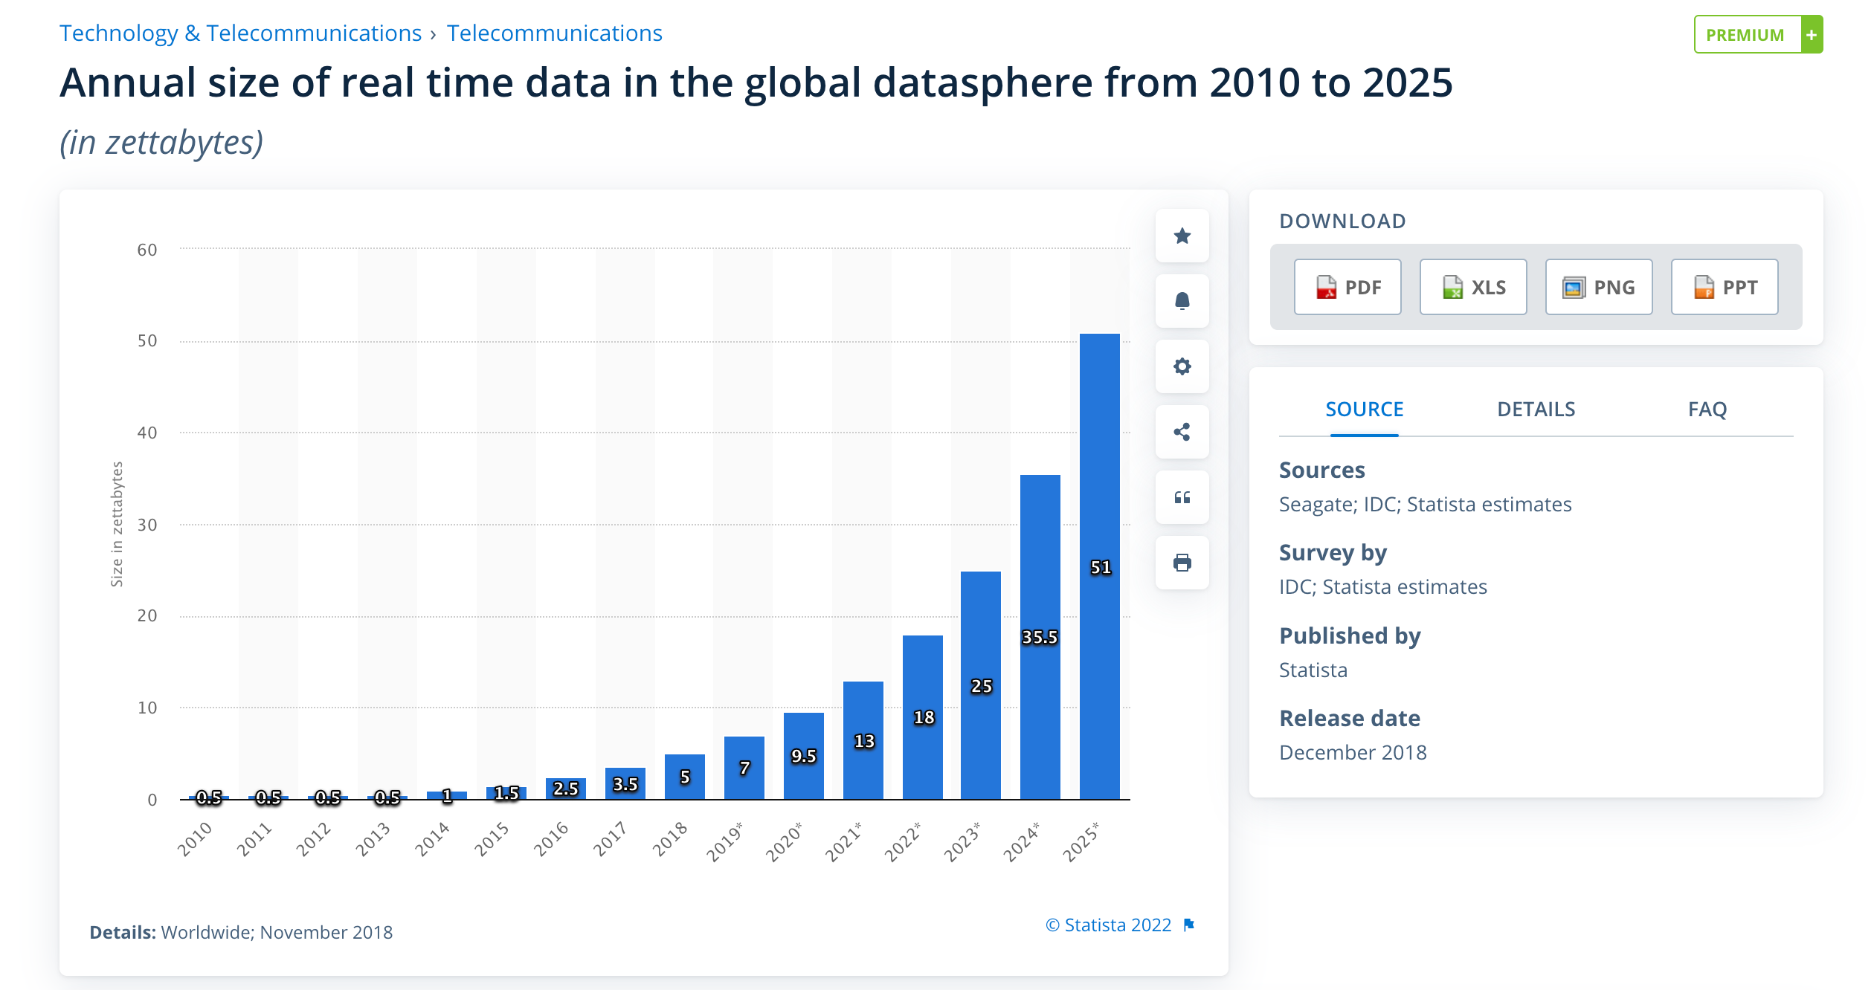
Storage of knowledge
How has knowledge been stored in history? How is it stored today? What role technology plays in preserving knowledge?
Does the fact that so few companies manage the vast amount of knowledge on the internet have a detrimental effect on the quality of our knowledge?
In what ways might our knowledge be unfairly shaped by these companies?

Slide 5
How should the knowledge of human kind be stored?
Design a solution with your group
Accessibility
Reliability
Non-biased
Etc.

Slide 6
Ethics and technology
Warm-up:
1) Come up with an ethical principle that is important to you.
2) Do you find it easy to follow the rule?
3) Share your rule and thoughts about it

Slide 7
Ethics and technology
Activity:
Reseach some ethical considereations of automated facial recognition software. Try entering ’ethics of facial recognition’ into your search engine.
Try to construct an ethical principle which you might appeal to, to justify the use of this software. What about an ethical principle you could rely on to challenge the use of the software?
In cases where there are conflicting ethical beliefs, how do you think we decide which principle should take priority? What methods can be used to decide what is the better principle?

Slide 8
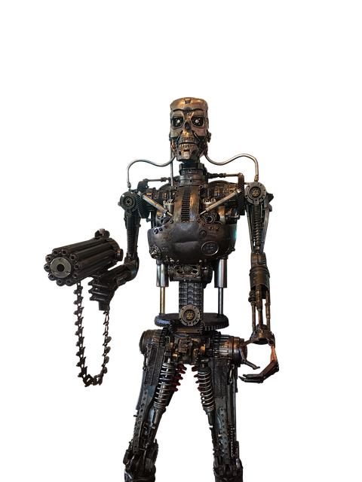
Ethics and technology
Activity: What ethical principles technology should follow? Engage in conversation around the two topics
Nuclear weapons as promoting peace
Using war robots to save lives

Slide 9
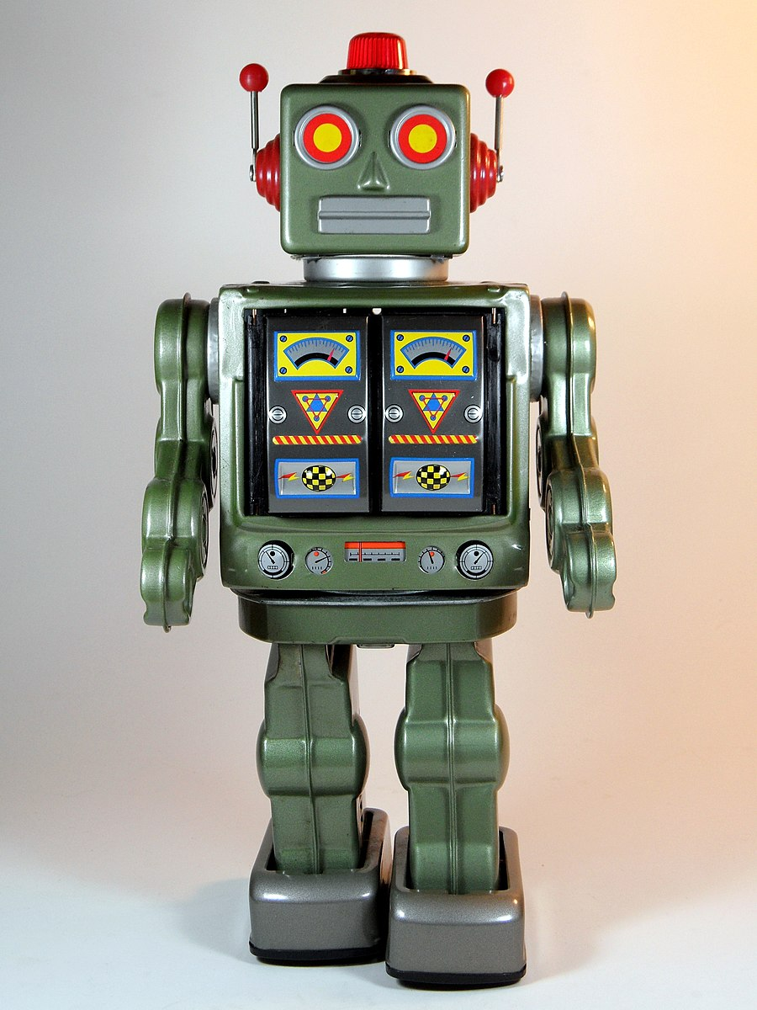
Isaac Asimov: laws for robotics
A robot may not injure a human being, or trough inaction, allow a human being to come to harm.
A robot must obey the orders given by human beings except where such orders would conflict with the First Law.
A robot must protect its own existence as long as such protection does not conflict with the First or Second Law.

Slide 10
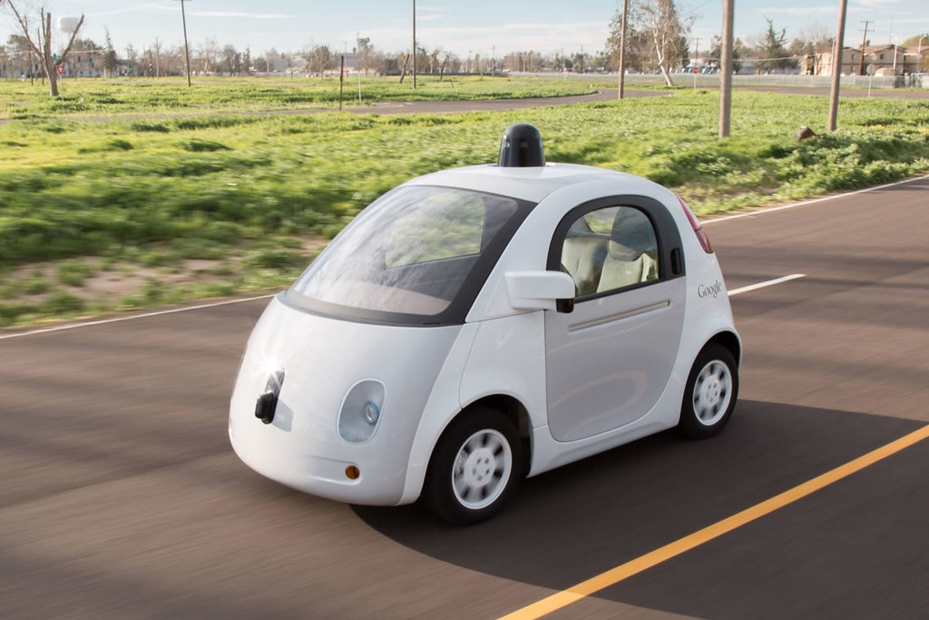
Activity: A self-driving car
Take the MIT Moral Machine test behind the QR code
After the test, consider your results with your group
How well do the Isaac Asimov laws apply here? Suggest improvements!

Slide 11
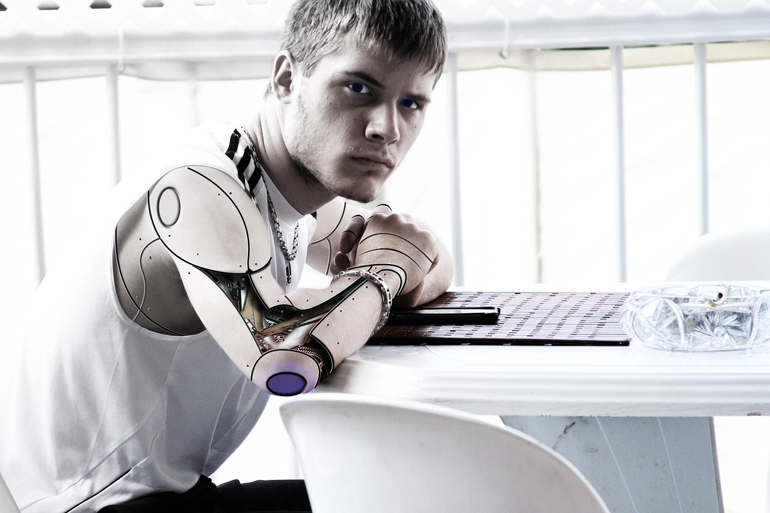
Can AI be a real person?
https://www.youtube.com/watch?v=XKe1qrQ5NtA
Should we care about the AI’s ’feelings’
What ethical rules should be applied here?

