Slide 1
PERSPECTIVES AND KNOWLEDGE
TOK Jyväskylän Lyseon lukio

Slide 2
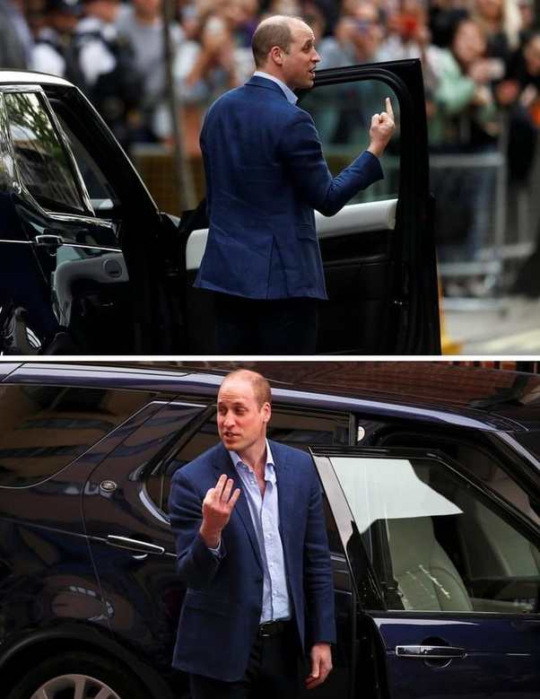
TASK
How do you understand the word perspective?
  Engage in conversation and give meaning(s) to that word
Does everything depend
on the point of view?

Slide 3

Meanings for perspective
In arts
  The method by which solid objects drawn or painted on a flat surface are given the appearance of depth and distance

Slide 4

Meanings for perspective
A particular way of viewing that depends on one´s experience and personality
  ”You´re approaching the problem from a completely different perspective”
A particular way of considering something.
  ”He writes from a Marxist perspective”

Slide 5

Meanings for perspective
The ability to consider things in relation to one another accurately and fairly
  ”Let’s try to talk about both sides of the issue and put it in perspective”

Slide 6
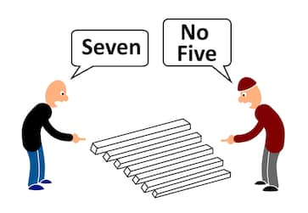
Meanings for perspective
The angle at which an object or concept is viewed by a person or a group of people.
Perspectives may converge or diverge and be a result of a plenty of factors such as upbringing or experience.

Slide 7
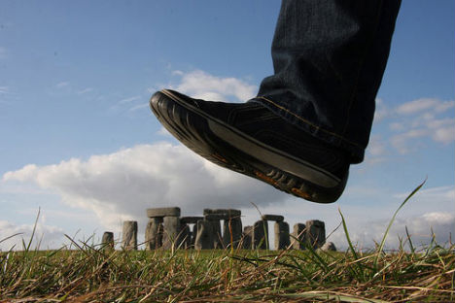
TASK
What is the difference between opinion and perspective?
  To what extent do they overlap and to what extent do they differ?

Slide 8
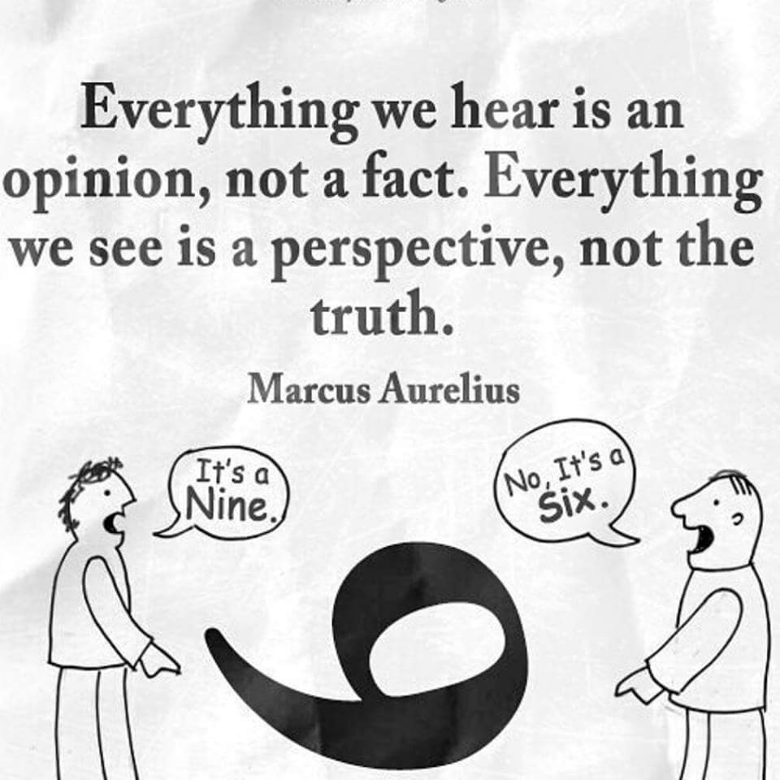
Meanings for perspective
’Different perspective’ can mean something more fundamental than just a ’different opinion’

Slide 9

TASK
Teacher divides you into five groups
Each group revolves around five checkpoints
Each group contributes to each checkpoint

Slide 10
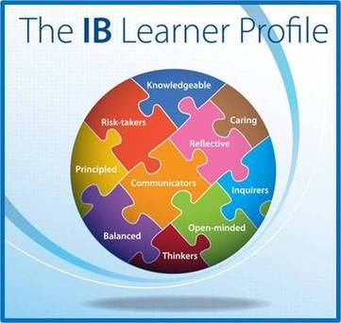
TASK
Is an understanding of the perspective of other knowers essential in the pursuit of knowledge?
  What does it demand that you can see things and world from other person’s perspective?
  How can empathy and imagination help us to understand other perspectives?

Slide 11

EXTRA TASK
Return to your knowledge profile
Pay close attention to the part ”What shapes my perspective as a knower?”
Make amendments, if necessary, based on what you have learned

Slide 12
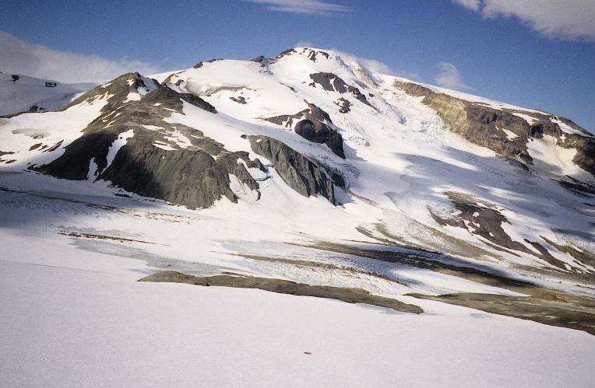
EXTRA TASK
Watch this video on extreme winter sports
How does this kind of way of life, outlook on life and community affect the perspectives and knowledge these people hold?

