Slide 1
INTRODUCTION TO THE
TOK WAY OF THINKING
TOK Jyväskylän Lyseon lukio

Slide 2

Nametag
Make a nametag out of A4 paper
Write a short description of your name
  What does your
  name mean?
  Description can be based on etymology or it can be invented

Slide 3

Picture
Draw a picture of a thing or a school subject or a hobby that you are really interested in

Slide 4

TOK INTRODUCTION GAME
Take your nametag with you
We shall form lines of people by using different methods and then we’ll form small groups with neighbouring students

Slide 5
Name and knowledge
Form a line by the alphabetical order of your first names
Tell the following things about your name to the persons next to you:
  Where does your name come from? What does it mean? How do you know this?
  Who has given you your name? How do you know this?

Slide 6

Favourite subject and knowledge
Form a line by the alphabetical order of your surnames
Tell the persons next to you about your favourite subject(s)
  What has been the most surprising thing you have learned from your favourite subject(s)?
  Does the fact that you have a favourite subject influence the way you know in general?

Slide 7
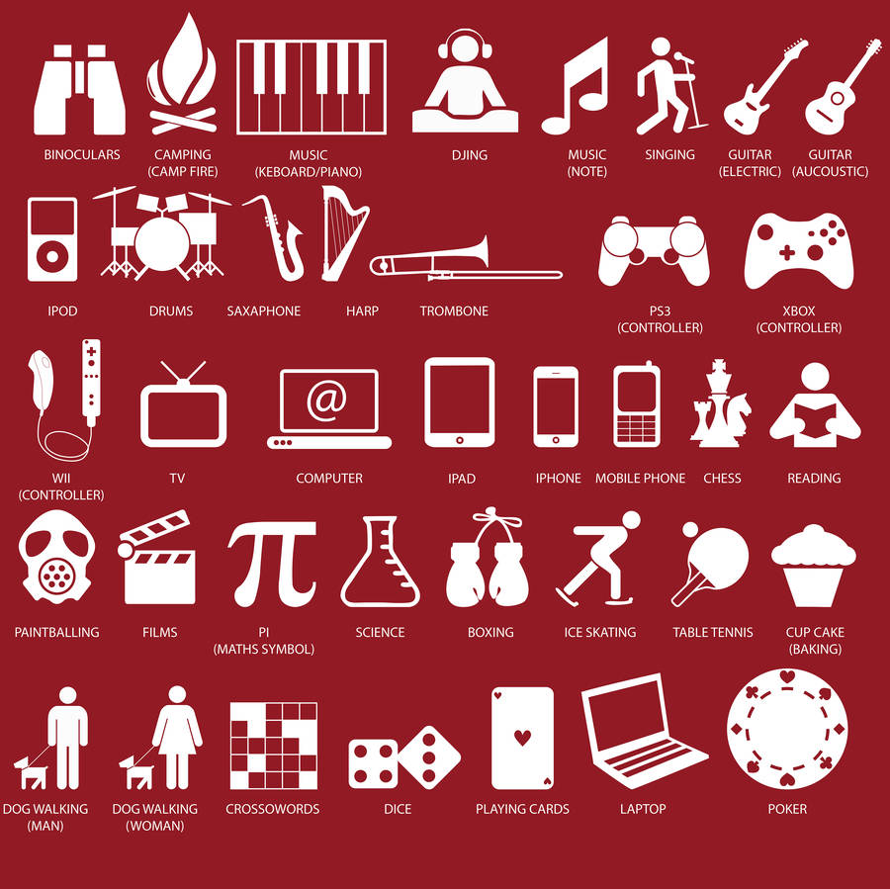
Hobbies and knowledge
Form a line by your shoe size number
Tell the persons next to you about your hobbies
  What kind of knowledge have you gained through your hobbies?
  How have you gained that knowledge?

Slide 8

Culture and knowledge
Form a line by your street address number
Tell the persons next to you about your cultural background
  Does your background play a role in what and how you know?

Slide 9

Uncertain knowledge
Form a line by your birthday date (day)
Reflect uncertainties of knowledge with your group
  What do you take as granted every day as ”true” but really aren’t sure of it?
  How do you know that you are not sure of something?

Slide 10

Unknowns
Form a line by your birthday month
Reflect the limitations of your knowledge
  Is there something that you do NOT know?
  How do you know what you don’t know?

Slide 11

What is knowledge?
Go to the persons that you haven’t been interacting with yet and form small groups
As a team, write a brief definition of knowledge and share it in the ManageBac discussion
  What is knowledge?
Do NOT use any assistive
devices or materials

Slide 12
Picture sources
Nametag <https://www.nametagwizard.com/hello-name-tag> Accessed 11th of August 2015.
Building a computer <http://theinstitute.ieee.org/career-and-education/education/what-would-make-girls-interested-in-engineering-just-ask-them> Accessed 12th of August 2018.
Note <https://pixabay.com/fi/huomautus-musiikki-nuottiavain-1314939/> Accessed 11th of August 2015.
School <https://comosaconnect.org/southern-cross-k-12-school/> Accessed 12th of August 2018.
Hobbies <https://www.notonthehighstreet.com/apieceof/product/personalised-hobbies-t-shirt> Accessed 12th of August 2018.
Culture <http://www.internationalmuseumofcultures.org/events/international-culture-dinner-world-cultures/> Accessed 12th of August 2018.
The truth is out there <http://quotesgram.com/the-truth-will-come-out-quotes/> Accessed 15th of August 2015.
Unknown <https://www.sexedcenter.org/what-are-the-unknown-unknowns-about-puberty/> Accessed 12th of August 2018.

