Slide 1
25IB INSTRUCTIONS FOR THE PRACTICE TOK EXHIBITION AND LONG LESSONS DAY ON THURSDAY 28TH OF MAY 2026
TOK Jyväskylän Lyseon lukio

Slide 2

Outline of Thursday 28th of May
We’ll start at 8.15
Practise TOK exhibition + finalising the document
Developing the knowledge profile (or getting it done if you were absent earlier)
The day ends ca. 14.00

Slide 3
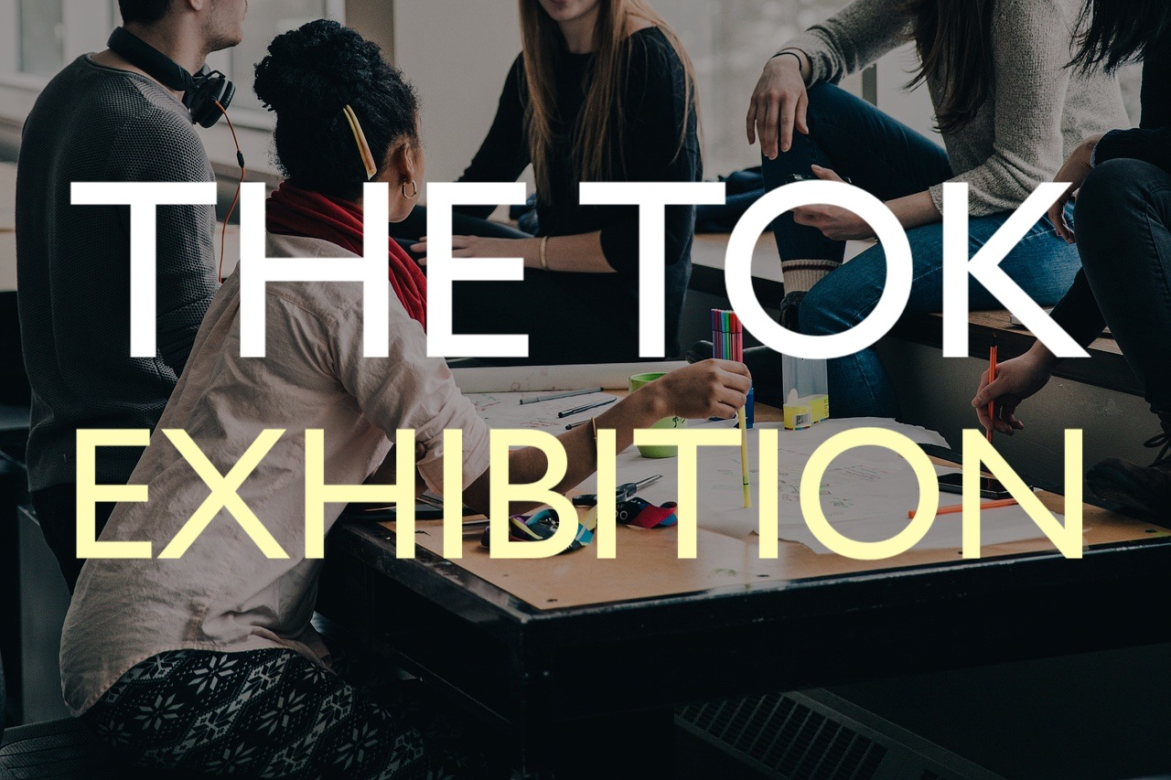
Real TOK exhibition (IB1 year)
Individual exhibition with three objects that connect to one IA prompt
One file maximum of 950 words for each student (ManageBac)
Approximately 8 hours of work per student
Internally assessed by the school’s TOK teachers

Slide 4
Practice TOK exhibition (pre-IB)
Individual exhibition with ONE object that connects to one IA prompt
One file maximum of 300 words for each student (ManageBac)
Brief oral presentation of the exhibition for the class
Peer-review + brief feedback from the teachers
PRACTICE

Slide 5
Practice TOK exhibition
The exhibition should be based on one TOK theme
  Core theme: knowledge and the knower
  One of the optional themes (technology, language, politics, religion, indigenous societies)
The chosen object and the IA prompt, the knowledge question, should fit within the chosen theme

Slide 6
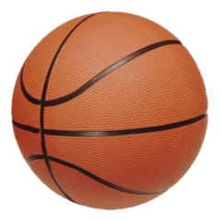
Practice TOK exhibition
The chosen object should have a specific real-world and personal context
  Moreover, the object should be well connected with the IA prompt
Students within the same class should NOT use the same objects

Slide 7

Practice TOK exhibition
The biggest mistake in practice TOK exhibition is that the work becomes a mere presentation of the object and not an enquiry of of the selected IA prompt or knowledge question

Slide 8

Practice TOK exhibition
What knowledge is manifested by the object and what it is about this object that makes it interesting for a discussion of the prompt?

Slide 9
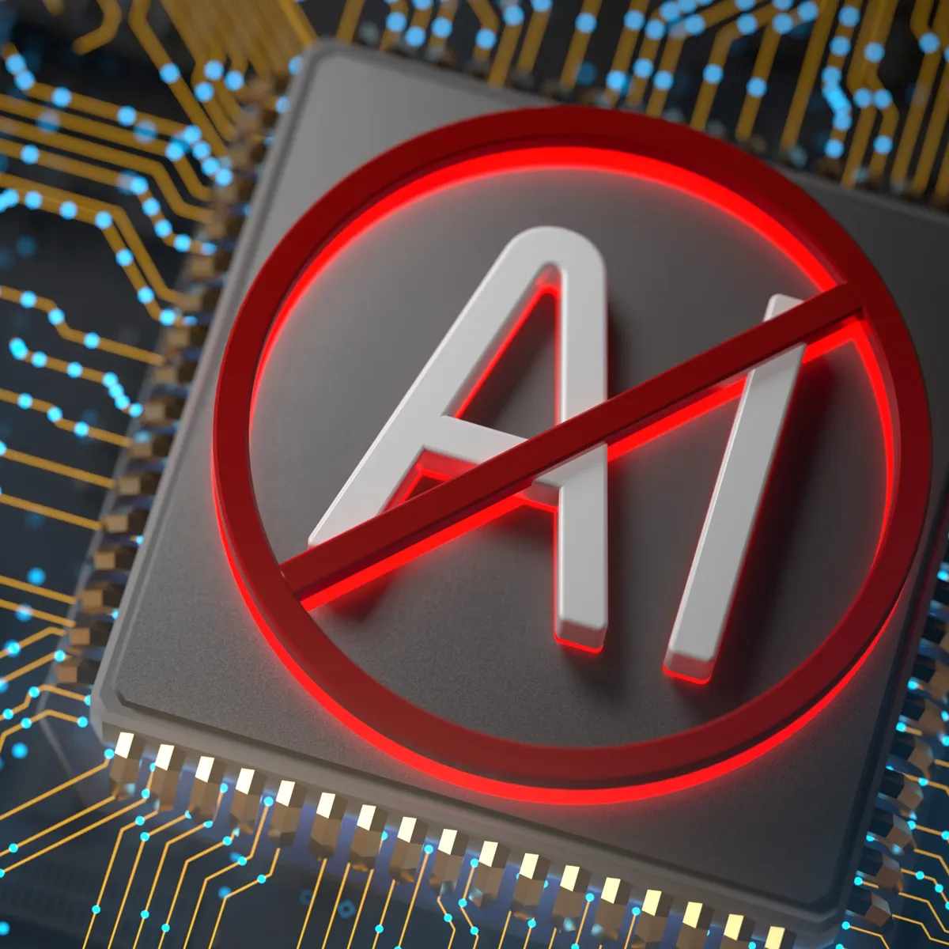
Practice TOK exhibition
Using Artificial Intelligence (AI) is NOT recommended!
  However, there are IBO’s guidelines for the proper use of AI
  Everyone is obliged to make an AI statement into their document

Slide 10

Practice TOK exhibition
Turnitin software is used to detect any kind of malpractice
Any unauthorized use of AI will lead to failing condition without exceptions!

Slide 11
TASK
Work in small groups
(1) Immerse yourselves with the IA prompt list
(2) Review the TOK themes (Core theme and Optional themes)
  What are the most interesting themes in your opinion?
(3) Compare your tentative objects
  How could the objects embody the nature of TOK and knowledge?
(4) What could be the best possible IA prompts and themes to support the objects you chose?

Slide 12

TASK
Start doing your practice TOK exhibition
Follow the instructions in the file TOKPExhibition.pdf

Slide 13
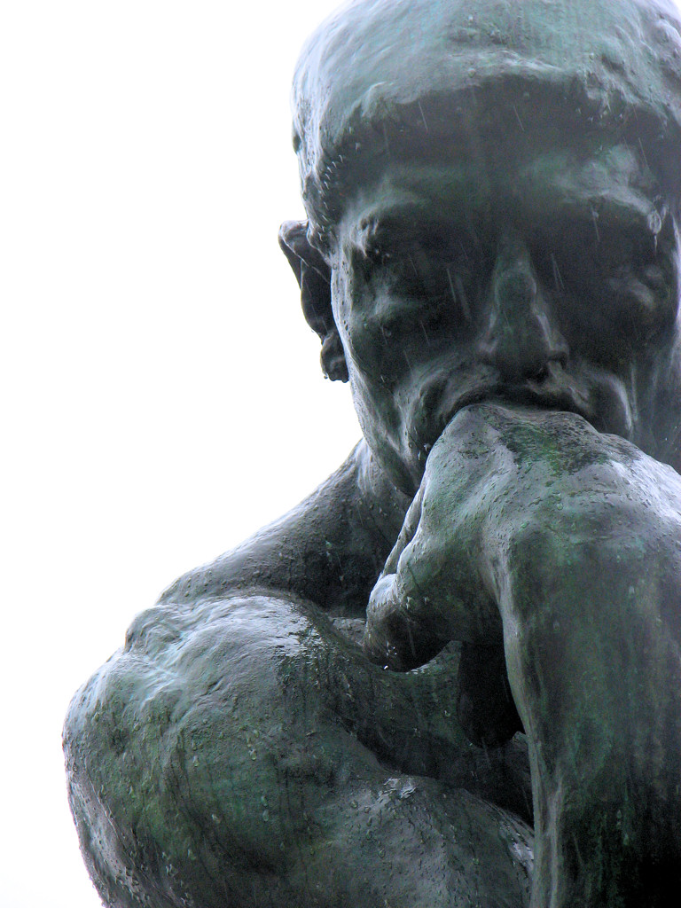
TASK
How has the pre-IB TOK course helped you to develop yourself as a knower?
  Engage in small group conversation

Slide 14

TASK
Return to the task
My Knowledge Profile
Improve your knowledge profile based on what you have learned during the pre-IB TOK course
  Original instructions can be found from peda.net
  Upload your enhanced knowledge profile to ManageBac

Slide 15
Picture sources
TOK <https://glopoib.wordpress.com/tok-and-global-politics/> Accessed 25th of May 2021.
TOK exhibition <https://www.theoryofknowledge.net/tok-2022/tok-exhibition/> Accessed 26th of March 2020.
Basketball <https://fi.wikipedia.org/wiki/Koripallo> Accessed 21st of
Red alert <https://james-scifi-journal.com/2023/05/10/red-alert-red-alert/> Accessed 13th of May 2025.
Knowledge <http://www.stonecobra.com/knowledge-as-a-service-kaas-a-proposal/> Accessed 15th of August 2015.
AI ban <https://www.zdnet.com/article/this-social-network-bans-all-ai-images-heres-why-and-how-to-sign-up/> Accessed 18th of March 2026.
Turnitin <https://www.turnitin.pt/press/turnitin-advances-academic-integrity-with-launch-of-ithenticate-2-0-and-new-similarity-report> Accessed 13th of May 2026.
Impossible framework <https://www.1001freedownloads.com/free-clipart/impossible-cubes> Accessed 26th of March 2020.
Rodin’s thinker <https://commons.wikimedia.org/wiki/File:The_Thinker_Musee_Rodin.jpg> Accessed 29th of April 2020.
Profile picture <http://baxtercoaching.com/testimonial/anthony-bennett-sport-communications-professional-in-the-cfl/facebook-default-no-profile-pic> Accessed 17th of August 2016.

