Slide 1
TOK FIRST ASSESSMENT 2022
IB TOK LAJM

Slide 2
Nature of TOK
TOK is still about critical thinking and knowing about knowing
”The main focus of TOK is not on students acquiring new knowledge but on helping students to reflect on, and put into perspective, what they already know.”
Holistic approach through different disciplines

Slide 3
What will change?
The TOK syllabus has been streamlined
Clearer ideas for schools of what should be done during the TOK course
Lots of given examples and ideas provided by the IBO

Slide 4
What will change?
NO formulation of knowledge questions
Just exploring / discussing given knowledge questions

Slide 5
What will change?
New ”knowledge framework”
Scope
Perspectives
Methods and tools
Ethics
The ”knowledge framework” should be applied in all parts of the TOK course

Slide 6
What will change?
New core theme:
knowledge and the knower

Slide 7
What will change?
Five optional themes
Knowledge and technology
Knowledge and language
Knowledge and politics
Knowledge and religion
Knowledge and indigenous societies
TWO optional themes should be covered
Five compulsory areas of knowledge
History
The human sciences
The natural sciences
The arts
Mathematics

Slide 8
What will change?
Course outline
Core theme: knowledge and the knower AND two optional themes 32h
Five areas of knowledge 50h
Assessment TOK exhibition 8h and TOK essay 10h, total 18h
TOTAL 100h

Slide 9
What will change?
TOK presentation has been transformed into TOK exhibition (8h)
TOK essay will remain, but TOK essay titles will be knowledge questions (10h)

Slide 10
Ideas for development
Implementing TOK in IB subjects should be easier with the new syllabus
How to do TOK links?
How to do integration?
Teachers’ TOK exhibition?

Slide 11
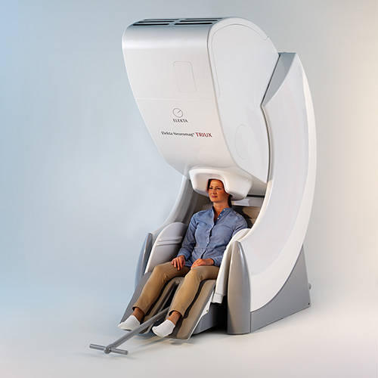
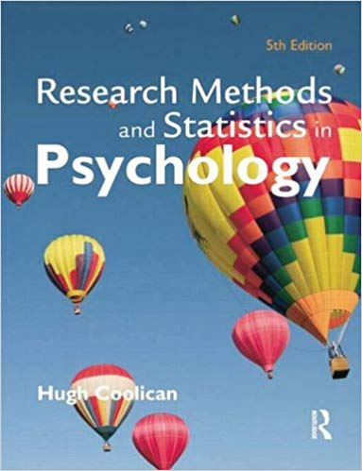
Example of teacher’s TOK exhibition
To what extent is objectivity possible in production or acquisition of knowledge?

Slide 12
Picture sources
IB logo <https://vimeo.com/iboorg> Accessed 29th of February 2020.
TOK Guide for First Assessment 2022. Published in February 2020.
Clock head <https://postmedia.us.janrainsso.com/static/server.html?origin=https%3A%2F%2Fnationalpost.com%2Fentertainment%2Fbooks%2Fhow-the-world-became-obsessed-with-time-and-efficiency> Accessed 6th of March 2020.
Wheel brain <https://businessmarketingengine.com/how-growing-your-knowledge-can-grow-your-business/> Accessed 29th of February 2020.
MEG device <https://www.elekta.com/diagnostic-solutions/elekta-neuromag-triux/> Accessed 6th of March 2020.
Interview <http://theconversation.com/the-surprising-secret-to-successful-psychotherapy-104301> Accessed 6th of March 2020.
Cooligan’s book <https://www.amazon.com/Research-Statistics-Psychology-Coolican-2009-03-27/dp/B01NH0BMW3> Accessed 6th of March 2020.

