Slide 1
LEARNING
Pre-IB Psychology LAJM

Slide 2

TASK
What have you learned
today?
a week ago?
a year ago?
How have you learned these things?

Slide 3

TASK
What is learning?
Try to give some kind of definition
You may also try to categorise different types of learning
DON’T use any assistive devices or materials

Slide 4

What is learning?
The relatively permanent change in knowledge and/or behaviour that is the result of experience

Slide 5
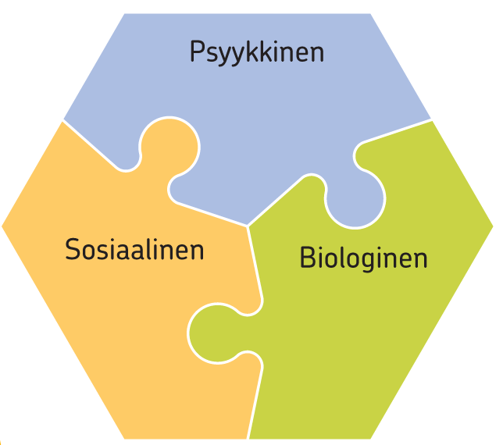
TASK
How does learning manifest itself:
psychologically (mentally)?
physically (biologically)?
socially / culturally?
Try to provide concrete examples!
Write down your ideas!

Slide 6
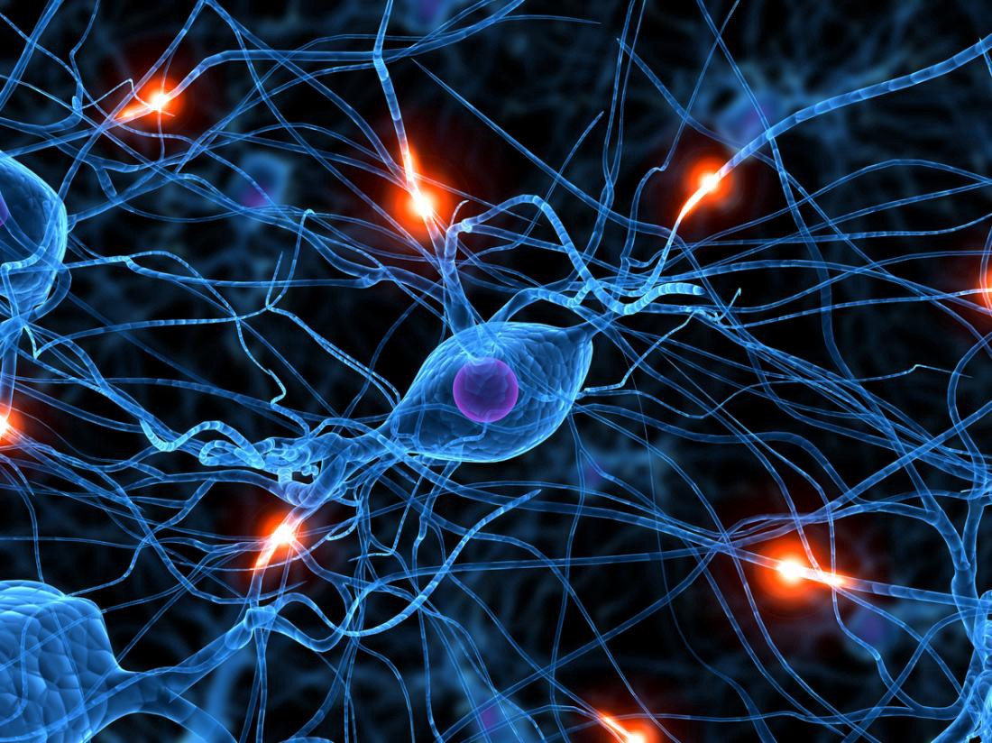
Biological aspects in learning
Learning is based on the activity of neurons and their intricate interplay in neural networks

Slide 7
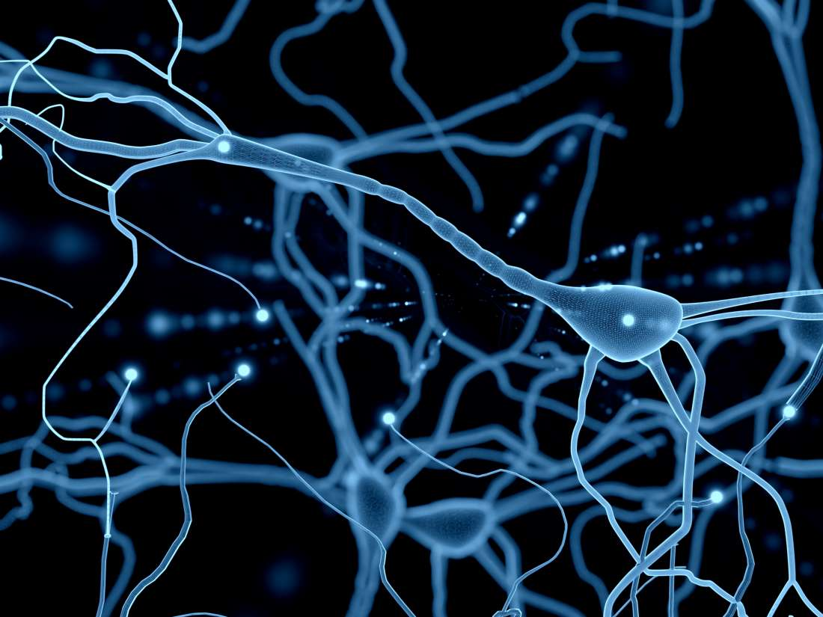
TASK
Read pages 70–74 and 82–83
Study the following
Neuron and its parts
Synapse
Neurotransmitter
Neuroplasticity

Slide 8
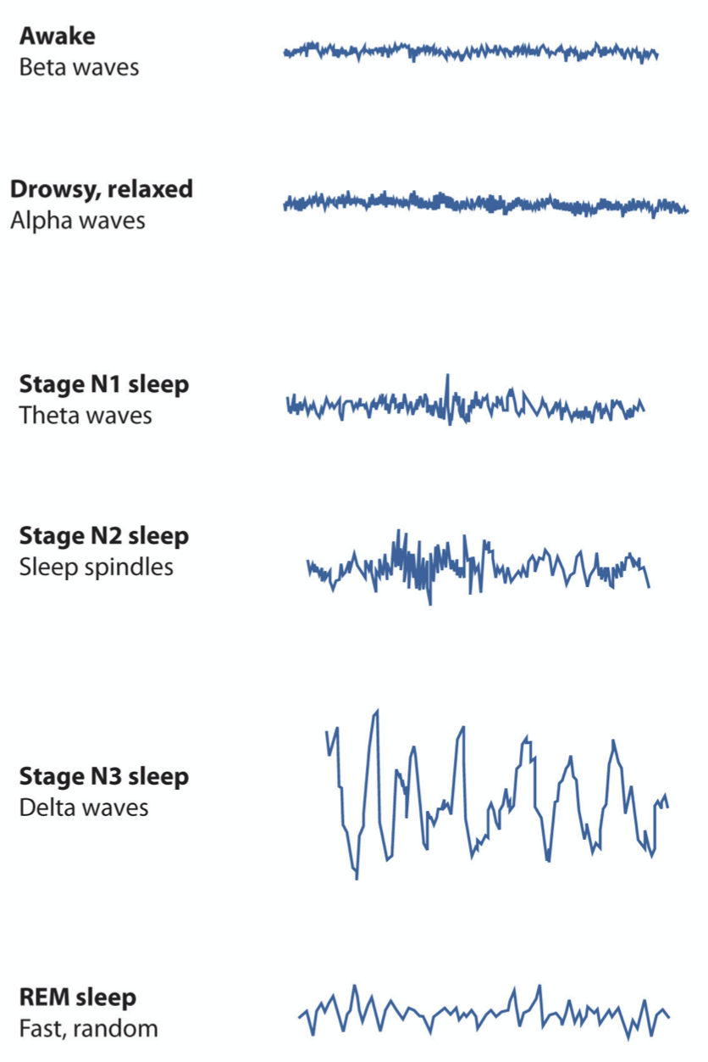
Biological aspects in learning
Sleep is the prerequisite for learning
During sleep the brain’s lymphatic system cleans up the brain from metabolic waste
Sleep consolidates learning and is vital for our overall well-being

Slide 9
TASK
Reflect your experiences under sleep deprivation
How has the lack of sleep influenced your learning?
Read pages 170–172 ”The Heavy Costs of Not Sleeping”
How much do you need sleep?
How could you enhance your sleeping habits?

Slide 10

Cognitive functions
Cognitive
The process of acquiring and using knowledge; information processing
E.g. attention, perception and memory

Slide 11

TASK
Two volunteers are needed for a psychological test
The volunteers need to act according to the teacher’s instructions

Slide 12
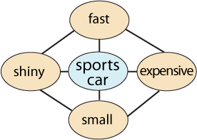
Cognitive functions
Reality is perceived and information is processed through schemas
Patterns of knowledge concerning self and/or environment

Slide 13
Cognitive functions
ENVIRONMENT
CYCLE OF PERCEPTION
SELECTS
TARGETS
CHANGES
SCHEMA
PERCEPTION
DIRECTS

Slide 14
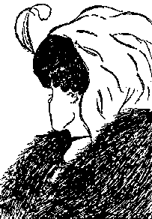
TASK
Think about your own schemas
How have they developed in the cycle of perception?
Explain to your pair/group

Slide 15
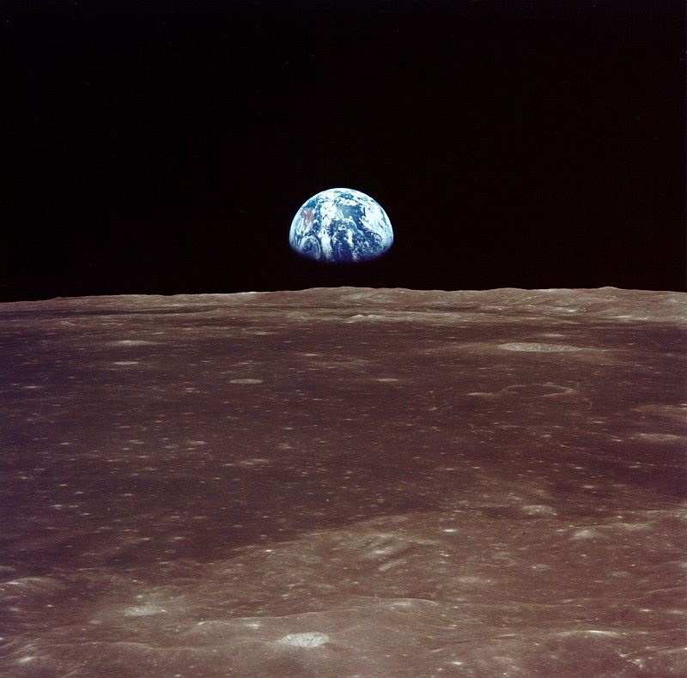
TASK
Describe the following things with five words
Self (you)
World
Values
Human
Engage in conversation with your pair/group
How different or similar were your word lists?

Slide 16

TASK
How do your schemas about yourself and the world around you influence your learning?
Reflect your learning experiences and engage in conversation
Try to provide examples

Slide 17

Cognitive functions
Memory
The ability to store and retrieve information over time

Slide 18
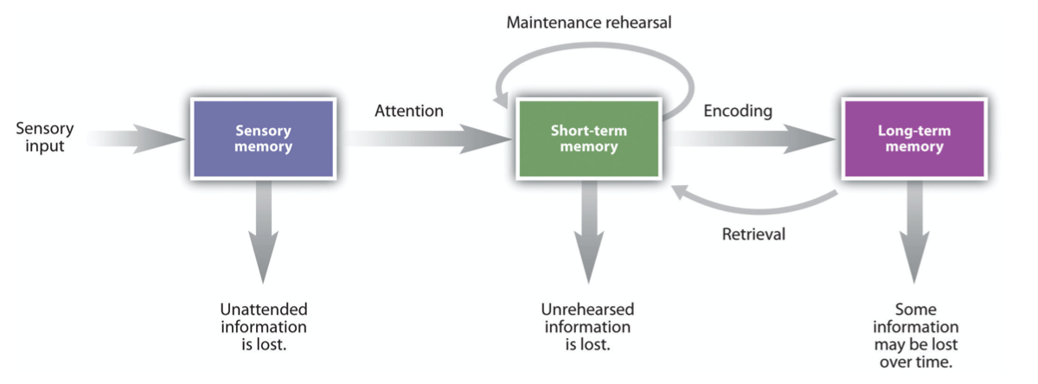
TASK
Read pages 294–299
Study the basics of
Sensory memory
Short-term memory
Long-term memory

Slide 19
TASK
How can you enhance maintenance rehearsal in order to encode stronger and longer lasting memories?

Slide 20
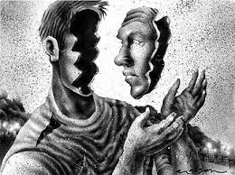
Conscious and unconscious mind
Consciousness
Our subjective awareness of ourselves and our environment
The whole of our psychic experiences in certain moment

Slide 21
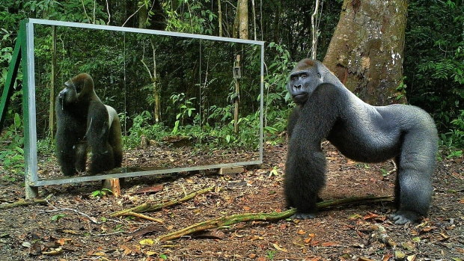
TASK
Watch this video on animals in front of a mirror

Slide 22

Conscious and unconscious mind
Attention acts as a gatekeeper
Selects what parts of perception and memories gets access to consciousness
Unconscious
Thing that is left outside the consciousness
Can influence our mind and behaviour

Slide 23

Conscious and unconscious mind
Psychodynamic view of unconsciousness
Forms about 90% of the human psyche
Mixture of primitive needs, childhood memories and repressed emotions

Slide 24

Conscious and unconscious mind
Cognitive view of unconsciousness
Automatized psychic functions
Things that are thoroughly learned

Slide 25
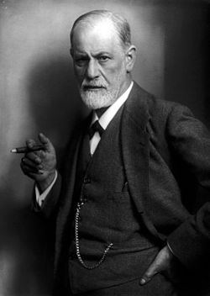
TASK
In your opinion, which theory explains unconsciousness better? Psychodynamic view or cognitive view?
Try to provide arguments!

Slide 26

TASK
How does the unconscious part of the mind influence your learning?
You can apply both psychodynamic and cognitive views
Try to provide examples

Slide 27

TASK
Choose things that are important to you
E.g. doing sports, point of interest or friends
Compile a small list
What makes you act towards your important things?
Write down reasons for your actions after each important thing

Slide 28
Motivation
Motive
Reason or incentive that makes you do something
Motivation
Sum of different motives
Hunger (motive)
Preference for chocolate (motive)
Desire to spend time with friends (motive)
Having a chocolate cake in a cafe with friends (motivation)

Slide 29
Motivation

Slide 30
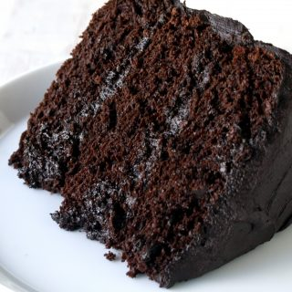
TASK
Make pairs
Swap the lists of important things and reasons for your actions with your pair
Analyse the reasons for actions in your pair’s list
Are the motives biological, psychological or social-cultural?

Slide 31
Motivation
Other classifications of motives
Innate | Learned
Short-term goal | Long-term goal
Extrinsic | Intrinsic
Approach | Avoidance
Conscious | Unconscious
Find examples of each type of motive

Slide 32
Motivation
GOALS
Human action is usually oriented towards a goal
EMOTIONS Emotions tell whether the goal is approached or not
SELF-EFFICACY
Beliefs in our ability
to carry out actions towards a goal
MOTIVATION

Slide 33

TASK
Compile a plan that enables you to act towards your important goal with bigger motivation
Is my goal clear?
How can I foster positive emotions in pursuing my goal?
Do I believe in my own abilities in pursuing my goal?

Slide 34
Motivation
Fixed mindset
Belief that abilities are hereditary and predetermined
Growth mindset
Belief that abilities are results of diligent practise and hard work
Beliefs concerning abilities can be changed!

Slide 35

TASK
How is motivation connected to learning?
How can you apply the contents and concepts related to motivation to your personal learning and studying?

Slide 36

Motivation
Different goals guide learning e.g.
aspiration to understand
quest for acceptance
ambition for high grades

Slide 37

TASK
When was the last time that you experienced a strong emotion?
What was the emotion?
How did the emotion influence your behaviour?
Was the emotion useful?

Slide 38

Emotion
Emotions helps us to guide our actions and to make decision
Emotions, cognitive functions and motivation are entwined
Describing emotions can be difficult due to their deep subjective nature

Slide 39
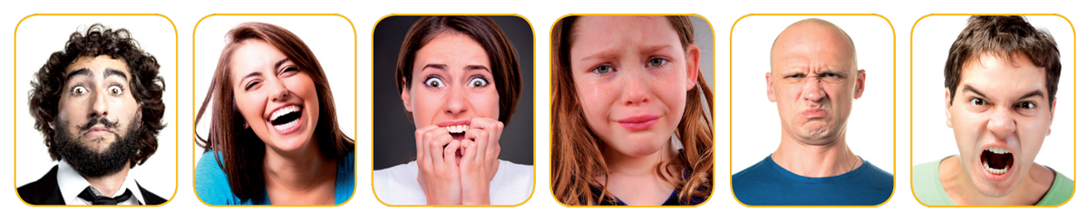
Emotion
Can you recognize the following basic emotions?
ASTONISHMENT
JOY
FEAR
SORROW
DISGUST
ANGER

Slide 40
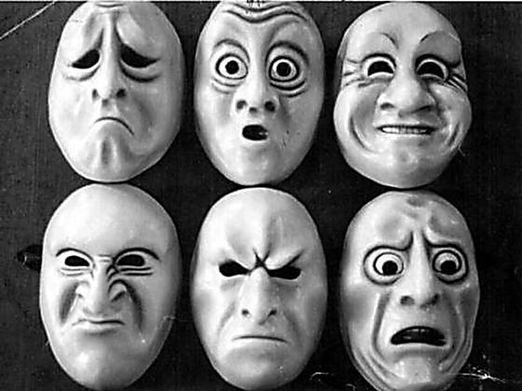
Emotion
Basic emotions are universal
Innate
Are interpreted in the same way in every culture
Cultures differ in when, how and to whom emotions are allowed to be expressed

Slide 41
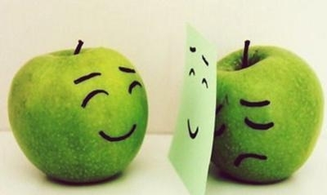
TASK
How do different emotions influence your learning?
Reflect your experiences and engage in conversation
Try to provide examples

Slide 42
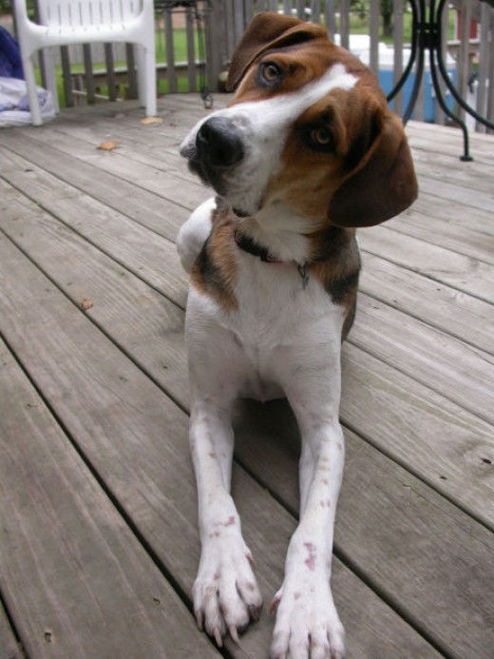
Incidental learning
(1) Habituation i.a. familiarization
Decreased responsiveness toward a stimulus after it has been presented numerous times in succession

Slide 43
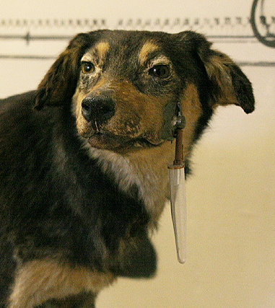
TASK
Read pages 254–256 and 261–263
Find out the basic principles of classical and operant conditioning

Slide 44
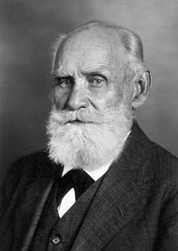
Incidental learning
(2) Conditioning
One learns to react to stimuli that has not been reacted before

Slide 45
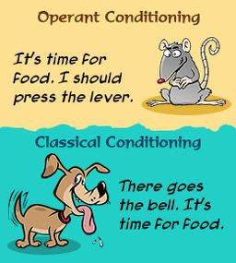
TASK
Watch this education video on classical and operant conditioning

Slide 46
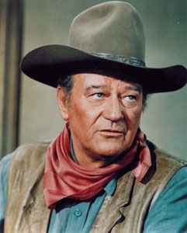
TASK
What kind of idols do you have?
Musicians?
Actors?
Athletes?
How have you imitated your idols?

Slide 47

Incidental learning
(3) Observational learning
Is often incidental, but can happen consciously
Does not necessarily require reinforcement
Vicarious reinforcement = reinforcing the idol reinforces the admirer as well

Slide 48

Cognitive learning
Intentional learning
Active information processing is essential
Constructing, modifying and developing one’s schemas

Slide 49

Cognitive learning
Surface approach to learning
Aim is to remember the content by heart
Deep approach to learning
Aim is to understand the meaning of the content

Slide 50
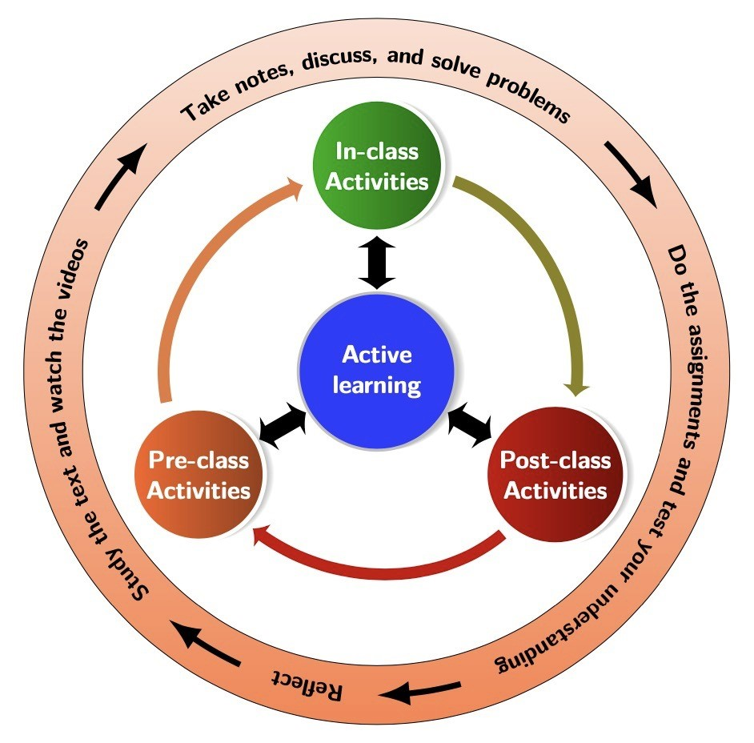
TASK
Study for the individual test with the help of the teacher’s instructions
Utilise your PDF text book and the instructions in the peda.net

Slide 51
Cognitive learning
Deep approach
Drive to understand
Diverse and well organized schemas
Modifying knowledge
Mind maps
Explaining in own words
Teaching a friend
Developing own examples

Slide 52
Cognitive learning
Ineffective studying techniques
Repeating information as it appears in the source
E.g. highlighting/ underlining and cramming
Effective studying techniques
Connecting, comparing and applying information
E.g. drawing charts, double encoding, extracting keywords, creating/answering questions, testing, creating concrete examples, elaboration

Slide 53
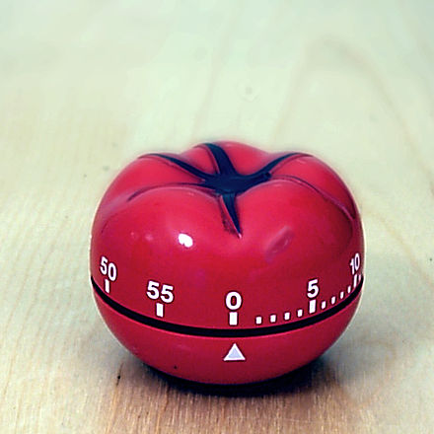
TASK
Watch this educational video on Pomodoro technique
Try to apply this technique in practice!

Slide 54
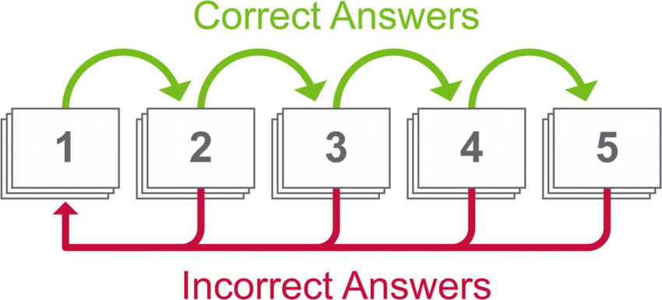
TASK
Watch this educational video on spaced learning
Try to apply this technique in practice!

Slide 55
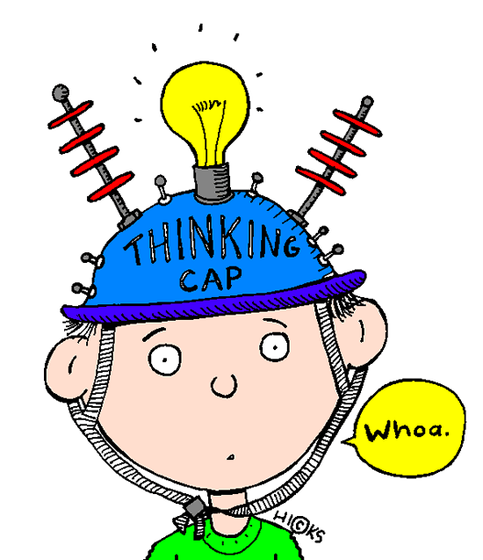
TASK
How do you learn:
words in foreign language?
mathematics?
theoretical subjects?
physical skills?
musical skills?
something else?

Slide 56
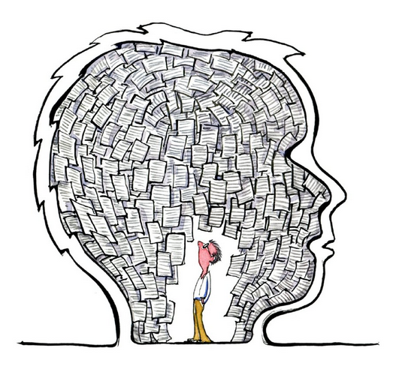
Cognitive learning
Metacognition
Ability to assess our own knowledge
Knowing about knowing
Metacognitive skills enhance learning

Slide 57
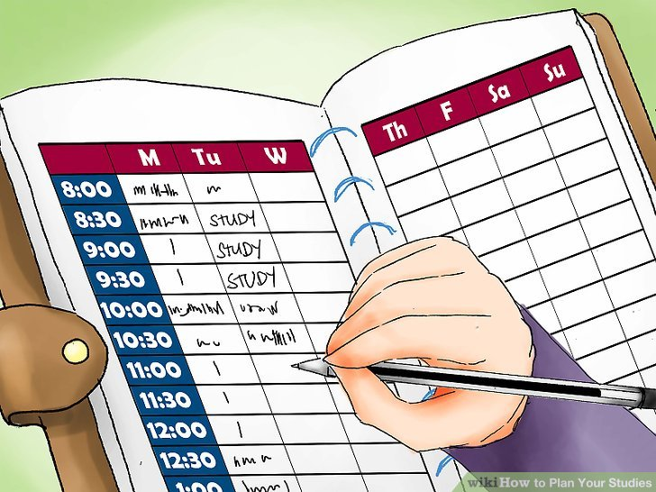
TASK
Make a studying plan for pre-IB Psychology individual test based on the information you have learned from the psychology of learning

Slide 58

TASK
How can learning in groups:
enhance learning?
sabotage learning?
What role does learning environment
play in learning and studying?

Slide 59
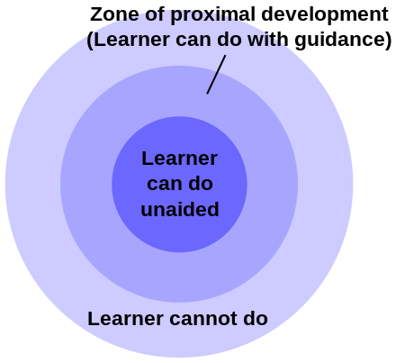
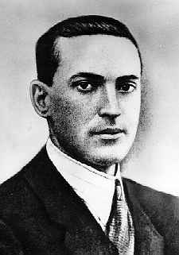
Learning and environment

Slide 60

TASK
Why it is efficient to study in the zone of proximal development?

Slide 61

TASK
How do different cultures or cultural backgrounds influence learning?
Reflect your experiences and engage in conversation
Try to provide examples

Slide 62
Picture sources
Idea lamp 1 <http://www.digitalistmag.com/lob/human-resources/work-culture-learning-03528954> Accessed 11th of October 2015.
Idea lamp 2 <https://favpng.com/png_view/teacher-learning-education-21st-century-clip-art-png/ZFYqDfJn> Accessed 14th of September 2021.
Head filled with ideas <http://clipart-library.com/clip-art/education-clipart-transparent-24.htm> Accessed 14th of September 2021.
Psyykkinen, sosiaalinen ja biologinen Skeema 1 – Opettajan materiaali
Blue brain cells 1 <https://medium.com/predict/artificial-neural-networks-mapping-the-human-brain-2e0bd4a93160> Accessed 10th of February 2020.
Blue brain cells 2 <https://www.medicalnewstoday.com/articles/320289.php> Accessed 10th of Februry 2020.
Sleep stages Introduction to Psychology, University of Minnesota Libraries Publishing edition 2015, page 167.

Slide 63
Picture sources
Cognitive head <https://www.hampshirepsychology.co.uk/therapies/cognitive-behavioural-therapy-cbt/> Accessed 24th of October 2017.
Blindfolded <http://theworkplacetherapist.com/how-im-trying-to-get-my-confidence-back/> Accessed 9th of January 2018.
Schema of sport cars <http://mercercognitivepsychology.pbworks.com/w/page/61207282/Schemas> Accessed 11th of November 2015.
Old/young lady <http://www.kolumbus.fi/juha.seppanen/opinnot/ps/ps3/ps3.html> Accessed 11th of November 2015.
Earthrise <https://www.nasa.gov/exploration/home/19jul_seaoftranquillity.html> Accessed 24th of October 2017.
Self <https://blog.psychicoz.com/simple-tips-for-self-improvement/> Accessed 24th of October 2017.
Memory head <https://www.medicalnewstoday.com/articles/320804> Accessed 14th of September 2021.
Stages of memory Introduction to Psychology, University of Minnesota Libraries Publishing edition 2015, page 294.
Self-consciusness <http://critique-of-pure-interest.blogspot.fi/2015/05/self-consciousness-and-possibility-of.html> Accessed 23rd of October 2017.
Gorilla in front of a mirror <http://www.cbc.ca/news/trending/jungle-animals-go-wild-upon-seeing-themselves-in-a-mirror-for-the-first-time-1.3100100> Accessed 23rd of October 2017.
Conscious and unconscius head <http://www.joshuanhook.com/just-coincidence-pay-attention/> Accessed 23rd of October 2017.

Slide 64
Picture sources
Iceberg <http://www.thinkwaystrategies.com/iceberg-ignorance-debunked> Accessed 23rd of October 2017.
Biker <http://www.sheknows.com/health-and-wellness/articles/810461/cycling-a-beginner-s-guide> Accessed 11th of November 2015.
Sigmund Freud <https://fi.wikipedia.org/wiki/Sigmund_Freud> Accessed 23rd of October 2017.
Iceberg inside a head <https://tybro.com/the-unconscious-mind-cleansing-system/> Accessed 14th of September 2021.
Motive <https://twitter.com/motivesalon> Accessed 23rd of October 2017.
Influences of eating behaviour Introduction to Psychology, University of Minnesota Libraries Publishing edition 2015, page 418.
Chocolate cake <https://thestayathomechef.com/the-most-amazing-chocolate-cake/> Accessed 23rd of October 2017.
Runner <http://www.freevectors.net/details/Athlete+Runner+Vector+Image> Accessed 23rd of October 2017.
Smiling face <http://sites.bu.edu/ombs/tag/emotion/> Accessed 23rd of October 2017.
Yellow faces <http://erikadolnackova.com/how-to-use-your-emotions-to-manifest-your-desires-intentionally/> Accessed 24th of October 2017.
Basic emotions 1 Skeema 1 – Opettajan materiaali, Edita 2016.
Basic emotions 2 <http://www.playbuzz.com/antihipster10/do-you-have-borderline-personality-disorder> Accessed 23rd of October 2017.
Apple emotions <https://www.biteback.org.au/things-to-do/real-stories/stories/why-does-it-have-to-be-this-way/> Accessed 24th od October 2017.

Slide 65
Picture sources
Leaning dog <http://alexadry.hubpages.com/hub/Dog-Behavior-Understanding-the-Orienting-Reflex> Accessed 11th of October 2015.
Pavlov’s dog and Ivan Pavlol himself <https://en.wikipedia.org/wiki/Ivan_Pavlov> Accessed 11th of October 2015.
Classical and operant conditioning <https://www.pinterest.co.uk/explore/operant-conditioning/> Accessed 25th of October 2017.
John Wayne <http://www.nndb.com/people/605/000023536/> Accessed 11th of October 2015.
Patrik Laine <http://www.idanihme.net/2017/02/15/patrik-laine-liekeissa-vain-selanne-pystynyt-parempaan/> Accessed 29th of August 2017.
Student studying <http://www.red-leaf.com/study-in-canada/> Accessed 15th of November 2015.
Wheel head <http://blog.kainexus.com/employee-engagement/continuous-learning/what-do-great-continuous-learning-organizations-have-in-common> Accessed 15th of November 2015.
Communicating minds <http://www.enspire.com> Accessed 15th of November 2015.
Studying student <http://saturdaywriters.org/nano-kick-off-party.html> Accessed 13th of Novenber 2019.
Learner in love <http://www.growthengineering.co.uk/learner-engagement-elearning/> Accessed 18th of September 2018.
Study plan <https://www.wikihow.com/Plan-Your-Studies> Accessed 13th of November 2019.
Thinking cap <http://www.coetail.com/yenidil/2014/09/20/metacognition-connecting-my-bloom-ing-thoughts/> Accessed 15th of November 2015.
Metacognition <http://www.ollielovell.com/tag/metacognition/> Accessed 15th of November 2015.
Motivation jump <https://www.freepik.com/free-photos-vectors/motivation> Accessed 5th of September 2019.
Target <https://www.idmfs.com/index.php/aims-objectives/> Accessed 5th of September 2019.
Pomodoro timer <https://en.wikipedia.org/wiki/Pomodoro_Technique> Accessed 13th of November 2019.
Spaced learning <https://www.researchgate.net/figure/The-Leitner-system-is-a-spaced-repetition-algorithm-which-sorts-flashcards-into-five_fig4_333147513> Accessed 14th of September 2021.
Study group <https://arc.duke.edu/beam> Accessed 5th of September 2019.
Zone of proximal development and Lev Vygotsky <https://en.wikipedia.org/wiki/Zone_of_proximal_development> Accessed 5th of September 2019.
Parent and cycling child <http://www.integrativemovement.com/how-a-special-needs-child-learns-new-skills/> Luettu Accessed 15th of September 2016.
Flaghand <https://psychology.iresearchnet.com/social-psychology/cultural-psychology/culture/> Accessed 11th of October 2017.

