Slide 1
HUMANS AS PSYCHIC, PHYSICAL AND SOCIAL BEINGS
Pre-IB Psychology LAJM

Slide 2
TASK
How do genes effect the mind?
How does alcohol influence the mind?
What happens to the mind in brain damage?
IS THE MIND JUST A PRODUCT OF THE NERVOUS SYSTEM?
How does anxiety influence the body?
How does stress effect the body?
What happens to your body when you fall in love?
CAN THE MIND INFLUENCE THE BODY?

Slide 3
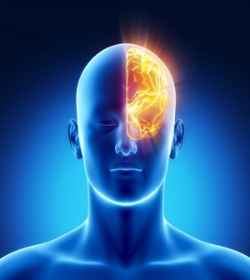
Mind and body
Mental functions require a developed central nervous system, especially brains

Slide 4
TASK
How does the human learn how to walk?
How does the human learn how to speak?
How does the human learn how to think?
IS THE MIND JUST THE PRODUCT OF THE ENVIRONMENT?
How can you persuade your friend to come to the movies?
How can you make your fellow student feel good in a classroom?
What do you want to express with your art?
CAN THE MIND EFFECT THE ENVIRONMENT?

Slide 5
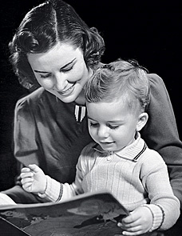
Mind and environment
Mental functions require adequate interaction with the environment

Slide 6
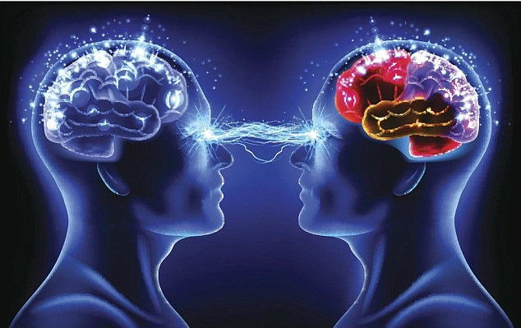
Conclusion
Human is a psychic, physical and social being

Slide 7
Orientation to psychological research
Form groups
Each group selects one psychological phenomenon that relates to welfare in one way or another
Each group analyses the psychic, physical and social dimensions of the phenomenon
Possible topics:
Sleep
Happiness
Love
Stress
Addiction
Eating behaviour
Social interaction
Flow
Creativeness

Slide 8
Picture sources
Brain-mind <http://operationmeditation.com/discover/mind-over-body-techniques-4-tips-for-mastery/> Accessed 15th of October 2015.
Mother and child <http://www.smallbizottawa.ca/2010/10/child-rearing-drop-out-provision/> Accessed 15th of October 2015.
Two minds <http://www.spiritscienceandmetaphysics.com/6-ways-to-read-someones-mind-easily/> Accessed 15th of October 2015.

