Slide 1
GROUP DYNAMICS
IB Psychology LAJM

Slide 2
TASK
Discuss the following questions with a partner:
  What groups do you belong to?
  What attracted you to this groups?
  What did you have to do (as initiation) to
  join these groups?
  When do you think you were accepted as a
  member of the group?
  How did membership of the group affect your
  self-concept and self-esteem?
  Have you ever been tempted to leave the group?
  If so, what factors led to your loss of attraction
  to the group?

Slide 3

TASK
Read page 387 ”Definitions of groups”
Which definition fits the best to your own groups and group memberships?

Slide 4

TASK
Do you behave differently in a group?
  Can you come up with examples from your
  own life?
  How did your normal individual behaviour changed in a group?

Slide 5
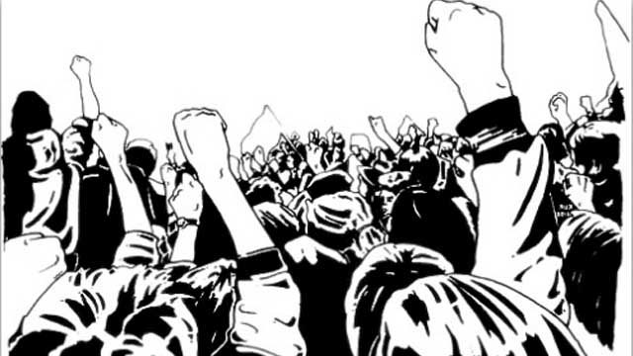
The individual and the group
Group mind (Gustav LeBon, 1896)
  Group can shape individuals’ behaviour

Slide 6
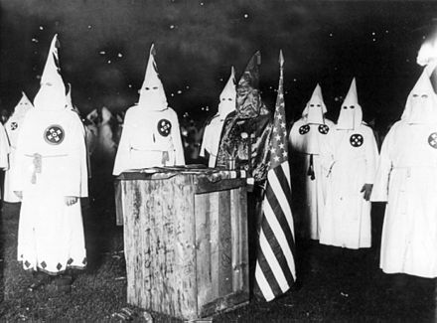
The individual and the group
Deindividuation theory
  Anonymity decreases sense of personal responsibility
  Increases individual’s sense of group identity

Slide 7
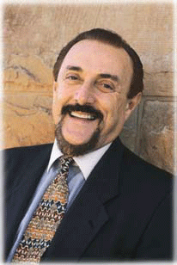
TASK
Watch the educational video on Zimbardo’s (1969) deindividuation study
  How does the study support deindividuation theory?
  Do MAGEC/GRENADE analysis of the study

Slide 8
The individual and the group
Diener et al. (1979)
  Does deindividuation has an effect on children’s behaviour in a naturalistic setting?
  Children were observed how many candies they would take as trick-or-treaters
  Half of the children were asked for their names and addresses and the other half were not
  Individuated took more than one candy in 8% of the cases
  Deindividuated took more than one candy in 80% of the cases

Slide 9
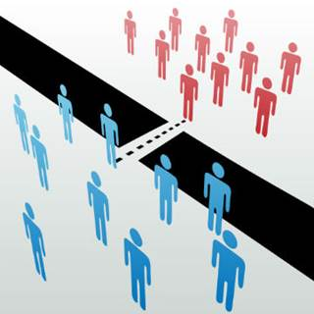
TASK
Search latest news for latest inter-group competition and conflict
  Can you find the
  cause of the competition and/or conflict?

Slide 10
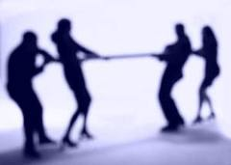
Co-operation and competition
Realistic group conflict theory (Cambell, 1965)
  If groups have opposite goals and compete for limited resources, inter-group conflict arises

Slide 11

TASK
Carefully read pages 389–391 on Sherif’s Robber’s Cave studies
  What were the aim, procedure and results of the studies?
  How do the studies support realistic group conflict theory?

Slide 12
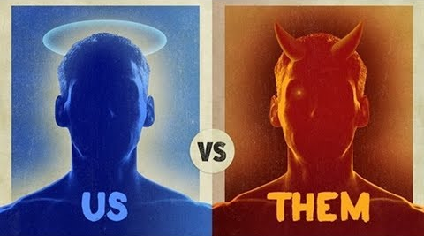
TASK
Review social identity theory (SIT) from sociocultural approach
  How do the Sherif’s Robber’s Cave studies support SIT?
  What kind of alternative explanation can SIT provide in comparison to realistic group conflict theory?

Slide 13

TASK
Read the Burton-Chellew, Ross-Gillespie and West (2010) study from teacher’s additional materials
  What does the study tell you about the role of inter-group competition and cooperation?

Slide 14
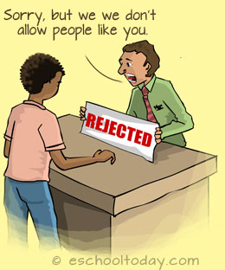
Prejudice and discrimination
Prejudice
  Negative attitude towards others
Discrimination
  Negative behaviour towards others

Slide 15
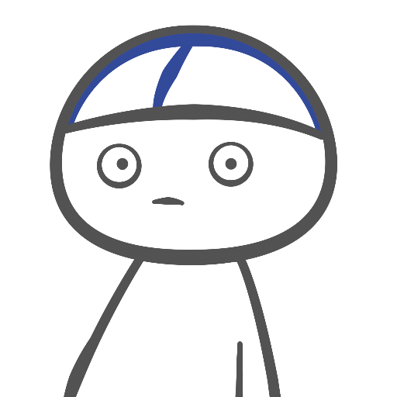
REVIEW
What was meant by stereotypes?
  Schemas by which we generalize and categorize groups and their members

Slide 16
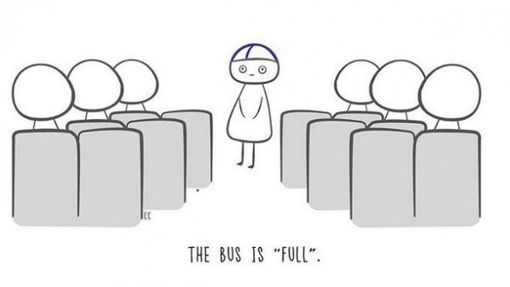
Prejudice and discrimination
Meta-stereotype
  Being aware of the stereotypes others
  hold of us

Slide 17

Prejudice and discrimination
Racism
  A form of discrimination based on racial characteristics
HOW CAN RACISM
BE EXPLAINED?

Slide 18
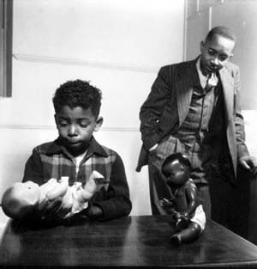
Prejudice and discrimination
Category awareness
  Three year old children are able to identify gender and ethnicity related differences
  Categorization is a natural tendency in humans (Campbell, 1958)
IS RACISM NATURAL
TO HUMANS?
Clark and Clark (1947)

Slide 19
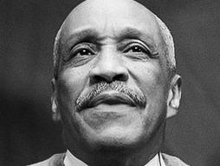
TASK
Watch the James A White sr. TED-talk ”The little problem I had renting a house”

Slide 20

TASK
Some of our stereotypes and prejudice may be unconscious
and implicit
Take a implicit association test provided by Harvard University

Slide 21
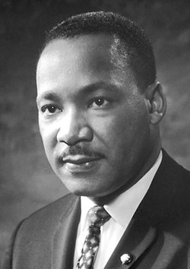
Prejudice and discrimination
Levinson (2007)
  How do implicit bias influence memory?
  Participant were told to remember facts from a story they were told just a moment ago
  Participants had more negative associations toward the African American characters

Slide 22
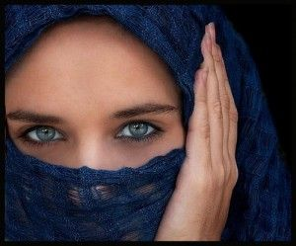
Prejudice and discrimination
Unkelbach, Forgas and Denson (2008)
  How do stereotypes influence our behaviour?
  Australian students were asked to shoot armed people in a computer game
  The participants shot more people wearing the Islamic headwear

Slide 23
TASK
Read the Columb and Plant (2011) study from teacher’s additional materials
  What does the study tell you about the means of decreasing implicit prejudice?
Read the Sevelkoul et al. (2011) study from teacher’s additional materials
  What does the study tell you about the perceived threat and relative out-group size in anti-immigration bias?

Slide 24

TASK
Watch the Verna Myers TED-talk ”How to overcome our biases?”

Slide 25
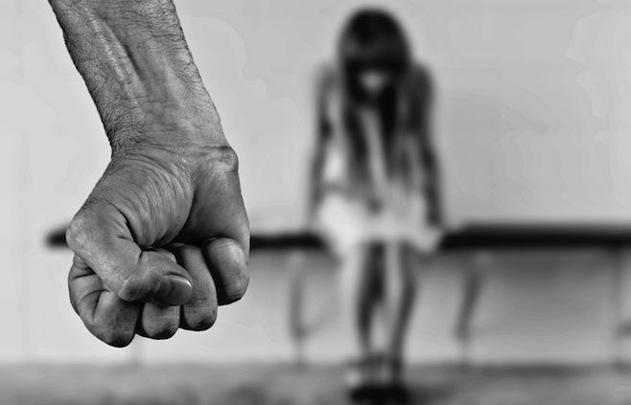
TASK
What is the difference between aggression, violence and conflict?
  Find the definitions of each concept and consider the differences between them

Slide 26
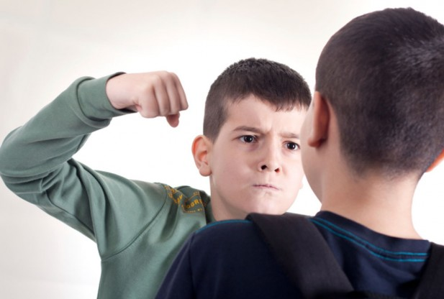
TASK
Can aggression and violence be beneficial?
  Can you provide any reasons?

Slide 27

TASK
Why are men more violent than women?
  Men kill more
  Men are killed more
  Women are more likely to be the victims of violent crime than perpetrators
  Violent behaviour in males peaks between 15 and 25 years of age
ENGAGE IN CONVERSTAION
WITH YOUR PAIR/GROUP

Slide 28
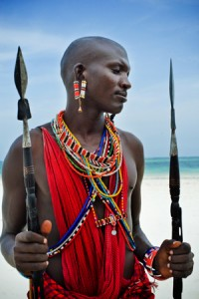
Origins of conflict
The male warrior hypothesis (McDonald, Navarrette and Van Vugt, 2012)
  Men possess psychological mechanisms that enable them to act aggressively in order to achieve a goal or to protect resources

Slide 29
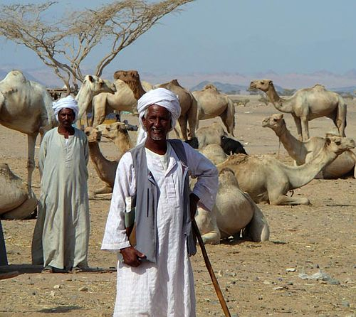
Origins of conflict
Honour culture and violent behaviour
(Nisbett & Cohen, 1996)
  In nomadic cultures, in order to avoid cattle raiding, it was useful to acquire a reputation of a fierce avenger
  Males are obliged to retaliate all insults

Slide 30

TASK
Read pages 401–402
Focus on Cikara, Botvinick and Fiske (2011) study, De Dreu et al. (2010) study and frustration-aggression hypothesis by Dollard el al. (1939)
  How do they provide explanations for the origins of conflict?

Slide 31
TASK
Read pages 402–403
  Pay close attention to the conflict resolution patterns
Read the Pettigrew and Tropp (2006) and Bruneau and Saxe (2012) studies from teacher’s additional materials
  Pay close attention to contact hypothesis and perspective-taking and perspective-giving
Compile a campaign against prejudice, discrimination and negative stereotypes based on your psychological knowledge
  Output can be anything from a poster to a video
  Upload the output to ManageBac and prepare to present it

Slide 32
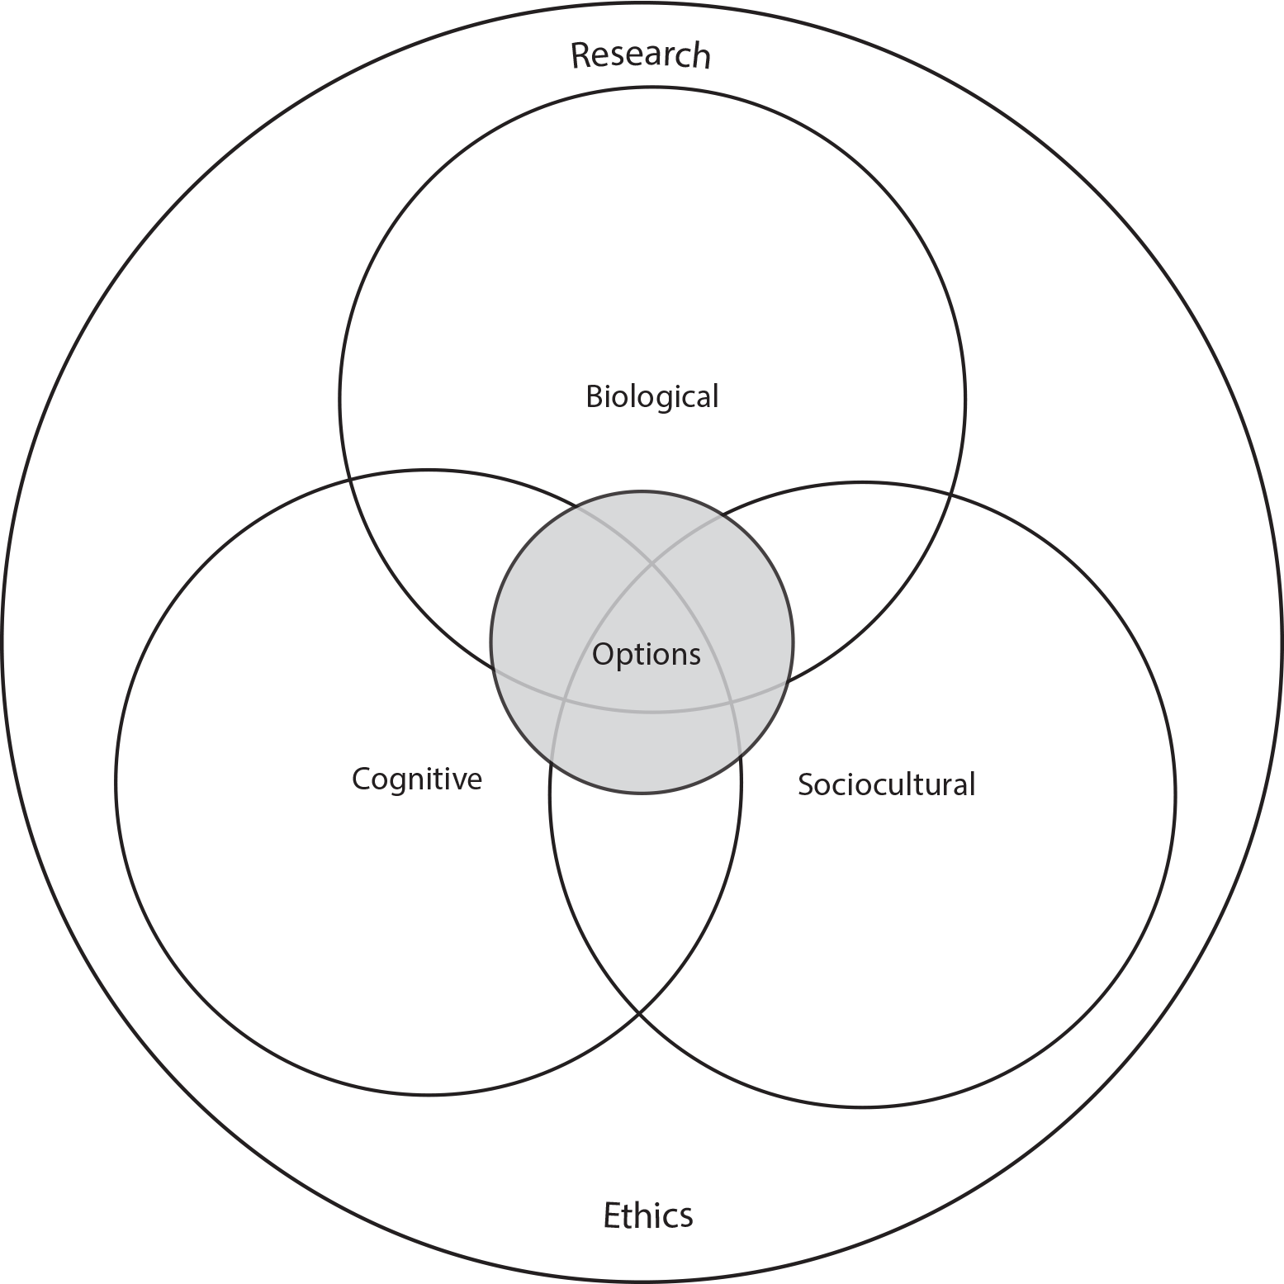
TASK
How do the different approaches of IB Psychology syllabus manifest themselves in what you have learned so far in Psychology of human relationships?

Slide 33
Past questions
Discuss origins of conflict and/or conflict resolution (M19)
To what extent does the sociocultural approach contribute to the understanding of group dynamics? (N19)
Discuss prejudice and/or discrimination in relation to group dynamics (N20)
Discuss co-operation and/or competition in groups (M21)

Slide 34
Picture sources
Group 1 <http://depressionuk.org/index.php/how-we-can-help/find-a-group/> Accessed 25th of April 2018.
Group 2 <http://www.claremontmedicalcentre.co.uk/ppg.aspx> Accessed 25th of April 2018.
Mob <http://registeringruth.com/2017/11/mob-mentality/> Accessed 25th of April 2018.
Ku Klux Klan <https://en.wikipedia.org/wiki/Ku_Klux_Klan> Accessed 19th of November 2017.
Zimbardo <http://www.zimbardo.com> Accessed 19th of November 2017.
Us and them <http://www.dmnews.com/marketing-strategy/theres-no-us-and-them/article/348233/> Accessed 25th of April 2018.
Intergroup conflict 1 <http://www.assignmentpoint.com/business/management/assignment-on-conflict-management-with-real-life-example.html> Accessed 25th of April 2018.
Robber’s Cave <https://www.explorepsychology.com/robbers-cave-experiment/> Accessed 25th of April 2018.
Us vs. them <https://wn.com/American_Psychology_Group> Accessed 21st of August 2017.
Intergroup conflict 2 <http://organisationdevelopment.org/tag/intergroup-conflict/> Accessed 25th of April 2018.
Rejected <http://eschooltoday.com/discrimination-and-prejudice/where-does-discrimination-occur-most.html> Accessed 11th of October 2017.
Finnish Matti <https://twitter.com/finn_matti> Accessed 22nd of August 2017.

Slide 35
Picture sources
Racism <https://taikonenfea.wordpress.com/2013/04/09/social-justice-101-racism/> Accessed 26th of April 2018.
Clark and Clark doll study <http://www.naacpldf.org/brown-at-60-the-doll-test> Accessed 26th of April 2018.
James A White sr. <https://www.ted.com/talks/james_a_white_sr_the_little_problem_i_had_renting_a_house> Accessed 26th of April 2018.
Harvard University <https://en.wikipedia.org/wiki/Harvard_University> Accessed 26th of April 2018.
Martin Luther King <https://fi.wikipedia.org/wiki/Martin_Luther_King,_Jr.> Accessed 26th of April 2018.
Islamic woman <https://www.psychologytoday.com/us/blog/millennial-media/201109/the-silenced-victims-911-part-i> Accessed 26th of April 2018.
Finnish nightmare <http://www.vol.at/herrliche-cartoons-matti-und-seine-finnischen-albtraeume/4904333> Accessed 26th of April 2018.
Verna Myers <https://www.njstatelib.org/category/innovation-blog/> Accessed 26th of April 2018.
Aggression 1 <https://themoscowtimes.com/articles/bill-decriminalizing-domestic-violence-passes-first-reading-in-russian-parliament-56783> Accessed 16th of November 2017.
Aggression 2 <https://www.ncronline.org/preview/parishes-take-domestic-violence-ministry> Accessed 16th of November 2017.
Aggression 3 <http://barefootsocialwork.weebly.com/blog/category/aggression> Accessed 16th of November 2017.
Masai warrior <https://fi.pinterest.com/pin/408490628679371496/> Accessed 30th of April 2018.
Nomad <https://en.wikipedia.org/wiki/Nomad> Accessed 19th of November 2017.
Team conflict <http://shifthr.com/how-to-manage-employee-conflict-to-build-better-teams/> Accessed 30th of April 2018.
IB Psychology syllabus <https://ibpublishing.ibo.org/d_3_psych_gui_1702_1/apps/dpapp/guide.html?doc=d_3_psych_gui_1702_1_e&part=1&chapter=3&section=1> Accessed 16th of May 2018.

