Slide 1
PERSONAL RELATIONSHIPS
IB Psychology LAJM

Slide 2

Personal relationships
The role of relationships in human happiness cannot be underestimated

Slide 3

TASK
What is love?
  Try to give a definition
  What kind of components or dimension can be found in love?
  Use your personal experiences
Don’t use any assistive devices or materials!

Slide 4
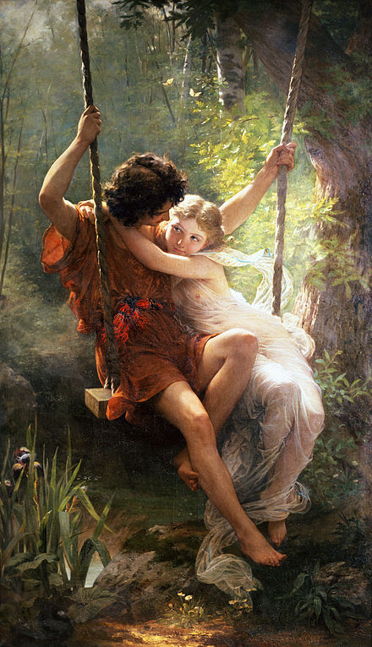
Love
Familial love (storge)
  Love between a parent and a child
Friendly love (philia)
  Love between friends
Romantic love (eros)
  Passionate love
Divine love (agape)
  Selfless love, charity

Slide 5
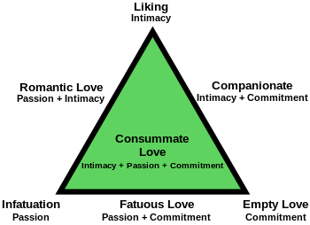
Love
Triangular theory of love (Sternberg, 1988)
  Descriptive theory of love
  Seem to be consistent with how people generally see love

Slide 6
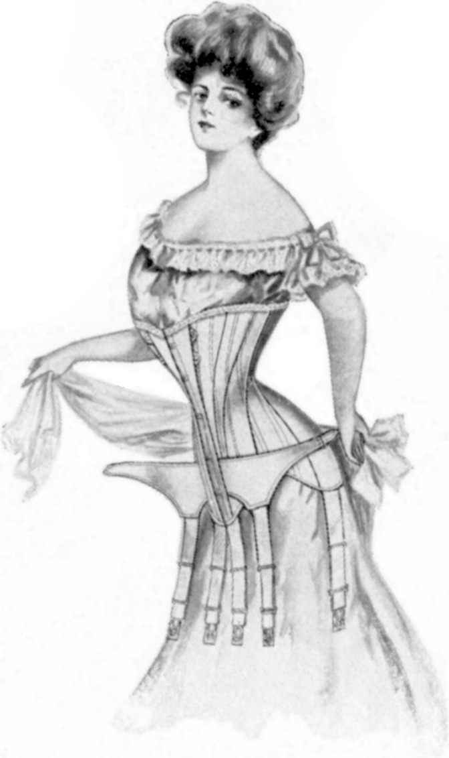
TASK
What kind of a male and female is attractive in your opinion?
  Form groups and compile a product where you present your ideals
  Are there any differences between male and female preferences?

Slide 7
Formation of personal relationships
Buss (1989)
  Does gender play a role in the determination of desirable characteristics in a mate?
  Over 10 000 participants in 33 countries filled questionnaires
Female preferences:
  Financial capacity
  Ambition and industriousness
  Older male
Male preferences:
  Physical attractiveness
  Youth
SUPPORTS EVOLUTIONARY THEORY OF MATE SELECTION

Slide 8
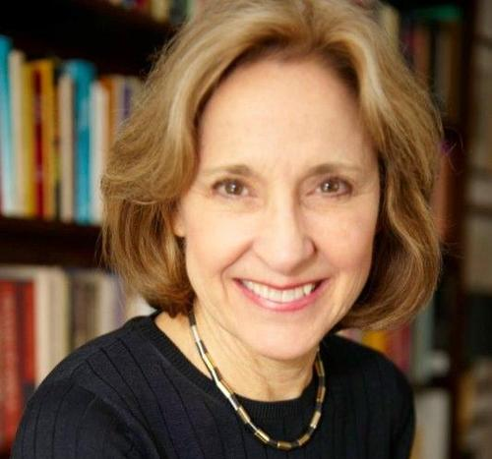
TASK
Watch Helen Fisher TED-talk ”The Brain in Love”
What are the essential neurobiological processes in love?

Slide 9
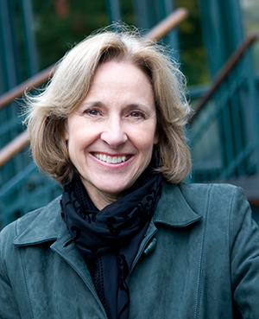
TASK
Watch another Helen Fisher TED-talk ”Why we love, why we cheat”
What are the evolutionary and biochemical foundations of love?

Slide 10
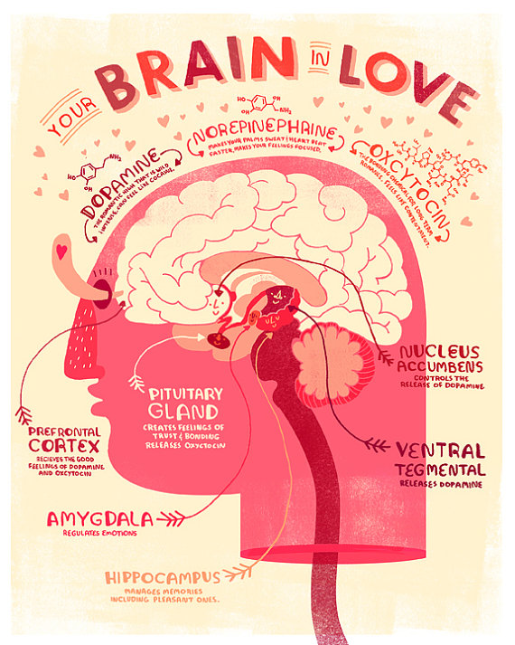
TASK
Read page 372 ”Attraction as addiction”
  Complete your memos from Helen Fischer TED-talks

Slide 11
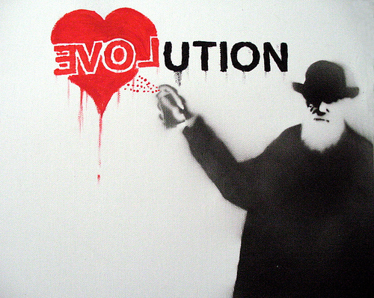
TASK
What are the strengths and the limitations of evolutionary explanations of love?
  Do a TEACUP analysis

Slide 12

TASK
Form three groups
  Biological group
  Cognitive group
  Sociocultural group
Every group finds out how attraction originates from their own approach
  Use the teacher’s handout

Slide 13

TASK
Form three-person mixed groups
  Every group should contain one member of each approach
Teach each other!
  In addition, engage in conversation

Slide 14

TASK
Has technology changed the way we form relationships?
  Engage in conversation with your pair/group

Slide 15
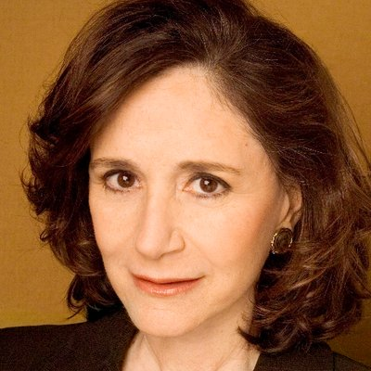
TASK
Watch Sherry Turkle TED-talk ”Connected, but alone”
Does technology change the way we form personal relationships?

Slide 16
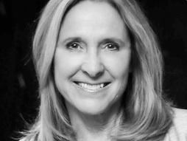
TASK
Watch Helen Fisher TED-talk ”Technology hasn’t changed love. Here is why.”

Slide 17
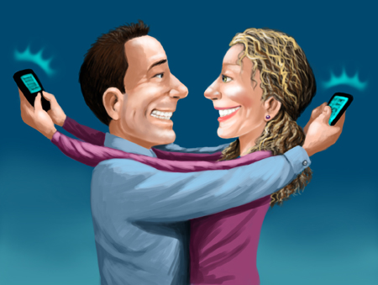
TASK
Did the two TED-talks complement one another on the effects of technology to personal relationships?

Slide 18
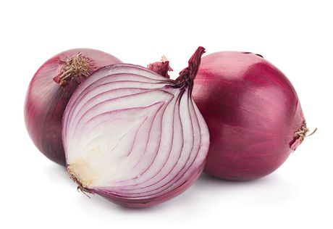
Role of communication
Social penetration theory (Altman & Taylor, 1973)
  Close relationships develop from a shallower level to more intimate level through self-disclosure

Slide 19
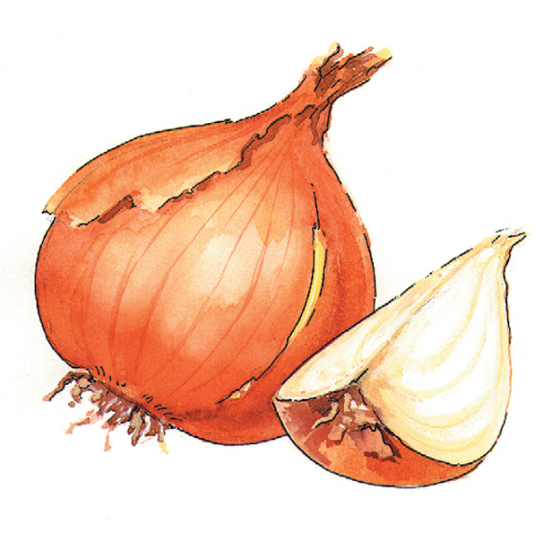
TASK
Read pages 378–379 and teacher’s additional materials
What is the evidence for social penetration theory?
What kind of research biases might there be in the results?

Slide 20
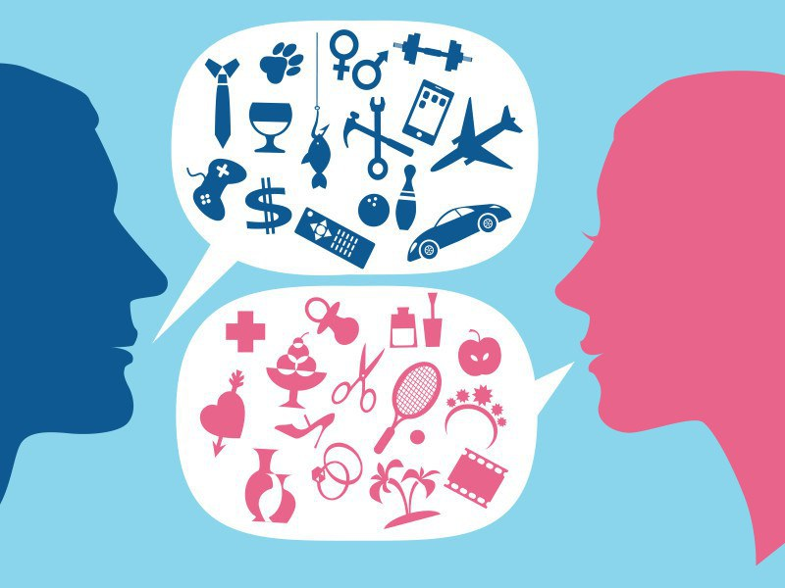
Role of communication
Deborah Tannen (1990)
  Female communication focuses more on sharing feelings
  Male communication focuses more on problem solving

Slide 21

Role of communication
YOU communication
  Blaming the partner
  for something
I communication
  Expressing our own feelings

Slide 22

REVIEW
What was meant by attribution?
  Explanation of causes of behaviour
  An interpretation why people behave the way they do
Dispositional and situational attributions

Slide 23
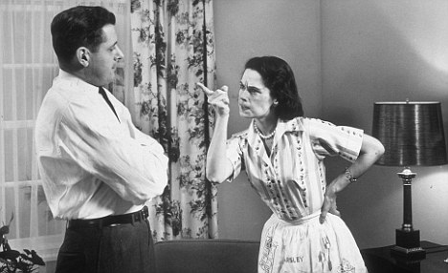
Role of communication
Attribution style
  In healthy relationships positive behaviour is attributed to personal dispositions and negative behaviour to situational factors
  Negative attribution style can hurt a relationship

Slide 24
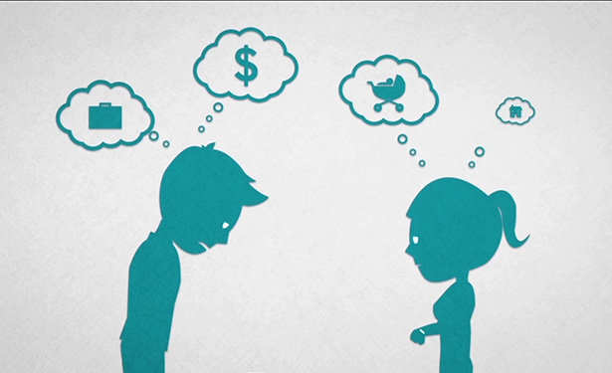
TASK
Read page 380
What were the aim, procedure and results of Karney & Bradbury (2000) study?
  What does it tell you about the importance of attribution style in relationship satisfaction?

Slide 25
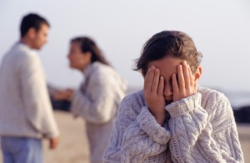
EXTRA TASK
Read the Stratton (2003) study from teacher’s additional materials
  What does it tell you about attributional styles in troubled families?

Slide 26
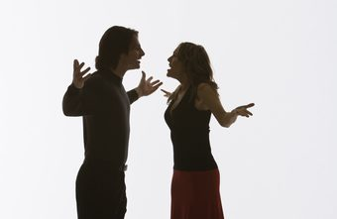
Role of communication
Patterns of accommodation
  How to deal constructively with conflicts and negative behaviour?
Notes:
Idealization of partner can contribute to constructive accommodation.

Slide 27
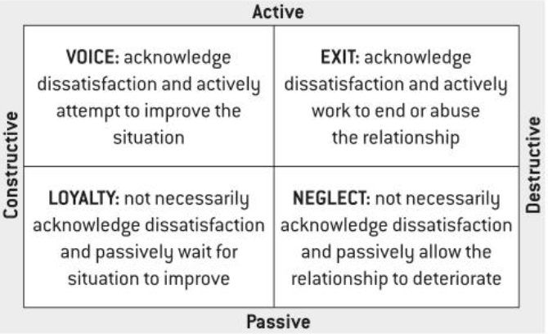
TASK
READ THE BASICS OF RUSBOLT AND ZEMBROT (1983) STUDY ON PAGE 380
AND CREATE EXAMPLES TO EACH RELATIONSHIP CONFLICT STRATEGY

Slide 28

Role of communication
Gottman and Krokoff (1989)
  Expressing anger and disagreement was NOT necessarily associated with marital dissatisfaction

Slide 29

Role of communication
Attachment styles play important role in accommodation
  Securely attached individuals favour constructive conflict resolution

Slide 30
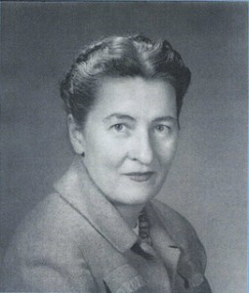
TASK
To find out more about different attachment styles and developmental psychology, watch the educational video on the topic

Slide 31
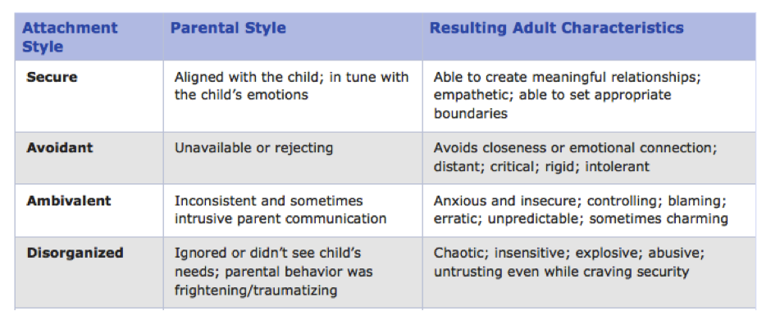
Role of communication

Slide 32
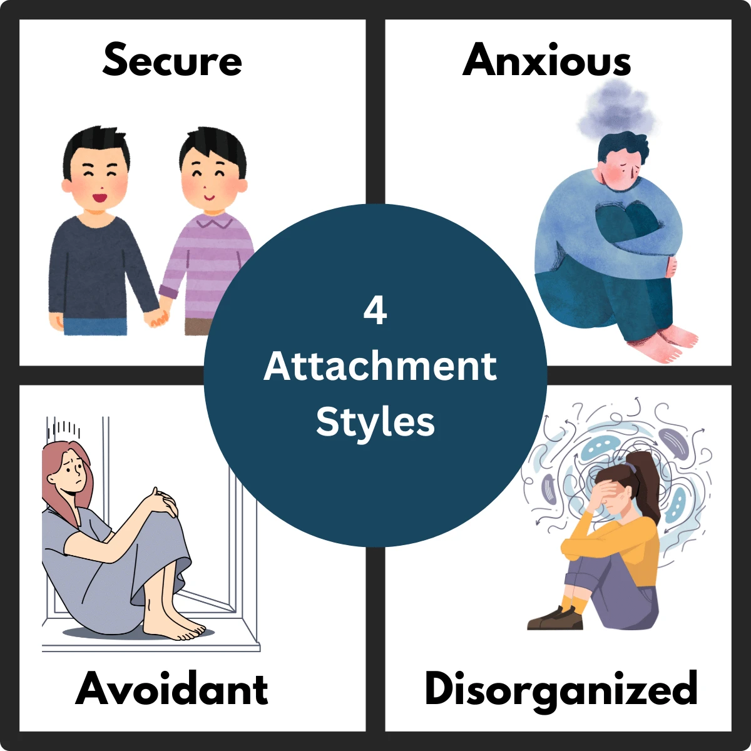
TASK
Study the gist of Hazan and Shaver (1987) related to attachment styles and their effect on romantic relationships from teacher’s additional materials

Slide 33
TASK
Practise different communication patterns with a “partner”
Form pairs and create mini-plays with a witty dialogue where different communication patterns appear
Gender differences in communication
I and YOU communication
Attribution styles
Patterns of accommodation
Attachment styles

Slide 34

TASK
Why relationships change or end?
  Try give answers to the question from several perspectives
Don’t use any assistive devices or materials!

Slide 35
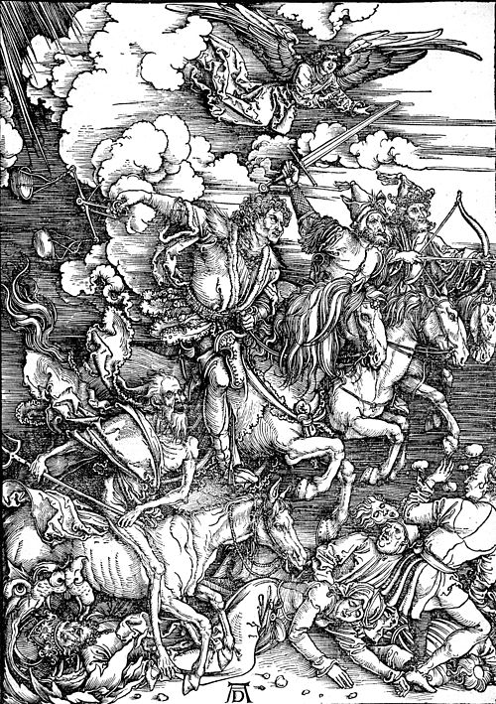
TASK
Read pages 381–382
Summarize the main points of Gottman’s theory of the Four Horsemen of the Apocalypse in your own words
  You may use the ”Discussion” -box questions on page 382 to evaluate the theory

Slide 36
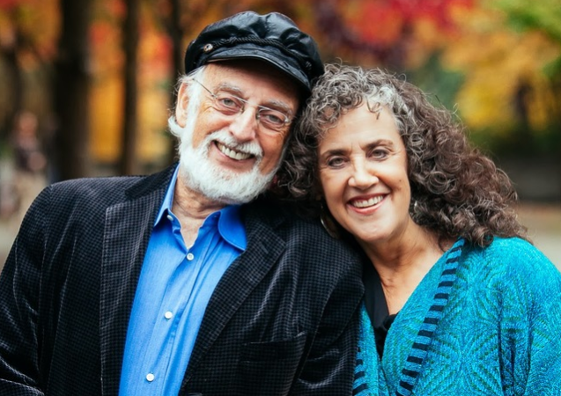
TASK
Study the gist of Gottman (1999) on positive and negative affect on marital satisfaction and the risk of divorce from teacher’s additional materials

Slide 37
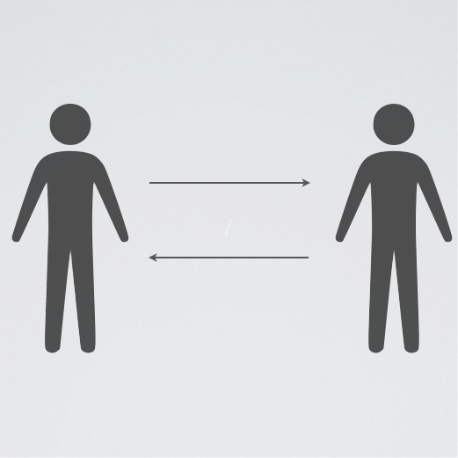
Why relationships change or end?
Social exchange theory (Kelley & Thibaut, 1959)
  Relationships are maintained through a cost-benefit analysis

Slide 38

Why relationships change or end?
Equity theory
(Adams, 1960s)
  If relationships are perceived equal, they will be maintained
  Balance of costs and benefits
Notes:
Empirical support (Hatfield, 1979), but considered cold.

Slide 39
TASK
What would be the costs and benefits of starting a relationship at this point of your life?

Slide 40
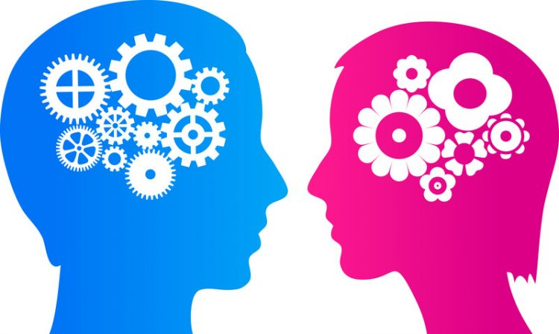
TASK
Do males and females expect different things from a relationship?
  Is there a gender difference?

Slide 41
Why relationships change or end?
Factors of relationship satisfaction in males
  Common interests
  Desire to spend time together
  Partner’s negative feelings
Flora & Segrim (2003)
Factors of relationship satisfaction in females
  Common interests
  Desire to spend time together
  Quantity of female’s own negative feelings
Notes:
(Flora and Segim, 2003)

Slide 42

TASK
Watch the SciShow video ”Are There ’Male’ and ’Female’ Brains?”

Slide 43
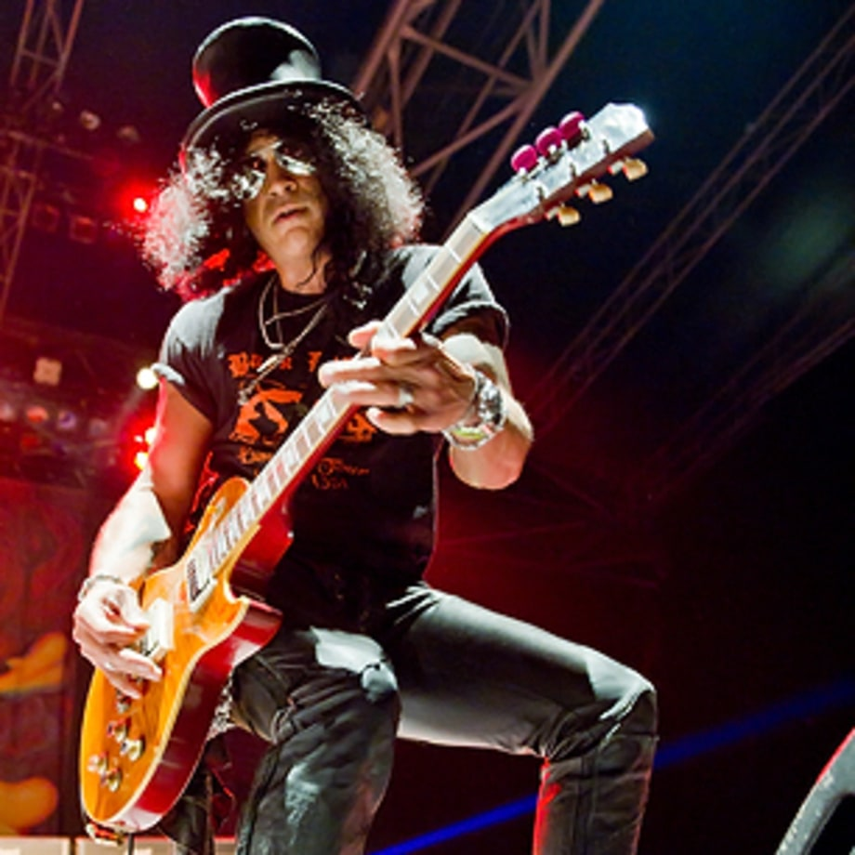
Why relationships change or end?
Fatal attraction theory (Felmlee, 1995)
  The trait that initially caused attraction can lead to breakup

Slide 44
Why relationships change or end?
Felmlee (1995)
  Sample of 301 university students, 101 males and 200 females
  88/301 of cases (29,2%) the trait that was seen attractive at first lead to the end of the relationship
Three common fatal attraction patterns:
  Fun to foolish
  Strong to domineering
  Spontaneous to unpredictable

Slide 45
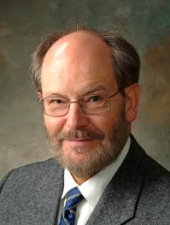
TASK
Watch the educational video on Steve Duck’s theory of breakdown
Compare the information provided by the video to pages 384–385

Slide 46

TASK
Read LeFebvre, Blackburn and Brody (2014) study from teacher’s additional materials
  How was Rollie and Duck’s model applied in this study?

Slide 47
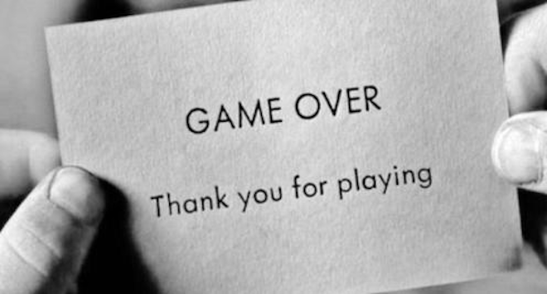
TASK
Could there be any other reasons for breakups?

Slide 48
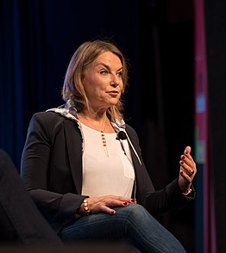
EXTRA TASK
Watch the Esther Perel TED-Talk ”Rethinking infidelity ... A talk to anyone who has ever loved”
How does this talk connect to all the things you have covered?

Slide 49
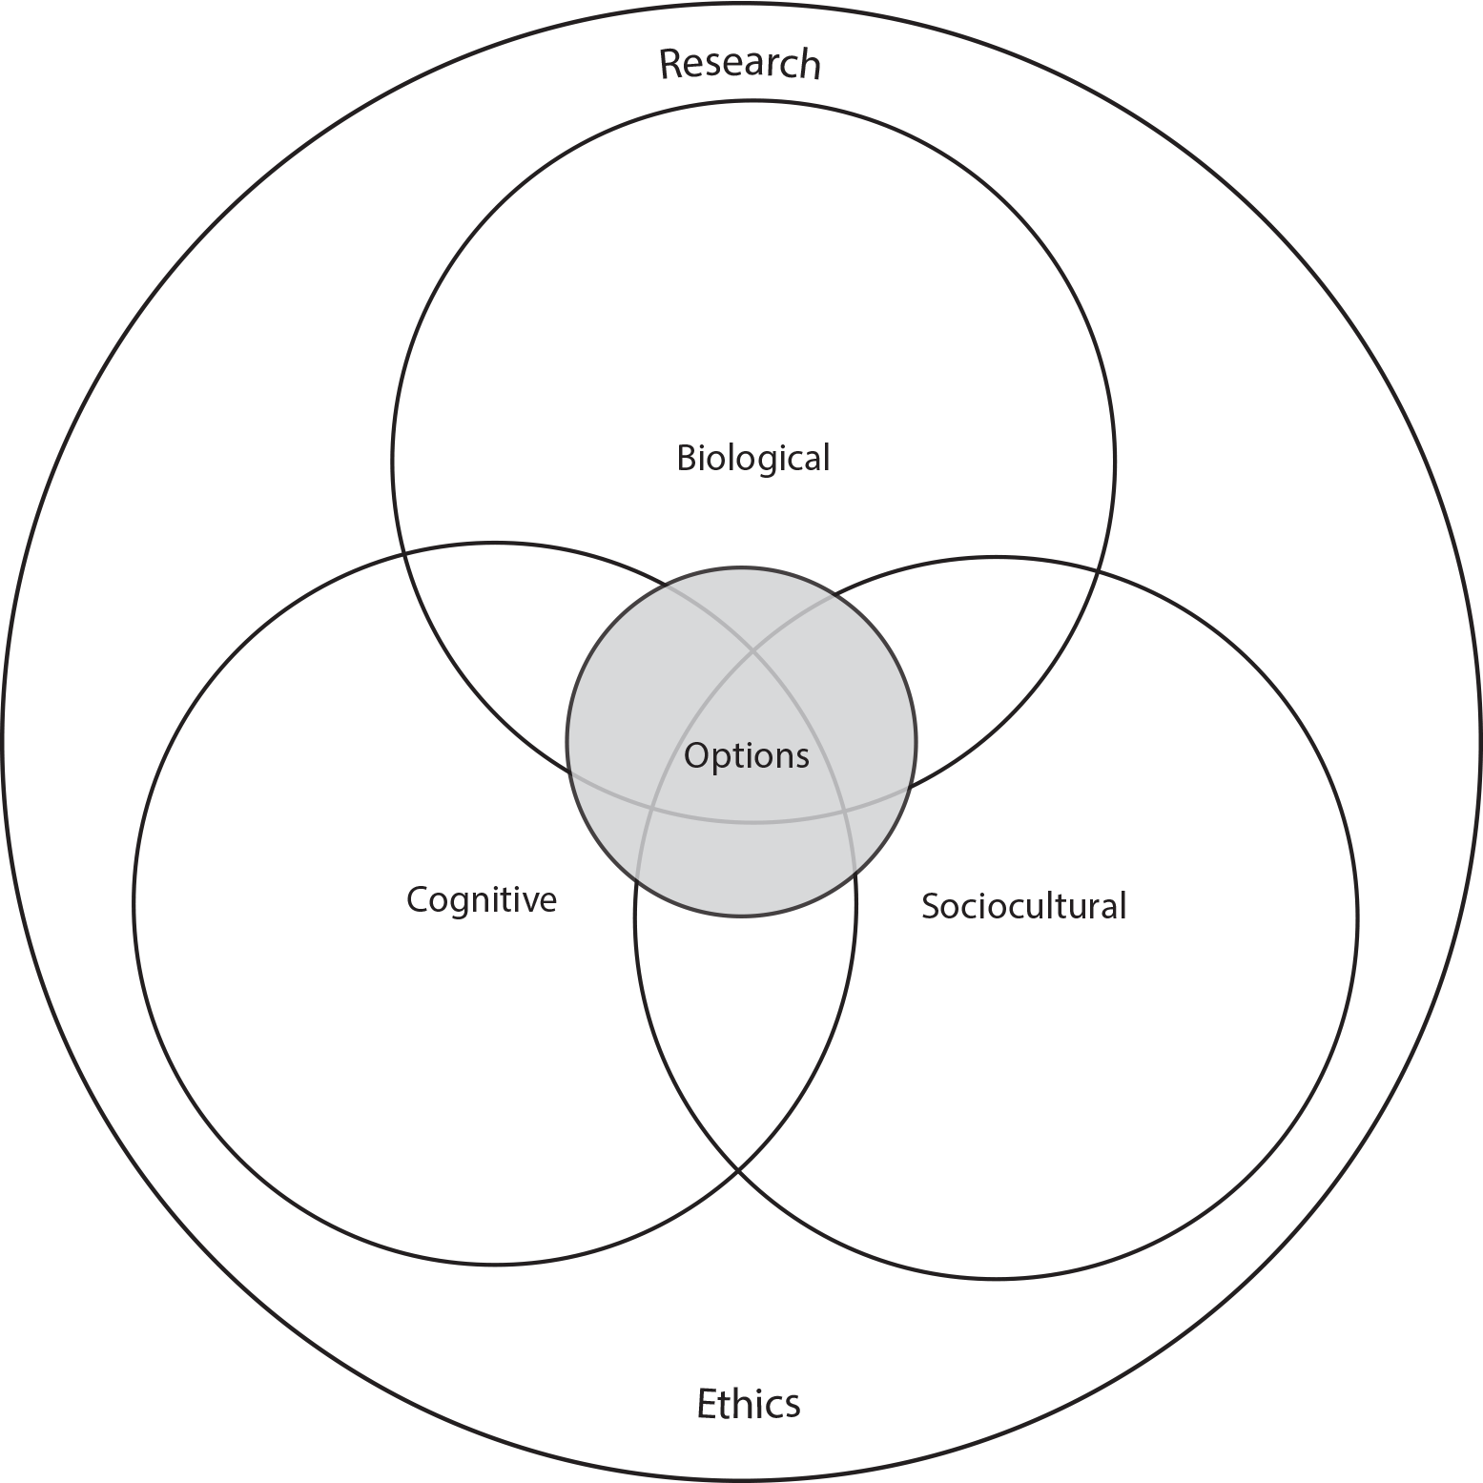
TASK
How do the different approaches of IB Psychology syllabus manifest themselves in what you have learned so far in Psychology of Human relationships?

Slide 50
TASK
Form five groups
Groups rotate through five sample essay checkpoints that relate to the contents in Personal relationships
Read the sample essays with examiner’s comments and engage in conversation
  What are the pros and the cons of each sample response?
  What did you learn from reading the samples?

Slide 51
Picture sources
Couple cooking <https://pixabay.com/fi/nainen-keittiö-mies-1979272/> Accessed 13th of November 2017.
Love character <http://weclipart.com/japanese+love+clipart> Accessed 13th of November 2017.
Spring <https://en.wikipedia.org/wiki/Eros_(concept)> Accessed 17th of April 2018.
Trianglar theory of love <https://en.wikipedia.org/wiki/Triangular_theory_of_love> Accessed 13th of November 2017.
Woman in corset <https://commons.wikimedia.org/wiki/File:CorsetStyles1909-1910p06A.png> Accessed 16th of April 2018.
Helen Fisher <http://www.greatthoughtstreasury.com/author/helen-fisher> Accessed 16th of April 2018.
Helen Fisher 2 <https://seniorplanet.org/planet-talk-love-chemistry-expert-helen-fisher/senior-planet-helen-fisher/> Accessed 18th of April 2018.
Your brain in love <https://www.etsy.com/listing/176998690/your-brain-in-love-anatomy-poster> Accessed 16th of April 2018.
Love-evolution <> Accessed 18th of April 18th of April 2018.
Cupid <https://pixabay.com/fi/enkeli-arrow-jousi-sarjakuva-2029668/> Accessed 13th of November 2017.
Group of three <https://www.freepik.com/free-icon/group-of-three-men-standing-side-by-side-hugging-each-other_717992.htm> accessed 13th of November 2017.
Tinder <https://mobiili.fi/2018/01/24/tinder-sovelluksen-salauksen-puute-avaa-hakkereille-oven-deittisovellukseen/> Accessed 17th of April 2018
Sherry Turkle <https://twitter.com/sturkle> Accessed 18th of April 2018.
Helen Fisher 3 <https://www.ted.com/speakers/helen_fisher> Accessed 18th of April 2018.
Love & Tech <https://www.theispot.com/whatsnew/2011/9/scott-pollack-love-tech.htm> Accessed 18th of April 2018.

Slide 52
Picture sources
Onions <https://www.walmart.ca/en/ip/onions-red/6000196006670> Accessed 20th of April 2018.
Onion drawing <http://capsi.fi/resepti/sipuli/> Accessed 20th of April 2018.
Male and female communication <https://www.theodysseyonline.com/food-for-thought-social-roles-of-males-and-females> Accessed 20th of April 2018.
You and I <https://weheartit.com/entry/108849504> Accessed 20th of April 2018.
Lazy student <http://gojmti.blogspot.fi/2016/05/why-students-lazy-to-learn.html> Accessed 18th of August 2017.
Nagging wife <http://www.dailymail.co.uk/news/article-1262179/Married-men-live-longer-wives-nag-visit-GP.html> Accessed 23rd of April 2018.
Troubled couple <https://www.theatlantic.com/health/archive/2013/08/when-a-relationship-becomes-a-game/278459/> Accessed 2nd of September 2019.
Troubled family <https://www.childrensdayton.org/the-hub/7-signs-troubled-family-relationships> Accessed 2nd of September 2019.
Conficlting couple <http://smallbusiness.chron.com/advantages-amp-disadvantages-conflict-organizations-40821.html> Accessed 23rd of April 2018.
Old couple <https://auxx.me/true-love-look-couple-youd-want-something-like/> Accessed 2nd of September 2019.
Distant couple <http://drjanethope.com/for-couples/relationship-feeling-distant/> Accessed 15th of November 2017.

Slide 53
Picture sources
Mary Ainsworth <https://www.feministvoices.com/mary-ainsworth/> Accessed 23rd of April 2018.
Attachment styles <http://believeperform.com/performance/using-attachment-theory-to-better-understand-your-athletes/> Accessed 15th of November 2017.
4 attechment styles <https://www.explorepsychology.com/attachment-styles/> Accessed 14th of August 2025.
Breakup <http://www.collective-evolution.com/2015/07/28/science-sheds-ligh-on-what-happens-to-your-brain-during-a-breakup/> Accessed 13th of November 2017.
The Four Horseman of the Apocalypse <https://fi.wikipedia.org/wiki/Ilmestyskirjan_ratsastajat> Accessed 23rd of April 2018.
Gottmans <https://www.throughthewoodstherapy.com/gottman-cheat-sheet/> Accessed 14th of August 2025.
Social exchange <http://social-exchange.me/participate.html> Accessed 15th of November 2017.
Scale <https://pixabay.com/fi/vaaka-tasa-käsi-tasapaino-asteikko-2402966/> Accessed 15th of November 2017.
Gernder differences <http://interestingthingsbox.com/2017/02/11-painfully-true-illustrations-prove-men-women-not-planet/> Accessed 15th of November 2017.
Gender symbols <https://en.wikipedia.org/wiki/Gender> Accessed 14th of August 2025.
Slash <http://www.rollingstone.com/music/lists/100-greatest-guitarists-20111123/slash-20111122> Accessed 15th of November 2017.
Steve Duck <https://psychology.uiowa.edu/people/steve-duck> Accessed 13th of November 2017.
Facebook <https://sco.wikipedia.org/wiki/Facebook> Accessed 3rd of September 2019.
Game over <http://www.scienceofrelationships.com/home/tag/breakup> Accessed 15th of November 2017.
Esther Perel <https://en.wikipedia.org/wiki/Esther_Perel> Accessed 3rd of November 2021.
IB Psychology syllabus <https://ibpublishing.ibo.org/d_3_psych_gui_1702_1/apps/dpapp/guide.html?doc=d_3_psych_gui_1702_1_e&part=1&chapter=3&section=1> Accessed 16th of May 2018.

