Slide 1
PSYCHOLOGY INTERNAL ASSESSMENT IN A NUTSHELL
IB Psychology LAJM

Slide 2

IA in IB Psychology
The purpose of Internal Assessment in IB Psychology is that students will investigate a published study, theory or model relevant to their learning in psychology by conducting an experimental investigation and reporting the findings

Slide 3

IA in IB Psychology
Students should show the skills of hypothesis testing and appropriate use of statistics

Slide 4
IA in IB Psychology
Replication of the chosen experiment and the collection of data must be done in groups
Group work may be undertaken by groups of up to four students
  Each group must collect its own data and pooling data with other groups is encouraged
Each student must write up his or her own individual report and analyse the results independently

Slide 5

IA in IB Psychology
Individual report must be written in APA format
Base document is provided in peda.net
  Download the document to your computer, rename it and start working with your IA report

Slide 6
IA in IB Psychology
The report should be between 1800 and 2200 words in length and consist of the following components:
  Introduction
  Exploration
  Analysis
  Evaluation
  References
  Appendices

Slide 7
IA in IB Psychology
Assessment criteria include:
  Introduction (6 marks)
  Exploration (4 marks)
  Analysis (6 marks)
  Evaluation (6 marks)
Although the Internal Assessment task is the same for both SL and HL students, IA weights 25% in SL overall assessment and 20% in HL overall assessment

Slide 8

IA in IB Psychology
Close attention should be payed to ethical guidelines
Students found to have carried out unethical work will be awarded no marks for the Internal Assessment

Slide 9

IA in IB Psychology
To fulfil ethical guidelines, students must produce a consent form for the participants
Unfilled consent form must be included in the IA reports’ appendices

Slide 10
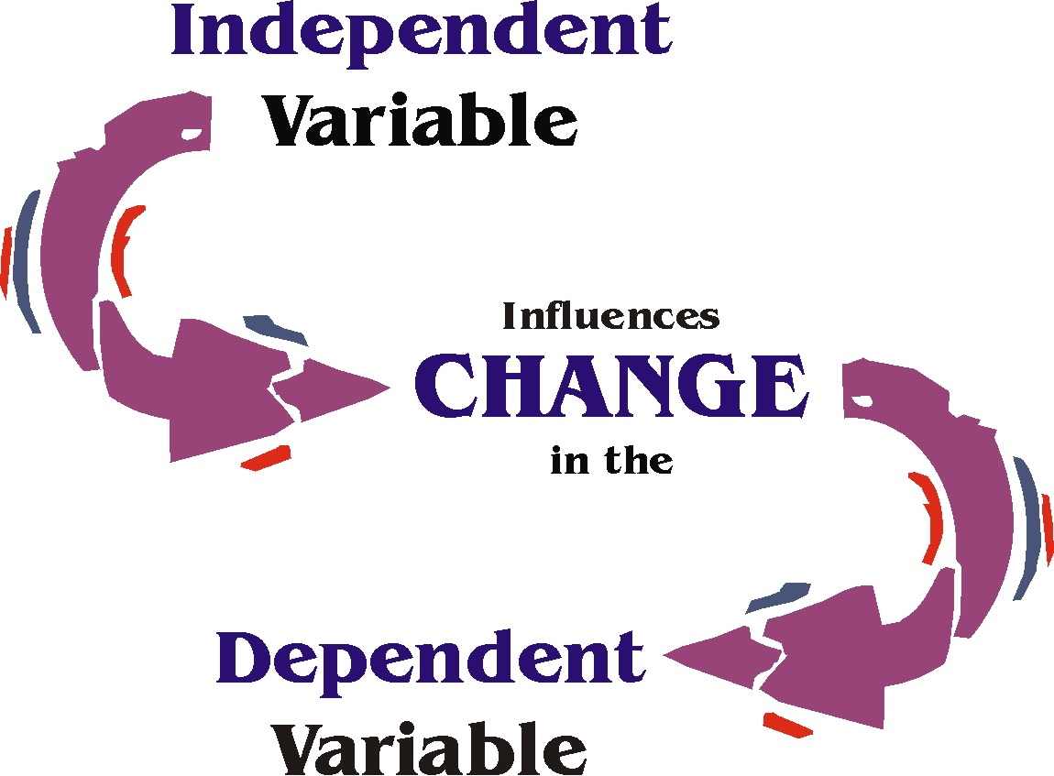
IA in IB Psychology
The experimental method is defined as requiring:
  the manipulation of independent variable while other variables are kept constant
  the measurement of the effect of the independent variable on dependent variable

Slide 11

IA in IB Psychology
There should be only one independent variable in the replicated experiment
To keep the experiment and the analysis simple, choose only two conditions for the independent variable

Slide 12

IA in IB Psychology
Teacher will provide options for the IA topic, but students can choose their own topic that seems interesting and worthwhile to them
Topics should fit the experimental method model and should not violate any ethical guidelines

Slide 13

IA in IB Psychology
Although only one source, the original study, is required in the IA task, you may use as many sources as possible and relevant for your IA
External sources can help you with analysis and evaluation of your results

Slide 14
IA in IB Psychology
22IB Deadlines
  First submission
  Friday 8th of March
  Final submission Thursday 28th of March
According to our present school policies, the only way to get additional time to the IA deadlines is to discuss with the IB coordinator and provide a medical certification

Slide 15
List of advice
Carefully study internal assessment part from the guide
  Especially internalize the internal assessment criteria and ethical guidelines
Carefully study pages 487–521
  Pay close attention to the inferential statistics
Don’t miss the deadlines!
Remember to ask for advice!

Slide 16
Picture sources
Wheel head <http://alexkwee.com/services/psychological-assessments/> Accessed 2nd of January 2018.
Statistics <https://www.edx.org/learn/statistics> Accessed 21st of January 2018.
APA logo <https://www.ariessys.com/views-press/press-releases/the-american-psychological-association-to-deploy-editorial-manager-for-70-journals/> Accessed 2nd of January 2018.
Got ethics? <https://siliconangle.com/blog/2013/08/10/how-ethical-is-your-big-data/got-ethics/> Accessed 2nd of January 2018.
Consent <https://baby.lovetoknow.com/wiki/Babysitter_Medical_Consent_Form> Accessed 21st of November 2018.
Independent and dependent variable <https://mkhernandez.wordpress.com/2017/03/18/quant-independent-and-dependent-variables/> Accessed 2nd of January 2018.
Controlled environment <https://www.amazon.com/Notice-Controlled-Environment-Closed-Aluminum/dp/B008YHY9I0> Accessed 21st of November 2018.
Idea <http://libguides.butler.edu/c.php?g=578630&p=3992658> Accessed 2nd of January 2018.
Cite your sources <https://uwsslec.libguides.com/c.php?g=248430&p=1655413> Accessed 21st of November 2018.

