Slide 1
MEMORY, SCHEMA THEORY AND THEIR RELIABILITY
IB Psychology LAJM

Slide 2
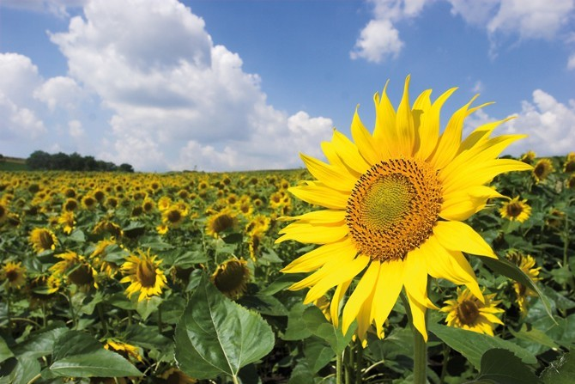
TASK
You have three minutes
Try to write down all possible information that you receive from the environment
Engage in conversation
What kind of things did you write down?
What senses did you mention?

Slide 3
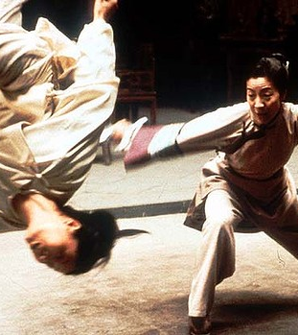
TASK
Watch the video clip and think which acts are possible for human information processing and which are not

Slide 4
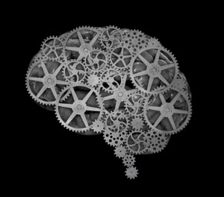
Cognitive approach
Researches human information processing
Cognition
”All the processes by which the sensory input is transformed, reduced, elaborated, stored, recovered and used” (Ulric Neisser, 1967)

Slide 5
TASK
Form five groups
Co-operative discussion
Each group is given one step in the history of the cognitive approach (pages 123–128)
Groups familiarise themselves with the essential content and arguments related to their historical step
In the end, groups are mixed and each member of the group engage in conversation from their own perspective
Each member tries to convince others of their own approach’s superiority

Slide 6
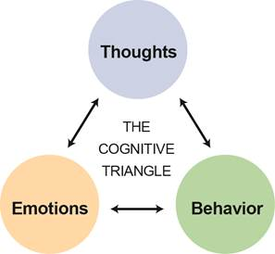
Cognitive approach
Principles of cognitive approach:
Mental processes can be studied scientifically
Mental representations guide behaviour
Cognitive processes do NOT function in isolation
Biases in cognitive processing can be systematic and predictable

Slide 7
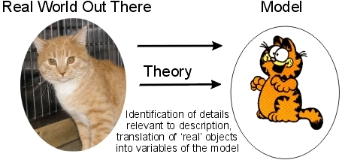
Models of memory
What is a model?
Physical representation what a psychological phenomenon could look like
Hypothetical construct

Slide 8
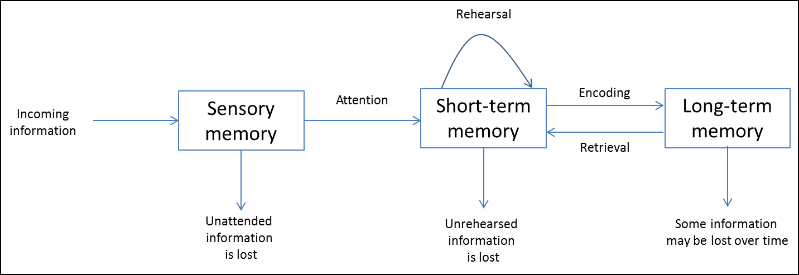
Models of memory
MULTI-STORE MODEL OF MEMORY
(Atkinson & Shiffrin, 1968)

Slide 9

TASK
Read pages 132–134 and complete the teacher’s handout

Slide 10
TASK
Prepare yourself for Sperling’s test (1960)!
Teacher will show you a 4x3 grid of characters for an extremely brief moment of time
After showing the grid, the teacher will say ”top”, ”middle” or ”bottom” indicating the line of the grid
Your job is to remember as many characters from that line as possible

Slide 11
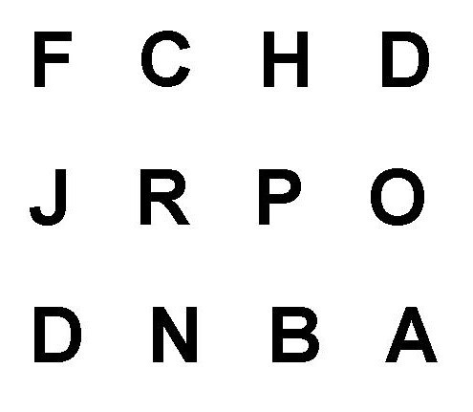

Slide 12
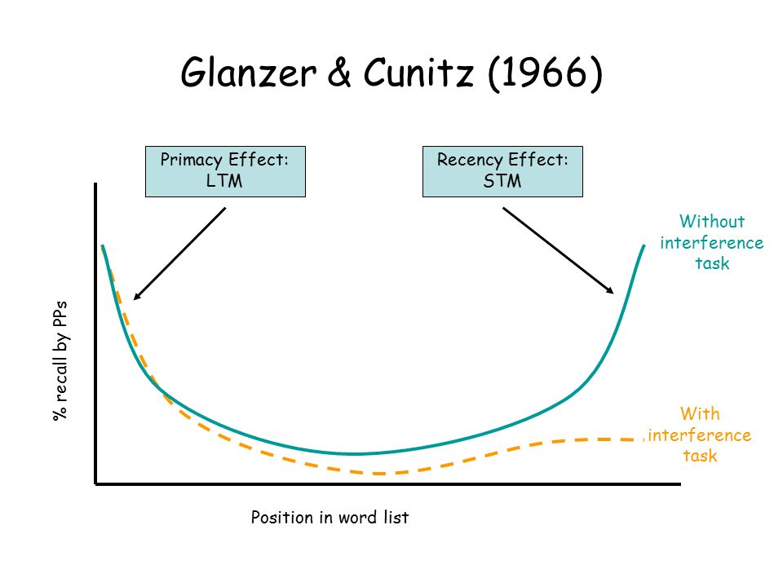
TASK
Read pages 135–136
What were the aim, procedure and results of Glanzer and Cunitz (1966) study?
What kind of evidence does serial position effect provide for the multi-store model of memory?

Slide 13
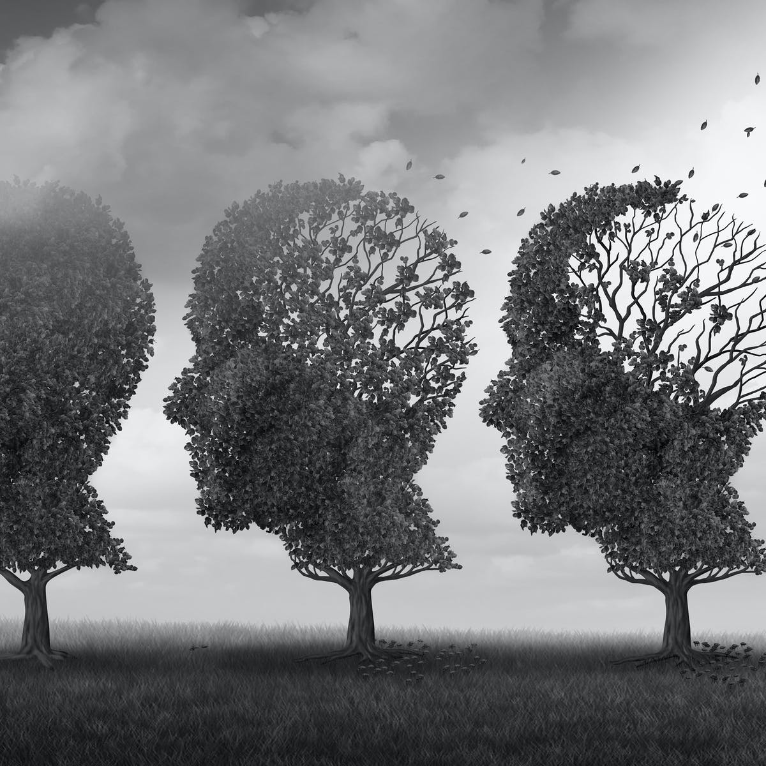
TASK
Read pages 136–137 and summarise the criticism of the multi-store memory model in your own words
What are the strengths and limitations of this model?
Do a TEACUP analysis

Slide 14
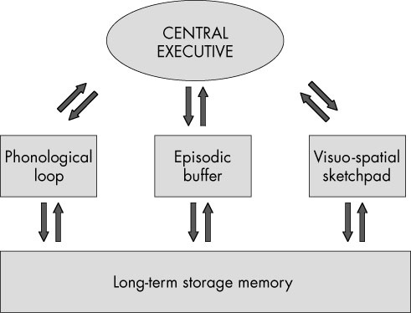
Models of memory
WORKING MEMORY MODEL
(Baddeley and Hitch, 1974)

Slide 15
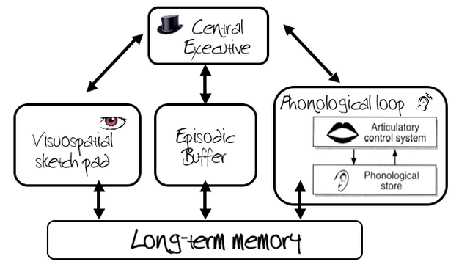
TASK
Read page 137 and summarize the main functions of the parts in the working memory model in your own words

Slide 16
TASK
Read pages 138-139 and the teacher’s handout
Form groups and choose at least one of the studies and try to create a simple replication
First, test your replication(s) on yourselves and then on other students
Do you get the same results?
Conrad and Hull (1964)
Baddeley and Hitch (1974)
Baddeley, Thompson and Buchanan (1975)
Baddeley, Lewis and Vallar (1984)
Baddeley (1996)
Quinn and McConnel (1996)

Slide 17
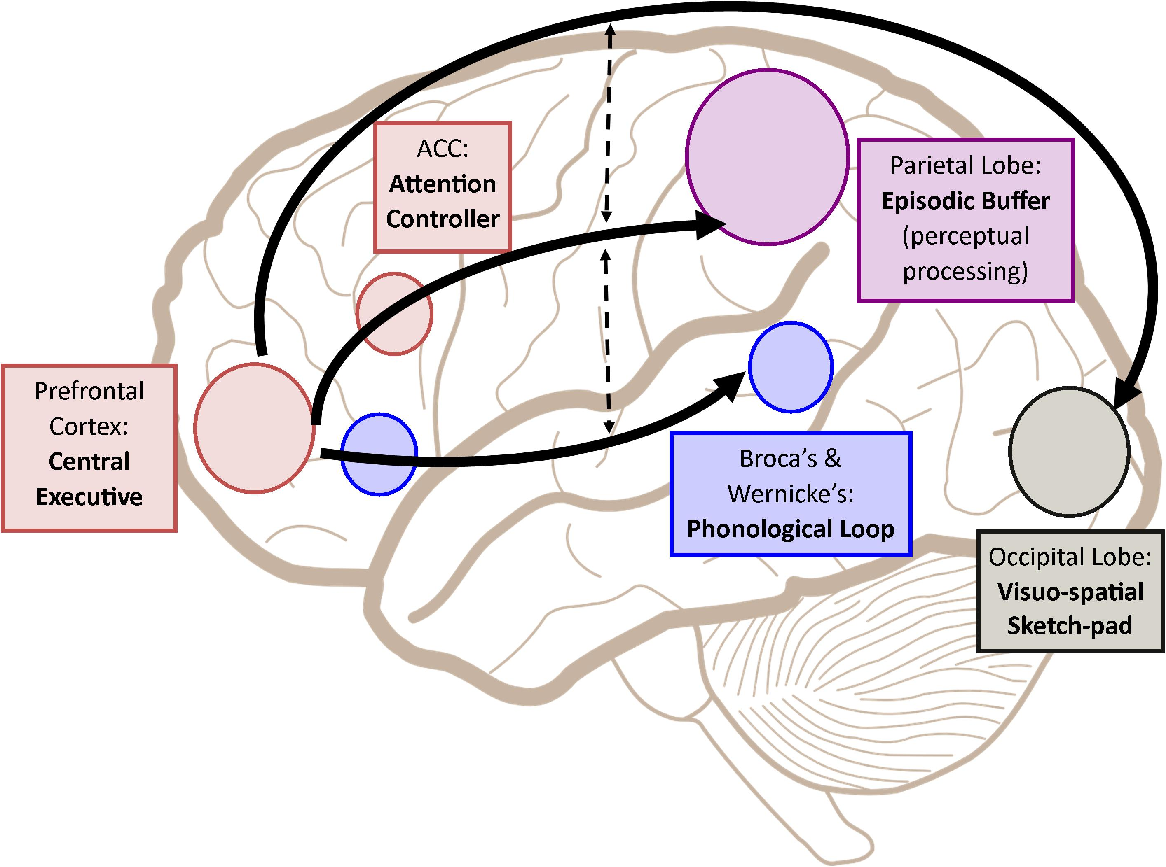
TASK
Read the evaluation of the working memory model on page 139
What are the strengths and limitations of this model?
Do a TEACUP analysis

Slide 18
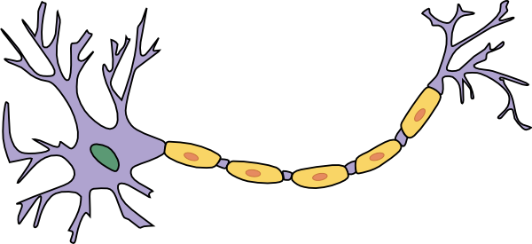
REVIEW
What was meant by:
synapse?
neuroplasticity?

Slide 19
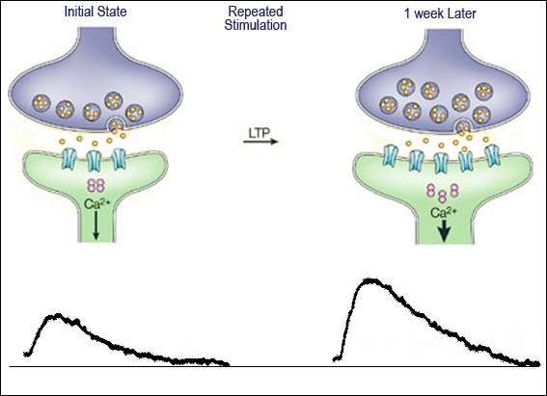
Biological base of memory
Long-term potentiation
Strengthening of synapses based on frequent activation
Produces a long-lasting increase in information transmission between neurons

Slide 20
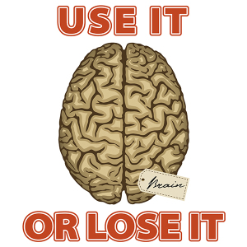
TASK
Watch the Khan Academy video on long-term potentiation (LTP)

Slide 21
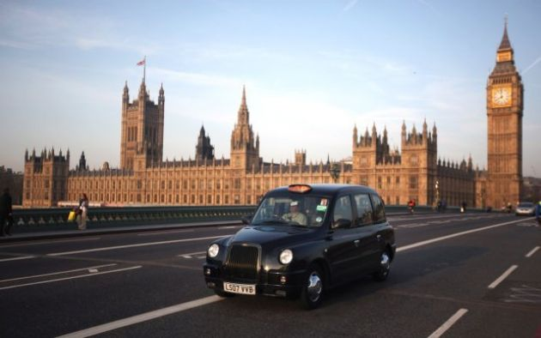
TASK
Watch the National Geographic video on London taxi drivers

Slide 22
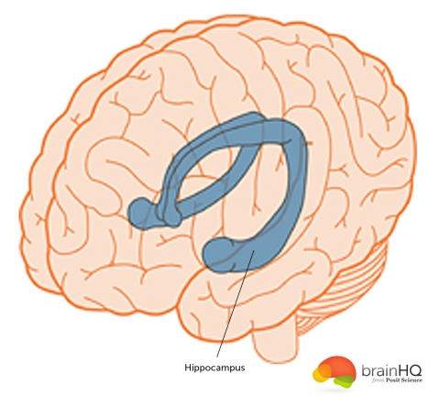
TASK
Read page 61
What were the aim, procedure and results of Maguire et al. (2000) study?
Based on the study, how does hippocampus relate to memory functions?

Slide 23
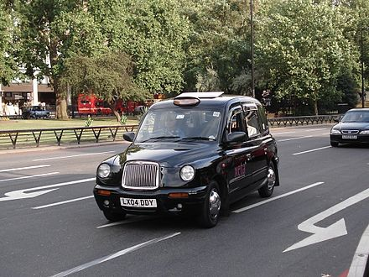
TASK
Evaluate the Maguire et al. (2000) study
What are its strengths and limitations?
Do a MAGEC/GRENADE analysis

Slide 24
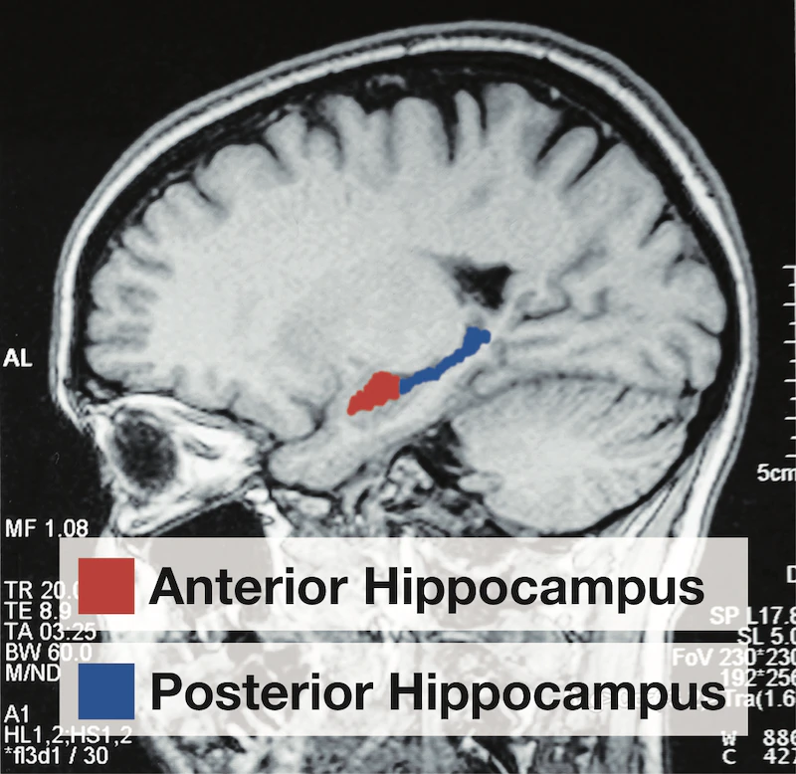
RESEARCH: Types of experiments
Quasi-experiment
Allocation into groups is done on the basis of pre-existing differences
Researchers do NOT manipulate the IV
Cause-effect inferences CANNOT be made
True experiment
Allocation into experimental groups is done randomly
Researchers manipulate the IV
Cause-effect inferences can be made
HOW IS QUASI-EXPERIMENT DIFFERENT FROM
TRUE-EXPERIMENT

Slide 25
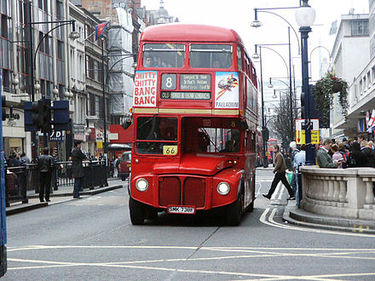
Biological base of memory
Maguire et al. (2006)
Comparison between London taxi drivers and bus drivers
Years of navigation experience correlated with hippocampal grey matter volume only in taxi drivers
Ability to acquire new visuo-spatial information was worse in taxi drivers than in bus drivers

Slide 26
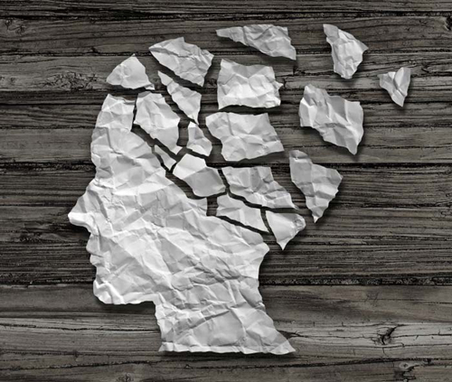
Biological base of memory
Amnesia
General term for memory dysfunctions caused by brain damage
Anterograde amnesia
Failure to store memories after the trauma
Retrograde amnesia
Failure to recall memories before the trauma

Slide 27
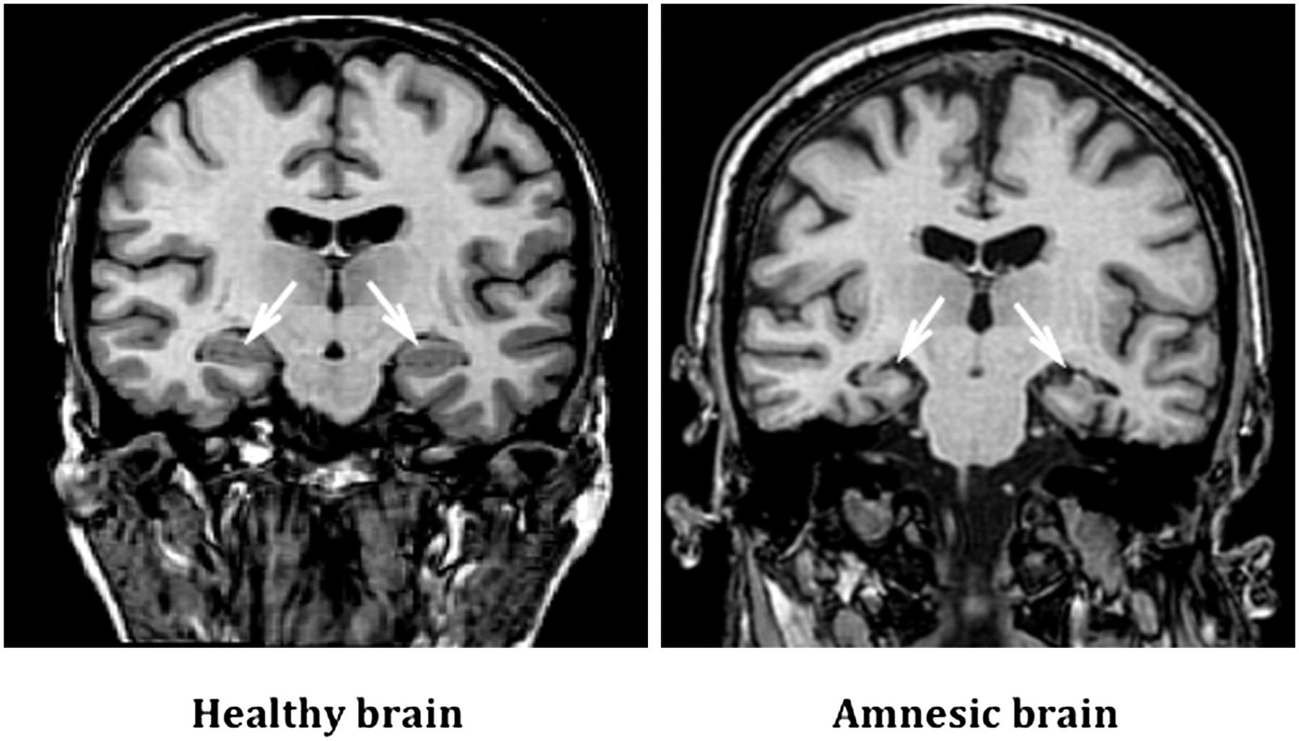
Biological base of memory

Slide 28
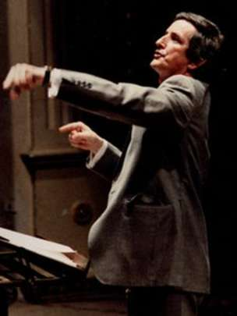
TASK
Watch the BBC video on the case of Clive Wearing
What brain parts are probably damaged in Clive’s case?

Slide 29
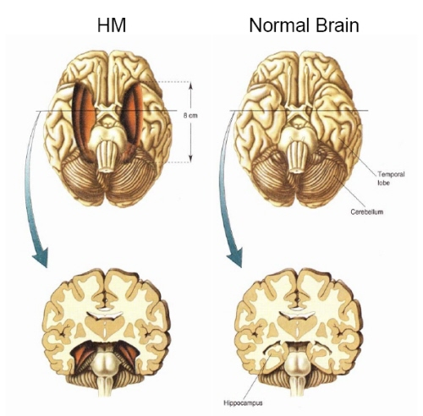
TASK
Watch the TED-Ed video on the case of HM
How is the case of HM similar to the case of Clive Wearing?

Slide 30
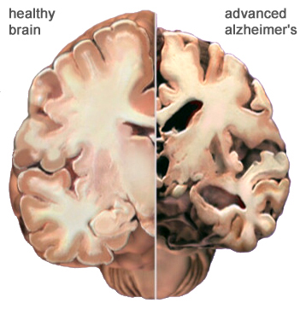
Biological base of memory
Dementia
General term for illnesses where mental capacities are deteriorated
Alzheimer’s disease
Most common form of dementia where semantic and episodic memories are decreased

Slide 31

REVIEW
What were meant by schemas?
What could be examples of different schemas?
How do schemas influence our behaviour?

Slide 32
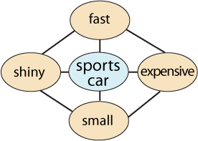
Schema theory
Cognitive schemas
Mental representations
Patterns of knowledge

Slide 33
Schema theory
ENVIRONMENT
CYCLE OF PERCEPTION
SELECTS
TARGETS
CHANGES
SCHEMA
PERCEPTION
DIRECTS

Slide 34
Schema theory
THREE MAIN STAGES IN MEMORY PROCESSES
ENCODING
STORAGE
RETRIEVAL
SCHEMA PROCESSING CAN INFLUENCE MEMORY AT ALL STAGES

Slide 35
TASK
What were the aim, procedure and results of Bransford and Johnson (1972) study?
How did schemas influence encoding?
What were the aim, procedure and results of Anderson and Pichert (1978) study?
How did schemas influence retrieval?
Read pages 142–145

Slide 36
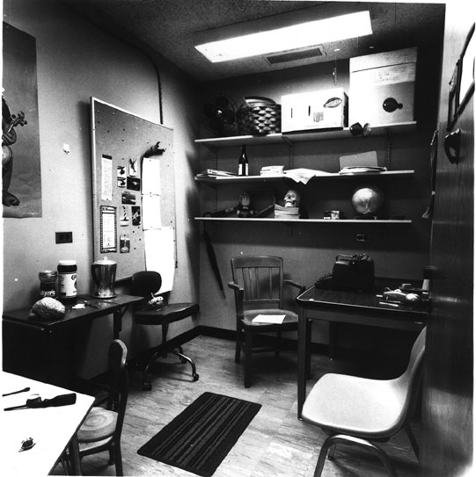
Schema theory
Brewer & Treyens (1981)
Does stereotypical schema of an office influence memory recall?
Participants were asked to wait 35 seconds in an office room
After the waiting period, participants were taken into another room and were asked to write down everything they could remember from the office room

Slide 37
Schema theory
Participants recalled things from a typical office
They did not recall the wine bottle and the picnic basket
Participants schema of an office influenced their memory of it
SKULL

Slide 38

Schema theory
Social schemas
Schemas about groups of people
E.g. stereotypes
Scripts
Schemas about sequences or events
E.g. grocery shopping

Slide 39
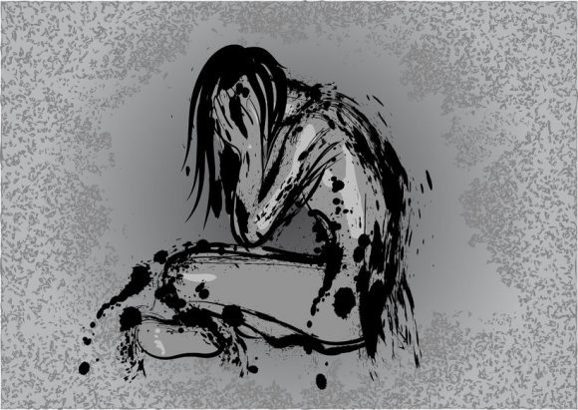
Schema theory
Self-schemas
Schemas about ourselves
”I wish I was different”
”People don’t notice me”
”No matter how hard I try I will fail for sure”

Slide 40
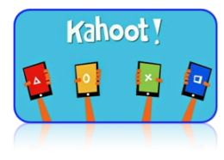
TASK
Teacher will divide the class in two groups
Both groups will given a stimulus material
Both groups will do a Kahoot! separately

Slide 41
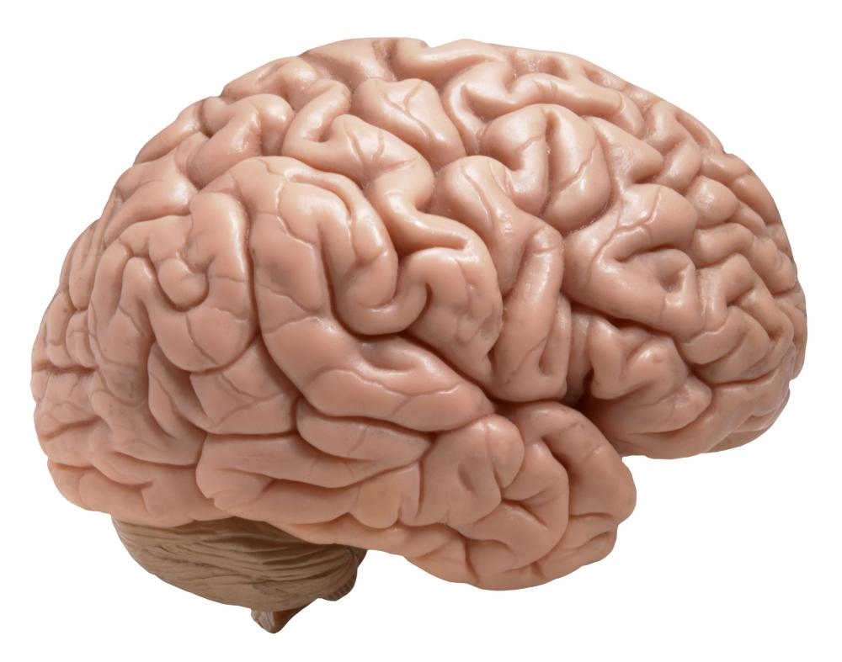

Schema theory
TOP-DOWN PROCESSING
BOTTOM-UP PROCESSING

Slide 42
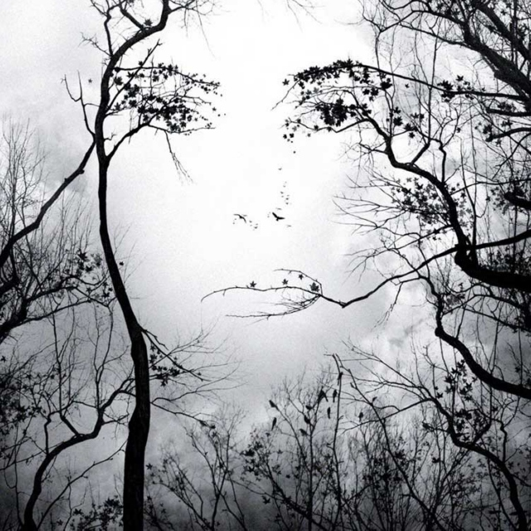
Schema theory
Pattern recognition
Matching the current sensory input to schemas in memory

Slide 43
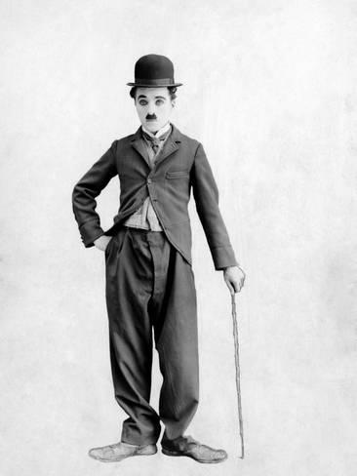
TASK
Watch the following video clip experience pattern recognition in action

Slide 44

TASK
What are the pros and the cons of schemas?
How do they facilitate and/or complicate the way we process information and guide our behaviour?
What are the strengths and limitations of schema theory?
Do a TEACUP analysis

Slide 45

Reliability of memory
Theory of reconstructive memory
Memory is an active process
Memory is NOT exact, it is distorted by existing schemas

Slide 46
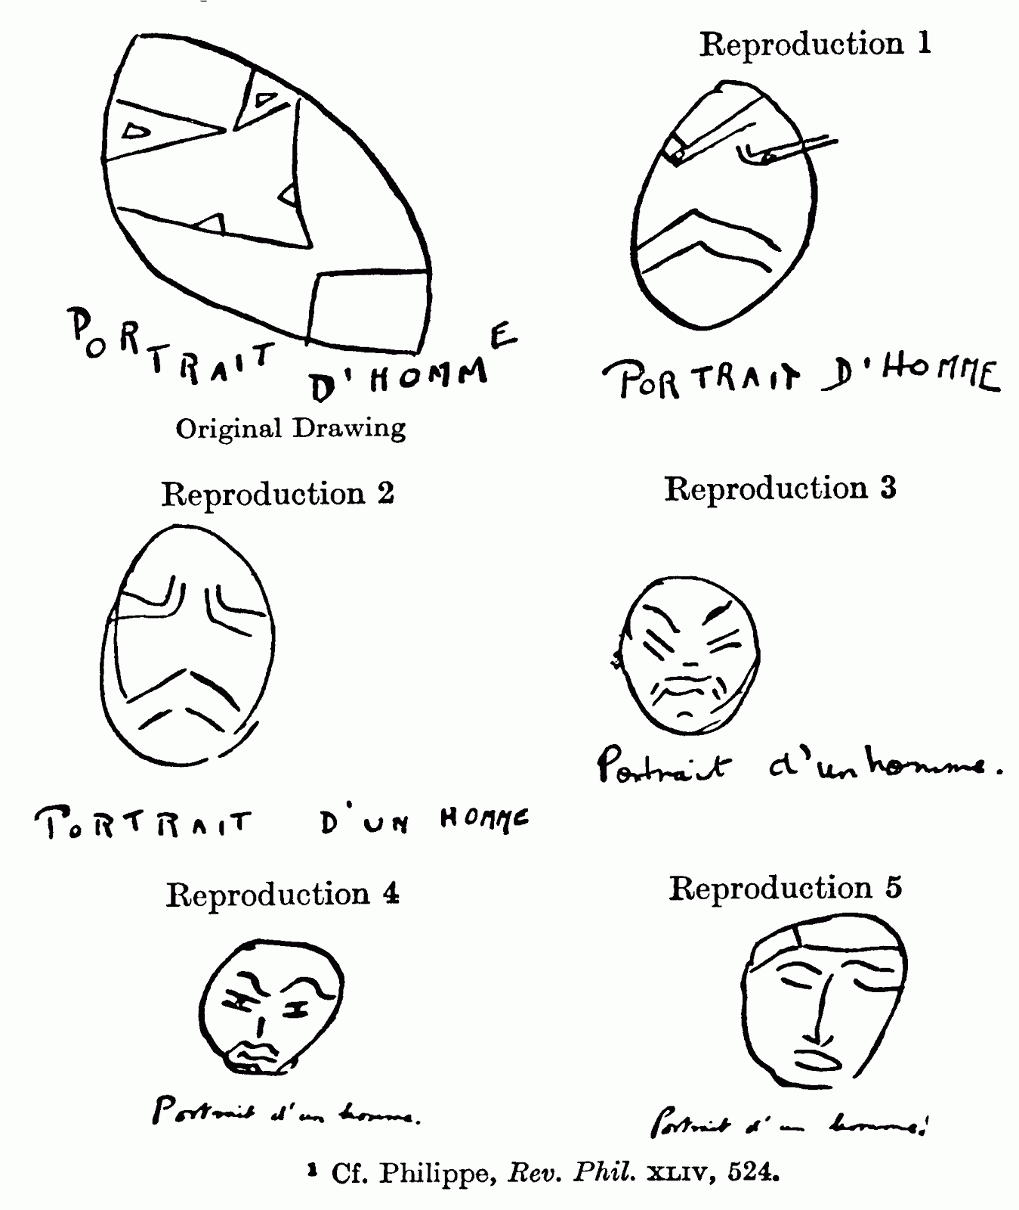
Reliability of memory
Bartlett (1932)
Studied the reliability of memory with serial reproduction of Native American legend “The War of Ghosts”

Slide 47
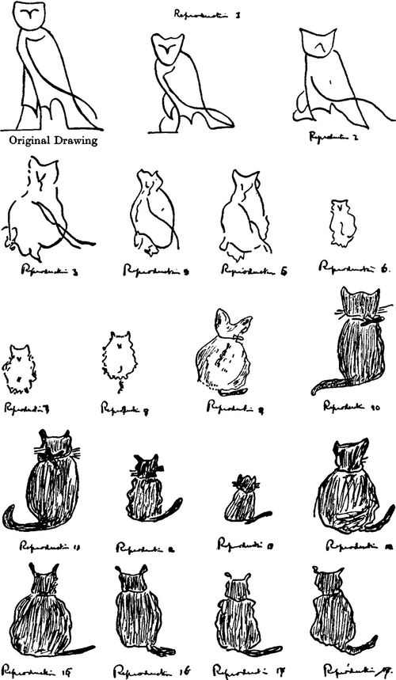
Reliability of memory
Effort after meaning
Attempt to match unfamiliar ideas into a familiar framework

Slide 48
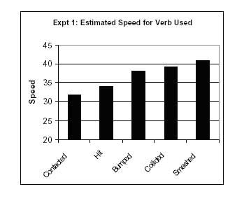
TASK
Watch the instructional video about Loftus and Palmer (1974) study
Focus on the aim, procedure and results of this twin experiment

Slide 49
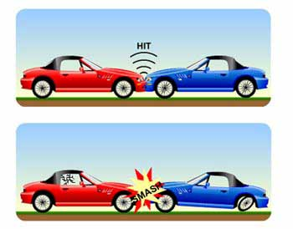
Reliability of memory
Loftus and Palmer suggested that the findings could be interpreted in two ways
Response bias: the verb biases the response to a higher estimate
Memory change: the verb causes an actual change in the memory

Slide 50
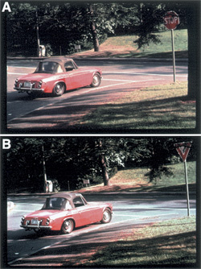
TASK
Read pages 162-164
What were the aim, procedure and results of Loftus, Miller and Burns (1978) study?
How was this study different from Loftus and Palmer (1974) study?

Slide 51
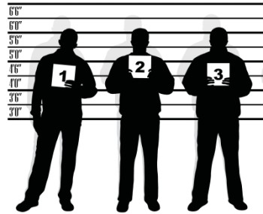
Reliability of memory
Yuille and Cutshall (1986)
Do real eyewitness accounts get distorted with misleading post-event information?
13 eyewitnesses of a gun store robbery were interviewed four months after the incident

Slide 52
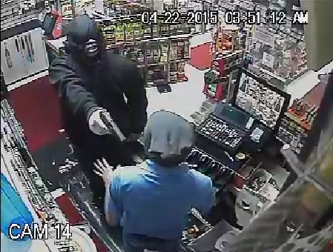
Reliability of memory
Half of the participants were asked leading questions with misleading information
When compared to the official police records, misleading questions had very little effect on the participants recall

Slide 53
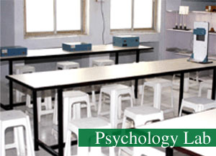
Reliability of memory
Yuille and Cutshall (1986) study can be explained in two ways
Reconstructive memory is an artificial phenomenon that takes place only in laboratory experiments
Study might be tapped into a separate memory mechanism: flashbulb memory

Slide 54
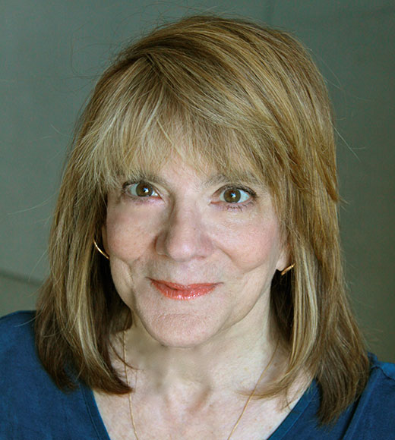
TASK
Watch Elizabeth Loftus TED-talk “How reliable is our memory?”

Slide 55
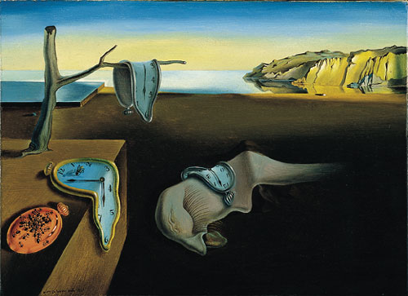
TASK
Is human memory reliable?
On what basis it is?
On what basis it is not?
Can you trust your memory?

Slide 56
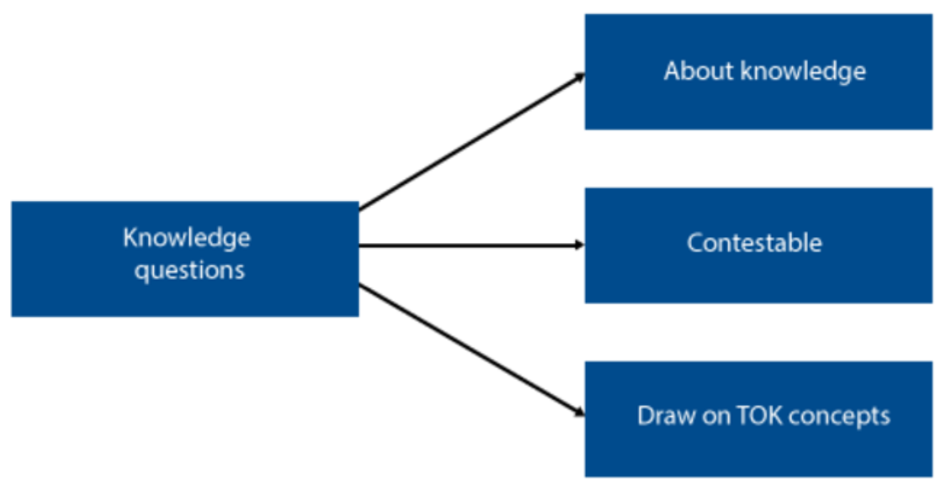
TOK-LINK
How do the following KQs relate to the contents we just covered?
What features of knowledge have an impact on its reliability?
What constraints are there on the pursuit of knowledge?
To what extent is certainty attainable?
DISCUSS AND EXPLORE THESE KNOWLEDGE QUESTIONS

Slide 57
TASK
Read at least one set of sample responses, both SAQs and ERQ/essays, in peda.net concerning models of memory, schema theory and reconstructive memory
After reading the responses, pay attention to the examiner’s comments
What were you able to learn from these responses?

Slide 58
Sources
Crane, J. & Hannibal, J. (2009). Psychology Course Companion. Oxford: Oxford University Press.
Gray, P. & Bjorklund, D. (2014). Psychology (7th edition). New York: Worth Publishers.
Popov, A., Parker, L. & Seath, D. (2017). IB Psychology Course Companion (2nd Edition). Oxford: Oxford University Press.

Slide 59
Picture sources
Sunflowers <http://www.lumon.fi/lumon/energiansaasto-ja-ymparisto/> Accessed 11th of November 2015.
Kung fu <https://thedissolve.com/news/2795-the-dissolve-on-our-favorite-female-badasses/> Accessed 11th of November 2015.
Wheel brain <http://careersinpsychology.org/becoming-a-cognitive-psychologist/> Accessed 11th of November 2015.
Cognitive triangle <https://fi.pinterest.com/pin/391813236312711130/> Accessed 23rd of November 2017.
Garfield model <http://backreaction.blogspot.com/2008/04/emergence-and-reductionism.html> Accessed 26th of October 2020.
Memory lapse <https://www.brainhq.com/brain-resources/memory/memory-lapses/> Accessed 26th of October 2020.
Glanzer and Cunitz (1966) <https://slideplayer.com/slide/7812447/> Accessed 26th of October 2020.
Tree memory <https://theconversation.com/a-memory-pill-cognitive-neurosciences-contributions-to-the-study-of-memory-109707> Accessed 26th of October 2020.
Working memory model <http://aspsychologyblackpoolsixth.weebly.com/working-memory-model.html> Accessed 28th of October 2020.
STM brain structures <https://www.frontiersin.org/articles/10.3389/fpsyg.2018.00401/full> Accessed 28th of October 2020.
Neuron <https://fi.m.wikipedia.org/wiki/Tiedosto:Neuron.svg> Accessed 23rd of November 2017.
LTP <https://sites.google.com/site/mcauliffeneur493/home/synaptic-plasticity> Accessed 23rd of November 2017.
Use it or lose it <https://languageattrition.org/use-or-lose/> Accessed 23rd of November 2017.

Slide 60
Picture sources
Multi-store model of memory <http://m.annals.yonsei.ac.kr/news/articleView.html?idxno=1692> Accessed 27th of November 2017.
London taxi 1 < http://www.cityam.com/blog/1402483881/which-londons-taxi-app-offers-best-fares> Accessed 30th of November 2017.
Hippocampus < https://www.brainhq.com/brain-resources/image-gallery/hippocampus > Accessed 30th of November 2017.
London taxi drivers study <http://www.pnas.org/content/97/8/4398.full> Accessed 30th of November 2017.
London taxi 2 <https://en.wikipedia.org/wiki/Hackney_carriage> Accessed 30th of November 2017.
Anterior and posterior hippocampus <https://www.tutor2u.net/psychology/reference/maguire-2000> Accessed 11th of August 2023.

Slide 61
Picture sources
London bus <https://en.wikipedia.org/wiki/London_Buses_route_8> Accessed 30th of November 2017.
Paper head <https://www.psychliverpool.co.uk/psychology-news/health/memory-loss-and-psychosis/> Accessed 30th of November 2017.
Healthy brain and amnesic brain <http://drugs-inn.com/the-30-year-amnesia-brain-damage/> Accessed 30th of November 2017.
Clive Wearing <http://www.bbc.com/news/magazine-15791973> Accessed 30th of November 2017.
HM brain and normal brain <http://www.redhotsci.com/patient_hm/> Accessed 30th of November 2017.
Normal brain and Alzheimer brain <https://www.alz.org/braintour/healthy_vs_alzheimers.asp> Accessed 24th of November 2015.

Slide 62
Picture sources
Milk carton <http://www.smallworlds.com/forum/archive/index.php/t-1274171.html> Accessed 23rd of November 2017.
Schema of sport cars <http://mercercognitivepsychology.pbworks.com/w/page/61207282/Schemas> Accessed 11th of November 2015.
Brewer & Treyens office <http://internal.psychology.illinois.edu/~wbrewer/office.html> Accessed 23rd of November 2017.
Information <http://www.aiim.org> Accessed 23rd of November 2017.
Groceries <https://www.groceryshoppingbusiness.com/hello-world/> Accessed 6th of November 2018.
Depression <https://www.docsopinion.com/2018/02/25/depression-symptoms/> Accessed 6th of November 2018.
Kahoot! <http://www.psi-solutions.org/kahoot-it/> Accessed 24th of January 2016.
Brain <http://cliparting.com/free-brain-clipart-4926/> Accessed 23rd of November 2017.
Eye drawing <http://www.clipartpanda.com/clipart_images/blue-eye-clip-art-image-1399516> Accessed 23rd of November 2017.
Face in trees <https://8tracks.com/theperksofbeingme/confusing-thoughts-on-a-chilly-afternoon> Accessed 27th of November 2017.
Chaplin <http://www.allposters.fi/-sp/Charlie-Chaplin-1925-posters_i5099494_.htm> Accessed 6th of November 2018.

Slide 63
Picture sources
Memory wheel head <http://exclusive.multibriefs.com/content/working-memory-in-english-language-development> Accessed 24th of November 2015.
Bartlett serial reproduction figures 1 <http://www.psychsummaries.com/2011/11/bartlett-1932-and-war-of-ghosts.html> Accessed 27th of November 2017.
Bartlett serial reproduction figures 2 <http://psycnet.apa.org/fulltext/2014-16777-001.html> Accessed 27th of November 2017.
Loftus & Palmer 1 & 2 <https://www.simplypsychology.org/loftus-palmer.html> Accessed 27th of November 2017.
Loftus, Miller & Burns <http://ezotera.ariom.ru/2014/04/16/effekt-dezinformacii.html> Accessed 6th of November 2018.
Eyewitness <http://www.mibba.com/Articles/Science/7609/Eyewitness-Testimony-Its-Uses-and-Shortcomings/> Accessed 6th of November 2018.
Armed robbery <https://www.mlive.com/news/kalamazoo/index.ssf/2015/04/police_seek_help_identifying_s_1.html> Accessed 6th of November 2018.
Psychology lab <http://www.ssimtmzn.org/labs-psychology-lab.html> Accessed 23rd of November 2017.
Elizabeth Loftus <http://www.law.uci.edu/faculty/full-time/loftus/> Accessed 30th of November 2017.
Dali <https://fi.wikipedia.org/wiki/Muiston_pysyvyys> Accessed 25th of November 2015.

