Slide 1
THE RELATIONSHIP BETWEEN GENETICS AND BEHAVIOUR
IB Psychology LAJM

Slide 2
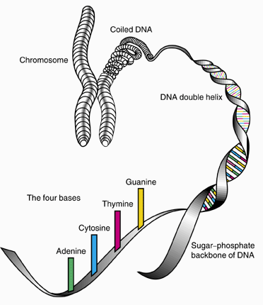
TASK
Read pages 96–98
Explain in your own words what the following terms mean
Chromosome
DNA
Gene
Allele
Genotype
Phenotype

Slide 3
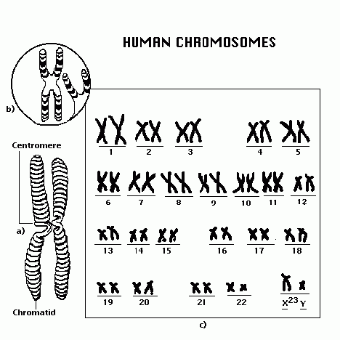
Genes and their effect on behaviour
Genome is the entirety of individual’s genetic information
The human genome contains 23 pairs of chromosomes, 20 000 genes and 3 billion bases

Slide 4
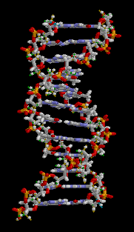
Genes and their effect on behaviour
Genes code and regulate the production of protein molecules
Structural proteins
Enzymes

Slide 5
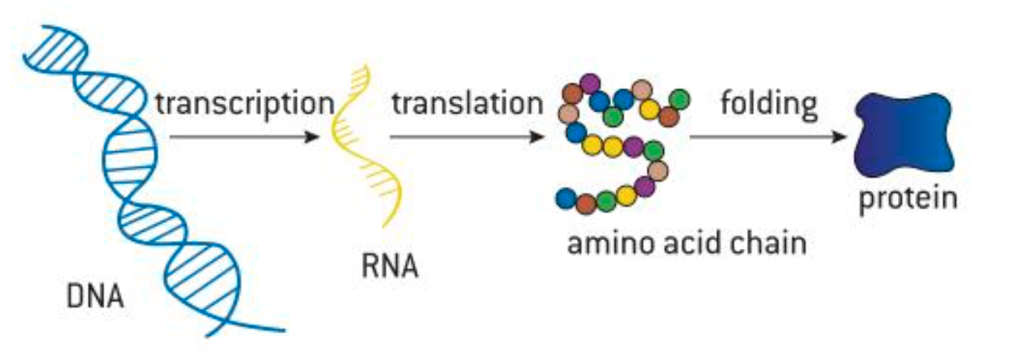
Genes and their effect on behaviour
Gene expression
The process of manifesting genotype as phenotype

Slide 6
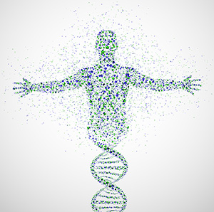
Genes and their effect on behaviour
Not all genes that individual possesses are expressed at the same time
Gene regulation
The process of switching genes on and off

Slide 7
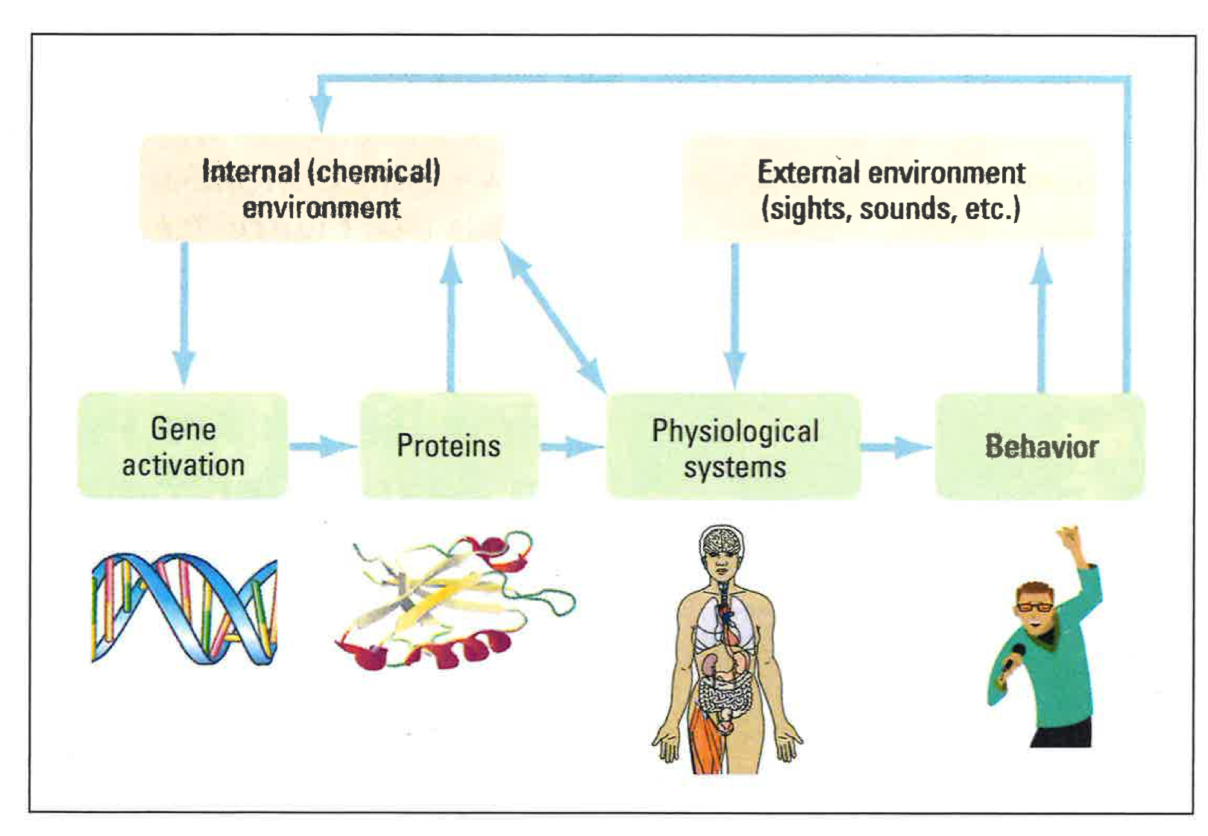
Genes and their effect on behaviour
Genes are entwined with the environment and behaviour
Influences what genes are switched on and off
Remember the interactionist approach!

Slide 8
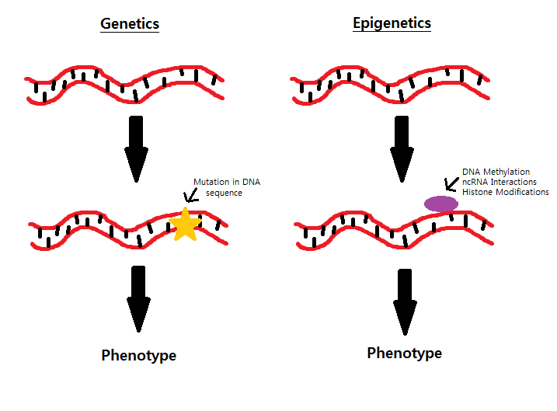
Genes and their effect on behaviour
Epigenetics refers to changes in gene functions that do not change the actual DNA structure
Methylation
The process where chemicals bind to the DNA molecule to suppress it

Slide 9
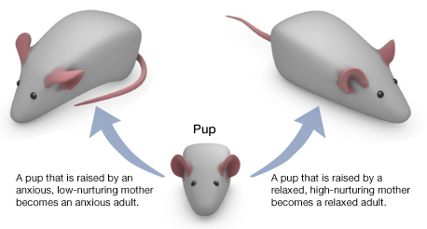
Genes and their effect on behaviour
Watch the TED-Ed video about epigenetics
Weaver et al (2004)

Slide 10
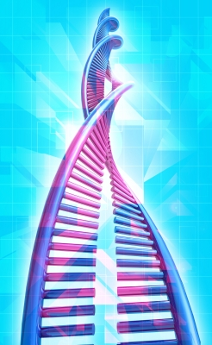
Genes and their effect on behaviour
5-HTT gene
Serotonin transporter gene
Regulates the reuptake of serotonin at brain synapses
Partially determines how strongly stressful events will influence depressive symptoms

Slide 11
TASK
Read pages 291–292
What were the aim, procedure and results of Chiao and Blizinsky (2010) study?
How is the 5-HTT gene associated with cultural factors?
How does this study contribute to the idea of gene-environment interaction?
Read page 291
What were the aim, procedure and results of Caspi et al (2003) study?
How does the 5-HTT gene influence depressive behaviour?

Slide 12
Genes and their effect on behaviour
Kendrell et al (2005)
Replication of Caspi et al (2003)
Random sample of 549 adult twins
Interview regarding stressful life events (SLEs) and reference to statistical data with computer algorithm
Individuals with short alleles at the 5-HTT gene were more sensitive to the depressing effects of all SLEs than were those with long alleles
Variation at the 5-HTT moderates the sensitivity of individuals to the depressing effects of SLEs

Slide 13
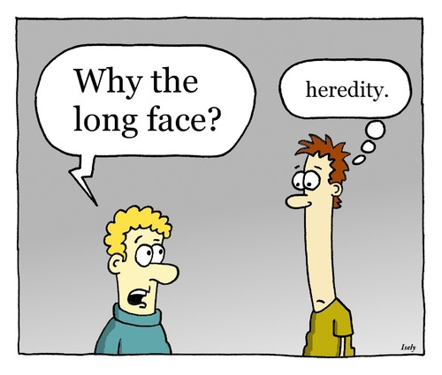
Genetic similarity
Genetic similarity refers to relatedness
Heredity means passing on traits from parents to offspring

Slide 14
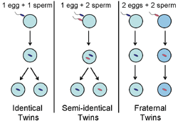
TASK
Read page 98
What are the main methods used to study the influence of genotype on behaviour?
Summarise key points in your own words

Slide 15

Genetic similarity
Niche-picking
Genetic predisposition causes individuals to select certain environments

Slide 16
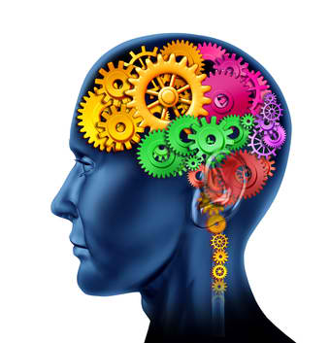
TASK
Read pages 100-104
Find out how the heritability of intelligence has been studied
Bouchard & McGue (1981)
Kendler et al (2015)
Scarr & Weinberg (1983)

Slide 17

EXTRA TASK
Watch the Nancy Segall lecture on twin studies
Write down the findings that are new to you

Slide 18
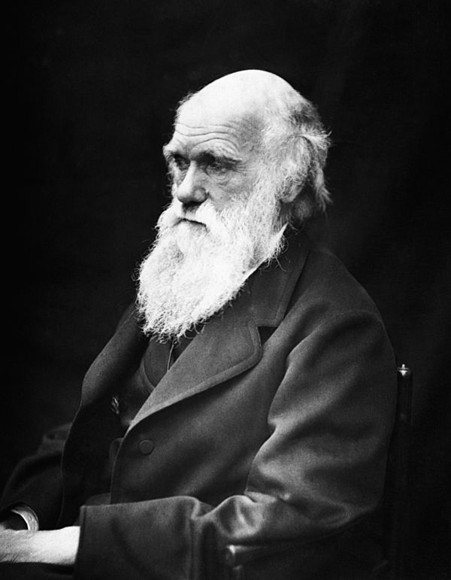
Evolutionary explanations for behaviour
Evolution is the process where genes that are better for survival and reproduction become more common within a population

Slide 19
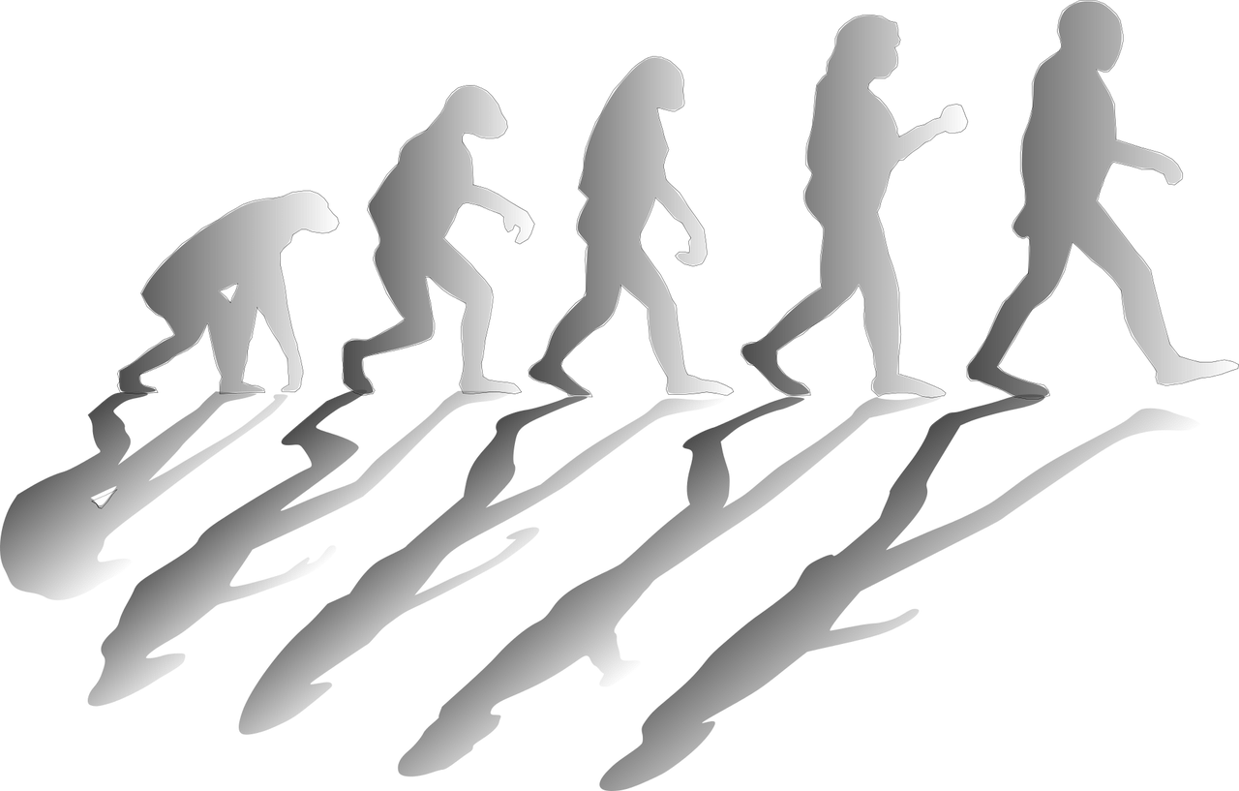
TASK
Watch the Kurtzgesagt video about evolution
Pick the following terms:
Recombination
Mutation
Selection

Slide 20
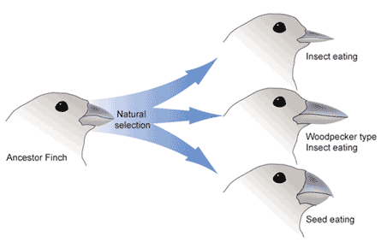
Evolutionary explanations for behaviour
Adaptation is an inherited characteristic that increases individual’s chances for survival and reproduction

Slide 21
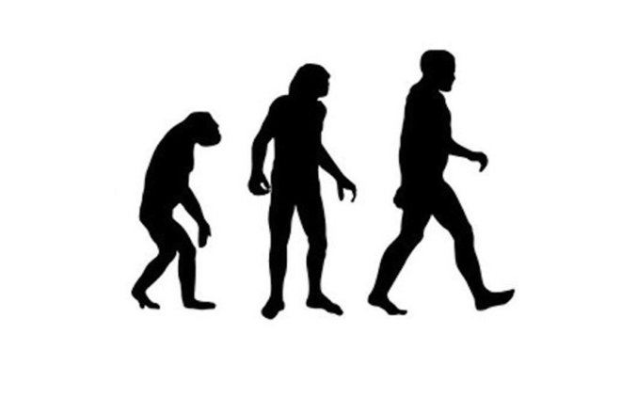
Evolutionary explanations for behaviour
Evolutionary psychology attempts to explain human behaviour based on the development of our species over time

Slide 22
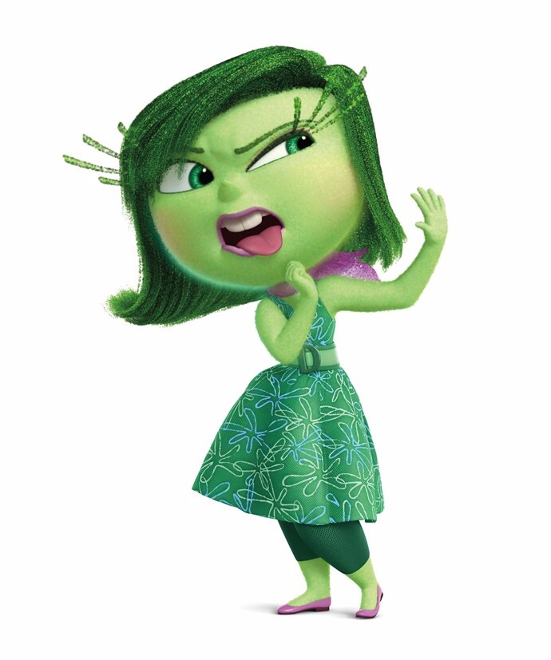
TASK
Read pages 111-112 and teacher’s additional materials
Find out how Curtis, Aunger and Rabie (2004) and Fessler et al. (2005) researched disgust from the perspective of evolutionary psychology

Slide 23
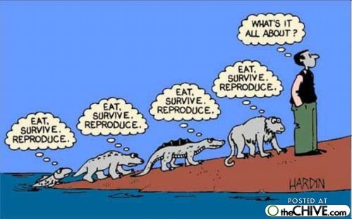
TASK
Read pages 112-113
Summarize the main criticism of evolutionary explanations in psychology in your own words
Try integrate some TOK into your memos!
What makes a good explanation?
What counts as a good justification for a claim?

Slide 24
TASK
Read the sample SAQ responses from peda.net concerning genetic inheritance and evolution
Pay attention to the examiner’s comments!
What were you able to learn from these responses?

Slide 25
Sources
Crane, J. & Hannibal, J. (2009). Psychology Course Companion. Oxford: Oxford University Press.
Gray, P. & Bjorklund, D. (2014). Psychology (7th edition). New York: Worth Publishers.
Popov, A., Parker, L. & Seath, D. (2017). IB Psychology Course Book. Oxford: Oxford University Press.

Slide 26
Picture sources
Chromoseme-DNA <https://science.howstuffworks.com/life/genetic/designer-children1.htm> Accessed 10th of November 2017.
Human chromosomes <http://www.123tagged.com/Tags/1/human+chromosomes.html> Accessed 10th of November 2017.
Rotating DNA <https://fi.wikipedia.org/wiki/DNA> Accessed 10th of November 2017.
Gene transcription, translation and folding into proteins. Popov, Parker & Seath, 2017, page 104
Human gene <http://www.sigmaaldrich.com/technical-documents/articles/white-papers/flavors-and-fragrances/ingredients-materials-safety-genotoxicity-testing.html> Accessed 26th of August 2017.
Genes, environment and behaviour. Björklund & Gray, 2014, page 59.
Genetics and epigenetics <http://studentblogs.med.ed.ac.uk/reproductive-systems-group-2/introduction/> Accessed 9th of October 2018.
Weaver rats <http://sites.bu.edu/ombs/2010/11/11/licking-rat-pups-the-genetics-of-nurture/> Accessed 5th of January 2018
DNA <https://www.fearofflying.com/library/the-5-htt-gene/> Accessed 13th of February 2020.
Heredity <https://www.toonpool.com/cartoons/long%20face_105569> Accessed 10th of November 2017.
Types of twins <http://genetics.thetech.org/ask/ask421> Accessed 10th of November 2017.
Twins <http://www.redflagnews.com/headlines/identical-twin-studies-prove-homosexuality-is-not-genetic> Accessed 11th of November 2015.
Wheel head <http://powerlisting.wikia.com/wiki/Intelligence_Manipulation> Accessed 10th of November 2017.
Nancy Segal <http://psych.fullerton.edu/nsegal/> Accessed 10th of November 2017.
Charles Darwin <https://fi.wikipedia.org/wiki/Charles_Darwin> Accessed 10th of November 2017.

Slide 27
Picture sources
Evolution <https://pixabay.com/fi/kehitys-kehittyvä-ihmiskunnan-1295256/> Accessed 10th of November 2017.
Adaptation <https://en.wikipedia.org/wiki/Adaptive_value> Accessed 10th of November 2017.
Evolutionary psychology <https://www.livescience.com/32503-why-havent-all-primates-evolved-into-humans.html> Accessed 10th of November 2017.
Disgust <http://pixar.wikia.com/wiki/Disgust> Accessed 10th of October 2017.
Evolution cartoon <http://thechive.com/2009/02/26/every-single-evolution-cartoon-we-could-get-our-hands-on-36-photos/> Accessed 10th of November 2017.

