Slide 1
APPROACHES TO RESEARCHING BEHAVIOUR
IB Psychology LAJM

Slide 2

REVIEW
Review essential contents from pre-IB psychology course concerning psychological research with the help of the teacher’s handout

Slide 3

Criteria for psychological research
Theories should be supported by empirical evidence
WHAT IS MEANT BY
EMPIRICAL EVIDENCE
AND HOW IT IS GAINED?

Slide 4
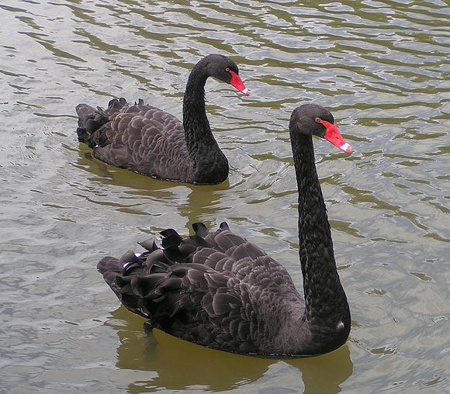
Criteria for psychological research
Theories and studies should be falsifiable
It should be possible for the theory or the study to be proven wrong
HOW CAN YOU FALSIFY A THEORY OR A STUDY?

Slide 5

Criteria for psychological research
Theories and concepts should be testable
HOW CAN YOU TEST
A THEORY OR A CONCEPT?

Slide 6

Criteria for psychological research
Independent research should be able to replicate studies
HOW CAN YOU REPLICATE
A STUDY AND WHY
IT IS IMPORTANT?

Slide 7

Construct
Any theoretically defined variable, a psychological phenomenon
E.g. love, aggression and memory
Constructs need to be operationalized

Slide 8
Sampling in experiments
SAMPLE
TARGET POPULATION
SAMPLE SHOULD REPRESENT
THE TARGET POPULATION

Slide 9

TASK
Read pages 11–12 and complete the teacher’s handout by comparing the strengths and the limitations of different sampling techniques used in experiments

Slide 10

Experimental designs
Different ways to organize groups and conditions in psychological experiments

Slide 11
Experimental designs
Independent measures design
Random allocation of groups and comparison between these groups
The larger the sample, the higher the chance of the groups being equivalent
EXPERIMENTAL GROUP
IV => DV
CONTROL GROUP
Same setting,
but without IV

Slide 12

Experimental designs
Matched pairs design
Researcher controls the equivalence of groups manually by ranking the participants and matching similar pairs randomly

Slide 13
Experimental designs
Repeated measures design
Compares conditions rather than groups
Same group of participants are exposed to different conditions
PARTICIPANTS
NOISE
SILENCE
RESULTS

Slide 14

TASK
Read pages 12–14 and complete the teachers memos with more accurate info on each experimental design
Independent measures design
Matched pairs design
Repeated measures design

Slide 15

Validity
Expresses the relationship between the reality and the experiment
Do the research methods used in the experiment correspond to the phenomenon that is being researched?

Slide 16

TASK
Read pages 14–15 and find out what the following forms of validity mean:
Construct validity
Internal validity
External validity

Slide 17

Bias
Factor or factors that might skew the research results

Slide 18
TASK
Teacher will divide the class into nine groups
Each group should construct a checkpoint in the classroom about one bias that threatens internal validity in experiments
Pages 16-17
You have 20 minutes
When checkpoints are ready, each group should go around all the checkpoints and collect the relevant data for themselves:
Definition
Example
Cure

Slide 19
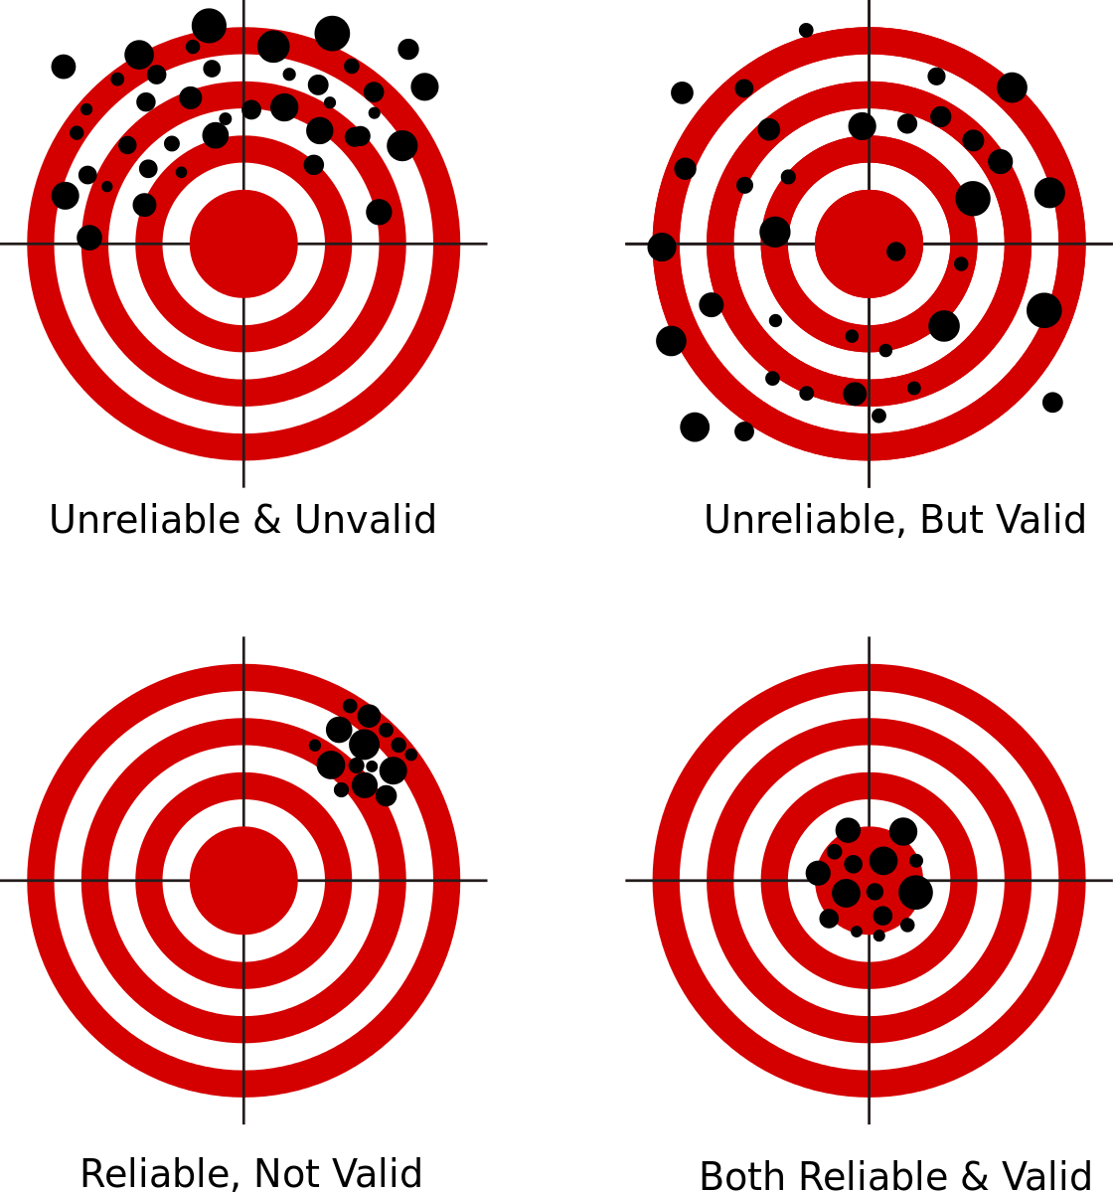
Reliability
Refers to the consistency of the results
Are the results of the experiment repeatable?

Slide 20

TASK
Review the limitations of experiments and psychological research in general with the help of SciShow video
How do the contents you have learned so far appear in this video?
What other remarks can you make?

Slide 21
REVIEW
What was meant by correlation?
How is correlational research different from experiments?

Slide 22
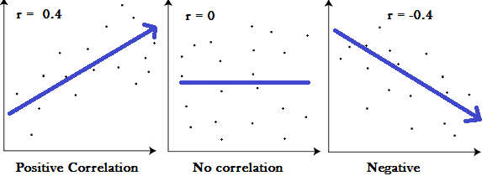
Correlational studies
Correlation
Measure of linear relationship between two variables
Effect size (r)
The value of correlation coefficient

Slide 23
Correlational studies
Statistical significance
Is the correlation effect size (r) obtained by chance?
p-value or probability value has to be less than .05 (5%) in order to be statistically significant
=> there is a 95% probability that the obtained correlation is NOT due to chance

Slide 24
Correlational studies
Good correlational study has large effect size (r) and small p-value

Slide 25
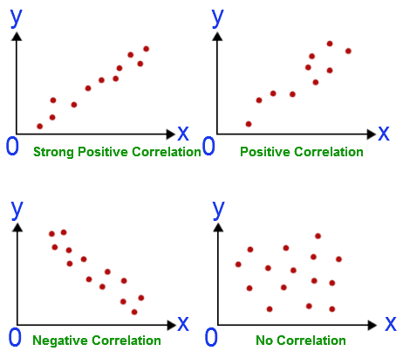
TASK
Read pages 22–23 and answer the following question:
What are the major limitations and biases in correlational studies and how to overcome them?

Slide 26

TASK
Correlation does not imply causation, or does it?
Watch this educational video to find out more

Slide 27
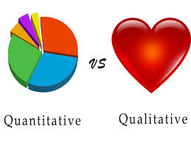
TASK/REVIEW
Read pages 5–7
What is meant by quantitative and qualitative research methods in psychology?
Focus on the terms nomothetic and idiographic
Write essential keywords to the whiteboard

Slide 28
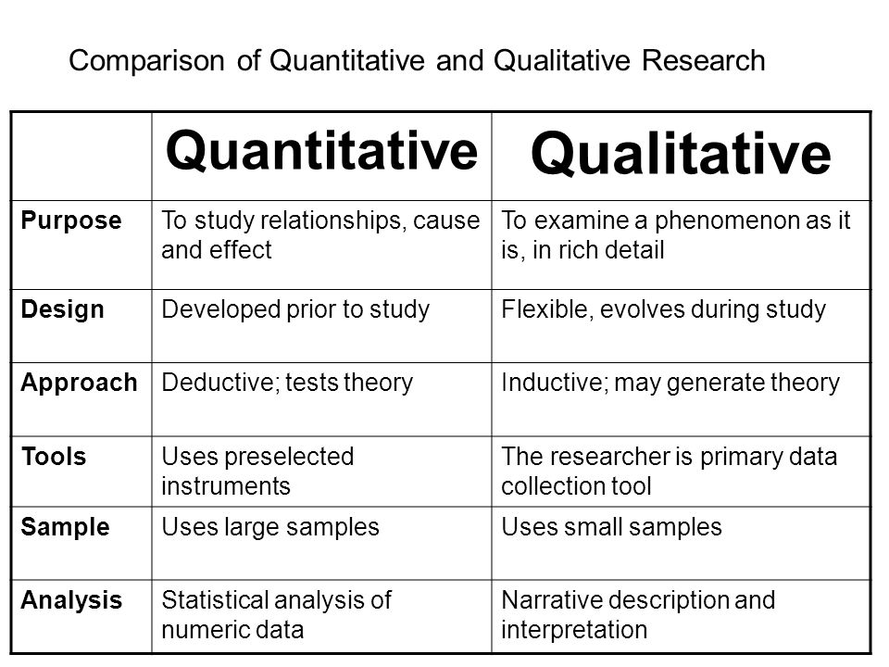

Slide 29
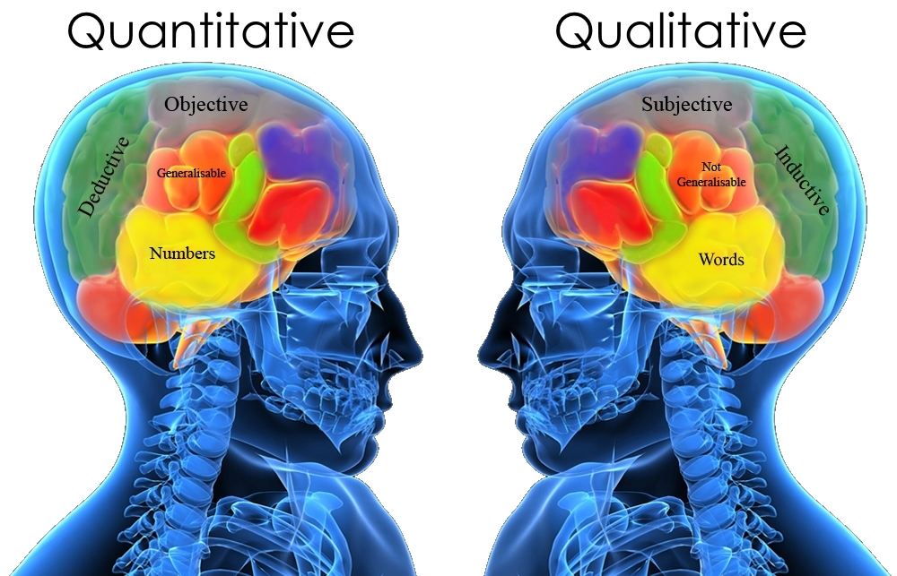
THESE TWO APPROACHES SHOULD NOT BE SEEN AS COMPETING, BUT AS COMPLEMENTARY TO DIFFERENT TYPES OF RESEARCH QUESTIONS

Slide 30
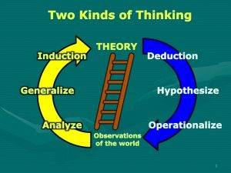

Slide 31

Validity in qualitative research
Credibility or trustworthiness in qualitative research is an equivalent of internal validity in the experimental studies

Slide 32
TASK
READ PAGES 25–26 AND EXPLAIN THE
ESSENCE OF THE FOLLOWING TERMS IN YOUR OWN WORDS

Slide 33
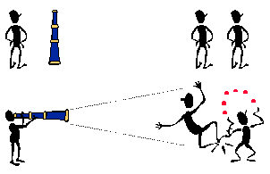
Bias in qualitative research
Bias is an integral part of qualitative research
Some types of biases can be eliminated while some others need to be recognised and taken into account

Slide 34
TASK
Teacher will divide the class into nine groups
Each group should construct a checkpoint in the classroom about one bias that hinders credibility and generalizability in qualitative research
Pages 26-28
You have 20 minutes
When checkpoints are ready, each group should go around all the checkpoints and collect the relevant data for themselves:
Definition
Example
Cure

Slide 35
TASK
Experimental research | Qualitative research
Selection | Acquiescence bias
History | Social desirability bias
Maturation | Dominant respondent bias
Testing effect | Sensitivity bias
Instrumentation | Confirmation bias
Regression to the mean | Leading questions bias
Experimental mortality | Question order bias
Demand characteristics | Sampling bias
Experimenter bias | Biased reporting
The sources of bias in experimental and qualitative research appear in the table on the right
Can you find any similarities, differences and overlaps?

Slide 36
Sampling in qualitative research
Samples in qualitative research are NOT statistically representative of the target population
Findings are NOT generalizable
Transferability
Generalizing the results to a group of people who are close to the qualitative sample
H O W E V E R !

Slide 37
Sampling in qualitative research
Quota sampling
Number AND the main characteristics of the participants are decided before the research
Purposive sampling
ONLY main characteristics of the participants are decided before the research
Theoretical sampling
Type of purposive sampling that ends when data saturation is reached
Data saturation is reached when no new evidence cannot be added to the background theory

Slide 38

Sampling in qualitative research
Snowball sampling
Small number of participants are invited and asked to invite other people to the research
Convenience sampling
Using a sample that is easily available

Slide 39
Please note!
Qualitative research methods will be covered in detail with HL students only
Observation
Interview
Focus group
Content analysis
Case study
FOR NOW IT IS ENOUGH THAT YOU
SKIM THROUGH PAGES 31–36

Slide 40

Ethics in psychological research
Ethicality is an important prerequisite for all psychological research

Slide 41

TASK
Read pages 38–41 and summarize the main points of ethical considerations in conducting the study and ethical considerations in reporting the results in your own words

Slide 42

TASK
Read IBO’s ethical guidelines for IA-task
Are the IBO’s guidelines in line with the general ethical guidelines you have been studying?
Can you find any similarities, differences and overlaps?

Slide 43
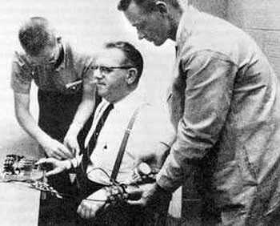
Ethics in psychological research
Evaluation of the ethics of psychological research is an essential part of critical thinking in IB Psychology

Slide 44
Picture sources
Review <http://ajslp.pubs.asha.org/article.aspx?articleid=2204333> Accessed 22nd of November 2017.
Hearts <https://www.freepik.com/free-photos-vectors/love> Accessed 30th of January 2018.
Pros and cons <https://ljcdspalette.org/1135/showcase/pros-and-cons-of-new-schedule/> Accessed 30th of January 2018.
Geometry head <https://www.onlinepsychologydegree.info/influential-psychological-experiments/> Accessed 10th of August 2023.
Matched pair <https://www.iconfinder.com/icons/1474916/caring_friend_friendship_pair_people_side_by_side_teammate_icon> Accessed 18th of May 2018.
Black mechnic head <https://study.com/academy/lesson/psychological-research-methods-overview-considerations.html> Accessed 10th of August 2023.
Validity target <http://www.readingeagle.com/voices/article/realism-of-archery-king-hits-a-bullseye> Accessed 6th of August 2018.
Face validity <https://blog.questionmark.com/face-validity-participants-connecting-assessments-to-constructs> Accessed 6th of August 2018.
Bias <https://crew.co/blog/cognitive-biases-decision-making/> Accessed 22nd of August 2017
Reliability and validity <https://commons.wikimedia.org/wiki/File:Reliability_and_validity.svg> Accessed 17th of August 2017.
SciShow <https://en.wikipedia.org/wiki/SciShow> Accessed 21st of August 2018.
Experiment <http://blog.stridekick.com/matchup-experiment-what-inspires-behavior-change/> Accessed 30th of January 2018.
Correlation 1 <http://www.statisticshowto.com/probability-and-statistics/correlation-coefficient-formula/> Accessed 1st of February 2018.
Minute Physics <https://www.youtube.com/channel/UCUHW94eEFW7hkUMVaZz4eDg> Accessed 25th of August 2021

Slide 45
Picture sources
Correlation 2 <http://math.tutorvista.com/statistics/correlation-and-regression.html> Accessed 16th of August 2015.
Quantitative and qualitative symbols <http://learnexperienceteach.com/2016/03/21/research-methods-quantitative-qualitative-research/> Accessed 22nd of August 2017.
Comparison of quantitative and qualitative research <https://www.google.fi/url?sa=i&rct=j&q=&esrc=s&source=images&cd=&cad=rja&uact=8&ved=0ahUKEwi79OaCp-XVAhXnQZoKHeQbAj8QjB0IBg&url=https%3A%2F%2Fueassignmentmccb.formation-conseil.info%2Fqualitative-research-case-study-approach.html&psig=AFQjCNF7xcd5d0nJibDVUc0iQ8bWo6HAsw&ust=1503300805080393> Accessed 18th of August 2017.
Quantitative and qualitative heads <http://www.cdsmr.com/newsworthy/qualitative-quantitative-research-the-cds-way> Accessed 18th of August 2017.
Two kinds of thinking <https://www.pinterest.ca/pin/395542779751940516/> Accessed 26th of November 2015.
Trust and credibility <https://www.tes.com/lessons/CN7qOjEDZ_0-Zw/credibility> Accessed 6th of August 2018.
Sampling bias <http://psychtutor.weebly.com/research-methods.html> Accessed 22nd of August 2017.
Snowball sampling <https://dollarcents.org/infographics/compound-interest-snowball-effect/> Accessed 7th of August 2018.
Code of ethics <https://www.bps.org.uk/news-and-policy/bps-code-ethics-and-conduct> Accessed 6th of August 2018.
Got Ethics? <https://sites.psu.edu/leadership/2014/10/26/should-employer-ethics-policies-extend-to-employee-personal-lives/> Accessed 24th of August 2015.
IB Diploma Programme <http://www.yis.ac.jp/page.cfm?p=763> Accessed 10th of August 2017.
Milgram <http://listverse.com/2008/09/07/top-10-unethical-psychological-experiments/> Accessed 31st of August 2018.

