Slide 1
INTRODUCTION TO
IB PSYCHOLOGY
IB Psychology LAJM

Slide 2
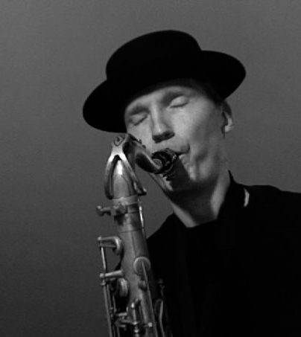
Who is the teacher?
Markus Lajunen (LAJM)
  Teacher of IB TOK and
  IB Psychology
  Worked previously in Konnevesi, Joensuu and of course Jyväskylä
  Part-time musician

Slide 3

Who are you?
Mini-interviews
  Form pairs
  Think of interesting questions you could ask from your pair
  Engage in conversation
  Introduce your pair to the class and to the teacher

Slide 4
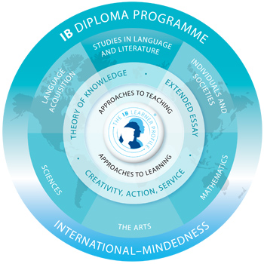
Psychology in the IB diploma programme
IB psychology is part of the group 3, individuals and societies
Psychology draws on concepts, methods and understandings from a number of different disciplines

Slide 5
IB psychology syllabus
Approaches to researching behaviour
Approaches to understanding behaviour
  Biological
  Cognitive
  Sociocultural
Options
  Abnormal psychology
  Psychology of human relationships
CORE

Slide 6
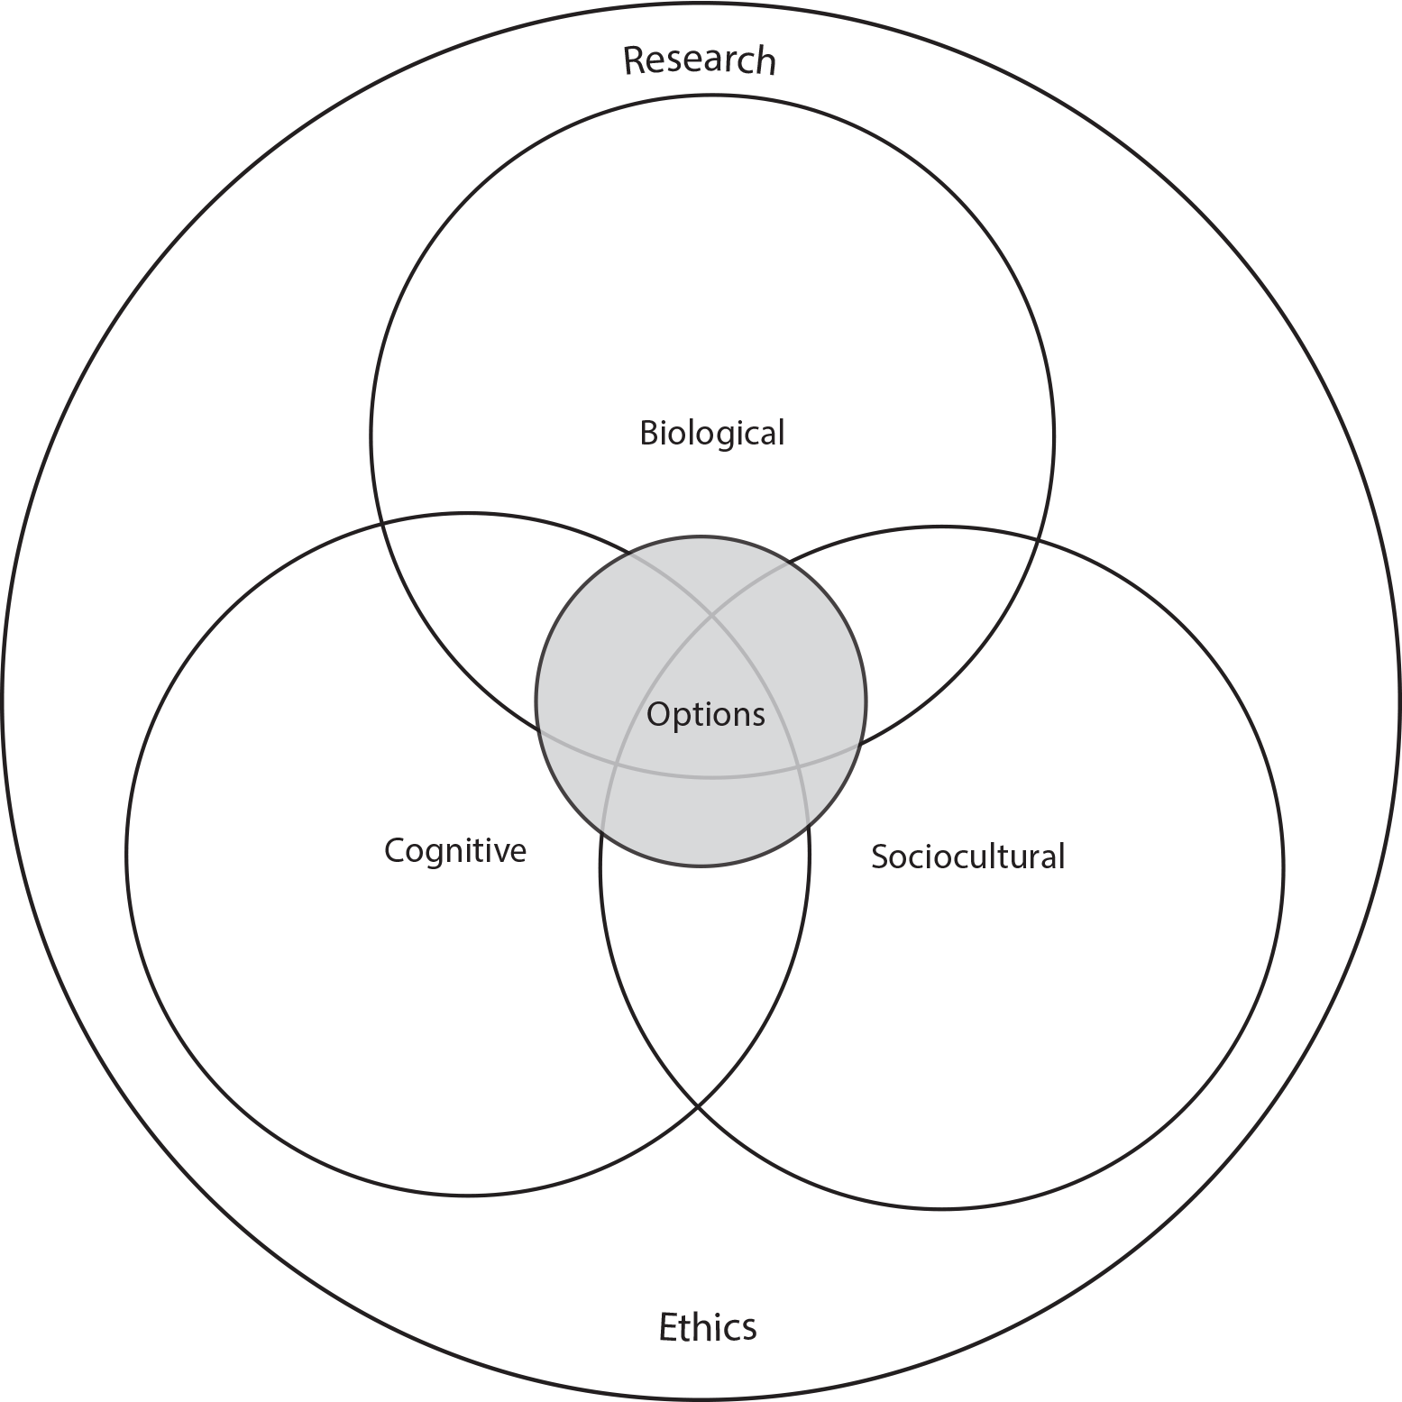
IB psychology syllabus

Slide 7
IB psychology assessment
Finals
  P1: Core (2 hours for both HL and SL)
  P2: Options (1 hour for SL, 2 hours for HL)
  P3: Approaches to research (1 hour, HL only)
Internal Assessment
  Replication of a psychological experiment and writing a research report

Slide 8
What are we studying for?
What is expected in the finals?
  Psychological terminology, theories and studies
How to answer in the finals?
  Critical thinking is important
What is useful to Internal Assessment?
  Applying statistics
How can we learn how to understand ourselves and others through psychology?

Slide 9
IB psychology schedules
IB1 year
  1st term: Approaches to researching behaviour and biological approach
  2nd term: Biological and cognitive approach
  3rd term: Animal research and digital world (HL only)
  4th term: IA task
  5th term: Sociocultural approach
IB2 year
  1st term: Option
  2nd term: Option
  3rd term: Approaches to researching behaviour (HL only)
  4th term: Review and final mocks
MOCK
MOCK
MOCK
MOCK
MOCK
MOCK?
MOCK
FINALS IN THE
BEGINNING OF MAY

Slide 10

IB psychology materials
Textbook:
  Popov, Parker & Sheath: Psychology Course Companion (2nd edition)
In addition to the textbook, IB psychology guide and teacher’s peda.net website should be used extensively

Slide 11

TASK
What are your goals in IB psychology?
  Write down your expectations and aims
  What would you like to learn in IB psychology?
  Engage in conversation

Slide 12
Picture Sources
Markus Lajunen playing the saxophone. Copyright Markus Lajunen.
Interview <https://medium.freecodecamp.org/how-to-interview-as-a-developer-candidate-b666734f12dd> Accessed 10th of August 2017.
IB Diploma Programme <http://www.yis.ac.jp/page.cfm?p=763> Accessed 10th of August 2017.
IB Psychology syllabus <https://ibpublishing.ibo.org/d_3_psych_gui_1702_1/apps/dpapp/guide.html?doc=d_3_psych_gui_1702_1_e&part=1&chapter=3&section=1> Accessed 16th of May 2018.
Writing hand drawing <https://www.comlib.org/event/ymca-creative-writing-workshop/> Accessed 16th of May 2018.

