Slide 1
TREATMENT OF DISORDERS
IB Psychology LAJM

Slide 2
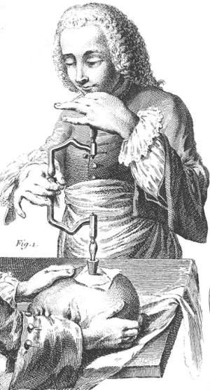
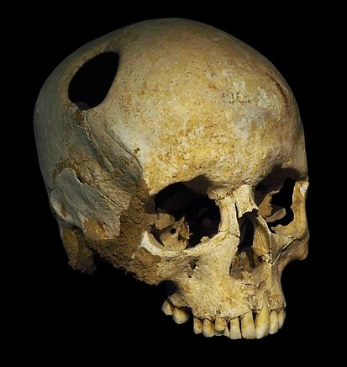
History

Slide 3
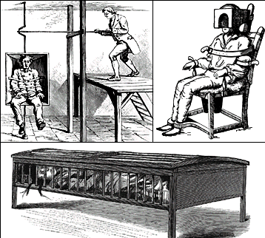
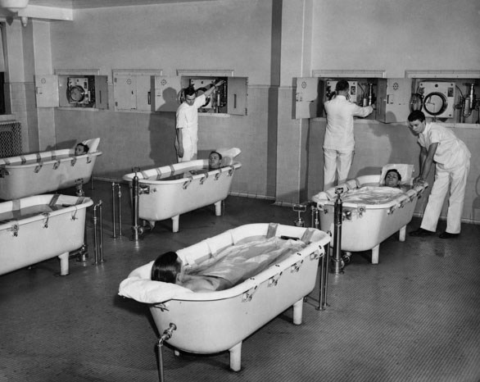
History

Slide 4
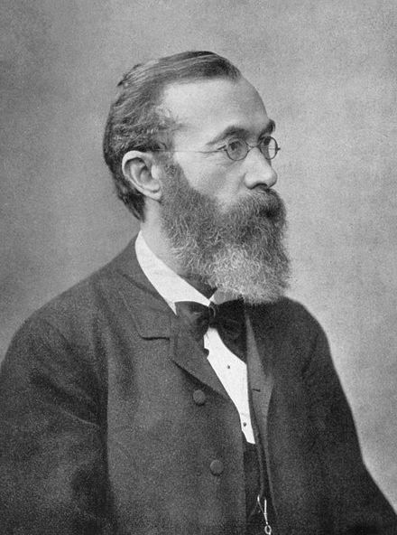
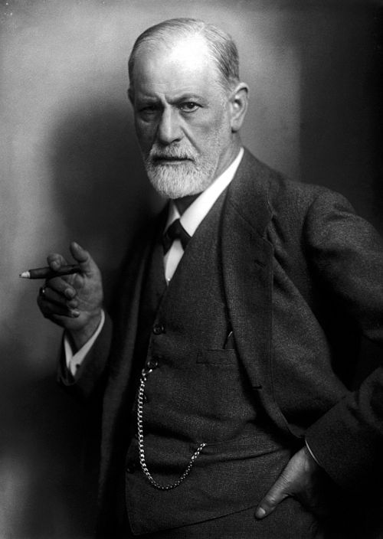
History

Slide 5
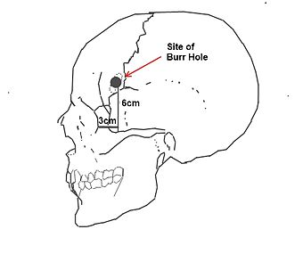
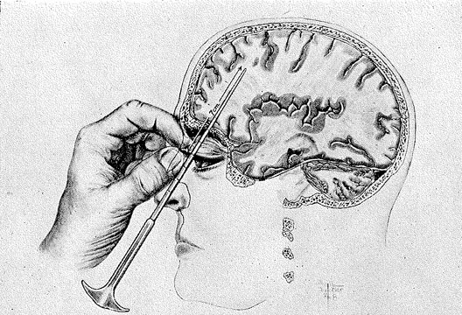
History

Slide 6
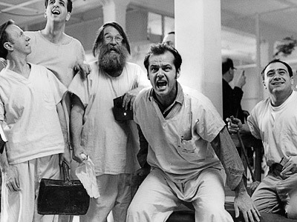
TASK
How should mentally ill be treated?
What kind of practises and principles should be applied?

Slide 7
Modern treatment of disorders
Biomedical treatment
Implementation of drugs and medical procedures
Psychological treatment
Individual and group therapy
Usually the best result is achieved when different approaches are combined
An eclectic approach to treatment
Cultural factors must be taken into consideration

Slide 8

TASK
How can we assess the effectiveness of treatment?
What kind of problems can arise?

Slide 9
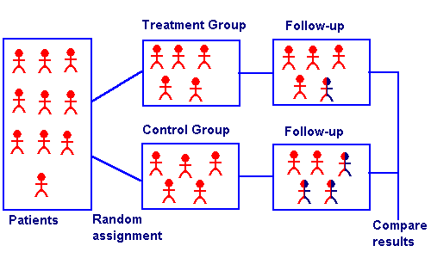
Assessing the effectiveness of treatment
Randomized control trials
Independent design experiments on the effectiveness of drugs and therapies

Slide 10
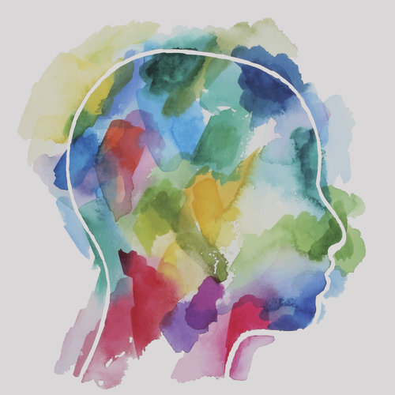
Assessing the effectiveness of treatment
Qualitative research
Analysing the subjective experiences of the patients undergoing treatment

Slide 11
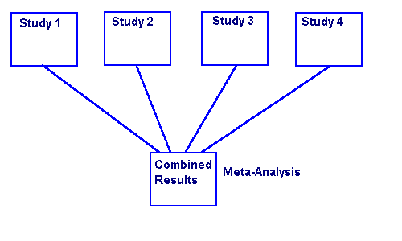
Assessing the effectiveness of treatment
Meta-analyses
Statistical analysis of a large number of existing studies

Slide 12
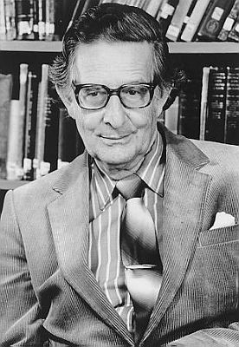
Assessing the effectiveness of treatment
Eysenck (1954)
”spontaneous remission alone is responsible for the individual’s improved condition regardless of psychotherapy”
IS EYSENCK RIGHT?

Slide 13
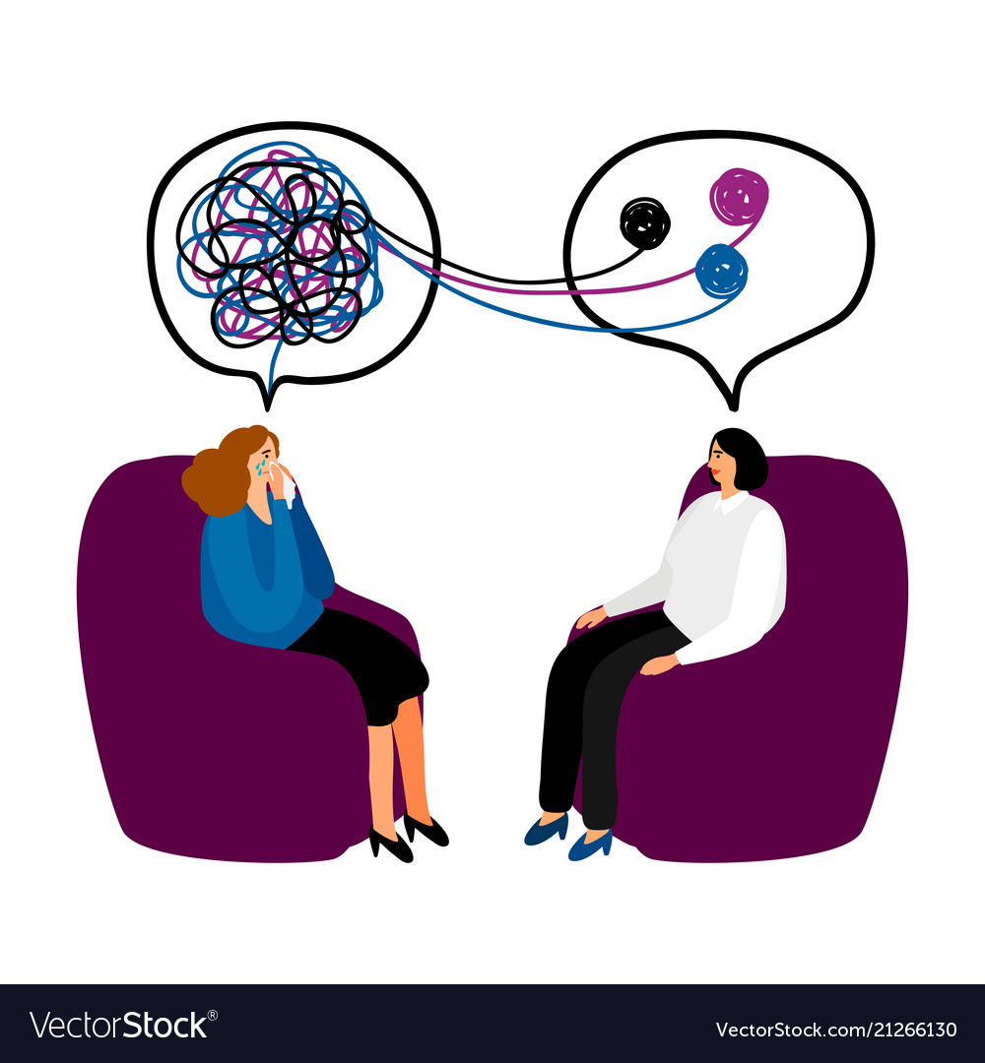
Assessing the effectiveness of treatment
Smith and Glass (1977)
Meta-analysis of 375 studies
Patients receiving psychotherapy are better off than 75% of untreated individuals

Slide 14
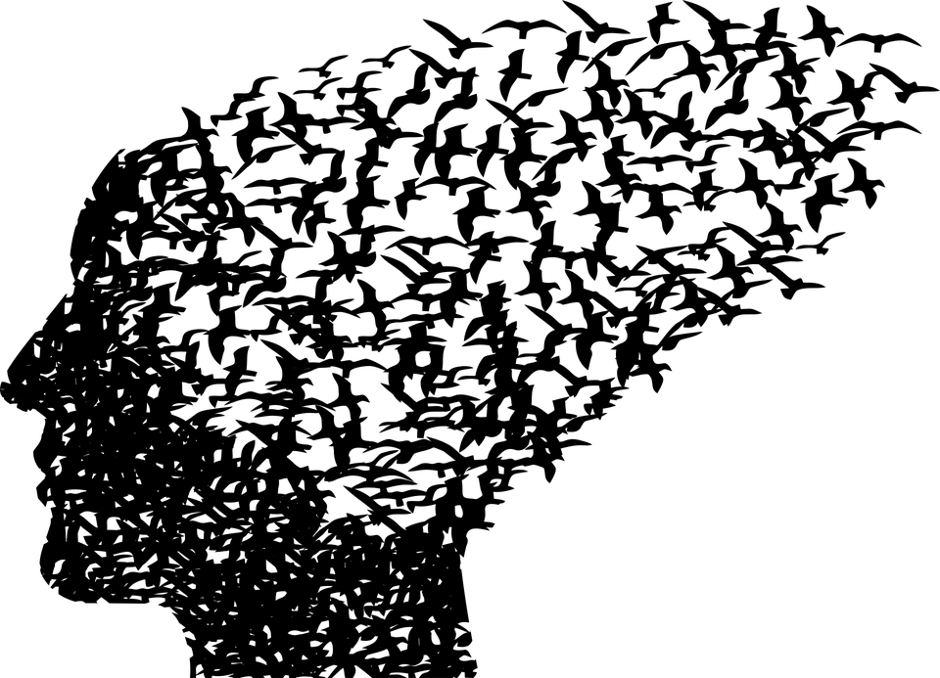
Assessing the effectiveness of treatment
Wampold (2007)
Meta-analysis comparing psychotherapy with medicine
Psychotherapy is typically as effective as pharmacological treatments of mental disorders and has more long-lasting effects

Slide 15
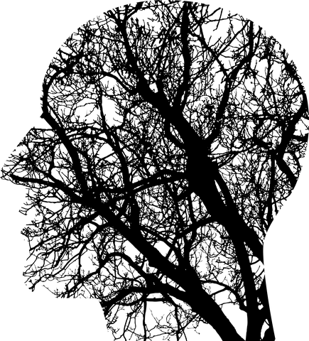
Assessing the effectiveness of treatment
Jacobson et al. (1996)
Experimental study to explain what components of cognitive behavioural therapy (CBT) are responsible for therapy outcomes
No evidence was found that full CBT is more effective than any of its components

Slide 16
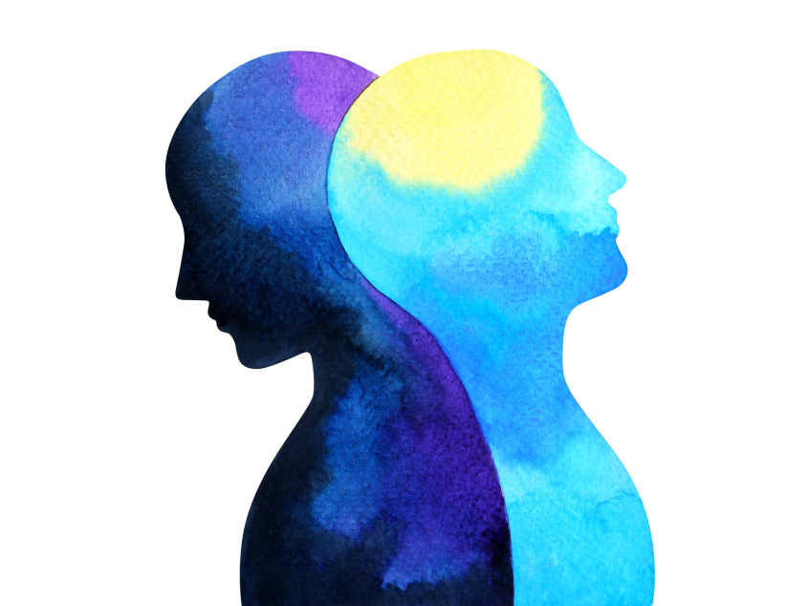
TASK
What makes psychotherapy effective?
Base your evaluation on presented studies

Slide 17

Assessing the effectiveness of treatment
Non-specific factors of psychotherapy
Common to all approaches
Specific factors of psychotherapy
Specific techniques used in certain approach

Slide 18

TASK
Familiarize yourself with the most common approaches to psychotherapy with the help of APA webpage

Slide 19
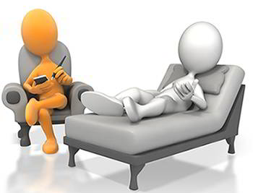
Assessing the effectiveness of treatment
Therapeutic approach does NOT play a crucial role in the effectiveness of psychotherapy

Slide 20
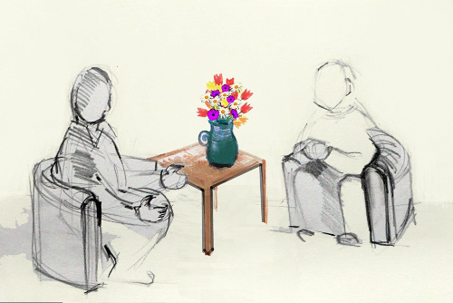
Assessing the effectiveness of treatment
Three common factors in the effectiveness of psychotherapy (Wampold, 2007)
(1) Client’s willingness to trust the therapist
(2) Working alliance with the client
(3) Placebo effect

Slide 21
GROUP PROJECT
Form 5 groups
Each group is given one type of treatment method to the treatment of depression
Each group compiles a PowerPoint presentation
Remember to mark all your sources and upload your work to ManageBac
Describe and evaluate the treatment method
Essential features, concepts and theories
The pros and the cons
Effectiveness
How and when should the method be used
Use empirical evidence!

Slide 22
GROUP PROJECT
Group 1: Antidepressants in the treatment of depression
Group 2: Electro convulsion therapy (ECT) in the treatment of depression
Group 3: Transcranial magnetic stimulation (TMS) and transcranial direct current stimulation (tDCS) in the treatment of depression
Group 4: Cognitive-behavioural therapy (CBT) in the treatment of depression
Group 5: Culture sensitive treatment in the treatment of depression

Slide 23
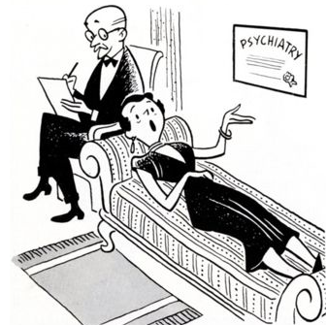
Treatment of depression
It’s unlike that there is only one etiology of depression
Different dimensions of depression can be addressed using a mixture of treatment approaches

Slide 24
TASK
Read the sample response to the question ”Contrast one biological and one psychological treatment for one disorder”
After reading the response, pay attention to the examiner’s comments
What were you able to learn from this sample response?

Slide 25
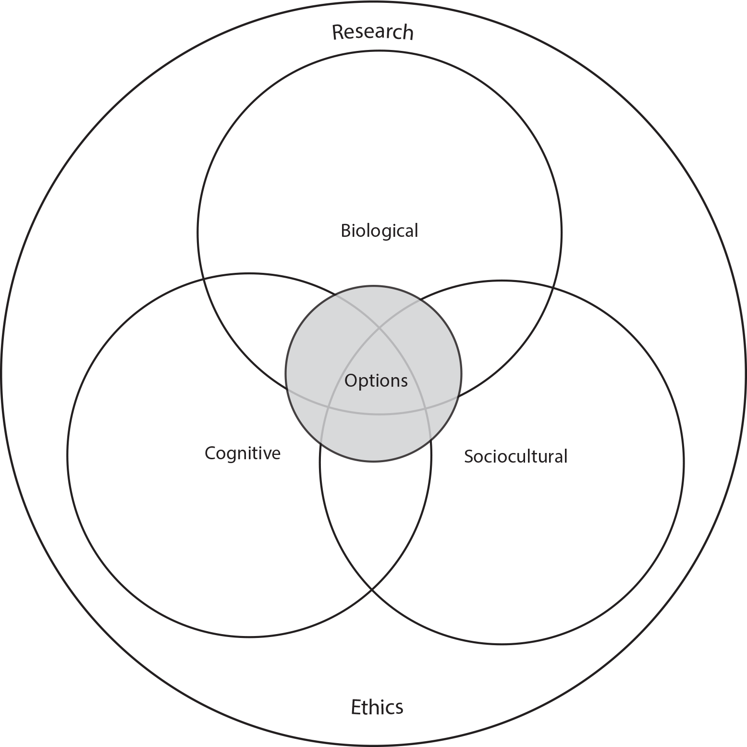
TASK
How do the different approaches of IB Psychology syllabus manifest themselves in what you have learned so far in Abnormal psychology?

Slide 26
Past questions
Discuss the role of culture in the treatment of one or more disorders (M19)
Evaluate the effectiveness of one or more treatments (N19)
Discuss the use of one or more psychological treatments for one psychological disorder (N20)
Discuss one or more ethical considerations in relation to the treatment of one or more psychological disorders (M21)
Evaluate one or more studies related to the treatment of one or more psychological disorders (N21)
Discuss one biological treatment and one psychological treatment for one or more psychological disorders (M22)

Slide 27
Picture sources
Trepanation 1 and 2 <https://en.wikipedia.org/wiki/Trepanning> Accessed 15th of August 2017.
History of therapy 1 and 2 <https://www.exposingtruth.com/13-shocking-pictures-showing-how-we-used-to-treat-the-mentally-ill/> Accessed 15th of August 2017.
Wilhelm Wundt <https://en.wikipedia.org/wiki/Wilhelm_Wundt> Accessed 15th of August 2017.
Sigmund Freud <https://fi.wikipedia.org/wiki/Sigmund_Freud> Accessed 15th of August 2017.
Lobotomy 1 and 2 <https://en.wikipedia.org/wiki/Lobotomy> Accessed 15th of August 2017.
One flew over the cockoo’s nest <http://thesociallyunjust.weebly.com> Accessed 15th of August 2017.
Comic therapy <https://www.vitalia.cz/clanky/jak-zvolit-dobreho-psychologa/> Accessed 13th of August 2018.
Randomized control trials <https://www.tes.com/lessons/tQgZc4lNh9ZgSw/randomized-controlled-trial> Accessed 13th of August 2018.
Qualitative head <https://www.greenroompsychology.com/about/> Accessed 13th of August 2018.
Meta-analysis <http://library.downstate.edu/EBM2/2700.htm> Accessed 13th of August 2018.
Eysenck <http://www.dandebat.dk/eng-person4.htm> Accessed 15th of August 2017.
Therapy 1 <https://www.vectorstock.com/royalty-free-vector/psychotherapy-concept-vector-21266130> Accessed 21st of August 2019.
Birdhead <https://pixabay.com/sv/vectors/psykisk-hälsa-fåglar-huvud-3813766/> Accessed 21st of August 2019.
Tree head <https://www.psychologywales.co.uk/2019/04/09/rewire-your-brain-and-protect-your-thinking-by-trying-something-brand-new/> Accessed 21st of August 2019.
Two heads back to back <https://digest.bps.org.uk/2019/05/13/there-is-limited-evidence-to-support-the-widely-held-belief-that-psychotherapy-changes-the-body-as-well-as-the-mind/> Accessed 21st of August 2019.
Therapy 2 <https://www.shaanicreates.com/spiritual-alignment/> Accessed 21st of august 2019.
Therapy 3 <https://www.mindomo.com/fi/mindmap/terapia-manual-21b3526c1c5d4bd3b3591eb9486ff635> Accessed 15th of August 2017
APA logo <https://www.ariessys.com/views-press/press-releases/the-american-psychological-association-to-deploy-editorial-manager-for-70-journals/> Accessed 2nd of January 2018.
Therapy 4 <http://mayajacobs-wallfischpsychotherapy.co.uk> Accessed 13th of August 2018.
Therapy 5 <http://dvc.libguides.com/psychology> Accessed 21st of August 2017.
IB Psychology syllabus <https://ibpublishing.ibo.org/d_3_psych_gui_1702_1/apps/dpapp/guide.html?doc=d_3_psych_gui_1702_1_e&part=1&chapter=3&section=1> Accessed 16th of May 2018.

