Slide 1
FACTORS INFLUENCING DIAGNOSIS
IB Psychology LAJM

Slide 2
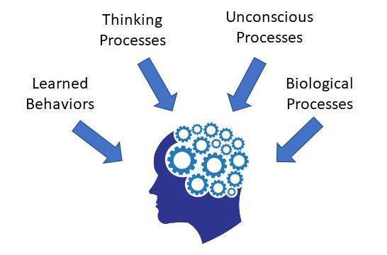
What is abnormal psychology?
Abnormal psychology studies unusual patterns of behaviour, mental disorders

Slide 3
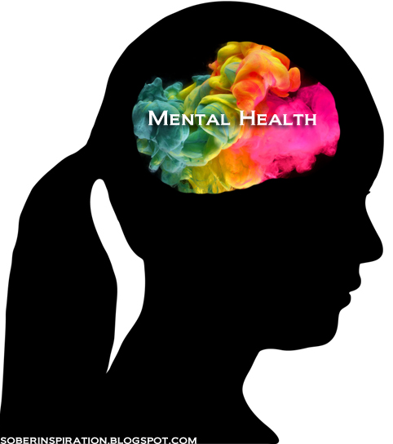
TASK
What is abnormality?
How can you differentiate normal from abnormal?
How can you tell the difference between sane and insane people?

Slide 4
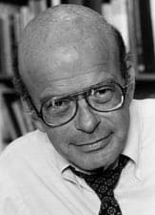
Rosenhan (1973) On being sane in insane places
Aim
To test the reliability and validity of diagnosis in a natural setting
Could psychiatrists distinguish between abnormal and normal behaviour?

Slide 5
Rosenhan (1973) On being sane in insane places
Procedure of the main experiment
Eight mentally healthy participants tried to gain access to 12 psychiatric hospitals in the USA
All participants were told to report hearing voices before admission and act normally after admission
IV: Participants complaints of hearing voices
DV: Psychiatrists admission of pseudo-patients

Slide 6
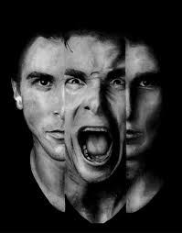
Rosenhan (1973) On being sane in insane places
Results of the main experiment
All participants were admitted to psychiatric wards
7/8 were diagnosed with schizophrenia and 1/8 with manic depression
It took between 7 to 52 days before the participants were released

Slide 7
Rosenhan (1973) On being sane in insane places
Procedure of the secondary experiment
Hospitals were misinformed that pseudo-patients were trying to gain admission
In reality, no impostors were trying to gain admission
IV: False information
DV: Number of patients whom staff suspected of being pseudo-patients

Slide 8
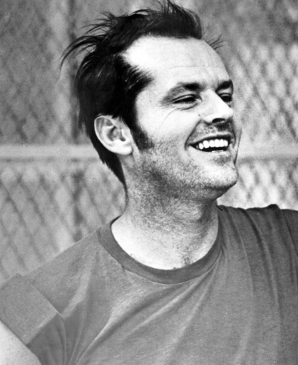
Rosenhan (1973) On being sane in insane places
Results of the secondary experiment
193 genuine patients were admitted for treatment
41 were clearly judged to be pseudo-patients by at least one staff member
23 were suspected by at least one psychiatrist
19 were suspected by one psychiatrist plus one other staff member

Slide 9
Rosenhan (1973) On being sane in insane places
Conclusions
Psychiatrists cannot distinguish the sane from the insane

Slide 10
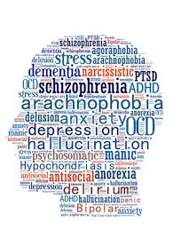
TASK
Analyse the study
Do a MAGEC/ GRENADE analysis
What does the Rosenhan (1973) experiment tell us about the concepts of normality and abnormality?

Slide 11
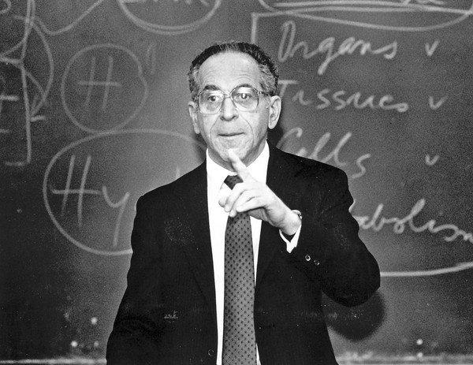
TASK
Watch the educational video on Thomas Szasz’s argument on the myth of mental illness

Slide 12
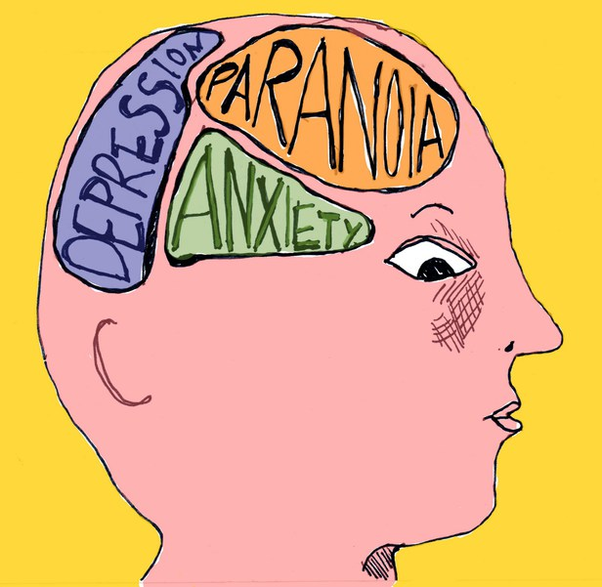
TASK
Is it really so that we cannot distinguish between the sane and the insane?
Is mental illness just a myth like Szasz suggest?

Slide 13

Labeling theory
Mental disorders are seen as labels that influence the self-identity and behaviour of individuals
Stigmatization
Stereotyping
Self-fulfilling prophecy

Slide 14

TASK
Watch the Ted Ronson TED Talk “Strange answers to the psychopath test”
Is there a definite line that divides the sane from the insane?

Slide 15
TASK
(1) Abnormality as deviation from social norms
(2) Abnormality as inadequate functioning (Rosenhan & Seligman, 1989)
(3) Abnormality as a deviation from ideal mental health (Jahoda, 1958)
(4) Abnormality as statistical infrequency
Read pages 257–260 and summarize the main points of four approaches of abnormality in your own words

Slide 16

TASK
What are the major differences and similarities between the four approaches?
Can they meet the challenges of Rosenhan (1973) and Szasz?

Slide 17

The medical model of abnormality
Psychological disorders are seen as psychopathology (illness in the psyche)
Each disorder is defined on the basis of its symptoms

Slide 18
The medical model of abnormality
Signs
Indicators of illness that can be detected by e.g. blood tests, brain scans and X-rays
Symptoms
What the patient reports to the doctor
What the doctor observes in a patient
Most psychological disorders don’t have signs equivalent to physical illnesses
Causes of psychological disorders has to be inferred from symptoms

Slide 19

The medical model of abnormality
Classification systems are based on symptoms
There is a pattern of recognizable behaviour in every disorder
Enables diagnosis of mental disorders

Slide 20
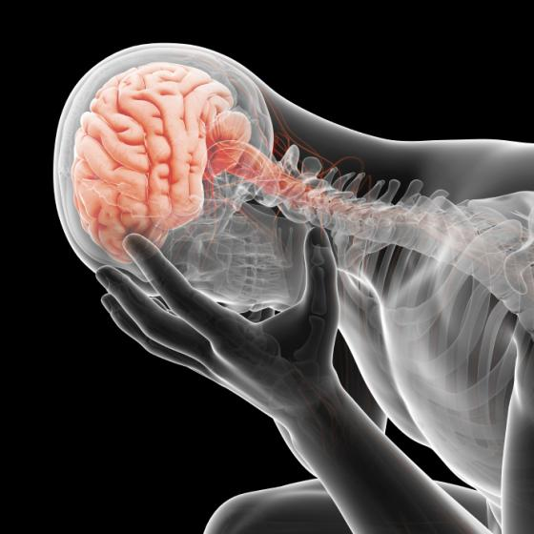
TASK
What are the strengths and the limitations of the medical model of abnormality?
How does it compare to other approaches of abnormality?

Slide 21

TASK
Form small groups and do the task in the ”Discussion” box on page 263
Compile a small poster where you create a classification that allows people to diagnose shyness

Slide 22

TASK
Watch the Elyn Saks TED-Talk “A tale of mental illness – from the inside”
What does this video tell you about how mental illnesses are experienced?

Slide 23
TASK
Read pages 262–265 and familiarize yourself with the most widely used classification systems
Pay close attention to the challenges of the classification systems
Study more about the DSM and the ICD
Links are in peda.net
What are the differences and similarities between these two classification systems?

Slide 24

Reliability and validity of diagnosis
Diagnosis
”Differentiating knowledge”
Relating a pattern of behaviour to a certain category

Slide 25

REVIEW
What was meant by
Psychologist?
Psychiatrist?
Psychotherapist?

Slide 26
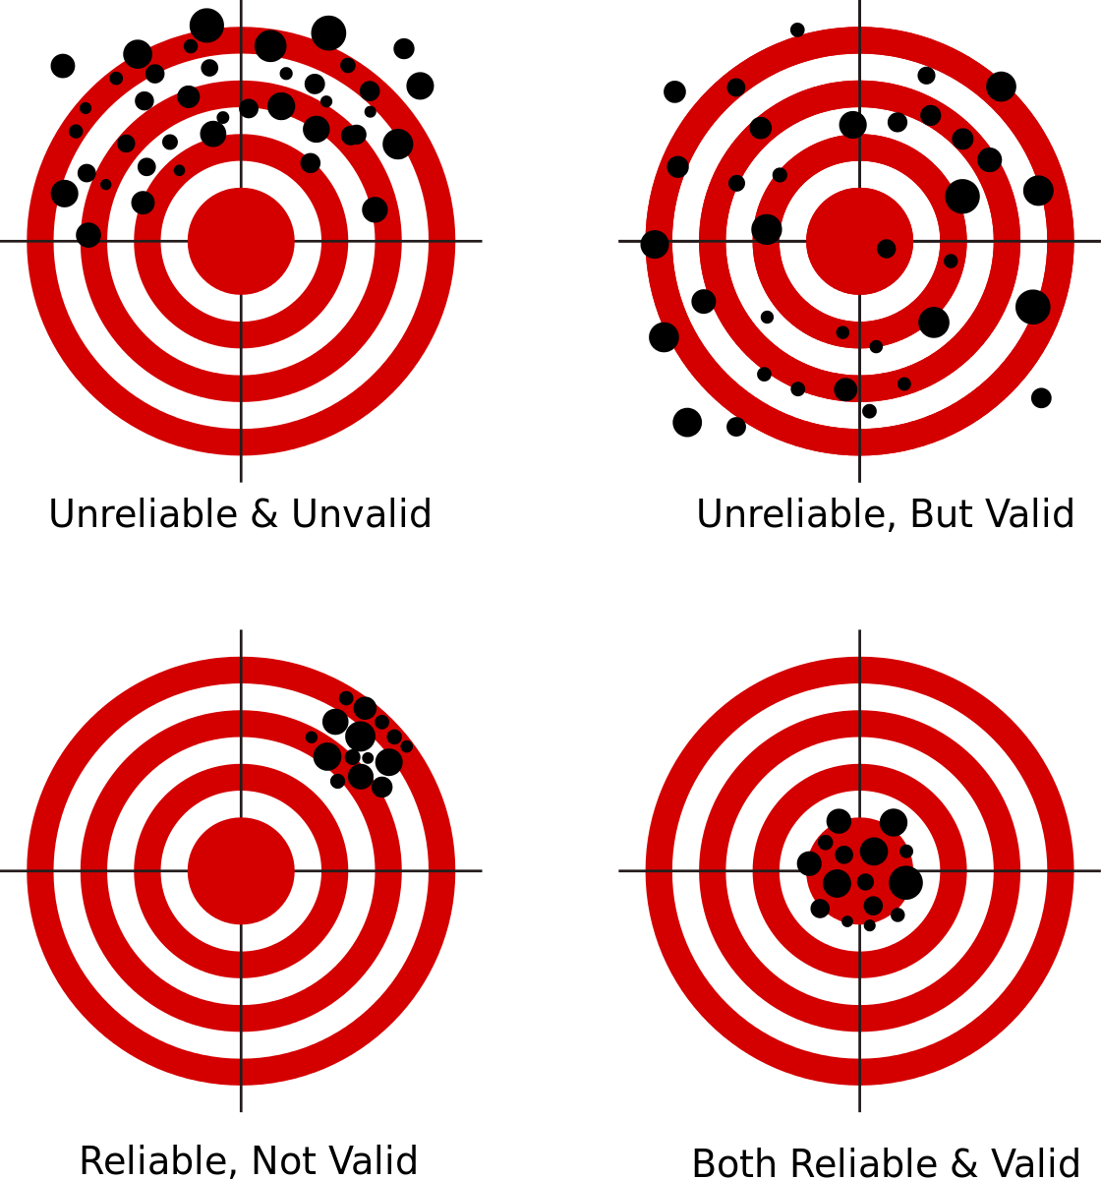
REVIEW
What was meant by reliability and validity?

Slide 27
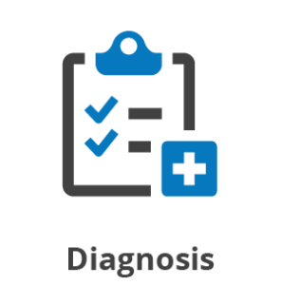
Reliability and validity of diagnosis
Reliability of diagnosis
Do different clinicians arrive at the same results with the same patients?
Validity of diagnosis
Is the diagnosis accurate?
Does the patient receive a correct diagnosis?

Slide 28

Reliability and validity of diagnosis
There is an inverse relationship between validity and reliability of diagnosis
As reliability increases, validity has a tendency to decrease, and vice versa

Slide 29
TASK
Read pages 270-272 and answer the following questions:
What is meant by inter-rater reliability and how it can be established?
What is meant by test-retest reliability and how does it relate to inter-rater reliability?
What is meant by kappa coefficient and how does it relates to the reliability of diagnosis?
What is meant predictive validity in diagnosis?

Slide 30
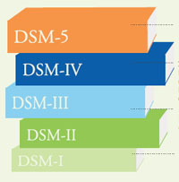
TASK
Read pages 272-275 and do the “ATL skills: Research” box on page 274
Try to understand how the reliability of DSM has been improved through the six studies

Slide 31
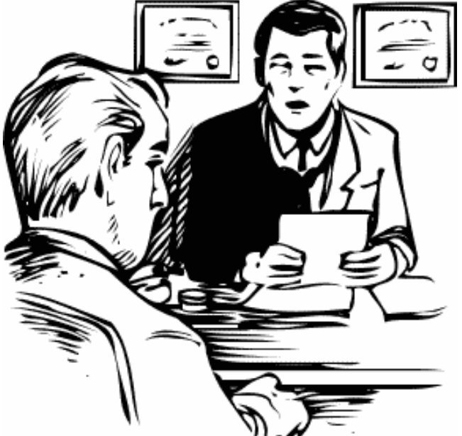
TASK
Read pages 275-276 and summarize the key problems of validity of diagnosis in your own words
What does the Cooper (1972) study tell about the validity of diagnosis?

Slide 32
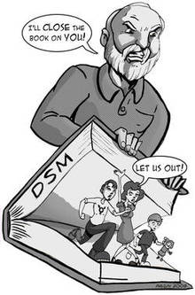
TASK
Review validity and reliability of diagnosis by reading pages 276-279

Slide 33
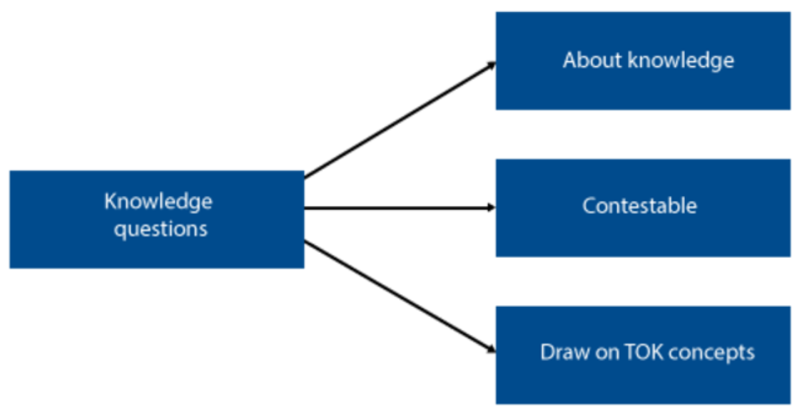
TOK-LINK
How do the following KQs relate to the contents we just covered?
How does the way we organize or classify knowledge affect what we know?
Does our knowledge depend on our interactions with other knowers?
DISCUSS AND EXPLORE THESE KNOWLEDGE QUESTIONS

Slide 34

The role of clinical biases in diagnosis
Clinical bias in diagnosis refers to a systematic deviation from accuracy in diagnosis caused by misinterpretation of the patient’s behaviour
Clinician variables
Patient variables
Cultural factors and syndromes

Slide 35
GROUP PROJECT
Form five groups
Each group is given one clinical bias
Each group creates a mini-play where the clinical bias appears AND writes small notes that will be uploaded to ManageBac about the clinical bias
What is the essence of the clinical bias?
How can you exemplify this in your mini-play?
Are there any studies/theories related to the clinical bias?
Briefly explain relevant studies/theories in your notes

Slide 36
GROUP PROJECT
GROUP 1: Clinical variables (281)
GROUP 2: Patient variables: Reporting bias (281–282)
GROUP 3: Patient variables: Somatization (283)
GROUP 4: Cultural factors: Expression of symptoms (284–285)
GROUP 5: Cultural factors in the DSM and cultural syndromes (285–287)

Slide 37
TASK
Form four groups
Groups rotate through four sample essay checkpoints that relate to the contents in Factors influencing diagnosis
Read the sample essays with examiner’s comments and engage in conversation
What are the pros and the cons of each sample response?
What did you learn from reading the samples?

Slide 38
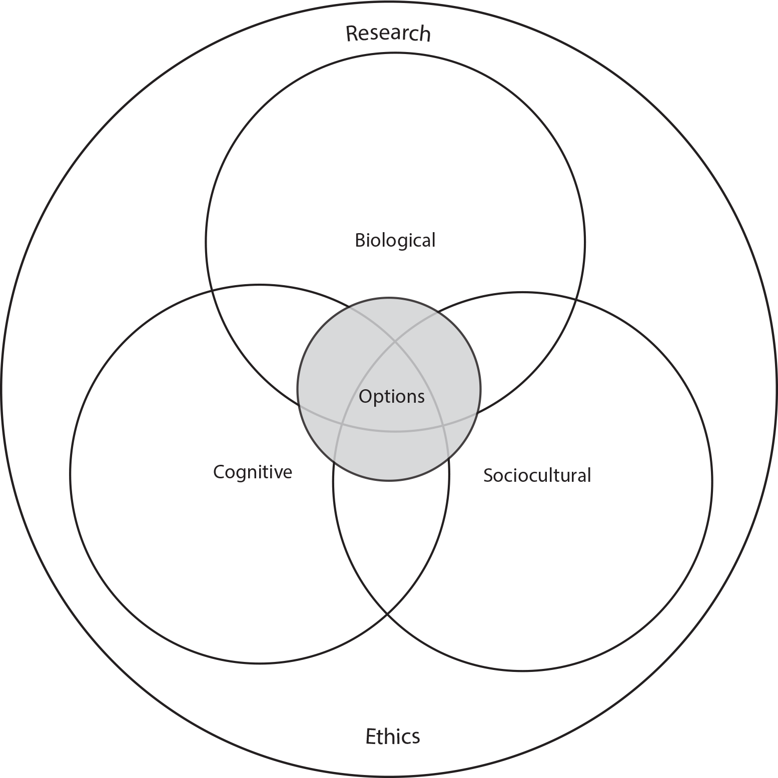
TASK
How do the different approaches of IB Psychology syllabus manifest themselves in what you have learned so far in Abnormal psychology?

Slide 39
Past questions
Discuss validity and reliability of diagnosis (M19)
Discuss the role of two or more clinical biases in diagnosis (N19)
Discuss normality versus abnormality (N20)
Evaluate one classification system for psychological disorders (M21)
Discuss validity and/or reliability of diagnosis (N21)
Evaluate one or more studies investigating the validity and/or reliability of diagnosis (M22)

Slide 40
Picture sources
Perspectives in abnormal psychology <https://www.simplypsychology.org/abnormal-psychology.html> Accessed 12th of March 2018.
Mental health <http://wellbody.net/2013/04/07/what-people-should-ask-a-mental-health-expert/> Accessed 11th of August 2016.
David Rosenham <https://schoolworkhelper.net/d-l-rosenhans-on-being-sane-in-insane-places-summary-analysis/> Accessed 12th of March 2018.
Schizophrenia <http://www.health-food.org/health/what-is-schizophrenia-and-what-causes-it/?lang=it> Accessed 12th of March 2018.
Jack Nicholson <http://www.fanpop.com/clubs/jack-nicholson/images/20476487/title/one-flew-over-cuckoos-nest-1975-photo> Accessed 12th of March 2018.
Mental disorder head <http://powerlisting.wikia.com/wiki/Mental_Disorder_Manipulation> Accessed 13th of March 2018.
Thomas Szasz <http://articles.latimes.com/2012/sep/17/local/la-me-thomas-szasz-20120917-1> Accessed 12th of March 2018.
Mental disorder head 2 <https://www.psychologytoday.com/blog/all-in-the-family/201711/mental-illness-and-violence> Accessed 13th of March 2018.

Slide 41
Picture sources
Label <https://fi.pinterest.com/pin/55239532912887581/> Accessed 15th of March 2018.
Jon Ronson <https://www.goodreads.com/author/show/1218.Jon_Ronson> Accessed 12th of March 2018.
Raining brain <https://choice.npr.org/index.html?origin=https://www.npr.org/sections/goatsandsoda/2018/10/15/656669752/report-world-support-for-mental-health-care-is-pitifully-small> Accessed 13th of August 2019.
Mentall illness <https://www.psychologytoday.com/blog/all-in-the-family/201711/mental-illness-and-violence> Accessed 12th of March 2018.
DSMs 1 <https://www.brainscape.com/blog/2015/06/dsm-5-changes-affect-gre-psychology-exam/> Accessed 15th of March 2018.
Depressed brain person <https://www.medicalnewstoday.com/news/severe-depression-linked-inflammation-brain-288715> Accessed 14th of August 2019.
Shyness <http://psychology.iresearchnet.com/social-psychology/personality/shyness/> Accessed 15th of March 2018.
Elyn Saks <http://gould.usc.edu/faculty/?id=300> Accessed 15th of March 2018.
Depressed person in an ocean <https://www.everydayhealth.com/depression/major-depressive-disorder/> Accessed 15th of August 2019.
Knowledge questions <https://tok-a-journey.wikispaces.com/Knowledge+Questions> Accessed 25th of September 2017.
Diagnosis 1 <http://www.alcoholicsoccermom.com/should-i-get-a-second-opinion-on-my-mental-health-diagnosis> Accessed 23rd of March 2018.

Slide 42
Picture sources
Reliability and validity <https://commons.wikimedia.org/wiki/File:Reliability_and_validity.svg> Accessed 17th of August 2017.
Diagnosis <http://adadfirst.com/2016/07/the-diagnosis-is/diagnosis/> Accessed 19th of March 2018.
Improvement <https://ergoweb.com/continuous-improvement-ergonomics-sustainable-by-design/> Accessed 19th of March 2018.
DSMs 2 <https://www.nationaleatingdisorders.org/blog/dsm-5-triumph-people-out-control-eating-issues> Accessed 19th of March 2018.
Clinical interview <https://commons.wikimedia.org/wiki/File:Clinical_interview.PNG> Accessed 19th of March 2018.
Bad DSM <https://coto2.wordpress.com/2011/07/24/dsm-5-approves-new-fad-diagnosis-for-child-psychiatry-antipsychotic-use-likely-to-rise/> Accessed 19th of March 2018.
Clinical interview <https://thiswayup.org.au/for-clinicians/returning-clinicians/> Accessed 23rd of March 2018.
IB Psychology syllabus <https://ibpublishing.ibo.org/d_3_psych_gui_1702_1/apps/dpapp/guide.html?doc=d_3_psych_gui_1702_1_e&part=1&chapter=3&section=1> Accessed 16th of May 2018.

