Slide 1
NEUROPLASTICITY AND NEUROTRANSMITTERS
IB Psychology LAJM

Slide 2

TASK
Use the ”21IB psych notes for revision”
  Contribute to the doc to the best of your ability!

Slide 3
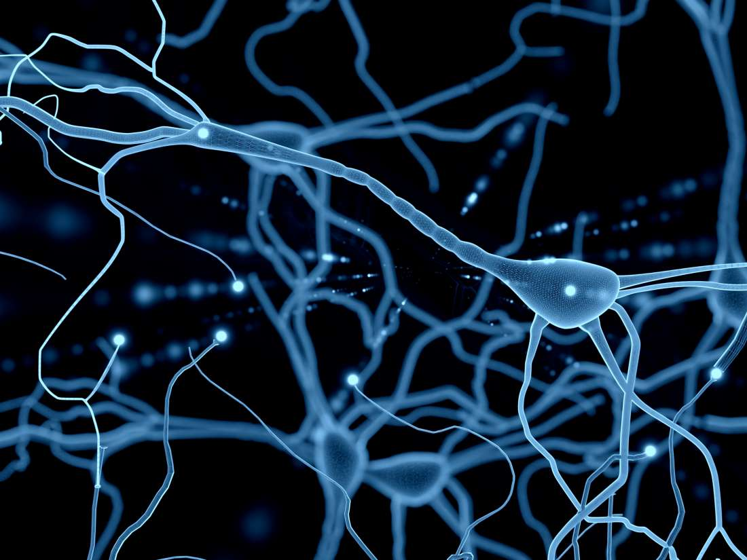
TASK
Review the following contents with ONE appropriate study
  Neural network
  Neural pruning

Slide 4
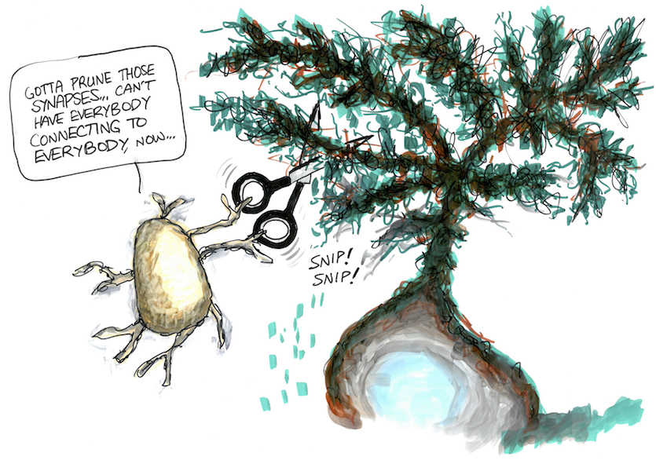
TASK
Can you answer the following SAQ question?
  Outline neural pruning with reference to one relevant study (N21)

Slide 5
TASK
”Neuroplasticity: Study one example of neuroplasticity”
Review what was meant by neuroplasticity
Review at least TWO studies that relate to neuroplasticity and possibly cast a different light on the topic
  Use the whole syllabus

Slide 6

TASK
Browse through past ERQ/essay questions related to neuroplasticity and try to make sketch responses to them

Slide 7
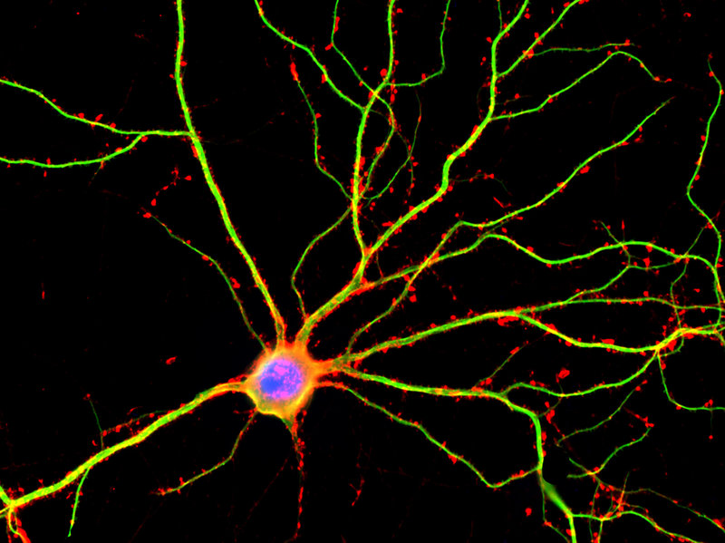
TASK
Review the following:
  Neuron and its parts
  Action potential
  (don’t use too much time with this)
  Synapse and synaptic transmission with excitatory and inhibitory neurotransmitters
  Agonist and antagonist

Slide 8
TASK
Review the following contents with the following studies:
  Excitatory neurotransmission: Fisher, Aron and Brown (2005) – Dopamine as an excitatory neurotransmitter in romantic love
  Inhibitory neurotransmission: Crockett et al. (2010) – Serotonin as an inhibitory neurotransmitter in prosocial behaviour
  Agonist and antagonist: Rogers and Kesner (2003) Acetylcholine (agonist) in the formation of memories with scopolamine (antagonist)

Slide 9
TASK
Study the following studies related to agonists and antagonists:
  Antonova (2010) – Acetylcholine in the formation of memories with scopolamine (human study)
  (Troster and Beatty (1989) – Another human study with acetylcholine and scopolamine)
DO NOT STUDY EVERYTHING! MAKE AN EFFECTIVE
PLAN ON HOW TO ADDRESS THE SYLLABUS

Slide 10
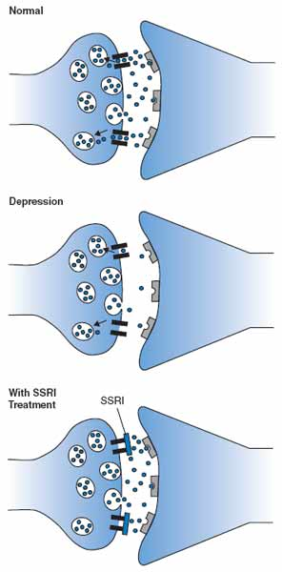
TASK
Can you answer the following SAQ question?
  With reference to one study, outline the effect of one agonist or one antagonist on human behaviour (M21 TZ2)

Slide 11
TASK
”Neurotransmitters and their effects on behaviour: Study one neurotransmitter and its effect on behaviour”
Review at least TWO studies that relate to neurotransmitters and possibly cast a different light on the topic
  Use the whole syllabus

Slide 12
TASK
Browse through past ERQ/essay questions related to neurotransmitters and try to make sketch responses to them

Slide 13
Picture sources
Research head <https://synergycodes.com/blog/3-steps-to-conduct-your-research-easier/> Accessed 14th of January 2022.
Blue brain cells <https://medium.com/predict/artificial-neural-networks-mapping-the-human-brain-2e0bd4a93160> Accessed 10th of February 2020.
Synaptic pruning <https://goodsciencewriting.wordpress.com/2017/04/11/zen-and-the-art-of-synaptic-pruning-new-cartoons/> Accessed 10th of February 2020.
The Finals <https://www.forbes.com/sites/mikestubbs/2024/01/16/the-finals-150-update-launches-tomorrow-and-brings-new-solo-mode/> Accessed 12th of September 2024.
SSRI <https://neurosciencenews.com/neuropharmacology-decynium-22-ssri-serotonin-248/> Accessed 11th of February 2020.
Green brain cells <https://fi.pinterest.com/pin/61854194853929129/> Accessed 15th of September 2017.

