Slide 1
REVIEWING THE WHOLE BIOLOGICAL APPROACH
IB Psychology LAJM

Slide 2
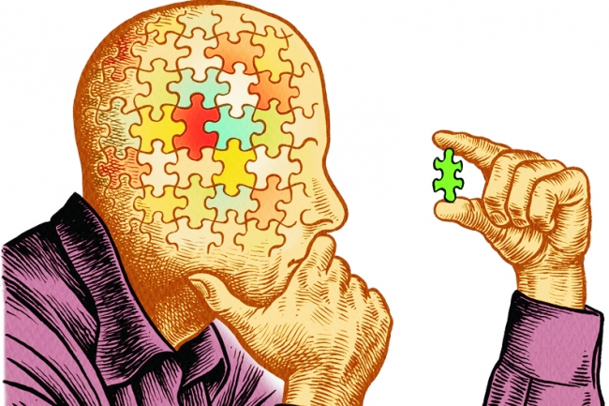
CRITICAL THINKING HUB
Review the content, theories and studies with the critical thinking in mind
  Use teacher’s materials in peda.net
See how critical thinking has been
implemented in the sample essays

Slide 3
CRITICAL THINKING HUB
The contribution of research methods used in the biological approach to understanding human behaviour
Ethical considerations in the investigation of the biological approach to understanding human behaviour
What are the key content, terms and theories related to these topics ?
What are the possible studies that could be addressed with these topics?

Slide 4
Picture sources
Critical thinking puzzle <https://www.chronicle.com/article/Beyond-Critical-Thinking/63288> Accessed 10th of February 2019.

