Slide 1
THINKING, DECISION-MAKING AND THEIR RELIABILITY (Dec 2019 syllabus revision)
IB Psychology LAJM

Slide 2
TASK
”Thinking and decision-making: Study one model in thinking and decision-making”
Review the theory of of planned behaviour (TPB) from pages 151-153 and 341-343
Review Albarracin et al (2001) from page 153 + Godin and Kok (1966) and Dunn et al (2011) from teacher’s materials

Slide 3
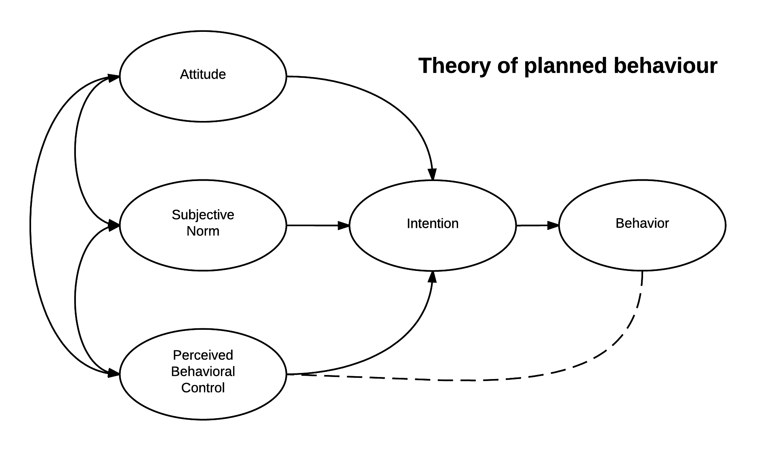
TASK
What are the strengths and the limitations of the TPB?
Do a TEACUP analysis of the theory

Slide 4
TASK
”Biases in thinking and decision-making: Study one bias in thinking and decision-making”
Review the dual process model of thinking and decision making from pages 169-170 and your memos
How does information processing differ in System 1 and System 2?

Slide 5
TASK
Review the Framing effect, expected utility theory and prospect theory from pages 172-173 and your memos
Review Tversky and Kahneman (1981) from pages 172-173 + Keysar et al (2012) and Strough et al (2011) from teacher’s materials
”Biases in thinking and decision-making: Study one bias in thinking and decision-making”

Slide 6
TASK
Reread the sample responses to the question “Discuss the use of one or more cognitive biases in thinking and decision-making”
After reading the responses, pay attention to the examiner’s comments
What could you learn from this sample?

Slide 7
CRITICAL THINKING HUB
The contribution of research methods used in the cognitive approach to understanding human behaviour
Ethical considerations in the investigation of the cognitive approach to understanding human behaviour
What are the key content, terms and theories related to these topics ?
What are the possible studies that could be addressed with these topics?

Slide 8
TASK
Reread the sample responses to the question “Contrast two research methods used in the study of cognitive processes”
After reading the responses, pay attention to the examiner’s comments
What could you learn from this sample?

Slide 9
Past questions
Discuss one or more biases in thinking and decision-making (M19 TZ2)
Discuss two or more ethical considerations related to one study investigating the reliability of one cognitive process (N19)
How would you answer these essay questions?
Create sketch responses
Compare your ideas to the markscheme

Slide 10
Sources
Kahneman, D. (2011). Thinking, Fast And Slow. Great Britain: Penguin Books.
Popov, A., Parker, L. & Seath, D. (2017). Psychology Course Companion (2nd Edition). Oxford: Oxford University Press.

Slide 11
Picture sources
Theory of planned behaviour (TPB) <https://en.wikipedia.org/wiki/Theory_of_planned_behavior> Accessed 28th of August 2019.
Fast food <https://pixabay.com/fi/illustrations/fast-food-juhla-virvoitusjuoma-4683707/> Accessed 11th of November 2020.
Rule of thumb <http://daysgoneby.me/dyk-rule-thumb/> Accessed 19th of February 2018.
Framing effect <https://medium.com/@mohit.rajkumar/management-lesson-from-parenting-the-framing-effect-ae334ec7d8ab> Accessed 16th of November 2020.
Tversky and Kahneman <https://www.sunoresearch.com.br/tudo-sobre/amos-tversky/> Accessed 17th of November 2020.
Foreign language <https://www.worcs.tgacademy.org.uk/subjects/mfl/> Accessed 17th of November 2020.
Lifespan <https://www.freepik.com/free-photos-vectors/lifespan> Accessed 17th of November 2020.

